Slide 1
2D PROJECTILE MOTION
Course: Numerical computing
Class ID: 103368
Student id: 62886

Slide 2
INTRODUCTION TO PROJECTILE MOTION
When a Body in A free motion (moving through the air without any forces other than gravity and air resistance) it is called a Projectile Motion.
Normally air resistance is Ignored so the only force acting upon the body is Gravity.
Gravity is a Uniform force acting downwards.

Slide 3
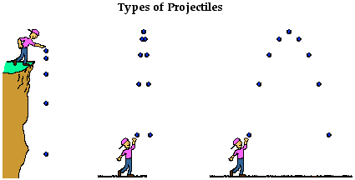
TYPES OF PROJECTILE

Slide 4
Types of Projectile Motion
Horizontal
Vertical
Parabolic
Motion of a ball rolling freely along a level surface
Horizontal velocity is ALWAYS constant
Motion of a freely falling object
Force due to gravity
Vertical component of velocity changes with time
Path traced by an object accelerating only in the vertical direction while moving at constant horizontal velocity

Slide 5
Velocity
Acceleration
The horizontal velocity of projectile will remain unchanged throughout the motion.
The vertical component changes linearly because of acceleration due to gravity is constant.
There is only acceleration in the vertical direction, the only velocity in the horizontal direction is constant. The vertical motion of the projectile will be free fall.
The acceleration will be equal to 9.8m/s^2

Slide 6
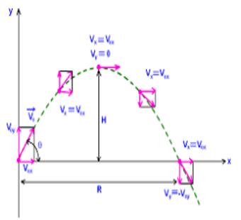
X- Component
Δ𝑥=𝑉0𝑥⋅𝑡
Y- Component
Δ𝑦=𝑉0𝑦⋅𝑡−12⋅𝑔⋅𝑡2
Range
𝑅=2⋅𝑉20⋅𝑠𝑖𝑛(2𝜃)/𝑔
Maximum Height for a Given Angle and Velocity
𝐻𝑚𝑎𝑥=𝑉20⋅𝑠𝑖𝑛(𝜃)22/𝑔
Total Time of Flight
𝑇=2⋅𝑉0⋅𝑠𝑖𝑛(𝜃)/𝑔

Slide 7
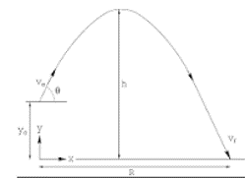
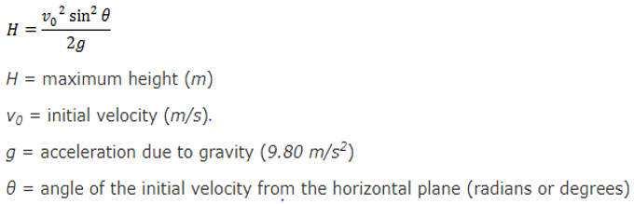
Height of an Projectile
The greatest height that the object will reach is known as height of projectile .
It does not depend on mass of the object.

Slide 8
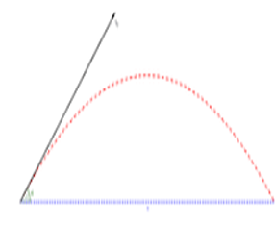
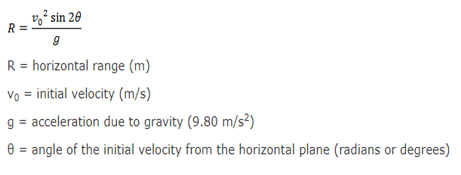
Range of an Projectile
The range of an projectile is the distance covered by the body till it comes to rest in x-axis.
It does not depend on mass of the object.

Slide 9
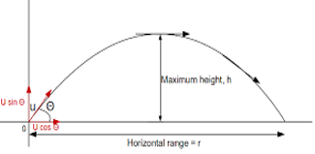
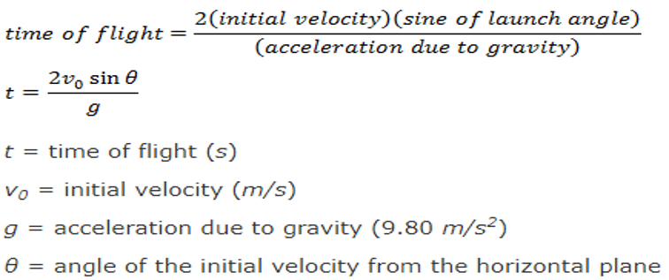
Time of flight of a Projectile
The total time for which the projectile remains in air is known as time of flight.

Slide 10
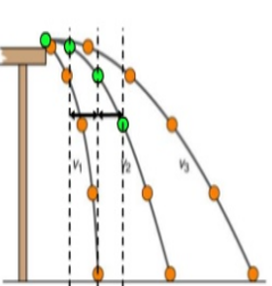
Horizontal Projectile
An object in free fall will accelerate at 9.81 meters per second squared downwards.
When investigating the trajectory of a projectile we can look at the horizontal motion and the vertical motion separately.

Slide 11
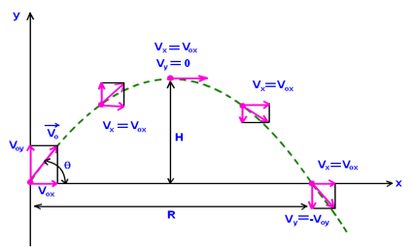
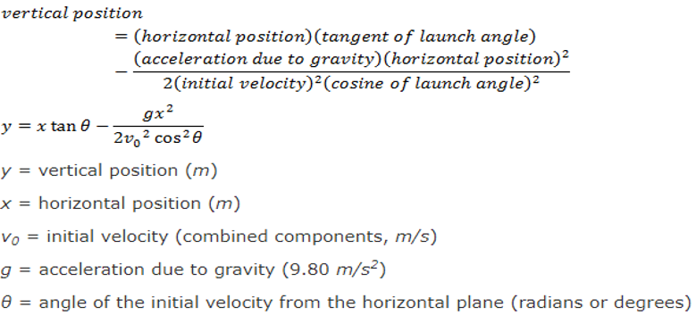
Vertical Projectile

Slide 12


