Slide 1

Hotel Booking & Reservation System Re-modeling
This presentation explains the problem, objectives, architecture, processes, data model, security, and expected outcomes for a digital hotel reservation platform.
IC 1202 - Information System Modeling
H. Hasan
V. Sathusrshan
J. N. Hathun
K. Jenistalan

Slide 2

Problem Statement(As we investigated
An existing normal hotel booking system)
Manual, paper-based booking processes cause frequent errors, double-bookings, lost records, slow billing, and poor reporting. These issues lead to guest dissatisfaction, revenue leakage, and inefficient staff workflows.
Key loopholes
Business impact
Paper records → data loss and hard audits
Double bookings and check-in delays
Manual invoicing → billing mistakes
Lower guest satisfaction
Lost revenue opportunities
Inefficient staff time use

Slide 3
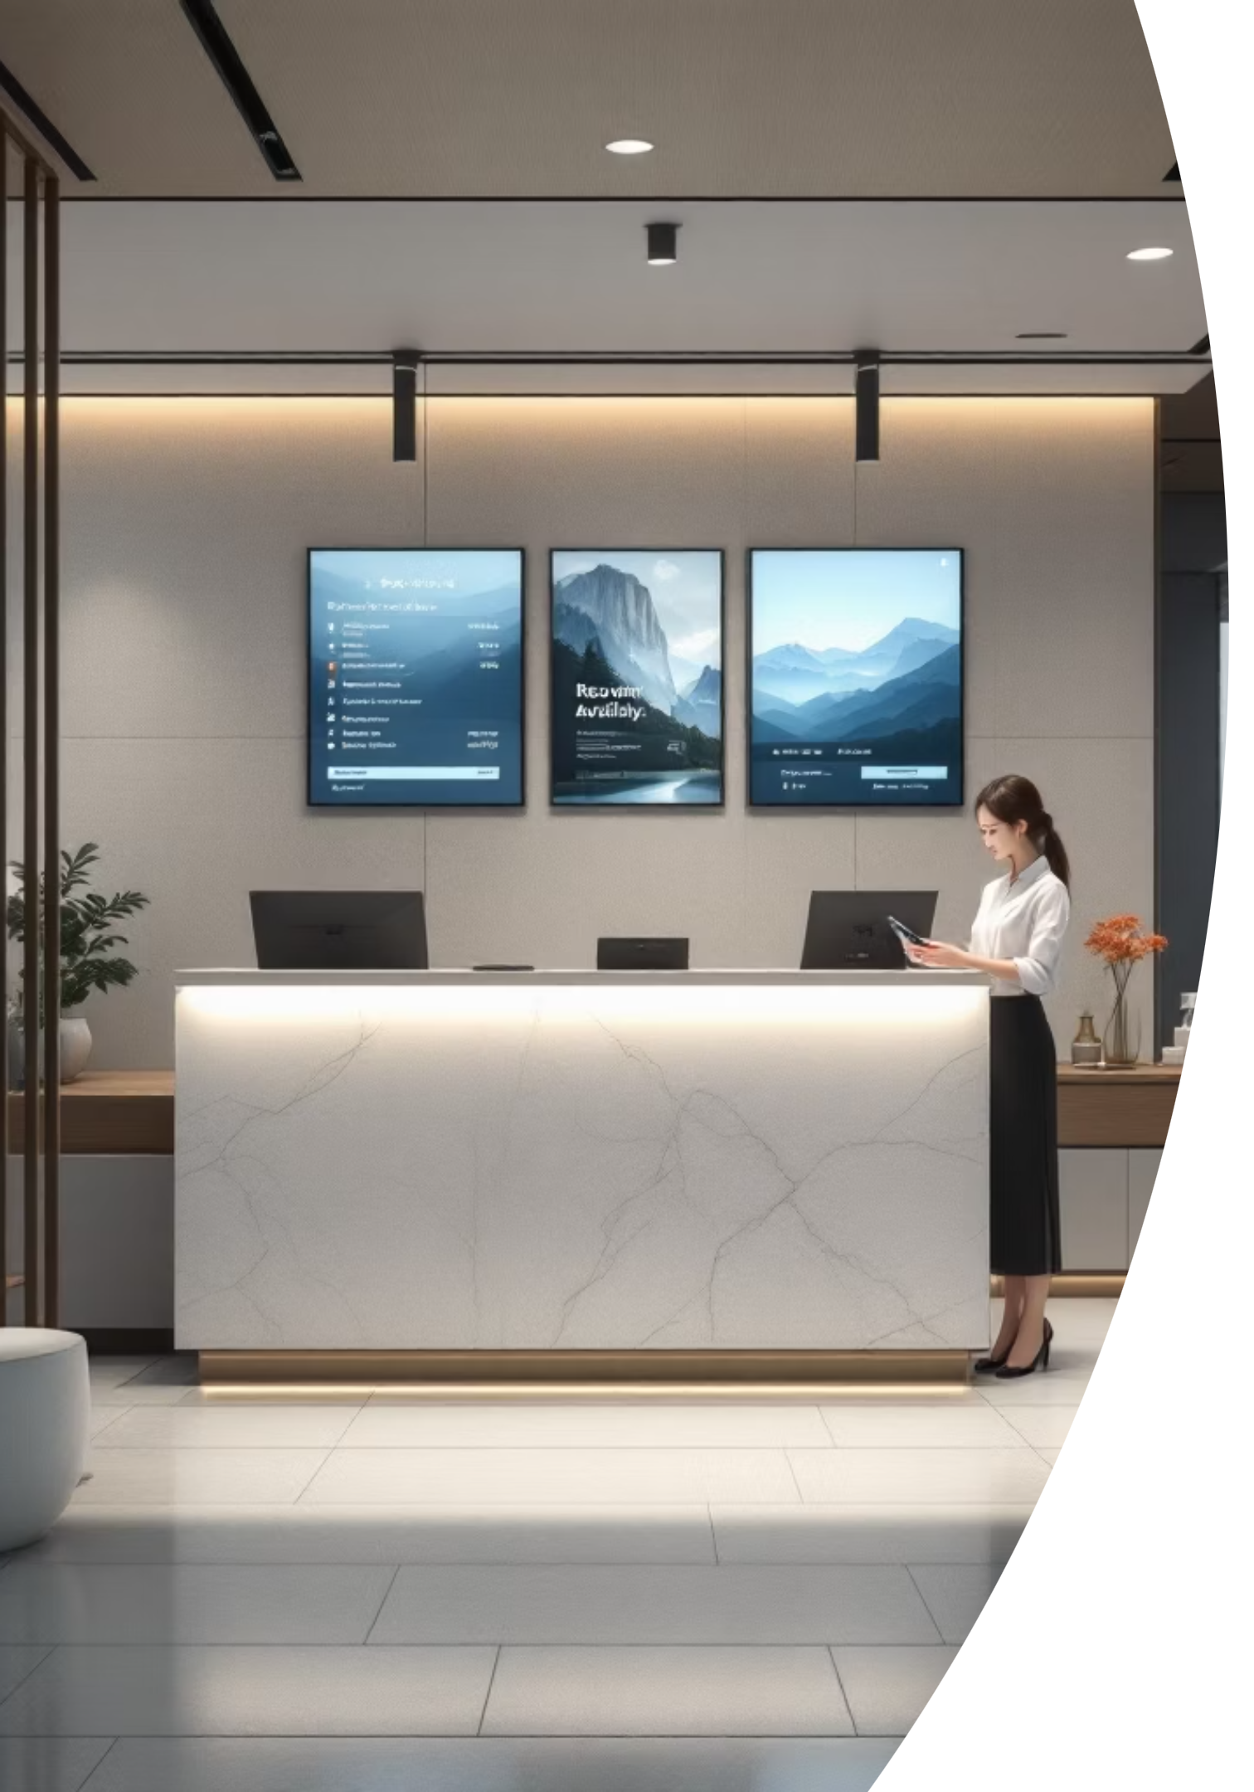
Project Objectives
Move from paper to a digital system that provides accurate, fast, and safe booking operations.
Real-time room tracking
Instant availability, holds, and status updates across channels.
Automated billing
Accurate invoices, tax calculations, discounts, and payments.
Efficient data retrieval
Fast searches for reservations, guest history, and audit logs.

Slide 4
System Context (ISM)
Who interacts with the system and the technology backbone that supports it.
Primary users
Technology stack
Admin — system configuration, reports, user management
Front desk clerk — bookings, check-in/out, room assignment
Manager — revenue reports, occupancy dashboards
Customer — search, book, pay, view invoices
Frontend: React or Vue for responsive UI
Backend: Node.js / Python (RESTful API)
Database: PostgreSQL (ACID) with relational schema
Payments: PCI-compliant gateway integration
Hosting: Cloud (AWS / Azure)

Slide 5
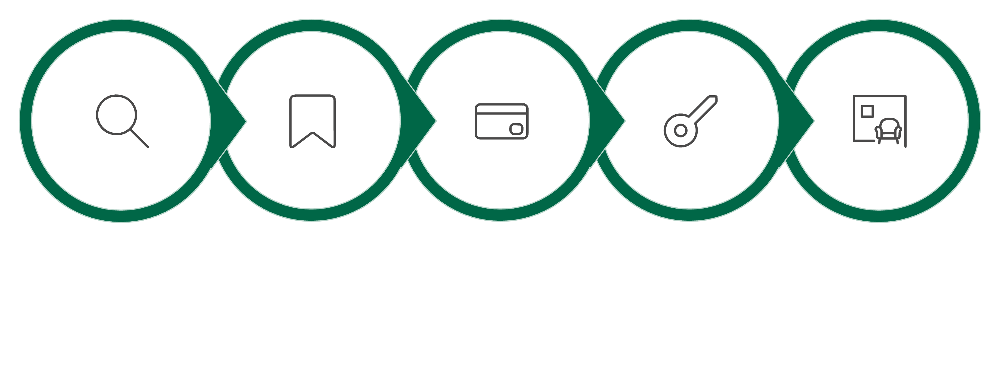
Business Process Flow
Search Rooms
Select & Hold
Confirm & Authorize
Check-in & Assign
Manage Stay
The diagram maps the customer journey and system actions: availability check, temporary holds to prevent double-booking, payment authorization at booking, live posting of charges during stay, and final invoice settlement at check-out.

Slide 6
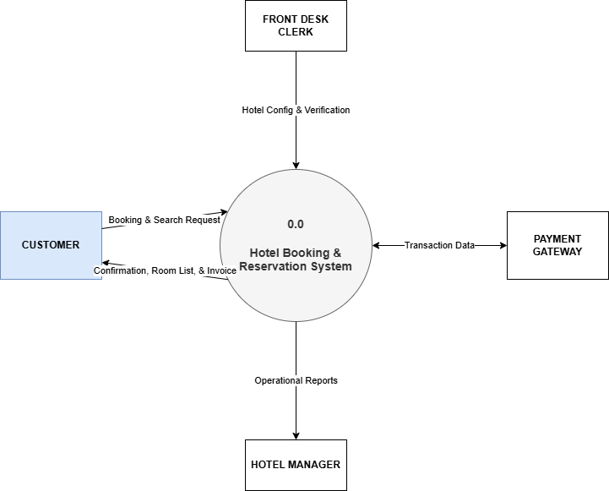
Context Diagram

Slide 7
Operational Workflows & Module Responsibilities
Receptionist
Admin
Search availability, create/modify reservations, check-in/out, apply charges.
Maintain room inventory, rates, tax settings, user accounts, and system configs.
Manager
Customer
View occupancy dashboards, generate revenue reports, approve overrides.
Self-service booking, payment, view/print invoices, cancel within policy.
Example process: Receptionist places a temporary hold when a guest requests a room; system creates reservation and authorizes payment; hold converts to confirmed when payment completes; charges posted to reservation during stay; checkout triggers invoice generation.

Slide 8
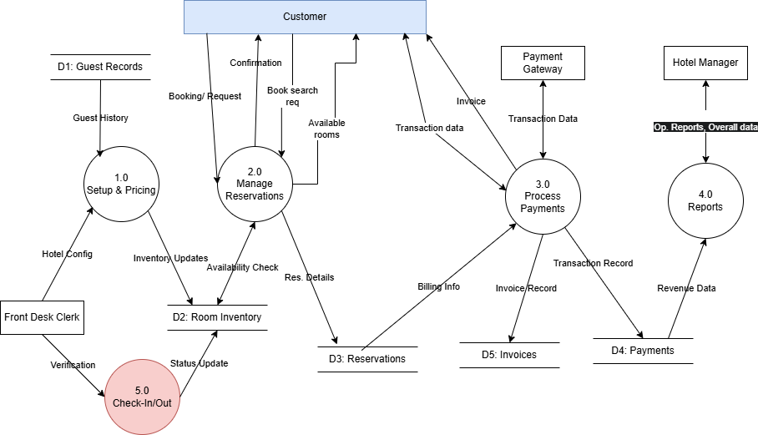
DFD Diagram

Slide 9
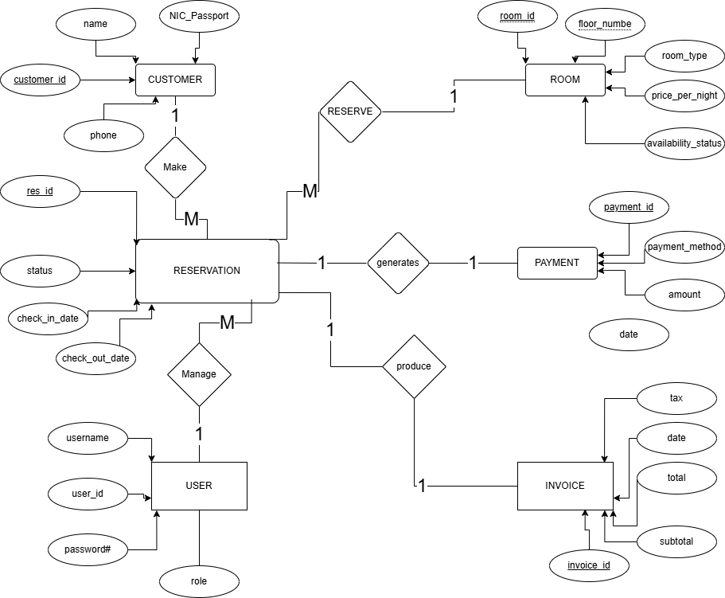
ER Diagram

Slide 10
Database Design Details
Customer: Stores personal profiles including customer_id (Primary Key), name, NIC / Passport (Unique), phone, and email (Unique) .
Room: Tracks hotel inventory with room_id (Primary Key), room_type, floor_number, price_per_night, and availability_status
Reservation: Links customers to rooms using res_id (Primary Key), customer_id (Foreign Key), room_id (Foreign Key), check_in_date, check_out_date, and booking status .
Payment: Records financial transactions with payment_id (Primary Key), res_id (Foreign Key), amount, payment_method, and payment_date
Invoice: Automatically generated billing records containing invoice_id, res_id, subtotal, tax, total, and generated_date.
User (Staff): Manages internal access with user_id, username, password_#, and defined role.
Core tables and relationships enforce data integrity and allow strong queries for reporting and audits.

Slide 11
Entity Relationships Details
Customer to Reservation (One-to-Many ): A single customer can make multiple reservations .
Room to Reservation (One-to-Many ): One room can be reserved for different dates .
Reservation to Payment (One-to-One ): Each confirmed reservation produces one payment record .
Reservation to Invoice (One-to-One ): Every confirmed reservation generates a single invoice .
User to Reservation (One-to-Many): A staff member (User) can handle and manage multiple bookings .

Slide 12
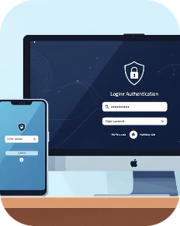



System modules and Security
Authentication
Role-based access
Data backup & retention
Payments & compliance
Username/password , Password policies
Manager, Receptionist, Guest. permissions per role.
Daily backups, weekly full snapshots
Use Safer gateway,
To protect Transfer and account information

Slide 13
Expected Outcomes & Next Steps
Measured improvements
Implementation roadmap (next 90 days)
Success criteria
~90% reduction in booking errors (target)
100% billing accuracy with automated invoice generation
Faster check-in/out and improved guest satisfaction
Automated reports available daily
Audit logs for all booking/payment actions
Backup restore verified monthly
Design & data model finalization (2 weeks)
Core module development: bookings, payments, rooms (6 weeks)
Integration, testing, and staff training (4 weeks)

Slide 14
Questions and Discussions
We welcome Questions about our proposed system for Hotel booking and reservation
Please feel free to ask anything about the system's design, functionality, or implementation plan

Slide 15
Thank You for Your Time We sincerely appreciate your valuable attention and insightful feedback during this presentation.

