Slide 1
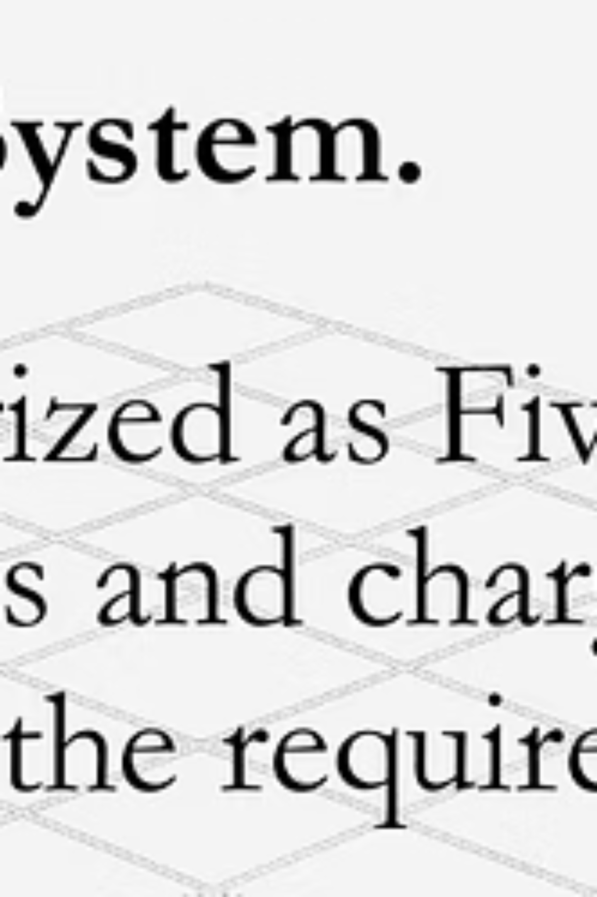
Hotel Rooms Reservation System
Designing a flexible reservation platform for hotels of all categories — from three-star to five-star — that manages inventory, pricing, and guest requirements while integrating with hotel managers' operational needs.

Slide 2

What the System Must Solve
Room Categorization
Dynamic Pricing
Rules for seasonal rates, weekend/weekday differentials, promotions, and occupancy-based price adjustments.
Support multiple hotel classes (5★, 4★, 3★, boutique). Define room types, amenities, and rate plans per category.
Inventory & Availability
Real-time room status (available, blocked, housekeeping) with seamless updates across channels and front-desk tools.

Slide 3
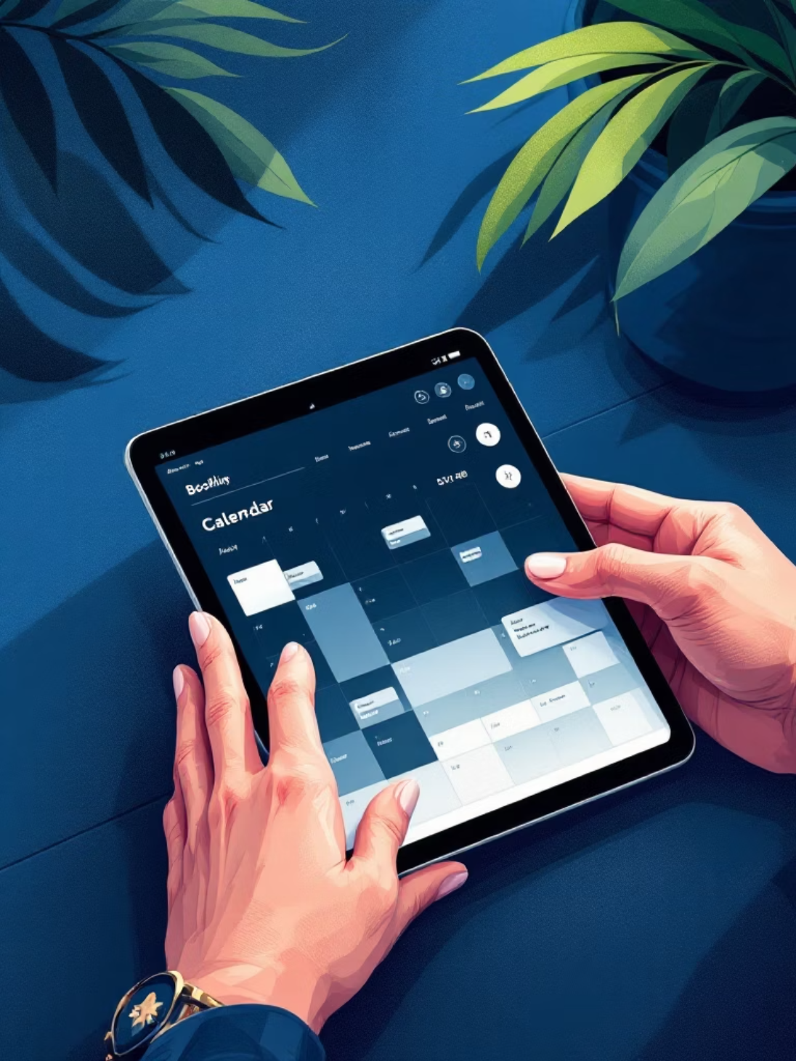
Key Features & Manager Workflow
Manager-driven room configuration: define room classes, assign rates, set policies.
Group bookings and corporate accounts: block rooms, negotiated rates, contract terms.
Custom charges and taxation: attach extras (breakfast, spa) and apply local taxes automatically.
Reporting & alerts: occupancy forecasts, revenue dashboards, low-availability notifications.

Slide 4
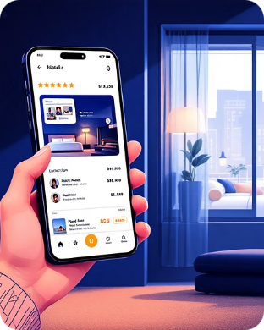


Guest Experience & Distribution
Seamless Booking
Amenity-driven Choices
Payments & Policies
Fast search by date, flexible rate filters, transparent fees, instant confirmation.
Highlight amenities per room (suite with balcony, breakfast included) to guide selections.
Multiple payment methods, pre-authorizations, clear cancellation and refund rules per rate plan.

Slide 5
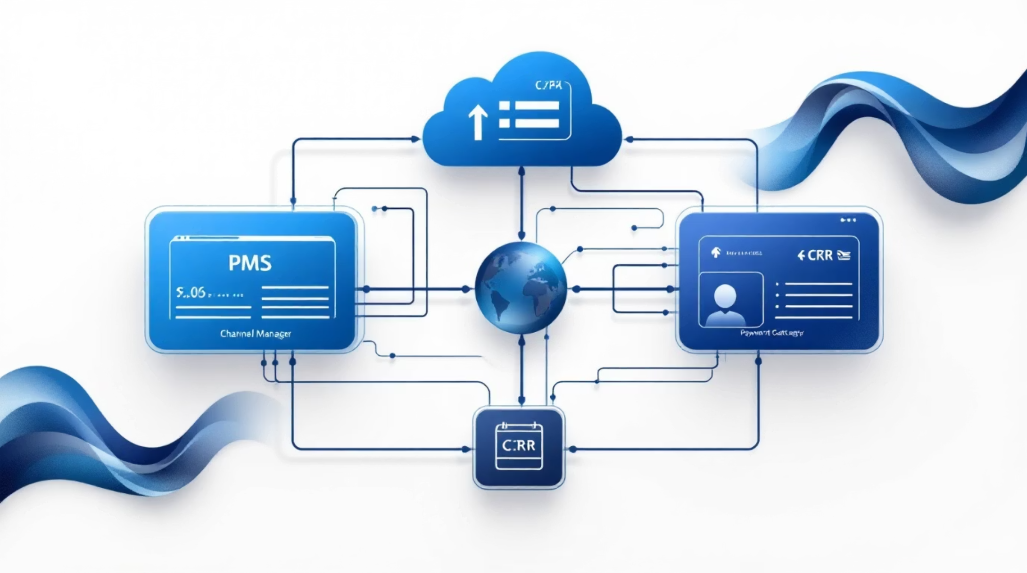
Integration, Security & Operations
Integrations and compliance form the backbone of a production-ready reservation system:
Channel manager & OTA connections (real-time sync to avoid double-booking).
PMS and payment gateway integrations with PCI-DSS compliance.
Role-based access: front desk, revenue manager, housekeeping dashboards.
Audit logs, backup, and disaster recovery to protect bookings and guest data.

Slide 6
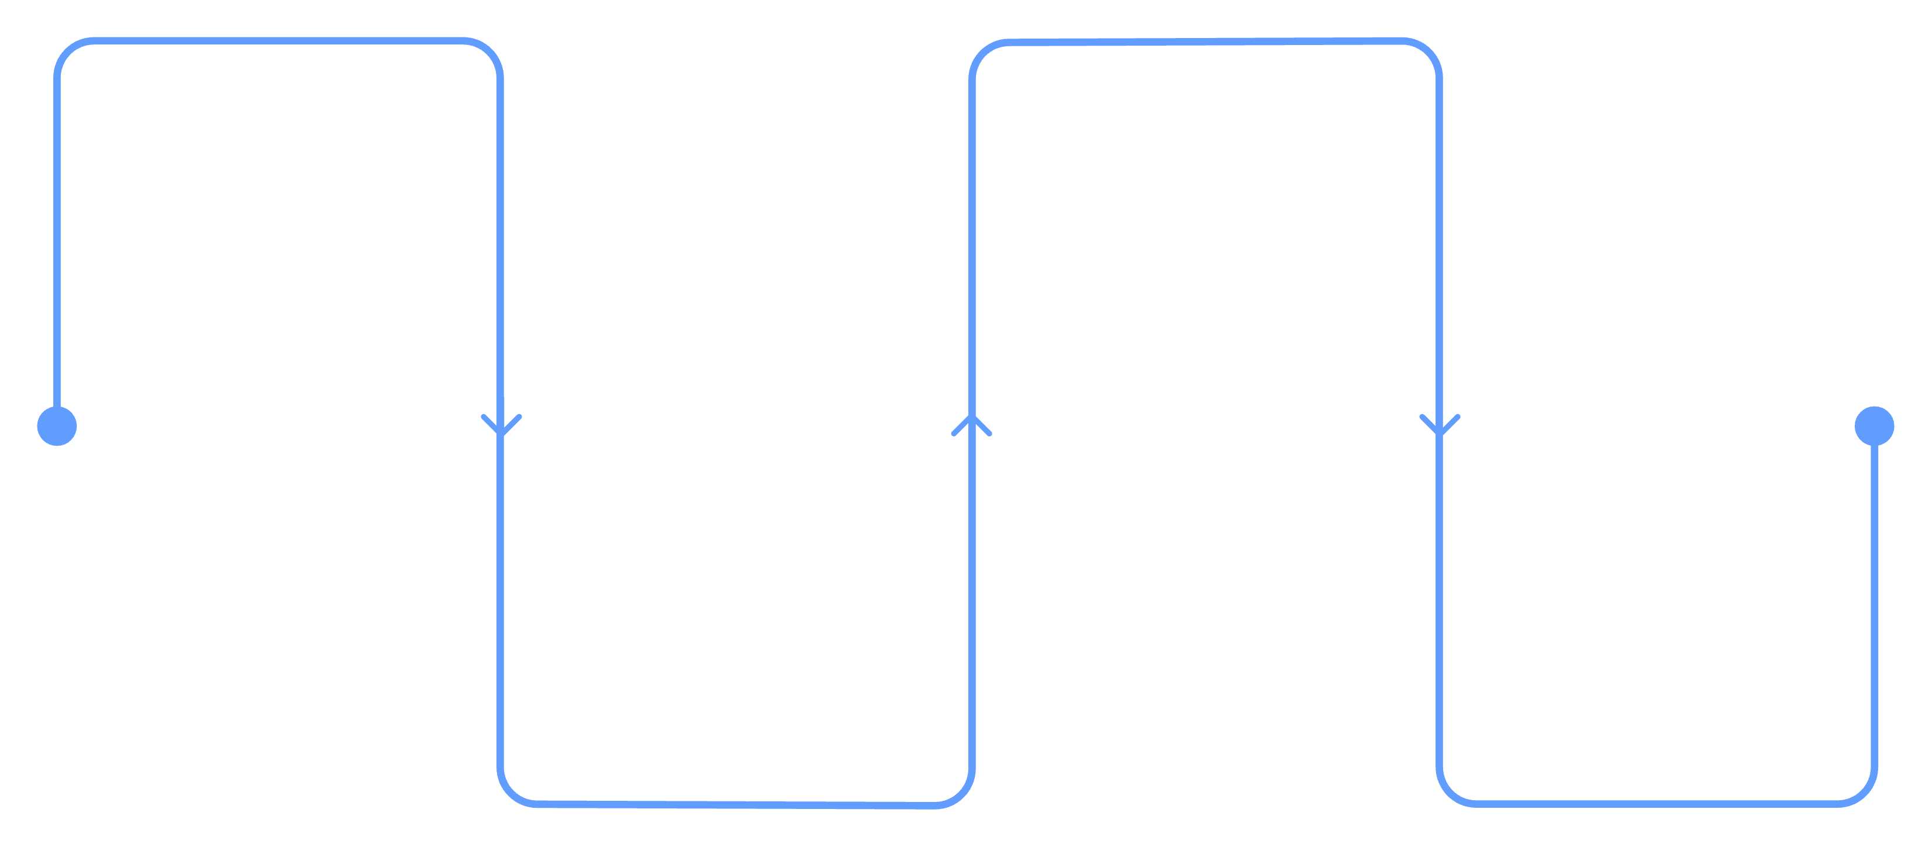
Implementation Roadmap
Discovery
Pilot
Manager interviews & requirements
Launch with one hotel category
Design
Scale
System design & integrations
Rollout, measure and optimize
Start with close collaboration with hotel managers to capture rules and expectations, then move to phased deployment (pilot → scale) while continuously measuring occupancy and revenue impact.

Slide 7
Success Metrics & KPIs
80%
12%
30%
Occupancy Improvement
ADR Growth
Booking Time Reduction
Target uplift in peak-season occupancy through smart pricing and distribution.
Increase in Average Daily Rate via optimized rate plans and upsells.
Faster check-out and booking flows for staff and guests.

Slide 8


Next Steps
1. Workshop with hotel managers
2. Technical design & integrations
Collect detailed category rules, preferred rate plans, and operational constraints.
Define APIs, channel mapping, and payment gateway choices.
3. Pilot & measure
Run a pilot with one hotel class, measure KPIs, iterate on pricing rules.
Use theme color #609DFF for callouts and prioritize manager interviews to ensure the system fits real operations.

