Slide 1
Promises and the event loop
APPLESEEDS

Slide 2
/TABLE OF CONTENTS
/01
Callback hell recap
/02
promises
/03
/04
The event loop
Promise hell and async await
APPLESEEDS
Callback hell
Promises, methods
Async await
The call stack, the event loop, the queue

Slide 3
/01
Callback hell recap
APPLESEEDS
INDEX.HTML

Slide 4
Callback hell recap
APPLESEEDS
Problem: JS is single thread, so our code is blocking.
solution?

Slide 5
Callback hell recap
APPLESEEDS
Solution: add external function that do not block.
Problem: in sync code we know what happens after every line. How we can control what code runs only after an async operation is complete?
solution?

Slide 6
Callback hell recap
APPLESEEDS
Solution? Pass callbacks to the async functions. Run the callback once the operation is complete.
Problem: what if we have multiple operations that we need to run after async operations? We need to nest them, and then we get…

Slide 7
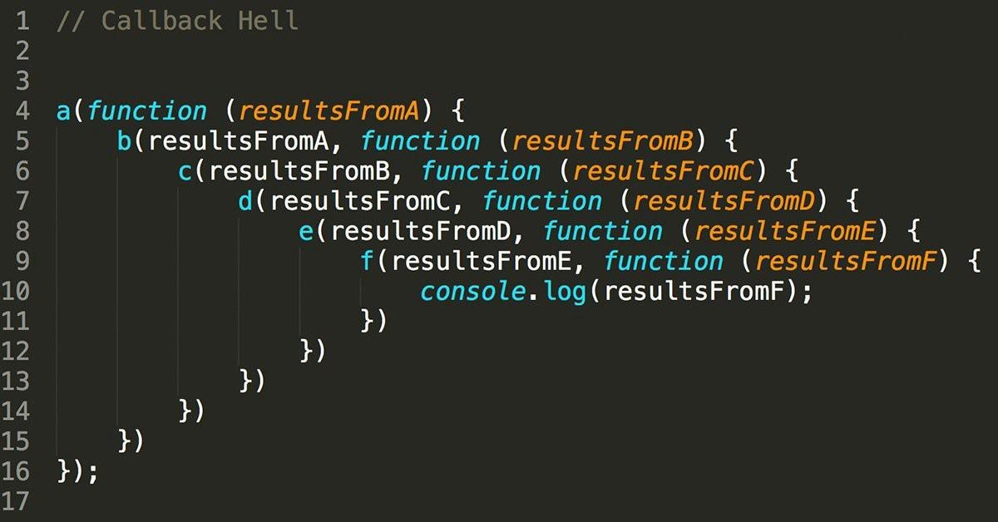
Callback hell
APPLESEEDS

Slide 8
Callback hell recap
APPLESEEDS
So what do we do if we want to control what happens after multiple async operations, but to write it in simple and easy to understand way?
solution?

Slide 9
/02
promises
APPLESEEDS
INDEX.HTML

Slide 10
Promises
APPLESEEDS
So the problem is: when we need the result of the cb, and then use them - we need to nest functions.
So in order to fix this nesting and make it easier to read - a new tool was created.
A promise.

Slide 11
Promises
APPLESEEDS
Promise is a placeholder, for a future value.
Promise is like in real life, when you make a promise to someone:
You can work on it, then it’s pending.
You can complete it - then it’s fulfilled.
It can be successful - resolve
It can fail - reject

Slide 12
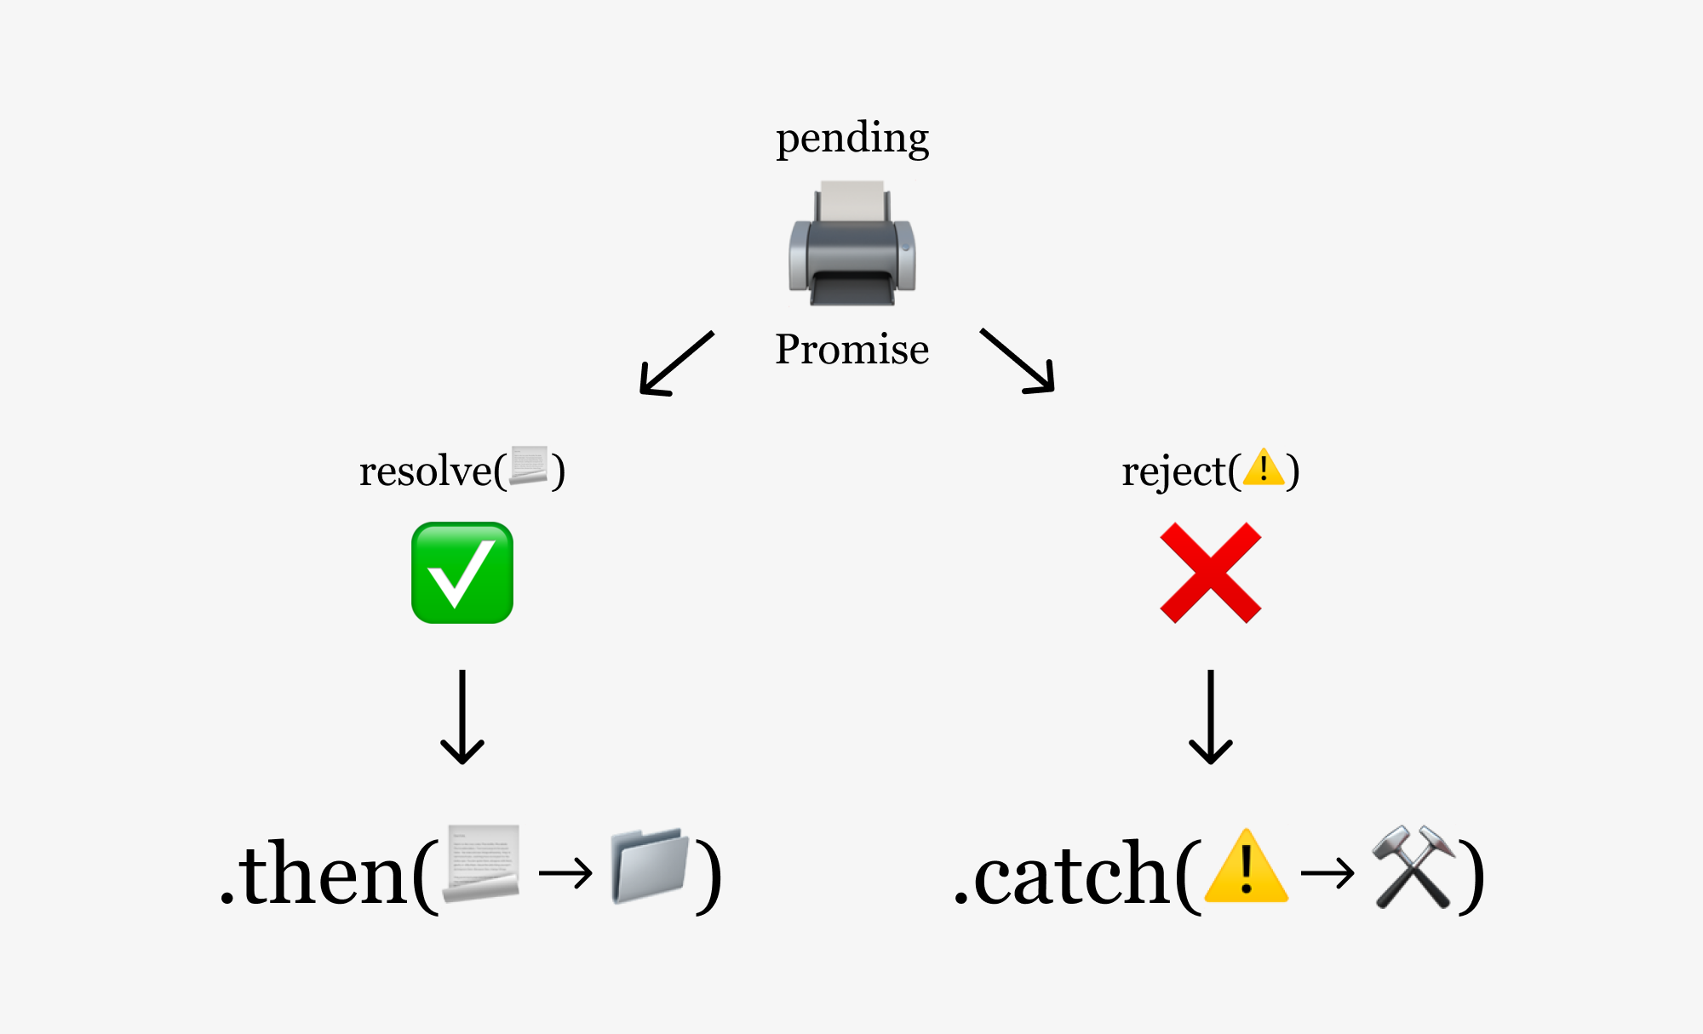
Promises
APPLESEEDS

Slide 13
Promises
APPLESEEDS
We can controller what happens after we reject a value with the method .catch
We control what happens after we resolve with .then

Slide 14
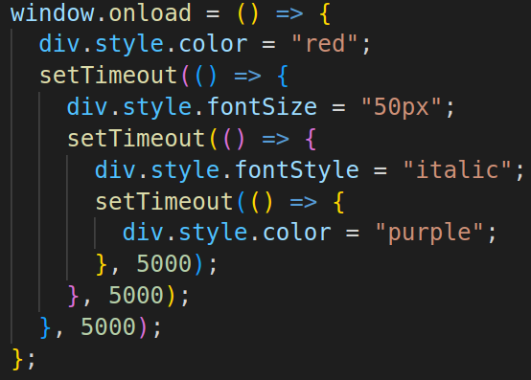

Promises
APPLESEEDS

Slide 15
Promises
APPLESEEDS
So how do we work with promises?
A promise is a constructor - we need to use “new”. const p1 = new Promise()
As a parameter, we pass a cb with 2 parameters - resolve and reject. This are functions that we get automatically.

Slide 16
Promises
APPLESEEDS
Inside the cb we do any async operation.
When we are done, we call resolve(value)
If the operation failed - we call reject()

Slide 17
Promises
APPLESEEDS
In the meantime, outside, we can pass the promise around, and control what happens with .then and .catch.
For example:

Slide 18
Promises
APPLESEEDS
const p1 = new Promise((res,rej)=>{ // do some async stuff if(success){ res(value) } }) p1.then(result=>{console.log(result)}

Slide 19
Promises
APPLESEEDS
The cool thing is that .then returns a promise. So we can chain promises: p1.then(fn()).then(fn()).then()...
The only thing that we need is fn that returns a promise.

Slide 20
Promises
APPLESEEDS
So let’s rewrite the exe with the callbacks - but now with promises.

Slide 21
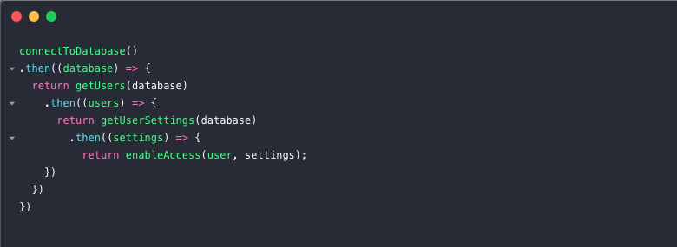
Promises
APPLESEEDS
What happens if we have a lot of nested .then calls?
= promise hell.

Slide 22
Promises
APPLESEEDS
This is why another syntax sugar was added: async await.

Slide 23
/03
Async await
APPLESEEDS
INDEX.HTML

Slide 24
Async await
APPLESEEDS
The problem: promises are good for changing and writing more manageable code.
But we still need to nest new promises inside “then”, so if there are multiple nesting, then it’s creating another hell for us.
So we have more syntax to help us.

Slide 25
Async await
APPLESEEDS
The first thing is the keyword “async”.
When we write “async” before a function, it automatically makes the function return a promise.
So we can write:

Slide 26
Async await
APPLESEEDS
The first thing is the keyword “async”.
When we write “async” before a function, it automatically makes the function return a promise.
So we can write:

Slide 27
Async await
APPLESEEDS
const fn = ()=>{ return new Promise(res,rej=>{ resolve(2) }) }
const fn = async()=>{ return 2 }

Slide 28
Async await
APPLESEEDS
But “async” is not only syntactic sugar. It allows us to use another keyword inside the function: “await”.
We use “await” before a promise.
Await basically means that the function will stop until the promise is ether resolved or rejecter.

Slide 29
Async await
APPLESEEDS
This means that the function acts like a sync function, even though its has async operation.
So instead of:

Slide 30
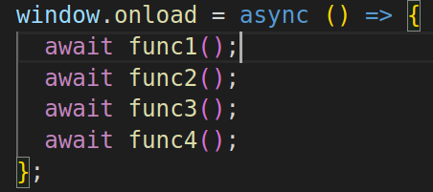
Async await
APPLESEEDS

Slide 31
Async await
APPLESEEDS
This makes our code alot easier to read and understand.
But this has a drawback - this will turn the code inside the funcion to blocking.
In general - async and non blocking behavior is good - don’t block if you don't need to!

Slide 32
Async await
APPLESEEDS
For example: let’s say we have an application that makes juice, and there are async function to fetch fruits.
The function “makeJuice” must be run after all the fruits are fetched.
How will you build it?

Slide 33
Async await
APPLESEEDS
One option: async function main(){ await getFruit(‘apple’) await getFruit(‘watermelon’) makeJuice() }
What is the problem with this code?

Slide 34
Async await
APPLESEEDS
The problem is that the “getFruit” calls are not depending on each other, and we are blocking them for nothing - only because of “makeJuice”.
If the function don’t need to run one by one - don’t block them with “await”!
You can use tools like: Promise.all()

Slide 35
/04
The event loop
APPLESEEDS
INDEX.HTML

Slide 36
The event loop
APPLESEEDS
The last piece of the puzzle for JS async behavior is the event loop.
This is the tool that the JS engine uses to make js non blocking, even though is is single thread.
How does it work? How the entire js engine works?

Slide 37

The event loop
APPLESEEDS
The first element is the “call stack”.
Every function call is added to the call stack, with the rull - FILO: first in, last out.
It’s like a stack of books:

Slide 38
The event loop
APPLESEEDS
The call stack is running each function, in order, until it’s empty.
This is the single thread of JS, where there is a blocking behavior - if a function takes a lot of time, it will block the rest of the stack.

Slide 39
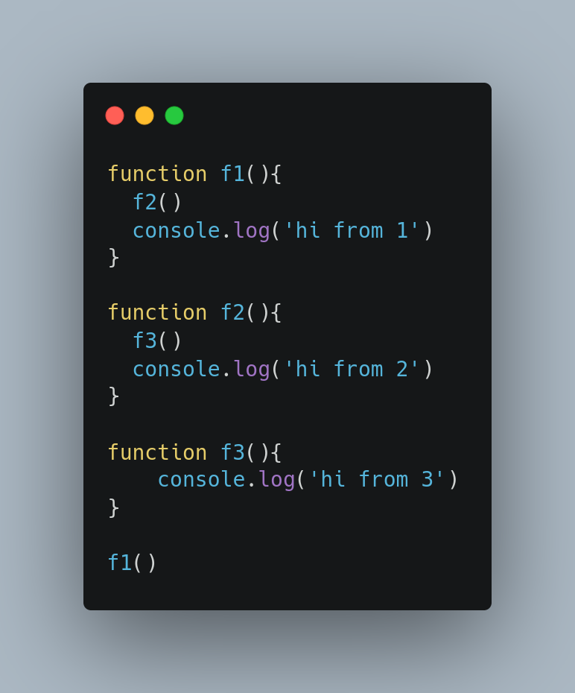
יסודות JS
How will the stack look?

Slide 40
יסודות JS
call stack
log3
f3
log2
f2
log1
f1

Slide 41
The event loop
APPLESEEDS
So let’s add the external functions that add async behavior. How do they work? Where are the callbacks stored?
In the “callback queue” - FIFO - first in, first out, like a queue.
The functions inside the queue will be accessed only after the call stack is empty.

Slide 42
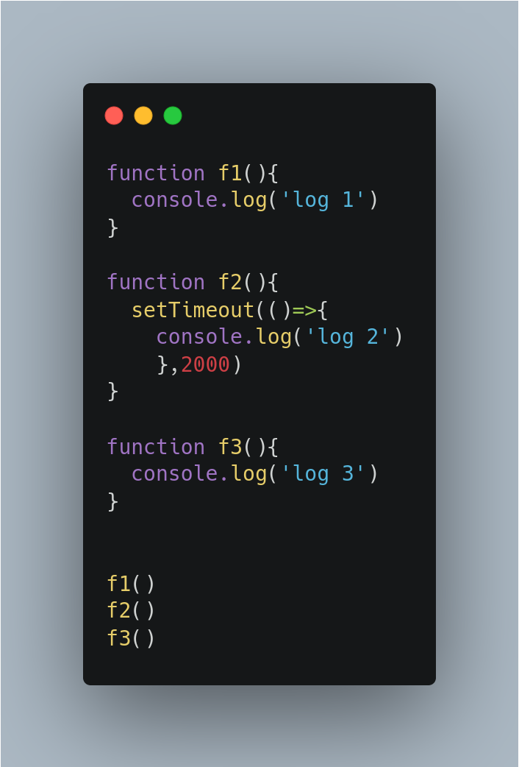
תרגילון 2
So if we have the following code:

Slide 43
יסודות JS
call stack
f3
f2
f1
cb1
callback queue
cb1

Slide 44
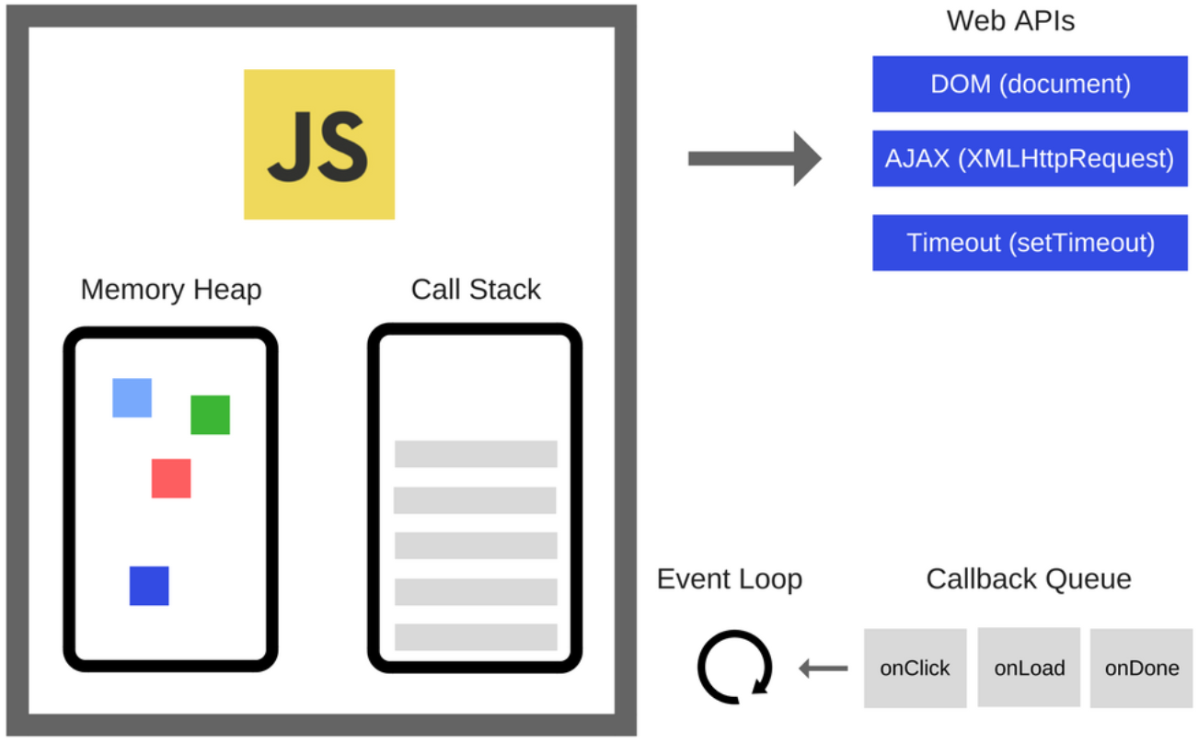
The event loop
APPLESEEDS
So what is responsible to check if the call stack is empty, and if it is - move cb from the queue into it?
The event loop:

Slide 45
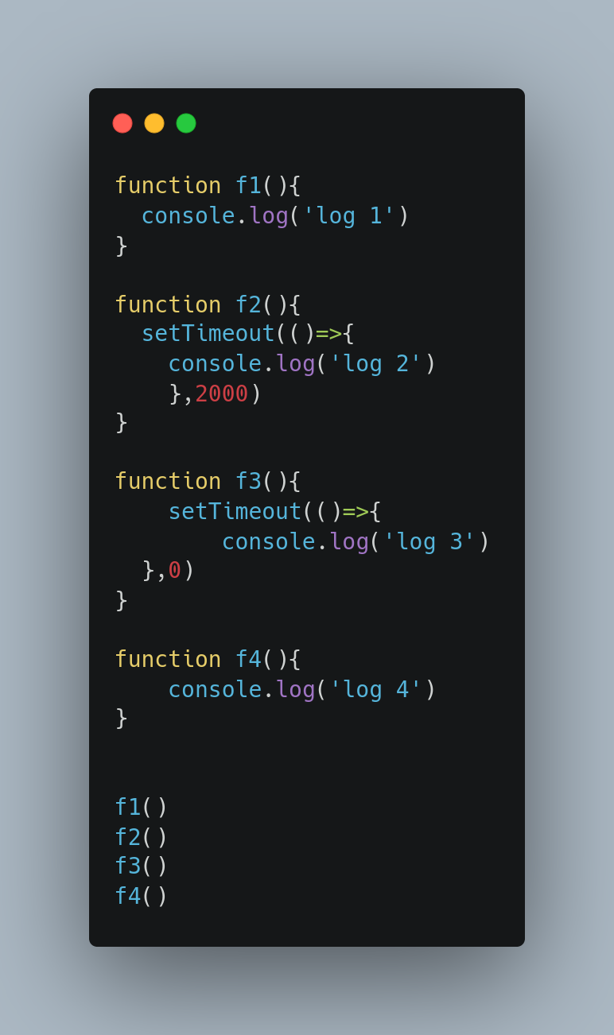
The event loop
APPLESEEDS
What will be printed?

Slide 46
Thanks, and good luck!
Contact us:
Yishai
yishain@appleseeds.org.il
0524605642
Shadi
shhadys@appleseeds.org.il 0543113297
APPLESEEDS
INDEX.HTML

