Slide 1
Add a Slide Title

Slide 2
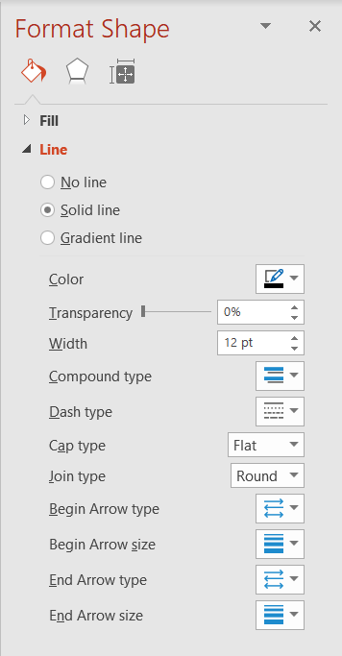

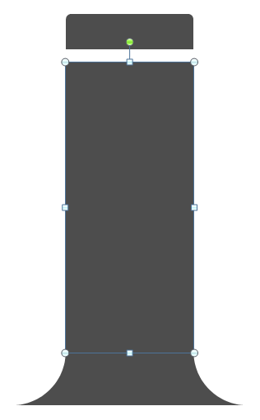
Placeholder Title
Adjusting Branches
Use the end points and the elbow as needed (A).
When scaling, you may have to change the width of the line (B).
Adjusting Tree Trunk
Scale the tree trunk vertically by adjusting the middle segment (C). Next, move the top or bottom to connect to the middle segment.
(A)
(C)
(B)

Slide 3
Customize this Template
Template editing instructions
and feedback

