Slide 1
Phase 3 Final Submission
Group 2: Hasan Zaidi, Mohammad Sufyaan

Slide 2

Beyond Sticker Price: Finding Affordable Excellence for Middle-Class Families
The Challenge: The Middle-Class "Aid Gap"
Families in the $75,001—$110,000 income bracket face a unique challenge: often ineligible for significant federal need-based aid, yet unable to comfortably afford a university's full sticker price.
Our project directly addresses this gap by focusing on a less transparent but highly impactful funding source: merit- based scholarships and institutional grants.
Our Mission: A Data-Driven Path to Minimal Debt
To leverage data science to identify the top 10 four-year institutions that offer the best financial value and academic return for high-achieving students from middle-income backgrounds.
The Final Goal: To provide a clear, actionable shortlist of colleges that enables graduating with the least possible debt.
Sticker Price
Your Price

Slide 3



Building a Foundation of Trust: Our Data Pipeline
IPEDS 2022-23
Access DB
Curated Analytical Dataset
ETL Script (Python/Pandas)
SQL Queries
(DuckDB)
8 Normalized CSV
Files for Efficiency
A Rigorous 8-File ETL Pipeline:
We merged eight distinct data files from the official IPEDS 2022-23 dataset, using the unique UNITID to create a 360-degree view of each institution.
Architectural Justification: Why CSV?
Performance: A staging layer of flat CSV files allows for significantly faster in-memory processing with Python/Pandas compared to repeated database
Portability: This modern approach ensures our analytical dataset is easily portable and compatible with a wide range of tools, including our fast, serverless SQL engine, DuckDB.
Files Merged:
HD2022 – college directory (names, type) — to identify each school
SFA2122_P1 – grant aid amounts — gives merit aid $ (IGRNT_A) SFA2122_P2 – net price — what families actually pay (NPT442) IC2022_AY – sticker price (TUITION2) — for comparison ADM2022 – SAT scores — academic quality signal DRVADM2022 – admissions rate — selectivity
DRVGR2022 – graduation rate — quality/outcome check IC2022Mission – mission statements — for the AI context tool

Slide 4
A New Lens on Value: The Merit Generosity Index (MGI)
The Problem with Standard Metrics:
Most public data focuses on need-based aid, obscuring an institution's strategic commitment to attracting students based on academic merit.
Justification for ’IGRNT as the Merit Proxy:
The IPEDS variable ’IGRNT_A’ (Average Institutional Grant Amount) represents discretionary funds the college awards, independent of federal need-based aid formulas.
It is the purest available signal of a college's strategic decision to attract high-achieving students, making it the ideal proxy for this project's mission.
Merit Generosity Index (MGI)
Average Institutional Grant Aid
Sticker Price
=
How the MGI Works:
This custom ratio normalizes a college's generosity against its cost, allowing for fair comparison. A school with a
$60k sticker price giving a $30k grant (MGI = 0.5) is more generous than a $20k school giving a $5k grant (MGI
= 0.25).
A higher MGI signals a stronger institutional commitment to making college affordable.

Slide 5
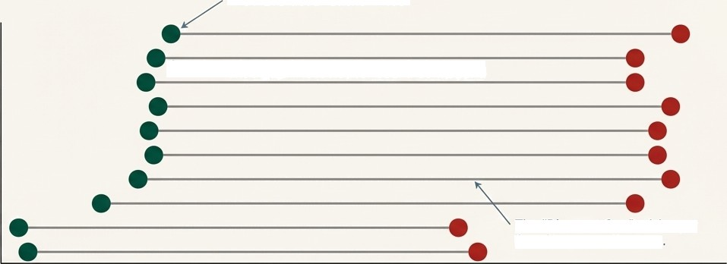
The Discount Gap: Visualizing the Difference Between Sticker Price and Your Price
The Actual Net Price for Your Income Band
The Advertised "Sticker Price"
Wesleyan University Princeton University
Massachusetts Institute of Technology
Yale University
Johns Hopkins University Washington and Lee University
Williams College Stanford University Holy Names University
Berea College
The ”Discount Gap"—A longer line signals a better deal
50k 60k
l0k
20k
30k
Cost ($)
40k
Why a Dumbbell Chart? This visualization was chosen over a standard bar chart because it excels at showing the difference
between two points for each category. Our story is about the size of the discount, and this chart illustrates that size through the gap between the two points.
Key Insight: The chart instantly reveals which institutions, despite potentially high sticker prices, offer the most significant discounts for middle-class families.
Interpreting the Data: Institutions like Wesleyan University and Princeton demonstrate a massive “Discount Gap,“ signaling a strong commitment to affordability that isn't apparent from their sticker prices alone.

Slide 6
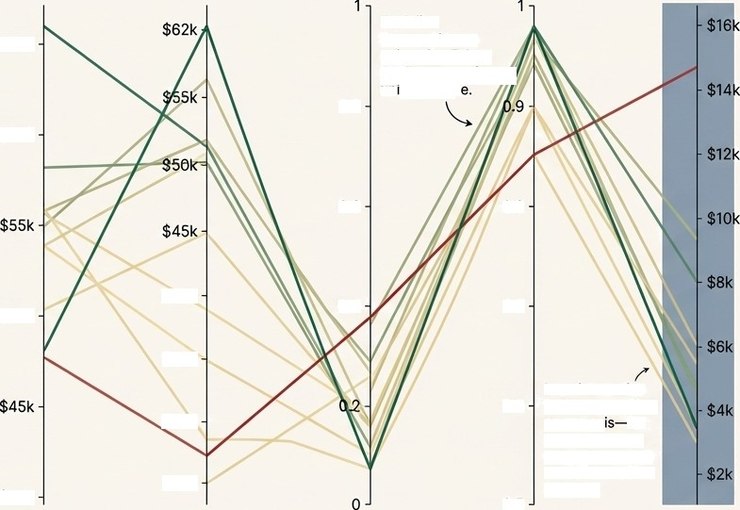

Finding the Sweet Spot: Balancing Cost, Quality, and Aid
A Multi-Dimensional View:
College selection is never about a single number. This Parallel Coordinates Plot reveals the complex trade-offs between competing institutional priorities:
Sticker Price
Avg Merit/Inst Grant
Admissions Rate Graduation Rate
Your Net Price
Each line represents one university. Follow the line to see its un”que profit
Higher Value
$65k
0.8
Sticker Price & Avg Merit/lnst Grant
(Cost vs. Generosity)
Admissions Rate (Selectivity)
Graduation Rate (Quality & Efficiency Proxy)
Your Net Price (The Bottom Line)
$60k
Score (Value)
0.6
0.8
Composše
$40k
0.5
0.7
$50k
Actionable Insight for Families:
This visualization strategy allows you to define "value" on your own terms. It helps answer critical questions IIke: "Which highly selective schools with a >90% graduation rate still offer a net price I can afford?" The answer lies where the lines converge in your desired "sweet spot."
$35k
0.6
In an interactive tool, you can filter on any axis for example, to see only schools with a Net Price below $15,000
$30k
Lower Value
$40k
Sticker Price
$25k
0
Avg Merit/lnst Grant
Admissions Raie
Graduation Rate Your Net Price

Slide 7



Beyond the Numbers: Understanding a College’s Values with AI
Quantitative Rankings Need Qualitative Context:
Our data can tell you what a college costs, but not what it stands for. We integrated an AI layer to provide this crucial context.
How Retrieval-Augmented Generation (RAG) Works:
Ingestion: We indexed the official mission statements of
all universities from the IPEDS ‘IC2022Mission' file.
Retrieval: When you ask a question in natural language,
the system finds the most semantically relevant passages
from the mission statements.
Generation: A Large Language Model then synthesizes
these retrieved passages into a coherent, direct answer.
Which of the top 10 schools emphasize leadership?
University Mission Statements (from IC2022Mission.csv)
Retrieval-Augmented Generation (RAG) Model
Contextual Answer
Note: the mission statement data is ready for ingestion, but currently does not initialize the vector store or build the query-answering AI
The Result:
A powerful tool to validate our quantitative findings against each university's own stated purpose, ensuring a holistic match.

Slide 8
2022-23 Top 10 College Shortlist for Merit-Based Value
Rank | Institution Name ("INSTNM”) Williams College | Your Net Price $18,500 | Merit Generosity Index (MGI) 0.82 | Composite Score 95.1
2 | Princeton University | $21,000 | 0.58 | 82.4
3 | Wesleyan University | $19,200 | 0.55 | 90.8
4 | Yale University | $22,300 | 0.53 | 88.7
5 | Stanford University | $17,900 | 0.51 | 87.5
6 | Massachusetts Institute of Tech | $23,100 | 0.50 | 86.2
7 | Johns Hopkins University | $24,500 | 0.48 | 84.0
8 | Washington and Lee University | $22,800 | 0.49 | 83.1
9 | Berea College | $15,500 | 0.54 | 82.5
10 | Amherst College | $24,900 | 0.46 | 81.9
The Final Ranking:
This list is the culmination of our analysis. Institutions are ranked by a ”Composite Score‘ that synthesizes the Merit Generosity Index (MGI), 4-year graduation rate, and affordability. These schools represent the optimal intersection of institutional generosity, academic quality, and financial value for your family.
Recommended Next Steps:
Explore the Top 5: Begin by visiting the websites of the top five
schools on this list.
Verify with a Net Price Calculator: Use each school's official online calculator to get a personalized estimate. Our figures are based on averages; theirs will be specific to your financial situation.
Align with Academic & Personal Fit: Discuss this list with your
student to ensure it aligns with their academic goals and personal
preferences, finalizing their application strategy.

Slide 9
Clarity Through Data: An Actionable and Rigorous Solution
Actionable Clarity (For the Family)
Technical Rigor (For the Professor)
Executed a robust 8-file ETL pipeline on official IPEDS data.
Developed and justified a novel metric (MGI) to proxy for merit-based aid.
Deployed innovative visualizations and an interactive tool to filter findings
Identified and addressed the middle-class "Aid Gap."
Delivered a data-validated shortlist of 10 high—value colleges.
Provided clear tools (visualizations, AI) and next steps for an informed decision.
Works Cited
National Center for Education Statistics (NCES). (2024). Integrated Postsecondary Education Data System (IPEDS) 2022-23 Survey Component Data Files. U.S. Department of Education. Retrieved from https://nces.ed.gov/ipeds/use-the-data
Pytlak, J. (2023). DuckoB: The SQL engine for data scientists. Retrieved from https://duckdb.org/ Plotly Technologies Inc. (2015). Co//aboraf/ve data science. Montréal, QC. Retrieved from https://plot.Iy
Python Software Foundation. (2024). Python Language Reference, version 3.12. Retrieved from https://www.python.orgl The LangChain Team. (2024). LangChain Documentation. Retrieved from https://docs.Iangchain.com/

