Slide 1
Smart Home
Using packet Tracer
Presented by:
MAHADE HASAN - 021 142 003
S.m. SHAHIDUL ALAM – 021 141 037
Md. Maruf ahmed – 021 142 109
md. Saiful islam – 021 141 035

Slide 2
Overview
INTRODUCTION
WHY SMART HOME?
FEATURES
PROPOSED IoT ARCHITECTURE
DESCRIPTION
INTERNET OF THINGS
SYSTEM FUNCTIONS
ADVANTAGES
CONCLUSION

Slide 3
INTRODUCTION
Today, technology has become an integrated part of people’s lives and continues to influence many aspects of daily life and has allowed better social interaction, ease of transportation etc.
Home automation or sensible home may be delineated as introduction of technology within the home atmosphere to provide ease and protection to its occupants.
By using the technology of the Internet of Things, the examination and execution of home automation have got additional average.

Slide 4
WHY SMART HOME?
Smart Home is Applicable in various aspect of our home and environment to suite our different preferences
Comfort or Ease of Control
Entertainment
Security
Convenience all time
Life time personalization
User friendly

Slide 5
FEATURES
Wireless Connectivity
Expansion Capability
Protocol Compatibility
Application Control
Device Management
Savings
Convenience

Slide 6
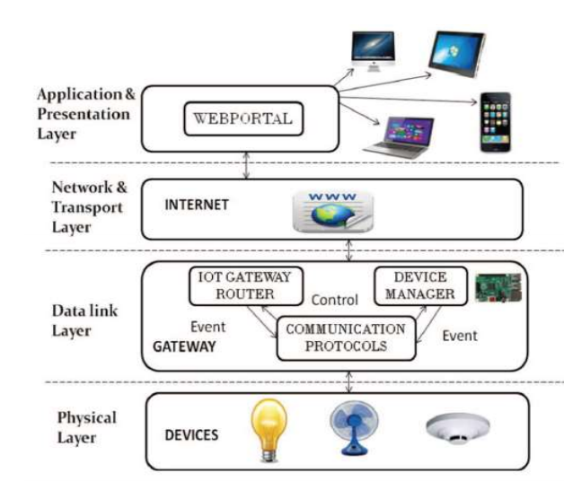
PROPOSED IoT ARCHITECTURE

Slide 7
PROPOSED IoT ARCHITECTURE
The physical layer consists of the devices which are to be controlled.
The data link layer consist of IoT gateway router, device manager and various communication protocols.
IoT gateway which communicates to personal computer or smart phone by means internet in the network and transport layer.
The application and presentation layer consist of web portal which is nothing but designing a web page by which we can control the various appliances .
The appliances can also be controlled by creating an app in mobile phone which is similar to web portal.

Slide 8
INTERNET OF THINGS
The Internet of things (IoTs) can be defined as connecting the various types of objects like smart phones, personal computer and Tablets to internet.
The aim of the IoT is that enable things to be connected any time, any where with any thing and anyone
With the introduction of IoTs, the research and development of home automation are becoming popular in the recent days.
IoTs technology is used to come in with innovative idea and great growth for smart homes to improve the living standards of life.
The IoT-based architecture provides high-level flexibility at the communication and information.
It is an approach which is relevant in many different environments such as patient monitoring system, security, traffic signal control or controlling various applications.

Slide 9
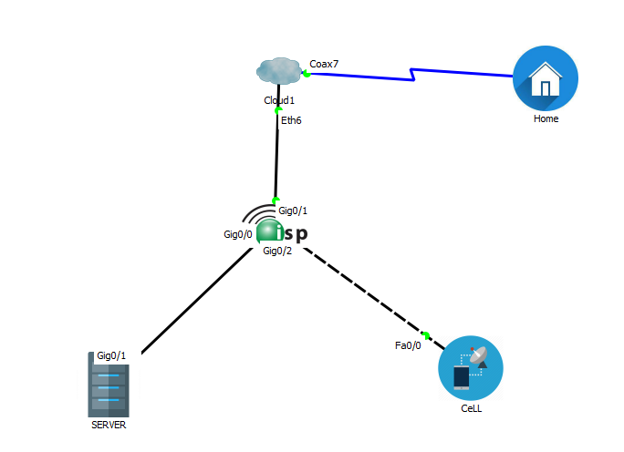
DESCRIPTION
Smart devices are connected with home gateway. Home gateway is connected with ISP through a cable modem. Two server DNS and IoT server are connected with ISP and a central office server is connected with ISP.

Slide 10
Home gateway ,DNS and Cell tower
Home Gateway is a device that allows a local area network (LAN) to connect to a wide area network (WAN) via a modem.
Domain Name Servers (DNS) are the Internet's equivalent of a phone book. They maintain a directory of domain names and translate them to Internet Protocol (IP) addresses. This is necessary because, although domain names are easy for people to remember, computers or machines, access websites based on IP addresses.
A Cell Tower is connected with central office server. Cell towers are usually placed so that they can cover a wide area. One can control the iot divices used inside the home using cell phone.

Slide 11
SYSTEM FUNCTIONS
To control lighting, heating, ventilation, air conditioning, appliances, communication systems, entertainment and home security devices.
To improve Convenience, Comfort and Security.

Slide 12
ADVANTAGES
Flexibility
Programmatically control devices
Better scalability and security
Energy saving
Improved comfort and safe

Slide 13
FUTURE SCOPE
Controlling various household devices of house with internet
Industrial automation and management through internet machine-driven fireplace exit systems
Improvement of security problems in extremely restricted areas.

Slide 14
CONCLUSION
we have introduced the event of a home management
security system exploitation using IoT
The system is suitable for remotely controlling the home appliances .
The system may be employed in many places like banks, hospitals etc.

