Slide 1
Dermatech
Mobile Skin Condition Diagnosis Using Neural Networks
Presented By:
Hasan Al-Zubaidi
Yara Al-Thahabi
Obada Muqbel
Supervised By:
Laith W. Al Shehab

Slide 2
Table of contents
01
02
03
04
05
06
Introduction
Dataset
Methodology
Results
Discussion
Conclusion

Slide 3
01
Introduction

Slide 4
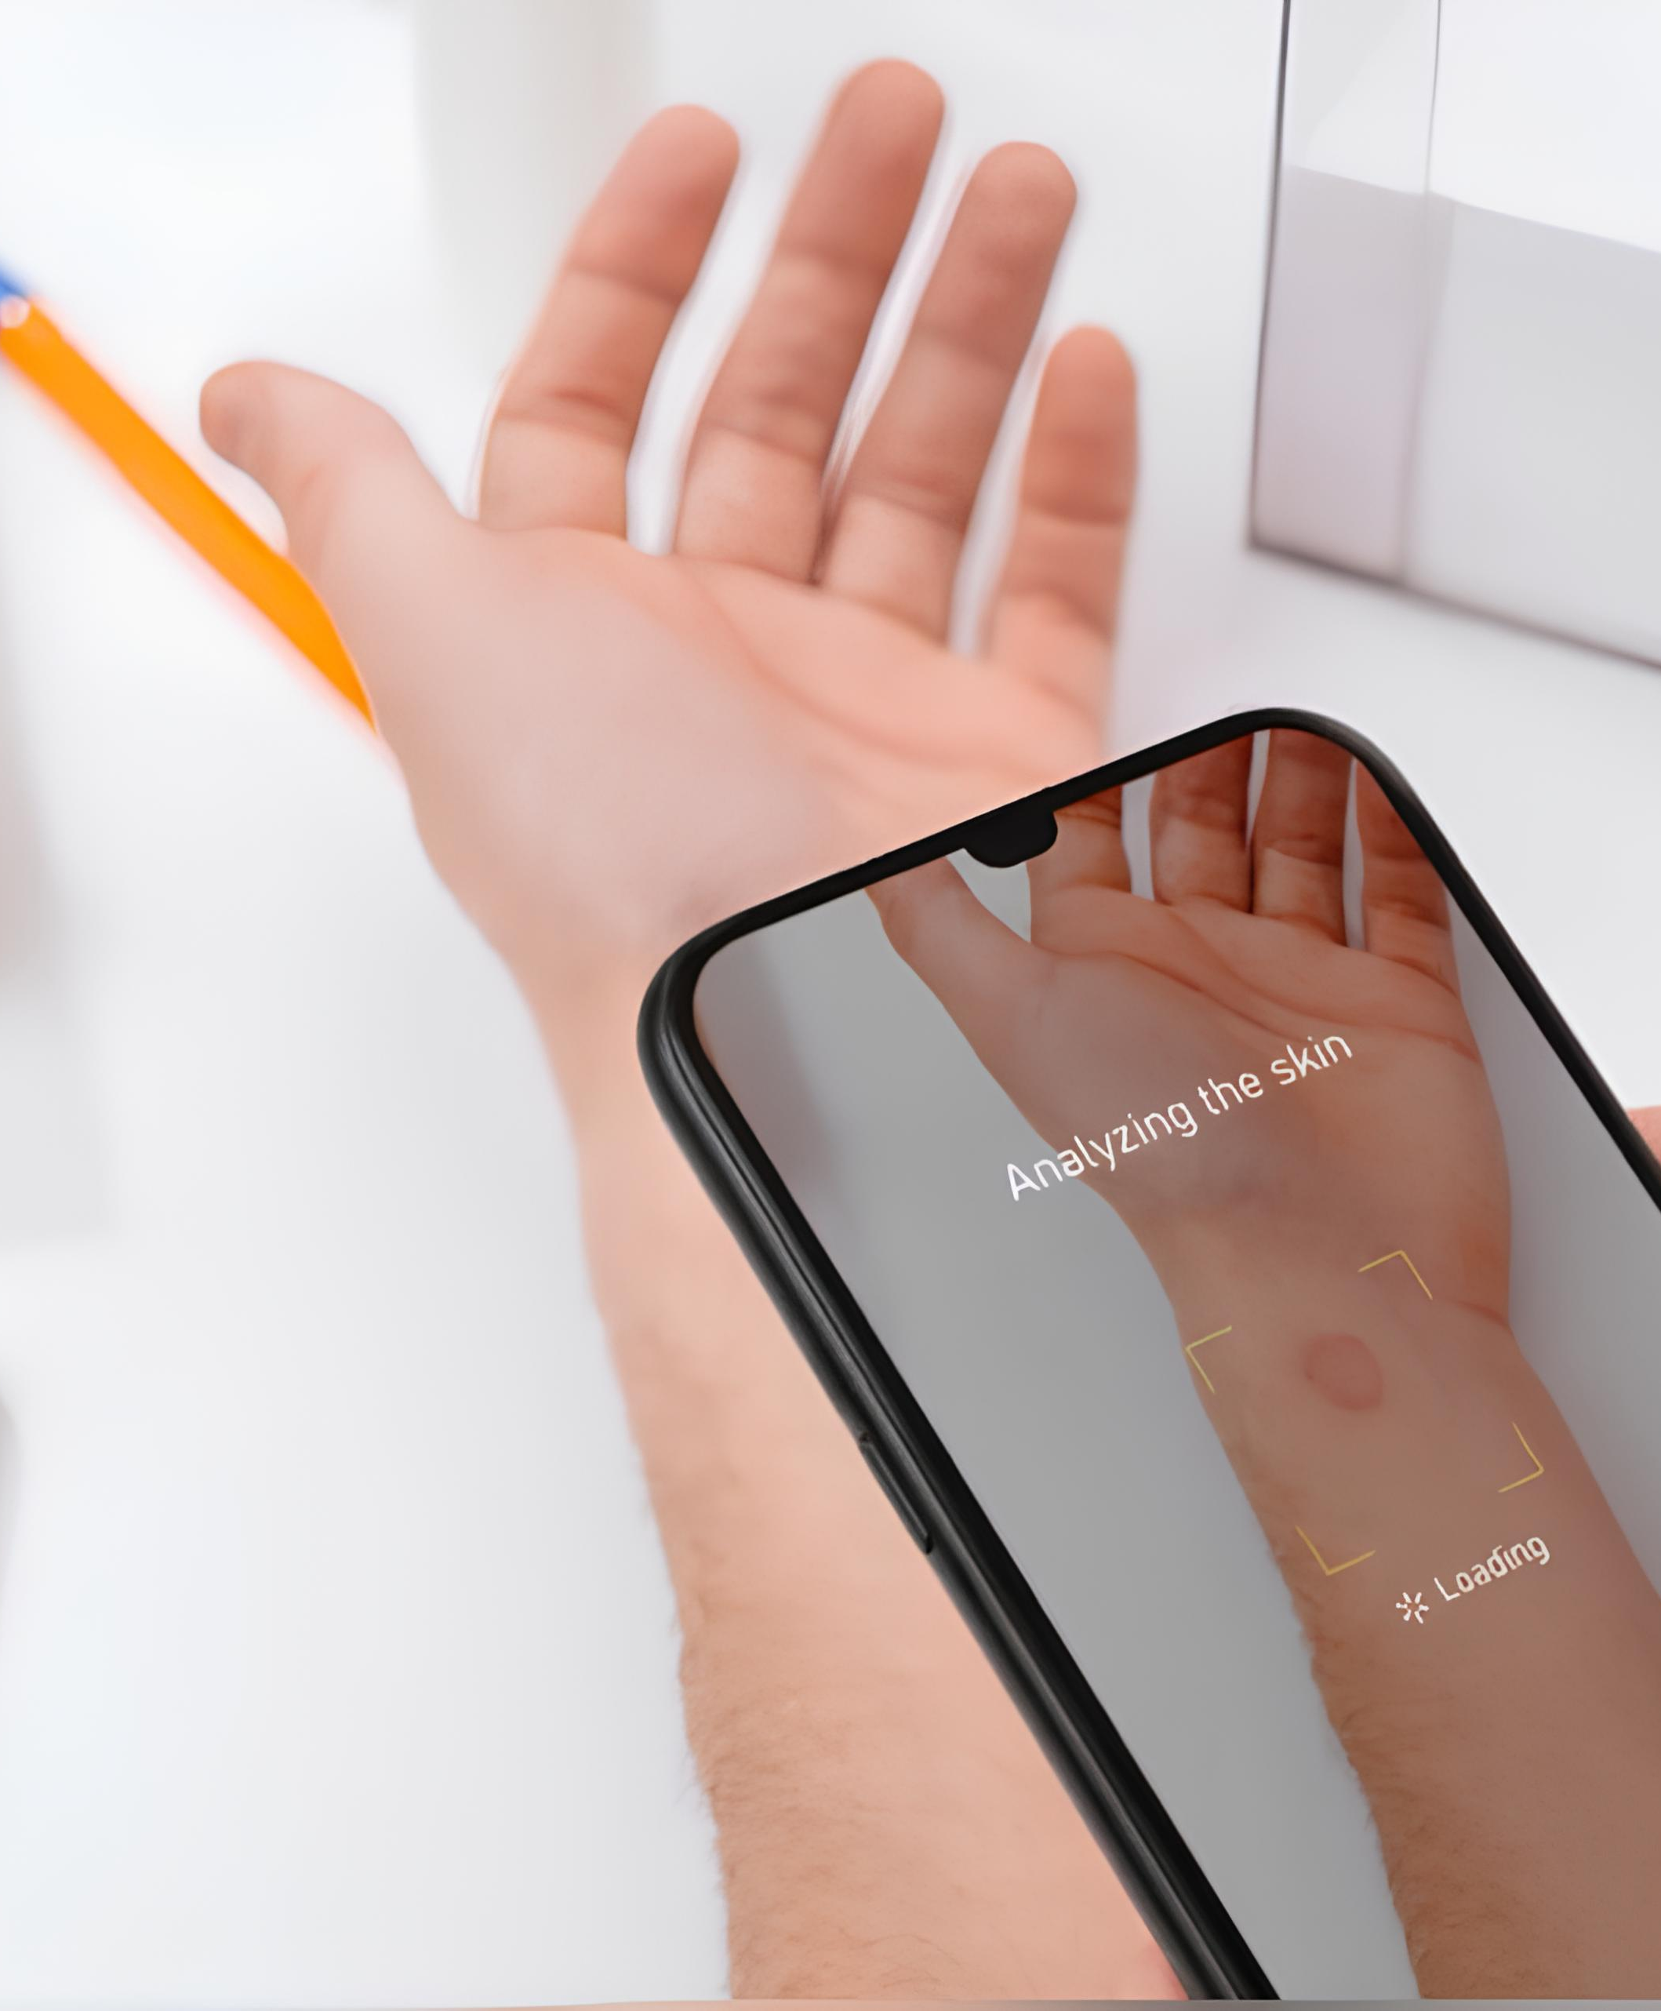
Introduction
DermaTech represents a leap in skin disease diagnosis, harnessing AI technology like convolutional neural networks (CNNs) to swiftly and precisely identify diverse skin conditions. This innovation promises to significantly enhance diagnostic speed and reliability, benefiting both medical professionals and patients.

Slide 5
Problem Statement
Skin diseases pose a significant challenge globally, particularly in areas lacking access to skin experts. Our app, DermaTech, addresses this issue by using advanced technology to allow users to upload photos of skin issues directly from their phones. Through smart AI, DermaTech quickly and accurately identifies different conditions, facilitating faster treatment and reducing healthcare expenses.

Slide 6
Contributions
1
2
3
Building Custome Dataset
Accessibility with Mobile Phone
Building a Robust Model

Slide 7
02
Dataset

Slide 8
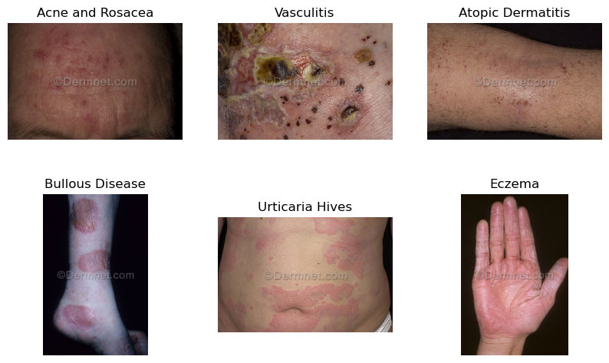
19,500
15,500
4,000
Dermnet Dataset
Consists of:
Images
Training Set
Test Set

Slide 9
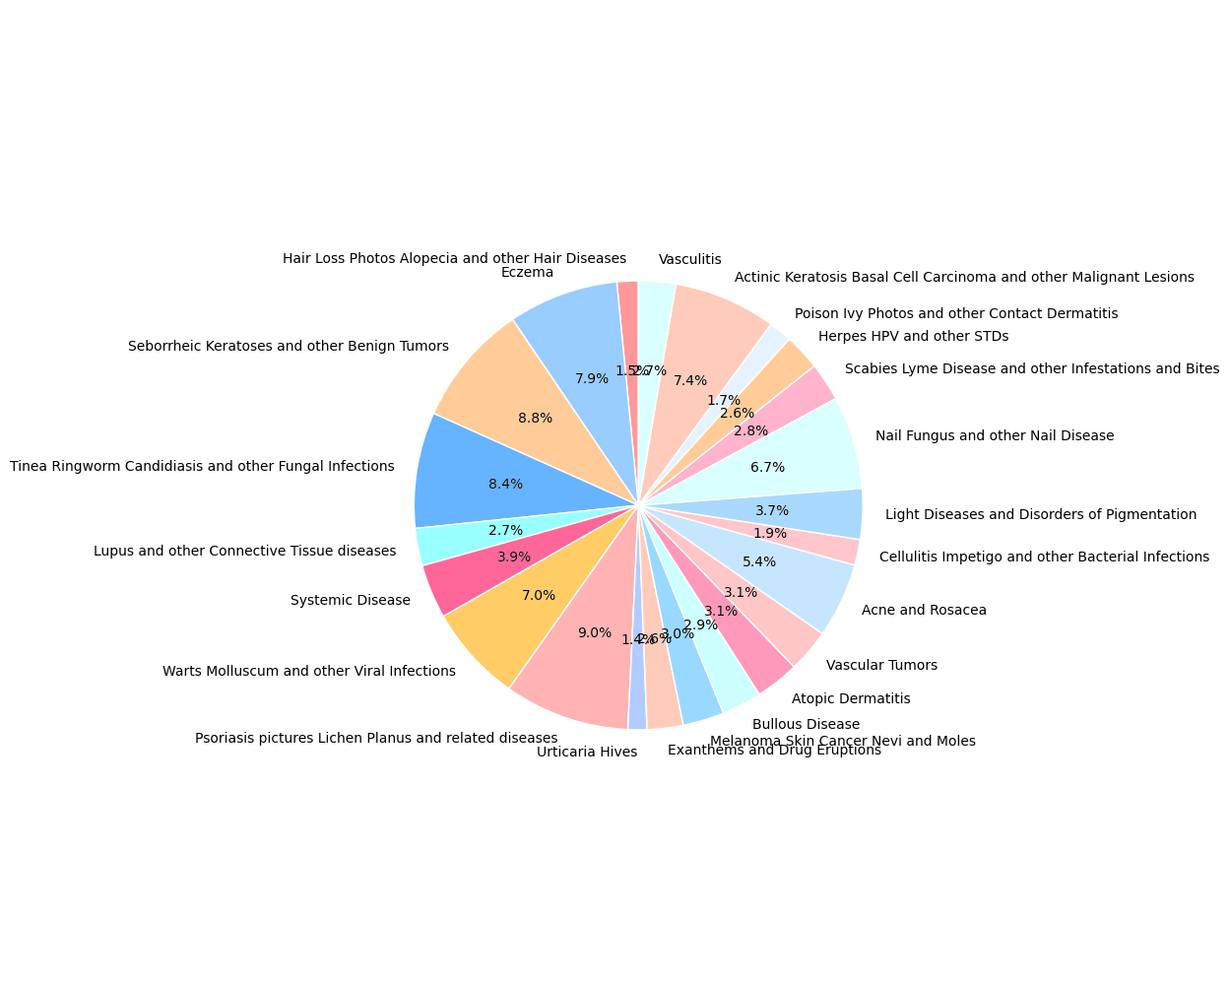

Dermnet Dataset Distrebution

Slide 10
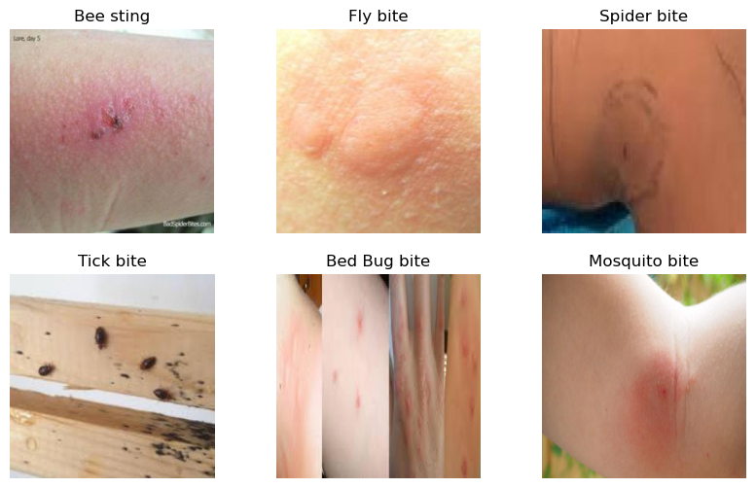
841
591
250
Bug Bites Dataset
Consists of:
Images
Training Set
Test Set

Slide 11
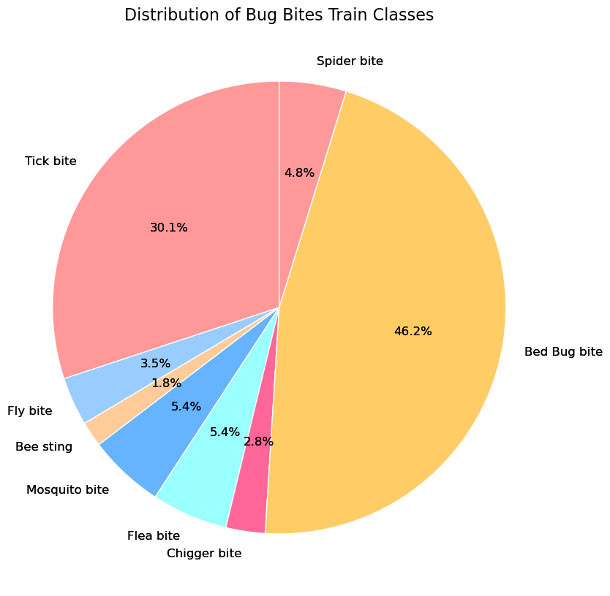
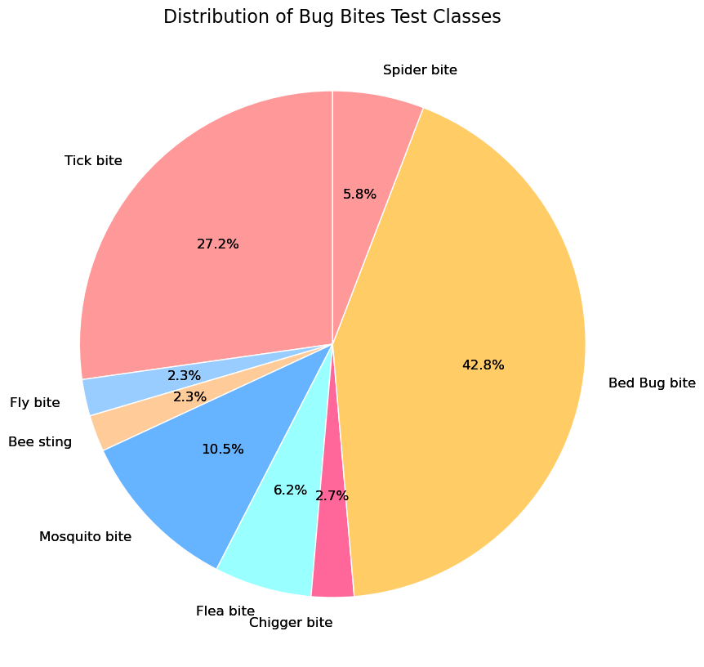
Bug Bites Dataset Distrebution

Slide 12
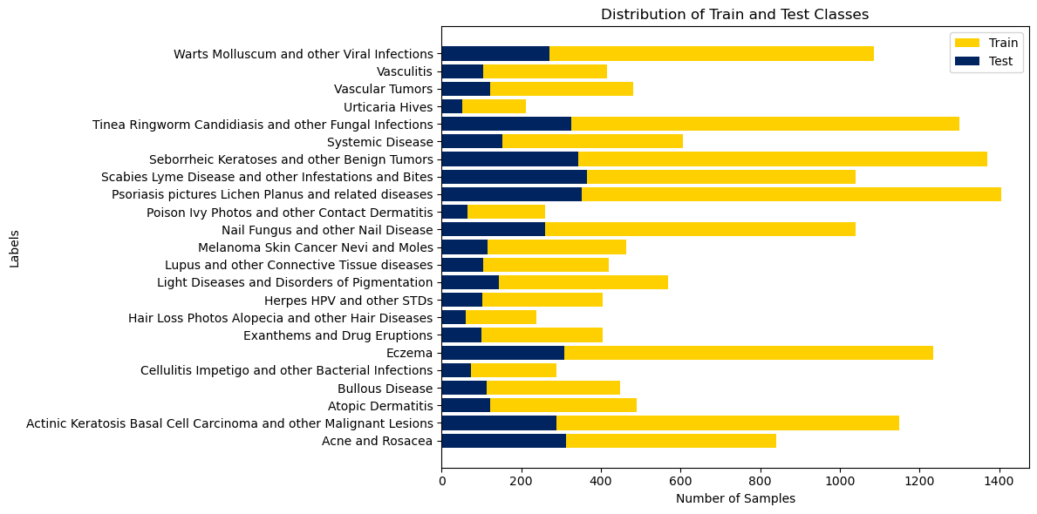
Dermtech 1.0 Dataset
Consists of 23 classes:

Slide 13
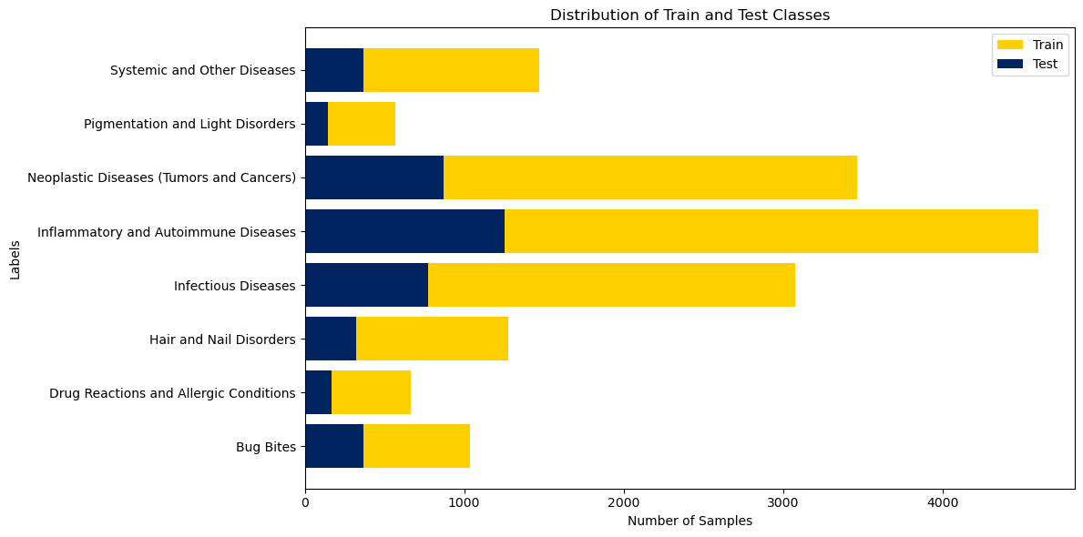
Dermtech 2.0 Dataset
Consists of 8 broad classes:

Slide 14
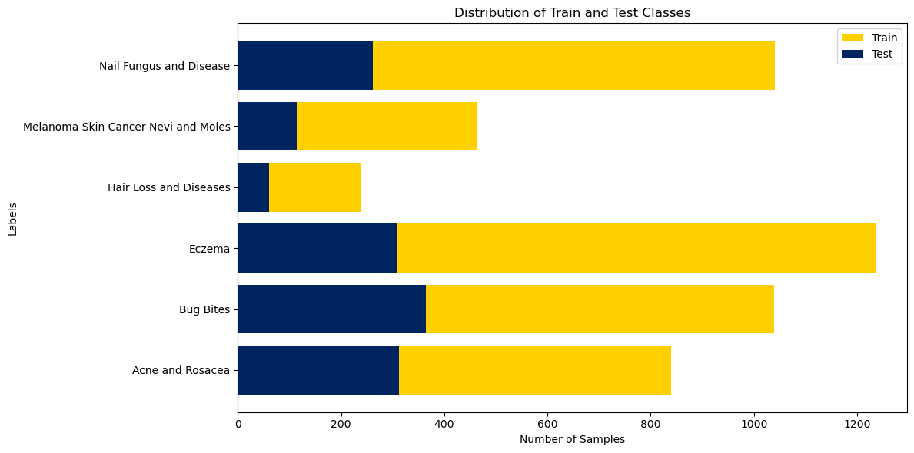
Dermtech 3.0 Dataset
Consists of 6 classes:

Slide 15
03
Methodology

Slide 16
Four Phazes
Mobile App Development
Data Collection and Preprocessing
Model Selection and Training
Model Evaluation and Testing
Data Collection
Data Integration
Data Preprocessing
Framework Selection
Architecture Selection
Training and Fine-Tuning
Confusion Matrix
Classification Report
Development Framework
API

Slide 17
Data Collection and Preprocessing
Data Collection
Data Integration
Combining Multiple datasets with Web-scraped Data
Data Preprocessing
Resize (224x224)
Data Augmentaion
To Tensor and Normalization

Slide 18
Model Selection and Training
Framework
Pytorch
Architecture
DenseNet-201
ResNet-152
VGG-19
Hyperparameters
AdamW Optimizer
Categorical CrossEntropy
K-Fold Cross Validation

Slide 19
Model Evaluation and Testing
Confusion Matrix
Classification Report
Accuracy
Precision
Recall
F1-Score

Slide 20
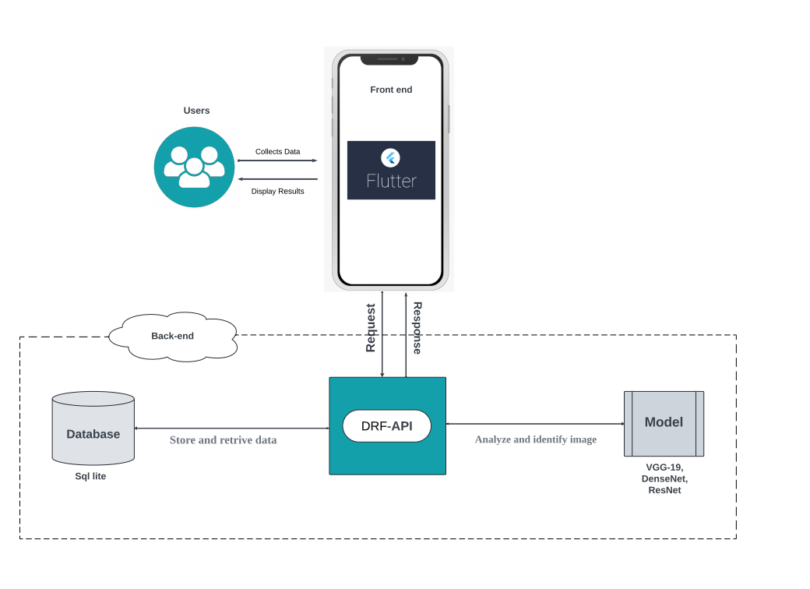
Mobile App Development
Development Framework
Flutter
Django API

Slide 21
04
Results

Slide 22
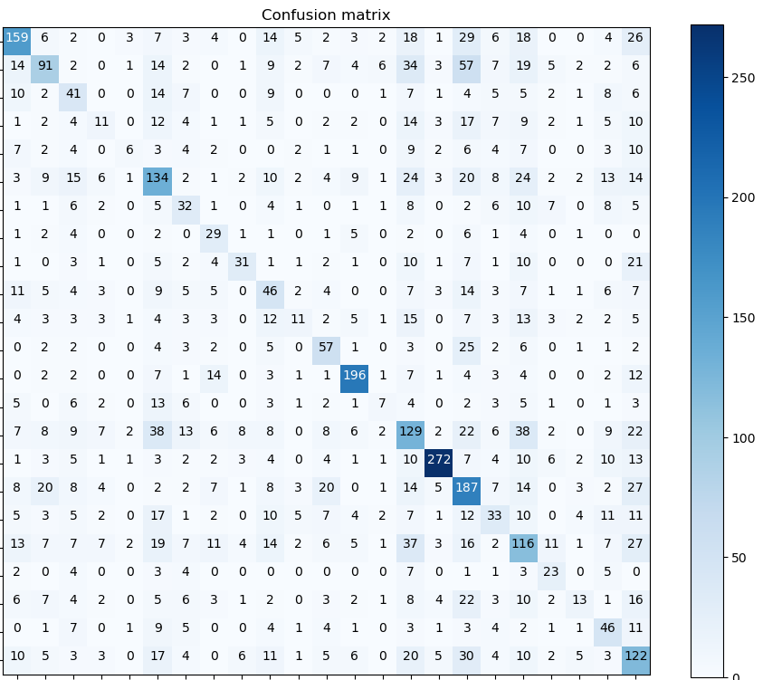
Experiment 1.0
Utilizing Dermatech 1.0 Dataset with 23 classes:
Best Performing Model was DenseNet-201
Best performing class was “Scabies Lyme”
Low Accuracy and Metrics
Bad Generalization

Slide 23
42%
Experiment 1.0 Best Performing Model
Weighted Average Metrics Summary
Accuracy
Precision
43%
Recall
42%
F1-Score
42%

Slide 24
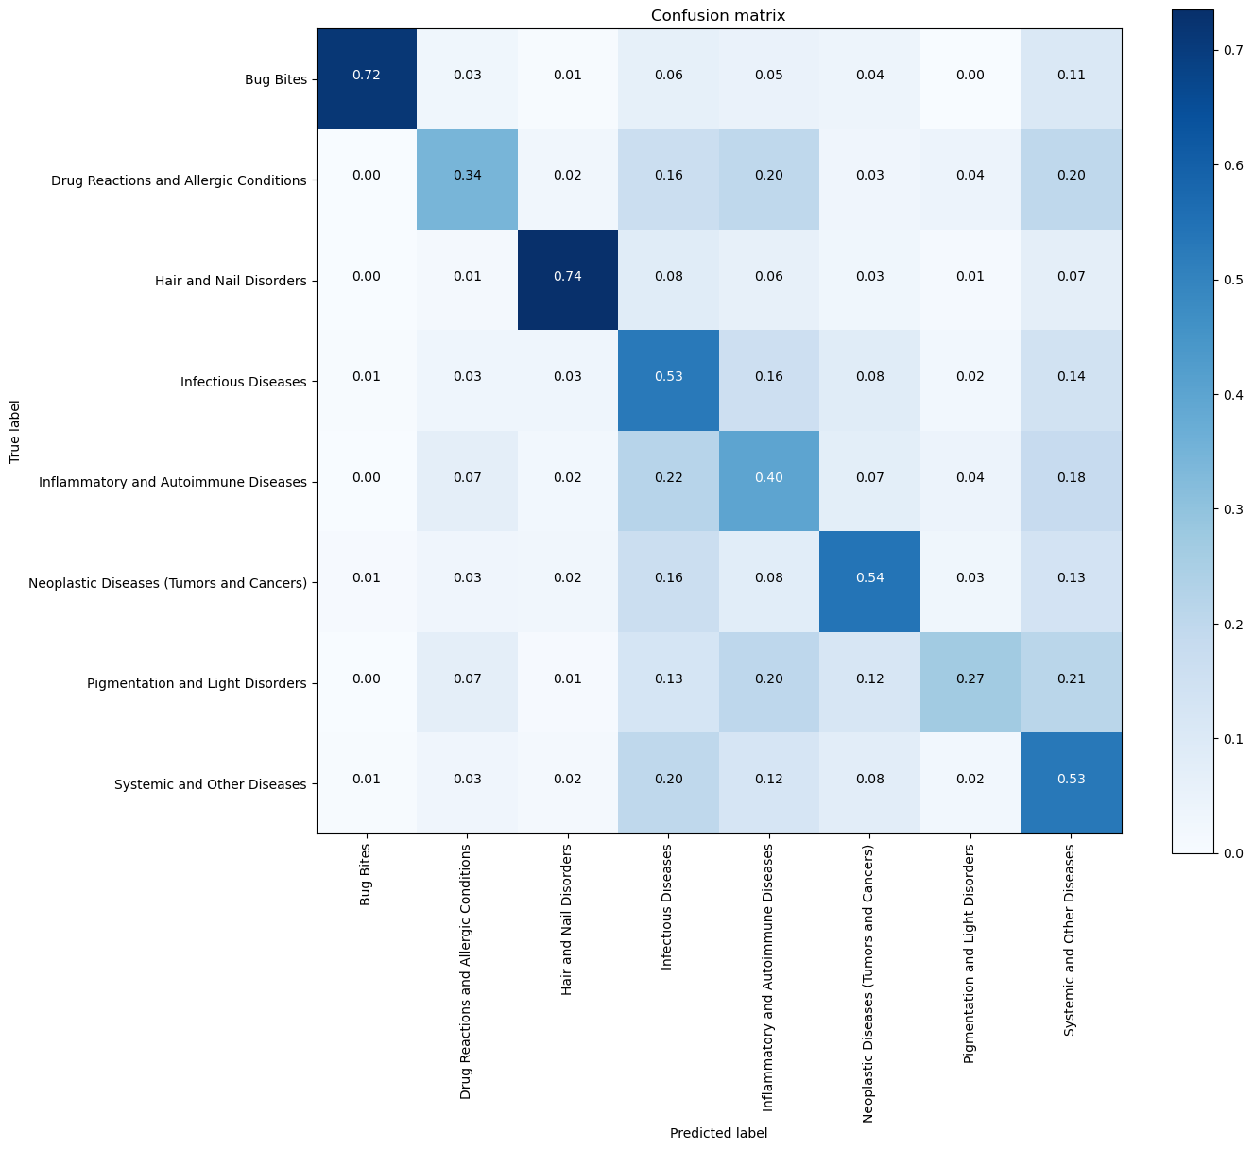
Experiment 2.0
Utilizing Dermatech 2.0 Dataset with 8 Broad classes:
Best Performing Model was DenseNet-201
Best performing class was “Bug Bites”
Better Accuracy and Overall Metrics
Better Generalization But Not Perfect

Slide 25
51%
Experiment 2.0 Best Performing Model
Weighted Average Metrics Summary
Accuracy
Precision
57%
Recall
51%
F1-Score
52%

Slide 26
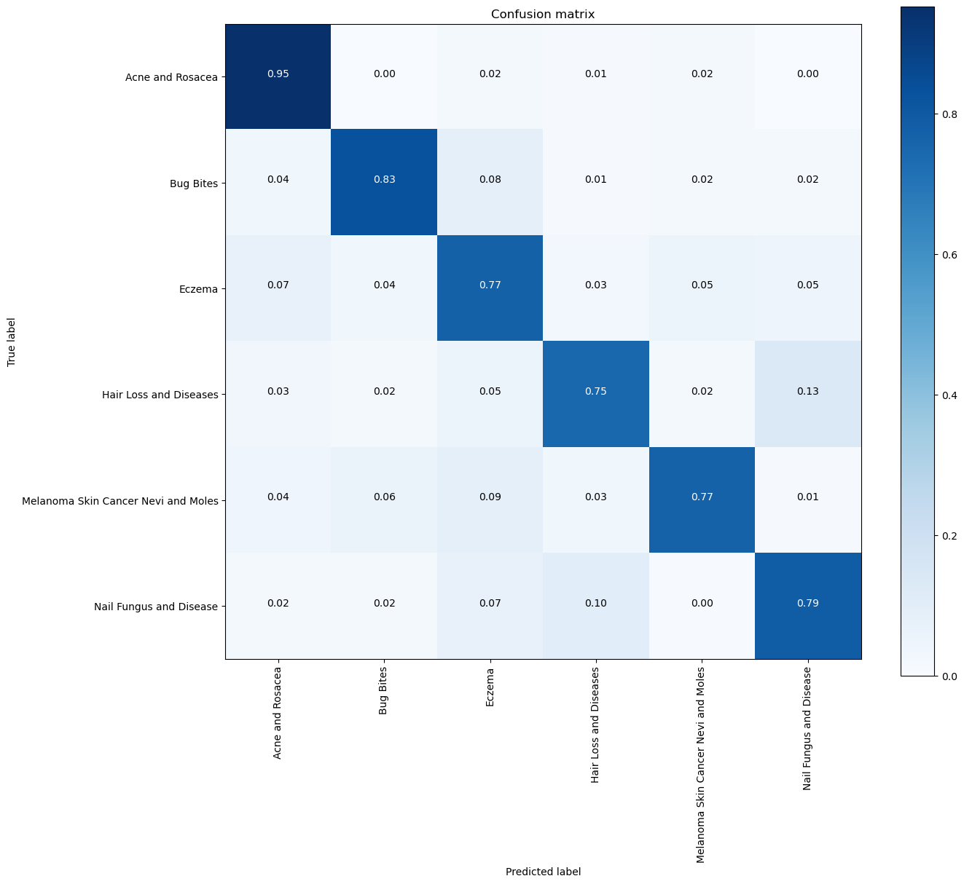
Experiment 3.0
Utilizing Dermatech 3.0 Dataset with 6 classes on DenseNet:
Best Performing Model was VGG-19
Best performing class was “Acne and Rosacea”
State of the art Accuracy and Overall Metrics
Very Good Generalization

Slide 27
83%
Experiment 3.0 Best Performing Model
Weighted Average Metrics Summary
Accuracy
Precision
84%
Recall
83%
F1-Score
83%

Slide 28
Experiments Comparison
Exp No. | Architecture | Accuracy | Precision | Recall | F1-Score
EXP 1.0 | DenseNet-201 | 42% | 43% | 42% | 42%
EXP 2.0 | DenseNet-201 | 51% | 57% | 51% | 52%
EXP 2.0 | ResNet-152 | 46% | 54% | 46% | 48%
EXP 2.0 | VGG-19 | 41% | 50% | 41% | 43%
EXP 3.0 | DenseNet-201 | 79% | 83% | 79% | 80%
EXP 3.0 | ResNet-152 | 78% | 82% | 78% | 79%
EXP 3.0 | VGG-19 | 83% | 84% | 83% | 83%

Slide 29
05
Discussion

Slide 30
This Research Aimed For:
Creating a Custom Dataset:
Derment Dataset
Bug Bites Dataset
Web-Scraped Images
Building a Classification Model:
Using Architectures Like DenseNet, ResNet, and VGGNet
Integrating it with a Mobile Application

Slide 31
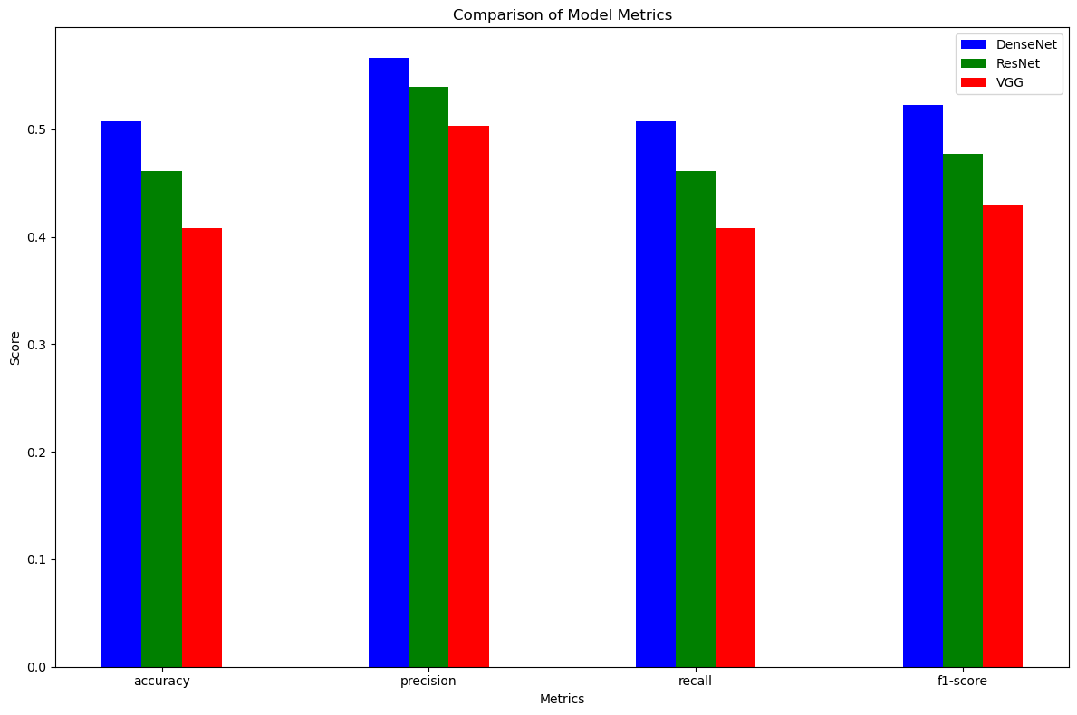
Expirement 2.0
Understanding the numbers
The results shows DenseNet achieving the highest score in all the metrics, and it’s most likely due to its deeper architecture and the use of densely connected layers which facilitate better gradient flow and feature reuse.

Slide 32
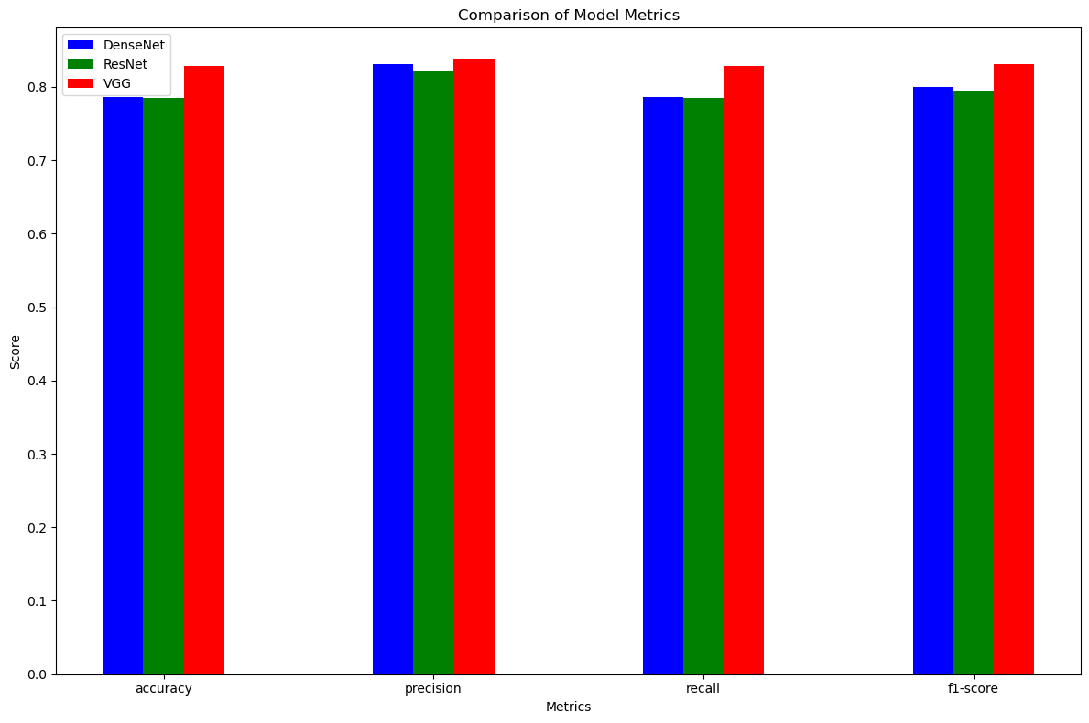
Expirement 3.0
Understanding the numbers
The results shows that VGG model did better than the other architectures, since the subset of the dataset is simpler, the more deep and complex models could lead to worse generalization and overfitting problems.

Slide 33
06
Conclusion

Slide 34
Conclusion
Our app stands as a pioneering solution in skin disease diagnosis, empowering users with quick photo uploads for decisive treatment insights. This milestone showcases our unwavering commitment to optimizing healthcare efficiency.

Slide 35
Future work
1
2
3
Data Enhancements:
Collaboration:
Model Enhancements:
Expand our app's capabilities to diagnose both skin and eye conditions.
Increase the dataset size and diversity to improve the model's generalization capabilities.
Collaborate with healthcare professionals to validate the model's accuracy and reliability.
Integrate these advancements into IoT devices.
Use of advanced techniques such as segmenting.
Incorporate user feedback.
Model Optimization.

Slide 36
Thanks
Do you have any questions?

