Slide 1
AI ACADEMY · NATIONAL AI CENTER
Research
question
Async Research
Assistant
Wikipedia
arXiv
Web
A resilient, concurrent system for cited research answers
Samir Həsənov · Elmir Əsgərov · Ramil Məmmədəliyev
Cited
answer
M301 Software Engineering Final Project
github.com/Hasanov57/AI-Academy---SE---Final-Project---AI-Researcher
Notes:
Opening, about 35 seconds. Introduce the team and the product in one sentence: a user asks a question, the system gathers evidence from three source families in parallel, and Gemini produces one concise answer with numeric citations. State that the deck focuses on the software engineering layer built around the provided AI package. Source: AI-ENG-110 Final Project Brief, Topic 4.

Slide 2
What the system delivers
02
One question becomes one concise answer grounded in retrieved evidence
Wikipedia
“What are the latest developments
in nuclear fusion energy?”
Answer with [1], [2] citations
Reference URLs
Timings and warnings
arXiv
Web search
Two entry points
CLI for grading and automation
Users can select sources and bypass cached results when freshness matters.
Streamlit UI for project-day interaction
Async Research Assistant
M301 • Spring 2026 • 2/10
Notes:
About 50 seconds. Explain the product contract, not implementation details. The input is a validated question plus an optional source subset. The output includes a short cited answer, URLs, timings, and degradation warnings. Mention that the CLI is mandatory and the Streamlit interface is the optional bonus built on the same business logic. Source: project brief sections 5.4 and 9.

Slide 3
Request flow
03
1
2
3
4
5
6
Validate
Fetch
Protect
Synthesize
Verify
Persist
Question, source subset, cache flag
Three bounded asynchronous tasks
Timeouts, retries, rate limits, cache
Gemini uses only retrieved evidence
Citation markers must map to sources
Session, sources, attempts and citations
Graceful degradation
A failed source becomes a warning. The remaining evidence still reaches synthesis; all-source failure stops cleanly before the LLM call.
Async Research Assistant
M301 • Spring 2026 • 3/10
Notes:
About 60 seconds. Walk from left to right. Validation happens once at the boundary. Fetching is concurrent because the sources are independent. The service layer applies reliability policy before evidence reaches Gemini. Citation validation happens after synthesis, and PostgreSQL records the complete audit trail. Emphasize that one failed source does not cancel its siblings. Source: repository docs/architecture.md and core implementation.

Slide 4
Architecture and boundaries
04
Student-owned software engineering layer
Provided AI package
CLI + Streamlit
Researcher
use case
SourceService
cache · retry · timeout
ai.fetch_*
SourceOrchestrator
bounded asyncio
Repository interface
PostgreSQL / memory
SynthesisService
thread offload · validation
ai.synthesize
Composition keeps provider code replaceable in tests. One repository contract supports durable PostgreSQL and fast in-memory execution.
Async Research Assistant
M301 • Spring 2026 • 4/10
Notes:
About 75 seconds. Identify the boundary explicitly. The supplied ai package remains a thin dependency. Our wrappers add configuration, persistence, retries, timeouts, caching, logging, and citation checks. Explain composition at the AI boundary and inheritance at the repository boundary. The in-memory repository makes tests and offline runs fast, while PostgreSQL supports durable production runs. Source: repository architecture documentation.

Slide 5
Concurrency and measured performance
05
2.64×
median speedup
Three live sources
Same question and machine
Application cache bypassed
Retrieval measured separately from synthesis
Why asyncio? Source calls spend most of their time waiting for remote servers. Overlapping that wait reduces wall-clock time without multiprocessing overhead.
Async Research Assistant
M301 • Spring 2026 • 5/10
Notes:
About 70 seconds. The benchmark ran Wikipedia, arXiv, and web retrieval three times with cache bypassed. Median time fell from 1.440 seconds sequentially to 0.544 seconds concurrently, a 2.64 times speedup. The speedup is below three times because the final duration is limited by the slowest provider and normal network variance. The semaphore bounds concurrency to protect provider limits. Source: artefacts/technical-verification-20260916.md.

Slide 6
Reliability and graceful degradation
06
External calls are unreliable; the pipeline makes failures visible and contained
Timeout
Usable evidence
Source request
Answer from available sources
Exponential retry
up to 3 attempts
Typed warning
Citation safety
The validator rejects missing, dangling, or mismatched numeric references and retries synthesis with the specific validation error.
Async Research Assistant
M301 • Spring 2026 • 6/10
Notes:
About 65 seconds. Explain the failure policy with one concrete case: if arXiv times out, the service retries transient failures. After exhaustion, the orchestrator records a typed warning instead of cancelling Wikipedia and web. Synthesis continues when at least one source succeeds. Citation validation checks structure and mappings, but it cannot prove semantic entailment. Source: source_service.py, orchestrator.py, and synthesis_service.py.

Slide 7
Storage, caching, and reproducibility
07
PostgreSQL keeps an audit trail for every research session
TTL source cache
research_sessions
question · answer · warnings · duration
Key
(source, normalized query)
24-hour expiry
research_sources
ordered excerpts and URLs
Fast repeated questions
Expired rows removed lazily
source_attempts
cache flag · timing · error
Bypass cache for fresh demonstrations
Memory repository for offline tests
citations
answer marker mapped to source
Docker Compose starts the application and PostgreSQL with a database health check.
Async Research Assistant
M301 • Spring 2026 • 7/10
Notes:
About 60 seconds. PostgreSQL stores the final result and its evidence relationships in one durable audit trail. The cache key combines the source and normalized question, and entries expire after a configurable TTL, 24 hours by default. The no-cache flag bypasses reads and writes for fresh tests. Docker Compose makes the application and database reproducible on another computer. Source: storage/postgres.py, docker-compose.yml, and project report.

Slide 8
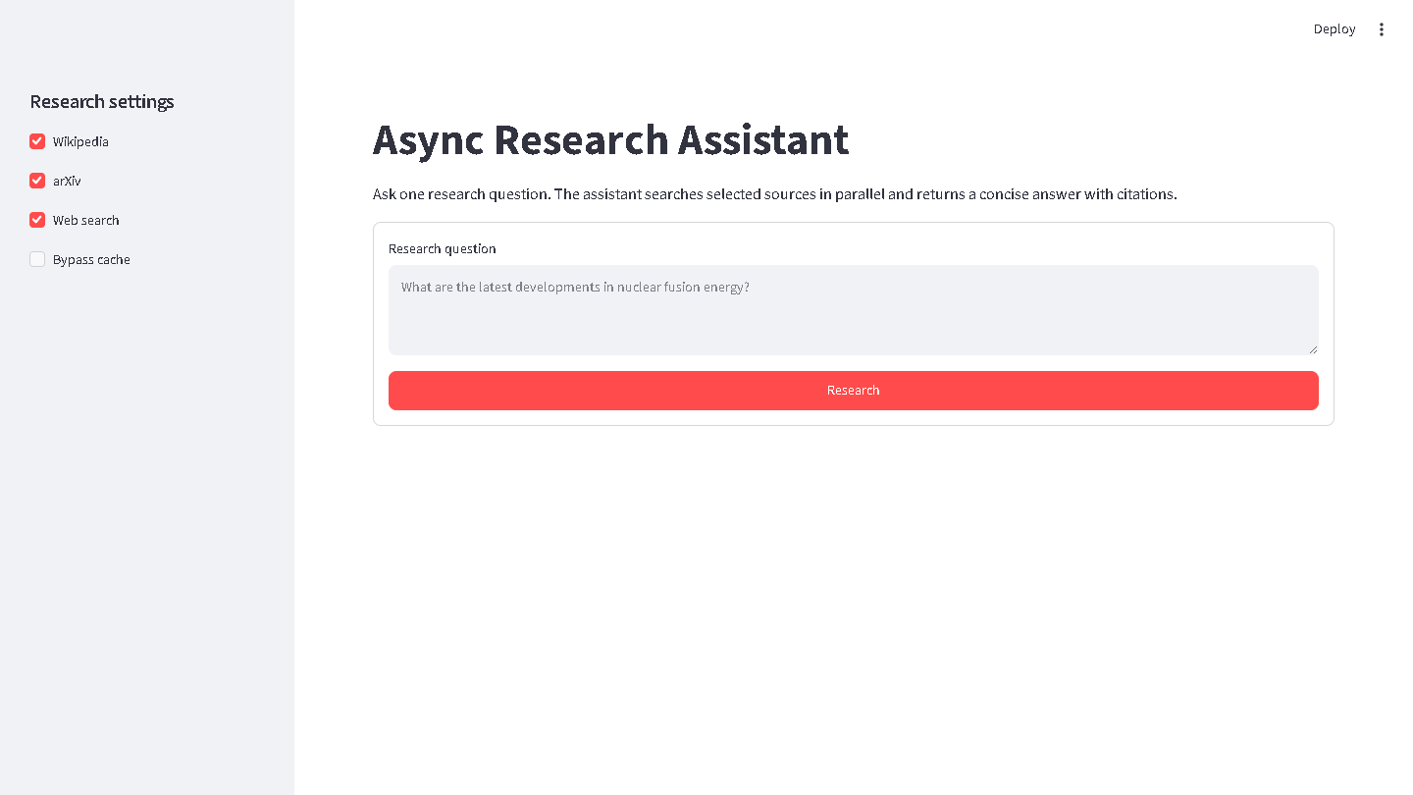
Project-day interface and live demo
08
Demo plan
1
Ask one current research question
2
Show three sources starting together
3
Match inline markers to reference links
4
Point out timing and session ID
Backup: the scripted five-question demo under scripts/demo.py
Async Research Assistant
M301 • Spring 2026 • 8/10
Notes:
About 70 seconds plus the live demonstration. Keep all three sources selected. Ask a prepared question such as 'How do transformer models handle long context windows?' While it runs, point to the source checkboxes. After the answer appears, show the numeric citations, open-source buttons, timings, and session ID. If the network is slow, run scripts/demo.py or show a saved artefact.

Slide 9
Verification and honest limits
09
64
73.56%
0
PASS
offline tests passing
branch-aware coverage
live-network test dependencies
Ruff and strict mypy
Current limitations
Next improvements
Citation structure is checked, but semantic support is not proven
Semantic citation entailment checks
Rate limits coordinate within one process, not across replicas
Multi-provider failover
Source relevance depends on upstream search quality
Distributed rate-limit coordination
Async Research Assistant
M301 • Spring 2026 • 9/10
Notes:
About 65 seconds. Report the verified results: 64 tests pass offline, current coverage is 73.56 percent, and both Ruff and strict mypy pass. Then state limitations honestly. Numeric marker validation confirms that a citation points to a retrieved source, but it does not prove that every claim is semantically entailed. Search quality still depends on upstream results. Source: pytest coverage run on September 17, 2026 and project report.

Slide 10
Team ownership and questions
10
Samir Həsənov
Elmir Əsgərov
Ramil Məmmədəliyev
Core workflow and concurrency
CLI, rendering, and Streamlit UI
Source and LLM service wrappers
Retries, rate limits, and synthesis
Storage and configuration
Scripts, packaging, and Docker
Questions?
We can explain the architecture, trade-offs, and request flow, then demonstrate the system live.
github.com/Hasanov57/AI-Academy---SE---Final-Project---AI-Researcher
Async Research Assistant
M301 • Spring 2026 • 10/10
Notes:
Closing, about 40 seconds. Each member states their primary ownership in one sentence. Confirm that the whole team understands the shared architecture and can explain why asyncio, PostgreSQL, retries, timeouts, and the provider boundary were chosen. Invite questions and move to the live system when requested.

