Slide 1
BIG MOUNTAIN RESORT
TICKET PRICING MODEL, INSIGHTS AND STRATEGY

Slide 2
Purpose of BM Project
Identifying Big Mountain’s current market position concerning its facilities, features and ticket prices.
Provide insight into what facilities and features customers are willing to pay for.
Provide guidance and recommendations for ticket pricing strategy.
Build a predictive pricing model to guide decisions based on ticket price and facility investment.

Slide 3
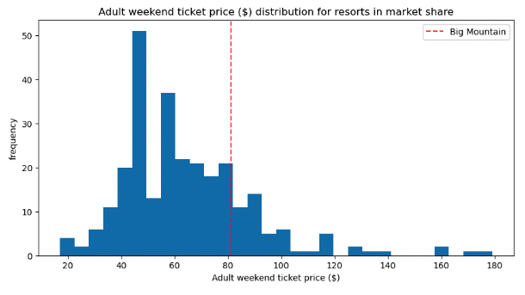
Problem Identification
BM is priced moderate-high in the ski resort market.
Investigate whether BM is capitalizing on its facilities potential.
Investigate whether BM is capitalizing on its pricing strategy.
Reviewing potential scenarios for either cutting costs or increasing revenue through ticket prices

Slide 4
Key Findings
Closing the runs down by 6 or more leads to a negative price change.
The following scenario increases support for ticket price by $1.99 - Increase runs by 1 - Increase vertical drop by 150ft - Increase total chairs by 1
This ticket price increase could total to $3,474,638 over a season.
An addition of 2 acres of snow making results in no difference in price.
Increasing longest run by 0.2 miles results in no difference in ticket price
Modelled price is $95.86 vs actual price $81.00; an MAE of $10.36 suggests there is potential for an increase.

Slide 5
Recommendations
Investigate the impact of operating costs on revenue in order to fully understand the ability to capitalize on revenue.
Increase the vertical drop by 150 feet, add one new ski run, and install an additional chairlift - These enhancements support a ticket increase of $1.99. - The price increase is projected to yield an additional revenue of $34.7 million over the course of 10 seasons. - The return on investment over 10 years covers the cost of the additional chairlift ($1.5 million) 23 times over.

Slide 6
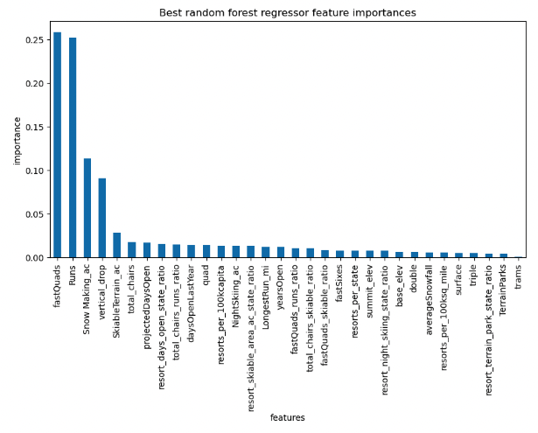

Modeling Comparison
Random Forest vs Linear Regression Feature Importance Results
Random Forest - MAE = 9.648, STD = 1.505
Linear Regression – MAE = 10.499, STD = 1.622
A lower MAE indicates better performance
A lower STD indicates less variability in prediction errors
Based on these results, the random forest outperforms linear regression model

Slide 7
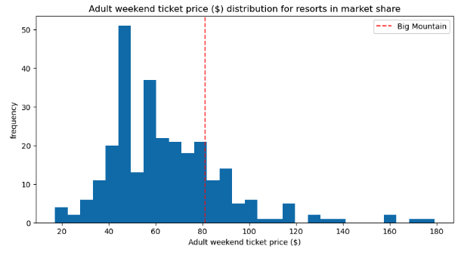
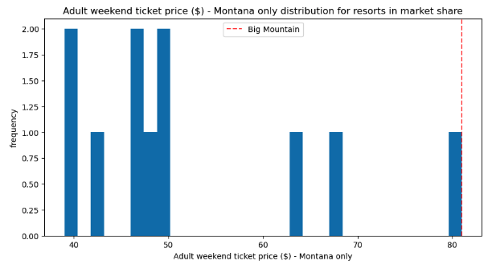
Modeling Data – Market Prices
BM is charging $81.00 while the modelled price is $95.86 - BM’s pricing is moderately-high across the market - However, it is priced among the highest in its state of Montana - Does state have a strong impact on pricing potential?

Slide 8
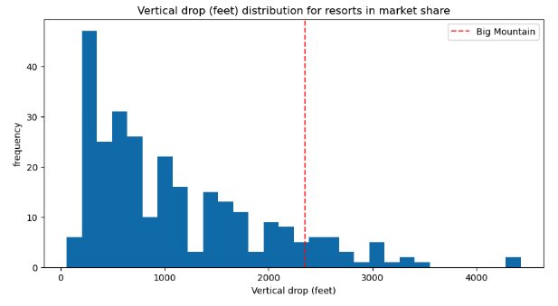
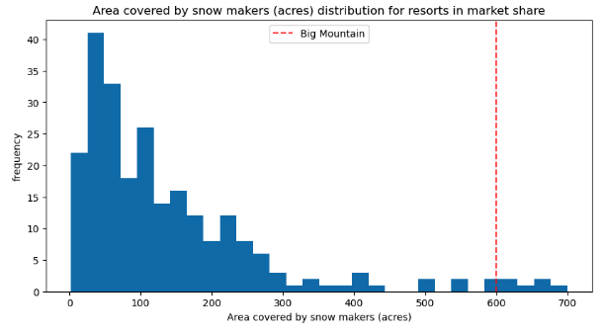
Modeling Data – Features
BM ranks moderately high for Vertical Drop and among the highest for Snow Making

Slide 9
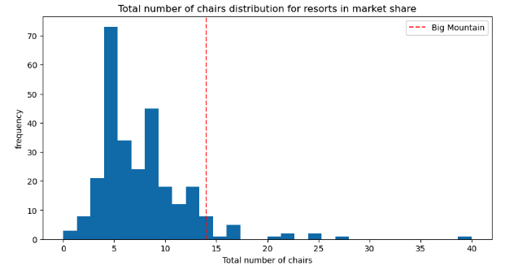
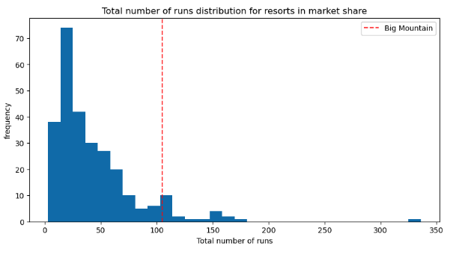
Modeling Data – Features(2)
BM ranks among the highest in number of chairs and total number of runs

Slide 10
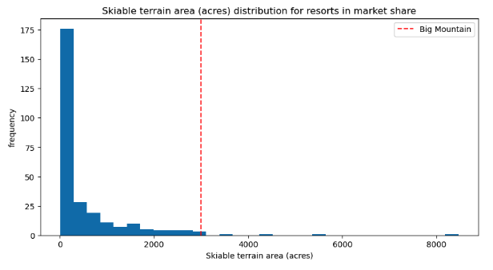
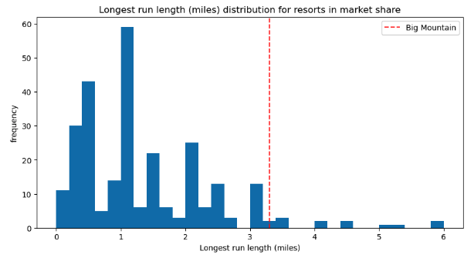
Modeling Data – Features(3)
BM ranks among the highest for Skiable terrain area and longest run length

Slide 11
Summary
BM ranks among the top resorts in terms of features the model determined most impactful on market ticket price, including: - Skiable terrain, Number of runs, Snow making capacity, Number of chairs
BM ranks only moderately high in vertical drop across the market.
The model determined that increasing vertical drop would not only increase its rank among the top resorts, but as well will justify an increase in ticket price; that would ultimately increase revenue opportunities.
Further analysis is recommended to comprehensively understand the impact of BM’s operating costs on its profitability.

