Slide 1



Ryvl
Confidential
SELLER MARKET INTELLIGENCE — MONTHLY BRIEFING
Aura Mobile Accessories
Market intelligence for Mobiles & Electronics
Last 30 days
Generated 4 Aug 2026
Ref: 7F3A1C9D
THIS CYCLE COVERS
Market position & percentiles
SKU performance & portfolio
Pricing intelligence
Inventory & demand risk
Competitor tracking
Prioritised recommendations
REVENUE
ORDERS
PRICE INDEX
Generated automatically from your store data and Ryvl’s market scan across 11 tracked marketplaces.
Rs 2,145,000
+18.4%
312
+12.0%
104
vs. market

Slide 2

Ryvl
02
What’s in this report
8 of 12 sections have enough tracked data this cycle
01
Executive Snapshot & Key Signals
07
Prioritised Recommendations
Included
Included
02
Market Position & Benchmark Percentiles
08
Methodology & Data Sources
Included
Included
03
Pricing Intelligence
—
Customer Health & Retention
Included
Not enough data
04
Marketplace & Competitor Tracking
—
Strategic Action Roadmap
Included
Not enough data
05
SKU Performance & Portfolio
—
Appendix (internal copies only)
Included
Omitted
06
Inventory & Demand Risk
Included
HOW THIS REPORT IS BUILT
Sections appear only when the underlying data clears Ryvl’s coverage threshold, so length varies by seller and by cycle — from 3 slides to 20.
Section inclusion is decided at generation time from your account’s tracked coverage.
Confidential

Slide 3





Ryvl
03
Executive Snapshot & Key Signals
Aura Mobile Accessories · Last 30 days vs. prior 30 days
REVENUE
ORDERS
PRICE INDEX
STOCKOUT RISK SKUS
Rs 2,145,000
312
104
6
+18.4%
+12.0%
100 = market median
Below threshold
RYVL INSIGHT
What changed this cycle
“Revenue grew 18.4% this period, driven by higher order volume. Your pricing sits slightly above the tracked market median. Six SKUs are approaching your low-stock threshold and should be reviewed.”
WATCH
Zenith Gadgets on Daraz repriced 32% of tracked SKUs this period.
OPENING
Volt Traders is out of stock on 45% of their tracked assortment.
POSITION
Your price sits at the 82nd percentile — above most of the category.
ORDER VOLUME
AVG. ORDER VALUE
MARKET PERCENTILE
+12.0%
Rs 6,875
82nd
Source: your store orders (312 orders, 30 days) & Ryvl market scan of 42 tracked competitors.
Confidential

Slide 4
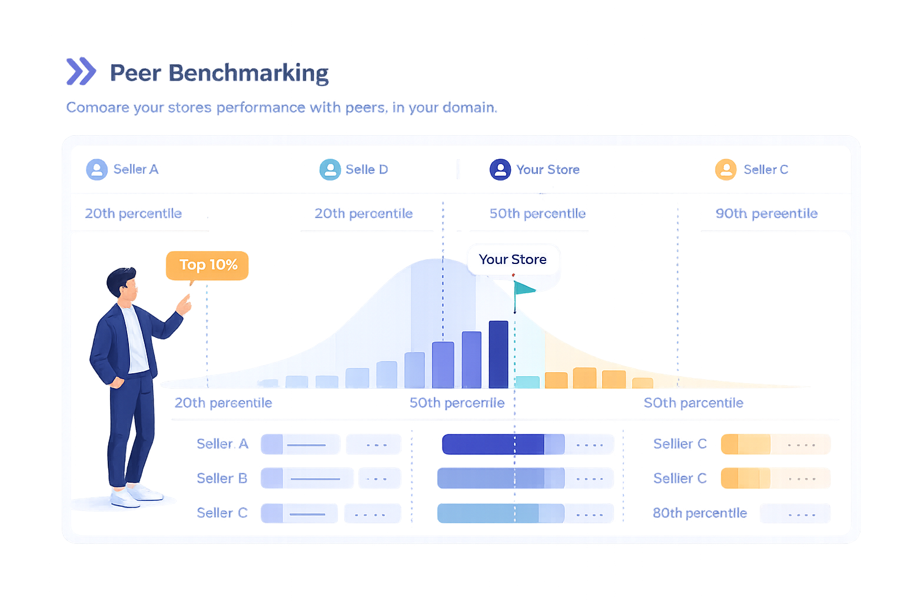
Ryvl
TRACKED-SET PRICE DISTRIBUTION
02
YOUR PERCENTILE
SELLERS TRACKED
PRICE INDEX
SECTION 02 OF 08
82nd
42
104
Market Position & Benchmark Percentiles
BENCHMARK RANGE
P25
25
Where your pricing sits against 42 tracked sellers in Mobiles & Electronics this period.
P75
75
Your position
82
Your percentile position across the tracked set
P25 / P75 benchmark range and where you sit in it
You price above three quarters of the tracked set — margin held, exposure noted.
Ryvl market scan · Daraz · last 30 days

Slide 5
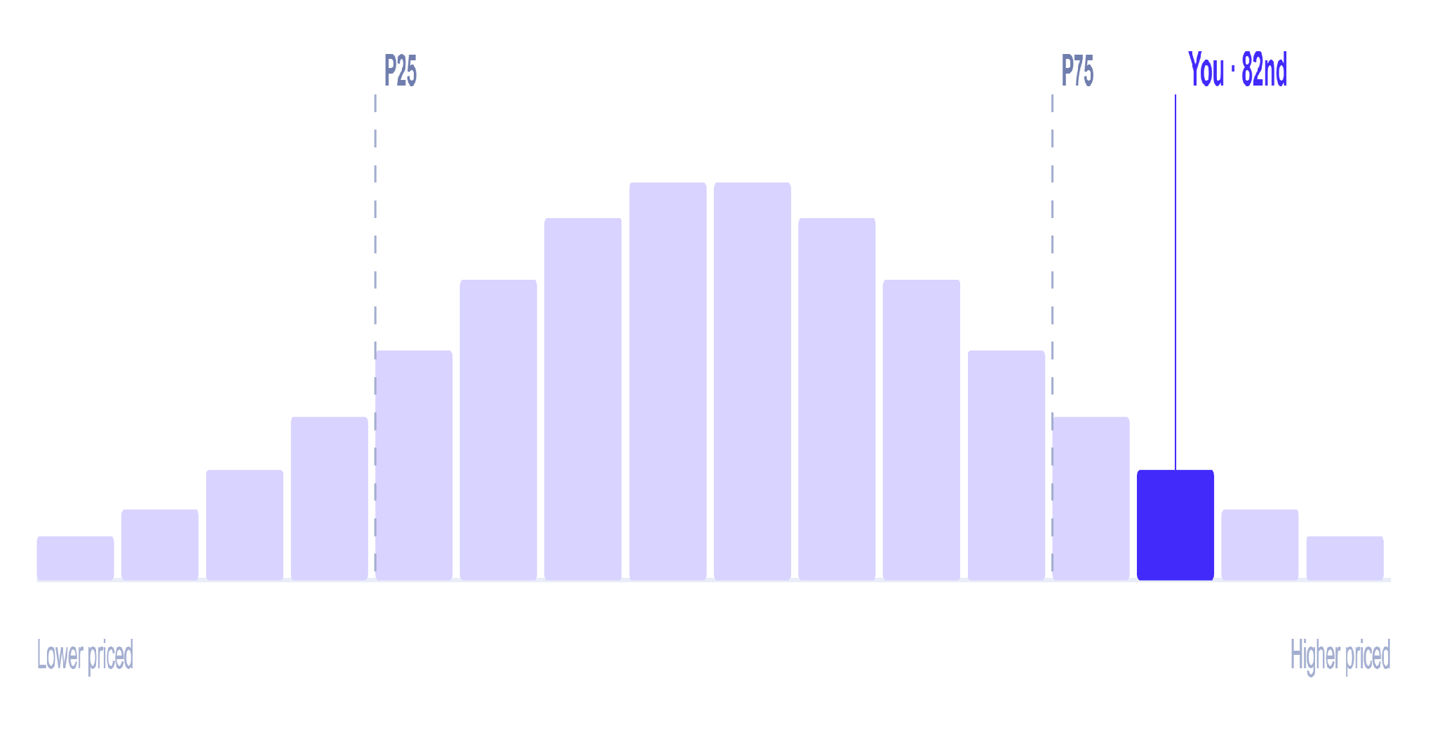
Ryvl
05
Market Position & Benchmark Percentiles
Price distribution across 42 tracked sellers · Mobiles & Electronics · Daraz
Where your price sits in the tracked market
Tracked sellers
Your position
PRICE INDEX VS. MARKET
104
100 = market median
BENCHMARK RANGE
25
75
82
P25
P75
You
READ
You price above three quarters of tracked sellers. That holds margin, but leaves you exposed if Zenith Gadgets keeps repricing downward.
Source: Ryvl market scan — publicly listed prices from 42 tracked sellers in your category.
Confidential

Slide 6

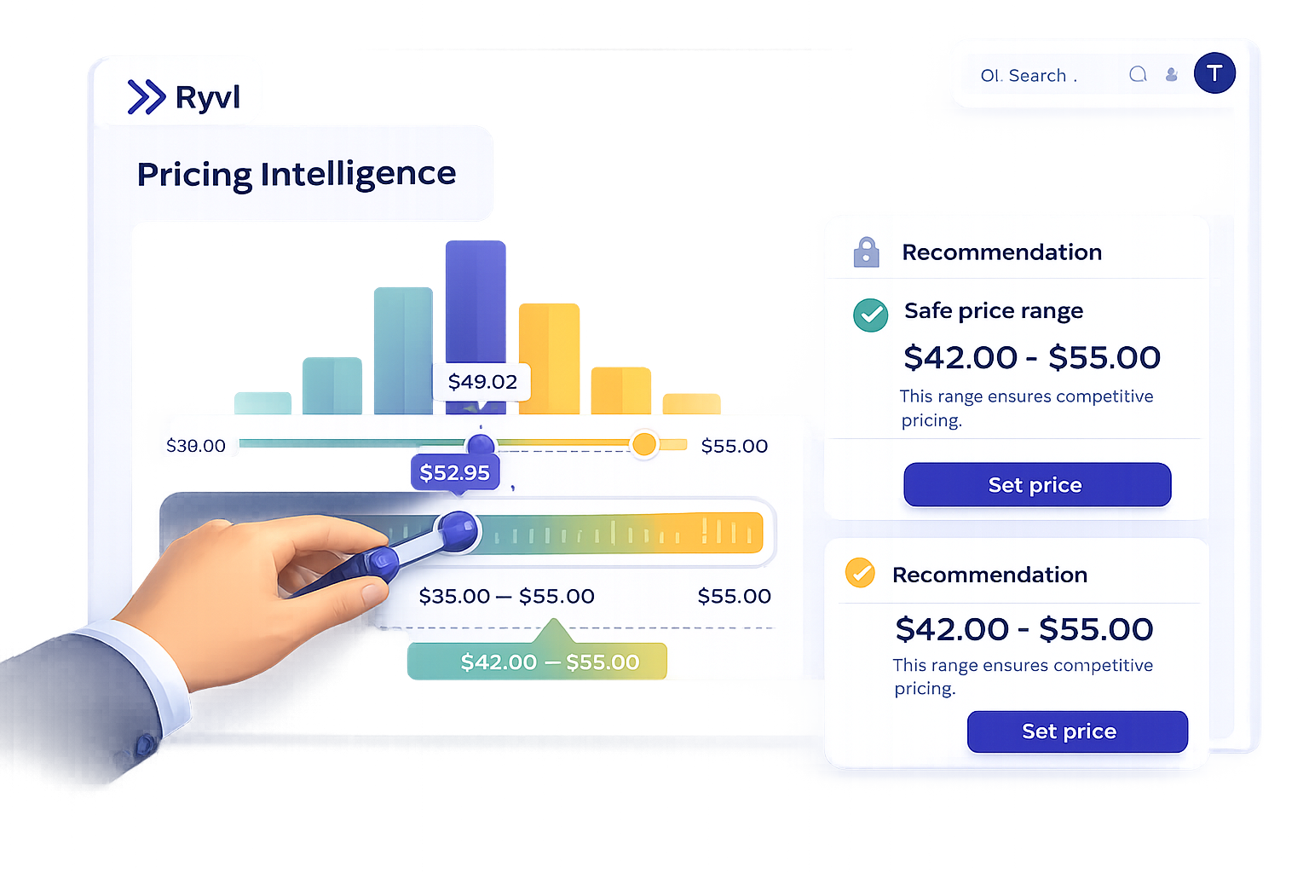
Ryvl
Section 03 of 08
SECTION 03
Pricing Intelligence
Your price against the tracked market median — and the band Ryvl recommends holding this cycle.
YOUR PRICE
MARKET MEDIAN
GAP
Rs 4,200
Rs 3,950
+6.3%

Slide 7
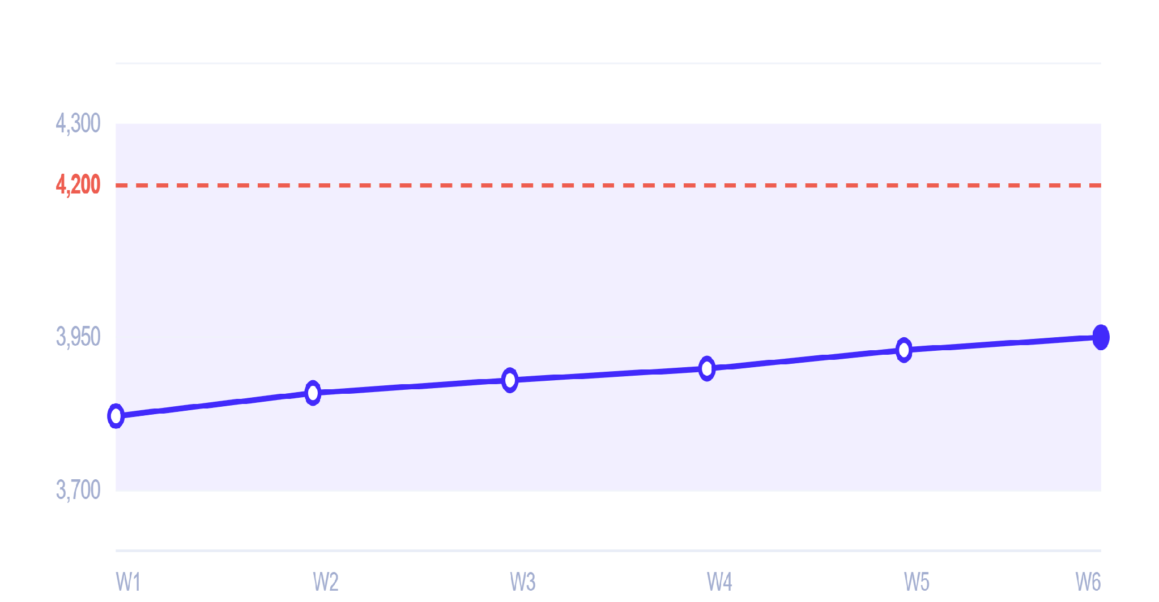
Ryvl
07
Pricing Intelligence
Aura MagSafe Charger 20W (AUR-MSC20) · tracked against 42 sellers
Market median price — last 90 days
Market median
Your price
Recommended band
Price ladder
Scale starts at Rs 3,700
Your price
Rs 4,200
Highest tracked
Rs 4,120
Market median
Rs 3,950
Lowest tracked
Rs 3,760
RECOMMENDED BAND
Rs 3,700 – 4,300
Median has climbed Rs 130 (+3.4%) over the tracked window, narrowing your premium from 9.9% to 6.3%.
You are inside the band, near its upper edge.
Source: Ryvl market scan — scheduled scrapes of publicly listed prices, last 90 days.
Confidential

Slide 8

Ryvl
Section 04 of 08
SECTION 04
Marketplace & Competitor Tracking
Who moved on price, who ran out of stock, and where that leaves you.
COMPETITORS TRACKED
SKUS MONITORED
PRICE MOVES OBSERVED
42
259
71

Slide 9
Ryvl
09
Marketplace & Competitor Tracking
Top 5 by tracked SKU count · Daraz · Last 30 days
Competitor
SKUs
Median price
In stock
Repricing
MOST ACTIVE REPRICER
Zenith Gadgets
Zenith Gadgets
84
Rs 3,890
91%
+32%
Moved price on 27 of 84 tracked SKUs — 2.6× the tracked-set average.
Volt Traders
61
Rs 4,050
55%
+12%
Nova Tech Store
47
Rs 3,760
88%
+8%
SUPPLY VOID
Pulse Accessories
39
Rs 4,120
95%
+5%
Volt Traders
Circuit Bazaar
28
Rs 3,980
79%
+14%
Out of stock on 45% of their assortment, including 18 SKUs that overlap yours.
+37 more tracked competitors — see your Ryvl dashboard for the full list.
TRACKED-SET MEDIANS
Median price
Rs 3,980
Median in-stock
88%
Median repricing
+12%
Source: Ryvl market scan. Repricing rate is a floor — moves that reverted between scrapes are not observed.
Confidential

Slide 10
Ryvl
10
SKU Performance & Portfolio
Top 5 products by inventory value share · category mix
Top products by inventory value share
Category mix
Aura MagSafe Charger 20W
24.1%
Chargers
38%
AUR-MSC20
Cases & Covers
27%
Aura Tempered Glass Pro
18.7%
AUR-TGP01
Audio
21%
Aura USB-C Cable 2m
15.3%
Cables
14%
AUR-UCC2M
Aura Wireless Earbuds X2
12.9%
AUR-WEX2
Aura Car Mount Vent Clip
9.4%
AUR-CMVC
Share is measured on inventory value, not recorded sales revenue.
CONCENTRATION
Your top two SKUs hold 42.8% of inventory value — both sit in Chargers, your most contested category.
Source: your store products & inventory, as recorded in your account.
Confidential

Slide 11
Ryvl
11
Inventory & Demand Risk
SKUs below your low-stock threshold · competitor stockouts you can absorb
Supply void opportunities
At risk of stocking out
6 SKUs flagged · 3 shown
6 days
Volt Traders
CRITICAL
Aura Wireless Earbuds X2
Daraz
AUR-WEX2
cover left
Out of stock on 45% of their assortment — 18 SKUs overlap with yours.
11 days
WATCH
Aura Fast Charger 30W
Demand you can absorb
AUR-FC30
cover left
14 days
WATCH
Aura Screen Protector Matte
Circuit Bazaar
Daraz
AUR-SPM1
cover left
Out of stock on 21% of their assortment — 6 SKUs overlap with yours.
Demand you can absorb
NET POSITION
Two of your six at-risk SKUs sit in categories where competitors are already out of stock. Reordering those first protects the opening.
Source: your store inventory & Ryvl market scan stock status. Days of cover assume the last 30 days’ order rate.
Confidential

Slide 12
Ryvl
12
Prioritised Recommendations
Four actions, ordered by what this cycle’s data says will cost you most if ignored
01
HIGH
02
HIGH
Reorder the 3 SKUs nearing your low-stock threshold.
Review pricing against Zenith Gadgets.
Earbuds X2 has 6 days of cover at the current order rate, and it is 12.9% of your inventory value.
They repriced 32% of tracked SKUs this cycle while your premium sits at +6.3% over the median.
Act this week
Act this week
03
MEDIUM
04
MEDIUM
Stock up where Volt Traders has gone out of stock.
Re-check your band against the category’s typical range.
18 of their out-of-stock SKUs overlap your catalogue, mostly in Chargers.
You sit at the 82nd percentile — inside the recommended Rs 3,700–4,300 band, but near its ceiling.
Next 30 days
Next 30 days
Recommendations are generated from this cycle’s tracked signals only — no forecasts or projections.
Confidential

Slide 13
Ryvl
Section 08 of 08
SECTION 08
Methodology, Privacy & Data Sources
DATA SOURCES
LIMITATIONS
REPORT STATUS
Your store data
Repricing rate is a floor, not exhaustive — price moves that reverted between scheduled scrapes are not observed.
Approved
Orders, products and customers from your own account.
Reviewed by staff@ryvl.com before release.
Ryvl market scan
Product and portfolio contribution is based on inventory value, not recorded sales revenue.
Report ref 7F3A1C9D · generated 4 Aug 2026 for the last 30 days.
Publicly listed prices and stock status scraped from tracked retailer marketplaces.
End of report
Every figure in this report traces to a tracked measurement — nothing is estimated or projected.
Confidential

