Slide 1
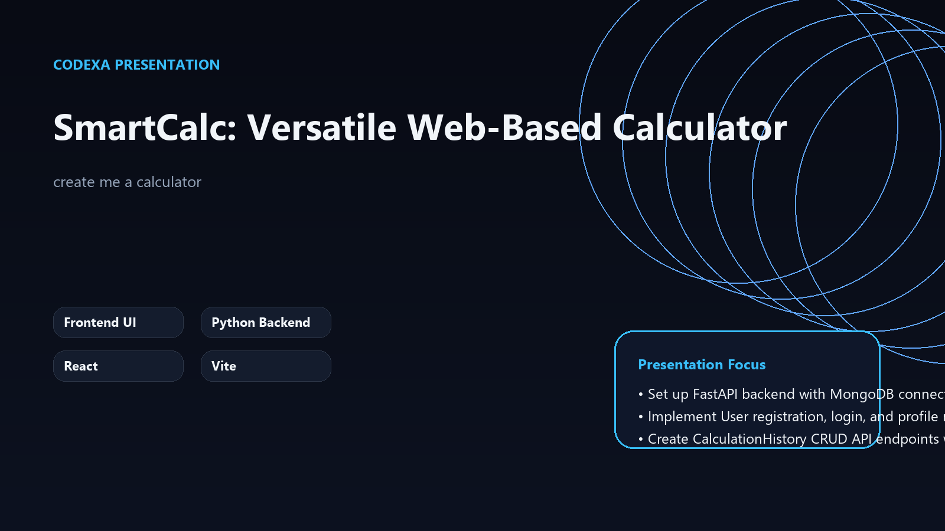
PROJECT OVERVIEW
SmartCalc: Versatile Web-Based Calculator
Your Intelligent Companion for Every Calculation
Frontend UI
Python Backend
React
Vite
Presentation focus
• Set up FastAPI backend with MongoDB connection and JWT authentication
• Implement User registration, login, and profile management endpoints
• Create CalculationHistory CRUD API endpoints with JWT protection, scoped to the current user

Slide 2
WHY THIS MATTERS
The Calculation Conundrum
01
Lack of cross-device sync for calculation history
• Lack of cross-device sync for calculation history
• Limited functionality in basic web calculators
• No personalization or user accounts
• Inconsistent UI/UX across platforms
• Security concerns for sensitive calculation data
02
Limited functionality in basic web calculators
03
No personalization or user accounts

Slide 3
PROPOSED APPROACH
Introducing SmartCalc
• Unified platform for all calculation needs
• Secure user authentication and data privacy
• Personalized calculation history management
• Intuitive interface with multiple calculation modes
• Accessible from any web browser
1
Unified platform for all calculation needs
2
Secure user authentication and data privacy
3
Personalized calculation history management

Slide 4
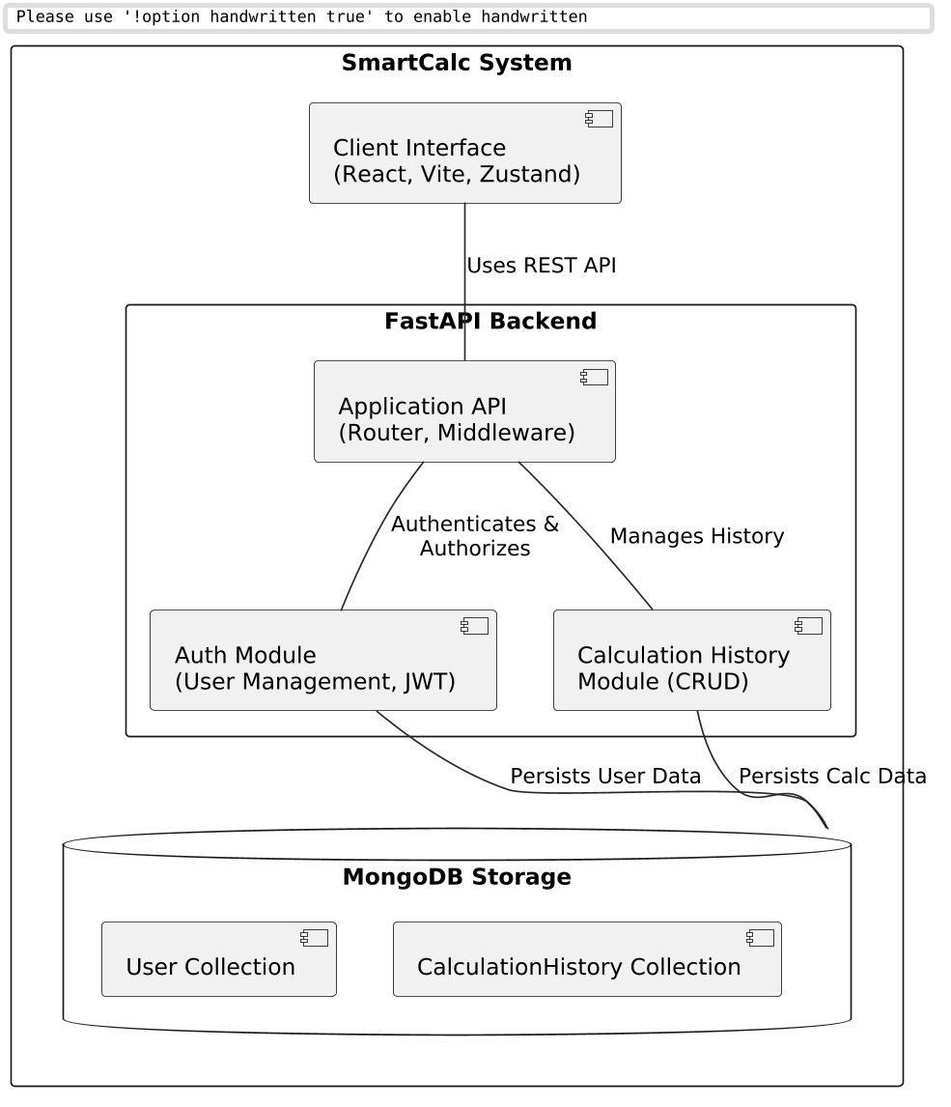
SYSTEM VIEW
SmartCalc System Architecture
• Frontend: React/Vite for responsive UI
• Backend: FastAPI for high-performance APIs
• Database: MongoDB for flexible data storage
• Authentication: JWT for secure user sessions
• Clear separation of concerns for maintainability

Slide 5
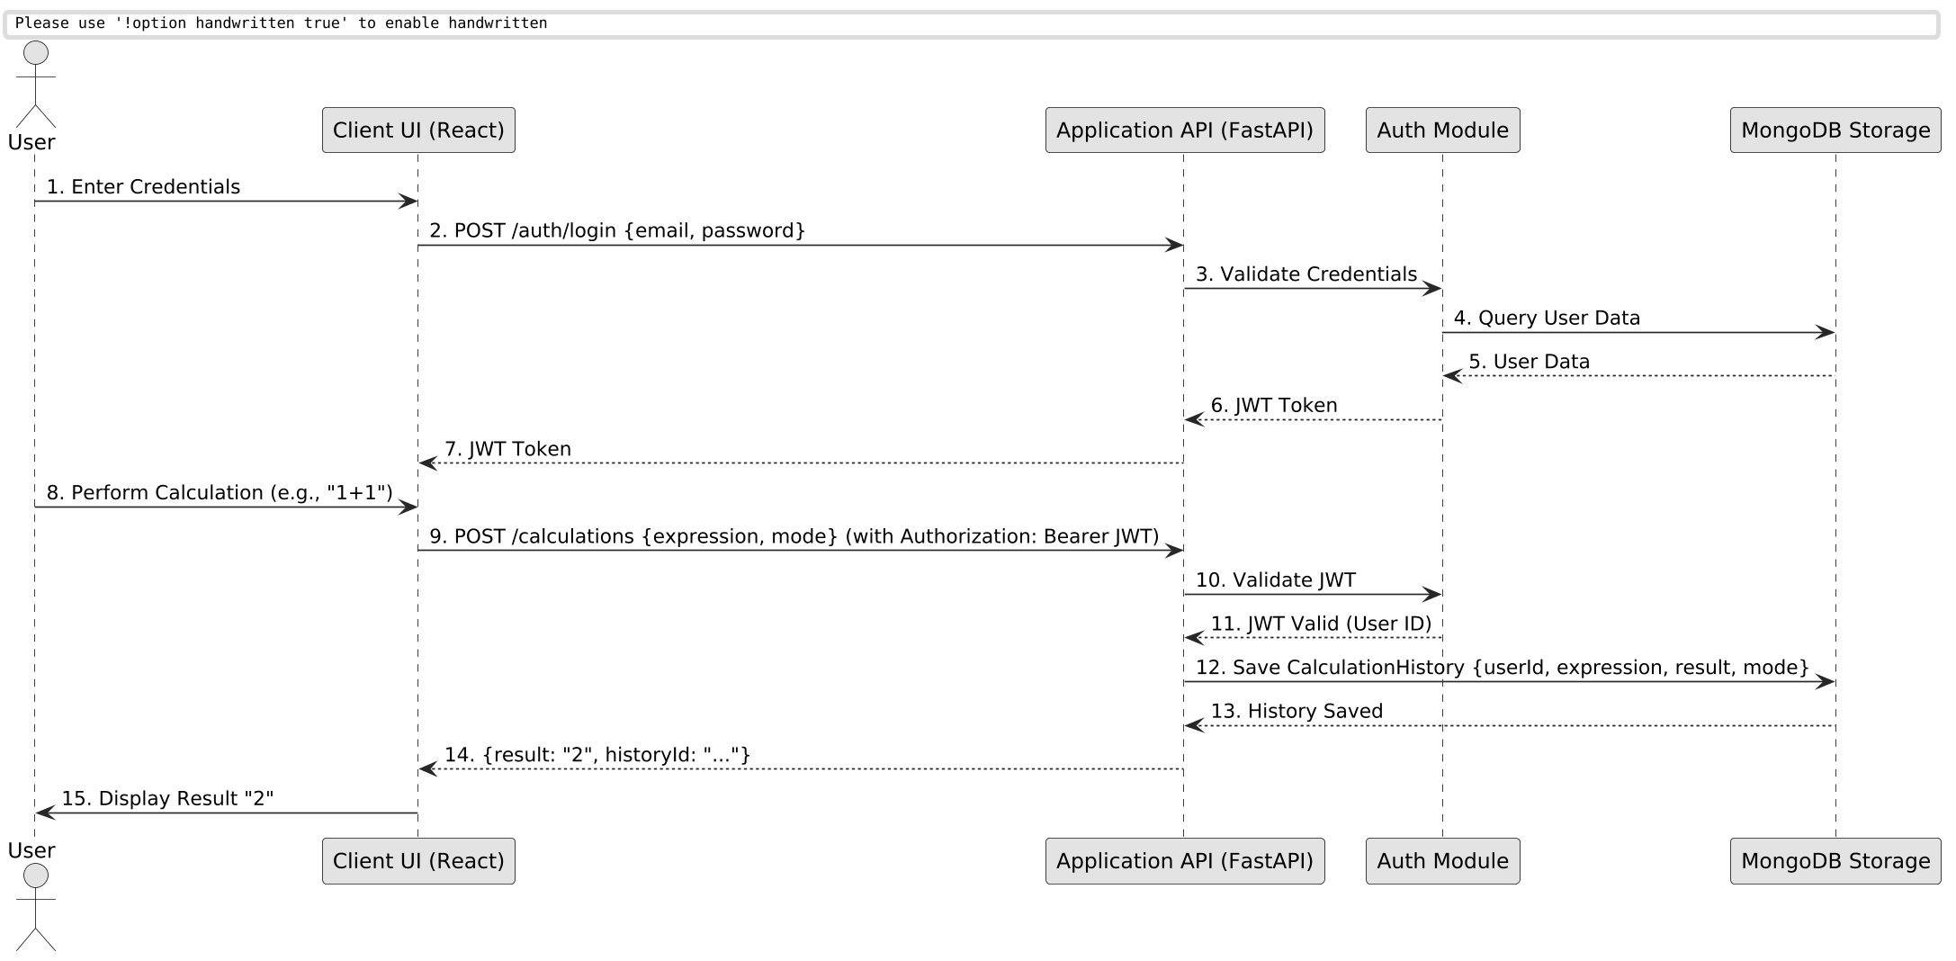
FLOW OF EXECUTION
Development & Delivery Workflow
• Backend foundation: FastAPI, MongoDB, JWT setup
• Core API development: User & Calculation History
• Frontend development: React, Zustand stores
• UI/UX implementation: Calculator modes, styling
• Testing, Refinement, and Deployment

Slide 6
WHAT STANDS OUT
Key Features
Multi-Mode Calculator: Standard, Scientific, Programming
User Management: Secure registration, login, profile
Calculation History: CRUD operations, user-scoped
Memory Functions: M+, M-, MR, MC, and keyboard support
• Responsive UI: Seamless experience across devices

Slide 7
STRATEGIC VALUE
Key Insights
1. Modular architecture enables independent scaling
2. Cached assets reduce redundant processing by 80%
3. Real-time preview loops accelerate iteration cycles
4. Service decoupling improves fault tolerance

Slide 8
ROADMAP
Implementation Path
1
2
3
4
Core architecture and data models (Weeks 1-2)
Service implementation and integration (Weeks 3-4)
Preview pipeline and validation (Week 5)
Testing, optimization, and deployment (Week 6)
• Iterative delivery with weekly checkpoints
• Continuous integration and deployment
• Regular stakeholder reviews and feedback loops

Slide 9
IMPLEMENTATION BASE
Technology Stack
Frontend: React, Vite, TypeScript, Tailwind CSS, Zustand
Backend: Python, FastAPI, Uvicorn
Database: MongoDB, Motor (async driver)
Authentication: JWT, bcrypt
Development Tools: Docker, Git
• Stack selected to keep the system modular and maintainable
• AI features stay decoupled from presentation and UML services
• Outputs are stored and reused through cached project assets

Slide 10
NEXT EVOLUTION
Future Enhancements
Now
Advanced graphing capabilities
Next
Integration with external APIs (e.g., unit conversion)
Later
Offline support via PWA features
• Customizable themes and layouts
• Collaborative calculation sessions

