Slide 1
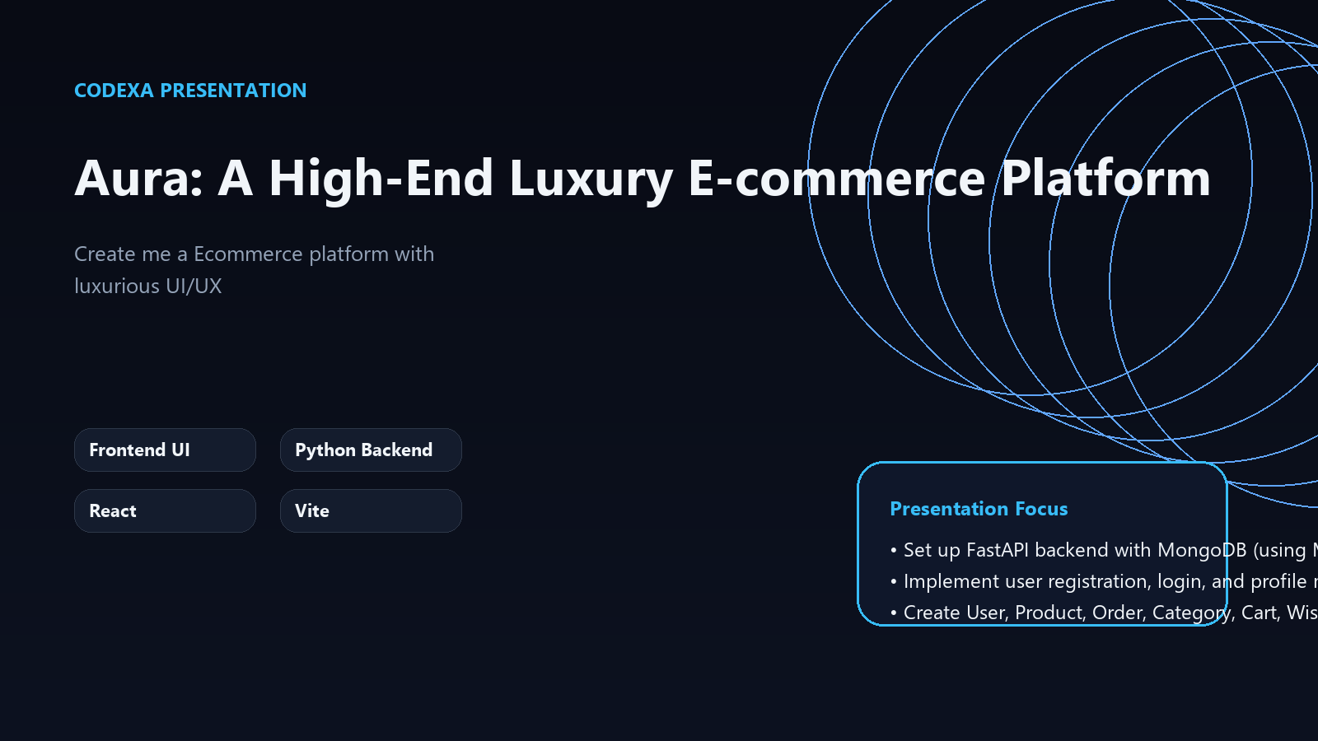
PROJECT OVERVIEW
Aura: A High-End Luxury E-commerce Platform
Create me a Ecommerce platform with luxurious UI/UX
Frontend UI
Python Backend
React
Vite
Presentation focus
• Set up FastAPI backend with MongoDB (using Motor for async) and JWT authentication
• Implement user registration, login, and profile management with password hashing
• Create User, Product, Order, Category, Cart, Wishlist CRUD API endpoints with JWT protection and Pydantic models for validation

Slide 2
WHY THIS MATTERS
Problem
01
Teams need faster delivery without losing structure
• Teams need faster delivery without losing structure
• Context is often scattered across code and conversation
• Preview and validation loops slow down iteration
02
Context is often scattered across code and conversation
03
Preview and validation loops slow down iteration

Slide 3
PROPOSED APPROACH
Solution
• Combine planning, generation, and review in one workflow
• Use modular services for assets, code, and presentation outputs
• Keep changes traceable and easy to iterate on
1
Combine planning, generation, and review in one workflow
2
Use modular services for assets, code, and presentation outputs
3
Keep changes traceable and easy to iterate on

Slide 4
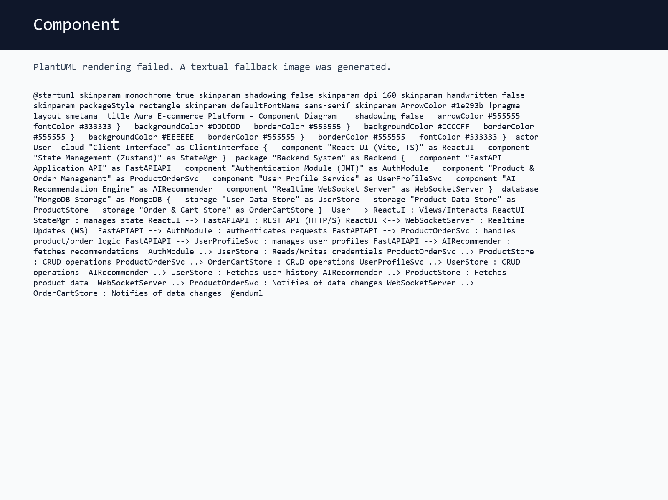
SYSTEM VIEW
Architecture
• Client Interface
• Application API
• FastAPI Service
• MongoDB Storage
• Realtime Channel

Slide 5
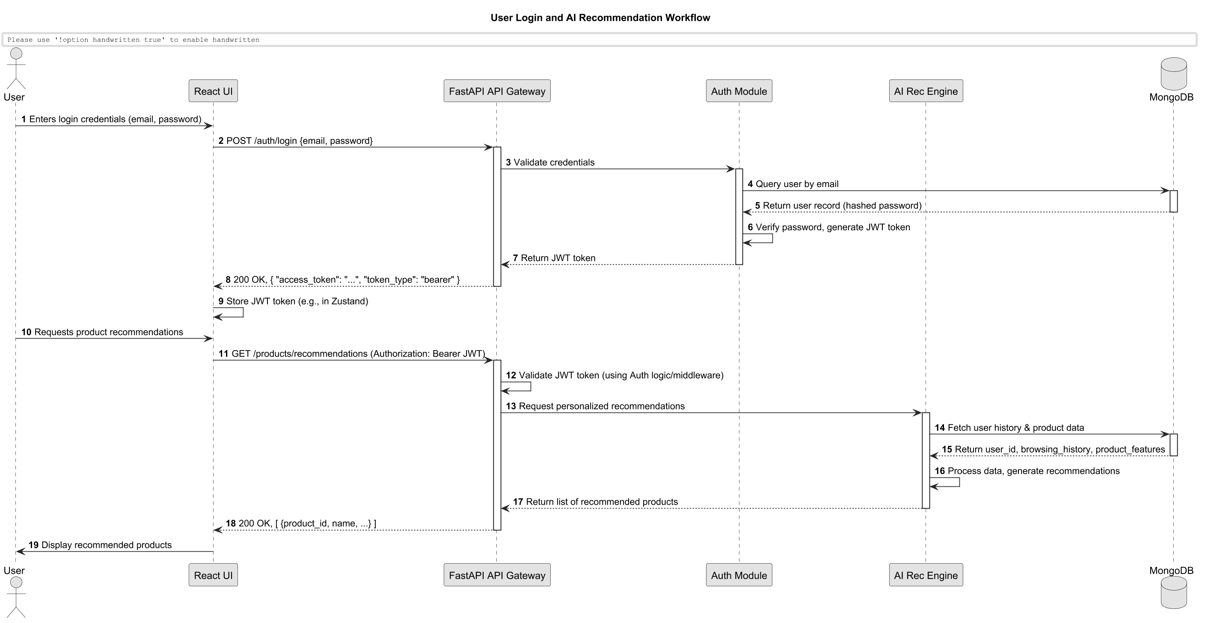
FLOW OF EXECUTION
Workflow
• Set up FastAPI backend with MongoDB (using Motor for async) and JWT authentication
• Implement user registration, login, and profile management with password hashing
• Create User, Product, Order, Category, Cart, Wishlist CRUD API endpoints with JWT protection and Pydantic models for validation
• Develop AI recommendation engine endpoint using user history and product data
• Build React frontend with Vite, TypeScript, Zustand for state, and set up project structure

Slide 6
WHAT STANDS OUT
Features
Set up FastAPI backend with MongoDB (using Motor for async) and JWT authentication
Implement user registration, login, and profile management with password hashing
Create User, Product, Order, Category, Cart, Wishlist CRUD API endpoints with JWT protection and Pydantic models for validation
Develop AI recommendation engine endpoint using user history and product data
• Authentication and secure user access

Slide 7
STRATEGIC VALUE
Key Insights
1. Modular architecture enables independent scaling
2. Cached assets reduce redundant processing by 80%
3. Real-time preview loops accelerate iteration cycles
4. Service decoupling improves fault tolerance

Slide 8
ROADMAP
Implementation Path
1
2
3
4
Core architecture and data models (Weeks 1-2)
Service implementation and integration (Weeks 3-4)
Preview pipeline and validation (Week 5)
Testing, optimization, and deployment (Week 6)
• Iterative delivery with weekly checkpoints
• Continuous integration and deployment
• Regular stakeholder reviews and feedback loops

Slide 9
IMPLEMENTATION BASE
Tech Stack
Frontend UI
Python Backend
React
Vite
TypeScript
• Stack selected to keep the system modular and maintainable
• AI features stay decoupled from presentation and UML services
• Outputs are stored and reused through cached project assets

Slide 10
NEXT EVOLUTION
Future Enhancements & Roadmap
Now
Integration with various payment gateways (e.g., Stripe, PayPal).
Next
Advanced analytics dashboard for business insights.
Later
Augmented Reality (AR) features for product visualization.
• Multi-language and multi-currency support for global reach.
• Enhanced CRM and loyalty program integration.

