Slide 1
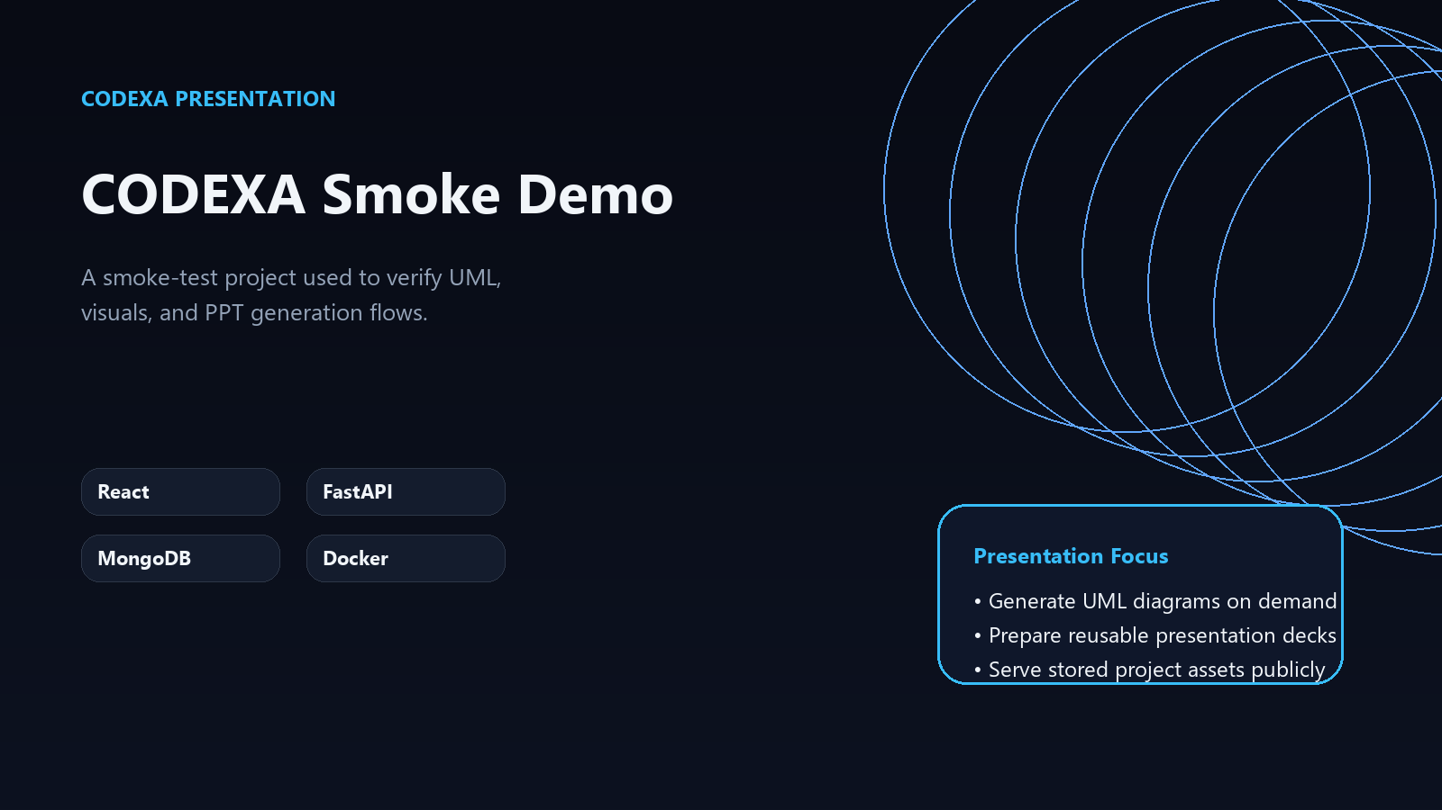
PROJECT OVERVIEW
CODEXA Smoke Demo
A smoke-test project used to verify UML, visuals, and PPT generation flows.
React
FastAPI
MongoDB
Docker
Presentation focus
• Generate UML diagrams on demand
• Prepare reusable presentation decks
• Serve stored project assets publicly

Slide 2
WHY THIS MATTERS
Problem
01
Teams need faster delivery without losing structure
• Teams need faster delivery without losing structure
• Context is often scattered across code and conversation
• Preview and validation loops slow down iteration
02
Context is often scattered across code and conversation
03
Preview and validation loops slow down iteration

Slide 3
PROPOSED APPROACH
Solution
• Combine planning, generation, and review in one workflow
• Use modular services for assets, code, and presentation outputs
• Keep changes traceable and easy to iterate on
1
Combine planning, generation, and review in one workflow
2
Use modular services for assets, code, and presentation outputs
3
Keep changes traceable and easy to iterate on

Slide 4
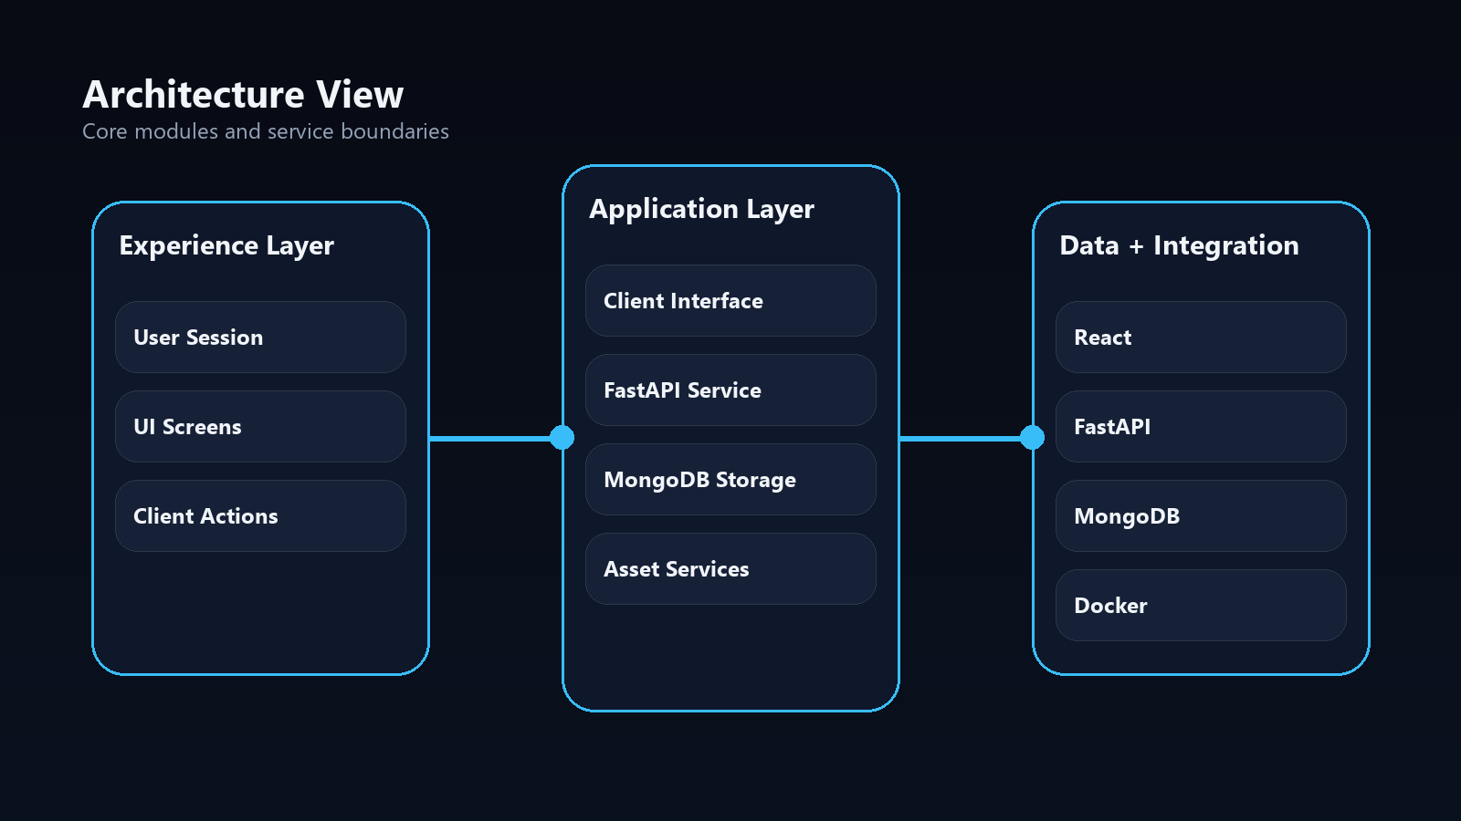
SYSTEM VIEW
Architecture
• Client Interface
• FastAPI Service
• MongoDB Storage
• Asset Services

Slide 5
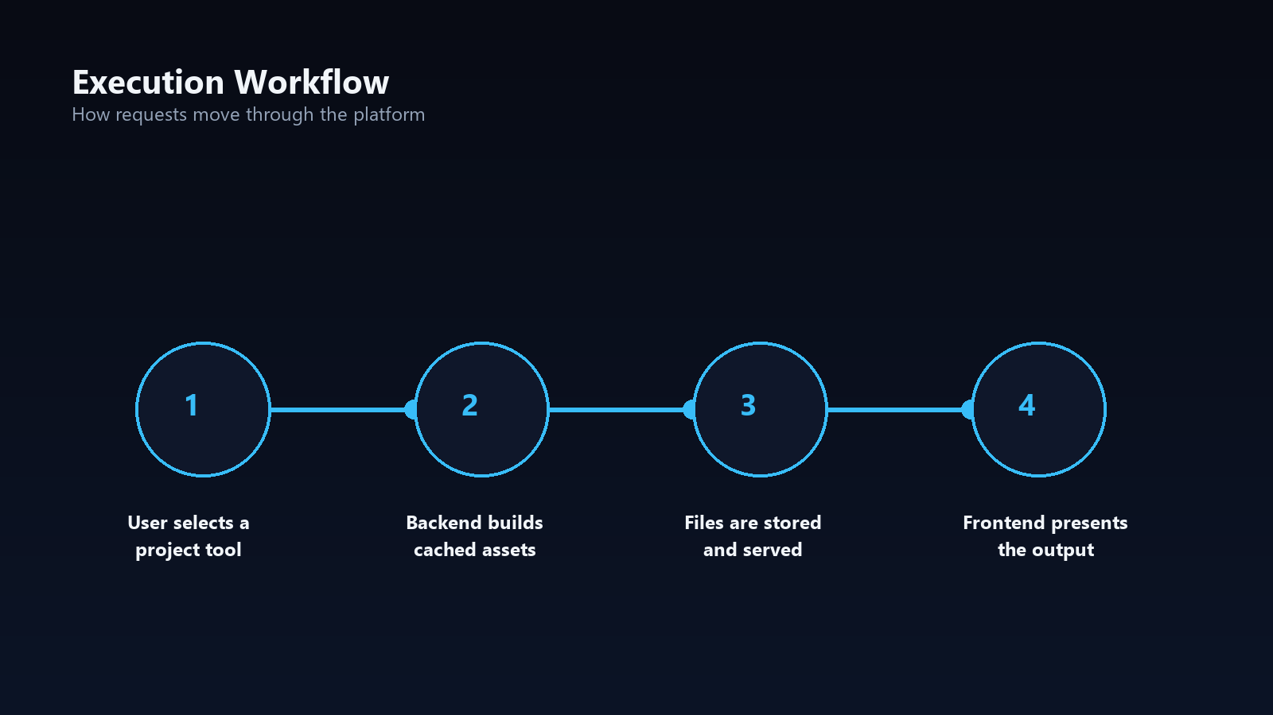
FLOW OF EXECUTION
Workflow
• User selects a project tool
• Backend builds cached assets
• Files are stored and served
• Frontend presents the output

Slide 6
WHAT STANDS OUT
Features
Generate UML diagrams on demand
Prepare reusable presentation decks
Serve stored project assets publicly
Keep asset generation cached per project state

Slide 7
IMPLEMENTATION BASE
Tech Stack
React
FastAPI
MongoDB
Docker
• Stack selected to keep the system modular and maintainable
• AI features stay decoupled from presentation and UML services
• Outputs are stored and reused through cached project assets

Slide 8
NEXT EVOLUTION
Future Scope
Now
Add deeper automation and richer reporting
Next
Expand integrations for deployment and monitoring
Later
Improve reusable templates and collaboration flows

