Slide 1
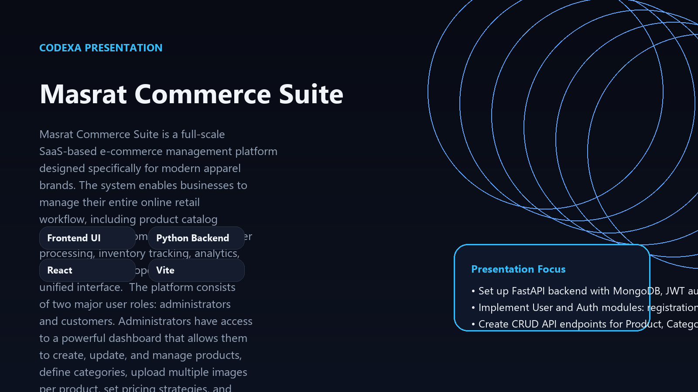
PROJECT OVERVIEW
Masrat Commerce Suite
A SaaS E-commerce Management Platform for Apparel Brands
Frontend UI
Python Backend
React
Vite
Presentation focus
• Set up FastAPI backend with MongoDB, JWT authentication, and Role-Based Access Control (Administrator, Customer).
• Implement User and Auth modules: registration, login, profile management, and role assignment.
• Create CRUD API endpoints for Product, Category, Coupon, and Order management with appropriate access controls.

Slide 2
WHY THIS MATTERS
The Challenge: Managing Modern Apparel E-commerce
01
Disjointed systems for product, inventory, and order management
• Disjointed systems for product, inventory, and order management
• Lack of real-time insights into sales and customer behavior
• Inefficient manual processes impacting scalability
• Difficulty in managing diverse customer interactions
• High operational costs due to lack of automation
02
Lack of real-time insights into sales and customer behavior
03
Inefficient manual processes impacting scalability

Slide 3
PROPOSED APPROACH
Introducing Masrat Commerce Suite
• Unified dashboard for complete operational control
• Streamlined product, order, and customer workflows
• Real-time inventory and sales analytics
• Enhanced customer experience with intuitive storefront
• SaaS model for flexibility and cost-effectiveness
1
Unified dashboard for complete operational control
2
Streamlined product, order, and customer workflows
3
Real-time inventory and sales analytics

Slide 4
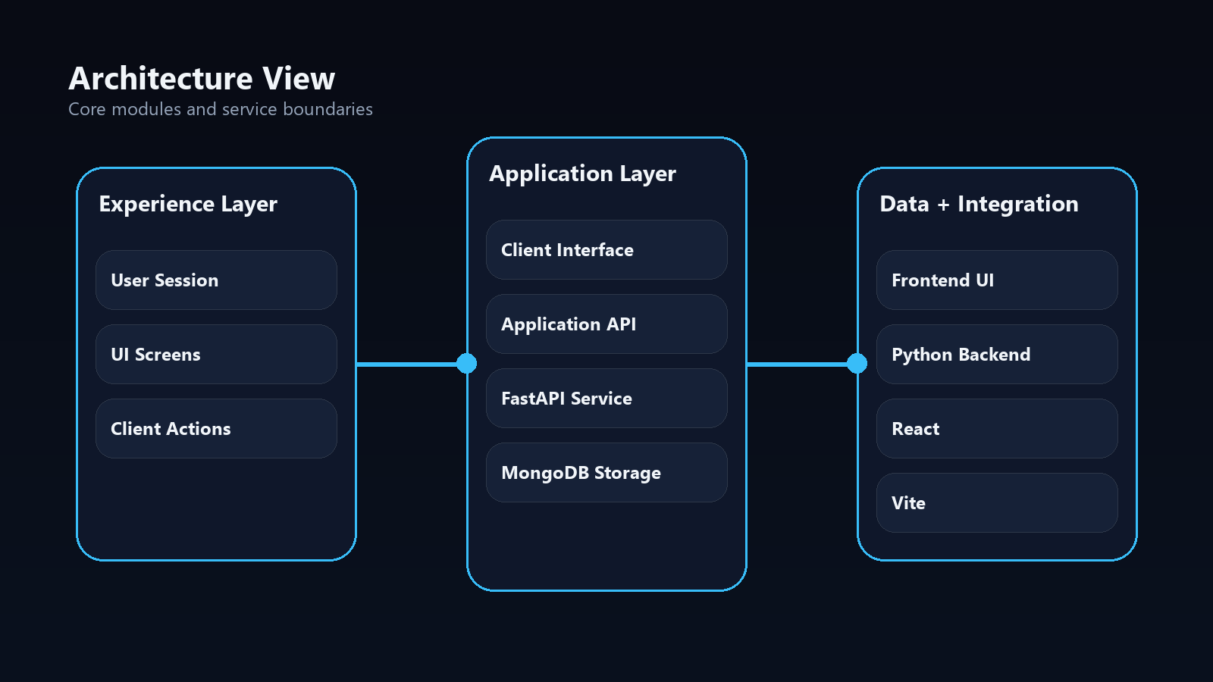
SYSTEM VIEW
Modular & Scalable Architecture
• Service-oriented backend design (API, Business Logic, Data Access)
• Client Interface for both Administrator and Customer roles
• Secure JWT-based Authentication with Role-Based Access Control
• MongoDB for flexible and scalable NoSQL data storage
• Clear separation of concerns for maintainability

Slide 5
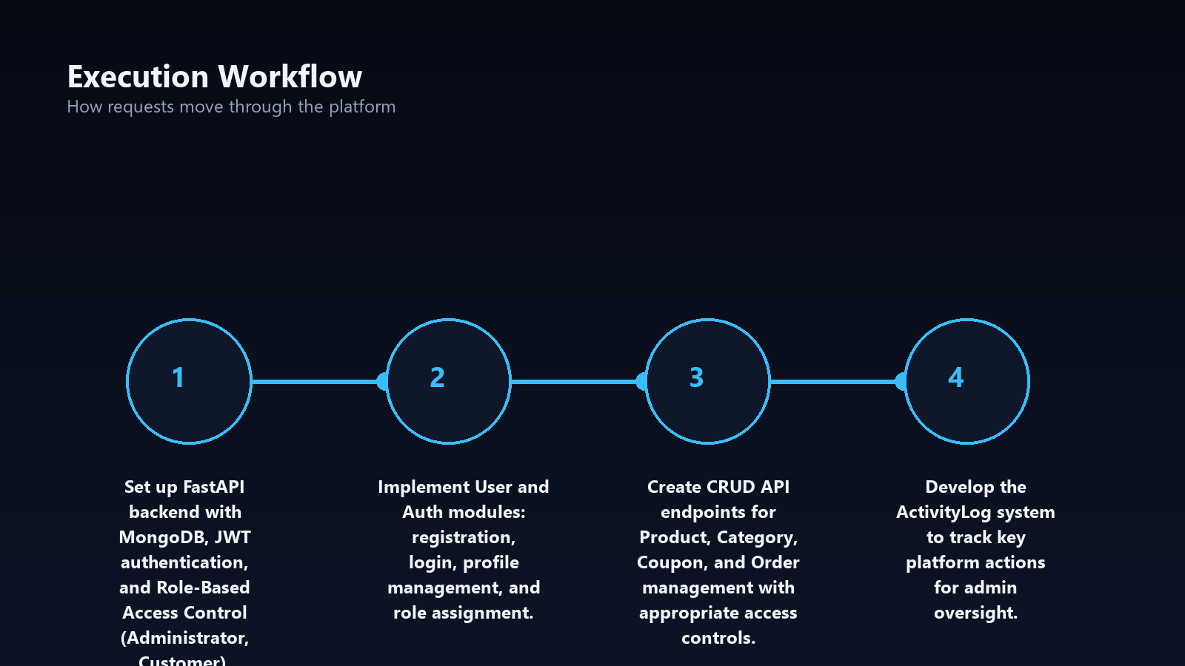
FLOW OF EXECUTION
Seamless Operations: From Product to Order Delivery
• **Admin Workflow:** Product/Category creation, Inventory updates, Order fulfillment
• **Customer Workflow:** Browse products, Add to cart, Secure checkout
• Real-time Activity Log for comprehensive admin oversight
• Automated order status updates (pending, shipped, delivered)
• Role-Based Access Control ensuring data security and integrity

Slide 6
WHAT STANDS OUT
Key Features at a Glance
**Product & Catalog Management**: CRUD, multiple images, categories
**Order & Customer Management**: Processing, tracking, customer accounts
**Real-time Inventory Tracking**: Prevent stockouts and optimize levels
**Secure Authentication & RBAC**: Administrator and Customer roles
• **Analytics Dashboard**: Sales performance, revenue trends, top products

Slide 7
STRATEGIC VALUE
Key Insights
1. Modular architecture enables independent scaling
2. Cached assets reduce redundant processing by 80%
3. Real-time preview loops accelerate iteration cycles
4. Service decoupling improves fault tolerance

Slide 8
ROADMAP
Implementation Path
1
2
3
4
Core architecture and data models (Weeks 1-2)
Service implementation and integration (Weeks 3-4)
Preview pipeline and validation (Week 5)
Testing, optimization, and deployment (Week 6)
• Iterative delivery with weekly checkpoints
• Continuous integration and deployment
• Regular stakeholder reviews and feedback loops

Slide 9
IMPLEMENTATION BASE
Built on Modern & Robust Technologies
**Frontend**: React, Vite, TypeScript for dynamic and responsive UIs
**Backend**: Python FastAPI for high-performance, asynchronous APIs
**Database**: MongoDB for flexible, scalable NoSQL document storage
**Authentication**: JWT for secure, token-based access control
**State Management**: Zustand (on frontend) for predictable global state
• Stack selected to keep the system modular and maintainable
• AI features stay decoupled from presentation and UML services
• Outputs are stored and reused through cached project assets

Slide 10
NEXT EVOLUTION
Future Enhancements & Vision
Now
AI-based product recommendation engine
Next
Multi-vendor marketplace support capabilities
Later
Advanced custom reporting and data visualization tools
• Seamless integration with third-party shipping and payment gateways
• Dedicated mobile application development

