Slide 1
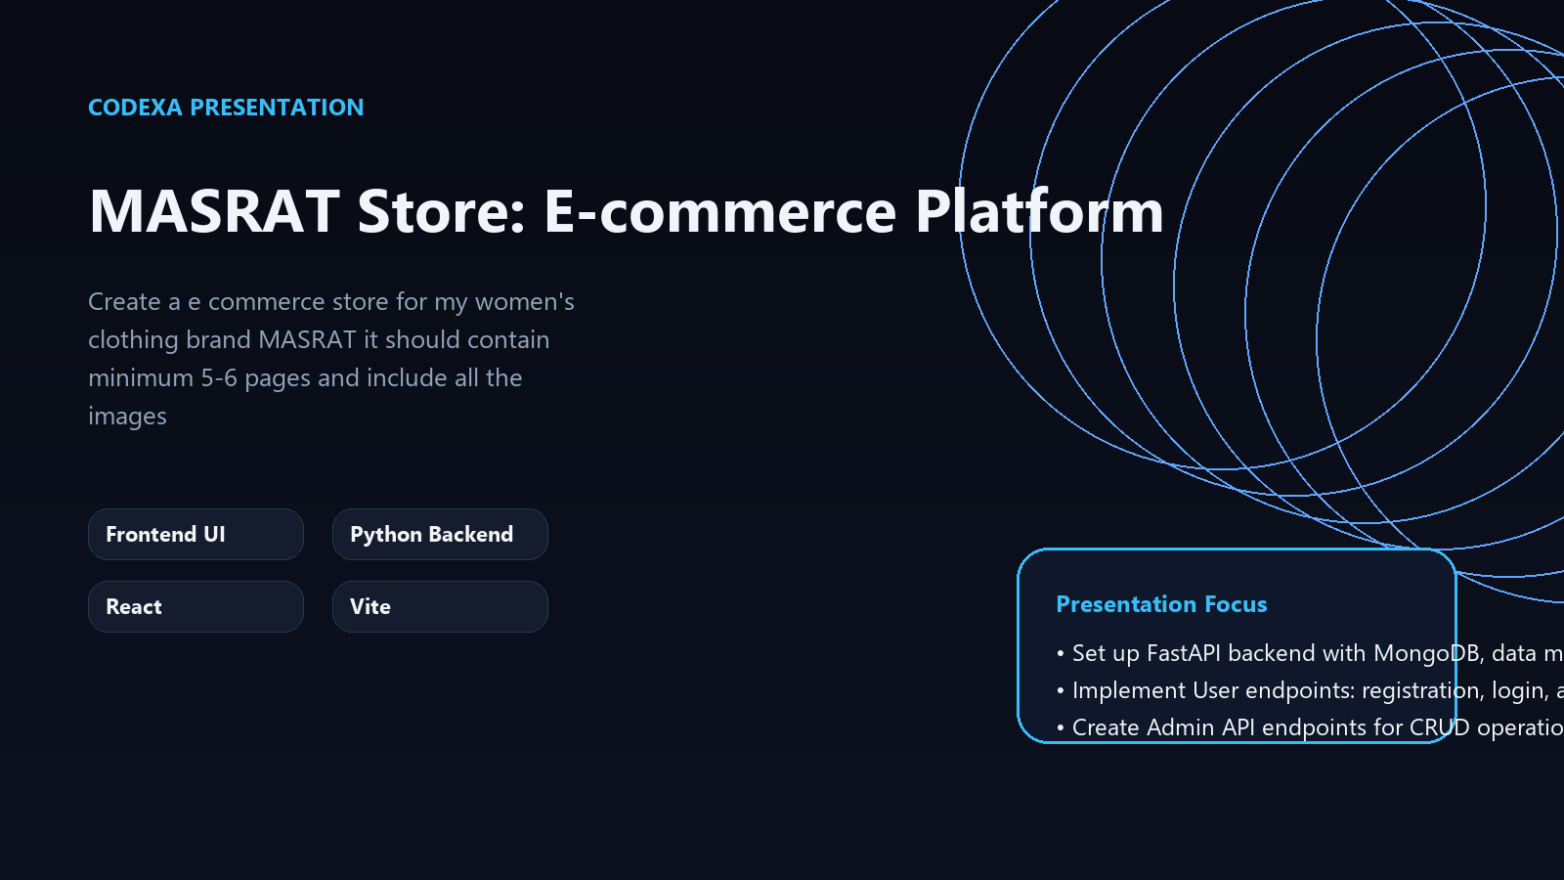
PROJECT OVERVIEW
Welcome to MASRAT Store: E-commerce Platform
A Modern Digital Showcase for Women's Fashion
Frontend UI
Python Backend
React
Vite
Presentation focus
• Set up FastAPI backend with MongoDB, data models, and JWT authentication.
• Implement User endpoints: registration, login, and profile management.
• Create Admin API endpoints for CRUD operations on Product, Category, and Order entities.

Slide 2
WHY THIS MATTERS
The Challenge: Bringing MASRAT Online
01
Lack of a dedicated online sales channel for MASRAT
• Lack of a dedicated online sales channel for MASRAT
• Limited market reach beyond physical storefronts
• Requirement for secure transactions and user management
• Inefficiencies with manual inventory and order processing
• Demand for a visually appealing and intuitive shopping experience
02
Limited market reach beyond physical storefronts
03
Requirement for secure transactions and user management

Slide 3
PROPOSED APPROACH
Our Solution: The MASRAT E-commerce Platform
• Full-featured online store for women's clothing
• Secure user authentication and personalized profile management
• Intuitive product browsing, cart management, and order placement workflows
• Robust administrative backend for product, category, and order control
• Responsive design ensuring seamless access on any device
1
Full-featured online store for women's clothing
2
Secure user authentication and personalized profile management
3
Intuitive product browsing, cart management, and order placement workflows

Slide 4
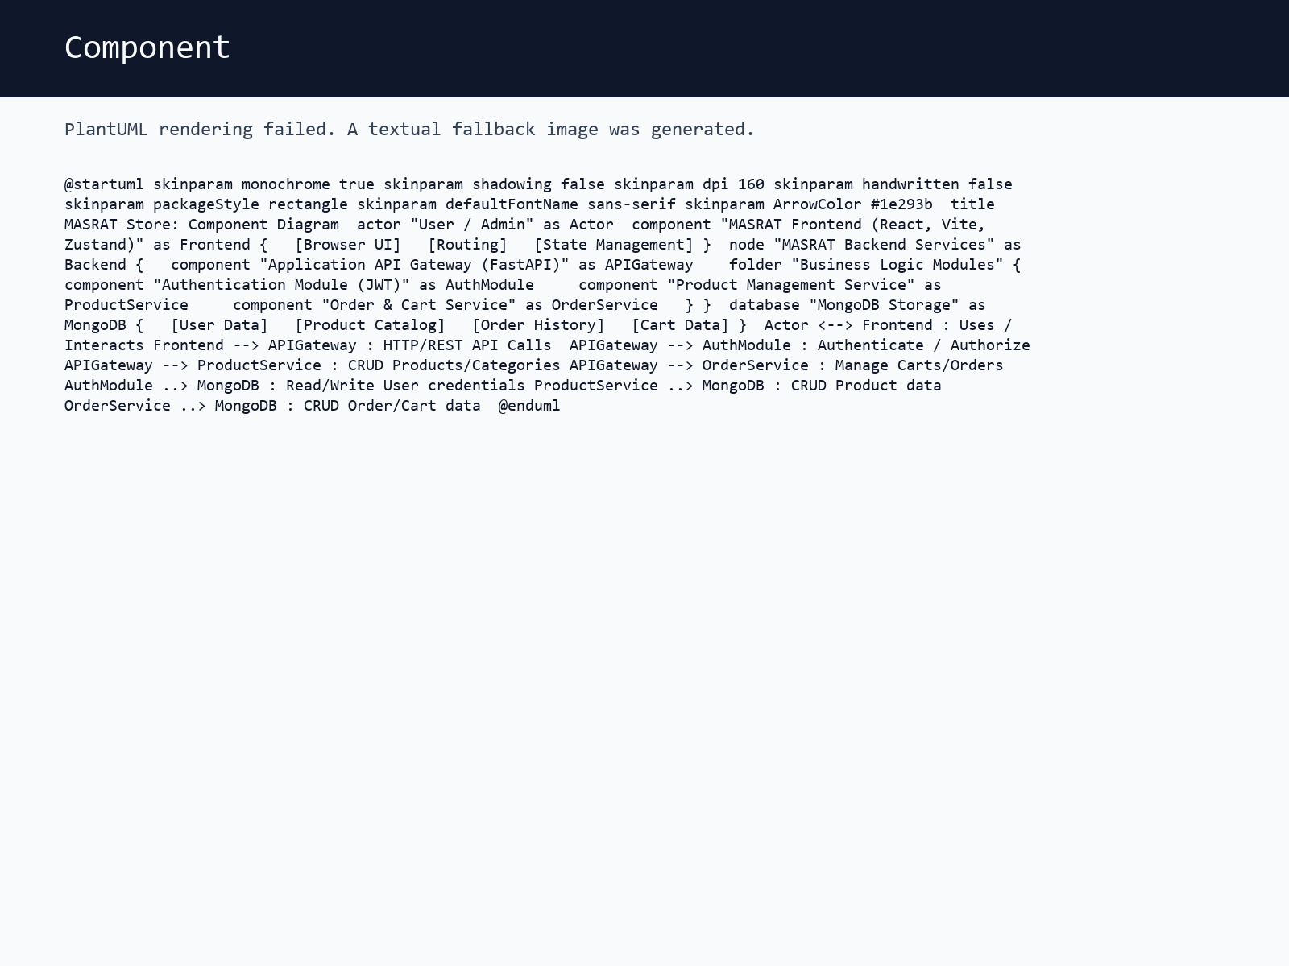
SYSTEM VIEW
Platform Blueprint: Our Architectural Design
• Client Interface: React/Vite for dynamic user interaction
• Application API: FastAPI Service for all backend logic
• MongoDB Storage: Persistent and flexible data management
• Auth Module: Dedicated JWT authentication for security
• Modular design for easier development and scaling

Slide 5
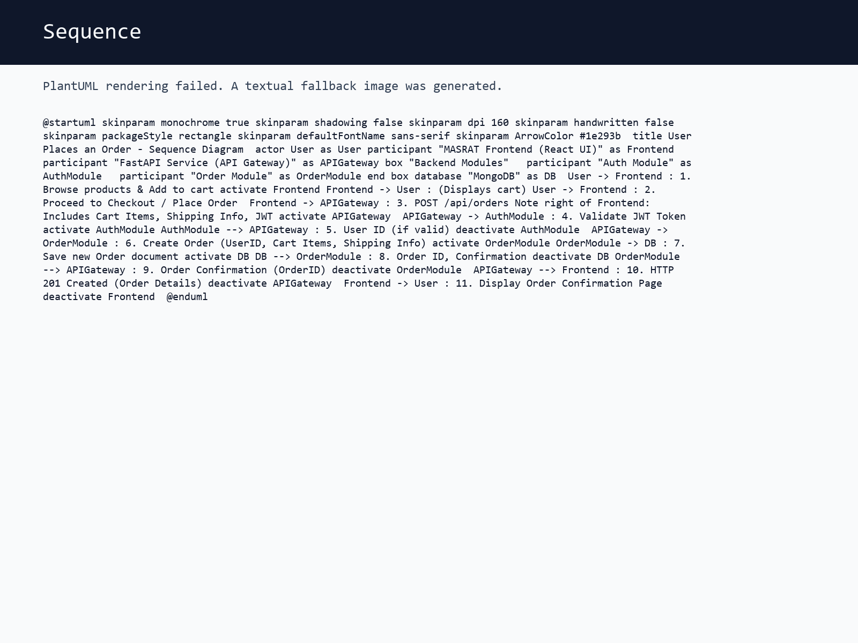
FLOW OF EXECUTION
Development Flow: From Concept to Delivery
• Backend Setup: FastAPI, MongoDB, and initial JWT authentication
• Core API Development: User, Admin, and Customer endpoints
• Frontend Implementation: React/Vite, routing, and Zustand state management
• UI/UX Refinement: Tailwind CSS for responsive and modern design
• Comprehensive testing and deployment preparations

Slide 6
WHAT STANDS OUT
Core Capabilities: What MASRAT Store Offers
**Customer Experience**: Effortless product browsing, robust cart, secure checkout
**User Management**: Registration, login (JWT), and comprehensive profile updates
**Admin Tools**: CRUD operations for Products, Categories, and Orders via API
**Authentication**: Role-based access and secure API interactions
• **Responsive UI**: Optimized shopping experience across desktop and mobile

Slide 7
STRATEGIC VALUE
Key Takeaways: Performance & Optimization Highlights
1. **Robust API Design**: FastAPI ensured high performance and maintainability.
2. **Efficient Data Handling**: MongoDB provided flexibility and scalability.
3. **Seamless User Experience**: Modern React frontend delivered intuitive interactions.
4. **Prioritized Security**: JWT authentication for secure access and data.

Slide 8
ROADMAP
Our Journey: Implementation & Development Roadmap
1
2
3
4
Backend Foundation (FastAPI, MongoDB setup, initial Auth)
Core API Endpoints (User, Product, Category, Order CRUD)
Frontend Structure & Core Pages (React, Routing, Basic UI)
UI/UX Integration & State Management (Tailwind, Zustand)
• Iterative delivery with weekly checkpoints
• Continuous integration and deployment
• Regular stakeholder reviews and feedback loops

Slide 9
IMPLEMENTATION BASE
Technology Powering MASRAT: Our Robust Stack
**Frontend**: React, Vite, TypeScript, Tailwind CSS, Zustand
**Backend**: Python, FastAPI, Uvicorn, Motor (MongoDB driver)
**Database**: MongoDB (NoSQL, flexible schema for products)
**Authentication**: JWT, bcrypt for secure password hashing
**Tooling**: Pydantic, Zod for robust data validation
• Stack selected to keep the system modular and maintainable
• AI features stay decoupled from presentation and UML services
• Outputs are stored and reused through cached project assets

Slide 10
NEXT EVOLUTION
What's Next: Expanding MASRAT Store Capabilities
Now
Integration with Payment Gateways (e.g., Stripe, PayPal)
Next
Advanced Search & Filtering functionalities
Later
Personalized Product Recommendations Engine
• Customer Reviews & Ratings System for social proof
• Internationalization (Multi-language, Multi-currency support)

