Slide 1
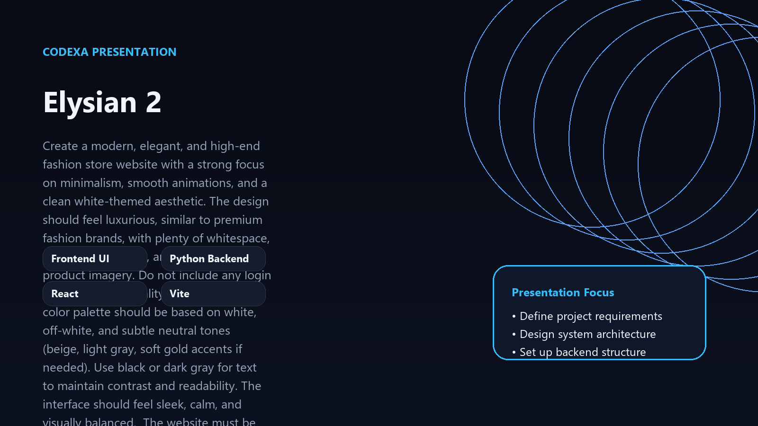
PROJECT OVERVIEW
Elysian 2
Create a modern, elegant, and high-end fashion store website with a strong focus on minimalism, smooth animations, and a
Frontend UI
Python Backend
React
Vite
Presentation focus
• Define project requirements
• Design system architecture
• Set up backend structure

Slide 2
WHY THIS MATTERS
Problem
01
Elysian 2 needs a clearer story from problem to delivery
• Elysian 2 needs a clearer story from problem to delivery
• Teams need faster delivery without losing structure
• Preview and validation loops slow down iteration
02
Teams need faster delivery without losing structure
03
Preview and validation loops slow down iteration

Slide 3
PROPOSED APPROACH
Solution
• Position Elysian 2 as a cohesive delivery-ready solution
• Combine planning, generation, and review in one workflow
• Keep changes traceable and easy to iterate on
1
Position Elysian 2 as a cohesive delivery-ready solution
2
Combine planning, generation, and review in one workflow
3
Keep changes traceable and easy to iterate on

Slide 4
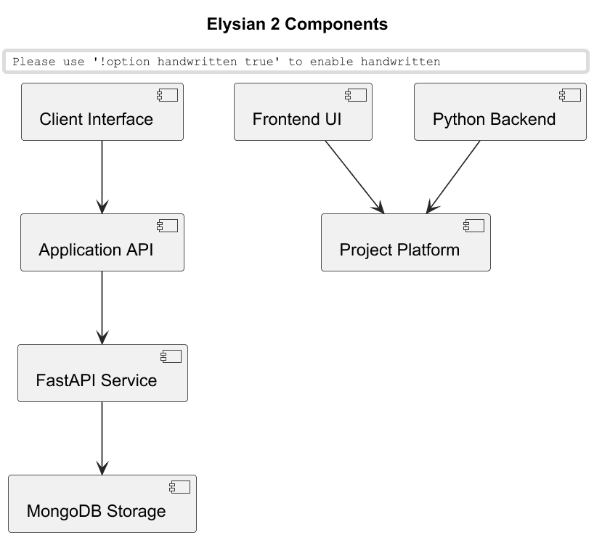
SYSTEM VIEW
Architecture
• Client Interface
• Application API
• FastAPI Service
• MongoDB Storage

Slide 5
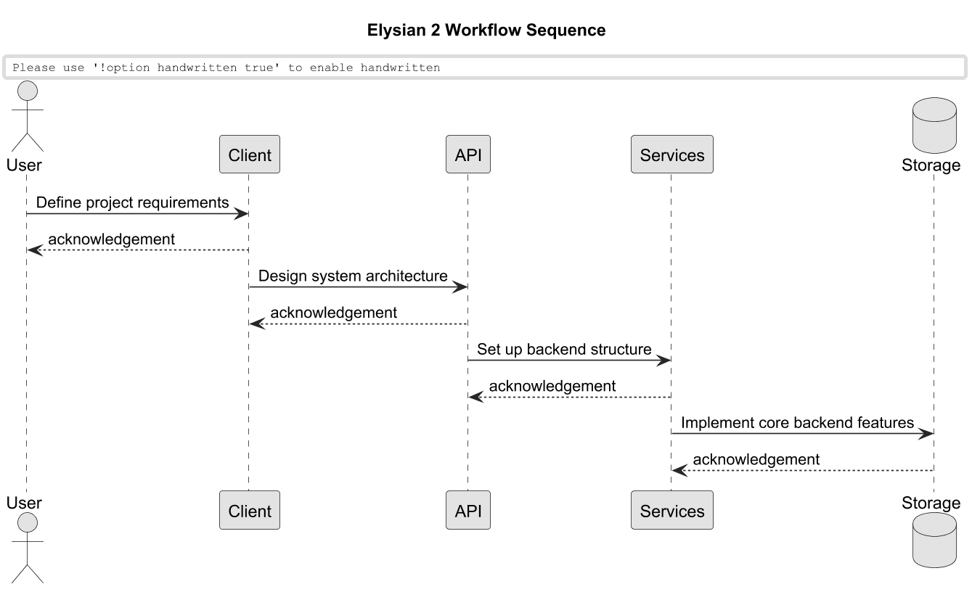
FLOW OF EXECUTION
Workflow
• Define project requirements
• Design system architecture
• Set up backend structure
• Implement core backend features
• Build frontend interface

Slide 6
WHAT STANDS OUT
Features
Define project requirements
Design system architecture
Set up backend structure
Implement core backend features
• Authentication and secure user access

Slide 7
STRATEGIC VALUE
Key Insights
1. Elysian 2 benefits from a modular architecture that can evolve incrementally
2. Cached assets reduce redundant processing during repeated runs
3. Real-time preview loops accelerate iteration cycles
4. Project-specific workflows stay easier to reason about when elysian 2 concerns are separated

Slide 8
ROADMAP
Implementation Path
1
2
3
4
Frame the core elysian 2 workflow and data contracts
Implement services and integrate the happy path
Validate preview/runtime flows and tighten failure handling
Polish delivery quality, optimize, and prepare rollout
• Iterative delivery with weekly checkpoints
• Continuous integration and deployment
• Regular stakeholder reviews and feedback loops

Slide 9
IMPLEMENTATION BASE
Tech Stack
Frontend UI
Python Backend
React
Vite
TypeScript
• Stack selected to keep the system modular and maintainable
• AI features stay decoupled from presentation and UML services
• Outputs are stored and reused through cached project assets

Slide 10
NEXT EVOLUTION
Future Scope
Now
Add deeper automation and richer reporting
Next
Expand integrations for deployment and monitoring
Later
Improve reusable templates and collaboration flows

