Slide 1
What this deck shows
Baseline models on both datasets
Simple feature engineering
Key graphs from the pipeline
LIME status: planned, not final yet
XAI Medical Baseline Slides
Heart Disease + Diabetes LIME work still in progress
Status
Heart pipeline completed
Diabetes pipeline completed
Lime Discussions done
Members
Haseeb Farooq
Zainab Salman
Luqman Azhar
Explainable AI for medical
risk prediction

Slide 2
Project Scope
Goal: predict heart disease and diabetes risk with simple, interpretable models.
Current stage: data cleaning, feature engineering, and baseline evaluation are done.
Next stage: add LIME explanations on selected cases and refine the report.
Current deliverables
• Two notebooks / pipelines
• Baseline metrics
• Plots for discussion
02

Slide 3
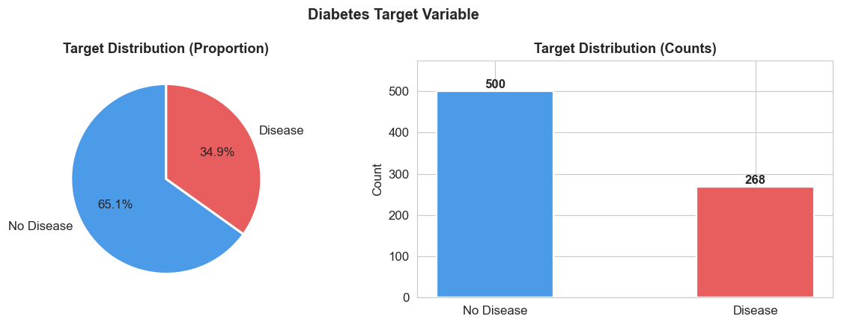
Dataset Snapshot
Heart cleaned rows: 302
Diabetes rows: 768
Target balance is not extreme, but recall still matters.
Use simple splits and keep the workflow transparent.
03

Slide 4
Cleaning + Feature Engineering
How to choose baseline model?
Objective metric: for medical tasks, prioritize recall/F1 (and ROC-AUC), not just accuracy.
Prefer the simplest model that gives stable cross-validation performance
Removed duplicates and handled missing values.
Standardized numeric columns before modeling.
Added a few low-cost engineered features:
squared terms
simple interaction features
ratio-style indicators where useful
04

Slide 5
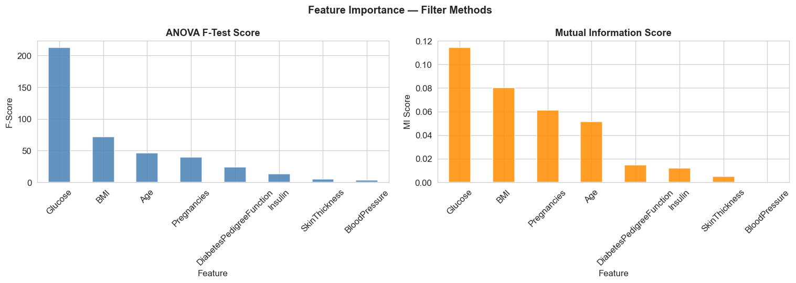
Feature Selection View
Filter methods keep the feature set small and interpretation-friendly
05

Slide 6
Models Used
Logistic Regression: strong, explainable baseline.
Decision Tree: easy to inspect and discuss.
Random Forest: compact performance boost for comparison.
Model | Why it helps
LR | Simple and interpretable
DT | Visible split rules
RF | Stronger baseline check
note: these are baselines, not the final model stack.
06

Slide 7
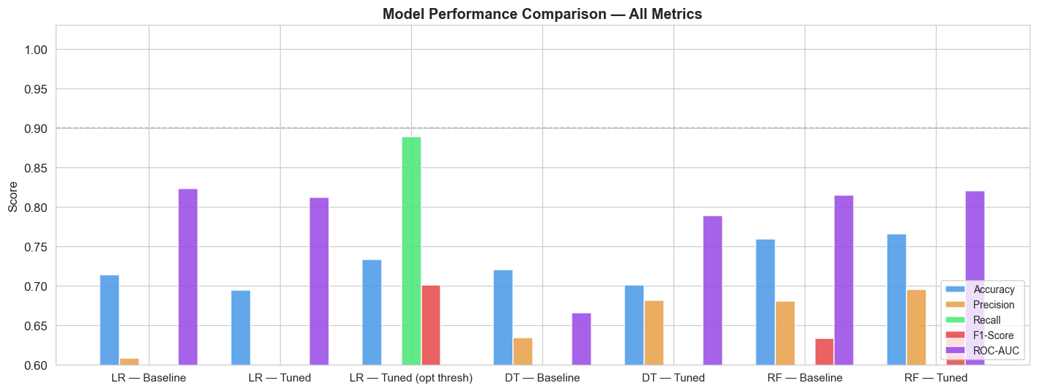
Heart Disease Results
The chart shows a clear baseline comparison.
Use it to discuss trade-offs between simplicity and fit.
Keep the final claims modest until LIME is added.
07

Slide 8
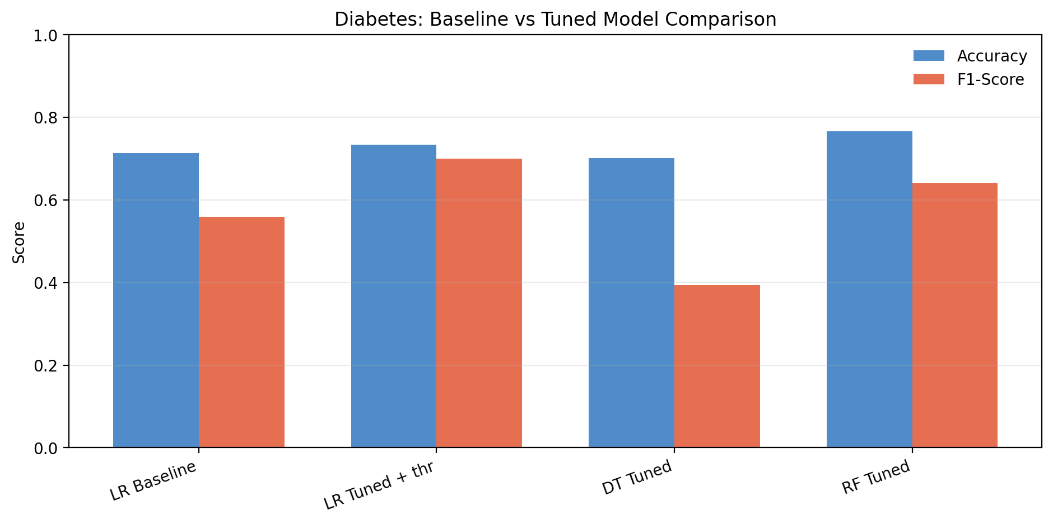
Diabetes Results
Compact summary from the saved evaluation file
Model | Acc | F1 | Note
LR baseline | 0.714 | 0.560 | simple baseline
LR tuned + thr | 0.734 | 0.701 | best recall
RF tuned | 0.766 | 0.640 | best accuracy
08

Slide 9
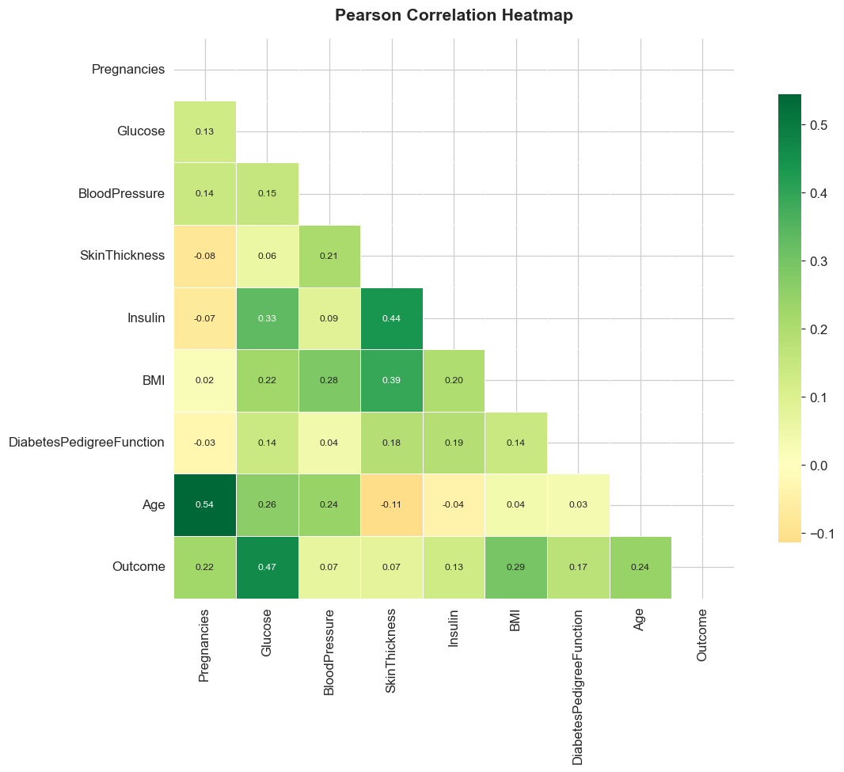
Correlation View
Useful for talking about engineered features and feature relationships
The strongest relationships help justify a small set of engineered features.
09

Slide 10
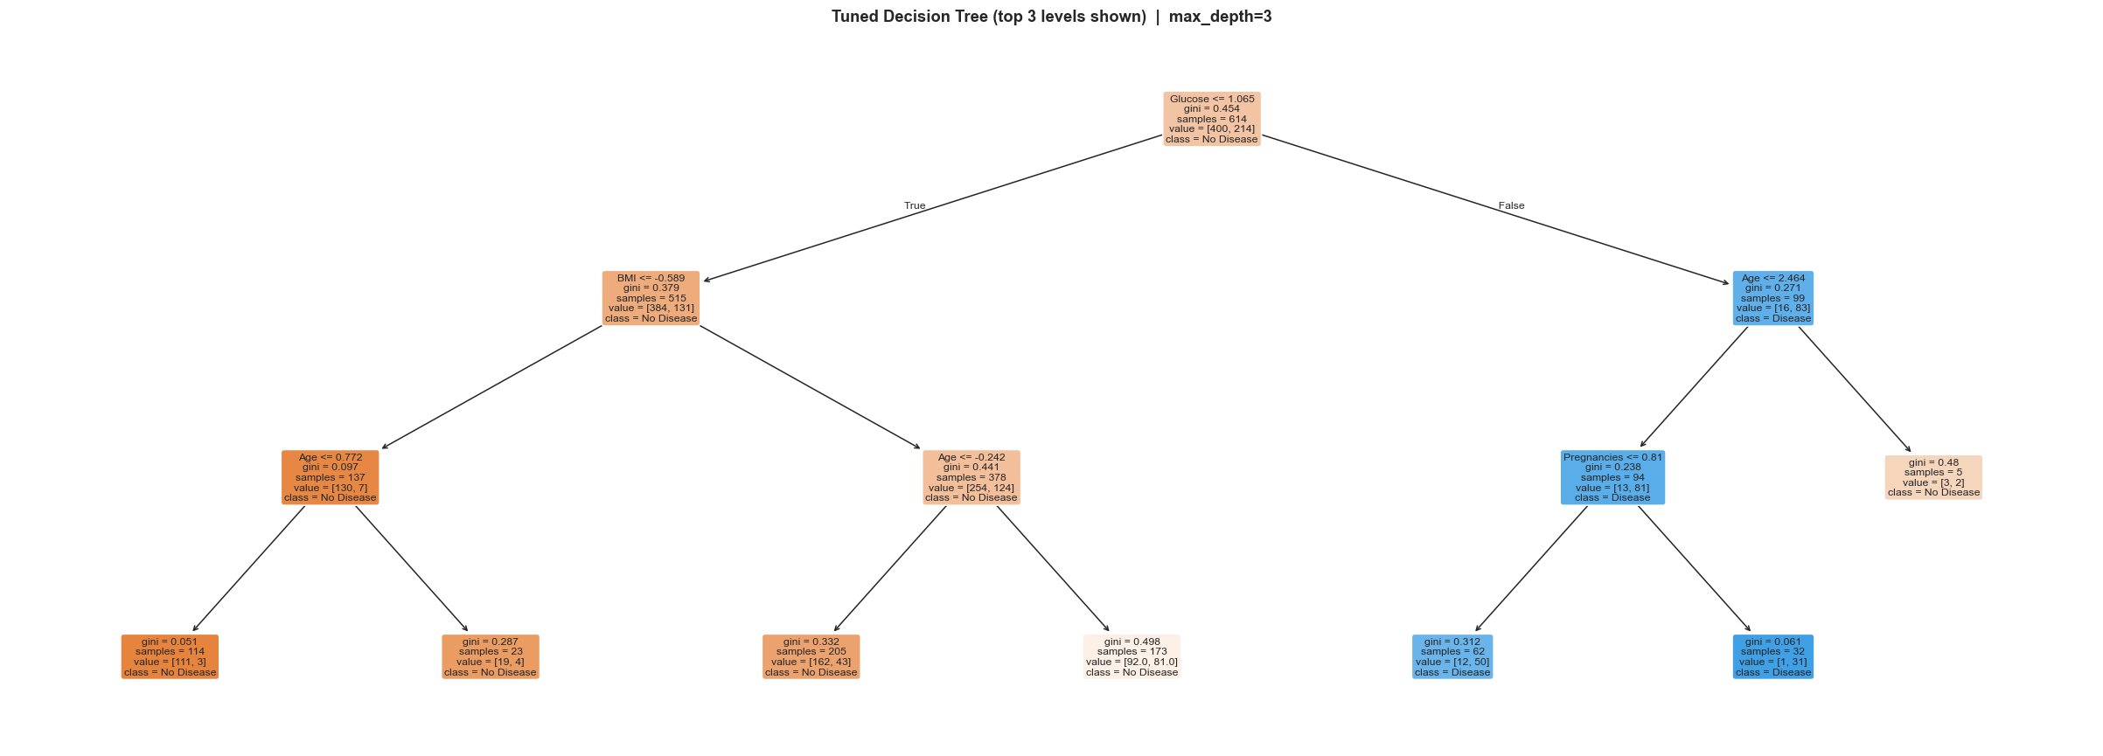
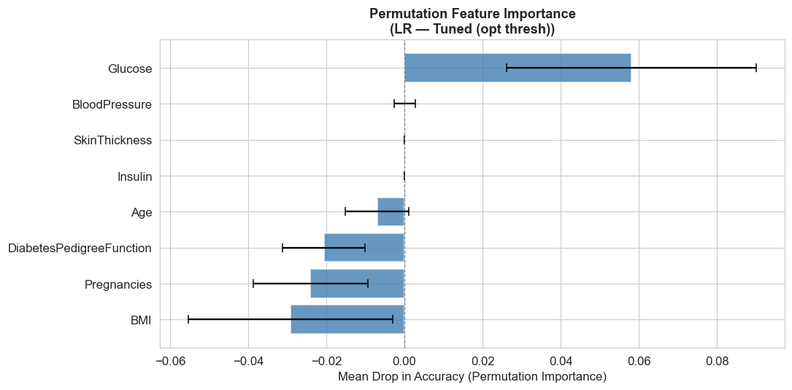
Model Interpretability Graphs
10

Slide 11
LIME Status
What LIME will show
• Local explanation for one patient/sample
• Feature contributions around one prediction
• Why the model predicted disease / no disease
Current status
• Baselines are ready
• Graphs are ready
• LIME discussion done, implementation in progress
11

Slide 12
Takeaways
Current state: data, features, models, and plots.
Keep the story focused on simplicity and interpretability.
Do not overclaim results until LIME is completed.
Next steps
• Finish LIME examples
• Add 1-2 sample explanations
12

