Slide 1






CINEFLIX MOVIE STREAMING APP
Group Members:
Haseeb Ahmed(SP23-BSCS-0026)
Kamran Ali(SP23-BSCS-0119)

Slide 2
Features
Browse
Search
Stream Movies

Slide 3

Navigation:
The app has a navigation bar with options for
Home
Search
Favorites
Popular

Slide 4
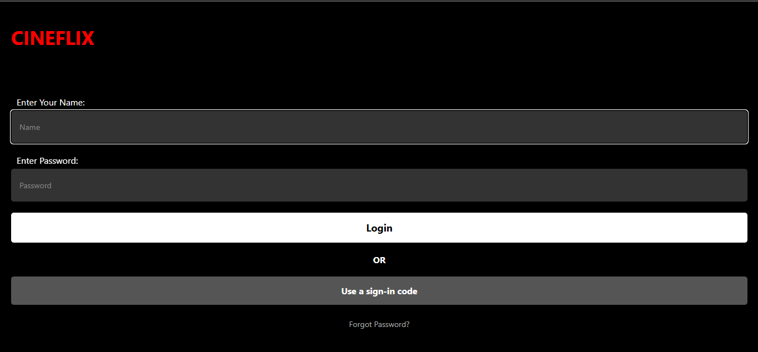
INTERFACE

Slide 5
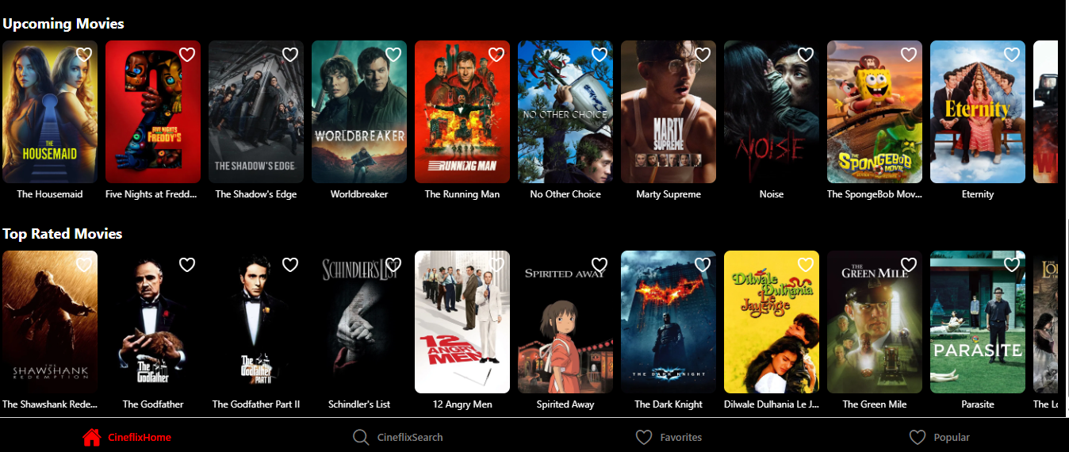
HOME SCREEN

