Slide 1
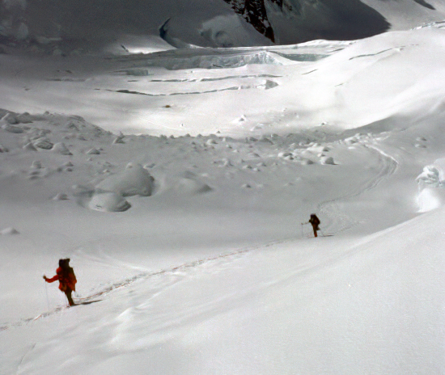
Chapter 12, Rationale Management

Slide 2
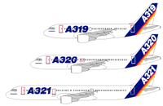
An aircraft example
A320
First fly-by-wire passenger aircraft
150 seats, short to medium haul
A319 & A321
Derivatives of A320
Same handling as A320
Design rationale
Reduce pilot training & maintenance costs
Increase flexibility for airline

Slide 3
An aircraft example (2)
A330 & A340
Long haul and ultra long haul
2x seats, 3x range
Similar handling than A320 family
Design rationale
With minimum cross training, A320 pilots can be certified to fly A330 and A340 airplanes
Consequence
Any change in these five airplanes must maintain this similarity

Slide 4
Overview: rationale
What is rationale?
Why is it critical in software engineering?
Centralized traffic control example
Rationale in project management
Consensus building
Consistency with goals
Rapid knowledge construction
Summary

Slide 5
What is rationale?
Rationale is the reasoning that lead to the system.
Rationale includes:
the issues that were addressed,
the alternatives that were considered,
the decisions that were made to resolve the issues,
the criteria that were used to guide decisions, and
the debate developers went through to reach a decision.

Slide 6
Why is rationale important in software engineering?
Many software systems are like aircraft:
They result from a large number of decisions taken over an extended period of time.
Evolving assumptions
Legacy decisions
Conflicting criteria
-> high maintenance cost
-> loss & rediscovery of information

Slide 7
Uses of rationale in software engineering
Improve design support
Avoid duplicate evaluation of poor alternatives
Make consistent and explicit trade-offs
Improve documentation support
Makes it easier for non developers (e.g., managers, lawyers, technical writers) to review the design
Improve maintenance support
Provide maintainers with design context
Improve learning
New staff can learn the design by replaying the decisions that produced it

Slide 8
Representing rationale: issue models
Argumentation is the most promising approach so far:
More information than document: captures trade-offs and discarded alternatives that design documents do not.
Less messy than communication records: communication records contain everything.
Issue models represent arguments in a semi-structure form:
Nodes represent argument steps
Links represent their relationships

Slide 9
ATM Example
Question: Alternative Authentication Mechanisms?
References: Service: Authenticate
Decision: Smart Card + PIN
Criteria 1:
ATM Unit Cost
Criteria 2:
Privacy
Option 1: Account number
+
–
Option 2: Finger print reader
–
+
Option 3: Smart Card + PIN
+
+

Slide 10
Centralized traffic control
CTC systems enable dispatchers to monitor and control trains remotely
CTC allows the planning of routes and replanning in case of problems

Slide 11
Centralized traffic control (2)
CTC systems are ideal examples of rationale capture:
Long lived systems (some systems include relays installed last century)
Extended maintenance life cycle
Although not life critical, downtime is expensive
Low tolerance for bugs
Transition to mature technology

Slide 12
Issues
Issues are concrete problem which usually do not have a unique, correct solution.
Issues are phrased as questions.
input?:Issue
display?:Issue
How should the dispatcher input commands?
How should track sections be displayed?

Slide 13
Proposals
Proposals are possible alternatives to issues.
One proposal can be shared across multiple issues.
input?:Issue
display?:Issue
addressed by
addressed by
addressed by
text-based:Proposal
point&click:Proposal
The display used by the dispatcher can be a text only display with graphic characters to represent track segments.
The interface for the dispatcher could be realized with a point & click interface.

Slide 14
Consequent issue
Consequent issues are issues raised by the introduction of a proposal.
input?:Issue
display?:Issue
addressed by
addressed by
addressed by
text-based:Proposal
point&click:Proposal
raises
terminal?:Issue
Which terminal emulation should be used for the display?

Slide 15
Criteria
A criteria represent a goodness measure.
Criteria are often design goals or nonfunctional requirements.
input?:Issue
display?:Issue
addressed by
addressed by
addressed by
text-based:Proposal
point&click:Proposal
raises
meets
meets
terminal?:Issue
fails
fails
usability$:Criterion
availability$:Criterion
The CTC system should have at least a 99% availability.
The time to input commands should be less than two seconds.

Slide 16
Arguments
Arguments represent the debate developers went through to arrive to resolve the issue.
Arguments can support or oppose any other part of the rationale.
Arguments constitute the most part of rationale.

Slide 17
Arguments (2)
input?:Issue
display?:Issue
addressed by
addressed by
addressed by
text-based:Proposal
point&click:Proposal
raises
meets
meets
terminal?:Issue
fails
fails
is opposed by
usability$:Criterion
availability$:Criterion
is supported by
availability-first!:Argument
Point&click interfaces are more complex to implement than text-based interfaces. Hence, they are also more difficult to test. The point&click interface risks introducing fatal errors in the system that would offset any usability benefit the interface would provide.

Slide 18
Resolutions
Resolutions represent decisions.
A resolution summarizes the chosen alternative and the argument supporting it.
A resolved issue is said to be closed.
A resolved issue can be re-opened if necessary, in which case the resolution is demoted.

Slide 19
Resolutions (2)
text-based&keyboard
:Resolution
resolves
resolves
input?:Issue
display?:Issue
addressed by
addressed by
addressed by
text-based:Proposal
point&click:Proposal
raises
meets
meets
terminal?:Issue
fails
fails
is opposed by
usability$:Criterion
availability$:Criterion
is supported by
availability-first!:Argument

Slide 20
Questions, Options, Criteria
Designed for capturing rationale after the fact (e.g., quality assessment).
QOC emphasizes criteria
Question ?
consequent question
response
positive
assessment +
Option !
Criterion $
negative
assessment -
supports +
objects-to -
supports +
objects-to -
Argument .

Slide 21
Other issue models: Decision Representation Language

Slide 22
Overview: rationale
What is rationale?
Why is it critical in software engineering?
Centralized traffic control example
Rationale in project management
Consensus building (WinWin)
Consistency with goals (NFR Framework)
Rapid knowledge construction (Compendium)
Summary

Slide 23
Consensus building
Problem
Any realistic project suffers the tension of conflicting goals
Stakeholders come from different background
Stakeholders have different criteria
Example
Requirements engineering
Client: business process (cost and schedule)
User: functionality
Developer: architecture
Manager: development process (cost and schedule)

Slide 24
Consensus building: WinWin
Incremental, risk-driven spiral process
Identification of stakeholders
Identification of win conditions
Conflict resolution
Asynchronous groupware tool
Stakeholders post win conditions
Facilitator detects conflict
Stakeholders discuss alternatives
Stakeholders make agreements

Slide 25
Consensus building: Model

Slide 26
Consensus building: Process
2. Identify stakeholders’
win conditions
1. Identify stakeholders
3. Reconcile win conditions.
Establish alternatives.
7. Review & commit
6. Validate
4. Evaluate & resolve risks.
5. Define solution

Slide 27
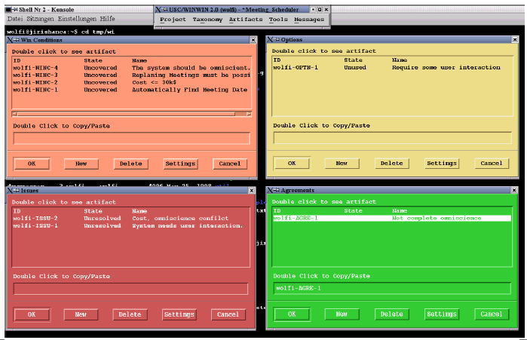
Consensus building: WinWin tool

Slide 28
Consensus building: Experiences
Context
Initial case studies used project courses with real customers
Used in industry
Results
Risk management focus
Trust building between developers and clients
Discipline
Inadequate tool support

Slide 29
Consistency with goals
Problem
Once multiple criteria have been acknowledged
Find solutions that satisfy all of them
Document the trade-offs that were made
Example
Authentication should be secure, flexible for the user, and low cost.

Slide 30
Consistency with goals: NFR Framework
NFR goal refinement
NFRs are represented as goals in a graph
Leaf nodes of the graph are operational requirements
Relationships represent “help” “hurt” relationships
One graph can represent many alternatives
NFR evaluation
Make and break values are propagated through the graph automatically
Developer can evaluate different alternatives and compare them

Slide 31
Consistency with goals: Model




Slide 32
Consistency with goals: Process
Elicit
high-level goals
Evaluate
alternatives
Refine into
detailed goals
Identify
operational goals
Identify goal
dependencies

Slide 33
Consistency with goals: Experiences
Case studies on existing systems lead to clearer trade-offs
Research into integrating NFR framework and design patterns
Match NFRs to design pattern “Forces”
Link NFRs, design patterns, and functional requirements
Tool support inexistent

Slide 34
Rapid knowledge construction
Problem
When a company is large enough, it doesn’t know what it does.
Knowledge rarely crosses organizational boundaries
Knowledge rarely crosses physical boundaries
Example
Identify resources at risk for Y2K and prioritize responses.

Slide 35
Rapid knowledge construction: Compendium
Meeting facilitation
Stakeholders from different business units
External facilitator
Real-time construction of knowledge maps
The focus of the meeting is a concept map under construction
Map includes the issue model nodes and custom nodes (e.g., process, resource, etc.)
Knowledge structuring for long term use
Concept map exported as document outline, process model, memos, etc.

Slide 36
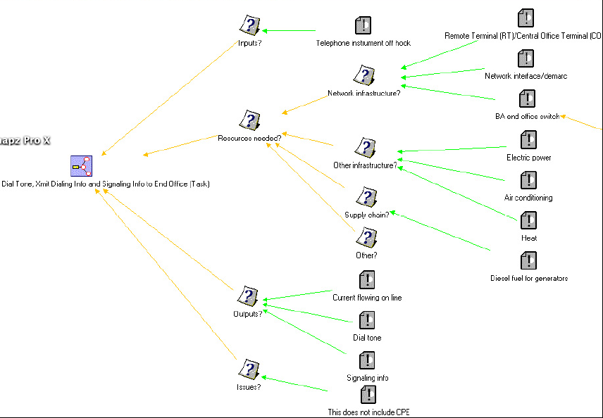
Rapid knowledge construction: Model

Slide 37
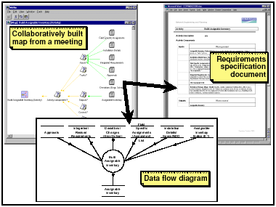
Rapid knowledge construction: Process example

Slide 38
Rapid knowledge Construction: Experiences
Context
Several industrial case studies, including Y2K contingency planning at Bell Atlantic
Results
Increased meeting efficiency (templates are reused)
Knowledge reused for other tasks

Slide 39
Summary
Rationale can be used in project management
To build consensus (WinWin)
To ensure quality (NFR Framework)
To elicit knowledge (Compendium)
Other applications include
Risk management
Change management
Process improvement
Open issues
Tool support
User acceptance

