Slide 1
“Information Security through Steganography”
Hafiz Haseeb Ahmad Butt (313193)
Sanaullah (294942)

Slide 2
WHAT IS STEGANOGRAPHY?
SECURITY
Steganography is the art of writing hidden messages such a way that no one, apart from sender and recipient, suspects the existence of the message, a form of security through obscurity.
The word steganography is of Greek origin and means “concealed writing” from the Greek words steganos meaning “covered”, and graphein meaning “writing”
“Steganography means hiding one piece of data within another."

Slide 3

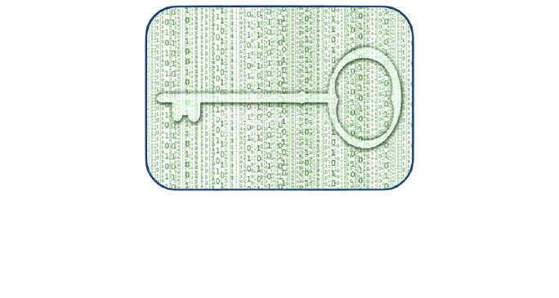
STEGANOGRAPHY v/s CRYPTOGRAPHY
Steganography
Cryptography
Unknown messages passing.
Little known technology.
Technology still being develop for certain formats.
Steganography does not alter the structure of the secret messages.
Known message passing.
Common technology.
Most algorithm known by all.
Cryptography alter the structure of the secret message.

Slide 4
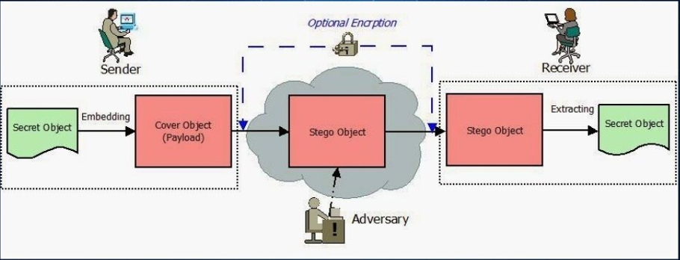
BASIC STEGANOGRAPHY MODEL

Slide 5
Proposed Methodology
We are implementing steganography by first encrypting the input data. This is done by changing the bits of passed message.
Complete hierarchy is explained on next slides.

Slide 6
Program Flow Diagram
Audio File
Text
Audio/Text File,
Image File
Text File
Image
Separate Characters
Embedding
Stego Object

Slide 7
Embedding
Character
12 Bits Conversion
Dividing in 3 Segments and Swapping 1st and Last Segment
Even to Odd Conversion
Pixels
8 Bits
Embedding in Last 4 Bits
Output Image

Slide 8
Extraction
Image
Inverse Embedding
Text File
Text File
Audio File

Slide 9
THE END
Thank You!

