Slide 1
WebAPI
Haseeb Ahmed

Slide 2
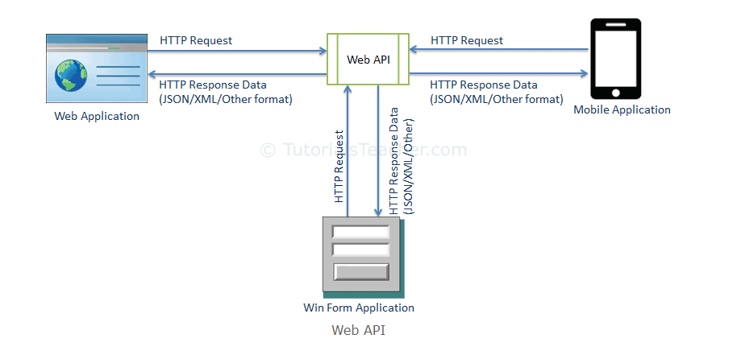
What is ASP.NET WebAPI?
The ASP.NET Web API is an extensible framework for building HTTP based services that can be accessed in different applications on different platforms such as web, windows, mobile etc.

Slide 3
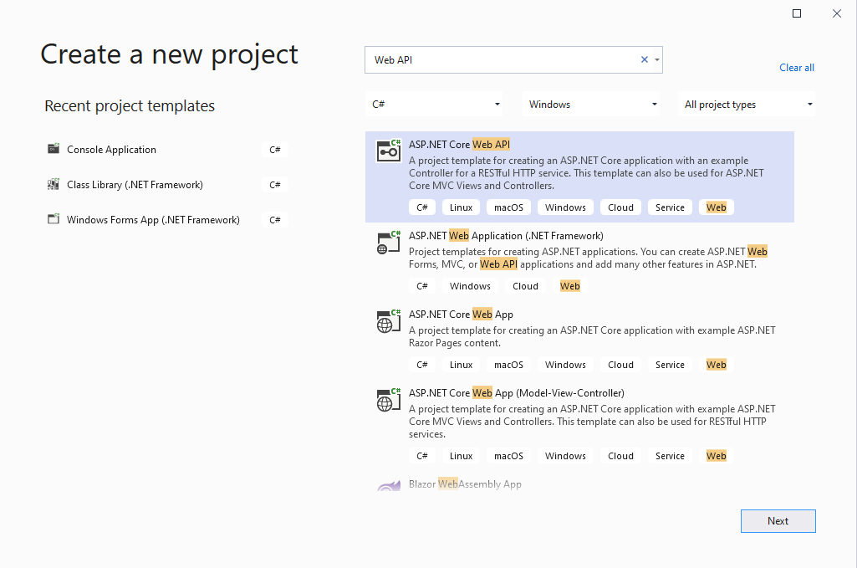
Visual Studio 2019
Create a new project using ASP.NET CORE WebAPI

Slide 4
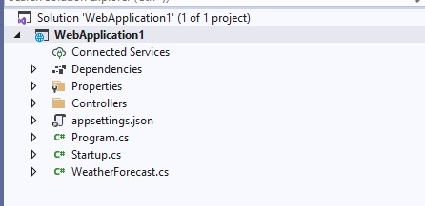
Default Solution Structure

Slide 5
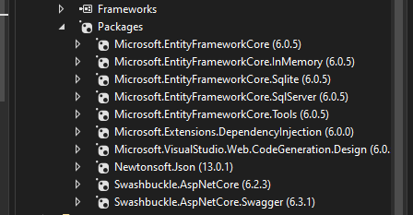
Add these packages using Nuget Package Manager

Slide 6

Steps for WebAPI
Add New folder named as Data.
Add New folder named as Models in the Data folder.
Add New folder named as Services in the Data folder.
Add New folder named as ViewModels in the Data folder.

Slide 7
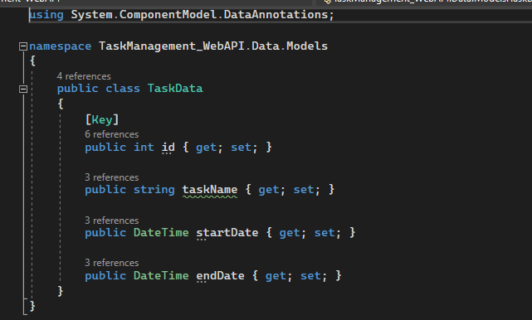
Steps for WebAPI (Cont.)
Create a class in the Model folder named as TaskData.
[Key] is the annotation tag for Primary Key in the table.
By default, EF use id property as Primary Key.

Slide 8
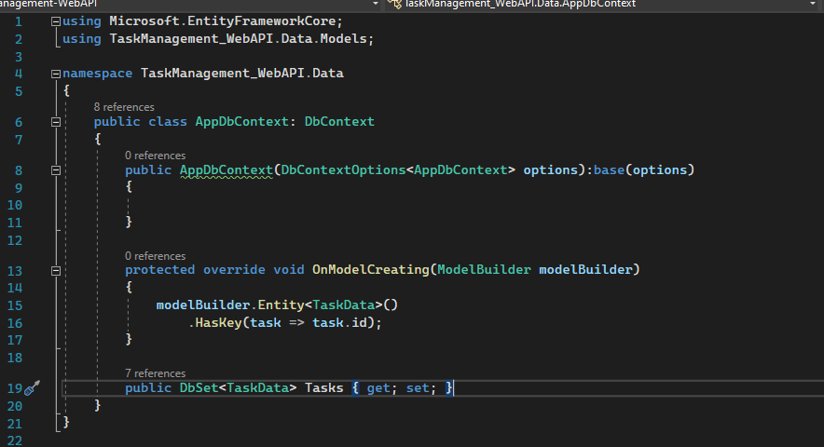
Steps for WebAPI (Cont.)
Create a class in the Data folder named as AppDbContext.cs
Inherit the class with DbContext.
Add following parameter DbContextOptions<AppDbContext> options in constructor and inherit with base(options).
Create override of OnModelCreating method in which we used to add the complex relationships i-e Many to Many.
Declare your table name with
public DbSet<TaskData> Tasks { get; set; }

Slide 9
Connection Strings
We will be working with SQLLite DB.
Add this type of Connection String where you have placed your DB.

Slide 10
SQLLite
We will be working with SQLLite DB.
Add this type of Connection String where you have placed your DB.
Configure your connection with SQLLite DB in Program.cs.

Slide 11
Migrations
Open Package Manager Console
Run this command “Add-Migration InitialMigration”
Once migration is added, update the database using “update-database”
Open SQLLite DB and see that your table will be created with the name mentioned in Slide 8.

Slide 12
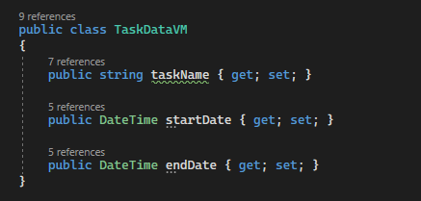
ViewModel
Same as model but a bit different. This class includes only those parameters or field that you would like to show to the user.
Add TaskDataVM class in ViewModels folder.
We will be using this Create and Update actions.

Slide 13
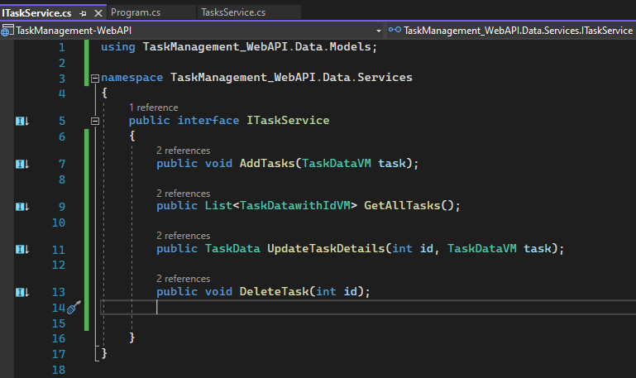
CRUD Operations
Add an interface with named “ITaskService” in the services folder and add your methods definition for CRUD operation.
C -> Create
R -> Read
U -> Update
D -> Delete

Slide 14
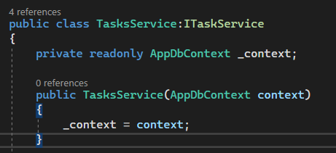
CRUD Operations (Cont.)
We have added CRUD methods definitions in the ITaskService interface.
Now time to add implementation for those methods.
Add a class with name “TaskService” and inherit “ITaskService” with that class.
Inject AppDbContext in the TaskService.

Slide 15
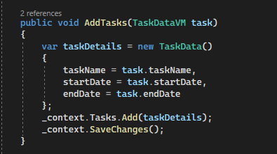
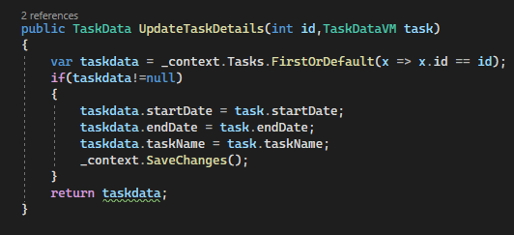
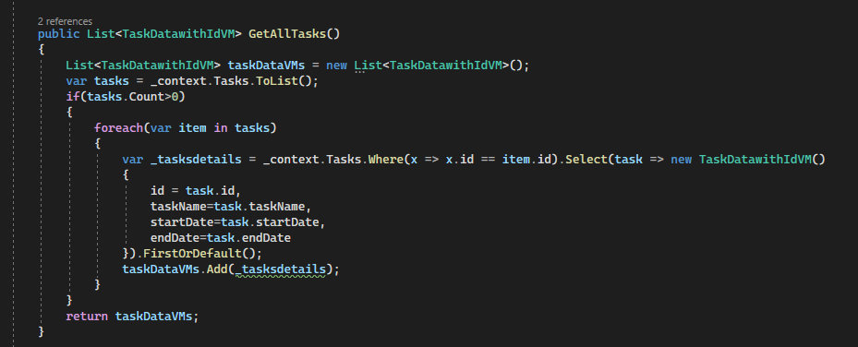
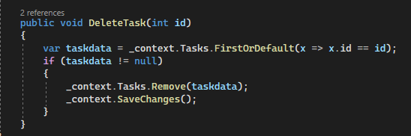
CRUD Operations (Cont.)
C -> Create
U -> Update
R -> Read
D -> Delete

Slide 16
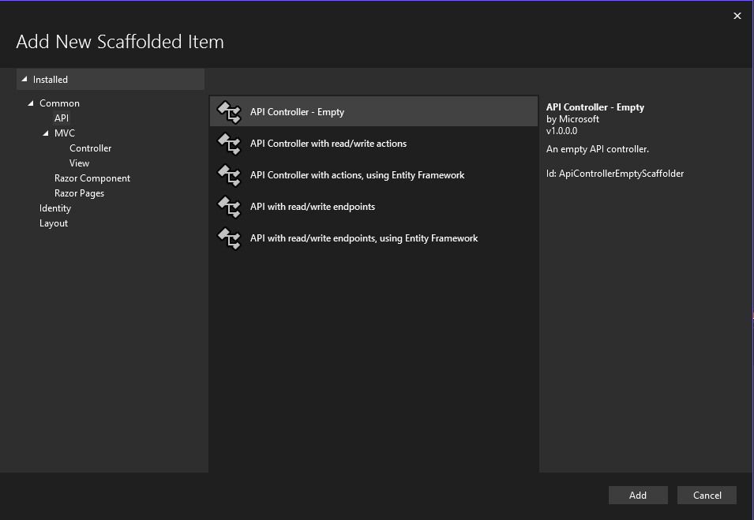
Controllers
Controllers are the endpoints, by which you will be performing CRUD operations.
Add a controller using Add->Controller-> API Controller Empty

Slide 17
Controllers
Controllers are the endpoints, by which you will be performing CRUD operations.
Add a controller using Add->Controller-> API Controller Empty.
C -> [HttpPost]
R -> [HttpGet]
U -> [HttpPut]
D -> [HttpDelete]

Slide 18
Manjan Sellers
Join my f****** youtube channel for more details

Slide 19
Manjan Sellers
Join my f****** youtube channel for more details

Slide 20
Manjan Sellers
Join my f****** youtube channel for more details

Slide 21
Manjan Sellers
Join my f****** youtube channel for more details

Slide 22
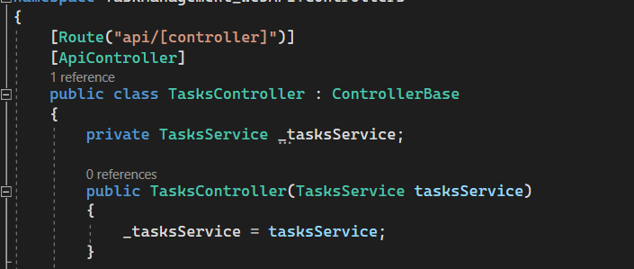
Service Injection into Controller

Slide 23
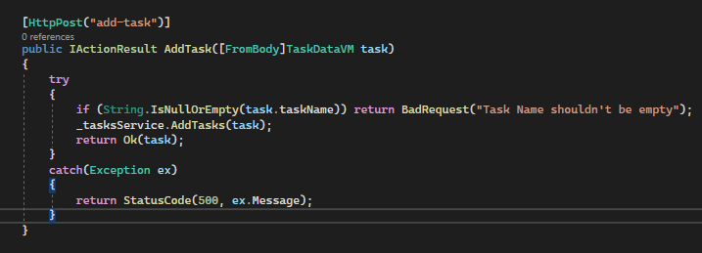
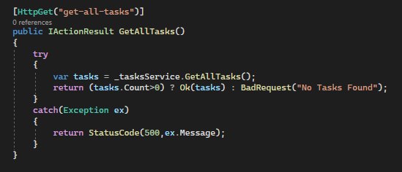
CRUD in Controllers
C -> Create
R -> Read

Slide 24
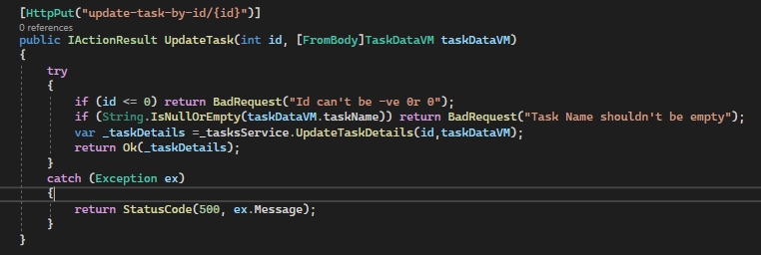
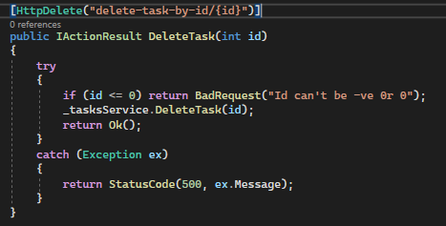
CRUD in Controllers
U -> Update
D -> Delete

Slide 25
GitHub
U -> Update

Slide 26
Thank you!

