Slide 1
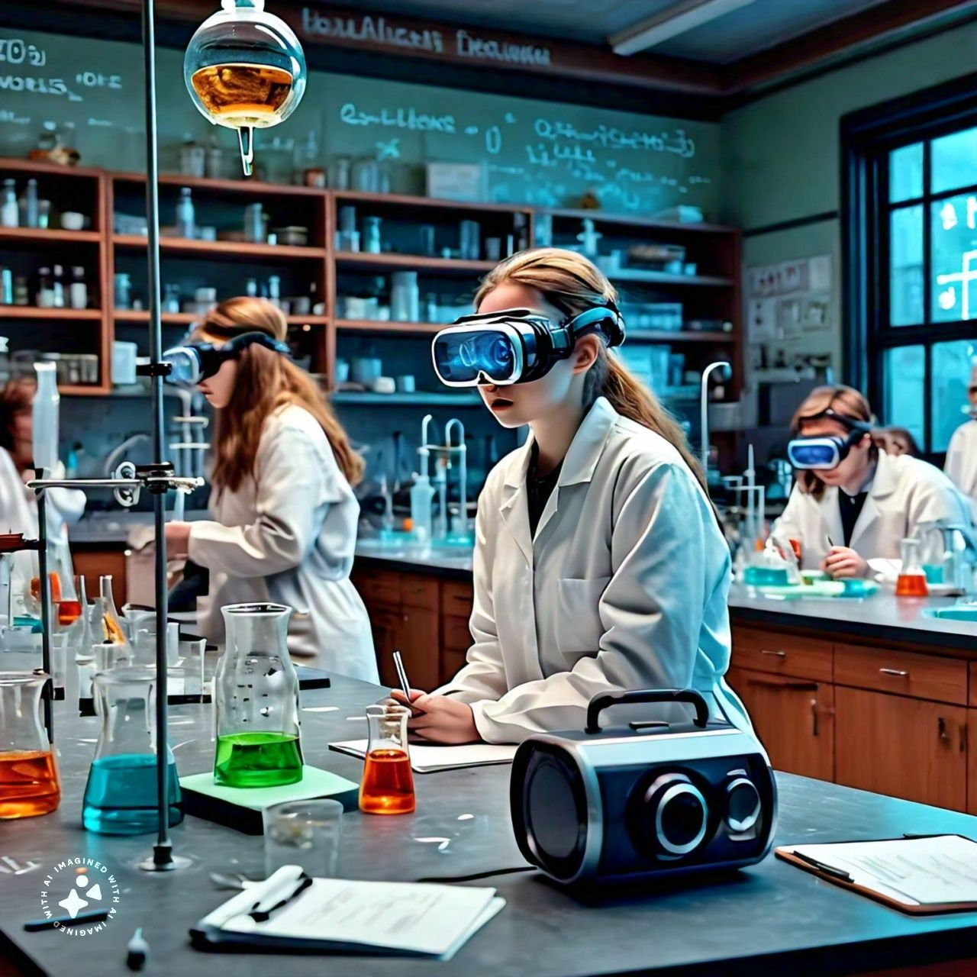

STEMxVR

Slide 2
Team Members
2021685 Ms. Urooj Akmal
2021578 Mr. Sermad Mehdi
2021623 Mr. Syed Ibrahim Hamza
2021389 Mr. Muhammad Haseeb Ishaq
Supervisor Co-Supervisor
Dr. Salman Ahmed Dr. Muhammad Hanif
Faculty of Computer Sciences and Engineering Ghulam Ishaq Khan Institute of Engineering Sciences and Technology, Pakistan

Slide 3
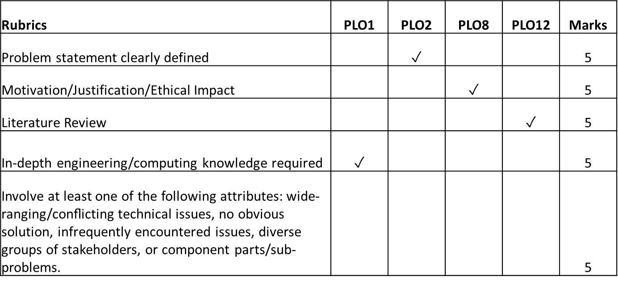
Evaluation Criteria

Slide 4
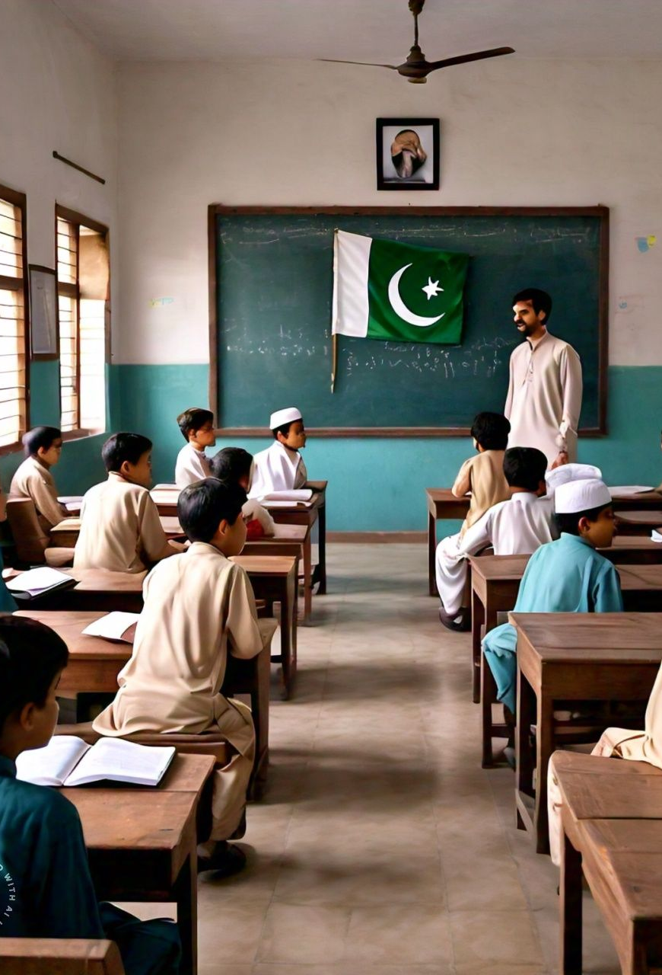
Problem Statement
Challenges in Pakistani High School Education
Cost Effectiveness: Setting up and maintaining physical labs with expensive equipment is financially burdensome for schools.
Safety Concerns: Experiments involve risks requiring investment in safety gear and training, limiting the range of experiments.
Limited Equipment Access: Many schools cannot afford specialized equipment, restricting the variety of experiments.
Engagement and Understanding: Memorization limits students' conceptual understanding and engagement in learning.

Slide 5
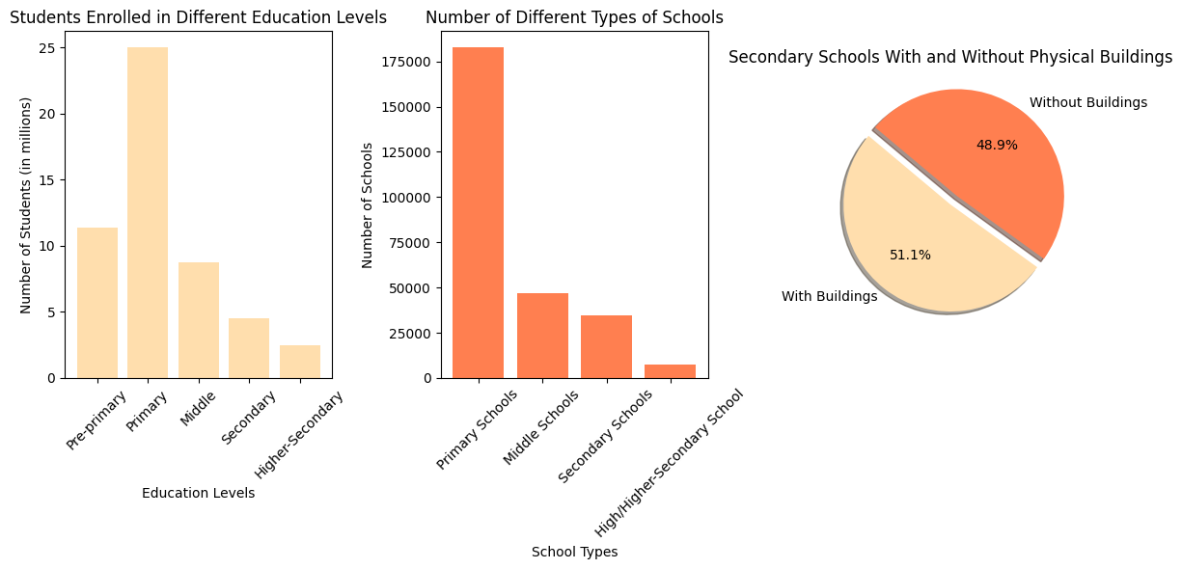
Statistic

Slide 6

Motivation
Empowering Access: VR breaks barriers, providing lab experiences to all students.
Ensuring Safety: Students conduct experiments in a risk-free virtual environment.
Fostering Engagement: VR offers an immersive, interactive learning experience.
Cost Effective: VR labs are more affordable.
Future Potential: Inspires a new generation of scientists and innovators in Pakistan.

Slide 7
App Name | Details
MEL VR Science Simulations | Developed by MEL Science, based in London, United Kingdom.
 | Specializing in providing interactive science education resources.
 | Offers a range of educational products including VR simulations and online resources.
HoloLAB Champions | Developed by Schell Games, a game development studio based in Pittsburgh, Pennsylvania.
 | Known for creating immersive and educational gaming experiences across various platforms.
 | HoloLAB Champions is one of their ventures into educational VR gaming, emphasizing safety and procedural knowledge in science labs.
VR Lab Academy | Originated from Virtual Reality in Education, a development group focusing on creating immersive educational experiences.
 | Designed to supplement real life lab experiences and enhance theoretical understanding through immersive simulations.
 | Aims to bridge the gap between traditional classroom learning and virtual reality technology.
Literature Review

Slide 8
Computing Knowledge
Category | Software/Tools
A. Environment Setup | Unity or Unreal Engine (primary development platform)
 | Blender or Maya (for 3D modeling)
B. Experiment Creation | C# (for Unity)
 | Blueprint or C++ (for Unreal Engine)
 | Substance Painter (for texturing)
 | Audacity (for sound effects)
C. Safety and Feedback System | Unity/Unreal scripting
 | JSON or XML (for configuration files)
D. Development Hardware | Processor : Intel i7 or higher, AMD Ryzen 7 or higher
 | Meta Quest 2, price of 90,000 PKR
E. Deployment | Oculus SDK
F. Version Control | Gitlab/ GitHub

Slide 9
Attribute and Justification
No Obvious Solution
In Pakistan, schools lack labs due to financial and safety issues, with no clear solution. Our project aims to provide a safe, affordable VR platform for immersive chemistry experiments, aiming to boost engagement and understanding, especially in underfunded areas.

Slide 10
Tentative Execution Plan
Semester 1: Planning and Initial Development | Semester 2: Refinement and Deployment
Project kickoff and research | Feature development
Requirement analysis and design | Testing and evaluation
Prototype development | Finalization and deployment

Slide 11
References
https://www.unesco.org/en
https://www.trade.gov/
https://www.vrlabacademy.com/
https://melscience.com/US-en/vr/
https://hundred.org/en/innovations/hololab-champions

Slide 12

Thank You Any Questions?

