Slide 1
Sequence Labeling
Asim Karim @ LUMS

Slide 2
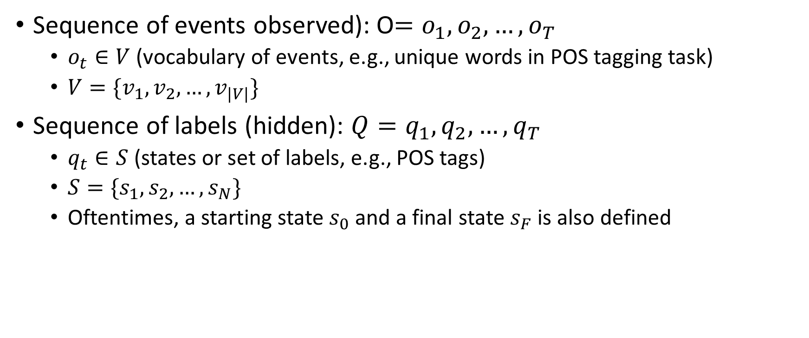
Problem Setting
Sequence of events observed): O$=o_{1},o_{2},…,o_{T}$
$o_{t}∈V$ (vocabulary of events, e.g., unique words in POS tagging task)
$V=\{v_{1},v_{2},…,v_{|V|}\}$
Sequence of labels (hidden): $Q=q_{1},q_{2},…,q_{T}$
$q_{t}∈S$ (states or set of labels, e.g., POS tags)
$S=\{s_{1},s_{2},…,s_{N}\}$
Oftentimes, a starting state $s_{0}$ and a final state $s_{F}$ is also defined

Slide 3

Probabilistic Model
The joint probability distribution $P(O,Q)$ completely defines the model
Generative model, i.i.d. samples from it will generate data comprising of sequence $O$ with corresponding sequence $Q$
If $P(O,Q)$ is known then various problems/tasks can be solved

Slide 4
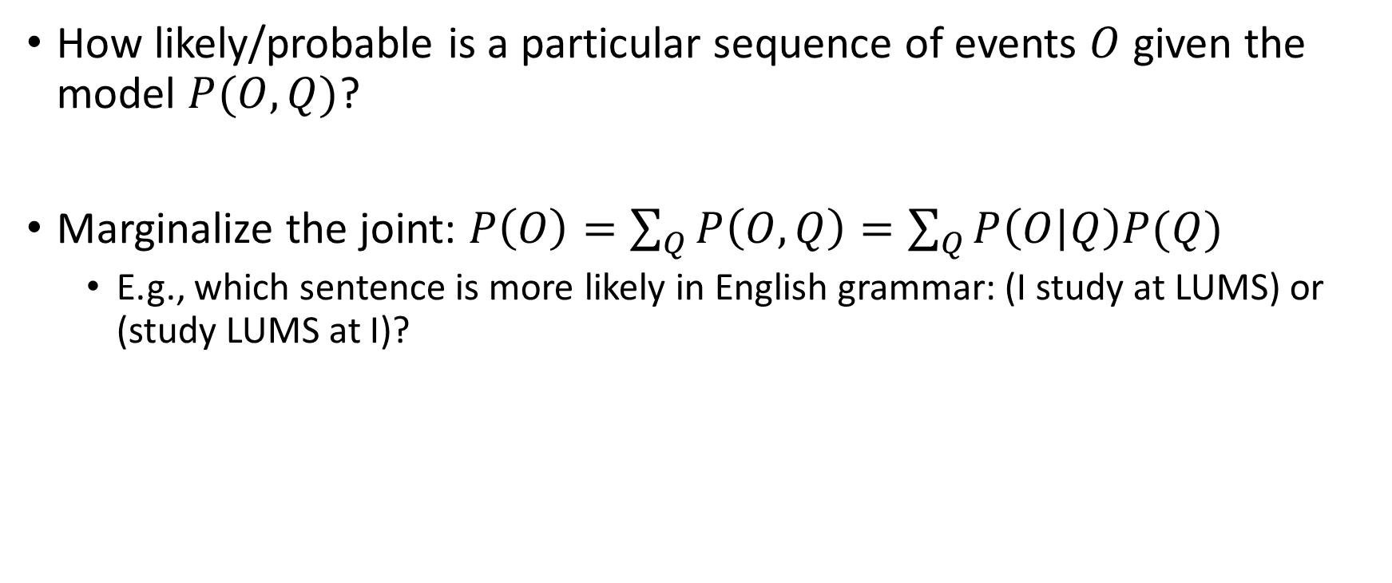
Problem 1: Likelihood
How likely/probable is a particular sequence of events $O$ given the model $P(O,Q)$?
Marginalize the joint: $P\left(O\right)=\sum_{Q}{P\left(O,Q\right)=\sum_{Q}{P\left(O | Q\right)P(Q)}}$
E.g., which sentence is more likely in English grammar: (I study at LUMS) or (study LUMS at I)?

Slide 5
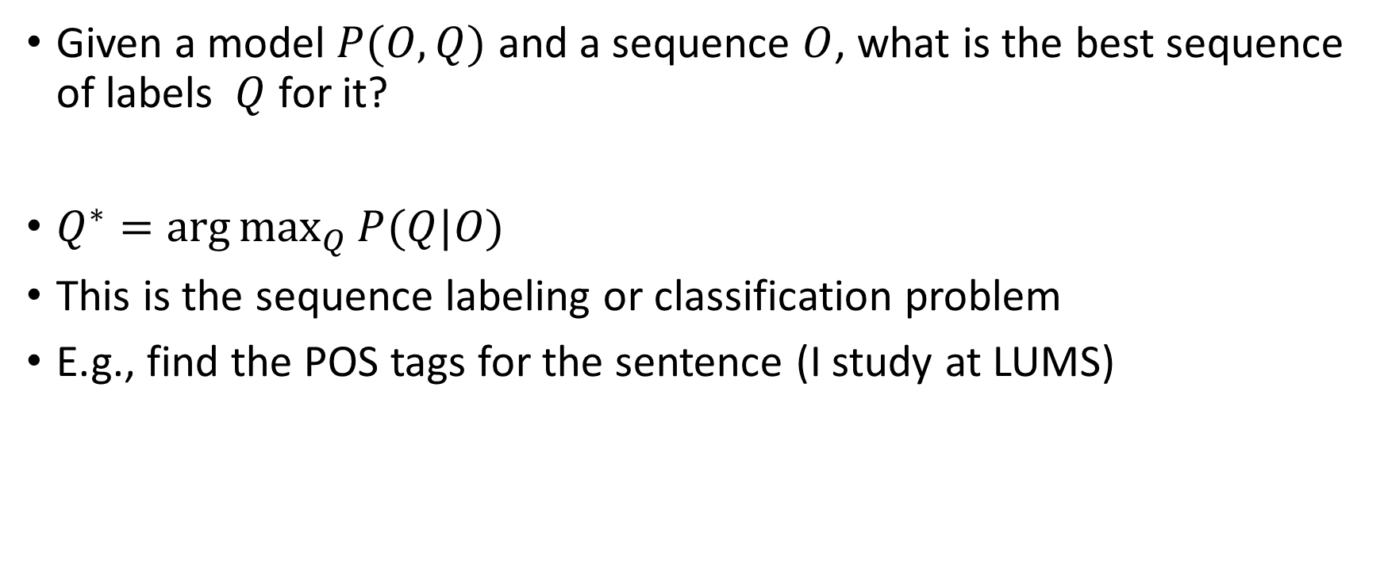
Problem 2: Decoding
Given a model $P(O,Q)$ and a sequence $O$, what is the best sequence of labels $Q$ for it?
$Q^{∗}=\arg{\max_{Q}{P(Q|O)}}$
This is the sequence labeling or classification problem
E.g., find the POS tags for the sentence (I study at LUMS)

Slide 6
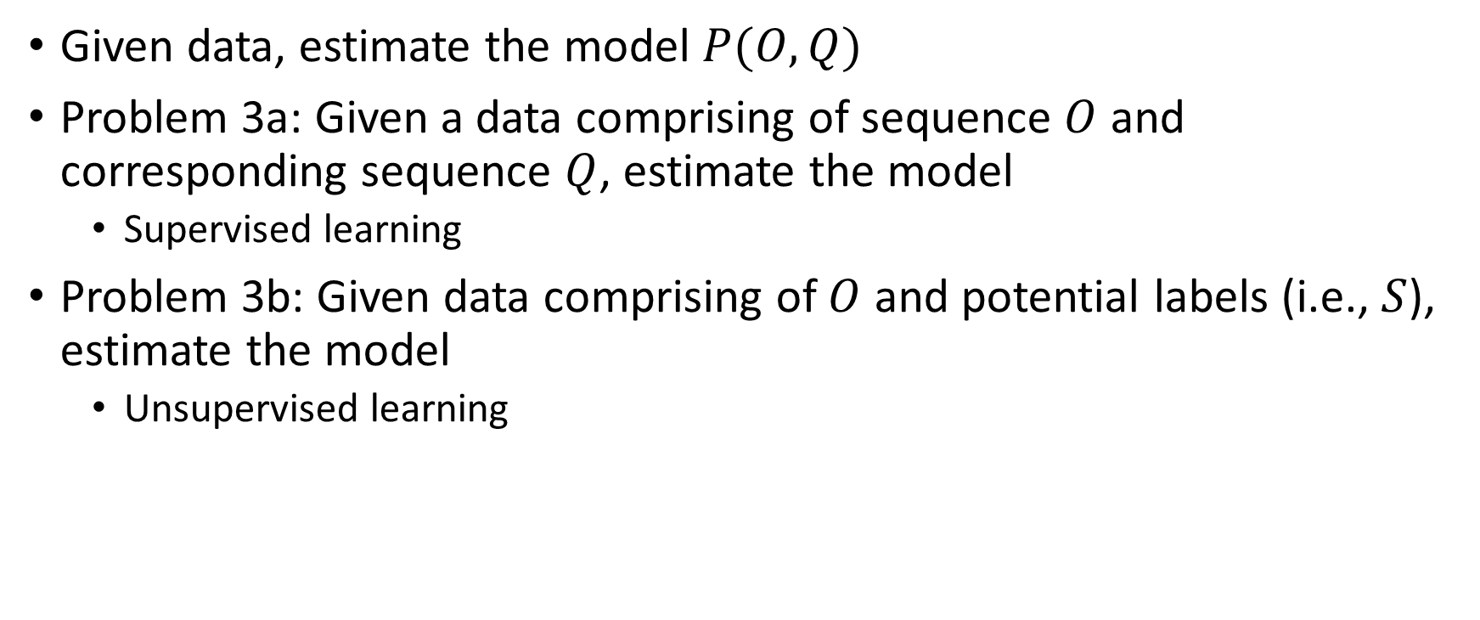
Problem 3: Learning
Given data, estimate the model $P(O,Q)$
Problem 3a: Given a data comprising of sequence $O$ and corresponding sequence $Q$, estimate the model
Supervised learning
Problem 3b: Given data comprising of $O$ and potential labels (i.e., $S$), estimate the model
Unsupervised learning

Slide 7
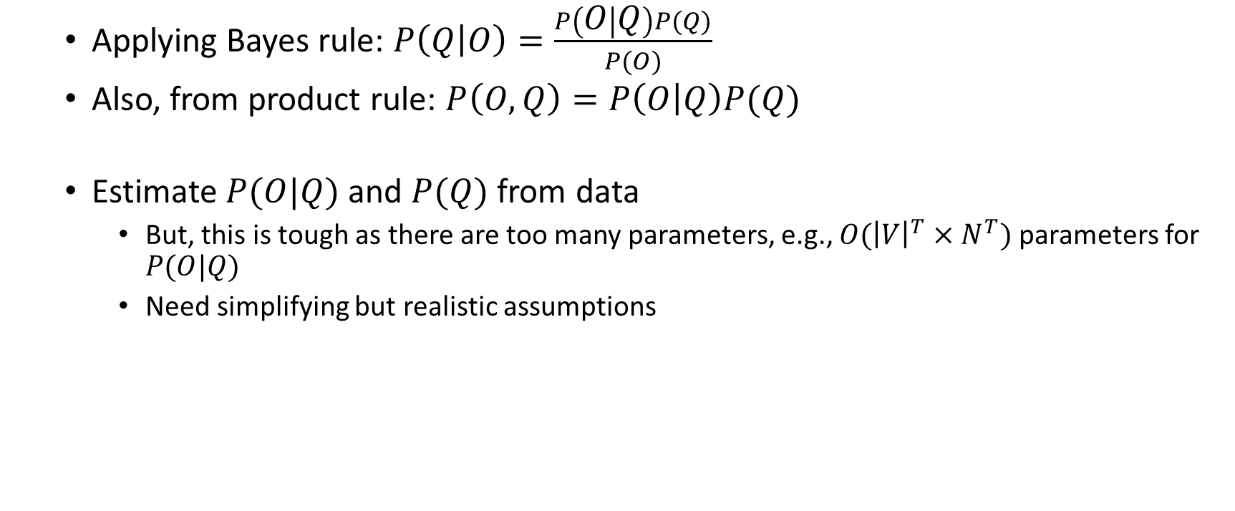
Generative Models
Applying Bayes rule: $P\left(Q | O\right)=\frac{P\left(O | Q\right)P(Q)}{P(O)}$
Also, from product rule: $P\left(O,Q\right)=P\left(O | Q\right)P(Q)$
Estimate $P(O|Q)$ and $P(Q)$ from data
But, this is tough as there are too many parameters, e.g., $O({\left|V\right|}^{T}×N^{T})$ parameters for $P(O|Q)$
Need simplifying but realistic assumptions

Slide 8
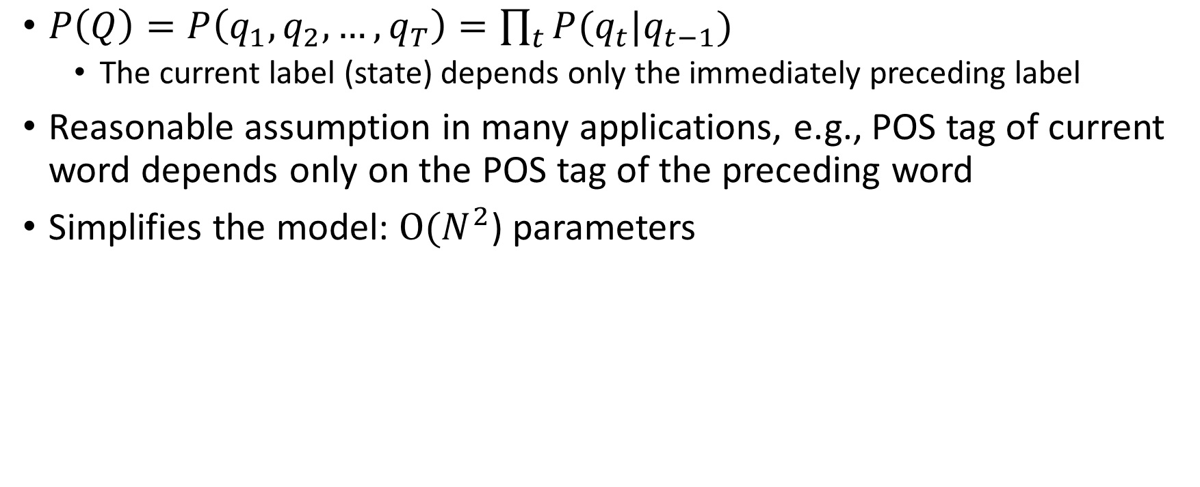
Markovian Assumption
$P\left(Q\right)=P\left(q_{1},q_{2},…,q_{T}\right)=\prod_{t}{P(q_{t}|q_{t−1})}$
The current label (state) depends only the immediately preceding label
Reasonable assumption in many applications, e.g., POS tag of current word depends only on the POS tag of the preceding word
Simplifies the model: $O(N^{2}$) parameters

Slide 9
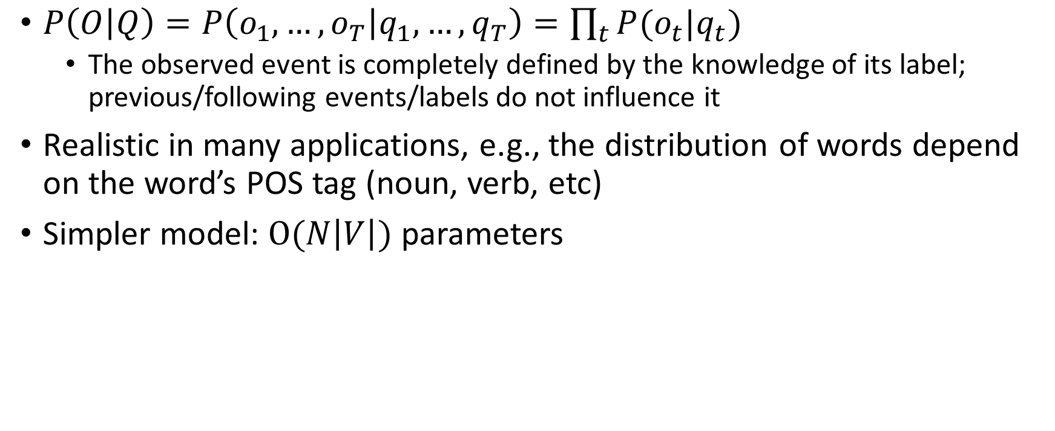
Conditional Independence Assumption
$P\left(O | Q\right)=P\left(o_{1},…,o_{T} | q_{1},…,q_{T}\right)=\prod_{t}{P(o_{t}|q_{t})}$
The observed event is completely defined by the knowledge of its label; previous/following events/labels do not influence it
Realistic in many applications, e.g., the distribution of words depend on the word’s POS tag (noun, verb, etc)
Simpler model: $O(N\left|V\right|)$ parameters

Slide 10
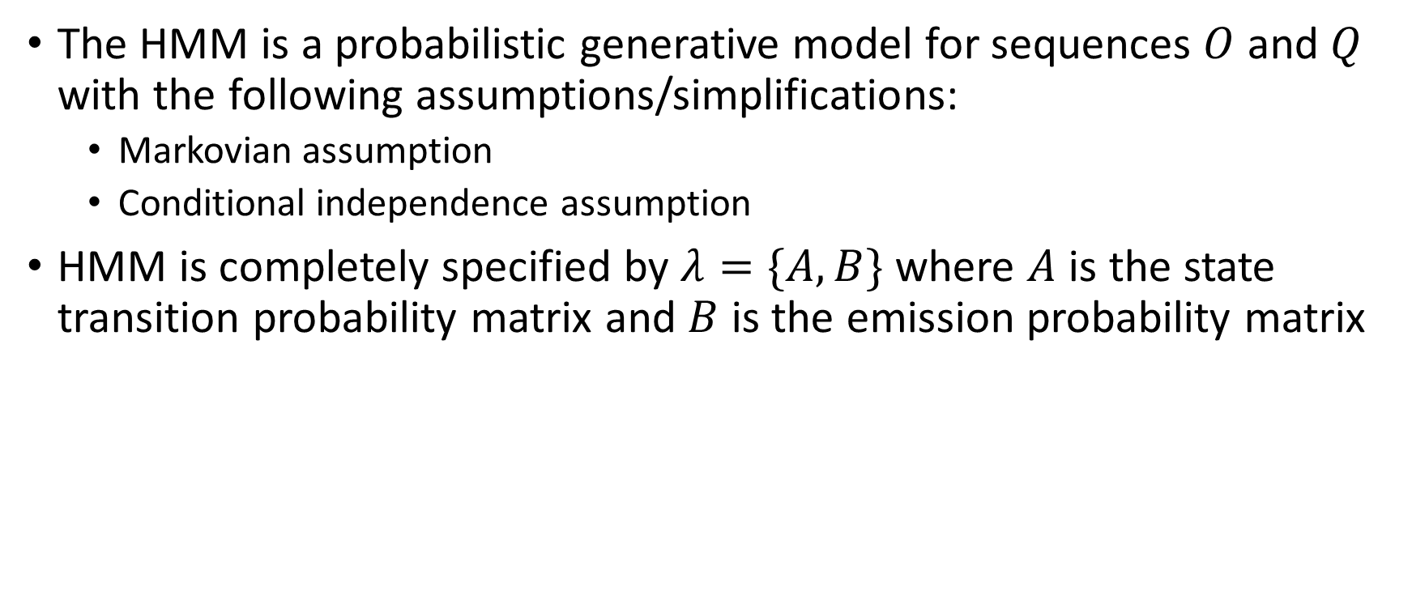
The Hidden Markov Model (HMM)
The HMM is a probabilistic generative model for sequences $O$ and $Q$ with the following assumptions/simplifications:
Markovian assumption
Conditional independence assumption
HMM is completely specified by $λ=\{A,B\}$ where $A$ is the state transition probability matrix and $B$ is the emission probability matrix

Slide 11
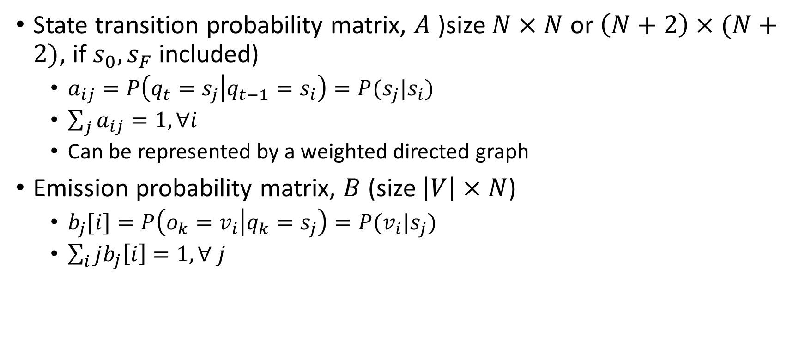
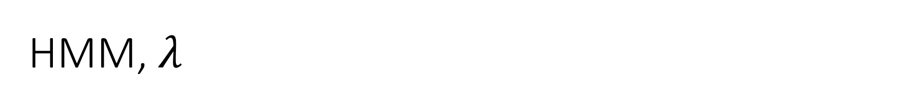
HMM, $λ$
State transition probability matrix, $A$ )size $N×N$ or $\left(N+2\right)×(N+2)$, if $s_{0},s_{F}$ included)
$a_{ij}=P\left(q_{t}=s_{j} | q_{t−1}=s_{i}\right)=P(s_{j}|s_{i})$
$\sum_{j}{a_{ij}=1, ∀i}$
Can be represented by a weighted directed graph
Emission probability matrix, $B$ (size $\left|V\right|×N$)
$b_{j}[i]=P\left(o_{k}=v_{i} | q_{k}=s_{j}\right)=P(v_{i}|s_{j})$
$\sum_{i}{jb_{j}\left[i\right]=1, ∀ j}$

Slide 12
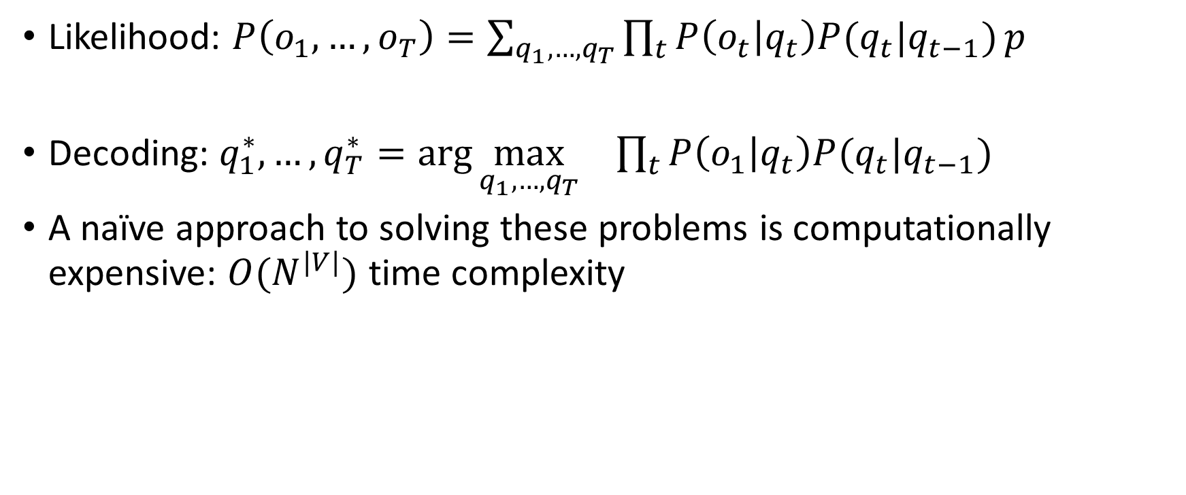
Problems 1 and 2
Likelihood: $P\left(o_{1},…,o_{T}\right)=\sum_{q_{1},…,q_{T}}{\prod_{t}{P\left(o_{t} | q_{t}\right)P(q_{t}|q_{t−1})}}p$
Decoding: $q_{1}^{∗},…,q_{T}^{∗}=\arg{{\max_{q_{1},…,q_{T}}}_{}{\prod_{t}{P\left(o_{1} | q_{t}\right)P(q_{t}|q_{t−1}) }}}$
A naïve approach to solving these problems is computationally expensive: $O(N^{|V|})$ time complexity

Slide 13
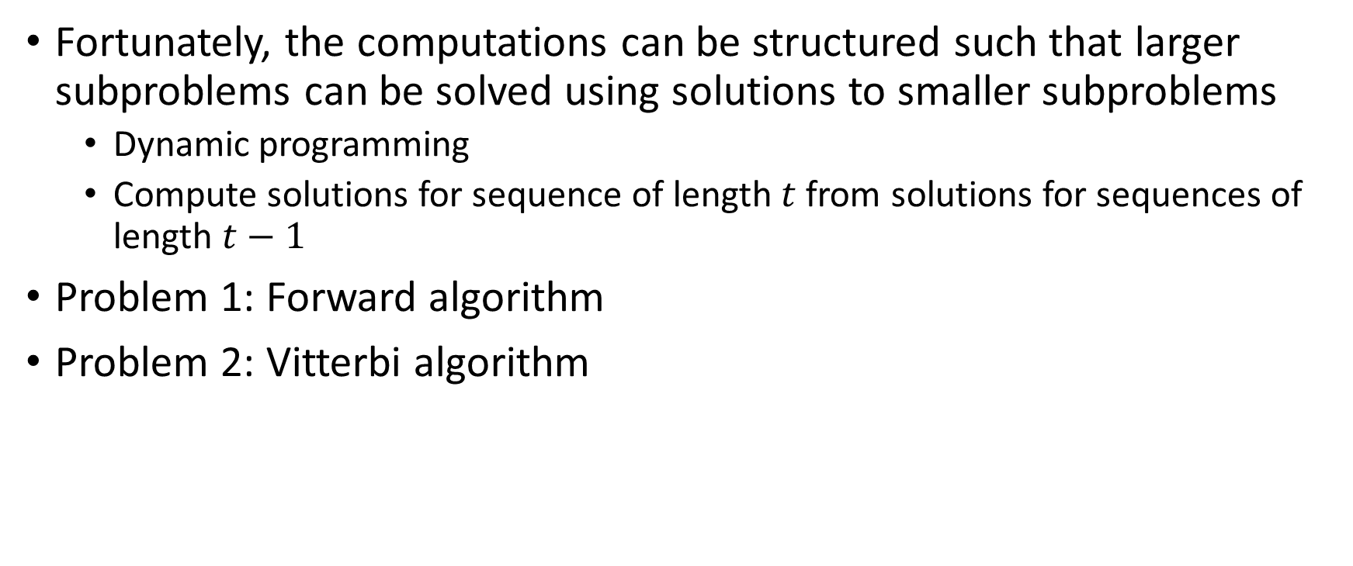
Dynamic Programming
Fortunately, the computations can be structured such that larger subproblems can be solved using solutions to smaller subproblems
Dynamic programming
Compute solutions for sequence of length $t$ from solutions for sequences of length $t−1$
Problem 1: Forward algorithm
Problem 2: Vitterbi algorithm

Slide 14
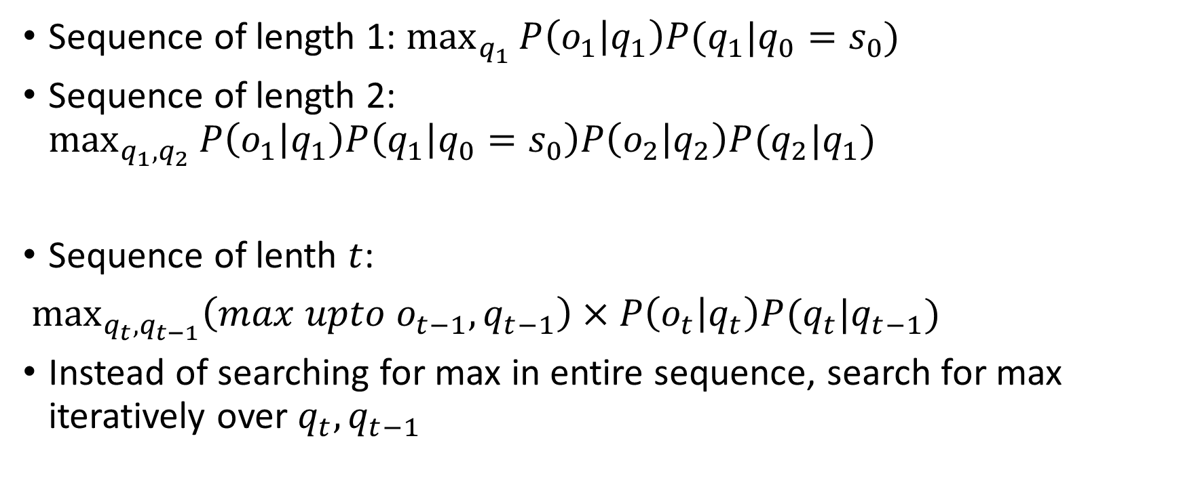
Vitterbi Algorithm: Idea
Sequence of length 1: $\max_{q_{1}}{P\left(o_{1} | q_{1}\right)P(q_{1}|q_{0}=s_{0}) }$
Sequence of length 2: $\max_{q_{1},q_{2}}{P\left(o_{1} | q_{1}\right)P\left(q_{1} | q_{0}=s_{0}\right)P\left(o_{2} | q_{2}\right)P(q_{2}|q_{1}) }$
Sequence of lenth $t$:
$\max_{q_{t},q_{t−1}}\left(max upto o_{t−1},q_{t−1}\right)×P\left(o_{t} | q_{t}\right)P(q_{t}|q_{t−1})$
Instead of searching for max in entire sequence, search for max iteratively over $q_{t},q_{t−1}$

Slide 15
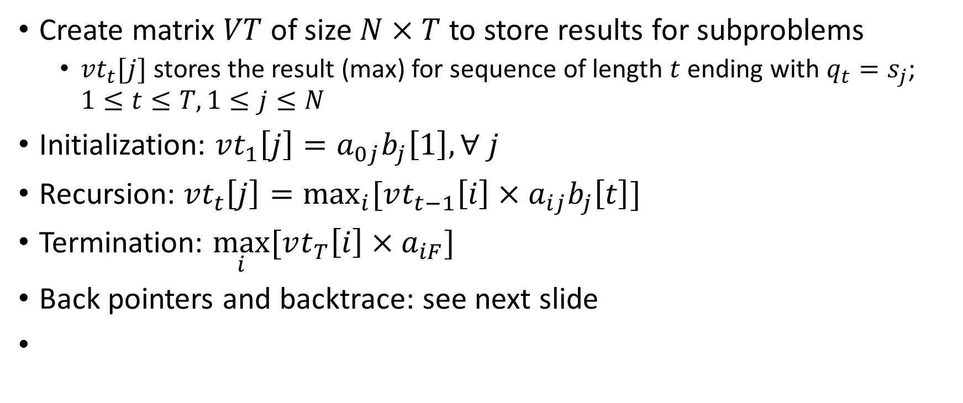
Vitterbi Algorithm
Create matrix $VT$ of size $N×T$ to store results for subproblems
$vt_{t}[j]$ stores the result (max) for sequence of length $t$ ending with $q_{t}=s_{j}$; $1≤t≤T, 1≤j≤N$
Initialization: $vt_{1}\left[j\right]=a_{0j}b_{j}\left[1\right], ∀ j$
Recursion: $vt_{t}\left[j\right]=\max_{i}{[vt_{t−1}\left[i\right]×a_{ij}b_{j}\left[t\right]]}$
Termination: $\max_{i}{[vt_{T}\left[i\right]×a_{iF}]}$
Back pointers and backtrace: see next slide

Slide 16
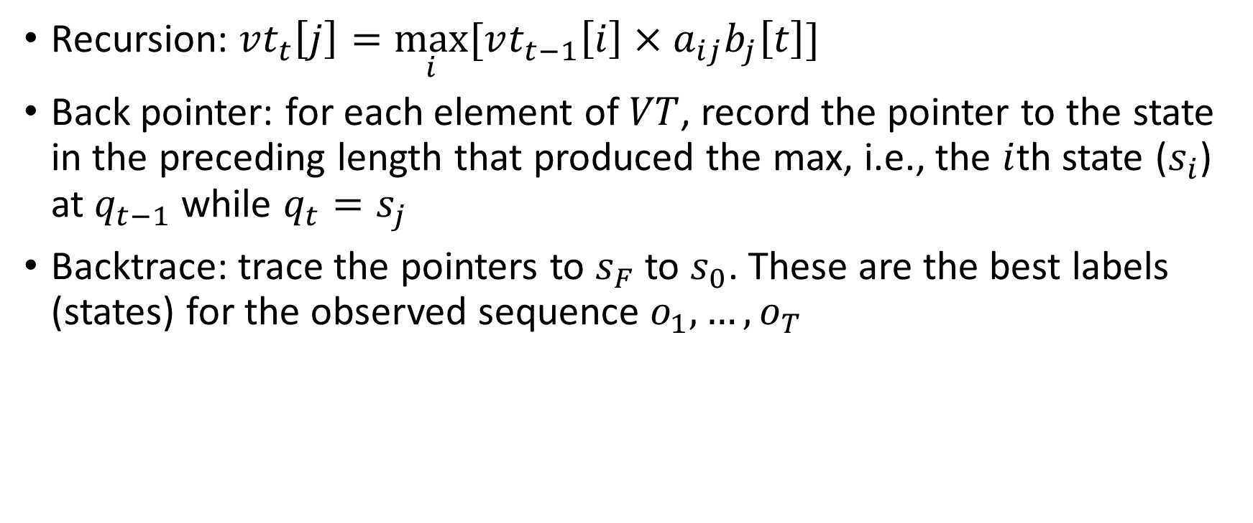
Backtrace
Recursion: $vt_{t}\left[j\right]=\max_{i}{[vt_{t−1}\left[i\right]×a_{ij}b_{j}\left[t\right]]}$
Back pointer: for each element of $VT$, record the pointer to the state in the preceding length that produced the max, i.e., the $i$th state ($s_{i}$) at $q_{t−1}$ while $q_{t}=s_{j}$
Backtrace: trace the pointers to $s_{F}$ to $s_{0}$. These are the best labels (states) for the observed sequence $o_{1},…,o_{T}$

Slide 17
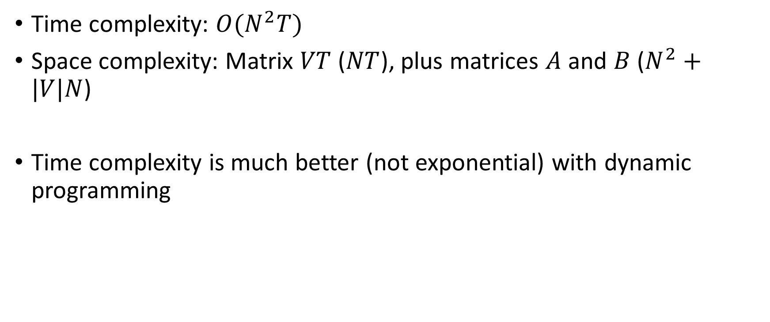
Computational Complexity
Time complexity: $O(N^{2}T)$
Space complexity: Matrix $VT$ ($NT$), plus matrices $A$ and $B$ ($N^{2}+|V|N$)
Time complexity is much better (not exponential) with dynamic programming

Slide 18
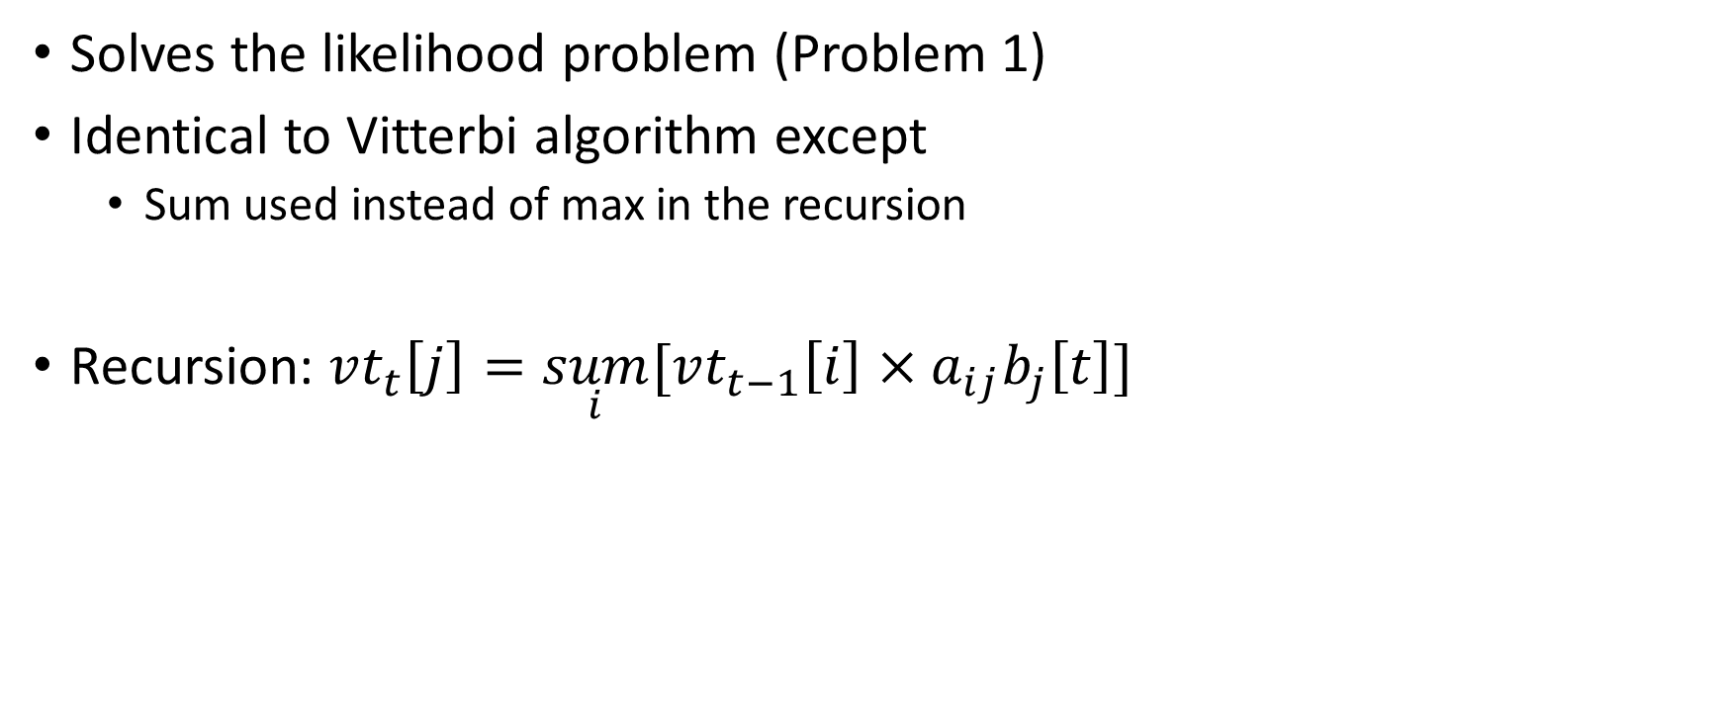
Forward Algorithm
Solves the likelihood problem (Problem 1)
Identical to Vitterbi algorithm except
Sum used instead of max in the recursion
Recursion: $vt_{t}\left[j\right]=\underset{i}{sum}{[vt_{t−1}\left[i\right]×a_{ij}b_{j}\left[t\right]]}$

Slide 19
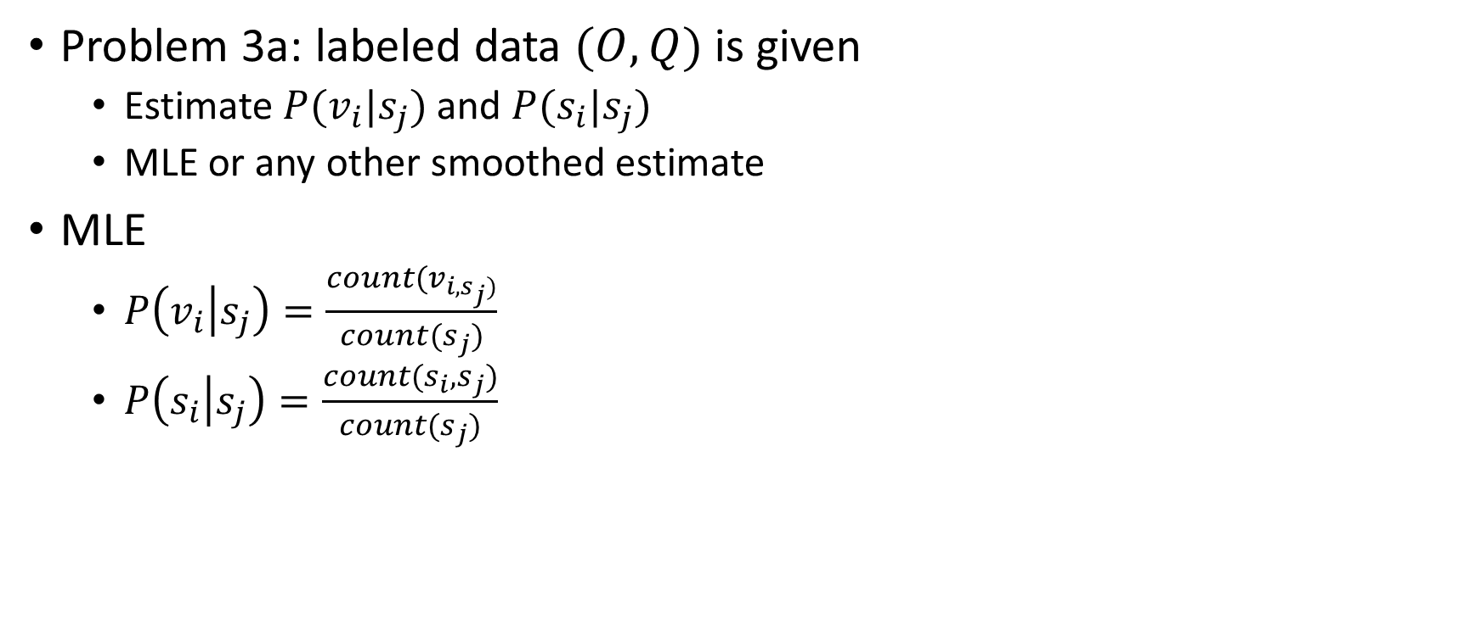
Learning (1)
Problem 3a: labeled data $(O,Q)$ is given
Estimate $P(v_{i}|s_{j})$ and $P(s_{i}|s_{j})$
MLE or any other smoothed estimate
MLE
$P\left(v_{i} | s_{j}\right)=\frac{count(v_{i,s_{j})}}{count(s_{j})}$
$P\left(s_{i} | s_{j}\right)=\frac{count(s_{i},s_{j})}{count(s_{j})}$

Slide 20

Learning (2)
Problem 3b: only $O$ and $S$ is (set of possible states) available
Expectation-Maximization algorithm (EM)
Start with assumed $A,B$ ; estimate $Q$ ; Given $(O,Q)$ re-estimate $A,B$ ; repeat until no change in $Q$ or $A,B$

Slide 21
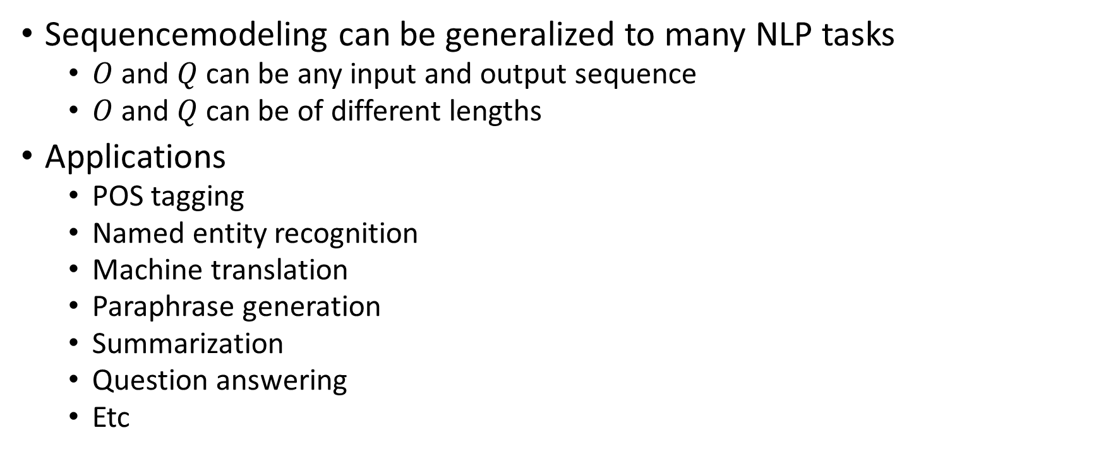
Sequence Modeling Generalization
Sequencemodeling can be generalized to many NLP tasks
$O$ and $Q$ can be any input and output sequence
$O$ and $Q$ can be of different lengths
Applications
POS tagging
Named entity recognition
Machine translation
Paraphrase generation
Summarization
Question answering
Etc

