Slide 1
Introduction to NLP

Slide 2
What is NLP?
Study of computational approaches for processing natural languages
Process → acquire, represent, store, understand, characterize, generate, etc
Natural languages → human languages
Other names
Computational linguistics (CL)
Human language technologies (HLT)
Notes:
This is a test

Slide 3
Question Answering: IBM’s Watson
Won Jeopardy on February 16, 2011!
WILLIAM WILKINSON’S
“AN ACCOUNT OF THE PRINCIPALITIES OF WALLACHIA AND MOLDOVIA”
INSPIRED THIS AUTHOR’S
MOST FAMOUS NOVEL
Bram Stoker
Notes:
Q/A example given

Slide 4
Information Extraction
Subject: curriculum meeting
Date: January 15, 2012
To: Dan Jurafsky
Hi Dan, we’ve now scheduled the curriculum meeting.
It will be in Gates 159 tomorrow from 10:00-11:30.
-Chris
Event: Curriculum mtg
Date: Jan-16-2012
Start: 10:00am
End: 11:30am
Where: Gates 159
Create new Calendar entry

Slide 5

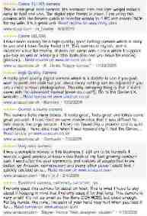
Information Extraction & Sentiment Analysis
Attributes:
zoom
affordability
size and weight
flash
ease of use
Size and weight
✓
nice and compact to carry!
since the camera is small and light, I won't need to carry around those heavy, bulky professional cameras either!
the camera feels flimsy, is plastic and very light in weight you have to be very delicate in the handling of this camera
✓
✗
Notes:
Camera review example
Attributes: size and weight, zoom, flash, ease of use affordability
Positive and negative comments for each attribute

Slide 6
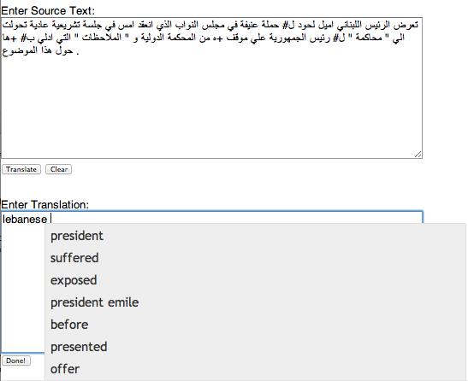
Machine Translation
Helping human translators
Fully automatic
Enter Source Text:
这 不过 是 一 个 时间 的 问题 .
Translation from Stanford’s Phrasal:
This is only a matter of time.
Notes:
Fully automatic (it is only a matter of time)
Helping human translators

Slide 7
Chatbots
Chatbots or conversational agents becoming mainstream for business, entertainment, and social applications
Text-based examples
Pizza Hut, Uber, Nordstrom, etc (https://www.bookingbug.com/blog/three-examples-of-leading-brands-innovating-with-chatbots/)
Speech-based examples
Alexa, Google Assistant, Siri, etc
Chatbot is the UI of the future

Slide 8




Language Technology
making good progress
Sentiment analysis
still really hard
mostly solved
Best roast chicken in San Francisco!
Question answering (QA)
The waiter ignored us for 20 minutes.
Spam detection
Coreference resolution
Q. How effective is ibuprofen in reducing fever in patients with acute febrile illness?
✓
Let’s go to Agra!
Paraphrase
✗
Carter told Mubarak he shouldn’t run again.
Buy V1AGRA …
Word sense disambiguation (WSD)
XYZ acquired ABC yesterday
Part-of-speech (POS) tagging
I need new batteries for my mouse.
ABC has been taken over by XYZ
ADJ ADJ NOUN VERB ADV
Summarization
Colorless green ideas sleep furiously.
Parsing
The Dow Jones is up
Economy is good
I can see Alcatraz from the window!
The S&P500 jumped
Named entity recognition (NER)
Machine translation (MT)
Housing prices rose
PERSON ORG LOC
第13届上海国际电影节开幕…
Dialog
Where is Citizen Kane playing in SF?
Einstein met with UN officials in Princeton
The 13th Shanghai International Film Festival…
Information extraction (IE)
Castro Theatre at 7:30. Do you want a ticket?
You’re invited to our dinner party, Friday May 27 at 8:30
Party May 27 add
Notes:
Mostly solved: spam detection, POS, NE recognition
Making good progress: sentiment analysis, parsing, WSD, MT, coreference resolution, IE
Still really hard: QA, paraphrase, summarization, dialogue

Slide 9
Ambiguity makes NLP hard: “Crash blossoms”
100% REAL
Violinist Linked to JAL Crash Blossoms
Teacher Strikes Idle Kids
Red Tape Holds Up New Bridges
Hospitals Are Sued by 7 Foot Doctors
Juvenile Court to Try Shooting Defendant
Local High School Dropouts Cut in Half

Slide 10
Ambiguity is pervasive
New York Times headline (17 May 2000)
Fed raises interest rates
Fed raises interest rates
Fed raises interest rates 0.5%
Notes:
Fed raises interest rates

Slide 11
Why else is natural language understanding difficult?
non-standard English
segmentation issues
idioms
Great job @justinbieber! Were SOO PROUD of what youve accomplished! U taught us 2 #neversaynever & you yourself should never give up either♥
dark horse
get cold feet
lose face
throw in the towel
the New York-New Haven Railroad
the New York-New Haven Railroad
neologisms
world knowledge
tricky entity names
unfriend
Retweet
bromance
Mary and Sue are sisters.
Mary and Sue are mothers.
Where is A Bug’s Life playing …
Let It Be was recorded …
… a mutation on the for gene …
But that’s what makes it fun!
Notes:
Non standard English
Segmentation issues
Idioms (dark horse, get cold feet)
Neologism (unfriend, retweet, bromance)
World knowledge
Tricky entity names (Where is a Bugs life playing)

Slide 12
Making progress on this problem…
The task is difficult! What tools do we need?
Knowledge about language
Knowledge about the world
A way to combine knowledge sources
How we generally do this:
probabilistic models built from language data
P(“maison” → “house”) high
P(“L’avocat général” → “the general avocado”) low
Luckily, rough text features can often do half the job.

Slide 13
Confluence of Fields
Statistics and probability
Data structures and algorithms
Artificial intelligence / machine learning
Linguistics
Psychology

Slide 14
Skills you’ll need
Simple linear algebra (vectors, matrices)
Basic probability theory
Java or Python programming

Slide 15
Introduction to NLP
What is Natural Language Processing?

