Slide 1
Question Answering
Summarization in Question Answering

Slide 2
Text Summarization
Goal: produce an abridged version of a text that contains information that is important or relevant to a user.
Summarization Applications
outlines or abstracts of any document, article, etc
summaries of email threads
action items from a meeting
simplifying text by compressing sentences

Slide 3
What to summarize? Single vs. multiple documents
Single-document summarization
Given a single document, produce
abstract
outline
headline
Multiple-document summarization
Given a group of documents, produce a gist of the content:
a series of news stories on the same event
a set of web pages about some topic or question

Slide 4
Query-focused Summarization & Generic Summarization
Generic summarization:
Summarize the content of a document
Query-focused summarization:
summarize a document with respect to an information need expressed in a user query.
a kind of complex question answering:
Answer a question by summarizing a document that has the information to construct the answer

Slide 5
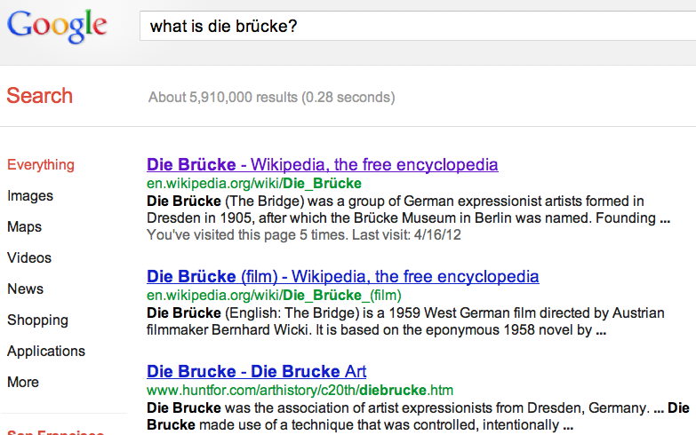
Summarization for Question Answering: Snippets
Create snippets summarizing a web page for a query
Google: 156 characters (about 26 words) plus title and link

Slide 6
Summarization for Question Answering: Multiple documents
Create answers to complex questions summarizing multiple documents.
Instead of giving a snippet for each document
Create a cohesive answer that combines information from each document

Slide 7
Extractive summarization & Abstractive summarization
Extractive summarization:
create the summary from phrases or sentences in the source document(s)
Abstractive summarization:
express the ideas in the source documents using (at least in part) different words

Slide 8
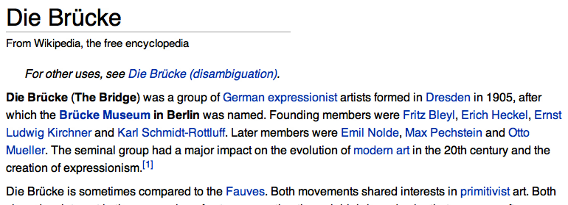
Simple baseline: take the first sentence

Slide 9
Question Answering: End of summarization in QA
Summarization in Question Answering

Slide 10
Question Answering: Start of generating snippets
Generating Snippets and other Single-Document Answers

Slide 11
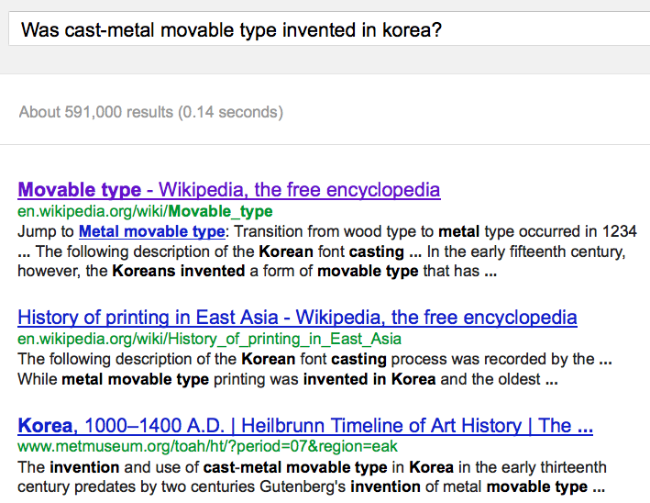
Snippets: query-focused summaries

Slide 12
Summarization: Three Stages
content selection: choose sentences to extract from the document
information ordering: choose an order to place them in the summary
sentence realization: clean up the sentences

Slide 13
Basic Summarization Algorithm
content selection: choose sentences to extract from the document
information ordering: just use document order
sentence realization: keep original sentences

Slide 14
Unsupervised content selection
H. P. Luhn. 1958. The Automatic Creation of Literature Abstracts.
IBM Journal of Research and Development. 2:2, 159-165.
Intuition dating back to Luhn (1958):
Choose sentences that have salient or informative words
Two approaches to defining salient words
tf-idf: weigh each word w_{i} in document j by tf-idf
2. topic signature: choose a smaller set of salient words
mutual information
log-likelihood ratio (LLR) Dunning (1993), Lin and Hovy (2000)

Slide 15
Topic signature-based content selection with queries
Conroy, Schlesinger, and O’Leary 2006
choose words that are informative either
by log-likelihood ratio (LLR)
or by appearing in the query
(could learn more complex weights)
Weigh a sentence (or window) by weight of its words:

Slide 16
Supervised content selection
Given:
a labeled training set of good summaries for each document
Align:
the sentences in the document with sentences in the summary
Extract features
position (first sentence?)
length of sentence
word informativeness, cue phrases
cohesion
Train
Problems:
hard to get labeled training data
alignment difficult
performance not better than unsupervised algorithms
So in practice:
Unsupervised content selection is more common
a binary classifier (put sentence in summary? yes or no)

Slide 17
Question Answering: End of generating snippets
Generating Snippets and other Single-Document Answers

Slide 18
Question Answering: Start of evaluating summaries, ROUGE
Evaluating Summaries: ROUGE

Slide 19
ROUGE (Recall Oriented Understudy for Gisting Evaluation)
Lin and Hovy 2003
Intrinsic metric for automatically evaluating summaries
Based on BLEU (a metric used for machine translation)
Not as good as human evaluation (“Did this answer the user’s question?”)
But much more convenient
Given a document D, and an automatic summary X:
Have N humans produce a set of reference summaries of D
Run system, giving automatic summary X
What percentage of the bigrams from the reference summaries appear in X?

Slide 20
A ROUGE example: Q: “What is water spinach?”
Human 1: Water spinach is a green leafy vegetable grown in the tropics.
Human 2: Water spinach is a semi-aquatic tropical plant grown as a vegetable.
Human 3: Water spinach is a commonly eaten leaf vegetable of Asia.
System answer: Water spinach is a leaf vegetable commonly eaten in tropical areas of Asia.
ROUGE-2 =
3 + 3 + 6
= 12/28 = .43
10 + 9 + 9

Slide 21
Question Answering: End of evaluating summaries, ROUGE
Evaluating Summaries: ROUGE

Slide 22
Question Answering: Start of complex questions: multiple documents
Complex Questions: Summarizing Multiple Documents

Slide 23
Definition questions
Q: What is water spinach?
A: Water spinach (ipomoea aquatica) is a semi-aquatic leafy green plant with long hollow stems and spear- or heart-shaped leaves, widely grown throughout Asia as a leaf vegetable. The leaves and stems are often eaten stir-fried flavored with salt or in soups. Other common names include morning glory vegetable, kangkong (Malay), rau muong (Viet.), ong choi (Cant.), and kong xin cai (Mand.). It is not related to spinach, but is closely related to sweet potato and convolvulus.

Slide 24
Medical questions
Demner-Fushman and Lin (2007)
Q: In children with an acute febrile illness, what is the efficacy of single medication therapy with acetaminophen or ibuprofen in reducing fever?
A: Ibuprofen provided greater temperature decrement and longer duration of antipyresis than acetaminophen when the two drugs were administered in approximately equal doses. (PubMedID: 1621668, Evidence Strength: A)

Slide 25
Other complex questions
Modified from the DUC 2005 competition (Hoa Trang Dang 2005)
How is compost made and used for gardening (including different types of compost, their uses, origins and beneﬁts)?
What causes train wrecks and what can be done to prevent them?
Where have poachers endangered wildlife, what wildlife has been endangered and what steps have been taken to prevent poaching?
What has been the human toll in death or injury of tropical storms in recent years?

Slide 26
Answering harder questions: Query-focused multi-document summarization
The (bottom-up) snippet method
Find a set of relevant documents
Extract informative sentences from the documents
Order and modify the sentences into an answer
The (top-down) information extraction method
build specific answerers for different question types:
definition questions
biography questions
certain medical questions

Slide 27
Query-Focused Multi-Document Summarization

Slide 28
Simplifying sentences
Zajic et al. (2007), Conroy et al. (2006), Vanderwende et al. (2007)
Simplest method: parse sentences, use rules to decide which modifiers to prune
(more recently a wide variety of machine-learning methods)
appositives | Rajam, 28, an artist who was living at the time in Philadelphia, found the inspiration in the back of city magazines.
attribution clauses | Rebels agreed to talks with government officials, international observers said Tuesday.
PPs without named entities | The commercial fishing restrictions in Washington will not be lifted unless the salmon population increases [PP to a sustainable number]]
initial adverbials | “For example”, “On the other hand”, “As a matter of fact”, “At this point”

Slide 29
Maximal Marginal Relevance (MMR)
Jaime Carbonell and Jade Goldstein, The Use of MMR, Diversity-based Reranking for Reordering Documents and Producing Summaries, SIGIR-98
An iterative method for content selection from multiple documents
Iteratively (greedily) choose the best sentence to insert in the summary/answer so far:
Relevant: Maximally relevant to the user’s query
high cosine similarity to the query
Novel: Minimally redundant with the summary/answer so far
low cosine similarity to the summary
Stop when desired length

Slide 30
LLR+MMR: Choosing informative yet non-redundant sentences
One of many ways to combine the intuitions of LLR and MMR:
Score each sentence based on LLR (including query words)
Include the sentence with highest score in the summary.
Iteratively add into the summary high-scoring sentences that are not redundant with summary so far.

Slide 31
Information Ordering
Chronological ordering:
Order sentences by the date of the document (for summarizing news)..
(Barzilay, Elhadad, and McKeown 2002)
Coherence:
Choose orderings that make neighboring sentences similar (by cosine).
Choose orderings in which neighboring sentences discuss the same entity (Barzilay and Lapata 2007)
Topical ordering
Learn the ordering of topics in the source documents

Slide 32
Domain-specific answering: The Information Extraction method
a good biography of a person contains:
a person’s birth/death, fame factor, education, nationality and so on
a good definition contains:
genus or hypernym
The Hajj is a type of ritual
a medical answer about a drug’s use contains:
the problem (the medical condition),
the intervention (the drug or procedure), and
the outcome (the result of the study).

Slide 33
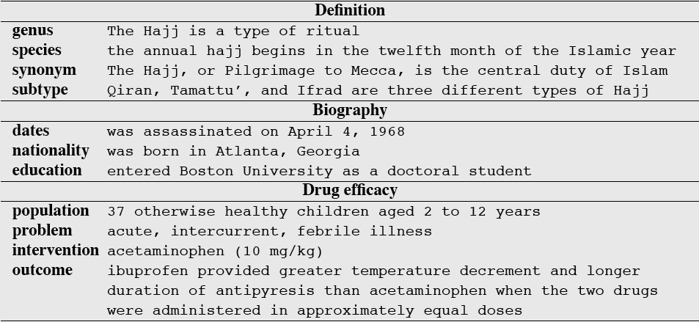
Information that should be in the answer for 3 kinds of questions

Slide 34
Architecture for complex question answering: definition questions
S. Blair-Goldensohn, K. McKeown and A. Schlaikjer. 2004. Answering Definition Questions: A Hybrid Approach.

Slide 35
Question Answering: End of complex questions
Answering Questions by Summarizing Multiple Documents

