Slide 1
Latency Fairness On Commodity Networking Infrastructure
PhD Thesis Defense Muhammad Haseeb (alias: Haseeb Ashfaq)
Advisor: Anirudh Sivaraman
Computer Science Department New York University
Committee: Anirudh Sivaraman, Aurojit Panda, Radhika Mittal Lakshminarayanan Subramanian, Jinyang Li

Slide 2
Can We Achieve
Latency Fairness On Commodity Networking Infrastructure
?

Slide 3
Latency Fairness

Slide 4
Latency Fairness
Server
Latency = x
Machine 1
Machine 2
Machine n

Slide 5
Latency Fairness
Server
Latency = x
x
x
Machine 1
Machine 2
Machine n

Slide 6
Latency Fairness
Server
Latency = x
x
x
Machine 1
Machine 2
Machine n

Slide 7
Latency Fairness
Server
Critical for competitive systems
e.g., financial exchanges, ad exchanges.
Latency = x
x
x
Machine 1
Machine 2
Machine n
Notes:
Not having latency fairness can lead to unwanted unfair competition, users may not come

Slide 8
Latency Fairness
Server
Critical for competitive systems
e.g., financial exchanges, ad exchanges.
Latency = x
x
x
Our Focus
Machine 1
Machine 2
Machine n
Notes:
Not having latency fairness can lead to unwanted unfair competition, users may not come

Slide 9
competitive systems

Slide 10
competitive systems
Two Common Communication Patterns
Outbound Communication
Inbound Communication

Slide 11
competitive systems
Two Common Communication Patterns
Outbound Communication
Inbound Communication
Multicast from server to machines
Unicasts from machines to server

Slide 12
competitive systems
Two Common Communication Patterns
Outbound Communication
Inbound Communication
Multicast from server to machines
Unicasts from machines to server
e.g., market data multicast in financial exchanges
e.g., traders submitting orders to a financial exchange server

Slide 13
competitive systems
Two Common Communication Patterns
Outbound Communication
Inbound Communication
Multicast from server to machines
Unicasts from machines to server
e.g., market data multicast in financial exchanges
e.g., traders submitting orders to a financial exchange server

Slide 14
competitive systems
Two Common Communication Patterns
Outbound Communication
Inbound Communication
Multicast from server to machines
Unicasts from machines to server
e.g., market data multicast in financial exchanges
e.g., traders submitting orders to a financial exchange server
Specialized Infrastructure used by on-premises financial exchanges

Slide 15
competitive systems
Commodity Networking Infrastructure
Two Common Communication Patterns
Outbound Communication
Inbound Communication
Multicast from server to machines
Unicasts from machines to server
e.g., market data multicast in financial exchanges
e.g., traders submitting orders to a financial exchange server
Specialized Infrastructure used by on-premises financial exchanges

Slide 16
Thesis: Latency Fairness
Outbound Communication
Inbound Communication

Slide 17
Thesis: Latency Fairness
Tightly Synchronized Clocks
Outbound Communication
Inbound Communication

Slide 18
Thesis: Latency Fairness
Tightly Synchronized Clocks
Outbound Communication
Inbound Communication
Inbound Communication

Slide 19
Thesis: Latency Fairness
Tightly Synchronized Clocks
Time as a random variable
Outbound Communication
Inbound Communication
Inbound Communication

Slide 20
Thesis: Latency Fairness
Tightly Synchronized Clocks
Time as a random variable
Outbound Communication
Inbound Communication
Inbound Communication
ACM HotNets’25
ACM SIGCOMM’25
Submitted to SIGCOMM’26

Slide 21
Thesis: Latency Fairness
Tightly Synchronized Clocks
Time as a random variable
Outbound Communication
Inbound Communication
Inbound Communication
ACM HotNets’25
ACM SIGCOMM’25
Submitted to SIGCOMM’26
Cited by researchers from Jane Street, Google, Microsoft Research
Considerable interest from Jane Street, working with them to build several systems atop

Slide 22
Thesis: Latency Fairness
Onyx
Tommy
Tightly Synchronized Clocks
Time as a random variable
Outbound Communication
Inbound Communication
Inbound Communication
ACM HotNets’25
ACM SIGCOMM’25
Submitted to SIGCOMM’26
Cited by researchers from Jane Street, Google, Microsoft Research
Considerable interest from Jane Street, working with them to build several systems atop

Slide 23
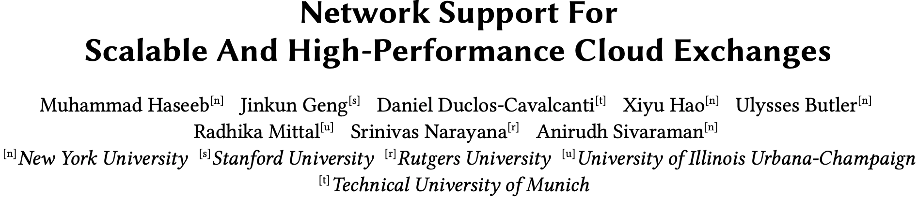
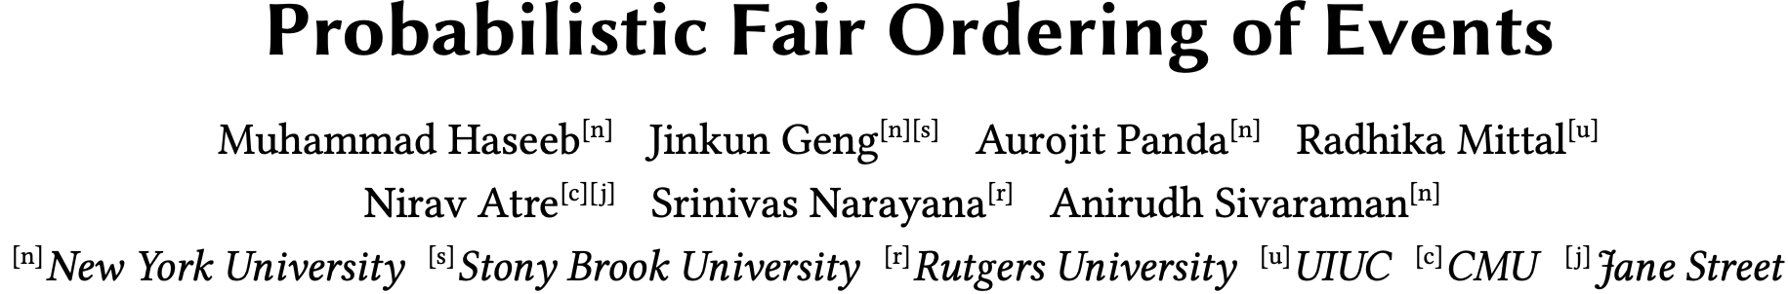
Onyx
Tommy

Slide 25
Network Support For Scalable And High-Performance Cloud Exchanges
Muhammad Haseeb, Jinkun Geng, Daniel Duclos-Cavalcanti, Xiyu Hao, Ulysses Butler, Radhika Mittal, Srinivas Narayana, Anirudh Sivaraman
New York University, Clockwork Inc., Technical University of Munich, Rutgers University, University of Illinois Urbana-Champaign

Slide 26
Primer On Financial Exchanges
Exchange Server
Market Participant 1
Market Participant 2
Market Participant 3

Slide 27
Primer On Financial Exchanges
Exchange Server
Market Participant 1
Market Participant 2
Market Participant 3

Slide 28
Primer On Financial Exchanges
Exchange Server
Market Participant 1
Market Participant 2
Market Participant 3

Slide 29
Primer On Financial Exchanges
Exchange Server
Market Participant 1
Market Participant 2
Market Participant 3

Slide 30
Primer On Financial Exchanges
Exchange Server
Market Participant 1
Market Participant 2
Market Participant 3

Slide 31
Primer On Financial Exchanges
Exchange Server
Market Participant 1
Market Participant 2
Market Participant 3

Slide 32
Primer On Financial Exchanges
Exchange Server
Market Participant 1
Market Participant 2
Market Participant 3

Slide 33
Primer On Financial Exchanges
Exchange Server
Market Participant 1
Market Participant 2
Market Participant 3

Slide 34
Primer On Financial Exchanges
Exchange Server
Market Participant 1
Market Participant 2
Market Participant 3

Slide 35
Primer On Financial Exchanges
Exchange Server
Market Participant 1
Market Participant 2
Market Participant 3

Slide 36
Primer On Financial Exchanges
Exchange Server
Market Participant 1
Market Participant 2
Market Participant 3

Slide 37
Primer On Financial Exchanges
Exchange Server
order closer to mid price → Immediate execution/match
order away from mid price → potential execution/match in future
Position in the queue/price level matters!
Notes:
Price time priority algorithm

Slide 38
Primer On Financial Exchanges
Traditional exchanges built in private data centers or colocation facilities!
Exchange Server
order closer to mid price → Immediate execution/match
Competition Among MPs
order away from mid price → potential execution/match in future
Position in the queue/price level matters!

Slide 39
Can we use the public cloud to build and scale
financial exchanges?

Slide 40
Benefits of Public Cloud for Financial Exchanges
Reducing constraints of physical space around the exchange server
Unprecedented scale – 1000s of traders can be supported
Low barriers to entry for launching new global markets
Various analytics/ML services residing nearby
And typical benefits of cloud: flexible resource allocation, reduced cost, offloading management etc.
There will be trade-offs.
Latencies will be higher.
Fairness guarantees will be coarser.

Slide 41
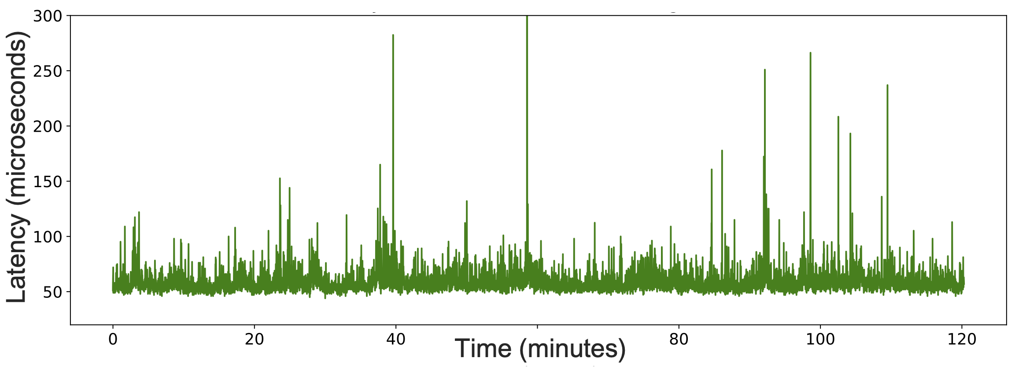
Public Cloud Exhibits High Latency & Variance
Latency varies temporally
Latency varies spatially – across multiple clients
Unfit for fair competition
Onyx: mechanisms to achieve fairness + high performance at scale
Notes:
Will replace png with pdf, somehow adding pdf is making it too heavy for powerpoint to handle.

Slide 42
economy
scalability
10,000 MPs
Web APIs
$16/month/MP
1000 MPs
Onyx
(this work)
$60K/month/MP
100 MPs
On-Prem
~100 ms
± 10 ms
< 100 us
± 1 us
± 10 ns
< 1 us
performance
fairness
Away from center = better

Slide 43
Onyx: Scalable Cloud Financial Exchange
An order submission service which effectively handles bursty traffic while maintaining fairness of competition among the participants
Prototyped on AWS and GCP
Multicast service that disseminates market data to 1000 participants, each receiving a message within 1-microsecond of each other

Slide 44
Onyx
Fairness definitions and relaxation
Scalable outbound fairness
Scalable inbound fairness
A scheduling policy to gracefully handle bursts
Definitions | Outbound | Inbound

Slide 45
Onyx
Fairness definitions and relaxation
Scalable outbound fairness
Scalable inbound fairness
A scheduling policy to gracefully handle bursts
Definitions | Outbound | Inbound

Slide 46
Fairness¹
[1] CloudEx: A Fair-Access Financial Exchange in the Cloud
Outbound Fairness
Inbound Fairness
Definitions | Outbound | Inbound

Slide 47
Fairness¹
[1] CloudEx: A Fair-Access Financial Exchange in the Cloud
Outbound Fairness
Exchange Server
Inbound Fairness
MP1
MP2
MP3
Definitions | Outbound | Inbound

Slide 48
Fairness¹
[1] CloudEx: A Fair-Access Financial Exchange in the Cloud
Outbound Fairness
Exchange Server
Inbound Fairness
MP1
MP2
MP3
Definitions | Outbound | Inbound

Slide 49
Fairness¹
[1] CloudEx: A Fair-Access Financial Exchange in the Cloud
Outbound Fairness
Exchange Server
Inbound Fairness
MP1
MP2
MP3
Definitions | Outbound | Inbound

Slide 50
Fairness¹
[1] CloudEx: A Fair-Access Financial Exchange in the Cloud
Outbound Fairness
Exchange Server
Difference in data reception time for any two participants should be 0
t1
t2
t3
Inbound Fairness
MP1
MP2
MP3
Definitions | Outbound | Inbound

Slide 51
Fairness¹
[1] CloudEx: A Fair-Access Financial Exchange in the Cloud
Exchange Server
Outbound Fairness
Exchange Server
Difference in data reception time for any two participants should be 0
MP1
MP2
MP3
t1
t2
t3
Inbound Fairness
MP1
MP2
MP3
Definitions | Outbound | Inbound

Slide 52
Fairness¹
[1] CloudEx: A Fair-Access Financial Exchange in the Cloud
Exchange Server
Outbound Fairness
Exchange Server
Difference in data reception time for any two participants should be 0
MP1
MP2
MP3
t1
t2
t3
Inbound Fairness
MP1
MP2
MP3
Definitions | Outbound | Inbound

Slide 53
Fairness¹
[1] CloudEx: A Fair-Access Financial Exchange in the Cloud
Exchange Server
Outbound Fairness
Exchange Server
Difference in data reception time for any two participants should be 0
MP1
MP2
MP3
t1
t2
t3
Inbound Fairness
MP1
MP2
MP3
Definitions | Outbound | Inbound

Slide 54
Fairness¹
[1] CloudEx: A Fair-Access Financial Exchange in the Cloud
Exchange Server
Outbound Fairness
Exchange Server
Difference in data reception time for any two participants should be 0
MP1
MP2
MP3
t1
t2
t3
Inbound Fairness
MP1
MP2
MP3
Definitions | Outbound | Inbound

Slide 55
Fairness¹
[1] CloudEx: A Fair-Access Financial Exchange in the Cloud
Exchange Server
Outbound Fairness
Orders should be seen by the exchange in the generation order
Exchange Server
Difference in data reception time for any two participants should be 0
MP1
MP2
MP3
t1
t2
t3
Inbound Fairness
MP1
MP2
MP3
Definitions | Outbound | Inbound

Slide 56
Fairness¹
[1] CloudEx: A Fair-Access Financial Exchange in the Cloud
Outbound Fairness
Difference in data reception time for any two participants should be 0
Orders should be seen by the exchange in the generation order
Inbound Fairness
Definitions | Outbound | Inbound

Slide 57
Fairness In Practice
[1] CloudEx: A Fair-Access Financial Exchange in the Cloud
Outbound Fairness
Difference in data reception time for any two participants should be 0
Orders should be seen by the exchange in the generation order
Inbound Fairness
Definitions | Outbound | Inbound

Slide 58
Fairness In Practice
[1] CloudEx: A Fair-Access Financial Exchange in the Cloud
Outbound Fairness
Difference in data reception time for any two participants should be ~0
Orders should be seen by the exchange in the generation order
Inbound Fairness
Definitions | Outbound | Inbound

Slide 59
Fairness In Practice
[1] CloudEx: A Fair-Access Financial Exchange in the Cloud
Outbound Fairness
Difference in data reception time for any two participants should be ~0
Orders should be seen by the exchange in the timestamped generation order
Inbound Fairness
Achieving fairness while being performant at scale is our goal.
Definitions | Outbound | Inbound

Slide 60
Fairness In Practice
[1] CloudEx: A Fair-Access Financial Exchange in the Cloud
Outbound Fairness
Difference in data reception time for any two participants should be ~0
We target 1000 market participants (MPs). Each MP is a separate VM.
Orders should be seen by the exchange in the timestamped generation order
Inbound Fairness
Achieving fairness while being performant at scale is our goal.
Definitions | Outbound | Inbound

Slide 61
Scalable Outbound Fairness
Fairness achieved by a simple “Hold-and-release” primitive.
Not scalable w.r.t the number of receivers/participants.
Definitions | Outbound | Inbound

Slide 62
Hold-and-release
S
Senders and receivers synchronized to the same clock
Sender attaches deadline to message
Deadline: 0009 | …
0000
0001
0002
0003
0004
0005
0006
0007
0008
0009
Sender multicasts message to all receivers
Deadline: 0009 | …
Deadline: 0009 | …
Deadline: 0009 | …
Deadline: 0009 | …
Deadline: 0009 | …
Messages arrive at unpredictable times
R1
R2
R3
R4
. . . . . . .
Rn
0000
0001
0002
0003
0004
0005
0006
0007
0008
0009
0000
0001
0002
0003
0004
0005
0006
0007
0008
0009
0000
0001
0002
0003
0004
0005
0006
0007
0008
0009
0000
0001
0002
0003
0004
0005
0006
0007
0008
0000
0009
0001
0002
0003
0004
0005
0006
0007
0008
0009
Receiver processes message when deadline is reached on receiver clock
Definitions | Outbound | Inbound
Notes:
We cannot control the arrival time of the messages at each receiver. The messages can arrive at the receivers at unpredictable times.
But since the receivers are sharing the same timeline,
we can make each receiver to hold the messages and process the message at the same time

Slide 63

Scalable Outbound Fairness
Fairness achieved by a simple “hold-and-release” primitive.
We scale it much further by proposing an efficient market data multicast mechanism.
A tree of proxy nodes is utilized that helps scale multicast.
Latency
Fairness
Exchange
But still many venues for latency fluctuations, which hinder latency fairness and increase latency
Definitions | Outbound | Inbound

Slide 64
Scalable Outbound Fairness
Fairness achieved by a simple “hold-and-release” primitive.
We scale it much further by proposing an efficient market data multicast mechanism.
A tree of proxy nodes is utilized that helps scale multicast.
Latency
Fairness
Exchange
Latency Spikes On Links
Proxy node’s performance variation
Receiver VMs’ performance variation
Round Robin Packet Spraying
Proxy Hedging i.e., multiple (H) parents
Two VMs per trader
Definitions | Outbound | Inbound

Slide 65
Scalable Inbound Fairness
Sequencer
Scheduling Policy
Definitions | Outbound | Inbound

Slide 66
Scalable Inbound Fairness
Sequencer
Scheduling Policy
Sequencer
LOQ
Definitions | Outbound | Inbound

Slide 67
Scalable Inbound Fairness
Sequencer
Scheduling Policy
Sequencer
Definitions | Outbound | Inbound
LOQ

Slide 68
A sequencer
Exchange Server
Guarantees that orders are seen by the exchange in non-decreasing order of their (generation) timestamps
Assumes clock synchronization
Strawman: Wait a fixed delay before releasing time-ordered messages to Exchange Server
Latency
Fairness
Participants
Definitions | Outbound | Inbound: Sequencer + LOQ

Slide 69
A sequencer
Can use knowledge of MPs!
Exchange Server
Clients attach message generation timestamps to outgoing messages
Sequencer waits for at least one message from each client
Clients/Participants
2
1
3
Definitions | Outbound | Inbound: Sequencer + LOQ

Slide 70
A sequencer
Can use knowledge of MPs!
Exchange Server
Clients attach message generation timestamps to outgoing messages
Sequencer waits for at least one message from each client
2
Clients/Participants
1
3
Definitions | Outbound | Inbound: Sequencer + LOQ

Slide 71
A sequencer
Can use knowledge of MPs!
Exchange Server
Clients attach message generation timestamps to outgoing messages
Sequencer waits for at least one message from each client
2
1
Clients/Participants
3
Definitions | Outbound | Inbound: Sequencer + LOQ

Slide 72
A sequencer
Can use knowledge of MPs!
Exchange Server
Clients attach message generation timestamps to outgoing messages
Sequencer waits for at least one message from each client
It releases the smallest ts’ message and waits again
3
2
1
Clients/Participants
Definitions | Outbound | Inbound: Sequencer + LOQ
Notes:
Results all for GCP, except AWS TGW >50 % lower latency than the latency provided by AWS TGW

Slide 73
A sequencer
Can use knowledge of MPs!
Exchange Server
Clients attach message generation timestamps to outgoing messages
Sequencer waits for at least one message from each client
1
It releases the smallest ts’ message and waits again
3
2
Clients/Participants
4
Definitions | Outbound | Inbound: Sequencer + LOQ

Slide 74
A sequencer
Can use knowledge of MPs!
Exchange Server
Clients attach message generation timestamps to outgoing messages
Sequencer waits for at least one message from each client
1
It releases the smallest ts’ message and waits again
4
3
2
Clients/Participants
Definitions | Outbound | Inbound: Sequencer + LOQ

Slide 75
A sequencer
Can use knowledge of MPs!
Exchange Server
Clients attach message generation timestamps to outgoing messages
Sequencer waits for at least one message from each client
2
1
It releases the smallest ts’ message and waits again
4
3
Clients/Participants
Definitions | Outbound | Inbound: Sequencer + LOQ

Slide 76
A sequencer
Drawback: liveness (progress) may halt under client failures
Safety (fairness) is guaranteed if clocks are perfectly synchronized
In practice, we ensure that clock synchronization accuracy is sufficiently high compared to the time granularity of interest.
Definitions | Outbound | Inbound: Sequencer + LOQ

Slide 77
Incast Congestion
As the number of clients increase, the incast congestion at the exchange occurs.
We see the opportunity to reuse the multicast tree in the reverse direction to reduce burstiness behavior at the ingress of the exchange.
Clients get partitioned into groups where each leaf proxy node handles a group of clients.
Reduced fan-in at the exchange, leads to lower packet drops.
Enables scheduling of packets at the tree nodes (virtual network nodes) as it moves queues from the exchange ingress to the tree nodes
Definitions | Outbound | Inbound: Sequencer + LOQ

Slide 78
Limit Order Queue
LOQ: A Domain-Specific Scheduling Policy
During bursty market activity, the exchange server may be overwhelmed.
Schedules order in a way to avoid idling the matching engine, using the knowledge that orders are matched by price time priority algorithm
$1
$4
$5
$2
Naively doing such prioritization will not preserve inbound fairness.
Definitions | Outbound | Inbound: Sequencer + LOQ
Notes:
If queues are filled with older and newer orders and we simply prioritize the orders with price closer to the mid-price, it may violate fairness. Perhaps another order in some other queue would have moved mid-price in favor of the order being de-prioritized if everything was FIFO.

Slide 79
Limit Order Queue Preserves Fairness
Exchange
FIFO Fabric
MP1
MP2
MP3
MPn
Definitions | Outbound | Inbound: Sequencer + LOQ
Notes:
Not all orders match immidiately

Slide 80
Limit Order Queue Preserves Fairness
Exchange
FIFO Fabric
MP1
MP2
MP3
MPn
Definitions | Outbound | Inbound: Sequencer + LOQ
Notes:
Not all orders match immidiately

Slide 81
Limit Order Queue Preserves Fairness
Exchange
I_{FIFO}
FIFO Fabric
MP1
MP2
MP3
MPn
Definitions | Outbound | Inbound: Sequencer + LOQ
Notes:
Input sequence

Slide 82
Limit Order Queue Preserves Fairness
S_{FIFO}
Exchange
I_{FIFO}
FIFO Fabric
MP1
MP2
MP3
MPn
Definitions | Outbound | Inbound: Sequencer + LOQ
Notes:
Not all orders match immidiately

Slide 83
Limit Order Queue Preserves Fairness
S_{FIFO}
Exchange
Exchange
I_{FIFO}
FIFO Fabric
LOQ Fabric
MP1
MP2
MP3
MPn
MP1
MP2
MP3
MPn
Definitions | Outbound | Inbound: Sequencer + LOQ
Notes:
Not all orders match immidiately

Slide 84
Limit Order Queue Preserves Fairness
S_{FIFO}
Exchange
Exchange
I_{FIFO}
FIFO Fabric
LOQ Fabric
MP1
MP2
MP3
MPn
MP1
MP2
MP3
MPn
Definitions | Outbound | Inbound: Sequencer + LOQ
Notes:
Not all orders match immidiately

Slide 85
Limit Order Queue Preserves Fairness
S_{FIFO}
Exchange
Exchange
I_{FIFO}
FIFO Fabric
LOQ Fabric
MP1
MP2
MP3
MPn
MP1
MP2
MP3
MPn
Definitions | Outbound | Inbound: Sequencer + LOQ
Notes:
Not all orders match immidiately

Slide 86
Limit Order Queue Preserves Fairness
S_{FIFO}
Exchange
Exchange
I_{FIFO}
I_{LOQ}
FIFO Fabric
LOQ Fabric
MP1
MP2
MP3
MPn
MP1
MP2
MP3
MPn
Definitions | Outbound | Inbound: Sequencer + LOQ
Notes:
Not all orders match immidiately

Slide 87
Limit Order Queue Preserves Fairness
S_{FIFO}
S_{LOQ}
Exchange
Exchange
I_{FIFO}
I_{LOQ}
FIFO Fabric
LOQ Fabric
MP1
MP2
MP3
MPn
MP1
MP2
MP3
MPn
Definitions | Outbound | Inbound: Sequencer + LOQ
Notes:
Not all orders match immidiately

Slide 88
Limit Order Queue Preserves Fairness
Exchange
Exchange
I_{FIFO}
I_{LOQ}
S_{FIFO}
=
S_{LOQ}
FIFO Fabric
LOQ Fabric
MP1
MP2
MP3
MPn
MP1
MP2
MP3
MPn
Definitions | Outbound | Inbound: Sequencer + LOQ
Notes:
Details in the paper how the function is designed to preserve the fairness while increasing performance

Slide 89
Limit Order Queue Preserves Fairness
Exchange
Exchange
S_{FIFO}
=
S_{LOQ}
FIFO Fabric
LOQ Fabric
I_{FIFO}
≠
I_{LOQ}
MP1
MP2
MP3
MPn
MP1
MP2
MP3
MPn
Definitions | Outbound | Inbound: Sequencer + LOQ
Notes:
Details in the paper how the function is designed to preserve the fairness while increasing performance

Slide 90
Limit Order Queue Preserves Fairness
Preserves Fairness
Exchange
Exchange
S_{FIFO}
=
S_{LOQ}
FIFO Fabric
LOQ Fabric
I_{FIFO}
≠
I_{LOQ}
MP1
MP2
MP3
MPn
MP1
MP2
MP3
MPn
Definitions | Outbound | Inbound: Sequencer + LOQ
Notes:
Details in the paper how the function is designed to preserve the fairness while increasing performance

Slide 91
Limit Order Queue Preserves Fairness
Key Idea:
Separate critical and non-critical orders using the mid-price
Preserves Fairness
Exchange
Exchange
S_{FIFO}
=
S_{LOQ}
FIFO Fabric
LOQ Fabric
I_{FIFO}
≠
I_{LOQ}
Room for improving performance with scheduling
MP1
MP2
MP3
MPn
MP1
MP2
MP3
MPn
Definitions | Outbound | Inbound: Sequencer + LOQ
Notes:
Details in the paper how the function is designed to preserve the fairness while increasing performance

Slide 92
Limit Order Queue Preserves Fairness
Key Idea:
Separate critical and non-critical orders using the mid-price
Preserves Fairness
Exchange Algorithm
S_{FIFO}
=
S_{LOQ}
I_{FIFO}
≠
I_{LOQ}
Room for improving performance with scheduling
Definitions | Outbound | Inbound: Sequencer + LOQ
Notes:
Details in the paper how the function is designed to preserve the fairness while increasing performance

Slide 93
Limit Order Queue Preserves Fairness
Key Idea:
Separate critical and non-critical orders using the mid-price
Preserves Fairness
Exchange Algorithm
S_{FIFO}
=
S_{LOQ}
I_{FIFO}
≠
I_{LOQ}
Room for improving performance with scheduling
Definitions | Outbound | Inbound: Sequencer + LOQ
Notes:
Details in the paper how the function is designed to preserve the fairness while increasing performance

Slide 94
Limit Order Queue Preserves Fairness
Key Idea:
Separate critical and non-critical orders using the mid-price
Preserves Fairness
Exchange Algorithm
S_{FIFO}
=
S_{LOQ}
I_{FIFO}
≠
I_{LOQ}
Room for improving performance with scheduling
Definitions | Outbound | Inbound: Sequencer + LOQ
Notes:
Details in the paper how the function is designed to preserve the fairness while increasing performance

Slide 95
Limit Order Queue Preserves Fairness
Key Idea:
Separate critical and non-critical orders using the mid-price
Preserves Fairness
Exchange Algorithm
S_{FIFO}
=
S_{LOQ}
I_{FIFO}
≠
I_{LOQ}
Room for improving performance with scheduling
Definitions | Outbound | Inbound: Sequencer + LOQ
Notes:
Details in the paper how the function is designed to preserve the fairness while increasing performance

Slide 96
Limit Order Queue Preserves Fairness
Key Idea:
Separate critical and non-critical orders using the mid-price
Preserves Fairness
Exchange Algorithm
S_{FIFO}
=
S_{LOQ}
I_{FIFO}
≠
I_{LOQ}
Room for improving performance with scheduling
Definitions | Outbound | Inbound: Sequencer + LOQ
Notes:
Details in the paper how the function is designed to preserve the fairness while increasing performance

Slide 97
Limit Order Queue Preserves Fairness
Key Idea:
Separate critical and non-critical orders using the mid-price
Preserves Fairness
Exchange Algorithm
S_{FIFO}
=
S_{LOQ}
I_{FIFO}
≠
I_{LOQ}
Room for improving performance with scheduling
Definitions | Outbound | Inbound: Sequencer + LOQ
Notes:
Details in the paper how the function is designed to preserve the fairness while increasing performance

Slide 98
Limit Order Queue Preserves Fairness
Key Idea:
Separate critical and non-critical orders using the mid-price
Preserves Fairness
Exchange Algorithm
S_{FIFO}
=
S_{LOQ}
I_{FIFO}
≠
I_{LOQ}
Room for improving performance with scheduling
Definitions | Outbound | Inbound: Sequencer + LOQ
Notes:
Details in the paper how the function is designed to preserve the fairness while increasing performance

Slide 99
Limit Order Queue Preserves Fairness
Key Idea:
Separate critical and non-critical orders using the mid-price
Preserves Fairness
Exchange Algorithm
S_{FIFO}
=
S_{LOQ}
I_{FIFO}
≠
I_{LOQ}
Room for improving performance with scheduling
Definitions | Outbound | Inbound: Sequencer + LOQ
Notes:
Details in the paper how the function is designed to preserve the fairness while increasing performance

Slide 100
Limit Order Queue Preserves Fairness
Key Idea:
Separate critical and non-critical orders using the mid-price
Preserves Fairness
Exchange Algorithm
S_{FIFO}
=
S_{LOQ}
I_{FIFO}
≠
I_{LOQ}
Room for improving performance with scheduling
Definitions | Outbound | Inbound: Sequencer + LOQ
Notes:
Details in the paper how the function is designed to preserve the fairness while increasing performance

Slide 101
Limit Order Queue Preserves Fairness
Key Idea:
Separate critical and non-critical orders using the mid-price
Preserves Fairness
Exchange Algorithm
S_{FIFO}
=
S_{LOQ}
I_{FIFO}
≠
I_{LOQ}
Room for improving performance with scheduling
Definitions | Outbound | Inbound: Sequencer + LOQ
Notes:
Details in the paper how the function is designed to preserve the fairness while increasing performance

Slide 102
Limit Order Queue Preserves Fairness
Key Idea:
Separate critical and non-critical orders using the mid-price
Preserves Fairness
Exchange Algorithm
S_{FIFO}
=
S_{LOQ}
I_{FIFO}
≠
I_{LOQ}
Room for improving performance with scheduling
Definitions | Outbound | Inbound: Sequencer + LOQ
Notes:
Details in the paper how the function is designed to preserve the fairness while increasing performance

Slide 103
Limit Order Queue Preserves Fairness
Key Idea:
Separate critical and non-critical orders using the mid-price
Preserves Fairness
Exchange Algorithm
S_{FIFO}
=
S_{LOQ}
I_{FIFO}
≠
I_{LOQ}
Room for improving performance with scheduling
Definitions | Outbound | Inbound: Sequencer + LOQ
Notes:
Details in the paper how the function is designed to preserve the fairness while increasing performance

Slide 104
Limit Order Queue Preserves Fairness
Key Idea:
Separate critical and non-critical orders using the mid-price
Preserves Fairness
LOQ accounts for how exchange algorithm works and only reorders the orders if the output wouldn’t change, while reducing idle time for the exchange server
Exchange Algorithm
S_{FIFO}
=
S_{LOQ}
I_{FIFO}
≠
I_{LOQ}
Room for improving performance with scheduling
Definitions | Outbound | Inbound: Sequencer + LOQ
Notes:
Details in the paper how the function is designed to preserve the fairness while increasing performance

Slide 105
Evaluation

Slide 106
Multicast Service

Slide 107
Multicast Service

Slide 108
Delivery Fairness

Slide 109
Delivery Fairness

Slide 110
Limit Order Queue Gracefully Handles Bursts
Load generation stops here
Notes:
Order matched per second

Slide 111
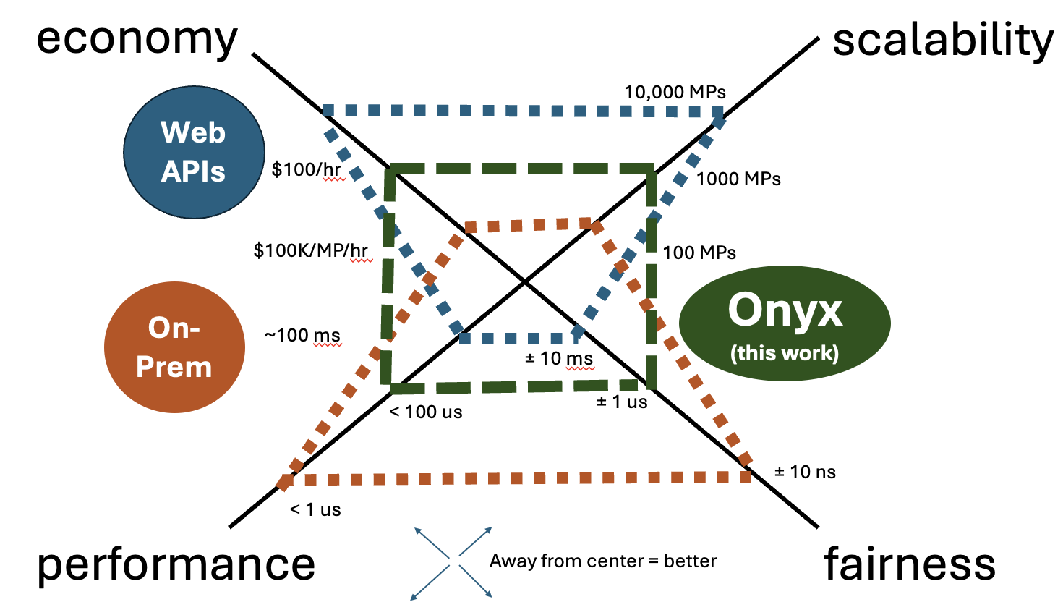
Remarks
Cloud financial exchanges can be realized by developing new primitives, without specialized infrastructure
Some fairness/performance guarantees need to be accordingly relaxed
Such exchanges present a new operating point in the cost-performance curve
Application-specific scheduling can have a significant beneficial impact while preserving fairness
Notes:
Not all orders match immidiately

Slide 113
Probabilistic Fair Order of Events
Muhammad Haseeb, Jinkun Geng, Aurojit Panda, Radhika Mittal, Nirav Atre, Srinivas Narayana, Anirudh Sivaraman
NYU, UIUC, Rutgers University, Jane Street
Notes:
cat

Slide 114
A Financial Market
Notes:
Lets imagine a financial market, where we have a stock

Slide 115
A Financial Market
Notes:
And several buyers are interested in buying

Slide 116
A Financial Market

Slide 117
A Financial Market
1 share, 4 buyers
Who gets to buy?
whoever asked first!
Notes:
But we run into this problem: ther is only 1 share of the stock to sell, but four interested buyers.
A question arises: who gets to buy it. Well a simple anwer is: whoever asked first. And this answer is actually used by many financial market today.

Slide 118
A Financial Market
whoever asked first!
How do we know that?
Fair Ordering
Notes:
But how do we know who asked first, after all networks are asynchronous and the server may receive information about events in an arbitrary order, not necessarily in the order of events occurence.
That’s why we need a mechanism to fairly order the events.

Slide 119
Fair Ordering
Events generated by clients should be observed by a server in the same order as their generation order!
Notes:
We define fair ordering as : events generated by clients, they should be observed by a server in the same order as their true occurrence order. True occurrence order is hard to determine.
Aa-kUr-Unce

Slide 120
Fair Ordering
Events generated by clients should be observed by a server in the same order as their generation order!

Slide 121
Fair Ordering
Events generated by clients should be observed by a server in the same order as their generation order!
Process events in the order of their timestamps!
Clients with perfectly synchronized clocks
Notes:
But lets say that we have clients with perfectly synchronized clocks. They could timestamp the events they generate. And a server coild process events in the order of their timestamps. It would achieve fair ordering.

Slide 122
Fair Ordering
Events generated by clients should be observed by a server in the same order as their generation order!
Process events in the order of their timestamps!
Clients with perfectly synchronized clocks
Notes:
But here is the problem: perfect clock synchronization is impossible to achieve.

Slide 123
Fair Ordering
Events generated by clients should be observed by a server in the same order as their generation order!
Process events in the order of their timestamps!
Clients with perfectly synchronized clocks
Notes:
That;s why this mechanism is not practical.

Slide 124
Fair Ordering
Our Proposal
It’s impossible to obtain precise timestamps.
Notes:
That;s where our proposal comes into the picture.
We embrach the fact that its impossible to obtain precise timestamps.

Slide 125
Fair Ordering
Our Proposal
It’s impossible to obtain precise timestamps.
because it’s impossible to remove all the error from clocks
But we can probabilistically compare two imprecise timestamps.
Notes:
We can probabilistically compare two imprecise timestamps and that’s the foundation of our system, Tommy that achieves probabilistic fair ordering.

Slide 126
Tommy
Probabilistic Fair Ordering
Our Proposal
:
It’s impossible to obtain precise timestamps.
because it’s impossible to remove all the error from clocks
But we can probabilistically compare two imprecise timestamps.
Enabled by treating time as a Random Variable!

Slide 127
Prior Work
Tommy
Equalized Cables FIFO
Onyx SIGCOMM’25
Onyx
On-premises exchanges / private data centers
Single region public cloud

Slide 128

Sequencer Overview
Learned Clock Error Distributions
Clients
Best Effort Clock Sync.
Events
Tommy, The Sequencer

Slide 129
Sequencer Overview
Learned Clock Error Distributions
Clients
Best Effort Clock Sync.
1
2
3
4
Events
Tommy, The Sequencer

Slide 130
Sequencer Overview
Learned Clock Error Distributions
Fair Order of Events
Clients
1
2
3
4
Best Effort Clock Sync.
Events
Output
Tommy, The Sequencer
Notes:
After the slide Ideal time left: 4 minutes

Slide 131
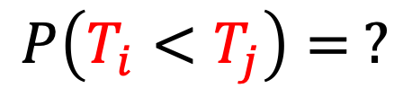




i
j
True Values
$$T_{i}$$
$$T_{j}$$
$$T_{i}^{′}$$
$$T_{j}^{′}$$
Observed Values
$$P\left(T_{i}<T_{j}\right)= ?$$
Notes:
Lets say we have two events I and j they occur at timestamp Ti and Tj which we cannot know. These are true values.
But what we can observe is: Ti’ and Tj’, which are the clients local clocks’ timestamps.

Slide 132
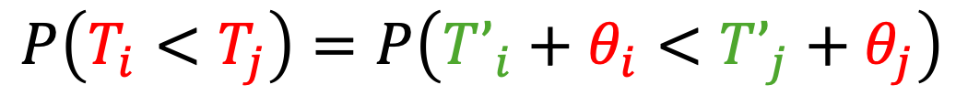
i
j
True Values
$$T_{i}$$
$$T_{j}$$
$$T_{i}^{′}$$
$$T_{j}^{′}$$
Observed Values
$$P\left(T_{i}<T_{j}\right)=P\left(T’_{i}+θ_{i}<T’_{j}+θ_{j}\right)$$
Clock Sync. Errors
Notes:
Here: Theta I and theta j are local clock offsets that we also don’t know. We will try to formulate this probability in a way that on the R.H.S we have no red term.

Slide 133

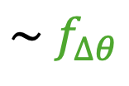

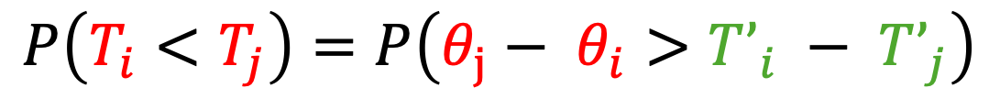
i
j
True Values
$$T_{i}$$
$$T_{j}$$
$$T_{i}^{′}$$
$$T_{j}^{′}$$
Observed Values
$$P\left(T_{i}<T_{j}\right)=P\left(T’_{i}+θ_{i}<T’_{j}+θ_{j}\right)$$
$$P\left(T_{i}<T_{j}\right)=P\left(θ_{j}− θ_{i}>T’_{i} − T’_{j}\right)$$
$$∆θ=θ_{j}−θ_{i}$$
$$\sim f_{∆θ}$$
estimated
$$P\left(T_{i}<T_{j}\right) = \int_{T’_{i}−T’_{j}}^{∞}{f_{∆θ} d∆}$$

Slide 134
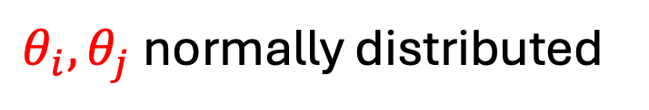


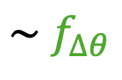


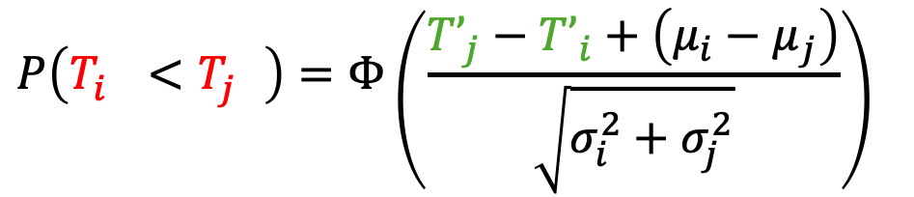
i
j
True Values
$$T_{i}$$
$$T_{j}$$
$$T_{i}^{′}$$
$$T_{j}^{′}$$
Observed Values
$$P\left(T_{i}<T_{j}\right)=P\left(T’_{i}+θ_{i}<T’_{j}+θ_{j}\right)$$
$$θ_{i}, θ_{j} \text{normally} \text{distributed}$$
$$P\left(T_{i}<T_{j}\right)=P\left(θ_{j}− θ_{i}>T’_{i} − T’_{j}\right)$$
$$∆θ=θ_{j}−θ_{i}$$
$$\sim f_{∆θ}$$
$$P\left(T_{i}^{}<T_{j}^{}\right)=Φ\left(\frac{{T’}_{j}−{T’}_{i}+\left(μ_{i}−μ_{j}\right)}{\sqrt{σ_{i}^{2}+σ_{j}^{2}}}\right)$$
$$P\left(T_{i}<T_{j}\right) = \int_{T’_{i}−T’_{j}}^{∞}{f_{∆θ} d∆}$$

Slide 135
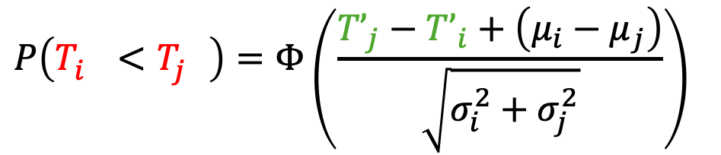
i
$$P\left(T_{i}^{}<T_{j}^{}\right)=Φ\left(\frac{{T’}_{j}−{T’}_{i}+\left(μ_{i}−μ_{j}\right)}{\sqrt{σ_{i}^{2}+σ_{j}^{2}}}\right)$$
j
k

Slide 136
j
i
k
Notes:
Cycles may occur, preventing us from getting a linear order of events
Open Question: Dealing with cycles

Slide 137
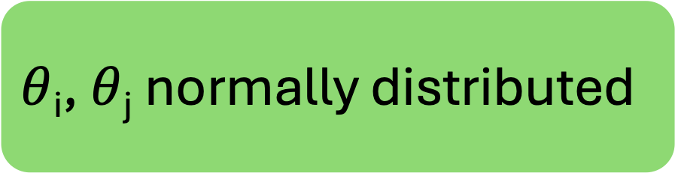
j
$θ$_{i}, $θ$_{j} normally distributed
i
k
No cycles ever!

Slide 138
$θ$_{i}, $θ$_{j} normally distributed
i
j
k
No cycles ever!

Slide 139
$θ$_{i}, $θ$_{j} normally distributed
In practice, cycles are present.
What do we do then?
No cycles ever!

Slide 140
Social Choice Theory
Ranking problem in social choice theory
Given votes from an electorate, find an election winner
Votes show pairwise preferences i.e., A candidate preferred over B candidate
Find the winner candidate that wins majority of votes/pairwise preferences

Slide 141
Social Choice Theory
Ranking problem in social choice theory
Can lead to cycles
A wins over B by 51% of votes
B wins over C by 51% of votes
C wins over A by 51% of votes
Well studied problem

Slide 142
Social Choice Theory
If no cycles forms, the winner exists
If cycle(s) form, no clear winner
Smith set: Smallest set of candidates who individually win over all the candidates not in the set

Slide 143
Social Choice Theory
Fair Ordering
Find the smith set of events
emit that batch of events
Repeat for the remaining events
Forsaking total order for partial order
The downstream application can decide how to deal with events that are left unordered w.r.t. each other

Slide 144
Social Choice Theory
Fair Ordering
Find the smith set of events
emit that batch of events
Repeat for the remaining events
Create the likely-happened-before graph 𝒢
Do a Strongly Connected Components (SCC) decomposition, 𝒢 → 𝒢’
Find topological ordering of 𝒢’
Emit each super-node in 𝒢’ in the topological order

Slide 146
Ordering in an online setting
Events/messages arrive in a stream
Information of all future events may not be available
Event arrives
t
Find stable frontier
All timestamps t’ for which P(T’ < T) is very high
One frontier per client calculated

Slide 147
Ordering in an online setting
Events/messages arrive in a stream
Information of all future events may not be available
Event arrives
t
Find stable frontier
All timestamps t’ for which P(T’ < T) is very high
One frontier per client calculated

Slide 148
Ordering in an online setting
Events/messages arrive in a stream
Information of all future events may not be available
Event arrives
t
t₁
t₂
Find stable frontier
Wait for events under the frontier
If new events received, repeat last two setps
Computer fair ordering of the current events

Slide 149
Ordering in an online setting
Events/messages arrive in a stream
Information of all future events may not be available
Event arrives
t
t₁
t₂
Find stable frontier
Wait for events under the frontier
If new events received, repeat last two setps
Computer fair ordering of the current events
Emit
Repeat

Slide 150
Evaluation

Slide 151
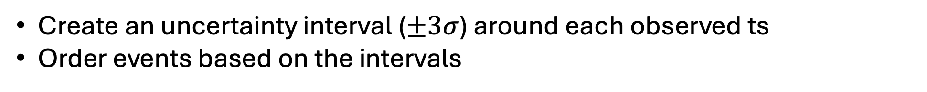
Setup
Ground truth does not exist in the real world
No perfect clock synchronization
Cannot know in what order events were generated across clients
We resort to simulations as we can construct a ground truth there
NS3 simulation
Clients send events to a server which finds probabilistic fair ordering
Clients are fed with a schedule to generate events at specific “simulator” timestamps
Latencies of the links are sampled from a separate data-center simulation
Baseline solution for ordering events:
Create an uncertainty interval ($±3σ$) around each observed ts
Order events based on the intervals

Slide 152
Fairness
For each correctly ordered pair of events → +1 score
For each incorrect → -1 score
For a pair left unordered → +0 score
Normalize by total number of pairs

Slide 153
Fairness

Slide 154
Fairness
We further evaluate fairness by sweeping several parameters
Number of messages, number of clients, clock errors, clock synchronization probes, etc.

Slide 155
Remarks
Probabilistic fair ordering can be achieved by modeling time as a random variable
Tools from social choice theory helpful in dealing with intransitivity induced by the probabilistic comparisons
Useful when the clock synchronization accuracy is not sufficient for an application
It has many more use cases other than achieving latency fairness in competitive systems
Scaling timestamped packet capture systems
Devising hypothesis from imperfect observability data for debugging
Better arbitrage finding in financial exchanges

Slide 157
Onyx
Tommy

Slide 158
Onyx
Achieving latency fairness probabilistically (inbound direction)
Achieving latency fairness in a cloud financial exchange
+
Achieving high performance while retaining latency fairness
Tommy

Slide 159
Future Work
Thank you!
Real world deployment of Tommy Studying performance and devising mechanisms for scalability
Theoretical treatment of Tommy
Efficiency of online mechanism (regret bounds etc.)
Extending partial order to total order by balancing out unfairness
Building systems atop Tommy Timestamped packet capture, observability, finding arbitrage opportunities
Expanding trust models for Onyx and Tommy

