Slide 1
Latency Fairness On Commodity Networking Infrastructure
PhD Thesis Defense Muhammad Haseeb (alias: Haseeb Ashfaq)
Advisor: Anirudh Sivaraman
Computer Science Department New York University
Committee: Anirudh Sivaraman, Aurojit Panda, Radhika Mittal Lakshminarayanan Subramanian, Jinyang Li

Slide 2
Can We Achieve
Latency Fairness On Commodity Networking Infrastructure
?
Notes:
As trisks

Slide 3
Latency Fairness

Slide 4
Latency Fairness
Server
Latency = x
Machine 1
Machine 2
Machine n

Slide 5
Latency Fairness
Server
Latency = x
x
x
Machine 1
Machine 2
Machine n

Slide 6
Latency Fairness
Server
Latency = x
x
x
Machine 1
Machine 2
Machine n

Slide 7
Latency Fairness
Server
Critical for competitive systems
e.g., financial exchanges, ad exchanges.
Latency = x
x
x
Machine 1
Machine 2
Machine n
Notes:
Not having latency fairness can lead to unwanted unfair competition, users may not come

Slide 8
Latency Fairness
Server
Critical for competitive systems
e.g., financial exchanges, ad exchanges.
Latency = x
x
x
Our Focus
Machine 1
Machine 2
Machine n
Notes:
Not having latency fairness can lead to unwanted unfair competition, users may not come

Slide 9
competitive systems

Slide 10
competitive systems
Two Common Communication Patterns
Outbound Communication
Inbound Communication

Slide 11
competitive systems
Two Common Communication Patterns
Outbound Communication
Inbound Communication
Multicast from server to machines
Unicasts from machines to server

Slide 12
competitive systems
Two Common Communication Patterns
Outbound Communication
Inbound Communication
Multicast from server to machines
Unicasts from machines to server
e.g., market data multicast in financial exchanges
e.g., traders submitting orders to a financial exchange server

Slide 13
competitive systems
Two Common Communication Patterns
Outbound Communication
Inbound Communication
Multicast from server to machines
Unicasts from machines to server
e.g., market data multicast in financial exchanges
e.g., traders submitting orders to a financial exchange server

Slide 14
competitive systems
Two Common Communication Patterns
Outbound Communication
Inbound Communication
Multicast from server to machines
Unicasts from machines to server
e.g., market data multicast in financial exchanges
e.g., traders submitting orders to a financial exchange server
Specialized Infrastructure used by on-premises financial exchanges

Slide 15
competitive systems
Commodity Networking Infrastructure
Two Common Communication Patterns
Outbound Communication
Inbound Communication
Multicast from server to machines
Unicasts from machines to server
e.g., market data multicast in financial exchanges
e.g., traders submitting orders to a financial exchange server
Specialized Infrastructure used by on-premises financial exchanges

Slide 16
Thesis: Latency Fairness
Outbound Communication
Inbound Communication

Slide 17
Thesis: Latency Fairness
Tightly Synchronized Clocks
Outbound Communication
Inbound Communication

Slide 18
Thesis: Latency Fairness
Tightly Synchronized Clocks
Outbound Communication
Inbound Communication
Inbound Communication

Slide 19
Thesis: Latency Fairness
Tightly Synchronized Clocks
Time as a random variable
Outbound Communication
Inbound Communication
Inbound Communication

Slide 20
Thesis: Latency Fairness
Tightly Synchronized Clocks
Time as a random variable
Outbound Communication
Inbound Communication
Inbound Communication
ACM HotNets’25
ACM SIGCOMM’25
Submitted to SIGCOMM’26

Slide 21
Thesis: Latency Fairness
Tightly Synchronized Clocks
Time as a random variable
Outbound Communication
Inbound Communication
Inbound Communication
ACM HotNets’25
ACM SIGCOMM’25
Submitted to SIGCOMM’26
Onyx
Tommy

Slide 22
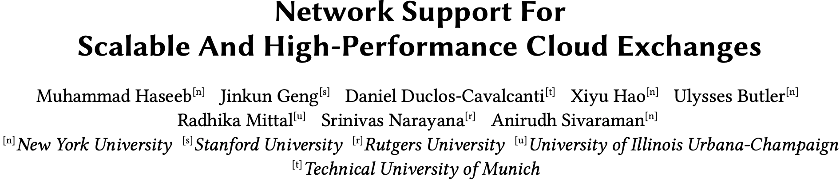
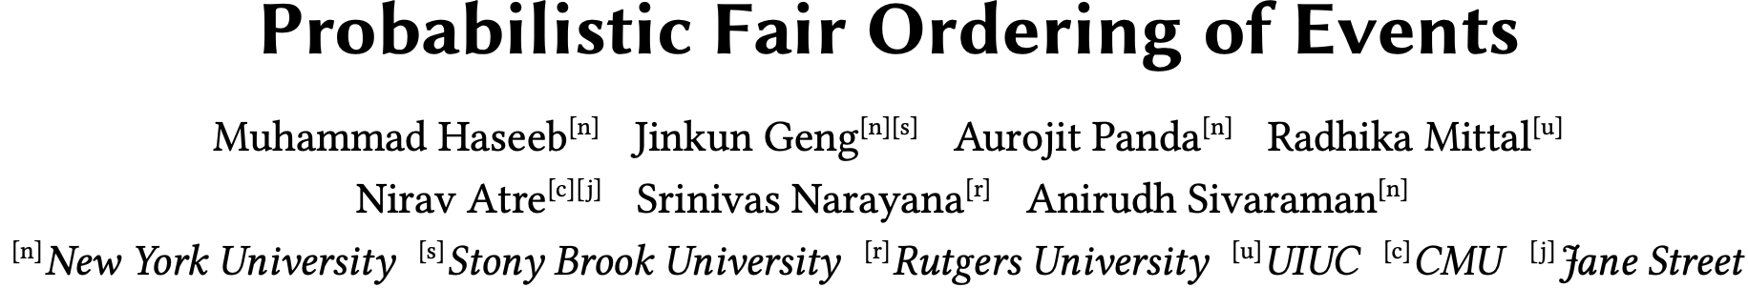
Onyx
Tommy

Slide 24
Network Support For Scalable And High-Performance Cloud Exchanges
Muhammad Haseeb, Jinkun Geng, Daniel Duclos-Cavalcanti, Xiyu Hao, Ulysses Butler, Radhika Mittal, Srinivas Narayana, Anirudh Sivaraman
New York University, Clockwork Inc., Technical University of Munich, Rutgers University, University of Illinois Urbana-Champaign

Slide 25
Primer On Financial Exchanges
Exchange Server
Market Participant 1
Market Participant 2
Market Participant 3

Slide 26
Primer On Financial Exchanges
Exchange Server
Market Participant 1
Market Participant 2
Market Participant 3

Slide 27
Primer On Financial Exchanges
Exchange Server
Market Participant 1
Market Participant 2
Market Participant 3

Slide 28
Primer On Financial Exchanges
Exchange Server
Market Participant 1
Market Participant 2
Market Participant 3

Slide 29
Primer On Financial Exchanges
Exchange Server
Market Participant 1
Market Participant 2
Market Participant 3

Slide 30
Primer On Financial Exchanges
Exchange Server
Market Participant 1
Market Participant 2
Market Participant 3

Slide 31
Primer On Financial Exchanges
Exchange Server
Market Participant 1
Market Participant 2
Market Participant 3

Slide 32
Primer On Financial Exchanges
Exchange Server
Market Participant 1
Market Participant 2
Market Participant 3

Slide 33
Primer On Financial Exchanges
Exchange Server
Market Participant 1
Market Participant 2
Market Participant 3

Slide 34
Primer On Financial Exchanges
Exchange Server
Market Participant 1
Market Participant 2
Market Participant 3

Slide 35
Primer On Financial Exchanges
Exchange Server
Market Participant 1
Market Participant 2
Market Participant 3

Slide 36
Primer On Financial Exchanges
Exchange Server
order closer to mid price → Immediate execution/match
order away from mid price → potential execution/match in future
Position in the queue/price level matters!
Notes:
Price time priority algorithm

Slide 37
Primer On Financial Exchanges
Traditional exchanges built in private data centers or colocation facilities!
Exchange Server
order closer to mid price → Immediate execution/match
Competition Among MPs
order away from mid price → potential execution/match in future
Position in the queue/price level matters!

Slide 38
Can we use the public cloud to build and scale
financial exchanges?

Slide 39
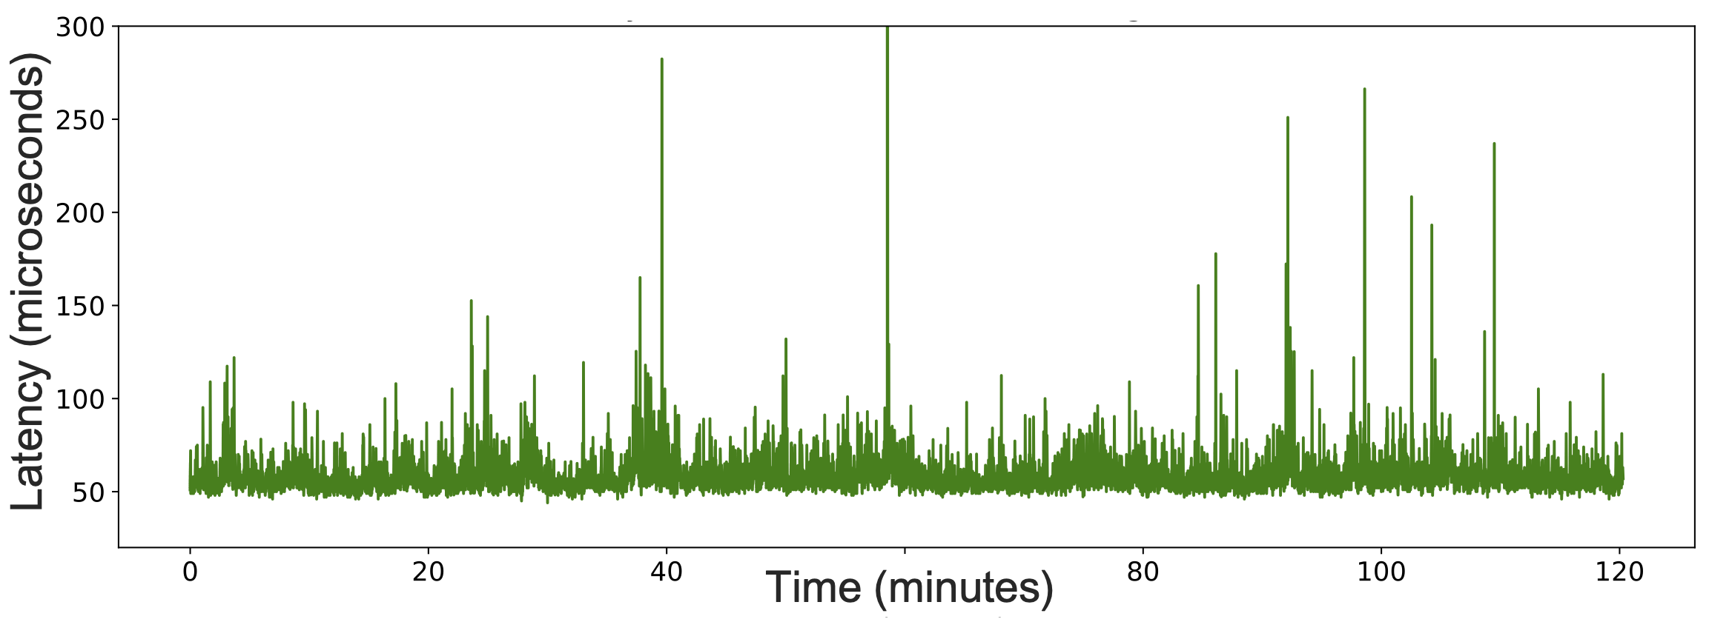
Public Cloud Exhibits High Latency & Variance
Latency varies temporally
Latency varies spatially – across multiple clients
Unfit for fair competition
Onyx: mechanisms to achieve fairness + high performance at scale
Notes:
Will replace png with pdf, somehow adding pdf is making it too heavy for powerpoint to handle.

Slide 40
economy
scalability
10,000 MPs
Web APIs
$16/month/MP
1000 MPs
Onyx
(this work)
$60K/month/MP
100 MPs
On-Prem
~100 ms
± 10 ms
< 100 us
± 1 us
± 10 ns
< 1 us
performance
fairness
Away from center = better

Slide 41
Onyx: Scalable Cloud Financial Exchange
A Scalable And Latency Fair Order Submission Service
Prototyped on AWS and GCP
A Scalable And Latency Fair Multicast Service

Slide 42
Onyx
Fairness definitions and relaxation
Scalable outbound fairness
Scalable inbound fairness
Definitions | Outbound | Inbound

Slide 43
Onyx
Fairness definitions and relaxation
Scalable outbound fairness
Scalable inbound fairness
Definitions | Outbound | Inbound

Slide 44
Fairness¹
[1] CloudEx: A Fair-Access Financial Exchange in the Cloud
Outbound Fairness
Inbound Fairness
Definitions | Outbound | Inbound

Slide 45
Fairness¹
[1] CloudEx: A Fair-Access Financial Exchange in the Cloud
Outbound Fairness
Exchange Server
Inbound Fairness
MP1
MP2
MP3
Definitions | Outbound | Inbound

Slide 46
Fairness¹
[1] CloudEx: A Fair-Access Financial Exchange in the Cloud
Outbound Fairness
Exchange Server
Inbound Fairness
MP1
MP2
MP3
Definitions | Outbound | Inbound

Slide 47
Fairness¹
[1] CloudEx: A Fair-Access Financial Exchange in the Cloud
Outbound Fairness
Exchange Server
Inbound Fairness
MP1
MP2
MP3
Definitions | Outbound | Inbound

Slide 48
Fairness¹
[1] CloudEx: A Fair-Access Financial Exchange in the Cloud
Outbound Fairness
Exchange Server
Difference in data reception time for any two participants should be 0
t1
t2
t3
Inbound Fairness
MP1
MP2
MP3
Definitions | Outbound | Inbound

Slide 49
Fairness¹
[1] CloudEx: A Fair-Access Financial Exchange in the Cloud
Exchange Server
Outbound Fairness
Exchange Server
Difference in data reception time for any two participants should be 0
MP1
MP2
MP3
t1
t2
t3
Inbound Fairness
MP1
MP2
MP3
Definitions | Outbound | Inbound

Slide 50
Fairness¹
[1] CloudEx: A Fair-Access Financial Exchange in the Cloud
Exchange Server
Outbound Fairness
Exchange Server
Difference in data reception time for any two participants should be 0
MP1
MP2
MP3
t1
t2
t3
Inbound Fairness
MP1
MP2
MP3
Definitions | Outbound | Inbound

Slide 51
Fairness¹
[1] CloudEx: A Fair-Access Financial Exchange in the Cloud
Exchange Server
Outbound Fairness
Exchange Server
Difference in data reception time for any two participants should be 0
MP1
MP2
MP3
t1
t2
t3
Inbound Fairness
MP1
MP2
MP3
Definitions | Outbound | Inbound

Slide 52
Fairness¹
[1] CloudEx: A Fair-Access Financial Exchange in the Cloud
Exchange Server
Outbound Fairness
Exchange Server
Difference in data reception time for any two participants should be 0
MP1
MP2
MP3
t1
t2
t3
Inbound Fairness
MP1
MP2
MP3
Definitions | Outbound | Inbound

Slide 53
Fairness¹
[1] CloudEx: A Fair-Access Financial Exchange in the Cloud
Exchange Server
Outbound Fairness
Orders should be seen by the exchange in the generation order
Exchange Server
Difference in data reception time for any two participants should be 0
MP1
MP2
MP3
t1
t2
t3
Inbound Fairness
MP1
MP2
MP3
Definitions | Outbound | Inbound

Slide 54
Fairness¹
[1] CloudEx: A Fair-Access Financial Exchange in the Cloud
Outbound Fairness
Difference in data reception time for any two participants should be 0
Orders should be seen by the exchange in the generation order
Inbound Fairness
Definitions | Outbound | Inbound

Slide 55
Fairness In Practice
[1] CloudEx: A Fair-Access Financial Exchange in the Cloud
Outbound Fairness
Difference in data reception time for any two participants should be 0
Orders should be seen by the exchange in the generation order
Inbound Fairness
Definitions | Outbound | Inbound

Slide 56
Fairness In Practice
[1] CloudEx: A Fair-Access Financial Exchange in the Cloud
Outbound Fairness
Difference in data reception time for any two participants should be ~0
Orders should be seen by the exchange in the generation order
Inbound Fairness
Definitions | Outbound | Inbound

Slide 57
Fairness In Practice
[1] CloudEx: A Fair-Access Financial Exchange in the Cloud
Outbound Fairness
Difference in data reception time for any two participants should be ~0
Orders should be seen by the exchange in the timestamped generation order
Inbound Fairness
Achieving fairness while being performant at scale is our goal.
Definitions | Outbound | Inbound

Slide 58
Fairness In Practice
[1] CloudEx: A Fair-Access Financial Exchange in the Cloud
Outbound Fairness
Difference in data reception time for any two participants should be ~0
We target 1000 market participants (MPs). Each MP is a separate VM.
Orders should be seen by the exchange in the timestamped generation order
Inbound Fairness
Achieving fairness while being performant at scale is our goal.
Definitions | Outbound | Inbound

Slide 59
Scalable Outbound Fairness
Fairness achieved by a simple “Hold-and-release” primitive.
Not scalable w.r.t the number of receivers/participants.
Definitions | Outbound | Inbound

Slide 60
Hold-and-release
S
Senders and receivers synchronized to the same clock
Sender attaches deadline to message
Deadline: 0009 | …
0000
0001
0002
0003
0004
0005
0006
0007
0008
0009
Sender multicasts message to all receivers
Deadline: 0009 | …
Deadline: 0009 | …
Deadline: 0009 | …
Deadline: 0009 | …
Deadline: 0009 | …
Messages arrive at unpredictable times
R1
R2
R3
R4
. . . . . . .
Rn
0000
0001
0002
0003
0004
0005
0006
0007
0008
0009
0000
0001
0002
0003
0004
0005
0006
0007
0008
0009
0000
0001
0002
0003
0004
0005
0006
0007
0008
0009
0000
0001
0002
0003
0004
0005
0006
0007
0008
0000
0009
0001
0002
0003
0004
0005
0006
0007
0008
0009
Receiver processes message when deadline is reached on receiver clock
Definitions | Outbound | Inbound
Notes:
We cannot control the arrival time of the messages at each receiver. The messages can arrive at the receivers at unpredictable times.
But since the receivers are sharing the same timeline,
we can make each receiver to hold the messages and process the message at the same time

Slide 61

Scalable Outbound Fairness
Fairness achieved by a simple “hold-and-release” primitive.
We scale it much further by proposing an efficient market data multicast mechanism.
A tree of proxy nodes is utilized that helps scale multicast.
Latency
Fairness
Exchange
But still many venues for latency fluctuations, which hinder latency fairness and increase latency
Definitions | Outbound | Inbound

Slide 62
Scalable Outbound Fairness
Fairness achieved by a simple “hold-and-release” primitive.
We scale it much further by proposing an efficient market data multicast mechanism.
A tree of proxy nodes is utilized that helps scale multicast.
Latency
Fairness
Exchange
Latency Spikes On Links
Proxy node’s performance variation
Receiver VMs’ performance variation
Round Robin Packet Spraying
Proxy Hedging i.e., multiple (H) parents
Two VMs per trader
Definitions | Outbound | Inbound

Slide 63
Scalable Outbound Fairness
Exchange
Latency Spikes On Links
Proxy node’s performance variation
Receiver VMs’ performance variation
Round Robin Packet Spraying
Proxy Hedging i.e., multiple (H) parents
Two VMs per trader
Definitions | Outbound | Inbound

Slide 64
Scalable Outbound Fairness
Exchange
Latency Spikes On Links
Proxy node’s performance variation
Receiver VMs’ performance variation
Proxy Hedging i.e., multiple (H) parents
Two VMs per trader
Round Robin Packet Spraying
Latency spikes affect some links for some short interval of time
RRPS dynamically adjusts parent-child relationships after each message
No link is used for a consecutive sequence of messages
Latency spike is only able to affect a small number of messages
Definitions | Outbound | Inbound

Slide 65
Scalable Outbound Fairness
Exchange
Latency Spikes On Links
Proxy node’s performance variation
Receiver VMs’ performance variation
Round Robin Packet Spraying
Two VMs per trader
Proxy Hedging i.e., multiple (H) parents
Proxies can show straggler behavior, delaying the forwarding of a message
Each proxy node gets multiple parents, each parent sends a copy of message to the child node
If one parent is a straggler, some other parent may be healthy
Definitions | Outbound | Inbound

Slide 66
Scalable Outbound Fairness
Exchange
Latency Spikes On Links
Proxy node’s performance variation
Receiver VMs’ performance variation
Round Robin Packet Spraying
Proxy Hedging i.e., multiple (H) parents
Two VMs per trader
A trader/MPs VM can also show straggler behavior
Each MP gets two VMs, both running the same trading algorithm, both receiving the same input and both generating the same output
An MP is able to receive messages on time
Definitions | Outbound | Inbound

Slide 67
Scalable Outbound Fairness
Exchange
Latency Spikes On Links
Proxy node’s performance variation
Receiver VMs’ performance variation
Round Robin Packet Spraying
Proxy Hedging i.e., multiple (H) parents
Two VMs per trader
Multicast latency becomes stable
Calculated deadlines in “hold-and-release” become effective
Multicast latency becomes low
Fairness achieved without large deadlines
Definitions | Outbound | Inbound

Slide 69
Inbound Fairness
Exchange
Orders are received in the same order
Synchronous network
Orders are generated in some order
MP1
MP2
MP3
MPn
Definitions | Outbound | Inbound

Slide 70
Inbound Fairness
Exchange
Orders are received in the same order
Synchronous network
Orders are generated in some order
MP1
MP2
MP3
MPn
Definitions | Outbound | Inbound

Slide 71
Inbound Fairness
Exchange
Orders are received in the same order
Synchronous network
Orders are generated in some order
MP1
MP2
MP3
MPn
Definitions | Outbound | Inbound

Slide 72
Inbound Fairness
Exchange
Orders are received in the same order
Synchronous network
Orders are generated in some order
MP1
MP2
MP3
MPn
Definitions | Outbound | Inbound

Slide 73
Inbound Fairness
Exchange
Orders are received in the same order
Synchronous network
Latency Fairness
Orders are generated in some order
MP1
MP2
MP3
MPn
Definitions | Outbound | Inbound

Slide 74
Inbound Fairness
Exchange
MP1
MP2
MP3
MPn
Definitions | Outbound | Inbound

Slide 75
Inbound Fairness
Exchange
All MPs synchronize their clocks
MPs timestamp their messages
Sequencer waits for at least one message from each MP
Sequencer
1
2
3
4
MP1
MP2
MP3
MPn
Definitions | Outbound | Inbound

Slide 76
Inbound Fairness
Exchange
All MPs synchronize their clocks
MPs timestamp their messages
Sequencer waits for at least one message from each MP
Sequencer
1
2
3
4
MP1
MP2
MP3
MPn
Definitions | Outbound | Inbound

Slide 77
Inbound Fairness
Exchange
All MPs synchronize their clocks
MPs timestamp their messages
Sequencer waits for at least one message from each MP
Sequencer
3
1
2
4
MP1
MP2
MP3
MPn
Definitions | Outbound | Inbound

Slide 78
Inbound Fairness
Exchange
All MPs synchronize their clocks
MPs timestamp their messages
Sequencer waits for at least one message from each MP
Sequencer
2
3
1
4
MP1
MP2
MP3
MPn
Definitions | Outbound | Inbound

Slide 79
Inbound Fairness
Exchange
All MPs synchronize their clocks
MPs timestamp their messages
Sequencer waits for at least one message from each MP
Sequencer
4
2
3
1
MP1
MP2
MP3
MPn
Definitions | Outbound | Inbound

Slide 80
Inbound Fairness
Exchange
All MPs synchronize their clocks
MPs timestamp their messages
Sequencer waits for at least one message from each MP
Sequencer
4
2
3
1
It sorts the messages
MP1
MP2
MP3
MPn
Definitions | Outbound | Inbound

Slide 81
Inbound Fairness
Exchange
All MPs synchronize their clocks
MPs timestamp their messages
Sequencer waits for at least one message from each MP
Sequencer
4
3
2
1
It sorts the messages
MP1
MP2
MP3
MPn
Definitions | Outbound | Inbound

Slide 82
Inbound Fairness
Exchange
All MPs synchronize their clocks
MPs timestamp their messages
Sequencer waits for at least one message from each MP
Sequencer
4
3
2
1
It sorts the messages
It releases the one with the smallest ts
MP1
MP2
MP3
MPn
Definitions | Outbound | Inbound

Slide 83
Inbound Fairness
Exchange
All MPs synchronize their clocks
MPs timestamp their messages
Sequencer waits for at least one message from each MP
1
Sequencer
4
3
2
It sorts the messages
It releases the one with the smallest ts
MP1
MP2
MP3
MPn
Definitions | Outbound | Inbound

Slide 84
Inbound Fairness
Exchange
All MPs synchronize their clocks
MPs timestamp their messages
Sequencer waits for at least one message from each MP
1
Sequencer
4
3
2
It sorts the messages
It releases the one with the smallest ts
Repeat (i.e., wait until one message from each MP and release)
MP1
MP2
MP3
MPn
Definitions | Outbound | Inbound

Slide 85
Inbound Fairness
Exchange
All MPs synchronize their clocks
MPs timestamp their messages
Sequencer waits for at least one message from each MP
1
Sequencer
4
3
2
It sorts the messages
It releases the one with the smallest ts
Repeat (i.e., wait until one message from each MP and release)
5
MP1
MP2
MP3
MPn
Definitions | Outbound | Inbound

Slide 86
Inbound Fairness
Exchange
All MPs synchronize their clocks
MPs timestamp their messages
Sequencer waits for at least one message from each MP
1
Sequencer
5
4
3
2
It sorts the messages
It releases the one with the smallest ts
Repeat (i.e., wait until one message from each MP and release)
MP1
MP2
MP3
MPn
Definitions | Outbound | Inbound

Slide 87
Inbound Fairness
Exchange
All MPs synchronize their clocks
MPs timestamp their messages
Sequencer waits for at least one message from each MP
2
1
Sequencer
5
4
3
It sorts the messages
It releases the one with the smallest ts
Repeat (i.e., wait until one message from each MP and release)
MP1
MP2
MP3
MPn
Definitions | Outbound | Inbound

Slide 88
Inbound Fairness
Exchange
All MPs synchronize their clocks
MPs timestamp their messages
Sequencer waits for at least one message from each MP
Correct if clocks perfectly synchronized
2
1
Sequencer
5
4
3
It sorts the messages
It releases the one with the smallest ts
Repeat (i.e., wait until one message from each MP and release)
MP1
MP2
MP3
MPn
Definitions | Outbound | Inbound

Slide 89
Inbound Fairness
Exchange
All MPs synchronize their clocks
MPs timestamp their messages
Sequencer waits for at least one message from each MP
Correct if clocks perfectly synchronized
2
1
Sequencer
5
4
3
It sorts the messages
Correct if clock error negligible compared to the time granularity of interest
It releases the one with the smallest ts
Repeat (i.e., wait until one message from each MP and release)
MP1
MP2
MP3
MPn
Definitions | Outbound | Inbound

Slide 90
Inbound Fairness
Exchange
Performance is not good!
Due to bursty nature of the workload, incast congestion at the exchange/sequencer occurs
Sequencer
MP1
MP2
MP3
MPn
Definitions | Outbound | Inbound

Slide 91
Inbound Fairness
Exchange
Use multicast tree in reverse
Reduced fan-in factor reduces incast congestion
Sequencer
MP1
MP2
MP3
MPn
Definitions | Outbound | Inbound

Slide 92
Inbound Fairness
Exchange
Use multicast tree in reverse
Reduced fan-in factor reduces incast congestion
Sequencer runs at each intermediate node (merge sort)
MP1
MP2
MP3
MPn
Definitions | Outbound | Inbound

Slide 93
Inbound Fairness
Exchange
Use multicast tree in reverse
Reduced fan-in factor reduces incast congestion
Sequencer runs at each intermediate node (merge sort)
MP1
MP2
MP3
MPn
Definitions | Outbound | Inbound

Slide 94
Inbound Fairness
Achieves same effect as the synchronous network
Queues form at the intermediate nodes during bursty activity
Opportunity to service the queues smartly
Exchange
MP1
MP2
MP3
MPn
Definitions | Outbound | Inbound

Slide 95
Inbound Fairness
LOQ: A Domain-Specific Scheduling Policy
Exchange
MP1
MP2
MP3
MPn
Definitions | Outbound | Inbound

Slide 96
Inbound Fairness
LOQ: A Domain-Specific Scheduling Policy
Exchange
MP1
MP2
MP3
MPn
Definitions | Outbound | Inbound

Slide 97
Inbound Fairness
LOQ: A Domain-Specific Scheduling Policy
Exchange
Identifies orders that will wait in the Limit Order Book at the exchange upon reaching the exchange
De-prioritizes such “non-critical” orders while scheduling
Critical orders get priority
Frees up resources of the exchange server i.e., the exchange receives orders that need to be executed right away
MP1
MP2
MP3
MPn
Definitions | Outbound | Inbound

Slide 98
Inbound Fairness
LOQ: A Domain-Specific Scheduling Policy
Exchange
Tries maintains the effect of synchronous network (i.e., preserves fairness)
LOQ identifies how the exchange processes orders → how the exchange reorders the sequence of received orders before executing them
Offloads some of that reordering to the intermediate nodes
MP1
MP2
MP3
MPn
Definitions | Outbound | Inbound

Slide 99
LOQ: A Domain-Specific Scheduling Policy
$1
$4
$5
$2
Naively doing such prioritization will not preserve fairness.
Definitions | Outbound | Inbound
Notes:
Somebody, before everyone, asked to buy at a very low price and then somebody, still ebfroe anyone else, is willing to seel at a very low price. In that settint these people’s orders should be matched with each other. But if we were to prioritize based on raw pirce, we may just leave such orders in the network and they may not reach the excgange on time. Such a price based prioritization changes the semantics, it definitely loses the fairness i.e., the same effect as if all the latencies were equal.

Slide 100
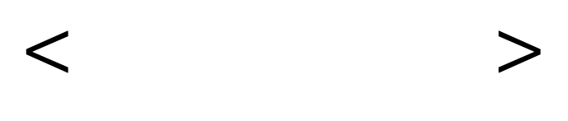
LOQ: A Domain-Specific Scheduling Policy
LOQ Priority Queue
ts
$$< >$$
It will not do anything; it just reduces to being a sequencer we discussed earlier
Definitions | Outbound | Inbound

Slide 101
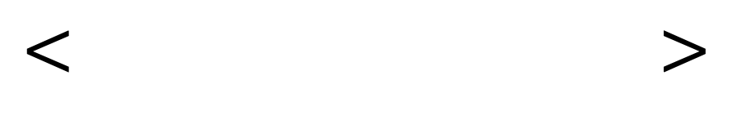
LOQ: A Domain-Specific Scheduling Policy
LOQ Priority Queue
Critical?
ts
$$< >$$
1 or 0 based on whether an order is critical or not
Critical or not?
Definitions | Outbound | Inbound
Notes:
No critical gonna match with non-critical with the same mid price

Slide 102
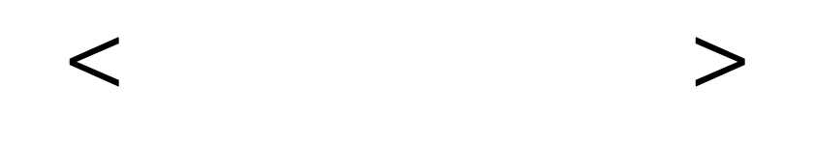
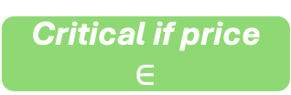
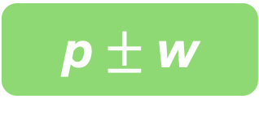
LOQ: A Domain-Specific Scheduling Policy
LOQ Priority Queue
Action Window (w)
maximum number of price levels above the mid-price that a generated bid can belong to
w = 1
Critical?
ts
Critical if price $∈$
$$< >$$
p $±$ w
p
For a fixed mid-price, all action is assumed to happen inside the action window
1 or 0 based on whether an order is critical or not
Critical or not?
Bids
Asks
Definitions | Outbound | Inbound
Notes:
No critical gonna match with non-critical with the same mid price

Slide 103
LOQ: A Domain-Specific Scheduling Policy
LOQ Priority Queue
Critical?
ts
$$< >$$
Within each category (critical/non-critical), the behavior is the same as it would have been in a synchronous network
All critical orders arrive at the exchange before any non-critical
That’s also fine because no no-critical order would be executed before any critical order
Definitions | Outbound | Inbound

Slide 104
LOQ: A Domain-Specific Scheduling Policy
LOQ Priority Queue
Critical?
ts
$$< >$$
There is a problem
Criticality definition dependent on the mid-price but mid-price can move
Two orders can co-reside s.t. one was generated after the mid-price changed
Can we have some ordering decision between such two orders? Difficult!
Definitions | Outbound | Inbound

Slide 105
LOQ: A Domain-Specific Scheduling Policy
LOQ Priority Queue
Mid-price ID
Critical?
ts
$$< >$$
First element of the ranking tuple: mid-price ID
Every time mid-price moves (and MPs receive the info from the exchange), mid-price ID is incremented
All the orders with old mid-price presented to the exchange before any order with a new mid-price
Definitions | Outbound | Inbound

Slide 106
LOQ: A Domain-Specific Scheduling Policy
LOQ Priority Queue
Mid-price ID
Critical?
ts
$$< >$$
Definitions | Outbound | Inbound

Slide 107
LOQ: A Domain-Specific Scheduling Policy
LOQ Priority Queue
Mid-price ID
ts
Critical
< , , >
LOQ lexicographically sorts the received orders based on the above tuple
LOQ enhances the order matching rate of the exchange while lowering the latency for matched orders
Definitions | Outbound | Inbound

Slide 108
Evaluation

Slide 109
Multicast Service

Slide 110
Multicast Service

Slide 111
Delivery Fairness

Slide 112
Delivery Fairness

Slide 113
Limit Order Queue Gracefully Handles Bursts
Load generation stops here
Notes:
Order matched per second 100K orders per second, cumulative by 100 MPs
Periodic burst makes 20x load
Every 3rd second, a burst occurs

Slide 114
Remarks
Latency fairness in cloud financial exchanges can be realized using synchronized clocks
Mechanisms for improving performance while retaining performance are also possible
Such exchanges present a new operating point
Notes:
Not all orders match immidiately

Slide 116
Probabilistic Fair Order of Events
Muhammad Haseeb, Jinkun Geng, Aurojit Panda, Radhika Mittal, Nirav Atre, Srinivas Narayana, Anirudh Sivaraman
NYU, UIUC, Rutgers University, Jane Street
Notes:
cat

Slide 117
A Financial Market
Notes:
Lets imagine a financial market, where we have a stock

Slide 118
A Financial Market
Notes:
And several buyers are interested in buying

Slide 119
A Financial Market

Slide 120
A Financial Market
1 share, 4 buyers
Who gets to buy?
whoever asked first!
Notes:
But we run into this problem: ther is only 1 share of the stock to sell, but four interested buyers.
A question arises: who gets to buy it. Well a simple anwer is: whoever asked first. And this answer is actually used by many financial market today.

Slide 121
A Financial Market
whoever asked first!
How do we know that?
Fair Ordering
Notes:
But how do we know who asked first, after all networks are asynchronous and the server may receive information about events in an arbitrary order, not necessarily in the order of events occurence.
That’s why we need a mechanism to fairly order the events.

Slide 122
Fair Ordering
Events generated by clients should be observed by a server in the same order as their generation order!
Notes:
We define fair ordering as : events generated by clients, they should be observed by a server in the same order as their true occurrence order. True occurrence order is hard to determine.
Aa-kUr-Unce

Slide 123
Fair Ordering
Events generated by clients should be observed by a server in the same order as their generation order!

Slide 124
Fair Ordering
Events generated by clients should be observed by a server in the same order as their generation order!
Process events in the order of their timestamps!
Clients with tightly synchronized clocks
Notes:
But lets say that we have clients with perfectly synchronized clocks. They could timestamp the events they generate. And a server coild process events in the order of their timestamps. It would achieve fair ordering.

Slide 125
Fair Ordering
Events generated by clients should be observed by a server in the same order as their generation order!
Process events in the order of their timestamps!
Clients with tightly synchronized clocks
Notes:
But here is the problem: perfect clock synchronization is impossible to achieve.

Slide 126
Fair Ordering
Events generated by clients should be observed by a server in the same order as their generation order!
Process events in the order of their timestamps!
Clients with tightly synchronized clocks
Notes:
That;s why this mechanism is not practical.

Slide 127
Fair Ordering
Our Proposal
It’s impossible to obtain precise timestamps.
Notes:
That;s where our proposal comes into the picture.
We embrach the fact that its impossible to obtain precise timestamps.

Slide 128
Fair Ordering
Our Proposal
It’s impossible to obtain precise timestamps.
because it’s impossible to remove all the error from clocks
But we can probabilistically compare two imprecise timestamps.
Notes:
We can probabilistically compare two imprecise timestamps and that’s the foundation of our system, Tommy that achieves probabilistic fair ordering.

Slide 129
Tommy
Probabilistic Fair Ordering
Our Proposal
:
It’s impossible to obtain precise timestamps.
because it’s impossible to remove all the error from clocks
But we can probabilistically compare two imprecise timestamps.
Enabled by treating time as a Random Variable!

Slide 130

Sequencer Overview
Learned Clock Error Distributions
Clients
Best Effort Clock Sync.
Events
Tommy, The Sequencer

Slide 131
Sequencer Overview
Learned Clock Error Distributions
Clients
Best Effort Clock Sync.
1
2
3
4
Events
Tommy, The Sequencer

Slide 132
Sequencer Overview
Learned Clock Error Distributions
Fair Order of Events
Clients
1
2
3
4
Best Effort Clock Sync.
Events
Output
Tommy, The Sequencer
Notes:
After the slide Ideal time left: 4 minutes

Slide 133
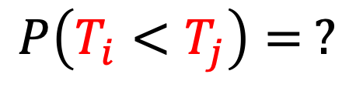




i
j
True Values
$$T_{i}$$
$$T_{j}$$
$$T_{i}^{′}$$
$$T_{j}^{′}$$
Observed Values
$$P\left(T_{i}<T_{j}\right)= ?$$
Notes:
Lets say we have two events I and j they occur at timestamp Ti and Tj which we cannot know. These are true values.
But what we can observe is: Ti’ and Tj’, which are the clients local clocks’ timestamps.

Slide 134
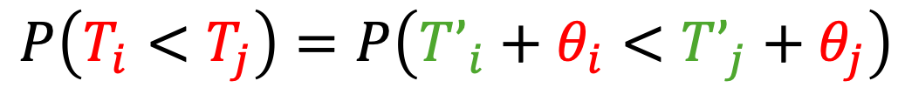
i
j
True Values
$$T_{i}$$
$$T_{j}$$
$$T_{i}^{′}$$
$$T_{j}^{′}$$
Observed Values
$$P\left(T_{i}<T_{j}\right)=P\left(T’_{i}+θ_{i}<T’_{j}+θ_{j}\right)$$
Clock Sync. Errors
Notes:
Here: Theta I and theta j are local clock offsets that we also don’t know. We will try to formulate this probability in a way that on the R.H.S we have no red term.

Slide 135

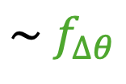

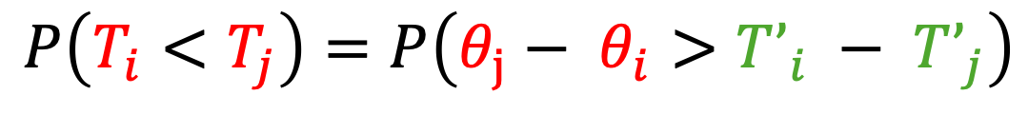
i
j
True Values
$$T_{i}$$
$$T_{j}$$
$$T_{i}^{′}$$
$$T_{j}^{′}$$
Observed Values
$$P\left(T_{i}<T_{j}\right)=P\left(T’_{i}+θ_{i}<T’_{j}+θ_{j}\right)$$
$$P\left(T_{i}<T_{j}\right)=P\left(θ_{j}− θ_{i}>T’_{i} − T’_{j}\right)$$
$$∆θ=θ_{j}−θ_{i}$$
$$\sim f_{∆θ}$$
estimated
$$P\left(T_{i}<T_{j}\right) = \int_{T’_{i}−T’_{j}}^{∞}{f_{∆θ} d∆}$$

Slide 136
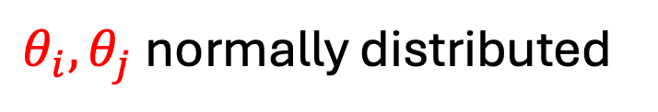


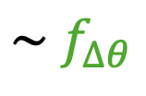


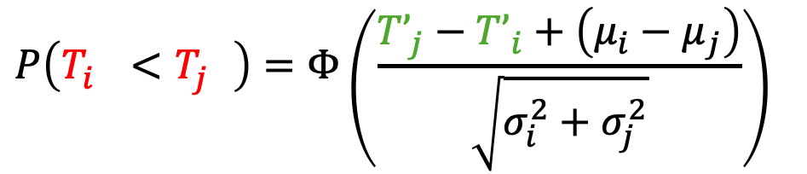
i
j
True Values
$$T_{i}$$
$$T_{j}$$
$$T_{i}^{′}$$
$$T_{j}^{′}$$
Observed Values
$$P\left(T_{i}<T_{j}\right)=P\left(T’_{i}+θ_{i}<T’_{j}+θ_{j}\right)$$
$$θ_{i}, θ_{j} \text{normally} \text{distributed}$$
$$P\left(T_{i}<T_{j}\right)=P\left(θ_{j}− θ_{i}>T’_{i} − T’_{j}\right)$$
$$∆θ=θ_{j}−θ_{i}$$
$$\sim f_{∆θ}$$
$$P\left(T_{i}^{}<T_{j}^{}\right)=Φ\left(\frac{{T’}_{j}−{T’}_{i}+\left(μ_{i}−μ_{j}\right)}{\sqrt{σ_{i}^{2}+σ_{j}^{2}}}\right)$$
$$P\left(T_{i}<T_{j}\right) = \int_{T’_{i}−T’_{j}}^{∞}{f_{∆θ} d∆}$$

Slide 137
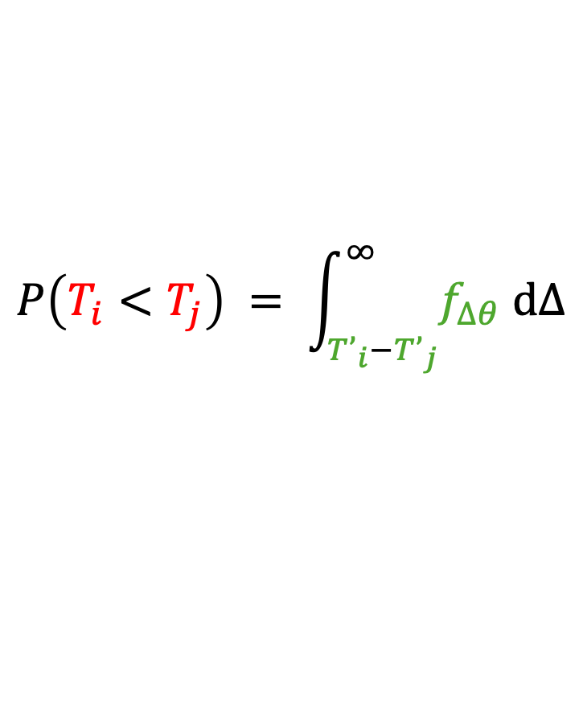
i
$$P\left(T_{i}<T_{j}\right) = \int_{T’_{i}−T’_{j}}^{∞}{f_{∆θ} d∆}$$
j
k

Slide 138
j
i
k
Notes:
Cycles may occur, preventing us from getting a linear order of events
Open Question: Dealing with cycles

Slide 139
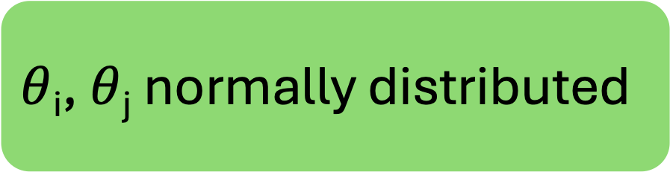
j
$θ$_{i}, $θ$_{j} normally distributed
i
k
No cycles ever!

Slide 140
$θ$_{i}, $θ$_{j} normally distributed
i
j
k
No cycles ever!

Slide 141
j
$θ$_{i}, $θ$_{j} normally distributed
i
k
No cycles ever!
In practice, cycles are present.
What do we do then?

Slide 142
Social Choice Theory
Fair Ordering
Ranking problem in social choice theory
Given votes from an electorate, find an election winner
Votes show pairwise preferences i.e., A candidate preferred over B candidate
Find the winner candidate that wins majority of votes/pairwise preferences

Slide 143
Social Choice Theory
Fair Ordering
Voter 1: A > B > C
Voter 2: B > C > A
Voter 3: C > A > B

Slide 144
Social Choice Theory
Fair Ordering
Aggregated votes per pair
Voter 1: A > B > C
Voter 2: B > C > A
Voter 3: C > A > B
A → B (2)
B → A (1)
B → C (2)
C → B (1)
C → A (2)
A → C (1)

Slide 145
Social Choice Theory
Fair Ordering
Majority based on aggregated votes per pair
Intransitive relation
Voter 1: A > B > C
Voter 2: B > C > A
Voter 3: C > A > B
A → B (2)
B → C (2)
C → A (2)
B
A
C

Slide 146
Social Choice Theory
Fair Ordering
If no cycles forms, the winner exists
If cycle(s) form, no clear winner
Smith set: Smallest set of candidates who individually do not lose to any candidate not in the set
Winners

Slide 147
Social Choice Theory
Fair Ordering
If no cycles forms, the winner exists
If cycle(s) form, no clear winner
Smith set: Smallest set of candidates who individually do not lose to any candidate not in the set

Slide 148
Social Choice Theory
Fair Ordering
Smith set: Smallest set of candidates who individually do not lose to any candidate not in the set
C
Create a graph with nodes as events and add an edge if preceding probability greater than 0.5
Find a Smith set
Extract and emit
Repeat
E
A
B
D

Slide 149
Social Choice Theory
Fair Ordering
Smith set: Smallest set of candidates who individually do not lose to any candidate not in the set
C
Create a graph with nodes as events and add an edge if preceding probability greater than 0.5
Find a Smith set
Extract and emit
Repeat
E
A
B
D

Slide 150
Social Choice Theory
Fair Ordering
Smith set: Smallest set of candidates who individually do not lose to any candidate not in the set
C
Create a graph with nodes as events and add an edge if preceding probability greater than 0.5
Find a Smith set
Extract and emit
Repeat
E
B
D
A

Slide 151
Social Choice Theory
Fair Ordering
Smith set: Smallest set of candidates who individually do not lose to any candidate not in the set
C
Create a graph with nodes as events and add an edge if preceding probability greater than 0.5
Find a Smith set
Extract and emit
Repeat
E
B
D
A

Slide 152
Social Choice Theory
Fair Ordering
Smith set: Smallest set of candidates who individually do not lose to any candidate not in the set
C
Create a graph with nodes as events and add an edge if preceding probability greater than 0.5
Find a Smith set
Extract and emit
Repeat
E
B
D
A

Slide 153
Social Choice Theory
Fair Ordering
Smith set: Smallest set of candidates who individually do not lose to any candidate not in the set
Create a graph with nodes as events and add an edge if preceding probability greater than 0.5
Find a Smith set
Extract and emit
Repeat
E
A
B, C, D

Slide 154
Social Choice Theory
Fair Ordering
Smith set: Smallest set of candidates who individually do not lose to any candidate not in the set
Create a graph with nodes as events and add an edge if preceding probability greater than 0.5
Find a Smith set
Extract and emit
Repeat
A
B, C, D
E

Slide 155
Social Choice Theory
Fair Ordering
Smith set: Smallest set of candidates who individually do not lose to any candidate not in the set
A
B, C, D
E
Partial Order

Slide 157
Ordering in an online setting
Events/messages arrive in a stream
Information of all future events may not be available
Event arrives
T
Find stable frontier
Find the smallest timestamp T’ for which P(T < T’) is very high
i.e., T’ and any timestamp greater than T’ will likely be ordered after T

Slide 158
Ordering in an online setting
Events/messages arrive in a stream
Information of all future events may not be available
Event arrives
T
T₁
T₂
Find stable frontier
Wait for events before the frontier
If new events received, repeat last two setps
Run fair ordering algorithm on the current events

Slide 159
Ordering in an online setting
Events/messages arrive in a stream
Information of all future events may not be available
Event arrives
T
T₁
T₂
Find stable frontier
Wait for events before the frontier
If new events received, repeat last two setps
Run fair ordering algorithm on the current events
Emit
Repeat

Slide 160
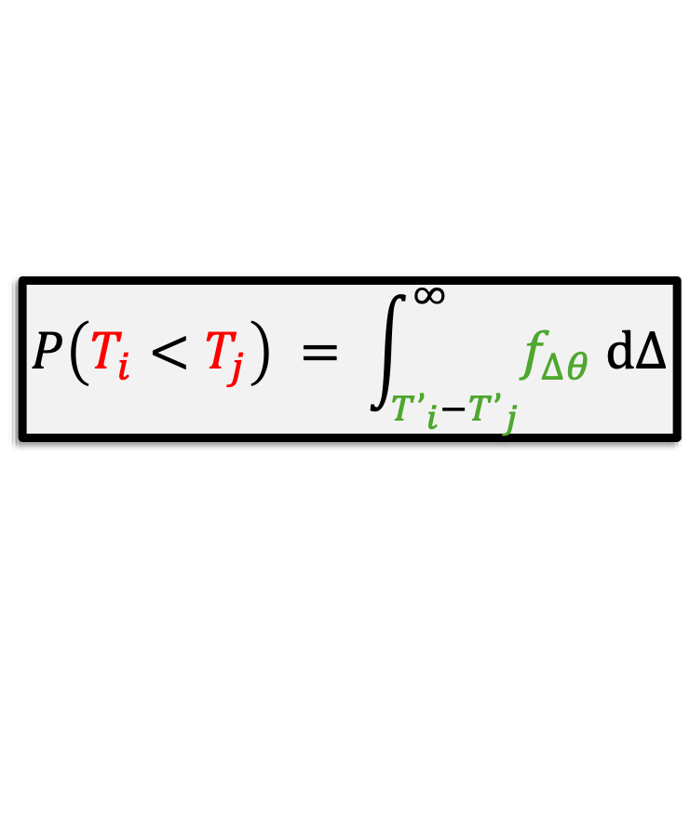
Computation Optimization
Remember from before:
$$P\left(T_{i}<T_{j}\right) = \int_{T’_{i}−T’_{j}}^{∞}{f_{∆θ} d∆}$$
Quadratic time complexity for computing the pairwise probability
Notes:
A simple way to implement the above integral is to have two for loops iterating over the distributions, then we find pariwsie differences of the iterating elements and see wehter they are above that threshold or not.

Slide 161
Computation Optimization
Remember from before:
$$P\left(T_{i}<T_{j}\right) = \int_{T’_{i}−T’_{j}}^{∞}{f_{∆θ} d∆}$$
Although the value of individual timestamps is not bounded, their difference will always fall in a relatively small range

Slide 162
Computation Optimization
Remember from before:
$$P\left(T_{i}<T_{j}\right) = \int_{T’_{i}−T’_{j}}^{∞}{f_{∆θ} d∆}$$
Although the value of individual timestamps is not bounded, their difference will always fall in a relatively small range
Precompute to enable faster calculation

Slide 163
Evaluation

Slide 164
Setup
Ground truth does not exist in the real world
No perfect clock synchronization
Cannot know in what order events were generated across clients
We resort to simulations as we can construct a ground truth there

Slide 165
Setup
Ground truth does not exist in the real world
No perfect clock synchronization
Cannot know in what order events were generated across clients
We resort to simulations as we can construct a ground truth there
Server
Fat tree data center topology + data center wide workload
Another Simulation
Latencies
Clients

Slide 166
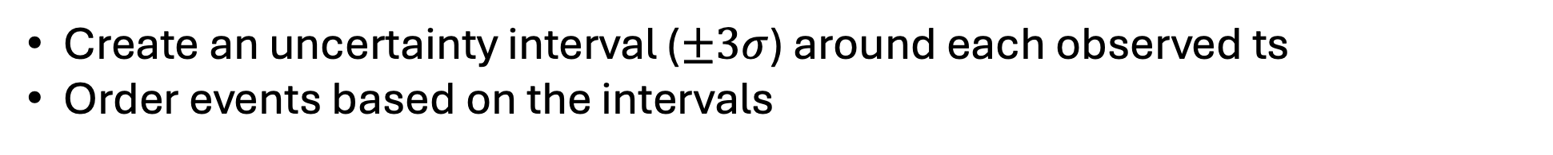
Setup
Ground truth does not exist in the real world
No perfect clock synchronization
Cannot know in what order events were generated across clients
We resort to simulations as we can construct a ground truth there
Clients are fed with a schedule to generate events at specific “simulator” timestamps
Baseline solution for ordering events:
Create an uncertainty interval ($±3σ$) around each observed ts
Order events based on the intervals

Slide 167
Fairness
For each correctly ordered pair of events → +1 score
For each incorrect → -1 score
For a pair left unordered → +0 score
Normalize by total number of pairs

Slide 168
Fairness

Slide 169
Fairness
We further evaluate fairness by sweeping several parameters
Number of messages, number of clients, clock errors, clock synchronization probes, etc.

Slide 170
Remarks
Probabilistic fair ordering can be achieved by modeling time as a random variable
Tools from social choice theory helpful in dealing with intransitivity induced by the probabilistic comparisons
Useful when the clock synchronization accuracy is not sufficient for an application
It has many more use cases other than achieving latency fairness in competitive systems
Scaling timestamped packet capture systems
Devising hypothesis from imperfect observability data for debugging

Slide 171
Onyx
Tommy

Slide 172
Onyx
Achieving latency fairness probabilistically (inbound direction)
Achieving latency fairness in a cloud financial exchange
+
Achieving high performance while retaining latency fairness
Tommy

Slide 173
Future Work
Thank you!
Real world deployment of Tommy Studying performance and devising mechanisms for scalability
Theoretical treatment of Tommy
Efficiency of online mechanism (regret bounds etc.)
Extending partial order to total order by balancing out unfairness
Building systems atop Tommy Timestamped packet capture, observability
Expanding trust models for Onyx and Tommy

