Slide 1




Probabilistic Fair Order of Events
Haseeb Ashfaq, Jinkun Geng, Aurojit Panda, Radhika Mittal, Nirav Atre, Srinivas Narayana, Anirudh Sivaraman
NYU, UIUC, Rutgers University, CMU
Notes:
cat

Slide 2
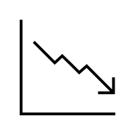
A Financial Market
Notes:
Lets imagine a financial market, where we have a stock

Slide 3




A Financial Market
Notes:
And several buyers are interested in buying

Slide 4

A Financial Market

Slide 5
A Financial Market
1 share, 4 buyers
Who gets to buy?
whoever asked first!
Notes:
But we run into this problem: ther is only 1 share of the stock to sell, but four interested buyers.
A question arises: who gets to buy it. Well a simple anwer is: whoever asked first. And this answer is actually used by many financial market today.

Slide 6
A Financial Market
whoever asked first!
How do we know that?
Fair Ordering
Notes:
But how do we know who asked first, after all networks are asynchronous and the server may receive information about events in an arbitrary order, not necessarily in the order of events occurence.
That’s why we need a mechanism to fairly order the events.

Slide 7
Fair Ordering
Events generated by clients should be observed by a server in the same order as their generation order!
Notes:
We define fair ordering as : events generated by clients, they should be observed by a server in the same order as their true occurrence order. True occurrence order is hard to determine.
Aa-kUr-Unce

Slide 8
Fair Ordering
Events generated by clients should be observed by a server in the same order as their generation order!

Slide 9

Fair Ordering
Events generated by clients should be observed by a server in the same order as their generation order!
Process events in the order of their timestamps!
Clients with perfectly synchronized clocks
Notes:
But lets say that we have clients with perfectly synchronized clocks. They could timestamp the events they generate. And a server coild process events in the order of their timestamps. It would achieve fair ordering.

Slide 10
Fair Ordering
Events generated by clients should be observed by a server in the same order as their generation order!
Process events in the order of their timestamps!
Clients with perfectly synchronized clocks
Notes:
But here is the problem: perfect clock synchronization is impossible to achieve.

Slide 11
Fair Ordering
Events generated by clients should be observed by a server in the same order as their generation order!
Process events in the order of their timestamps!
Clients with perfectly synchronized clocks
Notes:
That;s why this mechanism is not practical.

Slide 12
Fair Ordering
Our Proposal
It’s impossible to obtain precise timestamps.
Notes:
That;s where our proposal comes into the picture.
We embrach the fact that its impossible to obtain precise timestamps.

Slide 13
Fair Ordering
Our Proposal
It’s impossible to obtain precise timestamps.
because it’s impossible to remove all the error from clocks
But we can probabilistically compare two imprecise timestamps.
Notes:
We can probabilistically compare two imprecise timestamps and that’s the foundation of our system, Tommy that achieves probabilistic fair ordering.

Slide 14
Tommy
Probabilistic Fair Ordering
Our Proposal
:
It’s impossible to obtain precise timestamps.
because it’s impossible to remove all the error from clocks
But we can probabilistically compare two imprecise timestamps.
Enabled by treating time as a Random Variable!

Slide 15
Prior Work
Tommy
Equalized Cables
FIFO
Onyx
SIGCOMM’25
Onyx
On-premises exchanges / private data centers
Single region public cloud
Notes:
Without going into details, the first one is used by financial exchanges where all clients are attached the server using equalized cables, the second is my work but it takes on too many simplifying assumptions.

Slide 16


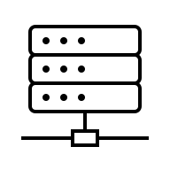


Sequencer Overview
Learned Clock Error Distributions
Clients
Best Effort
Clock Sync.
Events
Tommy, The Sequencer

Slide 17
Sequencer Overview
Learned Clock Error Distributions
Clients
Best Effort
Clock Sync.
1
2
3
4
Events
Tommy, The Sequencer

Slide 18
Sequencer Overview
Learned Clock Error Distributions
Fair Order of Events
Clients
1
2
3
4
Best Effort
Clock Sync.
Events
Output
Tommy, The Sequencer
Notes:
After the slide Ideal time left: 4 minutes

Slide 19
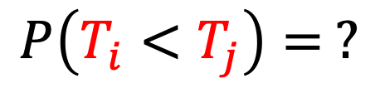




i
j
True Values
$$T_{i}$$
$$T_{j}$$
$$T_{i}^{′}$$
$$T_{j}^{′}$$
Observed Values
$$P\left(T_{i}<T_{j}\right)= ?$$
Notes:
Lets say we have two events I and j
they occur at timestamp Ti and Tj which we cannot know. These are true values.
But what we can observe is: Ti’ and Tj’, which are the clients local clocks’ timestamps.

Slide 20
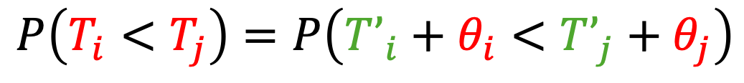
i
j
True Values
$$T_{i}$$
$$T_{j}$$
$$T_{i}^{′}$$
$$T_{j}^{′}$$
Observed Values
$$P\left(T_{i}<T_{j}\right)=P\left(T’_{i}+θ_{i}<T’_{j}+θ_{j}\right)$$
Clock Sync. Errors
Notes:
Here: Theta I and theta j are local clock offsets that we also don’t know. We will try to formulate this probability in a way that on the R.H.S we have no red term.

Slide 21

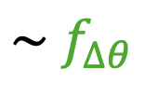

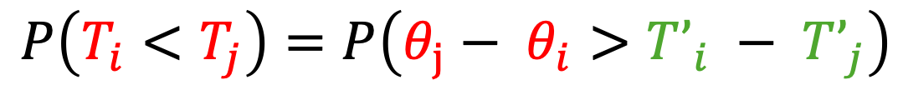
i
j
True Values
$$T_{i}$$
$$T_{j}$$
$$T_{i}^{′}$$
$$T_{j}^{′}$$
Observed Values
$$P\left(T_{i}<T_{j}\right)=P\left(T’_{i}+θ_{i}<T’_{j}+θ_{j}\right)$$
$$P\left(T_{i}<T_{j}\right)=P\left(θ_{j}− θ_{i}>T’_{i} − T’_{j}\right)$$
$$∆θ=θ_{j}−θ_{i}$$
$$\sim f_{∆θ}$$
Learned
$$P\left(T_{i}<T_{j}\right) = \int_{T’_{i}−T’_{j}}^{∞}{f_{∆θ} d∆}$$

Slide 22
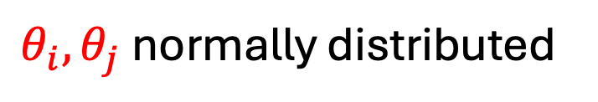


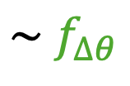


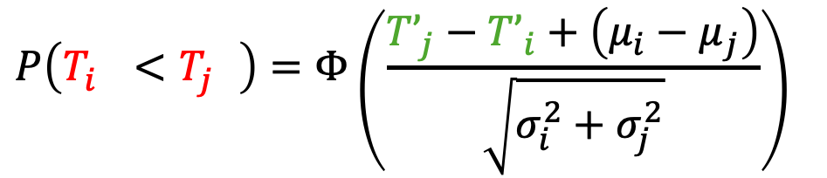
i
j
True Values
$$T_{i}$$
$$T_{j}$$
$$T_{i}^{′}$$
$$T_{j}^{′}$$
Observed Values
$$P\left(T_{i}<T_{j}\right)=P\left(T’_{i}+θ_{i}<T’_{j}+θ_{j}\right)$$
$$θ_{i}, θ_{j} \text{normally} \text{distributed}$$
$$P\left(T_{i}<T_{j}\right)=P\left(θ_{j}− θ_{i}>T’_{i} − T’_{j}\right)$$
$$∆θ=θ_{j}−θ_{i}$$
$$\sim f_{∆θ}$$
$$P\left(T_{i}^{}<T_{j}^{}\right)=Φ\left(\frac{{T’}_{j}−{T’}_{i}+\left(μ_{i}−μ_{j}\right)}{\sqrt{σ_{i}^{2}+σ_{j}^{2}}}\right)$$
$$P\left(T_{i}<T_{j}\right) = \int_{T’_{i}−T’_{j}}^{∞}{f_{∆θ} d∆}$$

Slide 23
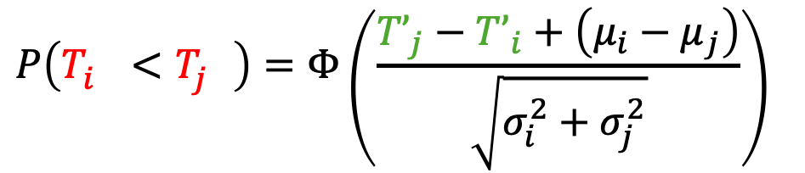
i
$$P\left(T_{i}^{}<T_{j}^{}\right)=Φ\left(\frac{{T’}_{j}−{T’}_{i}+\left(μ_{i}−μ_{j}\right)}{\sqrt{σ_{i}^{2}+σ_{j}^{2}}}\right)$$
j
k

Slide 24
j
i
k
Notes:
Cycles may occur, preventing us from getting a linear order of events
Open Question: Dealing with cycles

Slide 25
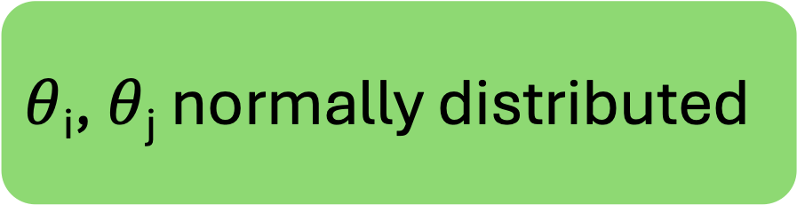
j
$θ$_{i}, $θ$_{j} normally distributed
i
k
No cycles ever!

Slide 26
$θ$_{i}, $θ$_{j} normally distributed
i
j
k
No cycles ever!
Notes:
After the slide ideal time left: 2 minutes

Slide 27
Simulation Result
Clients
1
2
3
500

Slide 28
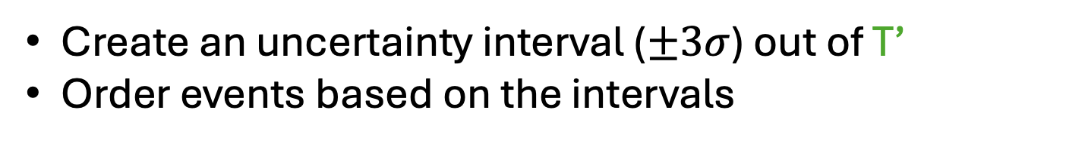
Simulation Result
Clients
Each client:
1
Generates an event at time T
Samples an error from the distribution
Adds error to T to get a simulated observed time T’
T’ and the distributions are shared with the sequencer
2
3
Baseline solution for ordering events:
Create an uncertainty interval ($±3σ$) out of T’
Order events based on the intervals
500
Notes:
Input some distributions

Slide 29

Simulation Result
Baseline
For each correctly ordered pair of events → +1 score
For each incorrect → -1 score
For a pair left unordered → +0 score
Normalize by total number of pairs
$$σ$$
Notes:
Input distribution

Slide 30
Simulation Result
Baseline
$$σ$$

Slide 31
Simulation Result
Baseline
$$σ$$

Slide 32
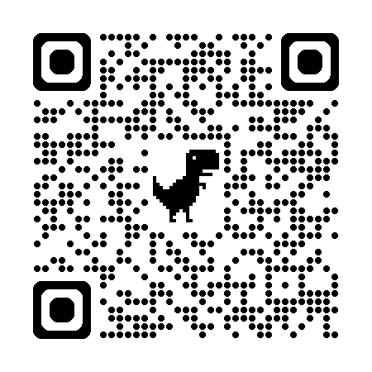
Ongoing
Generalizing to cycles
  Social Choice Theory
Online sequencing
  Efficiency
  Network asynchrony
mh6218@nyu.edu
haseebashfaq.com

