Slide 1
Towards Probabilistic Fair Order
Haseeb Ashfaq, Jinkun Geng, Radhika Mittal, Aurojit Panda, Srinivas Narayana, Anirudh Sivaraman
NYU, UIUC, Rutgers University

Slide 2
Sequencers are everywhere
Used for achieving total order of events
Paxos leader implicitly works as a sequencer
NOPaxos, Hydra, Eris decouple the sequencer from consensus and propose implementing a sequencer as a separate component
All these sequencers achieve a total order that is arbitrary i.e., any total order works.
An arbitrary total order is good enough for conventional applications

Slide 3
Need for Fair Order
An emerging class of applications are not okay with arbitrary order
These applications require a fair order where fairness amounts to achieving an order that respects the event generation order
Financial exchanges, ad exchanges, competitive marketplaces

Slide 4
Challenge
Challenging to achieve fair order in a general distributed setting.
  Two main culprits:
    Noisy timestamps
    Asynchrony in data path
What can we do?
Notes:
Asynchrony also affects the latency between application and local clock

Slide 5
What’s out there?
Onyx
On-premises exchanges / private data centers
Single region public cloud +
time resolution of microseconds
Everywhere
But probabilistic
Notes:
WFO was proposed in my previous project Jasper, quickly explain.

Slide 6
A Simple Solution
Use TrueTime (Spanner) API to represent each timestamp as an interval
Two non-overlapping intervals can be confidently ordered
Two overlapping intervals must be assigned the same sequence number/rank as ordering is uncertain
We will use this as a baseline to compare against.

Slide 7
Probabilistic Fair Ordering
Lamport introduced happened-before,
Causally related events can be related with
Achieves partial order on all causally relatable events
Concurrent events are not relatable with

Slide 8
Probabilistic Fair Ordering
We are precisely interested in ordering these concurrent events
We introduce: likely-happened-before,
x y means x happened before y with probability p
An ordering of events using where p is sufficiently high, is fair
p
p
p

Slide 9
Two Questions
How to find p for two messages to construct the relation?
How to achieve an order of several events from the pairwise relations?

Slide 10
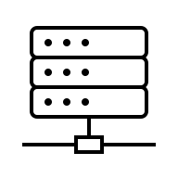
Sequencer Overview – Before Tommy
Arbitrary order
Clients
3
2
1
2
4
Msgs
Output
Sequencer

Slide 11




Sequencer Overview – After Tommy
Learned Clock Offset Distributions
Clients
Best Effort
Clock Sync.
Msgs
Output
Sequencer

Slide 12
Sequencer Overview – After Tommy
Learned Clock Offset Distributions
Fair Partial Order of Messages
p
p
p
Clients
1
2
2
3
4
Best Effort
Clock Sync.
Msgs
Output
Sequencer

Slide 13
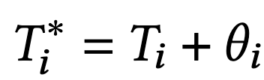
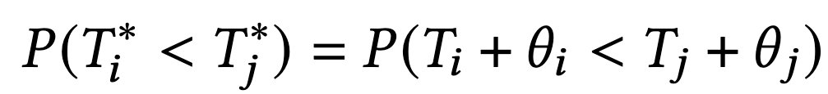
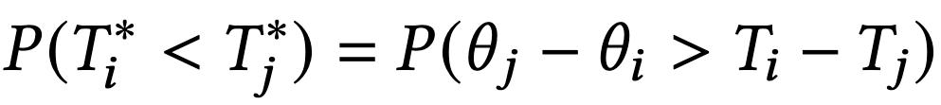
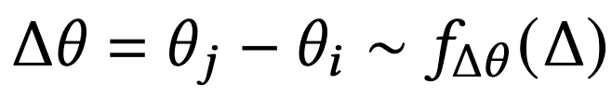
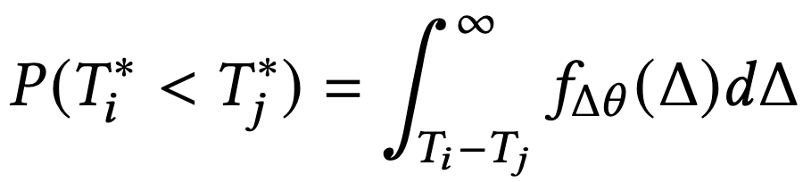
Ordering Probability p
1
True Time = Observed Time + offset

Slide 14
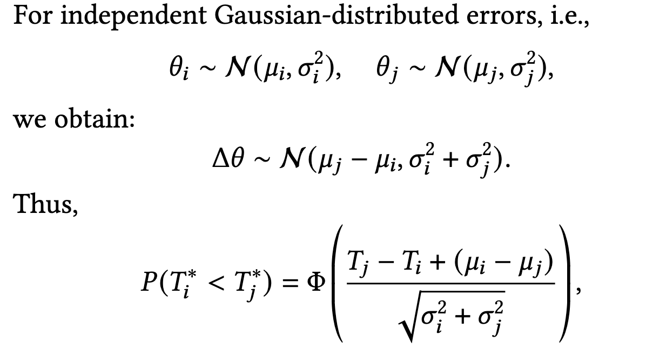
Ordering Probability p
1
True Time = Observed Time + offset
Notes:
Several step omitted for brevity

Slide 15
Ordering Probability p
1
Notes:
I will skip the details of how we find this probability if the distributions are not normal. Hint: Each client learns their own distribution, while the sequencer can use convolutions over those distributions to find what it needs.

Slide 16
Ordering Probability p
For arbitrary distributions, we may not have a known solution form
Sequencer could gather all clock sync. probes from all clients and compute pairwise differences for each pair of probes of two clients.
Then the distribution of these pairwise differences would be our distribution of interest.
Communication and compute intensive

Slide 17
Ordering Probability p
There exists an efficient method:
Each client learns their own clock drift distribution
These learned distributions are shared with the sequencer
Sequencer uses convolutions to learn the respective distributions of clock offset differences
Convolutions computations can be further optimized by using FFT

Slide 18
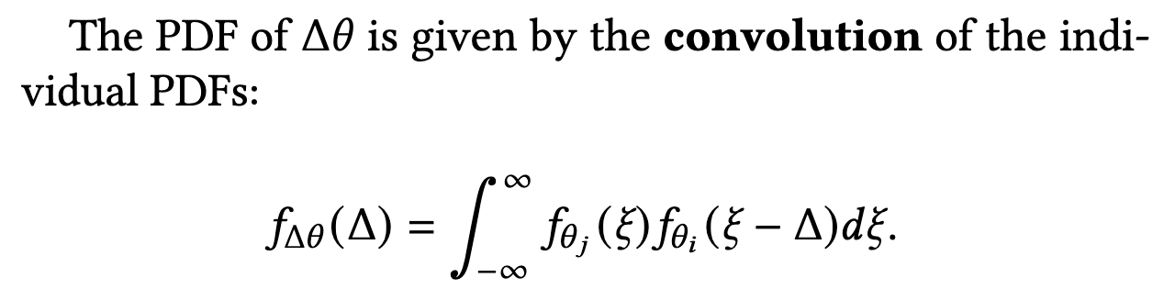
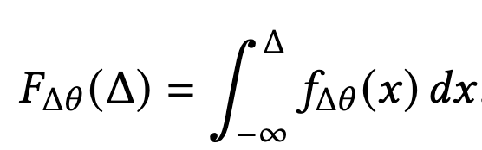

Ordering Probability p

Slide 19

Partial Order
2
happened-before relation is transitive so getting a partial order out of pairwise relations is easy
  A →B and B → C gives us A → B → C
likely-happened-before relation is not necessarily transitive.
  Depends on the clock offset distributions
  For Gaussian, yes it is transitive (proof in the paper)
  For others, it may not be

Slide 20
Partial Order
2
happened-before relation is transitive so getting a partial order out of pairwise relations is easy
  A →B and B → C gives us A → B → C
likely-happened-before relation is not necessarily transitive.
  may lead to cyclic ranking

Slide 21
Partial Order
2
2
1
4
3

Slide 22
Partial Order
2
2
p=0.2
1
p=0.8
4
3

Slide 23
Partial Order
2
With Guassian distributions, there will be no cycles in the resultant graph.
Topo. Ordering of this graph is our ordering of interest
2
1
4
But which topological ordering?
But not in our case.
3
Our resultant graph is a transitive tournament.
Usually, multiple orderings are
possible.

Slide 24
Partial Order
2
1
2
3
4
A transitive tournament has a unique Hamiltonian Path.^{[2]}
[2] About the number of directed paths in tournaments

Slide 25
Partial Order
2
1
2
3
4
But what about intransitivity?
Ordering probabilities may not be transitive, depending on the clock offset distributions
Such intransitivity could lead to cycles in our resultant graph.
Notes:
Efron’s dice, Condorcet paradox

Slide 26
Partial Order
2
1
2
3
4
No Topological Ordering Possible.

Slide 27
Partial Order
2
1
2
3
4
One direction could be to remove enough edges to make the graph acyclic.
Clearly unfair towards some clients/messages
Every time we process a set of messages, remove edges in a way that fairness is achieved over sufficiently long time → Stochastic Fairness

Slide 28
Partial Order
2
1
2
3
4
One direction could be to remove enough edges to make the graph acyclic.
Finding smallest set of edges whose removal makes a graph acyclic is an NP-hard problem in itself.
(Minimum Feedback Arc Set)
Clearly unfair towards some clients/messages
Every time we process a set of messages, remove edges in a way that fairness is achieved over sufficiently long time → Stochastic Fairness

Slide 29
Partial Order
Intransitivity hurts, more research work needed.
With transitivity (via Gaussian distributions), we get a unique linear order.

Slide 30
Partial Order
Once we have a linear ordering, this is not our final ordering yet
Some adjacent elements have ordering probability just more than 0.5, some may have closer to 1. So not a good confidence.
Make batches of adjacent elements so that all the elements of one batch don’t have good enough probability that they can be ordered confidently
Successive batches can be ordered confidently
what we now get is a fair partial order.

Slide 31
Simulation Result

Slide 32
Next steps
Extending the model for online sequencing
  Safe message emission from the sequencer
Characterizing
  Especially transitivity property i.e., when it is safe to assume transitivity, what is the downside of assuming it for arbitrary distributions
Extension to stochastically-fair total order
Evaluating a fair sequencer in the real world
p
Thanks for your attention!

