Slide 1
Towards Probabilistic Fair Order

Slide 2
Sequencers are everywhere
Used for achieving total order of events
Paxos leader implicitly works as a sequencer
NOPaxos, Hydra, Eris decouple the sequencer from consensus and propose implementing a sequencer as a separate component
All these sequencers achieve a total order that is arbitrary i.e., any total order works.
An arbitrary total order is good enough for conventional applications

Slide 3
Need for Fair Order
An emerging class of applications are not okay with arbitrary order
These applications require a fair order where fairness amounts to accounting for event generation timestamp while defining the total order
Financial exchanges, ad exchanges, competitive marketplaces

Slide 4
Challenge
Challenging to achieve fair order in a general distributed setting.
Two main culprits:
Noisy timestamps
Asynchrony in data path: host + physical network
What can we do?

Slide 5
What’s out there?
Onyx
On-premises exchanges / private data centers
Single region public cloud + time resolution of microseconds
Everywhere But probabilistic
Notes:
WFO was proposed in my previous project Jasper, quickly explain.

Slide 6
A Simple Solution
Use TrueTime (Spanner) API to represent each timestamp as an interval
Two non-overlapping intervals can be confidently ordered
Two overlapping intervals must be assigned the same sequence number/rank as ordering is uncertain
We will use this as a baseline later on.

Slide 7
Probabilistic Fair Ordering
Lamport introduced happened-before,
Causally related events can be related with
Achieves partial order on all causally relatable events
Concurrent events are not relatable with

Slide 8
Probabilistic Fair Ordering
I am precisely interested in ordering these concurrent events
I introduce: likely-happened-before,
x y means x happened before y with probability p
An ordering of events using where p is sufficiently high, is fair
p
p
p

Slide 9
Two Questions
How to find p for two messages?
How to achieve a total or partial order from the pairwise relations?

Slide 10
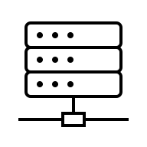
Overview – Before Tommy
Arbitrary order
Clients
3
2
1
2
4
Msgs
Output
Sequencer

Slide 11




Overview – After Tommy
Learned Clock Drift Distributions
Clients
Best Effort Clock Sync.
Msgs
Output
Sequencer

Slide 12
Overview – After Tommy
Learned Clock Drift Distributions
Fair Partial Order of Messages
p
p
p
Clients
1
2
2
3
4
Best Effort Clock Sync.
Msgs
Output
Sequencer

Slide 13
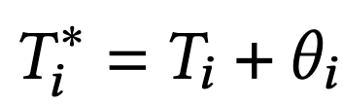
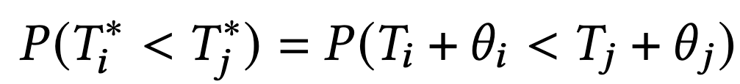
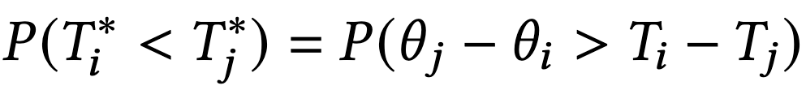
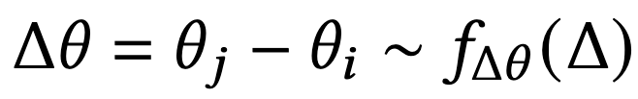
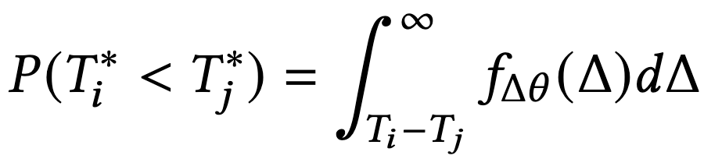
Ordering Probability p
True Time = Observed Time + Drift

Slide 14
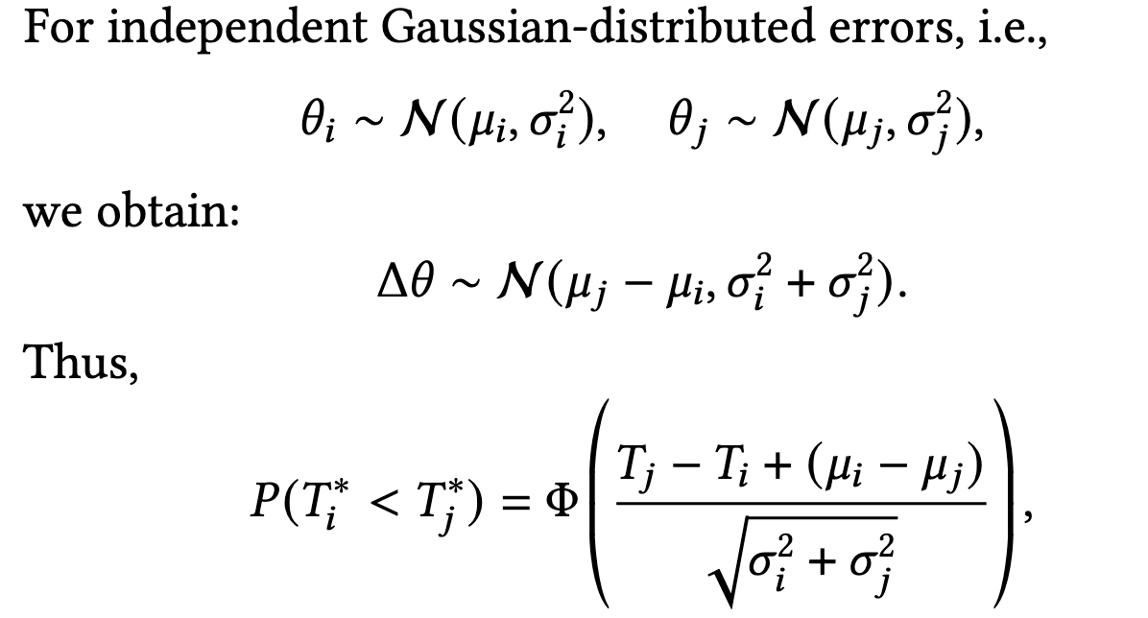
Ordering Probability p

Slide 15
Ordering Probability p
For arbitrary distributions, we may not have a known solution form
Sequencer could gather all clock sync. probes from all clients and compute pairwise differences for each pair of probes of two clients.
Then the distribution of these pairwise differences would be our distribution of interest.
Communication and compute intensive

Slide 16
Ordering Probability p
There exists an efficient method:
Each client learns their own clock drift distribution
These learned distributions are shared with the sequencer
Sequencer uses convolutions to learn the respective distributions of clock offset differences
Convolutions computations can be further optimized by using FFT

Slide 17
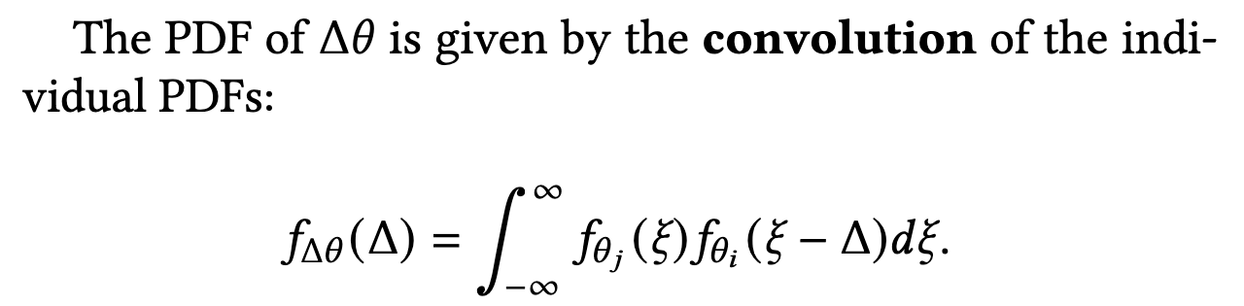
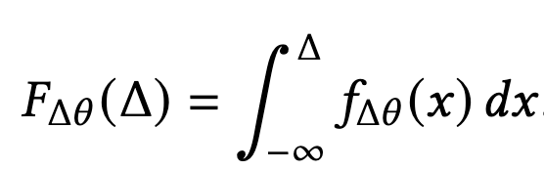

Ordering Probability p

Slide 18
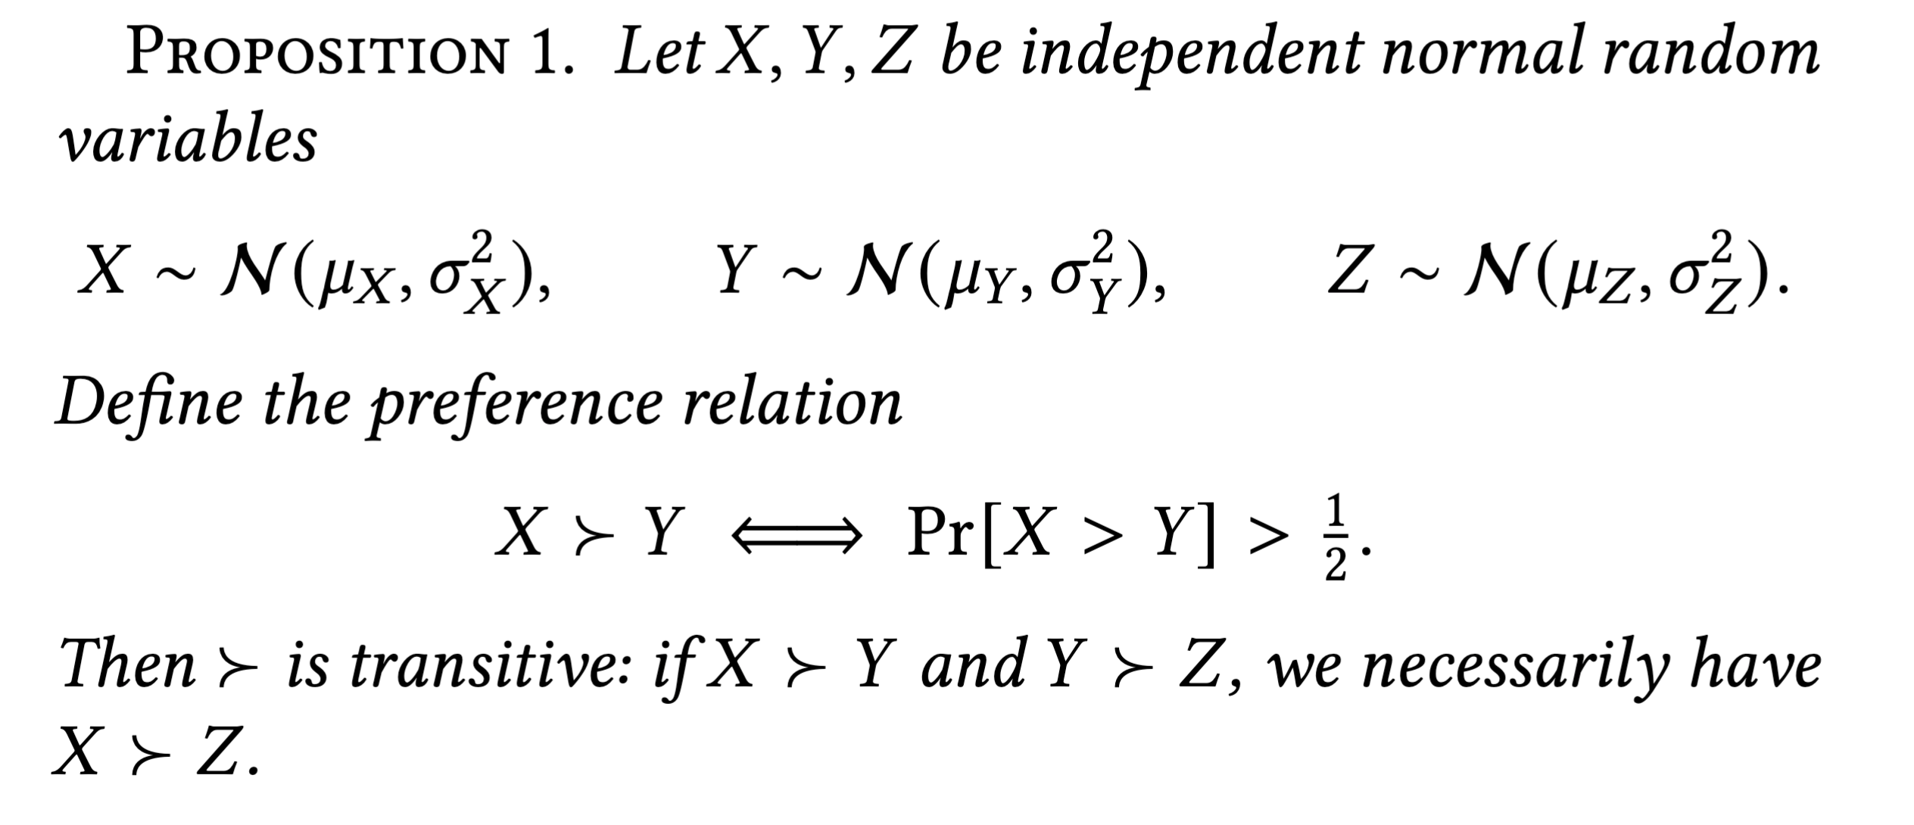
Partial Order
happened-before relation is transitive so getting a partial order out of pairwise relations is easy
A →B and B → C gives us A → B → C
likely-happened-before relation is not necessarily transitive.
Depends on the clock drift distributions
For Gaussian, yes it is transitive (proof in the paper)
For others, it may not be
A body of literature on finding a ranking of players out of pairwise games that can be looked at

Slide 19
Partial Order
2
1
4
3

Slide 20
Partial Order
2
p=0.2
1
p=0.8
4
3

Slide 21
Partial Order
With Guassian distributions, there will be no cycles in the resultant graph. Topo. Ordering of this graph is our ordering of interest
2
1
4
But which topological ordering?
But not in our case.
3
Our resultant graph is a transitive tournament.
Usually, multiple orderings are possible.

Slide 22
Partial Order
1
2
3
4
A transitive tournament has a unique Hamiltonian Path.^{[2]}
[2] About the number of directed paths in tournaments

Slide 23
Partial Order
1
2
3
4
But what about intransitivity?
Ordering probabilities may not be transitive, depending on the clock drift distributions
Such intransitivity could lead to cycles in our resultant graph.
Notes:
Efron’s dice, Condorcet paradox

Slide 24
Partial Order
1
2
3
4
No Topological Ordering Possible.

Slide 25
Partial Order
1
2
3
4
One direction could be to remove enough edges to make the graph acyclic.
Clearly unfair towards some clients/messages
Every time we process a set of messages, remove edges in a way that fairness is achieved over sufficiently long time → Stochastic Fairness

Slide 26
Partial Order
1
2
3
4
One direction could be to remove enough edges to make the graph acyclic.
Finding minimum number of edges to remove which make the graph acyclic is an NP-hard problem in itself. (Minimum Feedback Arc Set)
Clearly unfair towards some clients/messages
Every time we process a set of messages, remove edges in a way that fairness is achieved over sufficiently long time → Stochastic Fairness

Slide 27
Partial Order
Intransitivity hurts, more research work needed.
With transitivity (via Gaussian distributions), we get a unique linear order.

Slide 28
Partial Order
Once we have a linear ordering, this is not our final ordering yet
Some adjacent elements have ordering probability just more than 0.5, some may have closer to 1. So not a good confidence.
Make batches of adjacent elements so that all the elements of one batch don’t have good enough probability that they can be ordered confidently
Successive batches can be ordered confidently
what we now get is a fair partial order.

Slide 29
Simulation Result

Slide 30
Many next steps.
Extending the model for online sequencing
Characterizing
Especially transitivity property i.e., when it is safe to assume, what is the downside of assuming it for arbitrary distributions
Scalability of the sequencer via hierarchical sequencing
Fault tolerance
Against Byzantine faults?
Extension to stochastically-fair total order
And more.
p

