Slide 1
APPLICATION PROGRAMMING · RWU
PolySignal
Turning public Polymarket wallet behavior into organized, searchable, alertable intelligence.
Habib Asfahani · Matrikel-Nr. 15647172
Prof. Dr.-Ing. Tobias Miunske
⚠
The problem
◎
The solution
€
Entrepreneurial value
Traders, researchers & journalists manually check dozens of wallets, markets, sizes and unusual activity across Polymarket — slow and easy to miss.
One place to add wallets, refresh trades from the public API, filter activity, flag large/unusual trades, export data, and receive Telegram alerts.
Freemium monitoring tool. Pro target $49/mo, benchmarked against comparable prediction-market analytics tools — to be validated with the first user cohort.
Not a trading bot — a monitoring & analysis tool.
PolySignal
1 / 5

Slide 2
Architecture & Methodology
Separation of concerns: refresh pulls external data · pages read only stored data · ML & alerts run from saved records.
Wallet
address
→
Polymarket
API
→
FastAPI
refresh
→
SQLAlchemy
DB
→
Analytics
+ ML score
→
Dashboard /
trade pages
→
Telegram
alert
Why this architecture fits
Data processing
Server-rendered Jinja templates — simple, inspectable, no SPA overhead.
Normal page loads never call the external API → fast & reliable.
Deduplication by trade_id; sync events logged for every refresh.
SQLite locally, PostgreSQL on Render — same code, both targets.
Refresh fetches trades from data-api.polymarket.com via httpx.
Trades normalized → side, price, size, market, timestamp.
Stored rows feed analytics: YES/NO split, top wallets/markets, heatmap.
ML scores each new trade after refresh (NumPy inference, no leakage).
PolySignal
2 / 5

Slide 3
Technical Implementation & Configurations
Stack & key libraries
Key configs & ML hyperparameters
FastAPI · Starlette · SQLAlchemy · Jinja2
httpx · SlowAPI · APScheduler · psycopg
NumPy (inference) · TensorFlow (local train only)
pytest · optional Anthropic SDK
Refresh / page limit
200
Auto-refresh default
off (0 min)
Telegram min trade
$1000 · max 3/wallet
ML min prior trades
10 per wallet
Modular routes: app/main.py · app/ingest.py · app/routes/* · app/alerts.py · app/ml/*
Deployed score threshold
0.7792
Loss / optimizer
BCE · Adam 0.01
Pos-class weight
23.31 (3.5% positive)
Design decisions tested & adjusted
Leakage-safe features
MSE → BCE + class weight
TensorFlow off production
Expanding window per wallet — a trade's own size never feeds its own features.
Plain MSE collapsed to ~0 predictions under 3.5% imbalance; switched loss & weighted the rare class.
Train locally, export weights to JSON, serve NumPy-only inference to fit Render's 512 MB RAM.
PolySignal
3 / 5

Slide 4
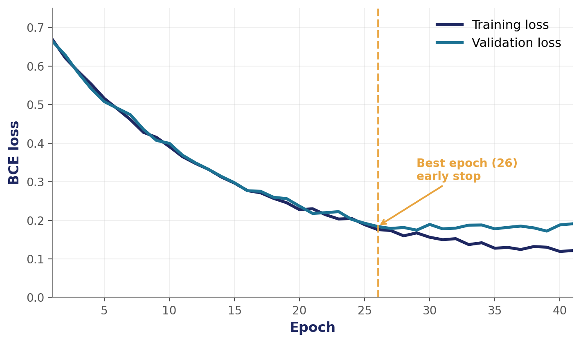
Results & Evaluation
Evaluation dataset = full local database (production runs the same code on a lighter live instance).
48,683
20
7,589
$300.4M
1,139
stored trades
tracked wallets
unique markets
stored trade value
ML-flagged trades
Model evaluation (test set)
Model
Single sigmoid neuron · NumPy inference
Split
33,938 train / 7,272 val / 7,273 test
Test ROC-AUC
0.7231 — ranks unusual trades > random
Test PR-AUC
0.0632 — low base rate (3.5%)
Precision @ thr
0.200
Recall @ thr
0.0198 — by design, rare high-confidence flags
Honest read: an anomaly / notability score, NOT a profit predictor.
BCE loss · 41/100 epochs · early-stop at best epoch 26 (mild overfit after).
PolySignal
4 / 5

Slide 5
Goal Achievement & Digital Implementation
Back to Slide 1 — does it work in practice? The app is deployed on Render and demonstrable live.
Goals met
Honest limitations
Real public data ingested & stored (no synthetic data).
AI method correctly applied — perceptron math → weighted BCE neuron.
Web-based Python app, deployed via Render Blueprint + Postgres.
Entrepreneurial case: freemium tool, Pro target $49/mo (to validate).
Does not predict market outcomes — score is anomaly, not profit.
Recall low at deployed threshold (favors rare, confident flags).
Telegram + external AI require valid config to run.
Polymarket-dependent; needs more resolved-market labels.
Live demo path
Add wallet /
import CSV
→
Refresh →
fetch trades
→
Dashboard
+ metrics
→
Trade detail
+ ML signal
→
Sync status /
healthz
PolySignal
5 / 5

