Slide 1
APPLICATION PROGRAMMING · RWU
PolySignal
Turning public Polymarket wallet behavior into organized, searchable, alertable intelligence.
Habib Asfahani · Matrikel-Nr. 15647172
Prof. Dr.-Ing. Tobias Miunske
⚠
The problem
◎
The solution
€
Entrepreneurial value
Traders, researchers & journalists manually check dozens of wallets, markets, sizes and unusual activity across Polymarket — slow and easy to miss.
One place to add wallets, refresh trades from the public API, filter activity, flag large/unusual trades, export data, and receive Telegram alerts.
Freemium monitoring tool. Pro target $49/mo, benchmarked against comparable prediction-market analytics tools — to be validated with the first user cohort.
Not a trading bot — a monitoring & analysis tool.
PolySignal
1 / 5

Slide 2
Architecture & Methodology
Separation of concerns: refresh pulls external data · pages read only stored data · ML & alerts run from saved records.
Wallet
address
→
Polymarket
API
→
FastAPI
refresh
→
SQLAlchemy
DB
→
Analytics
+ ML score
→
Dashboard /
trade pages
→
Telegram
alert
Why this architecture fits
Data processing
Server-rendered Jinja templates — simple, inspectable, no SPA overhead.
Normal page loads never call the external API → fast & reliable.
Deduplication by trade_id; sync events logged for every refresh.
SQLite locally, PostgreSQL on Render — same code, both targets.
Refresh fetches trades from data-api.polymarket.com via httpx.
Trades normalized → side, price, size, market, timestamp.
Stored rows feed analytics: YES/NO split, top wallets/markets, heatmap.
ML scores each new trade after refresh (NumPy inference, no leakage).
PolySignal
2 / 5

Slide 3
Technical Implementation & Configurations
Stack & key libraries
Key configs & ML hyperparameters
FastAPI · Starlette · SQLAlchemy · Jinja2
httpx · SlowAPI · APScheduler · psycopg
NumPy (inference) · TensorFlow (local train only)
pytest · Docker
Refresh / page limit
200
Auto-refresh default
off (0 min)
Telegram min trade
$1000 · max 3/wallet
ML min prior trades
10 per wallet
Modular routes: app/main.py · app/ingest.py · app/routes/* · app/alerts.py · app/ml/*
Learning rate η
0.1
Loss / optimizer
MSE · SGD
Update rule
w ← w + η(y − ŷ)x
Design decisions tested & adjusted
Leakage-safe features
Lecture math, deployed
TensorFlow off production
Expanding window per wallet — a trade's own size never feeds its own features. Excludes the value features the label is derived from.
Single sigmoid neuron with MSE loss and SGD (η = 0.1) — exactly the perceptron from the course, trained on 288k real trades.
Train locally, export weights to JSON, serve NumPy-only inference to fit the 512 MB free-tier RAM budget.
PolySignal
3 / 5

Slide 4
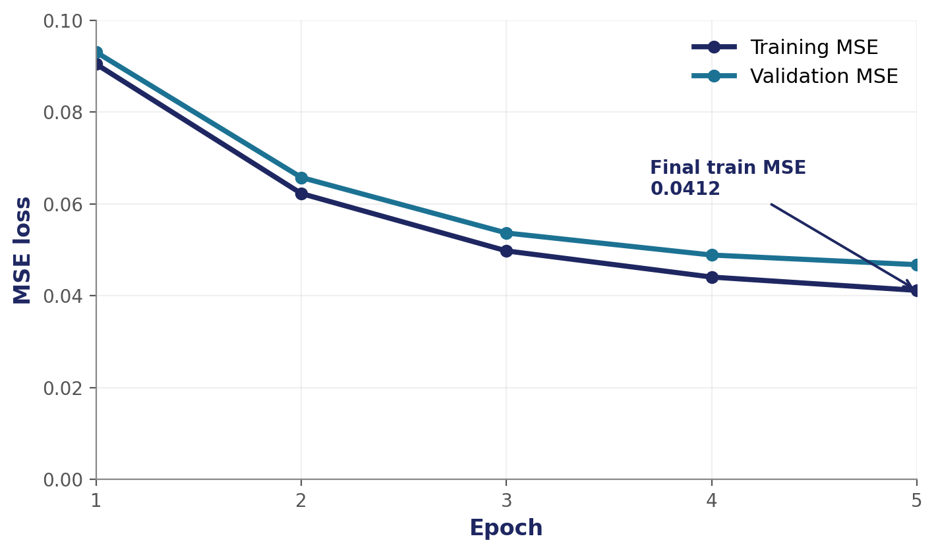
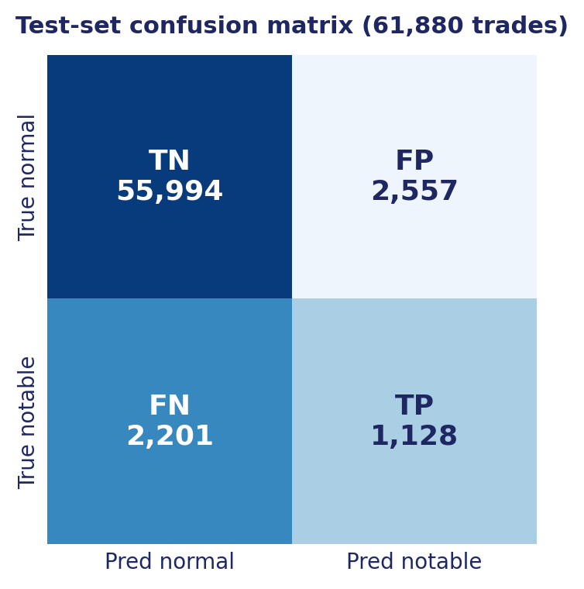
Results & Evaluation
Evaluation dataset = full local database (production runs the same code on a lighter live instance).
414,889
239
59,097
$1.88B
17,577
stored trades
tracked wallets
unique markets
stored trade value
ML-flagged trades
Test-set metrics
Split
288,771 / 61,879 / 61,880
Precision
0.306
Recall
0.339
F1-score
0.322
Final MSE
0.0412
Base rate
~5% notable
MSE loss · 5 epochs · SGD η = 0.1 · final train MSE 0.0412.
Anomaly score, NOT a profit predictor.
PolySignal
4 / 5

Slide 5
Goal Achievement & Digital Implementation
Back to Slide 1 — does it work in practice? The app is deployed to the cloud and demonstrable live.
Goals met
Honest limitations
Real public data ingested & stored — 414k trades, no synthetic data.
AI method correctly applied single sigmoid neuron, MSE + SGD
Web-based Python app, deployed via cloud Blueprint + Postgres.
Leakage-safe by design · 349 tests passing · entrepreneurial case.
Does not predict market outcomes score is anomaly, not profit.
Profit/outcome model tested but kept experimental: doesn't beat market-implied price (ROC 0.871 vs 0.878).
Telegram + external AI require valid config to run.
Polymarket-dependent; outcome model is data-starved on resolved markets.
Live demo path
Add wallet /
import CSV
→
Refresh →
fetch trades
→
Dashboard
+ metrics
→
Trade detail
+ ML signal
→
Sync status /
healthz
PolySignal
5 / 5

