Slide 1
WEST ICRH Antenna
Plasma Coupling Calculations with HFSS
Trucs et astuces

Slide 2
Plasma relative permittivity is defined as |S-D|
Messiaen, A., Dumortier, P., Kyrytsya, V., Louche, F., Vervier, M., 2011. Simulation of ICRF antenna plasma loading by a dielectric dummy load. Application to the ITER case. Fusion Engineering and Design 86, 855–859. https://doi.org/10/bj5vjz
Need to defined a radial permittivity profile
  Defined as an equation
  Or using interpolated data from density n_{e} profile
    Using a Project Dataset (need to define a project variable $epsr_profile
    Define material relative permittivity as piece-wise interpolated function:
    pwl($epsr_profile, X)
    NB: in material editor, X,Y,Z are the ones of the global frame)
  To plot the permittivity profile “as understood by HFSS”, in the equation editor:
    Number→Vector→X=1 ➔ Matl →permittivity ➔Mag ➔ Constant → Eps0 ➔ / to get:
    /(Mag(epsi*(<1,0,0>)), 8,8541e-12)

Slide 3
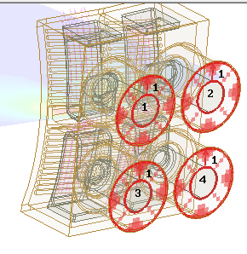
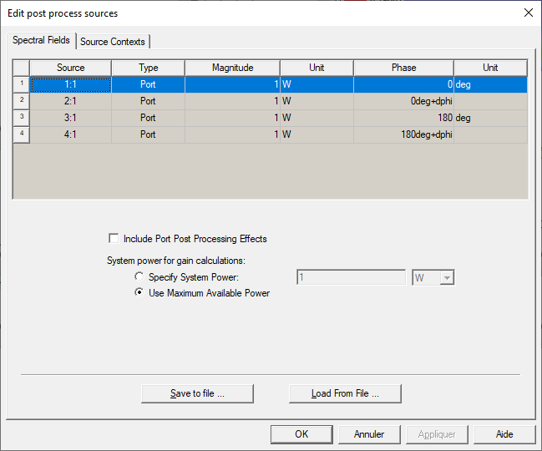
Excitation
Pay attention to the unit of a constant when adding a parameter

