Slide 1


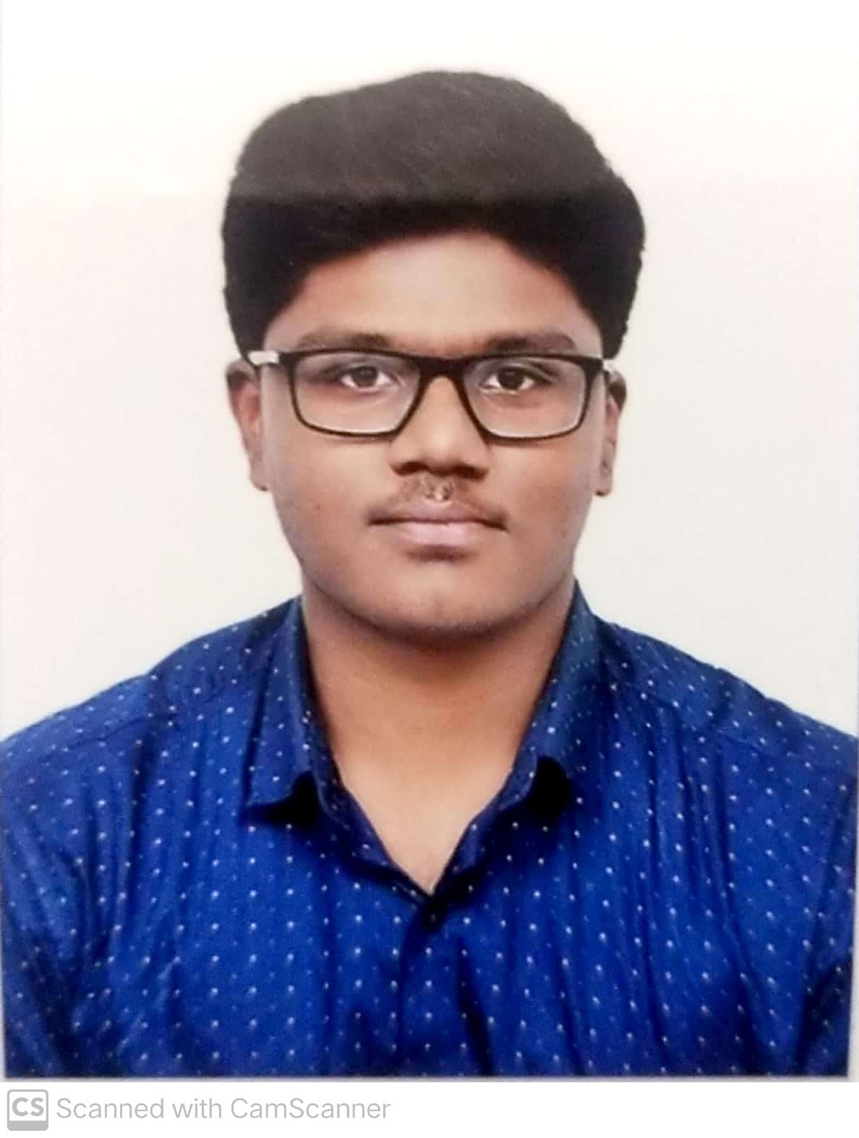
Review 3
SafeScape — On-Device Acoustic Distress & Hazard Recognition
Group No: 1 Category: Research-Product-Software
Faculty Guide: Dr. Bagyammal T, Professor, CSE Department
TEAM MEMBERS
Roll No | Name | Photo | Email ID | Mobile No | GitHub URL
Cb.en.u4ece23222 | Amruth Rohan KR |  | Cb.en.u4ece23222@cb.students.amrita.edu | 9994454198 | https://github.com/AmruthRohan
Cb.en.u4ece23219 | Harish Venkat VS |  | Cb.en.u4ece23219@cb.students.amrita.edu | 8807792343 | https://github.com/Hash-486
LinkedIn Product Demo: [URL] GitHub Repository: https://github.com/Hash-486/SafeScape
Course: 23CSE473 — Neural Networks and Deep Learning
2

Slide 2
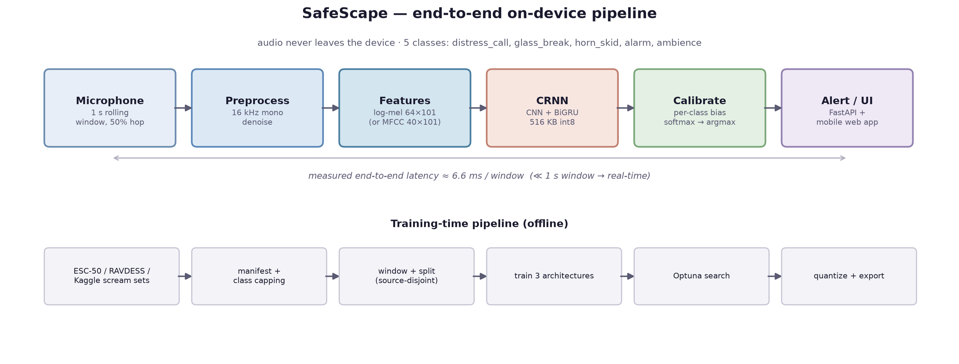
Integration — every model behind one interface
Review 3 · 6 marks
endpoint | used by | does
POST /predict?model=<key> | mobile app | one model (default CRNN) — unchanged from Review 1
POST /predict/all | dashboard | one clip → all three models, with per-model latency
GET /models | dashboard | test metrics, owner and served size per model
GET /testclips | dashboard | 20 held-out clips with ground truth
Each model is a self-contained bundle (weights, label map, pre-processing config, calibration); all share the same multi-window serving rule, so differences are architectural.

Slide 3
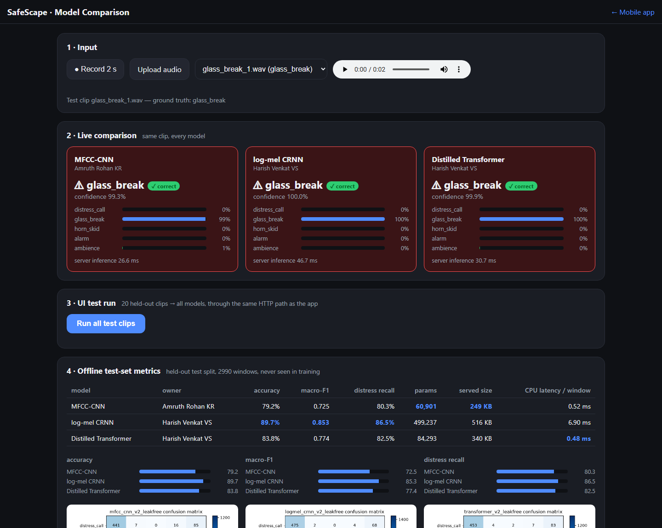
Comparison dashboard — same clip, every model
Review 3 · 6 marks
INPUTS
▪ record 2 s from the microphone
▪ upload any audio file
▪ pick one of 20 held-out test clips
PER MODEL
▪ label, confidence, full probability bars
▪ server inference time
▪ ✓ / ✗ against ground truth when known
No external libraries or CDN — runs offline on the demo laptop.

Slide 4
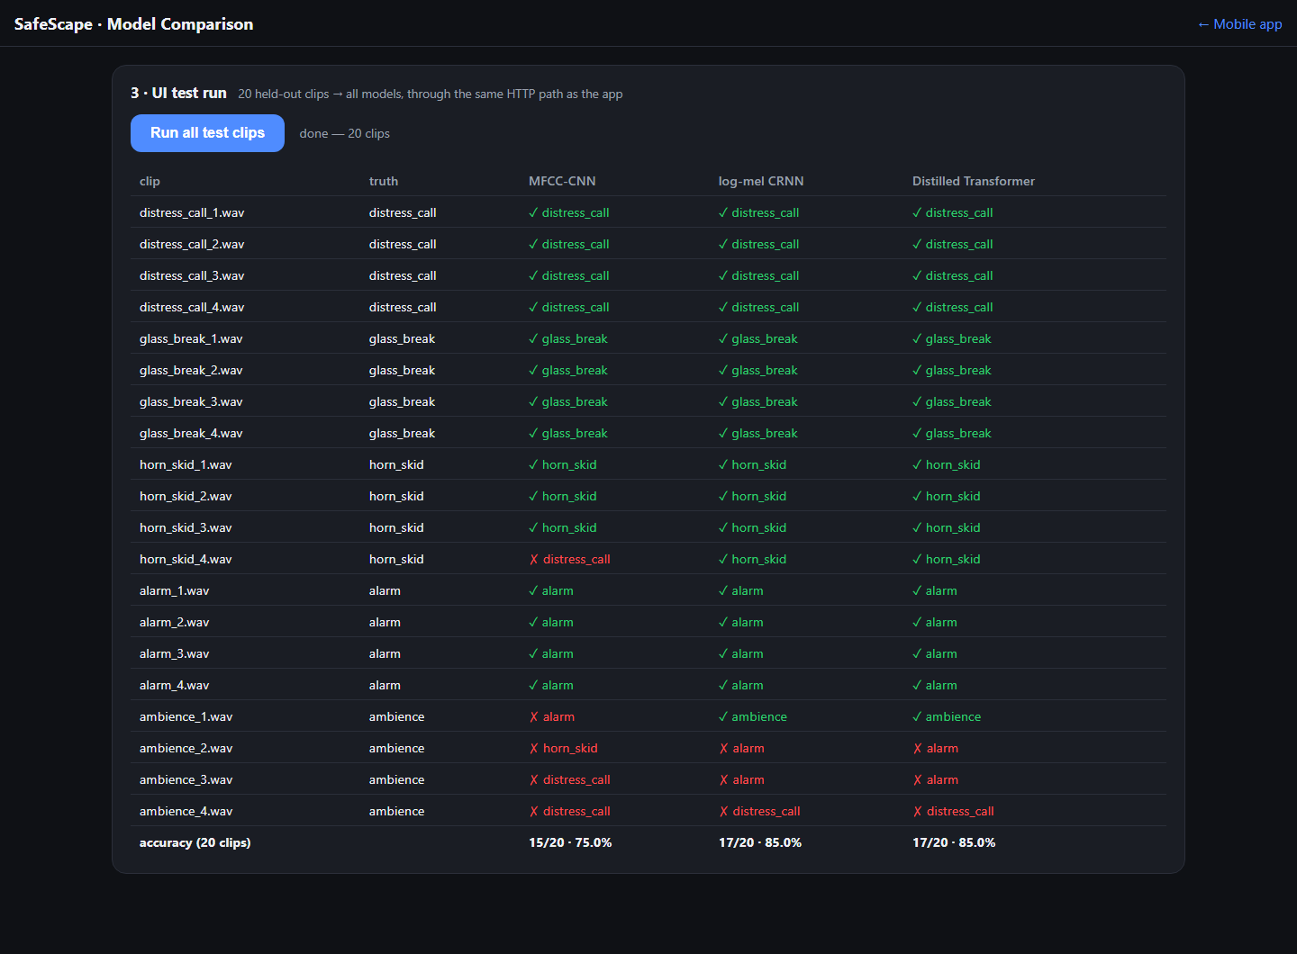
UI testing — 20 held-out clips through the interface
Review 3 · 6 marks
class | MFCC-CNN | CRNN | Transformer
distress_call | 4/4 | 4/4 | 4/4
glass_break | 4/4 | 4/4 | 4/4
horn_skid | 3/4 | 4/4 | 4/4
alarm | 4/4 | 4/4 | 4/4
ambience | 0/4 | 1/4 | 1/4
total | 15/20 | 17/20 | 17/20
WHAT THE TEST SHOWS
▪ Hazards: 47 of 48 model×clip calls correct
▪ Ambience is the weak spot: the serving rule lets any hazard window decide the clip — a deliberate false-alarm bias
▪ Clips are cut around their loudest second, which makes ambience harder than real use
Next: require two consecutive hazard windows before alerting.

Slide 5
Functional and edge-case tests
Review 3 · 6 marks
test | expected | result
Hazard in first or second half of a clip | detected | pass — all 4 hazard classes
Ambience followed by 1 s of silence | ambience | fail — distress_call 0.77 (same with the earlier model; pre-processing)
2 s of silence | ambience, every model | pass — energy gate
0.33 s clip | every model answers | pass — zero-padded window
Unknown model key | HTTP 404, server stays up | pass
No microphone access (LAN http) | record disabled with reason | pass — upload/test clips still work
Existing mobile app on the new server | unchanged | pass — 80/99 smoke test, all 5 classes
First request latency | inference only | pass — models warmed at startup (1.3 s → 47 ms)
Found and fixed by UI testing: the server originally judged only the last second of each 2 s clip, so a glass break in the first half was missed. Every window is now classified and the regression test guards it.

Slide 6
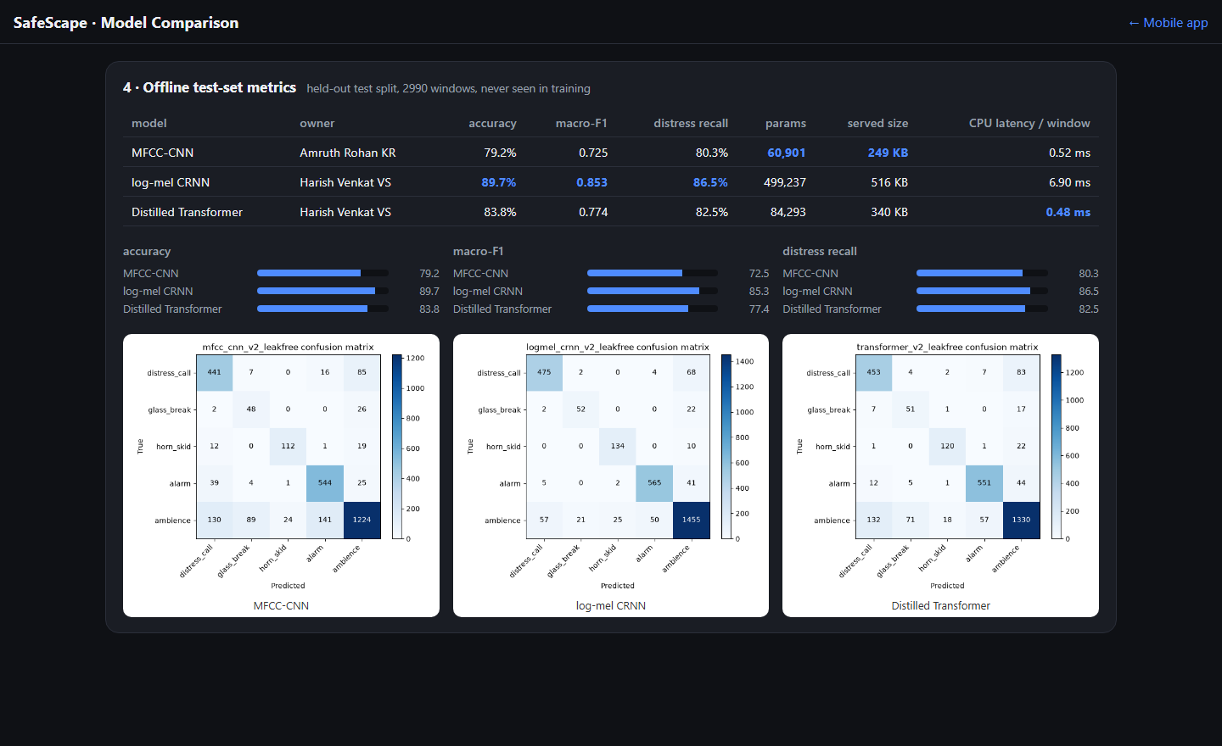
Offline metrics, as served by the dashboard
Review 3 · 6 marks

Slide 7
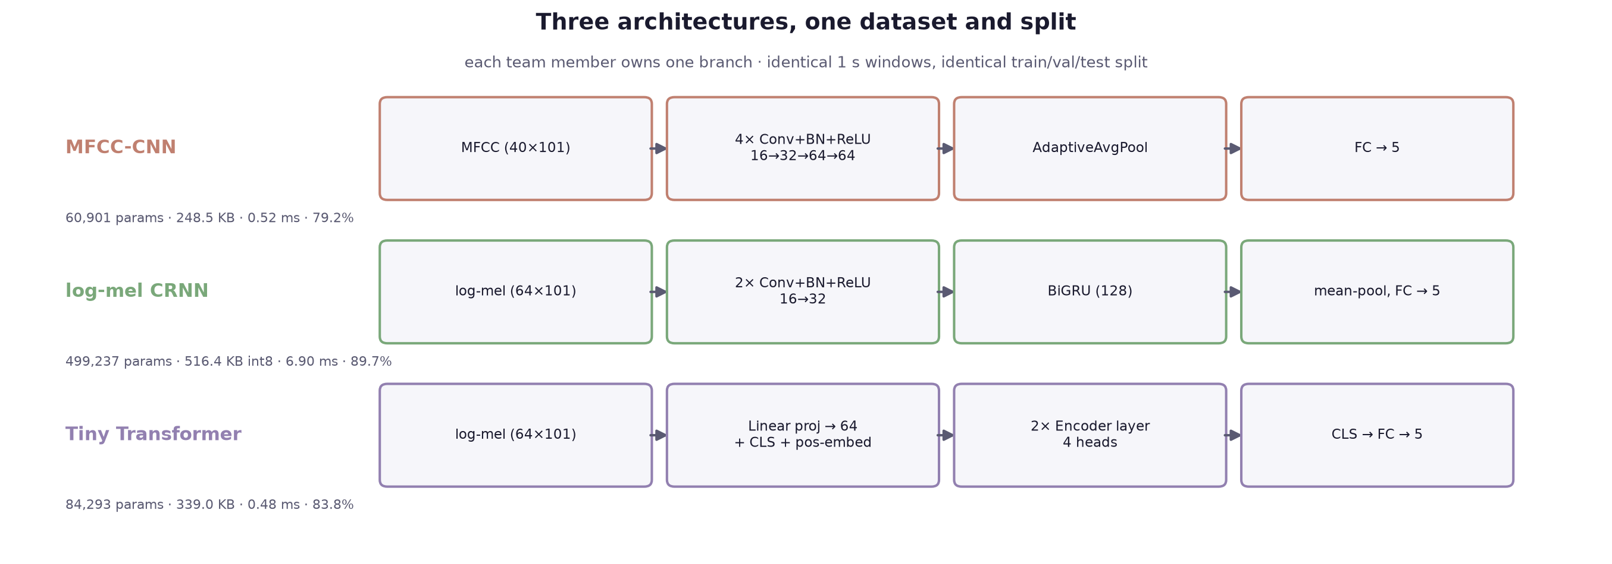
Three-model comparison — leak-free test split
Review 3 · 6 marks
model | owner | accuracy | macro-F1 | distress recall | params | served size | CPU / window
MFCC-CNN | Amruth Rohan KR | 79.2% | 0.725 | 80.3% | 60,901 | 249 KB | 0.52 ms
log-mel CRNN | Harish Venkat VS | 89.7% | 0.853 | 86.5% | 499,237 | 516 KB | 6.90 ms
Distilled Transformer | Harish Venkat VS | 83.8% | 0.774 | 82.5% | 84,293 | 340 KB | 0.48 ms
READING THE TABLE
▪ CRNN leads every quality metric: macro-F1 0.853 vs 0.774 / 0.725
▪ Transformer: 17% of the CRNN's parameters, 14× faster per window
▪ MFCC-CNN: smallest and fastest, weakest on glass_break
All three are far inside the 1 s real-time budget, so hazard recall decides: the quantized CRNN ships as the default.

Slide 8
Per-class comparison
Review 3 · 6 marks
class | MFCC-CNN P | MFCC-CNN R | MFCC-CNN F1 | CRNN P | CRNN R | CRNN F1 | Transformer P | Transformer R | Transformer F1
distress_call | 0.71 | 0.80 | 0.75 | 0.88 | 0.87 | 0.87 | 0.75 | 0.83 | 0.79
glass_break | 0.32 | 0.63 | 0.43 | 0.69 | 0.68 | 0.69 | 0.39 | 0.67 | 0.49
horn_skid | 0.82 | 0.78 | 0.80 | 0.83 | 0.93 | 0.88 | 0.85 | 0.83 | 0.84
alarm | 0.77 | 0.89 | 0.83 | 0.91 | 0.92 | 0.92 | 0.89 | 0.90 | 0.90
ambience | 0.89 | 0.76 | 0.82 | 0.91 | 0.90 | 0.91 | 0.89 | 0.83 | 0.86
DISCUSSION
▪ glass_break separates the models most (F1 0.43 / 0.69 / 0.49): a transient of a few hundred ms that the CRNN's time axis catches and pooling blurs
▪ alarm and horn_skid are strong for every model since UrbanSound8K added ~5× more data
▪ distress_call recall stays above 80% for all three — the class the proposal prioritises

Slide 9
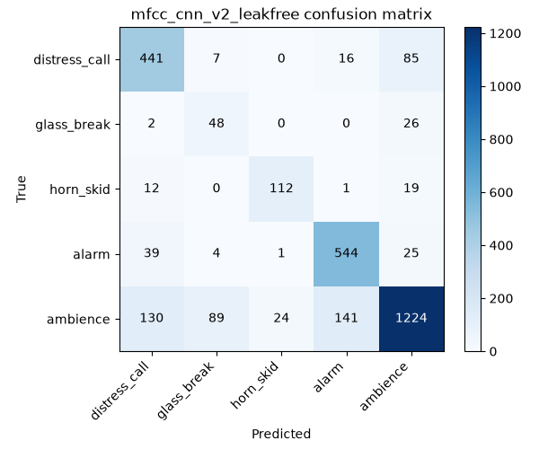
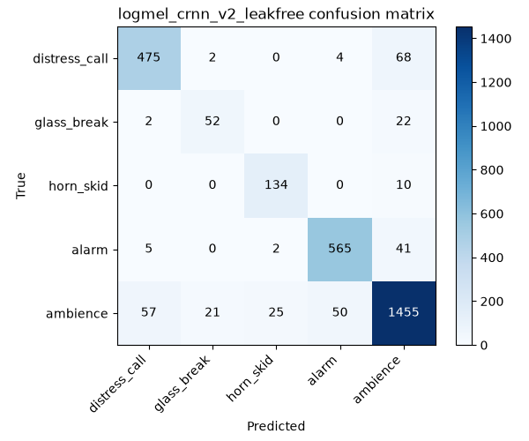
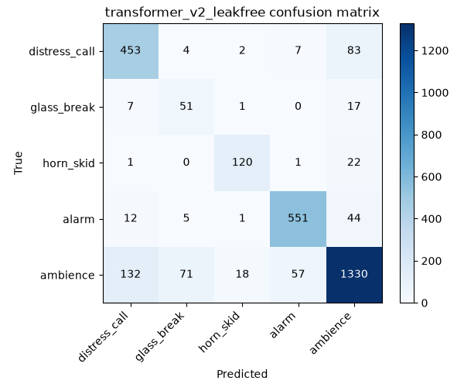
Confusion matrices — leak-free test split
Review 3 · 6 marks
MFCC-CNN · Amruth Rohan KR
log-mel CRNN · Harish Venkat VS
Distilled Transformer · Harish Venkat VS
Rows are the true class. The dominant error for every model is ambience predicted as a hazard — the price of class-weighted training and recall-floored calibration, which deliberately prefer a false alarm to a missed scream.

Slide 10
Limitations and next steps
Review 3 · 6 marks
▪ Distress audio is acted / emotional speech — a consented, self-recorded India-context set is the most valuable next step
▪ 169 validation windows still duplicate training audio — re-split on content hashes
▪ Ambience false alarms at clip level — require agreement between consecutive windows
▪ Ambience followed by silence reads as distress_call — likely per-window normalisation, not yet confirmed
▪ Inference runs on a laptop over LAN — export to TorchScript/ONNX for on-phone inference
▪ Phone microphone needs HTTPS — certificate or native wrapper
Deliverables: working app + dashboard, three trained models, case study report, code at github.com/Hash-486/SafeScape

