Slide 1


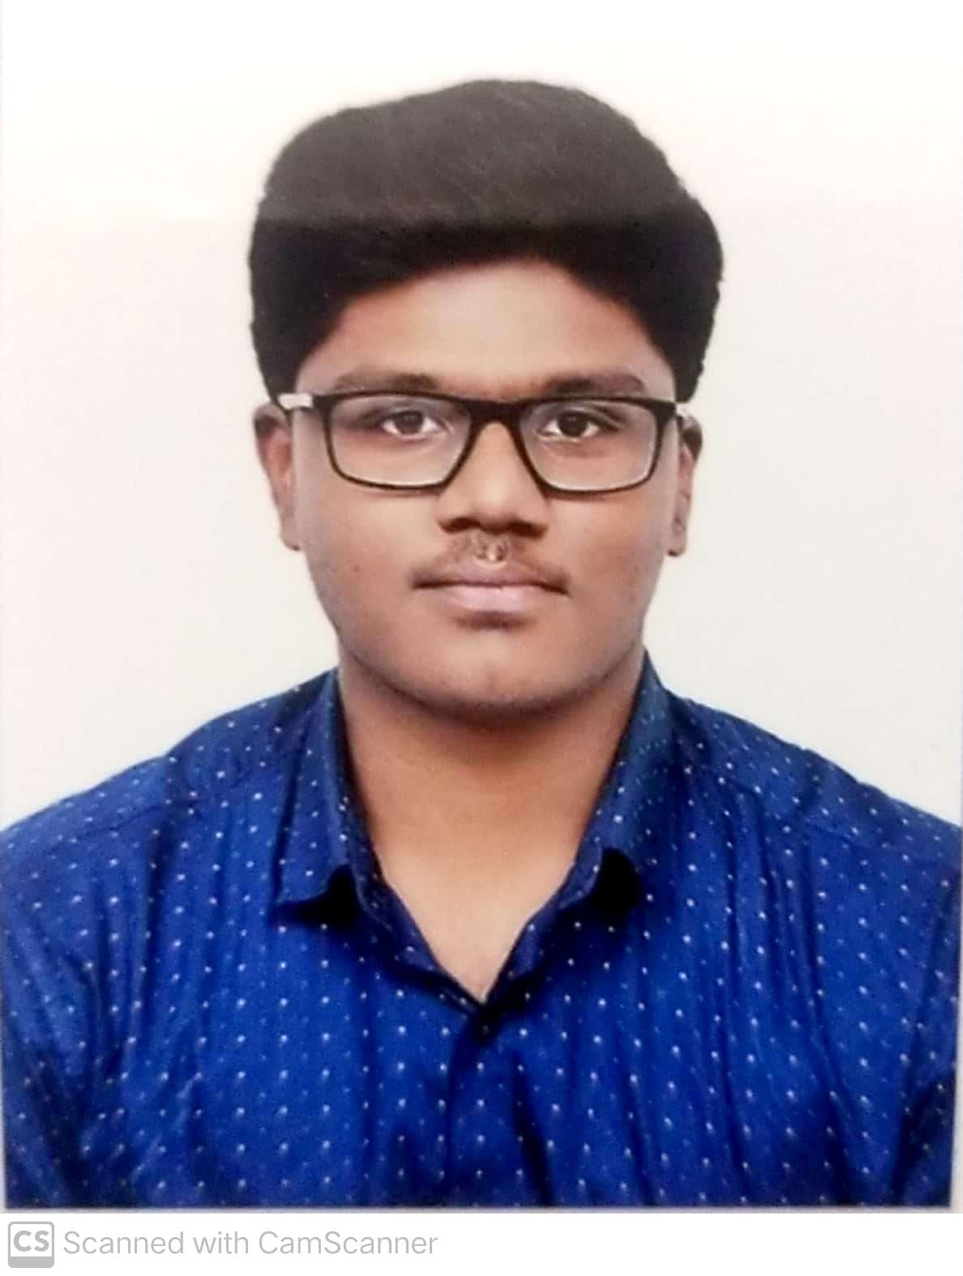
SafeScape — On-Device Acoustic Distress & Hazard Recognition
Group No: 1 Category: Research-Product-Software
Faculty Guide: Dr. Bagyammal T, Professor, CSE Department
TEAM MEMBERS
Roll No | Name | Photo | Email ID | Mobile No | GitHub URL
Cb.en.u4ece23222 | Amruth Rohan KR |  | Cb.en.u4ece23222@cb.students.amrita.edu | 9994454198 | https://github.com/AmruthRohan
Cb.en.u4ece23219 | Harish Venkat VS |  | Cb.en.u4ece23219@cb.students.amrita.edu | 8807792343 | https://github.com/Hash-486
LinkedIn Product Demo: [URL] GitHub Repository: https://github.com/Hash-486/SafeScape
Course: 23CSE473 — Neural Networks and Deep Learning
2

Slide 2
Problem statement, introduction & motivation
Rubric 1 · 4 marks
PROBLEM
Every mainstream personal-safety technology — panic buttons, GPS trackers, wearable alarms — requires the victim to consciously act: unlock a phone, press a button, speak a wake phrase.
In real assault, harassment or accident scenarios victims frequently cannot do this, due to shock, physical restraint, or simply lack of time.
There is no widely available, low-cost, privacy-preserving system that passively senses non-verbal acoustic distress cues and raises an alert automatically — fully on-device, without streaming audio to a cloud service.
MOTIVATION
▪ A large share of incidents of violence against women occur where the victim has no realistic opportunity to manually summon help.
▪ Screams, glass breaking and crashes carry strong, learnable acoustic signatures — embedded scream detectors already reach ~90% with sub-megabyte models.
▪ Commercial safety apps (bSafe, Raksha) are exclusively manual-trigger; none use passive multi-class acoustic sensing.
▪ TinyML techniques (quantisation, pruning, distillation) now make continuous phone-CPU inference realistic at low battery cost.
OBJECTIVE
Classify 1-second rolling audio windows into 5 classes in near real time, fully offline, in a model small enough to live on a phone.

Slide 3
Similar Products in the Same Area:
Product Name | URL | Features | Limitation
bSafe | getbsafe.com | SOS button, voice-activated alarm, live location sharing with guardians | Victim must trigger it (button or spoken keyword); no passive sensing of distress sounds
112 India (ERSS) | 112.gov.in | National emergency app: panic button sends location to the Emergency Response Support System | Manual trigger only; useless if the victim is restrained, in shock or out of time
Apple Sound Recognition | support.apple.com | On-device detection of glass breaking, sirens, shouting, alarms, car horns | Accessibility notification to the phone owner only; no hazard alert or escalation to contacts
4

Slide 4
Abstract of Product:
SafeScape listens to 1-second rolling audio windows on the device and classifies them into five classes — distress_call, glass_break, horn_skid, alarm, ambience — raising an alert automatically, with no button press and no audio leaving the phone. Three architectures (MFCC-CNN, log-mel CRNN, distilled Tiny Transformer) were trained on one source-disjoint dataset; the calibrated log-mel CRNN reaches 89.8% test accuracy at 516 KB and 11.6 ms per window.
Novelty:
1
State of the Art
2
Product
3
Product Features
4
Research Gap Focused
Hazard-sound detectors in the literature are single-class (scream vs. not) or cloud-based; none combine a multi-class safety taxonomy with on-device, sub-MB inference.
A passive, automatic safety layer: it hears the event and alerts, instead of waiting for the victim to press a button or speak a wake phrase.
5-class hazard taxonomy · 1 s windows, 50% overlap · 516 KB INT8 model · 11.6 ms/window · calibrated hazard-recall floor · mobile web UI with alert history.
Architecture comparison (CNN vs. CRNN vs. Transformer) on one dataset and split, and a safety-constrained operating point instead of a headline-metric one.
5

Slide 5
Member Contributions
Technical contribution of each team member
Member Name | Contribution (Technical)
Amruth Rohan KR Cb.en.u4ece23222 | MFCC-CNN branch: MFCC feature pipeline (40 coefficients), CNN design and training; literature survey for the MFCC-CNN architecture.
Harish Venkat VS Cb.en.u4ece23219 | log-mel CRNN (champion) and Distilled Tiny Transformer: model design, Optuna search, knowledge distillation, quantisation and calibration; literature survey for both architectures.
6

Slide 6
Literature survey — MFCC-CNN
Rubric 2 · 5 marks
Amruth Rohan KR · 5 journal papers (2025/2026, Scopus/SJR-indexed venues)
1. Robust Scream Detection and Scream Temporal Interval Prediction Using CNN-Transformer and Windowing CNN
Kim, Jang & Lee · IEEE Access, 13, 71374–71387, 2025 · DOI 10.1109/ACCESS.2025.3556729
Parallel CNN + Transformer with a regression head predicting exact scream start/end. — ~3 pp F-measure gain, ~10× lower EER vs. prior SOTA (relative figures)
2. A lightweight CNN–transformer hybrid architecture with channel attention for real-time hazardous acoustic event detection
Altayeva & Omarov · Frontiers in Artificial Intelligence, 9, art. 1824067, 2026 · DOI 10.3389/frai.2026.1824067
Lightweight CNN + channel attention for 8-class edge-deployable hazard detection. — 93.2% acc · F1 0.86 · 1.35 M params · 0.42 GFLOPs · 14.8 ms/sample
3. Environmental sound classification using two-stream deep neural network with interactive time-frequency attention
Chen & Peng · Applied Acoustics, 238, art. 110794, 2025 · DOI 10.1016/j.apacoust.2025.110794
Two-stream time/frequency branches with depthwise-separable convolutions. — 94.2% on ESC-50 · 95.3% on UrbanSound8K
4. Robust Classification of Urban Sounds in Noisy Environments: SPWVD-MFCC and Dual-Stream Classifier
Peng, Wang & Abdulla · Acoustics Australia, 53(2), 253–268, 2025 · DOI 10.1007/s40857-025-00350-6
Replaces the STFT front-end of MFCC with a Smoothed Pseudo-Wigner–Ville Distribution. — up to 37.2% improvement over STFT-based baselines (relative)
5. Robust Forest Sound Classification Using Pareto-Mordukhovich Optimized MFCC in Environmental Monitoring
Qurthobi, Damaševičius, Barzdaitis & Maskeliūnas · IEEE Access, 13, 20923–20944, 2025 · DOI 10.1109/ACCESS.2025.3535796
Tunes MFCC extraction parameters rather than fixing them; MobileNet/GoogleNet + BiLSTM. — 78.52% average accuracy on FSC22 (27 classes)

Slide 7
Literature survey — log-mel CRNN
Rubric 2 · 5 marks
Harish Venkat VS · 5 journal papers (2025/2026, Scopus/SJR-indexed venues)
1. An Ensemble of Convolutional Neural Networks for Sound Event Detection
Mukhamadiyev, Khujayarov, Nabieva & Cho · Mathematics (MDPI), 13(9), art. 1502, 2025 · DOI 10.3390/math13091502
Ensemble CNN + Bi-GRU CRNN for public-safety sound events incl. screams and breaking sounds. — segment-based F1 71.5% · event-based F1 46%
2. Frequency-Adaptive and Multi-Scale CRNN with Hybrid Sequential Modeling for Sound Event Detection
Zhou & Rui · Circuits, Systems, and Signal Processing (Springer), 2026 · DOI 10.1007/s00034-026-03754-5
Frequency-dynamic convolution + sliding multi-scale module + hybrid-minGRU on DESED 2023. — event-based F1 0.636 · PSDS1 0.589 · PSDS2 0.824
3. ASiT-CRNN: sound event detection with fine-tuning of a self-supervised pre-trained ASiT model
Zheng, Zhang, Atito, Yang, Wang & Mei · Digital Signal Processing, 160, art. 105055, 2025 · DOI 10.1016/j.dsp.2025.105055
Embeds a self-supervised spectrogram transformer into a CRNN backbone. — PSDS1 0.488 · PSDS2 0.767 vs. CRNN baseline 0.351 / 0.552
4. Dangerous Sound Detection Using Convolutional Feature Extraction and Temporal Modeling with BiLSTM
Omarov & Altayeva · Eng. Technology & Applied Science Research, 15(6), 28850–28855, 2025 · DOI 10.48084/etasr.13068
CNN + BiLSTM + attention over 8 hazard classes, 1 s window with 0.5 s hop — same framing as SafeScape. — >90% accuracy · 6.8 ms GPU / 23.5 ms CPU per window
5. Environmental sound classification using convolutional recurrent neural network and data augmentation
Bansal & Garg · Multimedia Tools and Applications, 84(34), 42827–42849, 2025 · DOI 10.1007/s11042-025-20820-3
CRNN over cepstral features with augmentation, motivated by security/crime-investigation use. — 99.89% on UrbanSound8K (verify split protocol before quoting)

Slide 8
Literature survey — Distilled Tiny Transformer
Rubric 2 · 5 marks
Harish Venkat VS · 5 journal papers (2025/2026, Scopus/SJR-indexed venues)
1. CMKD: CNN/Transformer-Based Cross-Model Knowledge Distillation for Audio Classification
Gong, Khurana, Rouditchenko & Glass · IEEE Trans. Pattern Analysis and Machine Intelligence, 48(3), 3571–3585, 2026 · DOI 10.1109/TPAMI.2025.3644853
CNNs and audio spectrogram transformers are mutually effective teachers; students beat their teachers. — ESC-50 96.8% · student 8 M params vs. AST-Base 88 M (~11× smaller)
2. Parameter-efficient target-specialized audio spectrogram transformers via selective cross-domain knowledge distillation
Liang, Luo & Zhong · Knowledge-Based Systems, 332, art. 114893, 2025/2026 · DOI 10.1016/j.knosys.2025.114893
Domain-specific adapters + sparse fusion transfer only useful knowledge into a specialized AST. — matches/outperforms SOTA across six domains, training only a small adapter fraction
3. Acoustic Intelligence with Multi-Stage Model Optimization for Environmental Sound Classification
Sarathchandra, Mallikarachchi, Madushani & Meedeniya · Smart Cities (MDPI), 9(5), art. 86, 2026 · DOI 10.3390/smartcities9050086
Channel pruning → quantization-aware training → distillation, the full compression stack. — 511,033 → 50,774 params (~10×) retaining 96.75% accuracy on ESC-10
4. A Sensor-Based TinyML Acoustic Monitoring System for Edge-Side Recognition on Resource-Constrained Microcontrollers
Wang & Yu · Sensors (MDPI), 26(13), art. 3972, 2026 · DOI 10.3390/s26133972
End-to-end MFCC → INT8-quantized NN deployed fully offline on an Arduino-class MCU. — 98.28% acc · 97.21% macro-F1 · ~26.9 KB deployed model
5. Low resource multi-head self-attention based transformer for airborne acoustic classification system
Mishra & Ghosh · Journal on Audio, Speech, and Music Processing (Springer), 2026, art. 467 · DOI 10.1186/s13636-026-00467-0
LAiT: inverted residual blocks + compact multi-head self-attention for real-time acoustic classification on low-power devices. — 0.23 M params · <1 MB memory · +1.18% over the ULNN lightweight baseline

Slide 9
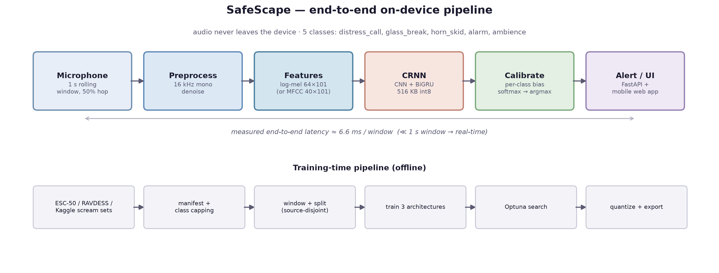
Architecture diagram — overall application
Rubric 3 · 5 marks
Inference path (top) runs entirely on the device: no audio, and no features derived from audio, ever leave it. The training path (bottom) runs offline, once.
Serving note: the present build runs the model in a local FastAPI process reachable over the LAN from the phone browser — true in-phone inference (TFLite / ONNX Runtime Mobile) is the documented next step.

Slide 10
Module details
Rubric 4 · 5 marks
Module | Implementation | Responsibility
1. Data acquisition | scripts/01_download_notes.md | Provenance log: exact commands, sources and licences for every dataset pulled.
2. Manifest builder | scripts/02_build_manifest.py | Maps every source file to one of 5 classes; caps the over-represented ambience class.
3. Preprocessing | scripts/03_preprocess_audio.py | Resample 16 kHz, mono, denoise, 1 s windows @ 50% overlap; 70/15/15 split at SOURCE-FILE level (no window leakage).
4. Feature extraction | scripts/04_extract_features.py | Pre-computes log-mel (64×101) and MFCC (40×101) to .npy — removed a Windows multiprocessing bottleneck (25–30× speed-up).
5. Training | scripts/06_train.py, 08_train_distilled_transformer.py | Trains each architecture; class-weighted loss; checkpoints on val macro-recall.
6. Hyper-parameter search | scripts/09_hparam_search.py | Optuna search over lr / batch / dropout / hidden size, then retrains the winner.
7. Evaluation | scripts/10_evaluate.py | Test metrics, per-class report, confusion matrix, latency, size — appends to reports/eval_results.md.
8. Quantise & export | scripts/11_quantize_export.py | Dynamic PTQ (qint8) + exports the champion bundle to models/exported/.
9. Calibration | scripts/12_calibrate_logits.py | Fits a per-class logit bias on the val split under a hazard-recall constraint.
10. Serving + UI | server/app.py, inference.py, static/ | FastAPI /predict and /health; mobile-styled web app (Home / History / Settings).

Slide 11
Performance metrics — definition & suitability
Rubric 5 · 3 marks
Metric | Formula | What it measures | Why suitable for SafeScape | Best in literature
Accuracy | (TP+TN) / all | Overall correctness across the 5 classes. | Easy to communicate, but misleading here: ambience is 63% of windows. | 93.2% [Altayeva 2026]
Macro recall | mean of per-class recall | Averages recall over classes, ignoring frequency. | The model-selection metric — treats a rare hazard as equally important as common ambience. | —
Per-class precision | TP / (TP+FP) | Of windows flagged class c, how many truly are. | Governs false-alarm rate: low precision on a hazard class means nuisance alerts. | 0.66–0.99 [Altayeva 2026]
Per-class recall | TP / (TP+FN) | Of true class-c windows, how many were caught. | The safety-critical metric: a miss is a hazard that goes unreported. | 0.58–0.87 [Altayeva 2026]
distress_call recall | recall of the scream class | Detection rate on the flagship SDG-5 class. | Called out separately: the proposal’s RQ4 states a missed danger costs far more than a false alarm. | —
Macro F1 | harmonic mean of macro P & R | Balances the two under imbalance. | Calibration objective — but constrained so it cannot buy precision with hazard recall. | 0.86 [Altayeva 2026]
CPU latency | ms per 1 s window | Wall-clock inference on the serving target. | Must sit far below the 1 s window for the rolling pipeline to keep up in real time. | 14.8 ms [Altayeva 2026]
Model size | KB on disk | Deployed footprint after quantisation. | The low-cost / on-device constraint from the proposal brief. | ~26.9 KB [Wang 2026]
Literature values come from the surveyed papers; datasets differ (ESC-50 / UrbanSound8K / custom 8-class sets), so they are reference points, not like-for-like comparisons.

Slide 12
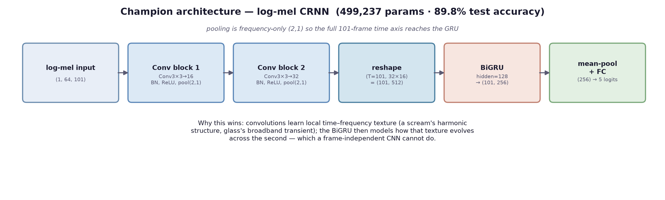
Deep learning architecture — log-mel CRNN (champion)
Rubric 6 · 5 marks
NOVELTY
▪ Multi-class hazard taxonomy, not a single scream-vs-not detector — richer, more actionable alerts than Renesas / IIIT-Delhi single-class systems.
▪ Architecture comparison as a first-class deliverable: three models, one dataset, one split, reported on accuracy vs. latency vs. size.
▪ Safety-constrained post-hoc calibration: the operating point is chosen under an explicit hazard-recall floor, not by maximising a headline metric.
WHY CRNN OVER PLAIN CNN
Frequency-only pooling (2,1) preserves all 101 time frames, so the BiGRU sees the full temporal evolution of the second. A scream is defined as much by its pitch contour over time as by any single frame — exactly the information an MFCC-CNN discards when it average-pools to a single vector.
Result: +18.2 accuracy points over the MFCC-CNN on identical data — and 89.8% once the dataset imbalance is fixed too.

Slide 13
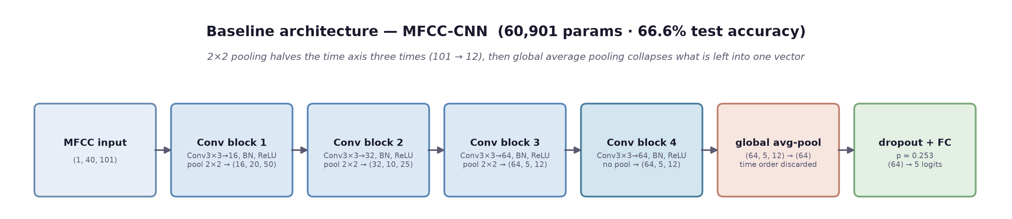
Deep learning architecture — MFCC-CNN (baseline)
Rubric 6 · 5 marks
TRAINING SETUP
▪ Input: 40 MFCCs per 10 ms frame (n_fft 512, hop 160 at 16 kHz) → a 40 × 101 matrix per 1 s window, z-normalised per window.
▪ Optuna TPE search, 8 trials × 6 epochs → lr 1.25 × 10⁻³, batch 64, dropout 0.253; winner retrained for up to 25 epochs.
▪ AdamW (weight decay 10⁻⁴), class-weighted cross-entropy (w_c ∝ 1/n_c). Early stopping (patience 6) ended at epoch 22; best checkpoint at epoch 16 (val macro-recall 0.646).
▪ Augmentation: SpecAugment frequency/time masking plus Gaussian feature noise, applied to 70% of hazard windows and 30% of ambience windows.
▪ Dynamic INT8 quantisation gives nothing (248.6 → 249.3 KB): it only touches Linear/GRU layers, and 99.5% of this model's weights are convolutions. Static PTQ or QAT is the route to compress it.
TEST RESULTS — PER CLASS (same split as the CRNN, 2,799 windows)
Class | Precision | Recall | F1 | Support
distress_call | 0.811 | 0.667 | 0.732 | 843
glass_break | 0.072 | 0.895 | 0.133 | 19
horn_skid | 0.148 | 0.617 | 0.239 | 47
alarm | 0.276 | 0.835 | 0.415 | 115
ambience | 0.876 | 0.654 | 0.749 | 1,775
macro avg | 0.436 | 0.733 | 0.453 | 2,799
Verdict: fastest and smallest of the three (0.44 ms, 248.6 KB) with high hazard recall — but it over-fires. glass_break precision 0.072 is ~13 false alarms per correct one, and 1 in 3 ambience windows is flagged as a hazard.

Slide 14
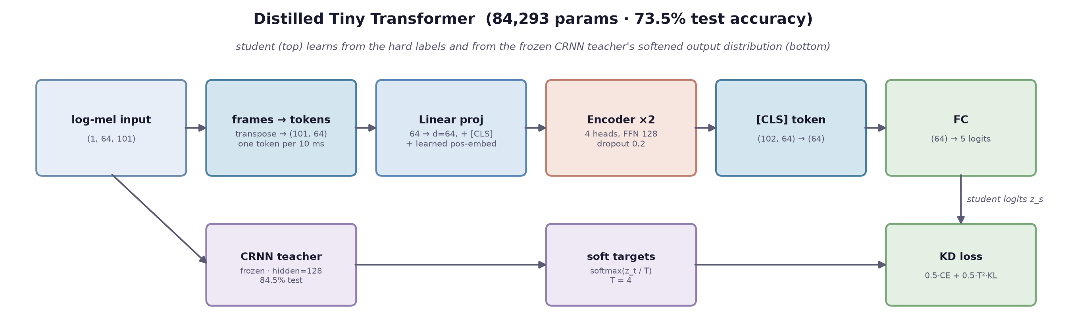
Deep learning architecture — Distilled Tiny Transformer
Rubric 6 · 5 marks
TRAINING SETUP — KNOWLEDGE DISTILLATION
▪ Teacher: the log-mel CRNN (hidden 128, 84.5% test accuracy), weights frozen; teacher and student see the same augmented log-mel window.
▪ Loss: L = α·CE_w(y, z_s) + (1 − α)·T²·KL(softmax(z_t/T) ‖ softmax(z_s/T)), α = 0.5, T = 4. The softened teacher output carries class-similarity information one-hot labels lack; T² keeps both terms on the same gradient scale.
▪ AdamW lr 10⁻³, weight decay 10⁻⁴, batch 32, class-weighted CE; not Optuna-tuned. Early stopping (patience 6) ended at epoch 18; best checkpoint at epoch 12 (val macro-recall 0.687).
▪ Attention is O(T²·d) over 102 tokens but fully parallel → 0.48 ms. Shipped FP32 (339 KB); being all-Linear, dynamic INT8 quantisation would apply directly.
TEST RESULTS — PER CLASS (same split as the CRNN, 2,799 windows)
Class | Precision | Recall | F1 | Support
distress_call | 0.787 | 0.687 | 0.733 | 843
glass_break | 0.167 | 0.789 | 0.275 | 19
horn_skid | 0.152 | 0.830 | 0.257 | 47
alarm | 0.460 | 0.643 | 0.536 | 115
ambience | 0.867 | 0.760 | 0.810 | 1,775
macro avg | 0.486 | 0.742 | 0.522 | 2,799
Verdict: +6.9 accuracy points over the MFCC-CNN at the same sub-millisecond latency, ~6× fewer parameters than its teacher — yet 11 points behind it: with no conv front-end, two small attention layers must learn spectral texture alone.

Slide 15
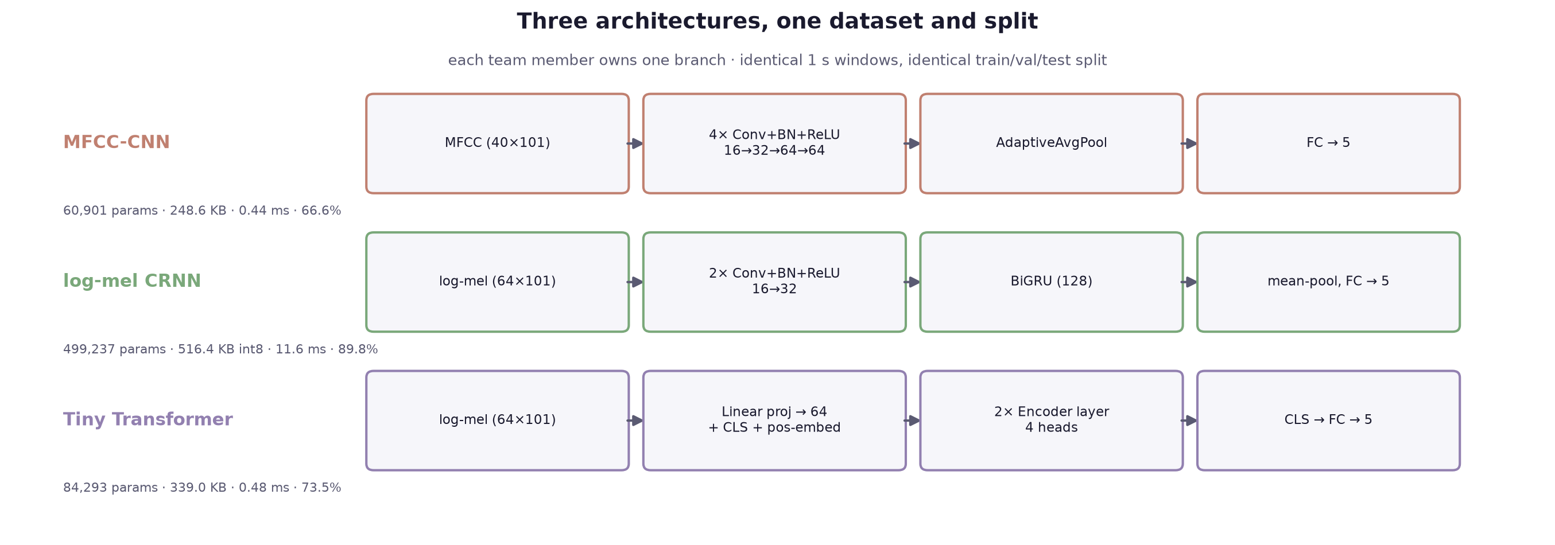
Time & space complexity — three architectures
Rubric 6 · 5 marks
Architecture | Asymptotic cost (per 1 s window) | Params | Size | CPU latency | Accuracy
MFCC-CNN | O(K²·C_in·C_out·F·T) per conv layer — 4 conv blocks, no recurrence | 60,901 | 248.6 KB | 0.44 ms | 66.6%
log-mel CRNN | conv as above + O(T·(D·h + h²)) for the BiGRU — sequential in T, cannot parallelise over time | 499,237 | 516.4 KB int8 | 11.6 ms | 89.8%
Tiny Transformer | O(T²·d) self-attention — quadratic in the 101 frames, but fully parallel over T | 84,293 | 339.0 KB | 0.48 ms | 73.5%
The CRNN’s recurrence makes it the slowest of the three, yet 11.6 ms is still ~85× under the 1 s window budget — so accuracy, not speed, is the binding constraint here.

Slide 16
Algorithm procedure — step by step
Rubric 7 · 5 marks
1 · Framing
x[n] sampled at fₛ = 16 kHz, segmented into 1 s windows of N = 16,000 samples with 50% hop (8,000 samples).
2 · STFT
X(m, k) = Σₙ x[n + mR]·w[n]·e^(−j2πkn/N_FFT), Hann window w, hop R → 101 frames.
3 · Mel filterbank
M(m, b) = Σₖ |X(m, k)|²·H_b(k), with B = 64 triangular filters spaced on mel(f) = 2595·log₁₀(1 + f/700).
4 · Log compression
S(m, b) = log(M(m, b) + ε), then per-feature normalisation → input tensor (1, 64, 101).
4b · MFCC branch
c(m, i) = Σ_b S(m, b)·cos[πi(b + ½)/B] — DCT of the log-mel, keeping 40 coefficients.
5 · Convolutional encoder
Hₗ = MaxPool₍₂,₁₎(ReLU(BN(Wₗ * Hₗ₋₁ + bₗ))), two blocks, 1→16→32 channels; frequency 64→16, time preserved.
6 · Reshape to sequence
(B, 32, 16, 101) → (B, 101, 512): each time frame becomes a 512-dim token.
7 · BiGRU recurrence
zₜ = σ(W_z·[hₜ₋₁, xₜ]), rₜ = σ(W_r·[hₜ₋₁, xₜ]), h̃ₜ = tanh(W·[rₜ ⊙ hₜ₋₁, xₜ]), hₜ = (1 − zₜ) ⊙ hₜ₋₁ + zₜ ⊙ h̃ₜ; forward and backward.
8 · Temporal pooling
h̄ = (1/T)·Σₜ hₜ → logits ℓ = W_fc·h̄ + b_fc ∈ ℝ⁵.
9 · Calibration
ℓ̃_c = ℓ_c + β_c, with β = [+0.4, −0.2, 0.0, −0.6, 0.0] fitted on validation (see rubric 8).
10 · Decision
p = softmax(ℓ̃), ŷ = argmax_c p_c; alert if ŷ ∈ {distress_call, glass_break, horn_skid, alarm}.
Training loss: L = −Σ_c w_c·y_c·log p_c, class weights w_c ∝ 1/n_c (inverse frequency) to protect rare hazards.

Slide 17
Hyper-parameter details & justification
Rubric 8 · 5 marks
Hyper-parameter | Value | How chosen | Justification
Learning rate | 8.56 × 10⁻⁴ | Optuna search, 8 trials | Best val macro-recall (0.751); higher rates (4.3×10⁻³) destabilised the GRU, lower (1.1×10⁻⁴) underfit in 25 epochs.
Batch size | 16 | Optuna search | Smaller batches gave noisier but better-generalising updates on a 12.6k-window training set.
Hidden size (GRU) | 128 | Optuna search | 32 and 64 both underperformed (0.69–0.70 vs 0.751); 128 doubles capacity for ~4× params, still only 516 KB quantised.
Dropout | 0.269 | Optuna search | Tuned jointly with the above; regularises the 499k-param model against a modest dataset.
Epochs | 25 | Fixed | Checkpointed on best val macro-recall, so extra epochs cannot overfit the selected weights.
Weight decay | 1 × 10⁻⁴ | Fixed default | Standard mild L2; not a sensitive axis in preliminary runs.
Class weights | ∝ 1 / n_c | Derived from train split | Hazards are 2–70× rarer than ambience; inverse-frequency weighting stops collapse to the majority class.
Window / hop | 1.0 s / 50% | Fixed by design | Matches the proposal’s near-real-time requirement and the 1 s convention in comparable work (Omarov 2025).
Quantisation | dynamic PTQ, qint8 | Post-training | −73.6% size with ≤0.001 metric change; Linear/GRU layers only, which is where CRNN parameters live.
Calibration bias β | [+0.4, −0.2, 0, −0.6, 0] | Coordinate ascent on val | Maximises macro-F1 subject to a hazard-recall floor (≥ uncalibrated − 0.02). See next slide.

Slide 18
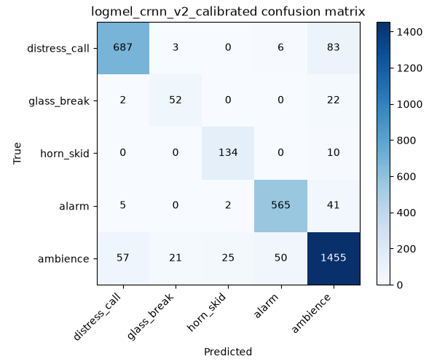
Results — architecture comparison
Rubric 9 · 3 marks
Architecture | Accuracy | Macro recall | Macro precision | distress recall | Params | Latency
MFCC-CNN | 66.6% | 73.3% | 0.436 | 66.7% | 60,901 | 0.44 ms
Tiny Transformer (distilled) | 73.5% | 74.2% | 0.486 | 68.7% | 84,293 | 0.48 ms
log-mel CRNN | 84.5% | 79.2% | 0.584 | 82.3% | 499,237 | 6.44 ms
log-mel CRNN + calibration | 84.8% | 78.4% | 0.598 | 85.6% | 499,237 | 6.64 ms
log-mel CRNN + expanded data + calibration | 89.8% | 86.5% | 0.849 | 88.2% | 499,237 | 11.6 ms
INFERENCE FROM THE RESULTS
▪ The CRNN wins decisively on accuracy (+18.2 pts over the CNN, +11.3 over the transformer) because temporal modelling matters for these classes.
▪ Quantisation is nearly free: −73.6% size for ≤0.001 change in every metric — the on-device constraint costs essentially no accuracy.
▪ Latency is not the binding constraint: even the slowest model runs 85× faster than the 1 s window it consumes.
▪ The first four rows share one dataset and split, so they compare like for like. The final row retrains the champion on an EXPANDED dataset and is therefore measured on a different, larger test set (3,220 vs 2,799 windows) — it is a data result, not an architecture result, and is kept separate for that reason.
▪ Macro precision is the headline: 0.598 → 0.849. Class imbalance, not architecture, was the binding limitation all along (see “Results — fixing the two weakest classes”).

Slide 19
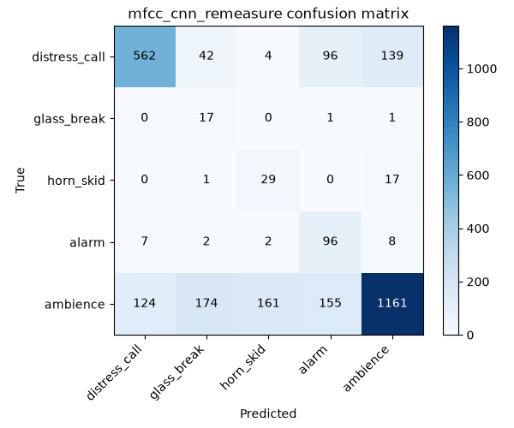
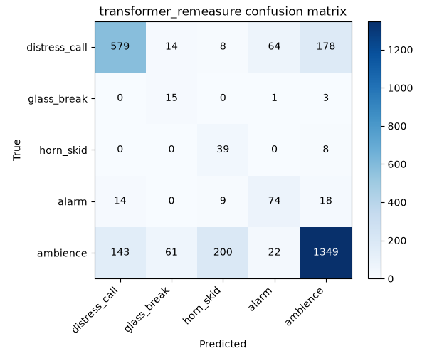
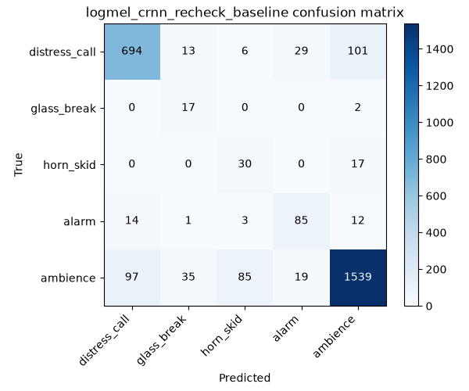
Results — per-class comparison
Rubric 9 · 3 marks
Class | Support | MFCC-CNN P | MFCC-CNN R | Transformer P | Transformer R | CRNN P | CRNN R
distress_call | 843 | 0.811 | 0.667 | 0.787 | 0.687 | 0.862 | 0.823
glass_break | 19 | 0.072 | 0.895 | 0.167 | 0.789 | 0.258 | 0.895
horn_skid | 47 | 0.148 | 0.617 | 0.152 | 0.830 | 0.242 | 0.638
alarm | 115 | 0.276 | 0.835 | 0.460 | 0.643 | 0.639 | 0.739
ambience | 1,775 | 0.876 | 0.654 | 0.867 | 0.760 | 0.921 | 0.867
macro avg | 2,799 | 0.436 | 0.733 | 0.486 | 0.742 | 0.584 | 0.792
accuracy | 2,799 | 0.666 |  | 0.735 |  | 0.845
MFCC-CNN
TINY TRANSFORMER (DISTILLED)
LOG-MEL CRNN (UNCALIBRATED)
WHAT THE PER-CLASS VIEW ADDS
▪ distress_call: CRNN recall 0.823 vs 0.687 / 0.667 — 132 more screams caught (of 843) than the CNN.
▪ False alarms: the CNN flags 614 of 1,775 ambience windows (35%) as hazards; the CRNN 236 (13%).
▪ The CNN's alarm and the Transformer's horn_skid recall beat the CRNN only by over-predicting: precision 0.276 / 0.152.
▪ All three fail the same way on glass_break / horn_skid (40 source clips each) — a data problem, fixed on the next slide.

Slide 20
Results — fixing the two weakest classes
Rubric 9 · 3 marks
Training used class-weighted loss to protect hazard recall — which pushes the decision boundary toward rare classes and costs precision. Calibration re-picks the operating point after training: one additive bias per class, fitted on validation only, no retraining.
Objective (validation set) | Accuracy | Macro F1 | Macro recall | glass_break R | horn_skid R | Verdict
uncalibrated | 0.845 | 0.662 | 0.758 | 0.844 | 0.560 | baseline
unconstrained macro-F1 | 0.863 | 0.700 | 0.671 | 0.594 | 0.340 | rejected — misses 2/3 of horn/skid events
safety-constrained (shipped) | 0.844 | 0.672 | 0.758 | 0.844 | 0.560 | keeps every hazard recall, takes free precision
THE DESIGN DECISION
Maximising macro-F1 without constraints produces the best-looking headline numbers (+1.8 accuracy, +3.8 macro-F1) — and is the wrong answer. It buys that precision by collapsing horn_skid recall to 0.340, i.e. missing two thirds of those events.
That contradicts RQ4 of the proposal: a missed danger event costs far more than a false alarm. The shipped calibration therefore maximises macro-F1 subject to a floor on every hazard class’s recall.
Chosen bias β = [+0.4, −0.2, 0.0, −0.6, 0.0]
STEP 2 — MORE DATA FOR THE THIN CLASSES
Precision | 40-clip classes | expanded data | change
glass_break | 0.283 | 0.684 | 2.4×
horn_skid | 0.246 | 0.832 | 3.4×
alarm | 0.694 | 0.910 | +0.216
distress_call | 0.840 | 0.915 | +0.075
ambience | 0.928 | 0.903 | −0.025
macro precision | 0.598 | 0.849 | +0.251
accuracy | 0.848 | 0.898 | +5.0 pts
UrbanSound8K supplied 167 car-horn and 435 siren clips, plus 630 urban hard negatives; DataSEC and Freesound CC0 added 73 glass clips. Calibration alone could not fix precision — the data scarcity had to go.

Slide 21
Dataset — sources, construction & novelty
Rubric 10 · 3 marks
Source | Classes contributed | Scale | Licence | URL
ESC-50 | glass_break, horn_skid (car horn), alarm (clock alarm, siren), ambience | 2,000 clips · 50 categories · 5 s each | CC BY-NC 3.0 | github.com/karolpiczak/ESC-50
Human Screaming Detection (Kaggle) | distress_call — primary source | screaming vs non-screaming clips | Kaggle terms | kaggle.com/datasets/whats2000/ human-screaming-detection-dataset
RAVDESS speech (Zenodo) | distress_call — supplement only (emotion 05 angry, 06 fearful) | 24 actors · acted emotional speech | CC BY-NC-SA 4.0 | zenodo.org/record/1188976
CONSTRUCTION & CHALLENGES ADDRESSED
▪ Resampled to 16 kHz mono and denoised before feature extraction.
▪ Windowed into 1 s segments at 50% overlap → 18,130 windows (12,619 train / 2,712 val / 2,799 test).
▪ Split performed at SOURCE-FILE level, not window level — no window from one recording can appear in two splits, which would inflate accuracy.
▪ Ambience deliberately capped; class-weighted loss compensates for the residual 2–70× imbalance.
▪ Ethics: only public, licensed, acted recordings — no real victims, no non-consenting bystanders.
NOVELTY OF THE DATASET
The contribution is the assembled 5-class safety taxonomy: no single public corpus covers distress_call, glass_break, horn_skid, alarm and ambience together. Three sources with different licences, sample rates and labelling conventions are unified into one consistently-windowed, source-disjoint benchmark.
HONEST LIMITATION
The proposal planned self-recorded, India-context campus audio. Under the deadline the implementation used public datasets only, and distress_call leans on acted/emotional speech. Self-collection is stated future work — not claimed as done.
IEEE DataPort: the datasets actually used are hosted on GitHub / Kaggle / Zenodo, not IEEE DataPort — confirm with the reviewer whether an IEEE DataPort URL is mandatory for this item.

Slide 22
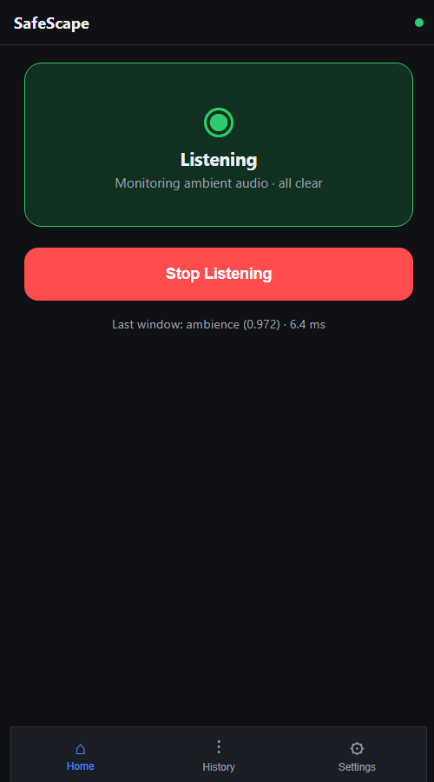
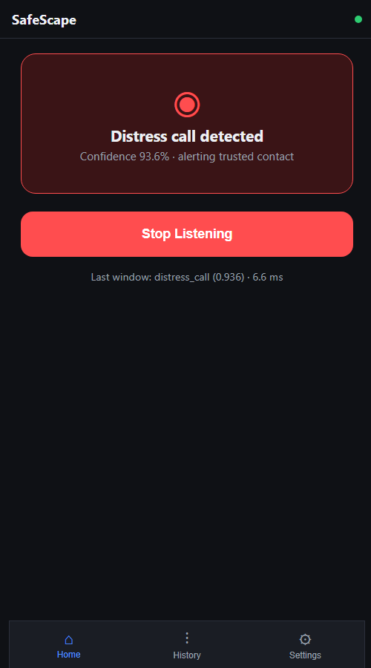
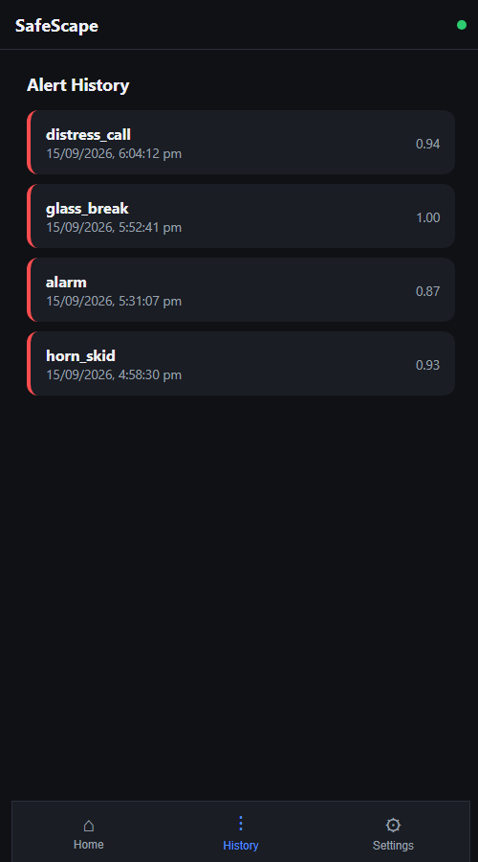
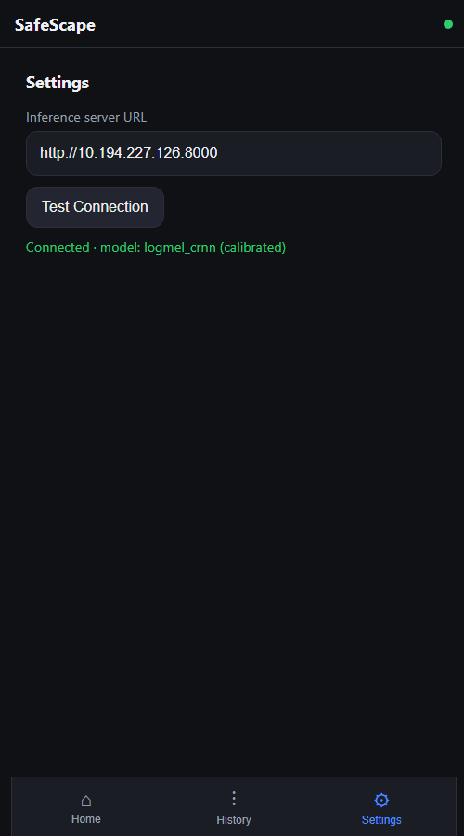
UI screens — mobile web application
Rubric 11 · 5 marks
Home — armed, monitoring
Home — hazard detected
Alert history
Settings — server & connection
Live screenshots from the running application (FastAPI + static web app), not mockups. Three screens: Home (arm/disarm + live status), History (persisted alerts), Settings (server URL + connectivity test).

Slide 23
Standard paper for the application
Rubric 12 · 2 marks
Scream and gunshot detection and localization for audio-surveillance systems
Valenzise, Gerosa, Tagliasacchi, Antonacci & Sarti (Politecnico di Milano)
IEEE Conf. on Advanced Video and Signal Based Surveillance (AVSS), pp. 21–26, 2007 · DOI 10.1109/AVSS.2007.4425280 · ~394 citations
JUSTIFICATION
▪ Defines the exact task SafeScape modernises: automatically recognising human distress vocalisations and impulsive hazard sounds from ambient audio for public-safety response.
▪ Its scream-vs-ambience discrimination problem is literally SafeScape's core class boundary.
▪ Most-cited foundational work in acoustic hazard detection — nearly every later scream / glass-break detection paper traces back to it.
▪ SafeScape's contribution reads as the natural update: hand-tuned GMMs → deep models, and a fixed camera-steering installation → a fully offline personal device.
Journal alternative if required: Foggia et al., "Audio Surveillance of Roads: A System for Detecting Anomalous Sounds," IEEE Trans. Intelligent Transportation Systems, 17(1), 279–288, 2016, DOI 10.1109/TITS.2015.2470216 — maps directly onto the horn_skid class.

Slide 24
Status, limitations & next steps
DELIVERED
▪ Full pipeline: acquisition → preprocessing → features → 3 trained architectures → Optuna search → evaluation → quantisation → calibration → serving.
▪ Champion model: log-mel CRNN — 89.8% test accuracy, 0.849 macro precision, 88.2% distress-call recall, 516 KB quantised, 11.6 ms per window.
▪ Working demo: FastAPI server + mobile web app, verified end-to-end on held-out clips.
▪ Reproducible: every number in this deck regenerates from scripts in the repository.
LIMITATIONS & NEXT STEPS
▪ Dataset: public corpora only; distress_call leans on acted emotional speech. Self-recorded India-context audio is the most valuable next addition.
▪ glass_break and horn_skid have only 40 source clips each — precision on them stays low. More data for these two classes is the highest-leverage improvement available.
▪ Serving is a LAN-reachable laptop process, not in-phone inference; TFLite / ONNX Runtime Mobile export is the documented next step.
▪ Dynamic PTQ cannot quantise conv layers — static quantisation or QAT would compress the CNN branch too.
▪ Alarm recall fell 6.9 pts under calibration; a floor tuned on a larger validation set would likely recover it.

