Slide 1


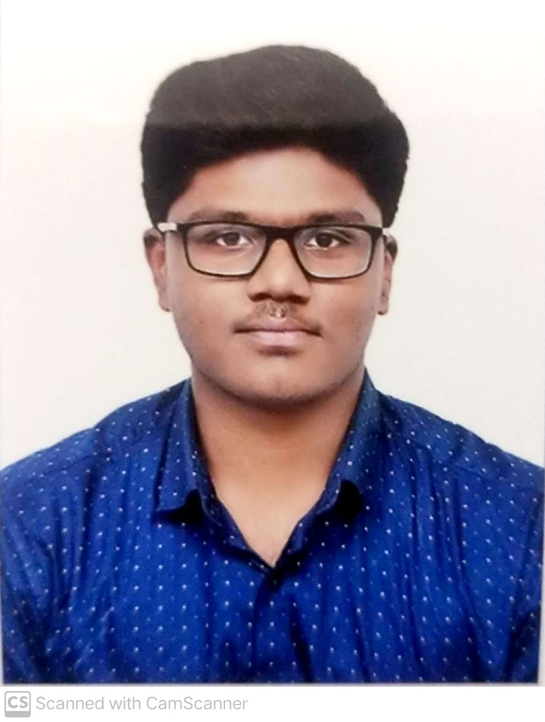
Review 2
SafeScape — On-Device Acoustic Distress & Hazard Recognition
Group No: 1 Category: Research-Product-Software
Faculty Guide: Dr. Bagyammal T, Professor, CSE Department
TEAM MEMBERS
Roll No | Name | Photo | Email ID | Mobile No | GitHub URL
Cb.en.u4ece23222 | Amruth Rohan KR |  | Cb.en.u4ece23222@cb.students.amrita.edu | 9994454198 | https://github.com/AmruthRohan
Cb.en.u4ece23219 | Harish Venkat VS |  | Cb.en.u4ece23219@cb.students.amrita.edu | 8807792343 | https://github.com/Hash-486
LinkedIn Product Demo: [URL] GitHub Repository: https://github.com/Hash-486/SafeScape
Course: 23CSE473 — Neural Networks and Deep Learning
2

Slide 2
Review 2 — one model per member, with the dataset
Review 2 · 5 marks
member | model | features | what is demonstrated
Amruth Rohan KR | MFCC-CNN | 40 MFCCs × 101 frames | train/eval on the v2 dataset, per-class results, live classification of held-out clips
Harish Venkat VS | log-mel CRNN | 64 log-mel × 101 frames | same, plus calibration and int8 quantization of the champion
Harish Venkat VS | Distilled Transformer | 64 log-mel × 101 frames | distillation from the CRNN teacher, same evaluation
COMMON GROUND
▪ One dataset (v2), one source-file-disjoint split, one leak-free test set of 2,990 windows
▪ Same metrics for every model: accuracy, macro-F1, distress-call recall, size, CPU latency
▪ Each model is calibrated the same way, so they are compared at equivalent operating points

Slide 3
Dataset — sources and class mapping
Review 2 · 5 marks
source | distress_call | glass_break | horn_skid | alarm | ambience | total
datasec | 0 | 40 | 0 | 0 | 0 | 40
esc50 | 0 | 40 | 40 | 80 | 966 | 1126
freesound_cc0 | 0 | 33 | 0 | 0 | 0 | 33
ravdess_supplement | 200 | 0 | 0 | 0 | 0 | 200
scream_kaggle_1 | 575 | 0 | 0 | 0 | 0 | 575
urbansound8k | 0 | 0 | 167 | 435 | 343 | 945
total | 775 | 113 | 207 | 515 | 1309 | 2919
WHERE EACH CLASS COMES FROM
▪ ESC-50 — glass, horn, siren, clock alarm, ambient scenes
▪ Kaggle scream set + RAVDESS angry/fearful speech → distress_call
▪ UrbanSound8K — car_horn → horn_skid, siren → alarm, 7 urban classes as hard-negative ambience
▪ DataSEC + Freesound CC0 → extra glass_break
DESIGN DECISIONS
▪ UrbanSound8K gun_shot excluded: a real hazard with no class here — labelling it ambience would teach the model gunfire is normal
▪ 16 kHz mono, denoised, 1 s windows with 50% overlap, near-silent windows dropped
2,919 recordings → 21,917 windows

Slide 4
Dataset — leakage-free split and duplicate audit
Review 2 · 5 marks
class | train | val | test (leak-free) | removed from test
distress_call | 3704 | 782 | 549 | 230
glass_break | 445 | 76 | 76 | 0
horn_skid | 764 | 137 | 144 | 0
alarm | 2852 | 611 | 613 | 0
ambience | 7741 | 1585 | 1608 | 0
total | 15506 | 3191 | 2990 | 230
SPLIT
70 / 15 / 15, stratified, at the source-file level — every window of a recording stays on one side.
AUDIT — FOUND DURING THIS REVIEW
Hashing every source file showed the Kaggle scream set ships the same recordings in two folders. 230 test windows (all distress_call) were byte-identical to training audio.
Fix without retraining: flag them (18_flag_duplicate_sources.py) and report every number on the remaining 2,990 windows.
Impact was small (CRNN 89.8% → 89.7%), and no test window has a byte-identical copy in training (exact-match check; re-encoded copies would not be caught).

Slide 5
Feature pipeline — shared by all three models
Review 2 · 5 marks
step | setting | why
resample + mono | 16 kHz | speech/hazard energy is below 8 kHz; smaller input
denoise | non-stationary spectral gating | suppress steady background before features
window | 1.0 s, 50% hop | short enough for near-real-time, long enough for a scream
energy gate | RMS ≥ 1e-4 | never train or predict on silence
STFT | 512-pt FFT, 10 ms hop → 101 frames | 10 ms resolution keeps glass transients
MFCC (CNN) | 40 coefficients | compact cepstral summary of the spectrum
log-mel (CRNN, Transformer) | 64 mel bands, dB | keeps spectral detail the DCT discards
normalise | per window, zero mean / unit var | loudness-invariant input
augment (train only) | SpecAugment masks + feature noise | regularise the rare classes

Slide 6
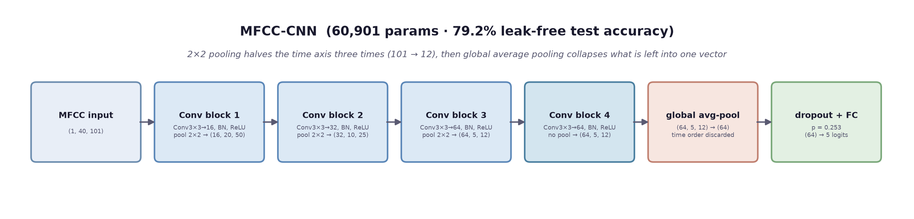
MFCC-CNN — Amruth Rohan KR
Review 2 · 5 marks
hyper-parameter | value
learning rate | 1.25e-3
batch / dropout | 64 / 0.25
selection | Optuna, val macro recall
epochs | 25, early stop at 17
class | precision | recall | F1
distress_call | 0.71 | 0.80 | 0.75
glass_break | 0.32 | 0.63 | 0.43
horn_skid | 0.82 | 0.78 | 0.80
alarm | 0.77 | 0.89 | 0.83
ambience | 0.89 | 0.76 | 0.82
LEAK-FREE TEST
accuracy 79.2%
macro-F1 0.725
distress recall 80.3%
60,901 params
249 KB · 0.52 ms

Slide 7
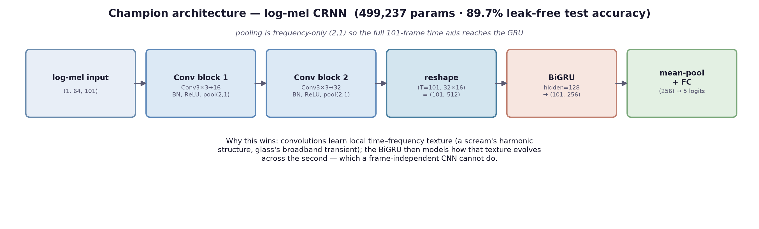
log-mel CRNN — Harish Venkat VS
Review 2 · 5 marks
hyper-parameter | value
learning rate | 8.56e-4
batch / dropout | 16 / 0.27
GRU | 128 units × 2 directions
compression | dynamic int8 → 516 KB
class | precision | recall | F1
distress_call | 0.88 | 0.87 | 0.88
glass_break | 0.68 | 0.68 | 0.68
horn_skid | 0.83 | 0.93 | 0.88
alarm | 0.91 | 0.92 | 0.92
ambience | 0.91 | 0.90 | 0.91
LEAK-FREE TEST
accuracy 89.7%
macro-F1 0.852
distress recall 86.7%
499,237 params
516 KB · 12.81 ms

Slide 8
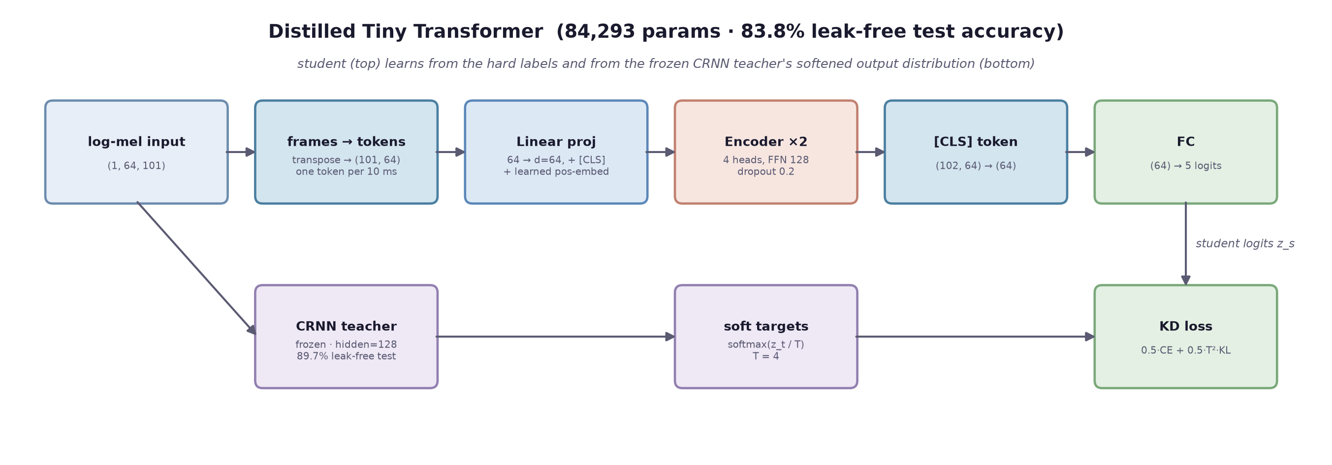
Distilled Transformer — Harish Venkat VS
Review 2 · 5 marks
hyper-parameter | value
teacher | v2 CRNN (frozen)
α / T | 0.5 / 4
learning rate / batch | 1e-3 / 32
epochs | 25, early stop at 20
class | precision | recall | F1
distress_call | 0.75 | 0.83 | 0.79
glass_break | 0.39 | 0.67 | 0.49
horn_skid | 0.85 | 0.83 | 0.84
alarm | 0.89 | 0.90 | 0.90
ambience | 0.89 | 0.83 | 0.86
LEAK-FREE TEST
accuracy 83.8%
macro-F1 0.774
distress recall 82.5%
84,293 params
340 KB · 0.48 ms

Slide 9
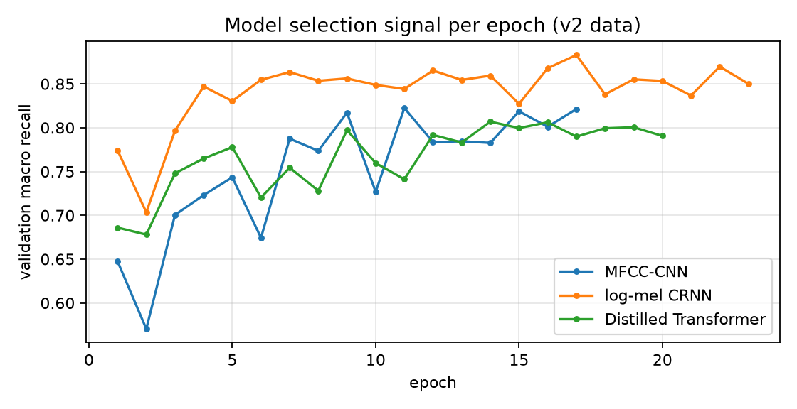
Training — validation macro recall per epoch
Review 2 · 5 marks
HOW EACH MODEL WAS SELECTED
▪ Checkpoint = best validation macro recall, not lowest loss — recall on rare hazards is what matters
▪ Early stopping after 6 epochs without improvement
▪ Class-weighted cross-entropy (1 / class frequency) for all three
▪ Then a per-class logit bias fitted on validation, with every hazard's recall floored

Slide 10
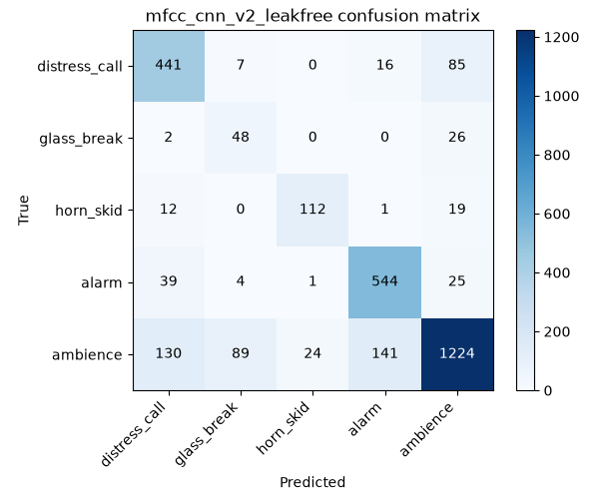
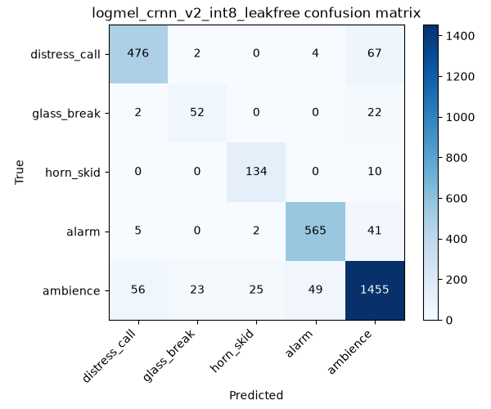
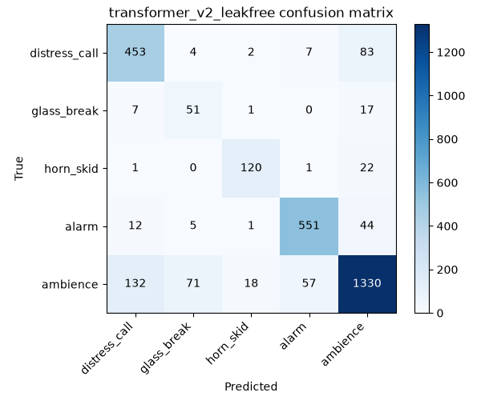
Results — confusion matrices per member
Review 2 · 5 marks
MFCC-CNN · Amruth Rohan KR
log-mel CRNN · Harish Venkat VS
Distilled Transformer · Harish Venkat VS
Rows are the true class. The dominant error for every model is ambience predicted as a hazard — the price of class-weighted training and recall-floored calibration, which deliberately prefer a false alarm to a missed scream.

Slide 11
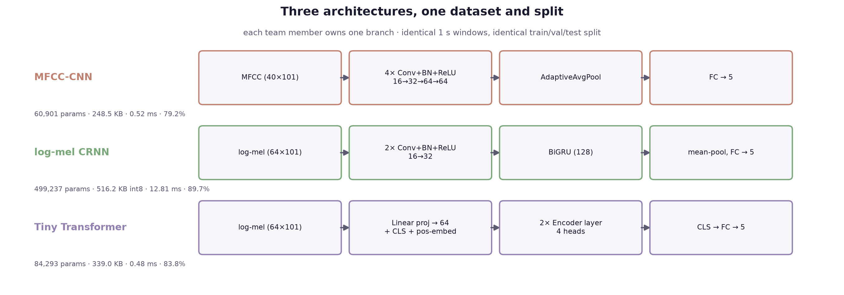
Three-model comparison — leak-free test split
Review 2 · 5 marks
model | owner | accuracy | macro-F1 | distress recall | params | served size | CPU / window
MFCC-CNN | Amruth Rohan KR | 79.2% | 0.725 | 80.3% | 60,901 | 249 KB | 0.52 ms
log-mel CRNN | Harish Venkat VS | 89.7% | 0.852 | 86.7% | 499,237 | 516 KB | 12.81 ms
Distilled Transformer | Harish Venkat VS | 83.8% | 0.774 | 82.5% | 84,293 | 340 KB | 0.48 ms
READING THE TABLE
▪ CRNN leads every quality metric: macro-F1 0.852 vs 0.774 / 0.725
▪ Transformer: 17% of the CRNN's parameters, 27× faster per window
▪ MFCC-CNN: smallest and fastest, weakest on glass_break
All three are far inside the 1 s real-time budget, so hazard recall decides: the quantized CRNN ships as the default.

Slide 12
Live demonstration
Review 2 · 5 marks
EACH MEMBER RUNS THEIR OWN MODEL ON THE HELD-OUT TEST SET
cd scripts; $env:SAFESCAPE_PROC_DIR = "data/processed_v2"
python 10_evaluate.py --arch mfcc_cnn --ckpt ../models/checkpoints/mfcc_cnn_v2.pt --calibration ../models/exported/mfcc_cnn/calibration.json --manifest ../data/processed_v2/windows_manifest_dedup.csv --cpu-only (Amruth)
python 10_evaluate.py --arch logmel_crnn --hidden-size 128 --ckpt ../models/exported/logmel_crnn/best_model.pt --quantized --calibration ../models/exported/logmel_crnn/calibration.json --manifest ../data/processed_v2/windows_manifest_dedup.csv (Harish)
python 10_evaluate.py --arch transformer --ckpt ../models/checkpoints/transformer_v2.pt --calibration ../models/exported/transformer/calibration.json --manifest ../data/processed_v2/windows_manifest_dedup.csv --cpu-only (Harish)
THEN THE SAME MODEL ON A SINGLE CLIP
python run_demo.py → http://127.0.0.1:8124/compare → pick a held-out test clip; each member's card shows their model's verdict, probabilities and latency.

