Slide 1

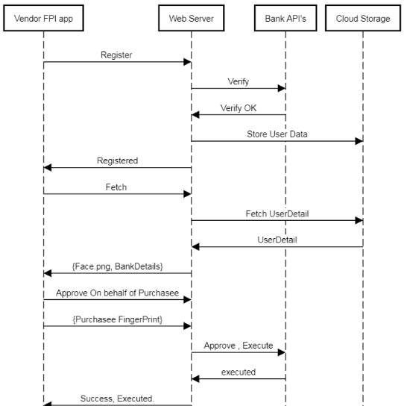
FPI
Theme: Business Innovation
Team: Hari Easvaran M
(harieasvaran@gmail.com)
Goal :
Enable Finger Print based UPI solution to local neighbourhood shops.
So to come up with a App that reads customer’s Fingerprint to fetch UPI / bank details and proceed with payment.
Target Audience :
Users with no experience with UPI apps / bank apps in general who only rely on physical payments for purchases. And to the users who find Fingerprint authentication / authorization convenient.
Solution
Solution Overview:
Record Fingerprint, Face, Bank/UPI details for our audience, from vendor’s app.
Fetch details with Purchaser Fingerprint while purchase and approve once with Fingerprint.
Tech Stack for POC:
ReactJS / React Native + Node.Js + Relational DB
(AWS lambda + Amazon S3)
Risks:
Onboarding Fingerprint registration based on trust of Purchaser’s from Vendors. Mitigation → minimum transaction only (say, max Rs.50). On-boarding booth from representative to explain the procedure.
UPI not enabled customers / SmartPhone non-users.

