Slide 1
How to Calculate Attainment of CO and PO
Prof (Dr.) J.N.Jha
Principal, MIT Muzaffarpur
Email: jagadanand@gmail.com

Slide 2
Engineering Programs
Graduates of Engineering Programs in India are required
To attain the Program Outcomes (POs) identified by the National Board of Accreditation (NBA)
To attain Program Specific Outcomes (PSOs) identified by the University or the Department offering the Program.
POs and PSOs are to attained
through courses, projects, co-curricular and extra-curricular activities (in which performance of the students is evaluated).

Slide 3
Courses
Courses are broadly classified
Core courses and Electives.
Core courses are Classified
Engineering/Engineering Science, and Basic Sciences / Humanities / Social Sciences /Management
POs and PSOs are to be attained
through core courses, project and activities
(in which all students Participate- Elective will not be considered).
Courses constitute the dominant part of any engineering program.

Slide 4
Students learn well
Course Outcome
when they are clear about what they should be able to do at the end of a course (Course Outcomes)
Assessment is in alignment with what they are expected to do (Assessment in alignment with Course Outcomes)
Instructional activities are designed and conducted to facilitate them to acquire and demonstrate what they are expected to do
(Alignment among Instruction, Assessment and Course Outcomes)

Slide 5
What are Course Outcomes?
Course Outcomes (COs): What the student should be able to do at the end of a course
It is an effective ability, including attributes, skills and knowledge to successfully carry out the identified activity
Most important aspect of a CO: Should be observable and measurable

Slide 6
Structure of a CO statement
Action: Represents a cognitive/ affective/ psychomotor activity the learner should perform. An action is indicated by an action verb, occasionally two, representing the concerned cognitive process(es).
Cognitive Process (Action Verb): Remember, Understand, Apply, Analyze, Evaluate, Create
Knowledge: Represents the specific knowledge from any one or more of the eight knowledge categories
Factual, Conceptual, Procedural, Metacognitive, Fundamental Design Principles, Criteria & Specifications, Practical Constraints, Design instrumentalities
Condition: Represents the process the learner is expected to follow or the condition under which to perform the action (This is an optional element of CO)
Criteria: Represent the parameters that characterize the acceptability levels of performing the action (This is an optional element of CO)

Slide 7
Two Action Verbs
Some times it becomes equally important for a student to perform two cognitive processes/sub-processes on given knowledge elements.
Only in such cases, two action verbs are used in a CO statement-Don’t combine two COs into one
Example
Draw Bode plots for the given dynamic system and determine the gain and phase margins
Drawing and determining are equally important and both processes are related to the same knowledge elements of Bode plots

Slide 8
Sample 1- CO statement
Calculate major and minor losses associated with fluid flow in piping networks
Action: Calculate (Apply)
Knowledge: major and minor losses associated with fluid flow in piping networks (Conceptual and Procedural)
Condition: None
Criteria: None

Slide 9
Sample 2- CO statement
Determine the dynamic unbalanced conditions of a given mechanical system of rigid bodies subjected to force and acceleration
Action: Determine (Apply)
Knowledge: Dynamic unbalanced conditions (Conceptual and Procedural)
Condition: given mechanical system of rigid bodies subjected to force and acceleration
Criterion: None

Slide 10
Sample 3- CO statement
Understand the effect of all the parameters in voltage controlled oscillators through simulation using TINATI.
Action: Understand
Knowledge: effect of all the parameters in voltage controlled oscillators (Conceptual)
Condition: using simulation using TINATI
Criterion: None

Slide 11
Sample 4- CO statement
Determine the root of the given equation, accurate to second decimal place, using Newton-Raphson method
Action: Determine (Apply)
Knowledge: root of the given equation (Conceptual and Procedural)
Condition: using Newton-Raphson method
Criterion: accurate to second decimal place

Slide 12
Number of COs for a Course
Too small a number of COs do not capture the course in sufficient detail and may not serve instruction design that well.
Too many COs make all the processes related to assessment design and computation of attainment of COs messy and demanding.
A 3:0:0, 3:1:0 and 3:0:1 courses should have about 6 course outcomes.
The number of COs of courses carrying different number of credits can be suitably adjusted

Slide 13
Dos and Don’ts
Use only one action verb
Do not use words including ‘like’, ‘such as’, ‘different’, ‘various’ ‘etc.’ with respect to knowledge elements. Enumerate all the relevant knowledge elements.
Put in effort to make the CO statement as detailed as possible, and measurable.
Do not make it either too abstract or too specific

Slide 14
Check List
Does the CO begin with an action verb?
Is the CO stated in terms of student performance (rather than teacher performance or course content to be covered)?
Is the CO stated as a learning product rather than as a learning process?
Is the CO stated at the proper level of generality, and relatively independent of other COs?
Is the CO attainable in the given context (students’ background, prerequisite competences, facilities, time available and so on)?

Slide 15
Acceptability of COs
Students will execute mini projects
Instructional activities are designed to facilitate the attainment of COs by learners, but themselves are not COs
Have the concepts of compensators and controllers (P, PD, PI, PID)
COs are competencies / behaviors that can be demonstrated; not descriptions of internal changes in the students (though these are necessary)
Optimal Generator scheduling for thermal power plants by using software package in the lab
No action verb; no way of assessing; no way of determining attainment level; syllabus part is rewritten.

Slide 16
Acceptability of Cos… Cont.
Will get knowledge of protection schemes for Generator, Transformer and Induction Motor
COs are competencies / behaviors that can be demonstrated; not descriptions of internal changes in the students (though these are necessary)
Apply problem solving techniques to find solutions to problems.
Too general; no clear way of assessing!
Study variety of advanced abstract data type (ADT) and data structures and their
Implementations
Activity that the student engages in during the Course; not what he / she becomes capable of demonstrating at the end of the course; the word “variety” is not to be used.
Know the stress strain relation for a body subjected to loading within elastic limit.
Internal change; Not an action that can be demonstrated

Slide 17
Acceptability of Cos… Cont.
Students will be able to learn the structure, properties and applications of modern metallic materials, smart materials non-metallic materials and advanced structural ceramics.
An outcome? How to assess?
Students will be aware of base band signal concepts and different equalizers.
Internal change; Not an action that can be demonstrated
Get complete knowledge regarding adaptive systems
Not an action that can be demonstrated; Internal change; Too ambitious to be realistic?

Slide 18
Tagging of Course Outcomes
Tag Course Outcomes
POs,
PSOs,
Cognitive Levels,
Knowledge Categories addressed,
Number of classroom/ laboratory/ field sessions associated with the COs

Slide 19
Tagging of Course Outcomes…Cont.
Tagging COs with Classroom Sessions-Different COs may have different number of classroom sessions
Tagging COs with Cognitive Levels-CO statement starts with an action verb from one of the cognitive levels
(R-Remember, U-Understand, Ap- Apply, An-Analyse, E-Evaluate and C-Create)
Tagging COs with Knowledge Categories-CO statement includes one or more categories of knowledge

Slide 20
Tagging COs with PSOs/POs- Concern/Grey areas
All the COs of a course typically address the same PSO(s).
Majority of the courses (non-autonomous institutions): Don’t address strongly any PO other than PO1
PO1: Engineering Knowledge
Possible that PO2, PO3, PO4, PO5 are addressed slightly by some courses.
PO2: Problem Analysis
PO3: Design/Development of Solutions
PO4: Conduct Investigations of Complex Problems
PO5: Modern Tool Usage
Hardly any course addresses complex engineering problems

Slide 21
Tagging COs with POs- Concern/Grey areas
Some specific courses address PO7, PO8, PO9, PO10 and PO11
PO7: Environment and Sustainability
PO8: Ethics
PO9: Individual and Teamwork
PO10: Communication
PO11: Project Management and Finance
Projects can potentially address many Pos, (Rubrics-used to evaluate)
Department can arrange for some activities outside the curriculum to address some POs
PO6: The Engineer and Society
PO12: Life-Long Learning

Slide 22
 | Course Outcome | POs/ PSOs | CL | KC | Class Sessions
CO1 | Understand the fundamentals of fluid mechanics and fluids | PO1, PSO1 | U | C, | 6
CO2 | Determine the basic equation to find the force on submerged surfaces | PO1, PSO1 | Ap | C, P | 9
CO3 | Calculate the center of buoyancy of floating body, and the, velocity and acceleration of a fluid | PO1, PSO1 | Ap | C, | 12
CO4 | Calculate flow parameters using fluid flow meters and using dimension analysis to predict flow phenomena, viscous effects using Hagen Poiseille’s equation | PO1, PSO1 | Ap | C, P | 12
CO5 | Calculate functional losses through pipes and to calculate the drag and life, displacement, momentum and energy thickness | PO1, PSO1 | Ap | C, P | 12
 | Total hour of Instruction |  |  |  | 54
Fluid Mechanics - Credits: 4:0:0
Cognitive Level (CL), Knowledge Categories (KC),

Slide 23
Attainment of Course Outcomes- CO Attainment and Quality Loop

Slide 24
Setting CO Attainment Targets
Same target (all the COs of a course) “class average marks > 60 marks”
Targets set in terms of performance levels of different groups of
students. (does not provide any specific clues to plans for improvement
of quality of learning)
Targets (% of students getting)
(< 50) | (>50 and < 65) | (>65 and < 80) | (≥ 80)
10 | 40 | 40 | 10

Slide 25
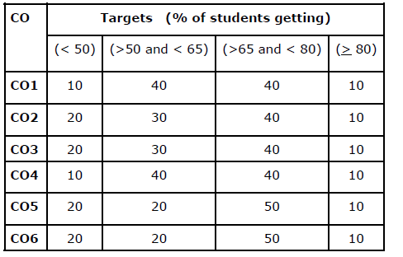

Slide 26
Targets are set for each CO of a course separately
Does not directly indicate the distribution of performance among the students
Advantage of finding out the difficulty of specific Cos
Improvements also can be planned CO-wise
CO | Target (Class Average %)
CO1 | 70
CO2 | 80
CO3 | 75
CO4 | 65
CO5 | 70
CO6 | 80

Slide 27
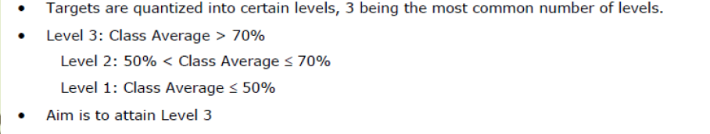

Slide 28
Attainment of COs
Attainment of COs can be measured directly and indirectly
Direct attainment of COs can be determined from the performances of students in all the relevant assessment instruments.
The exit survey form should permit receiving feedback from students on all the COs.
Computation of indirect attainment of COs is based on the perceptions of students! Hence, the percentage weightage to indirect attainment can be kept at a low value, say 10%.

Slide 29
Direct CO Attainment
Direct attainment of COs is determined from the performances of students in Continuous Internal Evaluation (CIE) and Semester End Examination (SEE).
The proportional weightages of CIE: SEE will be as per the academic regulations in force
Proportions of 20:80, 25:75, 30:70, 40:60, 50:50 are all possible!
Direct attainment of a specific COs is determined from the performances of students to all the assessment items related to that particular CO.
Also, we need data about performance of students, assessment item-wise

Slide 30
Direct CO attainment from CIE and SEE
Continuous Internal Evaluation (CIE) is conducted and evaluated by the Department itself in both Tier 1 and Tier 2 institutes.
When questions are tagged with relevant COs, the department has access to performances of students with respect to each CO.
• Hence, computing the direct attainment of COs from CIE is straight forward for both Tier 1 and Tier 2 institutes.
Semester End Examination (SEE) is conducted by the University for Tier 2 institutes
No means of computing the direct attainment of individual COs from SEE!
Only possible solution, though not satisfactory, is to treat the average marks in SEE as the common attainment of all COs!!!

Slide 31
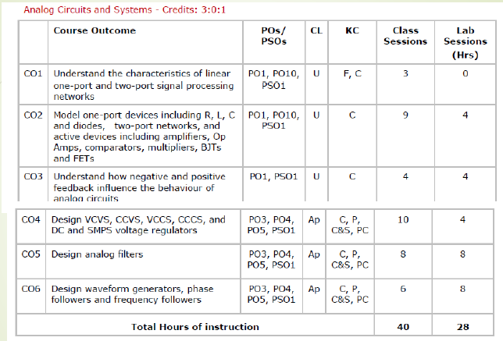

Slide 32
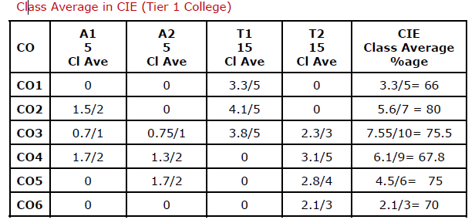

Slide 33
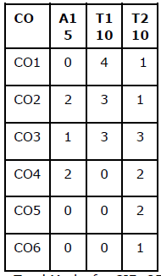
Assessment Plan for CIE - Tier 2 College (Sample Assessment Plan for CIE)
Total Marks for CIE: 25
(A1: Assignment 1; T1: Test 1; T2: Test 2)

Slide 34
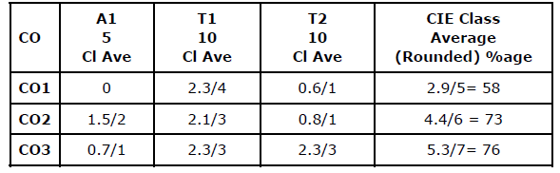
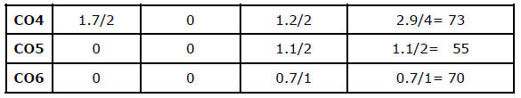
Class Average in CIE (Tier 2 College)

Slide 35
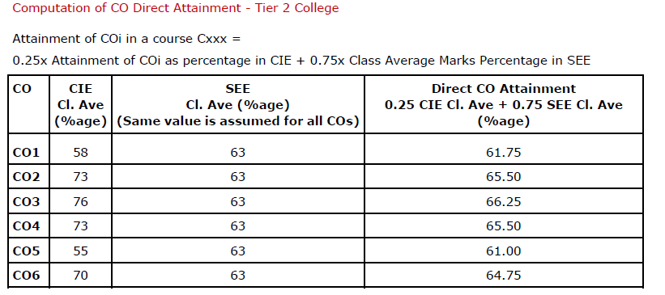

Slide 36
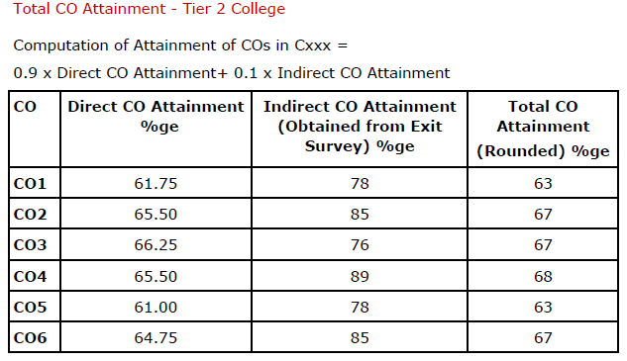

Slide 37
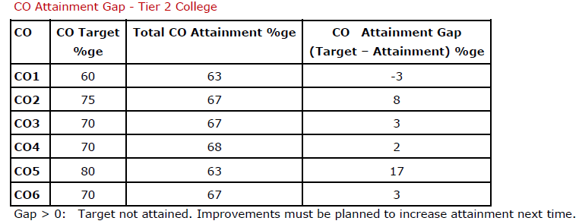

Slide 39
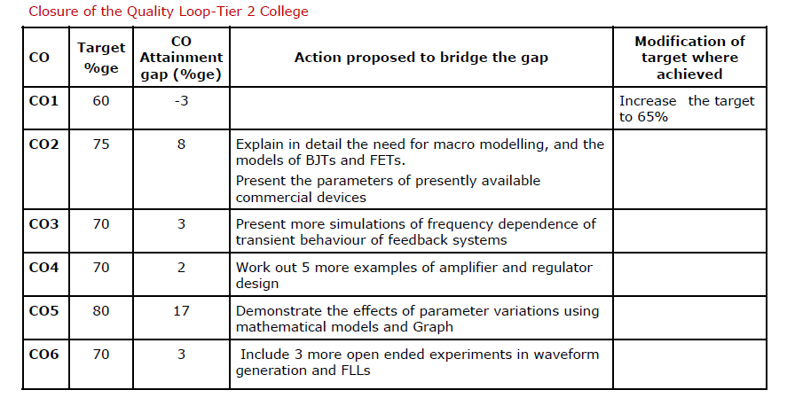

Slide 40
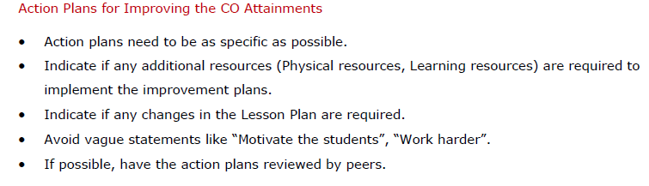

Slide 41
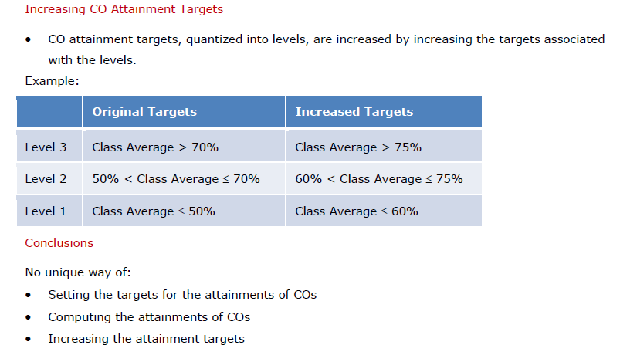

Slide 42
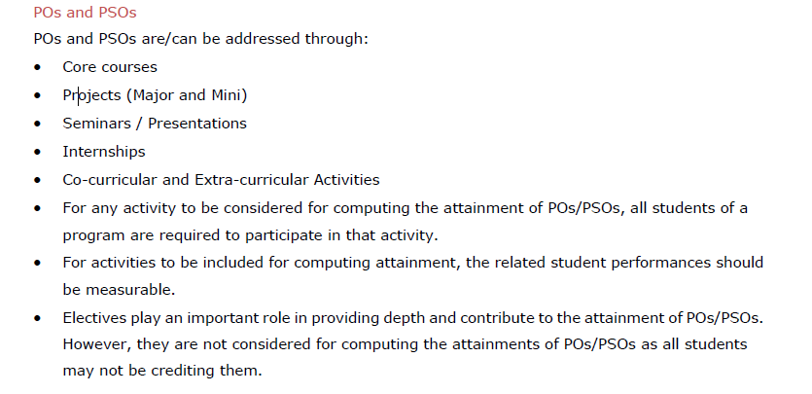

Slide 43
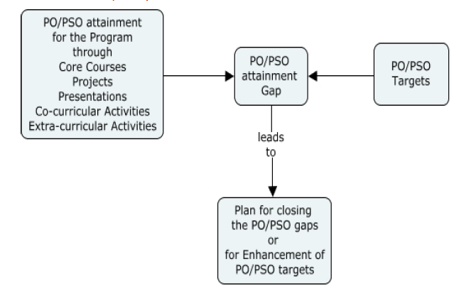
PO/PSO Attainment and quality loop

Slide 44
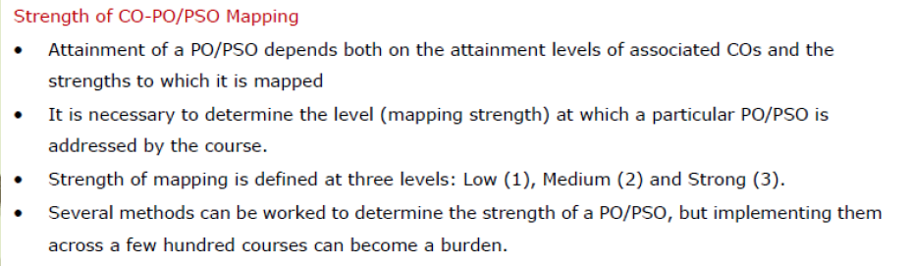

Slide 45
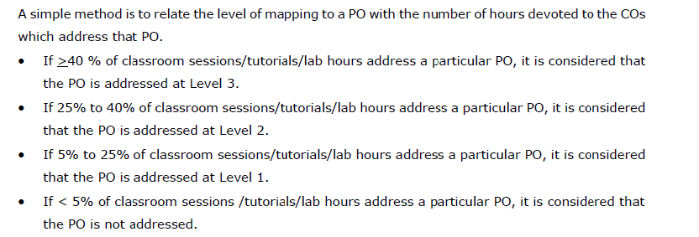

Slide 46
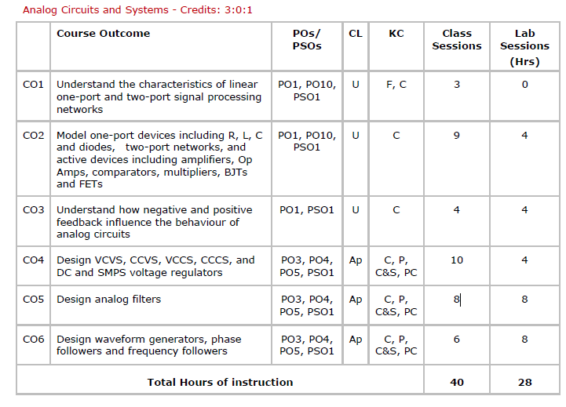

Slide 47
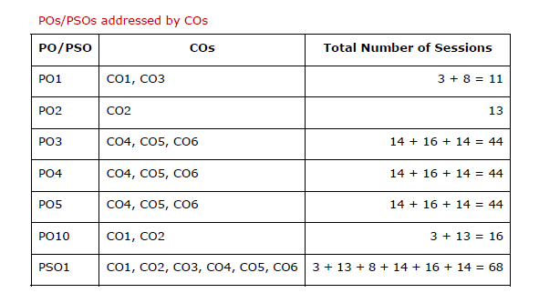

Slide 48
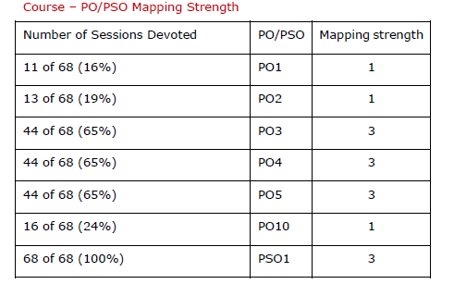

Slide 49
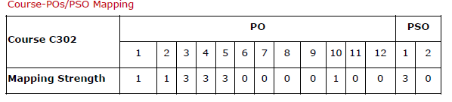

Slide 50
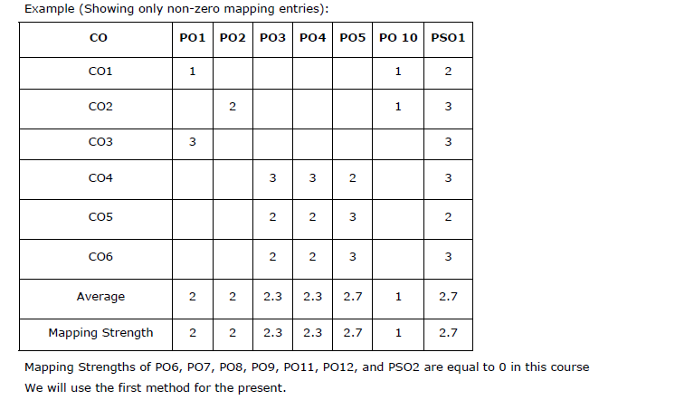

Slide 51

PO/PSO Attainment

Slide 52
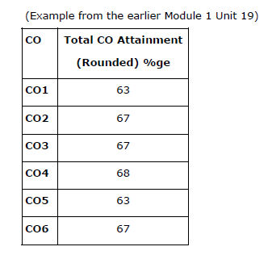
CO- attainment of TierII Institute

Slide 53
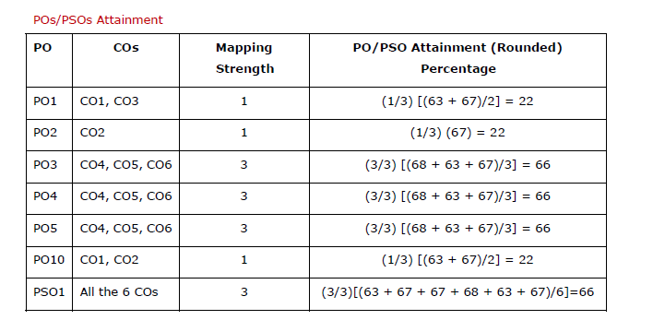
Cont…

Slide 54
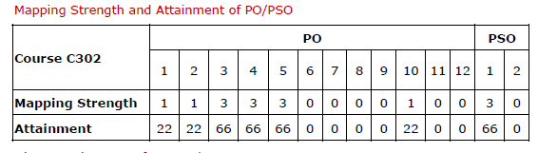
Cont…

Slide 55
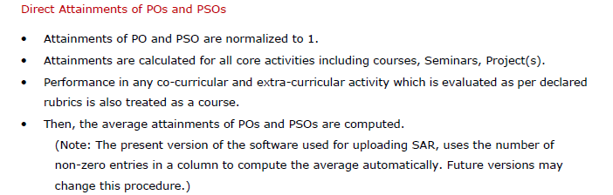
Cont…

Slide 56
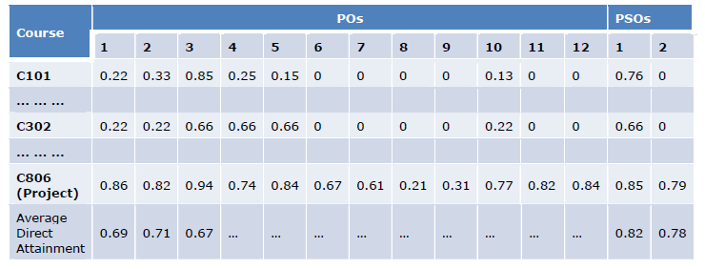
Cont…

Slide 57
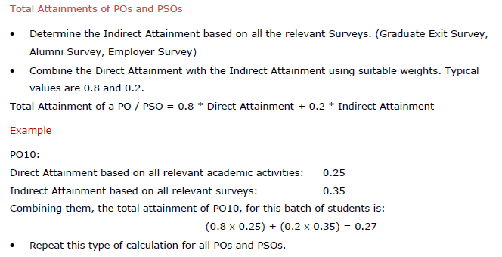
Cont…

Slide 58
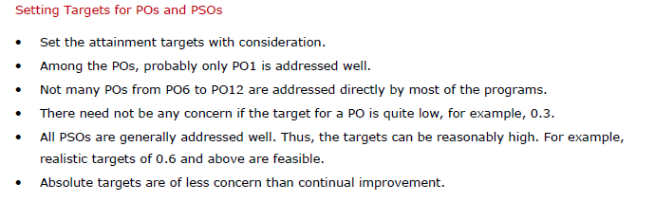
Cont…

Slide 59
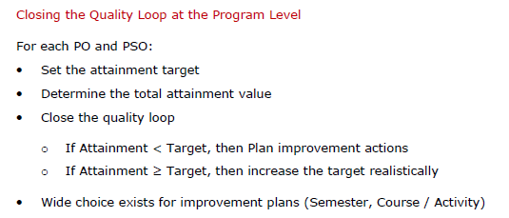
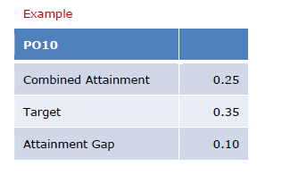
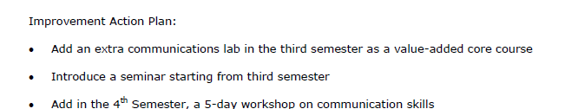
Cont…

Slide 60
Conclusions
Determining the strength to which a PO/PSO is addressed, and computing the attainment are approximations at best!
Even if a more precise computation of PO/PSO attainment is possible the effort involved may not be worth it.
What is important is to follow one method across an Institute
Strive for continual improvement in attainment, and demonstrate the improvements with evidence.

Slide 61
Any Question…..?

Slide 62
Acknowledgement
All the known or unknown sources used during making the presentation are duly acknowledged without the use of their data/information, the presentation would not have been so informative.

Slide 63
Thank You

