Slide 1

Crypto Data Analysis
This presentation explores the analysis of Crpto data using statistical and machine learning techniques. We'll delve into dimensionality reduction, control charts, and anomaly detection to gain insights into stock performance and stability.
Hasham Nadeem 2022205
Hammad Ahmed 2022653
Asad shah 2022123
Muhammad Ahmed 2022337
Notes:
1

Slide 2
Data Preprocessing
Reading CSV
Handling Missing Values
Scaling Data
The data is loaded into a pandas DataFrame from the provided filepath, with the Date column parsed as datetime.
For each of the numeric columns (Open, High, Low, Close, Volume), missing values are filled with the median of the column.
The data is scaled using the StandardScaler, which handles outliers by scaling features according to the interquartile range.
Notes:
2

Slide 3
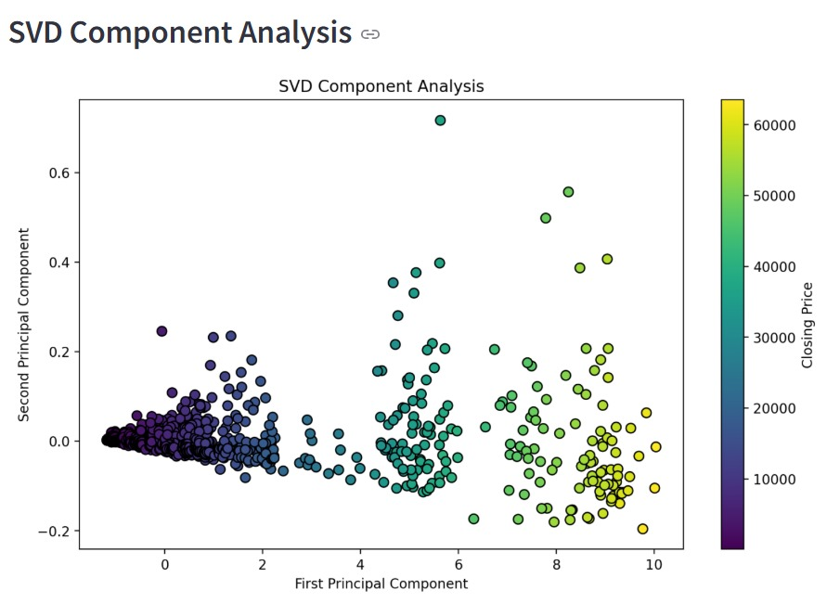
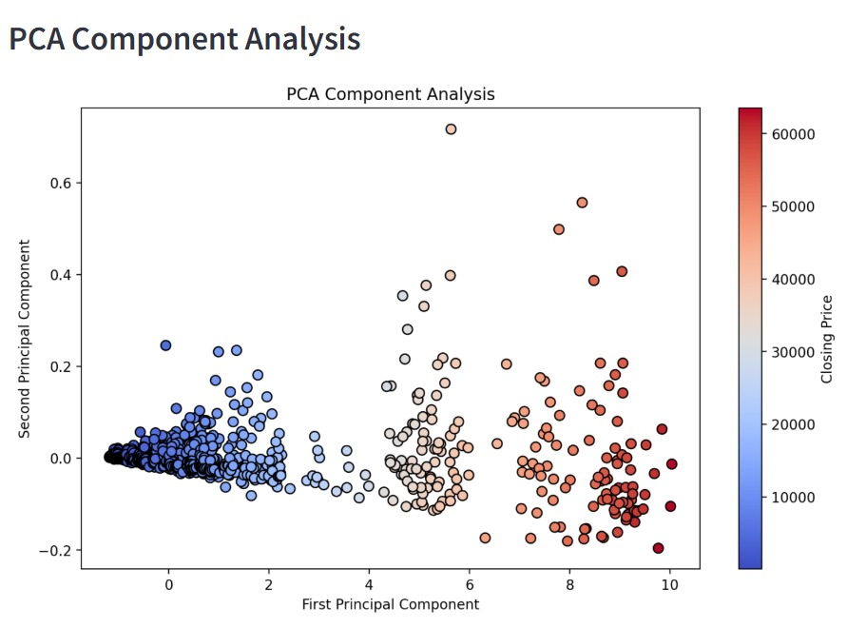
Dimensionality Reduction
SVD Decomposition
PCA Projection
1
2
The scaled data undergoes SVD decomposition, yielding matrices U, S, and Vt.
PCA is applied to the scaled data to project it into a lower-dimensional space (3 components by default).
Visualization
3
A scatter plot used to show the SVD and PCA reduction that in:
In SVD from purple to yellow represent increasing prices.
In PCA dark blue representing lower price and darker red showing higher price.
Notes:
3

Slide 4
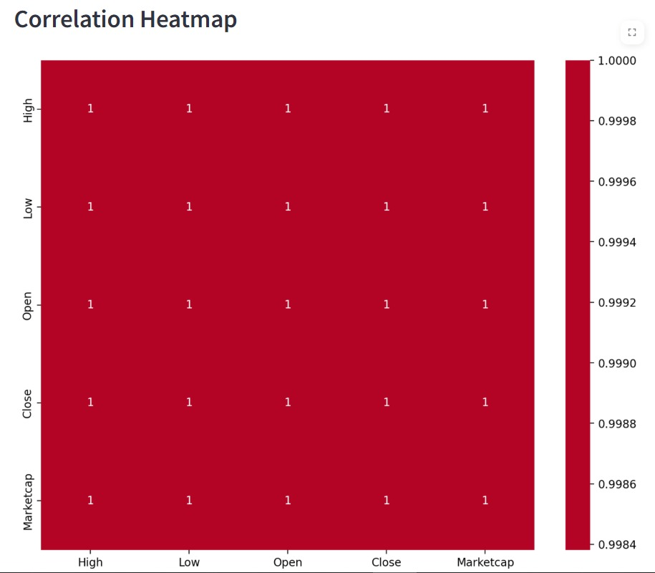
Correlation Analysis
Correlation Heatmap: Shows the correlation between different price metrics (High, Low, Open, Close). The uniform red color with values of 1 indicates perfect or near-perfect correlation between all these metrics, suggesting they move very closely together.
Notes:
4

Slide 5
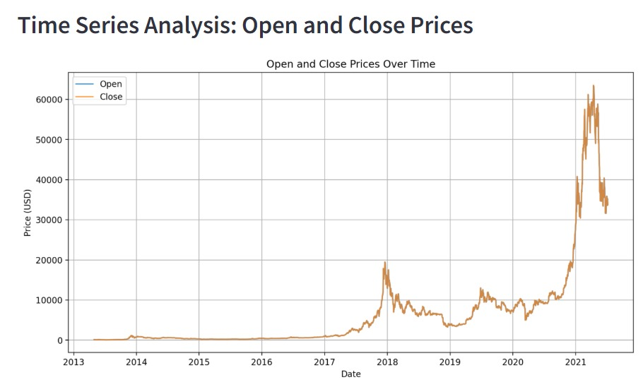
Time Series Analysis
A subplot layout is created with one subplot per stock attribute. For each attribute, a line chart is plotted showing its value over time, with different colors for each attribute.
This graph shows Bitcoin's price movement from 2013 to 2021. The blue line represents opening prices and the orange line shows closing prices. There's a notable bull run in late 2017 reaching around $20,000, followed by a bigger surge in 2021 reaching approximately $60,000. The price remained relatively stable below $5,000 from 2013 to 2017.
Notes:
5

Slide 6
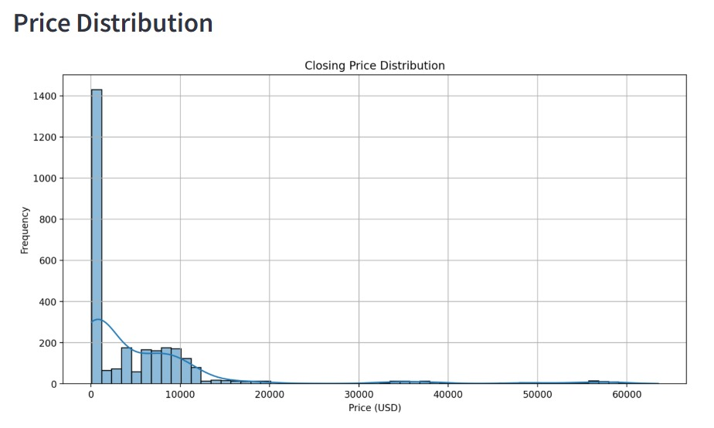
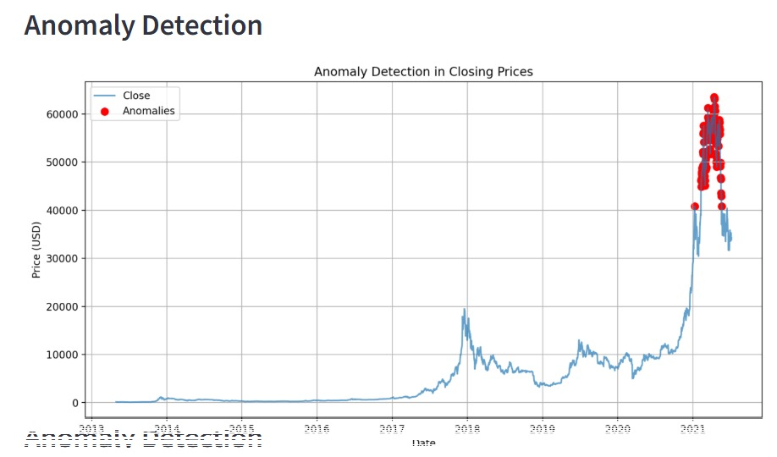
Distribution and Anomaly Detection
Box and violin plots are generated to visualize the distributions of stock attributes. Anomalies are detected using Z-scores (values greater than 3 standard deviations from the mean). The anomalies are marked on the plots using red stars.
Notes:
6

Slide 7
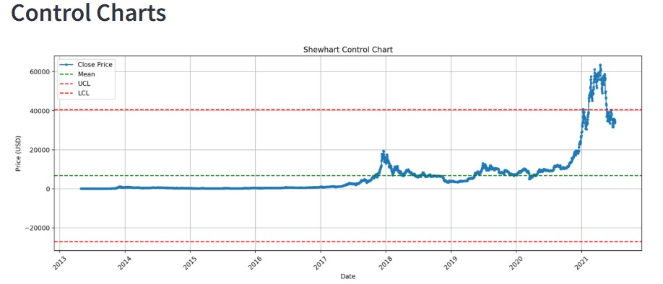


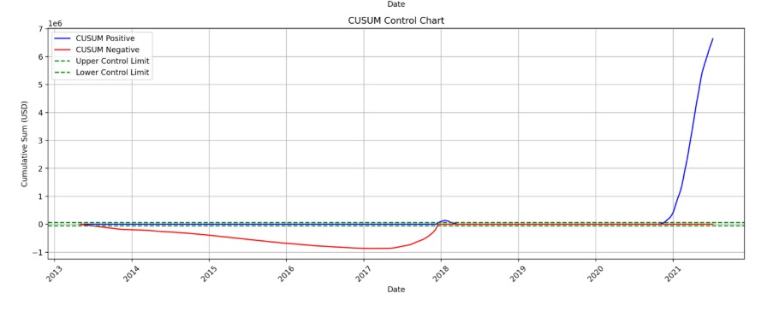

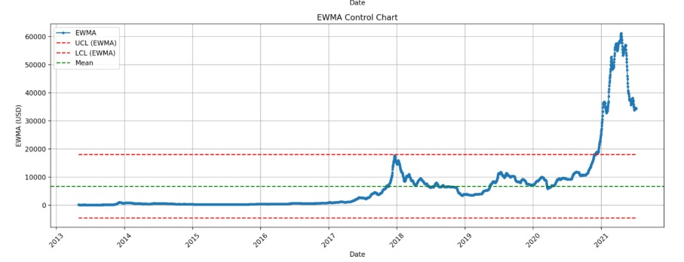
Control Chart Analysis
EWMA
CUSUM
The EWMA is calculated using a smoothing factor (λ = 0.2). Control limits (UCL and LCL) are calculated using the mean and standard deviation of the data, with a margin of 3 standard deviations.
CUSUM is calculated for both positive and negative deviations from the mean with a reference value k = 0.5. The cumulative sum for both positive and negative deviations is plotted, along with control limits.
Shewhart
The mean and standard deviation of each attribute are used to calculate the upper and lower control limits. Raw data and control limits are plotted on the same chart.
Notes:
7

Slide 8

Conclusion
This analysis provides a comprehensive view of Crypto data performance over time. By using PCA and SVD for data reduction, and various control charts (EWMA, CUSUM, Shewhart) for monitoring behavior, we can gain valuable insights into crypto performance, detect anomalies, and make informed decisions.
Notes:
8

