Slide 1
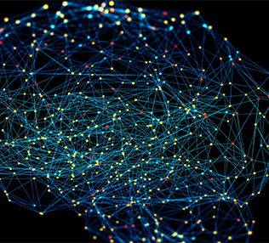
AI powered solution for
Alexithymia
Muhammad Ahmed 2022337 Hasham Nadeem 2022653

Slide 2

Introduction

Slide 3

Introduction
A robust system for accurately extracting emotions from live faces.
Emotion recognition plays a vital role in interpersonal communication and psychological wellbeing.

Slide 4
Motivation
Why we chose this project ?
The motivation is to help individuals with alexithymia in expressing emotions.
Traditional method rely on manual analysis, which can be prone to errors.
We aim to empower individuals with alexithymia to have better social interaction.

Slide 5

Dataset
CK+ databset was used which was released for the purpose of
promoting research into automatically detecting individual facial
expressions by Cohn Kanade(CK).
In addition to this, non-posed sequences for several types of smiles
and their associated metadata have been added.
Reference
Comprehensive database for facial expression analysis. Proceedings Fourth IEEE International Conference on Automatic Face and Gesture Recognition

Slide 6
Preprocessing
Implementation
Construction
Evaluation

Slide 7

Implementation Procedure
Preprocessing
Data is cleaned to prepare for training
Construction
Model is made by using CNN.
Evaluation
Model is evaluated on loss and accuracy and separately for validation dataset
Training
Model is trained on Images containing face emotion.

Slide 8
Data Preprocessing
Dataset undergoes preprocessing before implementation
Firstly, the Grayscale transformation is used to reduce the dimensionality of the data while retaining essential features related to facial expressions.
Next, the Resize transformation standardizes the size of the images to a fixed resolution of 48x48 pixels.
The RandomHorizontalFlip transformation introduces variability into the dataset by randomly flipping images horizontally with a probability of 0.5.

Slide 9
Model Construction
Model is made using several layers
First Layer:applies 32 distinct filters to the grayscale input images, each filter scanning through a 3x3 window. The resultant feature maps are then subjected to ReLU activation, introducing non-linearity to the network.
Second and Third Layers: Does the same as previous layer.
Outer Layer: No activation function is applied, enabling raw predictions to be produced.

Slide 10
Model Training
Model is trained using dataset
Model is trained using CK dataset which include emotions images.
Iterative adjustment of model parameters based on training data.
The optimization step involves backpropagation, where the gradients of the loss with respect to the model parameters are computed.
Validation dataset evaluation and early stopping implementation.

Slide 11
Model Evaluation
Model is evaluated in its ability to create summaries
Model is evaluated on accuracy and loss metrics on a validation dataset
Model accuracy is 0.95.
Model is tuned for future growth

Slide 12
Conclusion
In conclusion, our emotion recognition model achieves exceptional performance with an average accuracy, precision, recall, and F1 score all near 95%. This highlights its robustness in discerning facial expressions accurately. Such capability offers valuable insights into emotional states, particularly aiding individuals with alexithymia in better understanding emotions.

Slide 13
THANK
YOU

