Slide 1

K-means
Initialization: Start by selecting �k initial centroids. �k is the number of clusters you want to find. These centroids can be chosen randomly from the dataset or by other methods designed to speed up convergence and improve cluster quality.
Assignment: Assign each data point to the nearest centroid to form �k clusters. The distance between a data point and a centroid is typically measured using Euclidean distance, though other distance measures can also be used depending on the nature of the data.
Update: After all data points have been assigned to clusters, recalculate the centroids of these clusters. The new centroid of each cluster is calculated by taking the mean of all points assigned to that cluster.
Iteration: Repeat the assignment and update steps until the centroids no longer change significantly, indicating that the algorithm has converged, or until a specified number of iterations has been reached.

Slide 2

Challenges

Slide 3
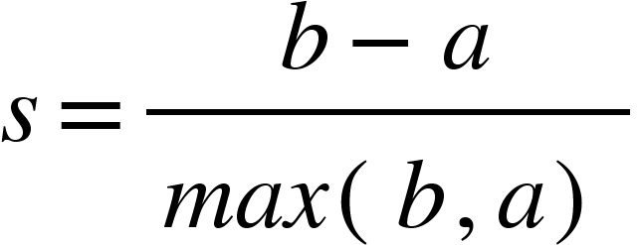
Silhouette Coefficient
where:
a is the average distance from the data point to the other points in the same cluster (cohesion),
b is the smallest average distance from the data point to points in a different cluster, minimized over clusters (separation).
The silhouette coefficient for a set of samples is given as the mean of the silhouette coefficient for each sample. The value of the silhouette coefficient ranges from -1 to 1, where:
A high value indicates that the object is well matched to its own cluster and poorly matched to neighboring clusters. If most objects have a high value, then the clustering configuration is appropriate.
If many points have a low or negative silhouette coefficient, it suggests that the clusters are overlapping and that the data point might have been assigned to the wrong cluster.

Slide 4
Hierarchical Clustering
Start by treating each data point as a single cluster.
Find the closest (most similar) pair of clusters and merge them into a single cluster, so that now you have one less cluster.
Compute distances (similarities) between the new cluster and each of the old clusters.
Repeat steps 2 and 3 until all items are clustered into a single cluster

Slide 5
DBSCAN
Initialization: Start with an arbitrary point that has not been visited. Determine if it is a core point by checking if it has at least MinPts within its ϵ-neighborhood.
Cluster Formation: If the point is a core point, form a cluster starting from it by recursively adding all directly reachable points in its ϵ-neighborhood to the cluster. This process includes adding other core points found in the neighborhood and their reachable points, expanding the cluster.
Border Points Identification: As the cluster expands, include border points found in the neighborhood of core points, but do not expand the cluster from these border points.
Handling Noise: Points that are not part of any cluster by the end of the algorithm are labeled as noise.
Repeat: Continue the process with another unvisited point until all points are either part of a cluster or marked as noise.

