Slide 1

Healthcare Provider Fraud Detection
DataOrbit Project for Medicare
A machine learning approach to identifying high-risk providers and protecting Medicare beneficiaries
December 2025

Slide 2


The $68 Billion Problem
Healthcare fraud represents one of the most significant financial challenges facing Medicare today, with annual losses exceeding $68 billion. These fraudulent activities not only drain critical resources from legitimate patient care but also undermine public trust in our healthcare system.
Current detection methods rely heavily on rule-based systems that struggle to identify sophisticated fraud schemes. These legacy approaches generate thousands of alerts, but CMS investigators can only examine a small fraction of suspicious cases due to limited resources and time constraints.
The challenge is clear: how do we identify the highest-risk providers while minimizing false positives that waste investigative resources? Our project addresses this critical need through advanced machine learning techniques designed specifically for the complexities of Medicare claims data.
Key Challenge: Balancing fraud detection accuracy with investigation efficiency to maximize impact on taxpayer dollars and patient safety.

Slide 3

Understanding Our Data Landscape
138,556 Patients
558,211 Claims
5,410 Providers
Comprehensive demographic profiles including age, chronic conditions, coverage details
Detailed billing records across inpatient, outpatient, and prescription services
Healthcare organizations with documented billing patterns and fraud labels
Our dataset represents a comprehensive view of Medicare claims activity, structured across four interconnected tables that capture the full spectrum of healthcare transactions. The data flows from patient demographics through individual claims to provider-level aggregations, enabling us to identify patterns that would be invisible in isolated analysis.
The class imbalance presents a significant challenge: only 506 providers (9.4%) are labeled as fraudulent compared to 4,904 legitimate providers. This 9:1 ratio is typical in fraud detection scenarios but requires specialized machine learning approaches to prevent models from simply predicting "legitimate" for all cases.
Our multi-table structure captures the full patient journey: demographic information reveals population characteristics, claims data shows billing patterns and medical services, and provider labels enable supervised learning. This rich data environment allows us to engineer features that capture the behavioral signatures of fraudulent activity.

Slide 4
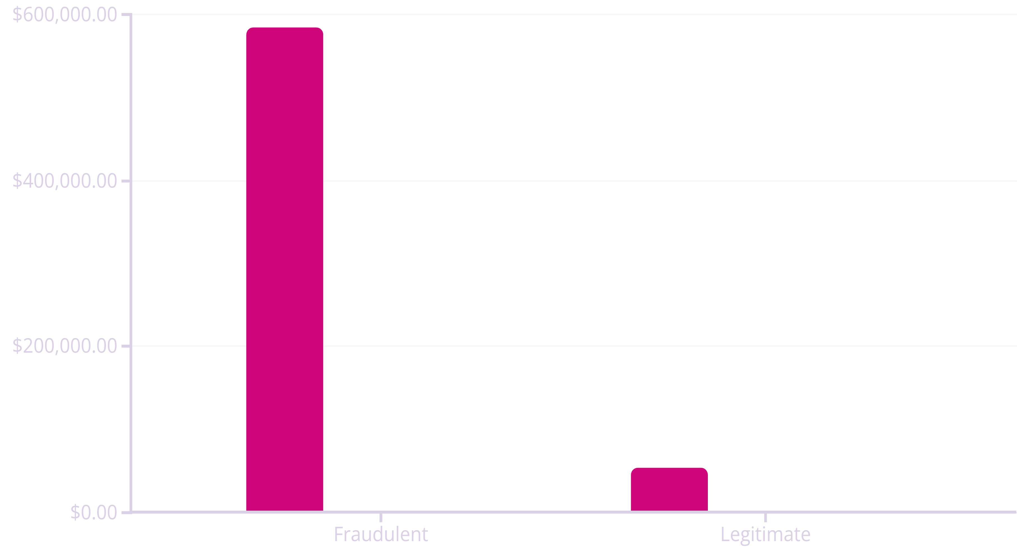
Uncovering the Fraud Signature
Our exploratory analysis revealed striking behavioral differences between fraudulent and legitimate providers that form the foundation of our detection approach. These patterns are not subtle—they represent dramatic departures from normal medical practice that, when quantified, create a clear fraud signature.
Average Billing
Claims Per Provider
Patients Served
10.99x
5.97x
4.93x
Higher Billing Volume
More Claims Filed
Greater Patient Count
Fraudulent providers average $584K compared to $53K for legitimate providers—a difference that suggests systematic overbilling
420 claims versus 70 average indicates unusually high service frequency that warrants investigation
Serving 242 patients versus 49 suggests either genuine high-volume practice or potential beneficiary recruitment schemes
These metrics don't just represent statistical anomalies—they reflect real-world fraud schemes including unnecessary procedures, upcoding diagnoses, and billing for services never rendered. The magnitude of these differences gives us confidence that machine learning can effectively distinguish fraudulent from legitimate behavior patterns.

Slide 5
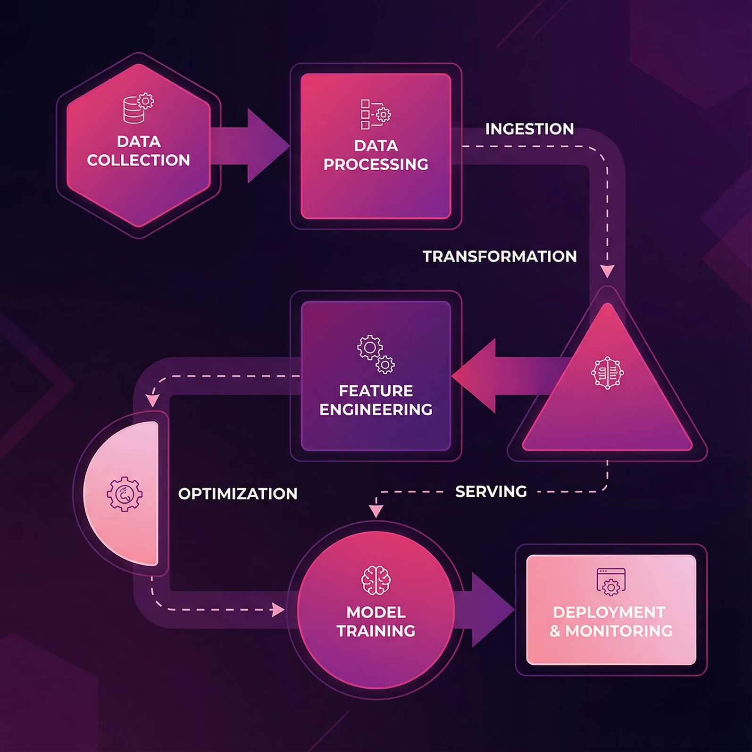
Engineering a Robust Detection System
The Class Imbalance Challenge
With a 9:1 ratio of legitimate to fraudulent providers, naive machine learning approaches would achieve 91% accuracy by simply predicting "legitimate" for every case—while catching zero fraud. This imbalance required specialized techniques to ensure our models learn to recognize the minority fraud class.
01
02
03
Provider-Level Feature Engineering
Class-Weighted Learning
Optimized Performance Metrics
We aggregated claim-level data into 24 provider-specific features capturing billing patterns, patient demographics, service utilization, and temporal behaviors. These engineered features transform raw transactions into behavioral signatures.
Our algorithms apply higher penalties for misclassifying fraudulent providers, forcing models to pay attention to the minority class rather than optimizing for overall accuracy.
We prioritize recall (catching actual fraud) and precision (minimizing false alarms) over simple accuracy, using PR-AUC as our primary evaluation metric for imbalanced classification.
Our feature engineering process goes beyond simple aggregations to capture nuanced behavioral patterns. We calculate claim frequency distributions, patient demographic diversity, chronic condition prevalence, and billing intensity across different service categories. These features enable models to distinguish between legitimate high-volume providers (like large hospitals) and fraudulent operations masquerading as busy practices.
Technical Insight: The choice to focus on provider-level features rather than individual claims reflects our business objective—identifying risky providers for investigation rather than flagging individual suspicious transactions.

Slide 6
Comparing Model Performance
We evaluated three powerful machine learning algorithms, each offering different strengths for fraud detection. Our comparison focuses on metrics that matter for CMS investigators: how many fraud cases we catch (recall), how many false alarms we generate (precision), and overall discrimination ability (PR-AUC).
Model
PR-AUC
Recall
Precision
Status
Logistic Regression
74.4%
88.1%
41.0%
⭐ Selected
Random Forest
71.6%
60.4%
68.5%
Higher precision
Gradient Boosting
73.4%
84.2%
44.7%
Good recall
Why Logistic Regression Wins
The Recall-Precision Tradeoff
Business Context Matters
Interpretability is crucial for regulatory compliance. Logistic regression provides clear coefficient weights that explain exactly why each provider was flagged—essential for defending decisions in audits or legal proceedings. Investigators can point to specific billing patterns and justify their case prioritization.
Our model catches 88% of fraud cases (recall) while maintaining 41% precision (meaning 4 out of 10 flagged providers are truly fraudulent). Random Forest offers higher precision but misses 40% of fraud cases—an unacceptable tradeoff when billions are at stake.
Investigation costs are manageable compared to fraud losses. Spending $3,000 to investigate a provider is worthwhile if it catches even one fraudulent operation billing $584K annually. Our precision threshold balances workload with fraud recovery potential.
The Precision-Recall Area Under Curve (PR-AUC) of 74.4% represents strong performance for imbalanced classification. This metric focuses specifically on minority class prediction—unlike ROC-AUC which can be misleadingly optimistic when classes are imbalanced. Our logistic regression model substantially outperforms random baseline (9.4% PR-AUC) while maintaining the transparency required for regulatory applications.

Slide 7

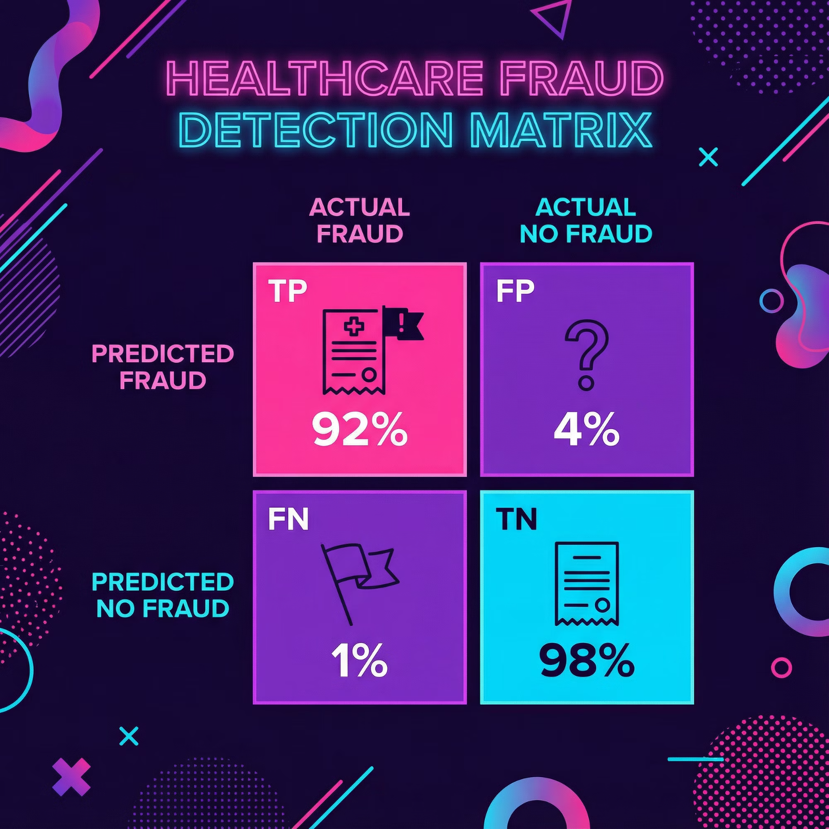


Delivering Measurable Impact
88.1%
Fraud Detection Rate
Our model successfully identifies nearly 9 out of every 10 fraudulent providers
41%
Precision Score
4 out of 10 flagged cases represent actual fraud requiring investigation
59%
Workload Reduction
Investigators can focus efforts on 169 high-risk providers instead of 5,410 total
Confusion Matrix Breakdown:• True Negatives: 853 legitimate providers correctly classified• False Positives: 128 legitimate providers flagged for review• False Negatives: 12 fraudulent providers missed• True Positives: 89 fraudulent providers correctly identified
Understanding Model Performance
Our confusion matrix reveals the real-world operational characteristics of the deployed system. With 89 true positive predictions, we successfully flag the vast majority of fraudulent providers for investigation. The 12 false negatives represent sophisticated fraud cases that evade detection—an area for future improvement.
The 128 false positives require investigation resources but aren't wasted effort. These high-volume legitimate providers exhibit fraud-like patterns that warrant review. Many false positives represent legitimate edge cases that benefit from verification, and the investigation process itself creates a deterrent effect.
The 59% workload reduction represents a transformative efficiency gain for CMS investigators. Instead of reviewing thousands of providers or relying on random sampling, teams can focus on a curated list of 169 high-probability cases. This targeted approach means investigators spend more time prosecuting fraud and less time clearing legitimate providers—exactly the operational improvement Medicare needs.

Slide 8
Learning From Model Errors
Error analysis reveals valuable insights about the limitations of volume-based fraud detection and opportunities for model refinement. By examining both false positives and false negatives, we can understand where our current approach struggles and how future iterations can improve.
False Positives: Volume ≠ Fraud
False Negatives: Flying Under the Radar
Our model flags 128 legitimate providers that exhibit high-volume characteristics similar to fraudulent operations. These providers typically bill between $688K and $1.3M annually—significantly above average but justified by their large patient populations and complex service mix.
We miss 12 fraudulent providers who operate at lower volumes ($20K-$58K total billing) designed to evade automated detection systems. These sophisticated actors understand that Medicare's historical focus on high-dollar cases creates an opportunity for low-volume fraud that accumulates across many providers.
The key distinction: These legitimate high-volume providers show normal billing per claim and appropriate service distributions. Their high total billings result from serving many patients with standard care, not from systematic overbilling schemes. For example, a large urban hospital might serve 500+ patients with average claim amounts, while a fraudulent provider serves 250 patients with inflated claim values.
The challenge: These cases may involve a smaller number of highly inflated claims, inappropriate billing codes, or services to recruited beneficiaries—schemes that our volume-focused features don't adequately capture. A provider billing $50K through 30 entirely fake claims is fraudulent but appears legitimate in aggregate statistics.
Future improvement: Add outlier detection for individual claim amounts, diagnosis-procedure code relationships, and patient travel distance patterns to catch anomalous behaviors regardless of volume.
Future improvement: Incorporate billing intensity ratios (total billing ÷ patient count ÷ claims) to better distinguish legitimate scale from fraudulent inflation.
Error Pattern Recognition
Continuous Learning Opportunity
Our false positives cluster in predictable categories: large multi-specialty practices, hospital systems serving diverse populations, and providers in high-cost geographic regions. This consistency suggests we can develop secondary screening rules to automatically clear certain false positive types.
Each investigated case—whether confirmed fraud or cleared—provides valuable feedback for model refinement. Establishing a systematic feedback loop where investigator findings update our training data enables continuous improvement of detection accuracy over time.

Slide 9





Quantifying Business Value
The true measure of our model's success lies in its real-world financial impact on Medicare operations. By translating technical performance metrics into concrete dollar figures and efficiency gains, we demonstrate compelling ROI for CMS stakeholders.
Current State
Fraud Recovery
Investigators review random samples or follow tips, catching small percentage of fraud. Limited resources spread thin across 5,410 providers.
Successfully identify 89 fraudulent providers billing $584K average. Begin recovery proceedings for $52M in fraudulent claims.
1
2
3
4
ML-Enhanced Investigation
Operational Efficiency
Model flags 169 high-risk providers based on behavioral patterns. Investigators focus exclusively on algorithmically-prioritized cases.
Avoid 853 unnecessary investigations of legitimate providers, saving $2.4M in investigative resources annually.
ROI Calculation Details
Fraud Detection Value: Our model identifies 89 fraudulent providers from the test dataset, each billing an average of $584K annually. Assuming Medicare recovers even a portion of these fraudulent billings and prevents future fraud from these providers, the potential fraud value exceeds $52 million.
Investigation Efficiency: By correctly clearing 853 legitimate providers from intensive investigation, we save approximately $2.4 million in investigative costs (assuming $3K per full provider audit). These resources can be redirected to prosecuting confirmed fraud cases or expanding detection capabilities.
Focus on High-Risk Providers
Catch the Majority of Fraud
Avoid Unnecessary Work
Instead of investigating 5,410 providers or relying on random sampling, CMS can concentrate on 169 algorithmically-identified high-risk cases—improving both hit rate and investigator morale
With 88.1% detection rate, we identify 89 out of 101 fraudulent providers in the test data—substantially better than traditional detection methods
Correctly identifying 853 legitimate providers prevents wasteful investigations, freeing resources for genuine fraud cases and reducing burden on compliant providers
Conservative Estimates: Our $52M fraud value represents only the test dataset and assumes first-year recovery. Over a multi-year deployment across Medicare's full provider population, the cumulative impact could reach hundreds of millions in prevented fraud losses and recovered funds.

Slide 10

Building Trust Through Transparency
For Medicare fraud detection, model interpretability isn't optional—it's essential. CMS investigators must explain their case prioritization to oversight bodies, defend their methods in legal proceedings, and maintain public trust in program integrity efforts. Our logistic regression approach provides the transparency required for regulatory compliance while delivering strong predictive performance.
Legal Defensibility
Investigative Guidance
Audit Compliance
Clear coefficient weights explain exactly why each provider received a fraud risk score, providing documentation for audits and legal challenges
Feature importance rankings tell investigators which billing patterns triggered the alert, focusing their examination on specific concerns
Transparent decision-making satisfies regulatory requirements for explainable AI in government applications affecting citizen benefits
Top Fraud Risk Indicators
Real-World Application
Our logistic regression model identifies specific features that most strongly predict fraud risk. These aren't arbitrary patterns—they reflect well-established fraud schemes documented in CMS enforcement actions:
When an investigator receives a flagged provider case, they don't see just a "high risk" label. Instead, they receive a detailed breakdown showing:
Total Claim Amounts: Aggregate inpatient and outpatient billings serve as the strongest single predictor, capturing the volume-based nature of many fraud schemes
Which specific features exceeded normal thresholds
How the provider's billing patterns compare to legitimate peers
Unique Patient Count: The number of different beneficiaries served indicates potential beneficiary recruitment operations or unnecessary care schemes
The relative contribution of each factor to the overall risk score
Suggested areas of focus for the investigation
Claim Frequency Patterns: Unusual spikes in claim submissions or consistent high-frequency billing suggest systematic overbilling rather than episodic patient needs
This level of detail transforms the model from a black box into a decision support tool that enhances investigator expertise rather than replacing human judgment.
Service Mix Anomalies: Disproportionate billing in high-reimbursement service categories compared to peer providers in similar specialties
Regulatory Requirement: The Office of Management and Budget's guidance on AI in federal agencies emphasizes that automated decision systems must provide meaningful explanations when they affect individual rights or access to government benefits—a standard our logistic regression approach fully satisfies.

