Slide 1

Analytical Insights for UK Online Retail
MANG3108: Analytics in Action I
ID: 34074759

Slide 2
Predicting Repeat Customers & Segmenting Value Groups
Dataset: UK Customers, 2010-2011 online transactions
Retention is cheaper than acquisition
Goals
Predict repeat purchase probability
Segment customers for targeted marketing
Outcome: Efficient marketing & higher ROI

Slide 3
Data Preparation & Feature Engineering
Removed missing CustomerIDs (~27% of data) & Outliers
Built Customer-level features:
Recency
Frequency
Monetary
These among with descriptive transformations such as RecencyFrequencyRatio capture buying behaviour directly

Slide 4
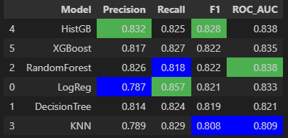
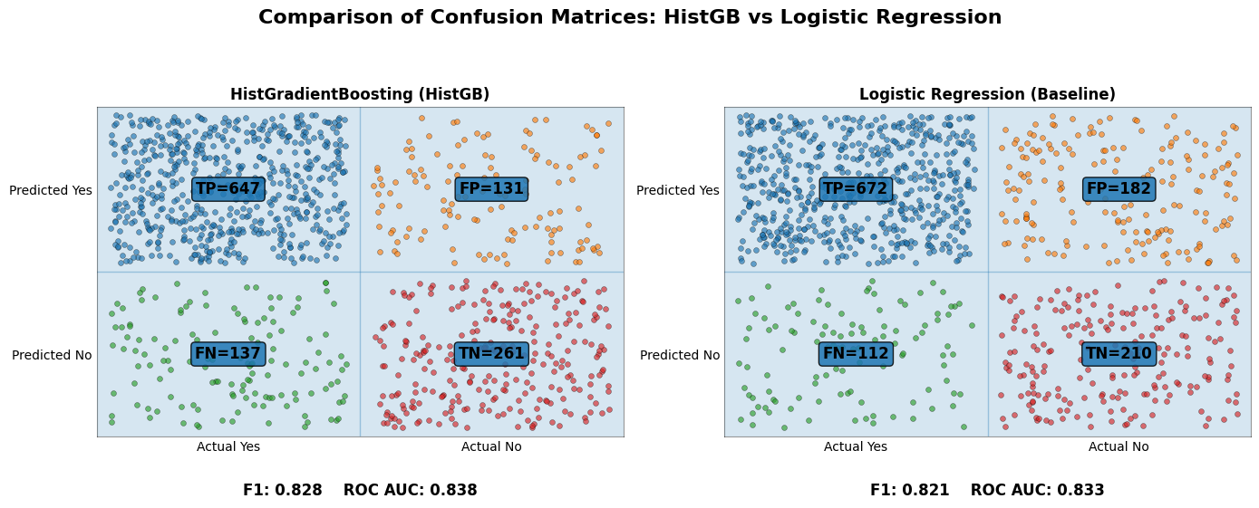
Predictive Modelling
HistGB most accurately predicts likelihood of repeat purchase
At the cost of being a more complex model that is black box and not easily interpretable to non-specialists
RandomForest offers comparable performance (Same ROC but lower F1 at 0.822)
HistGB also scores highest in precision, but tails behind Logistic Regression for recall

Slide 5
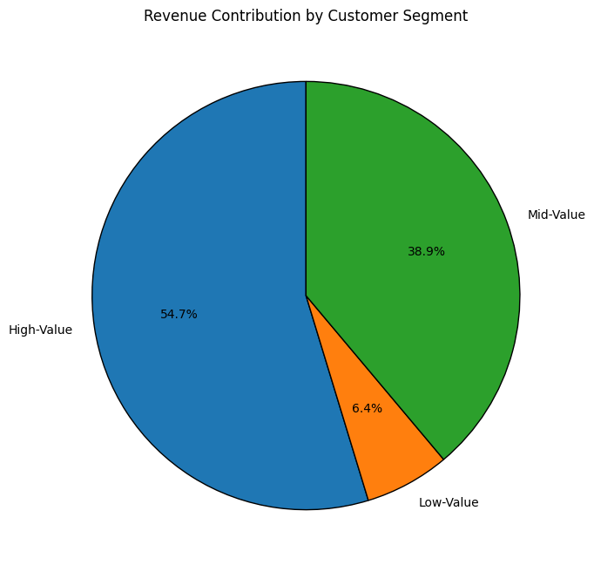
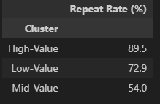
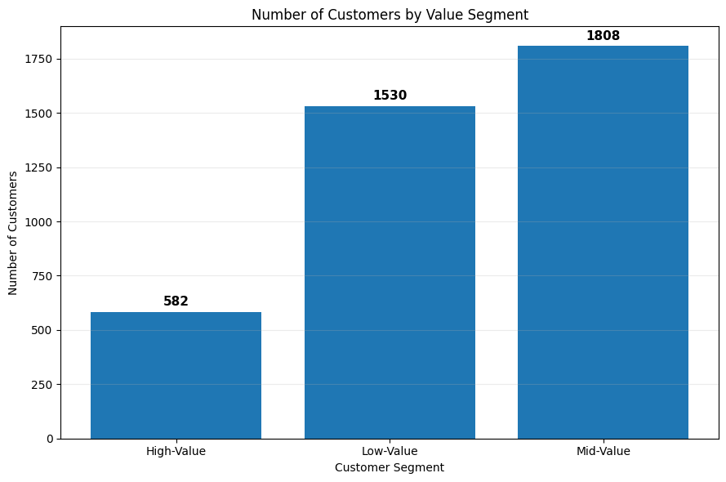
Customer Segmenting (K-means Clustering)
K-means clustering found 3 distinct groups of customers
Can be described as:
A high-value group with the low customer count, yet the highest contribution to total revenue (54.7%)
A low-value group with 2nd highest customer count and repeat rate, accounts for 6.4% of total revenue
A mid-value group with the highest customer count, yet lowest repeat rate but accounts for 38.9% of total revenue

Slide 6
Marketing Strategy for each segment
Segment | Strategy
High-Value | VIP Loyalty, early access and retention focus
Mid-Value | Bundles, upselling packages and repeat incentives
Low-Value | Low-cost email/SMS for high-potential customers and newsletter for the rest
Majority of marketing budget should be attributed to High-Value and Mid-Value to their revenue contribution
Low-cost methods for low-value allow higher spending for highest ROI customers

Slide 7

Business Implementation
HistGB to be integrated to CRM
Automatically triggering marketing campaigns with accurate and up-to-date data
Different thresholds of this model should be applied to each segment
High-Value: High recall, low precision
Mid-Value: Balanced
Low-Value: Low recall, high precision

