Slide 1

Stock Price Prediction: Addressing the Challenge of Market Dynamics
Prepared by:Hashem Al-Ayasrah 202010678 Qais Qawasmi 201920084
Supervised by:Dr. Ahmad Hussein

Slide 2
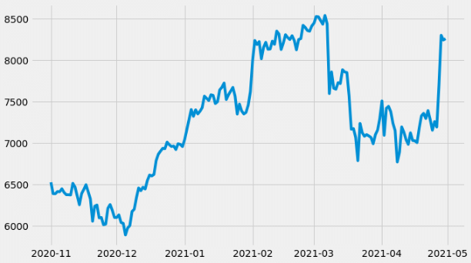
Introduction
This study addresses the challenge of predicting stock prices in a highly volatile market by leveraging advanced machine learning techniques.

Slide 3

Objectives
Pinpoint the best methods for forecasting stock prices
Determine which techniques are most accurate in their predictions
Create visual displays of actual and predicted prices
Test the consistency and dependability of the forecasting models
Use the project's findings to make real trades in the stock market

Slide 4
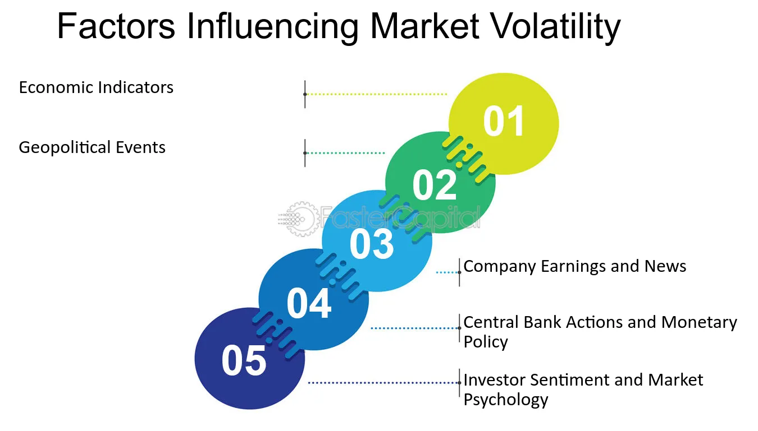
Background
Stock price prediction is a critical area of research in finance and economics. Accurate predictions can lead to significant financial gains for investors and institutions. However, the stock market is highly volatile and influenced by various unpredictable factors, making accurate predictions challenging.

Slide 5
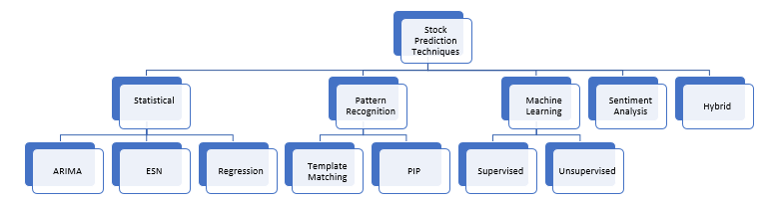
Traditional Methods
Traditional methods for stock price prediction include techniques such as moving averages, exponential smoothing, and ARIMA models. While these methods have been useful, they often rely on linear assumptions and may not capture the complex patterns present in stock price movements.

Slide 6
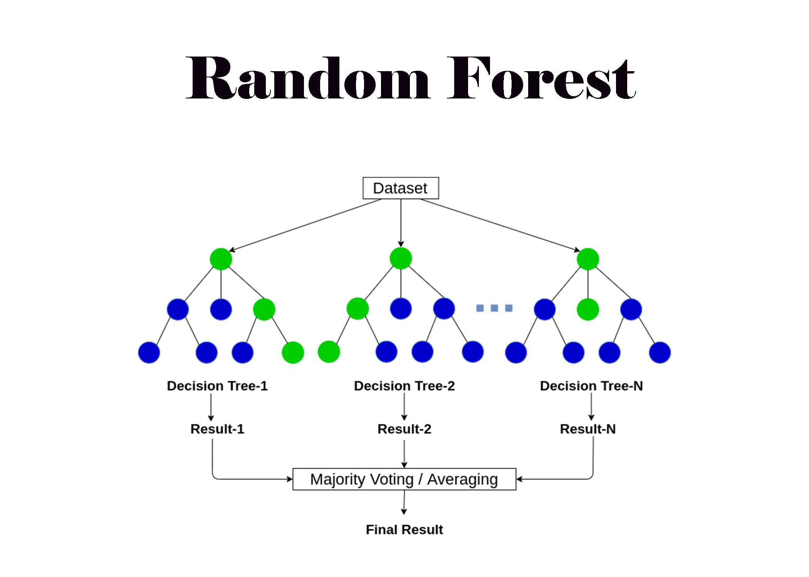
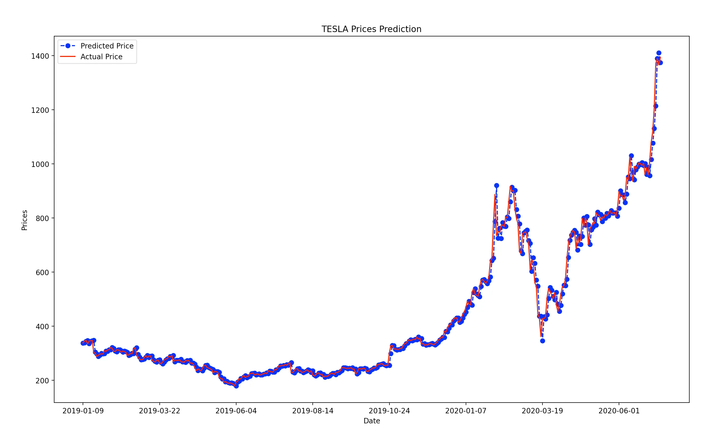
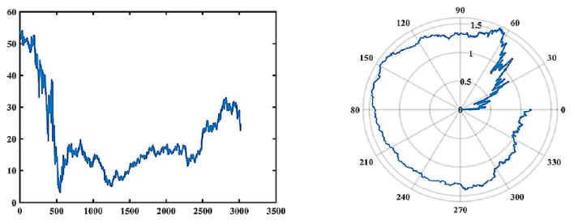
Literature Review
Traditional Methods:
Moving averages, exponential smoothing, ARIMA
Machine Learning:
SVM, Random Forests
Deep Learning:
RNNs: Time series forecasting, vanishing gradient problem
LSTMs: Superior performance, addresses vanishing gradient
CNNs: Captures local features and patterns
Hybrid Models:
Combining RNNs and CNNs
Sentiment Analysis:
News articles, social media, financial reports
Research Gaps:
Robust models, alternative data sources

Slide 7
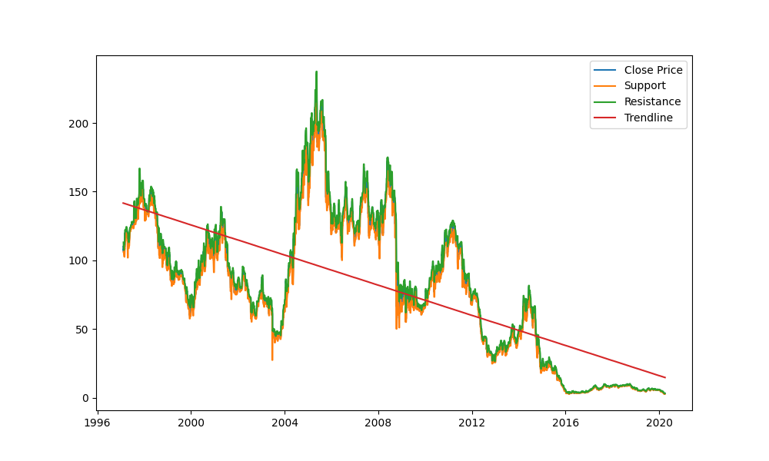
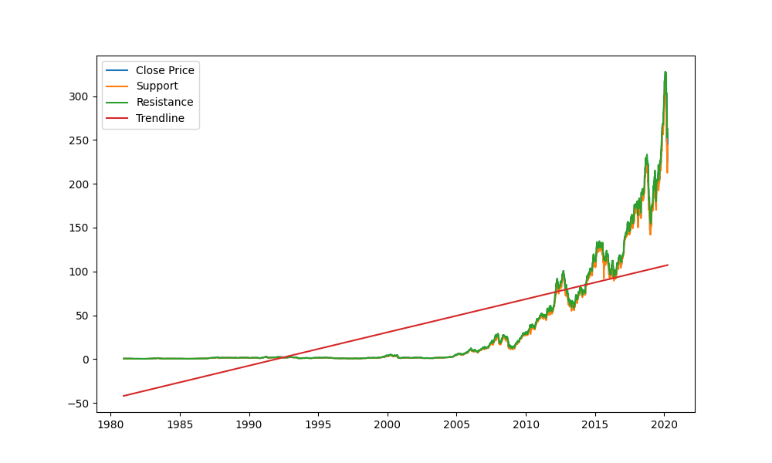
Data Collection
- Source: Yahoo Finance via yfinance Python package
- Location: Kaggle - Historical daily prices for NASDAQ stocks and ETFs
- Dataset Format: CSV files named by ticker symbols
- Fields: Date, Open, High, Low, Close, Adj Close, Volume
- Processing: Identified trends, support, and resistance levels
- Reference: Kaggle Stock Market DatasetKaggle DataSet

Slide 8
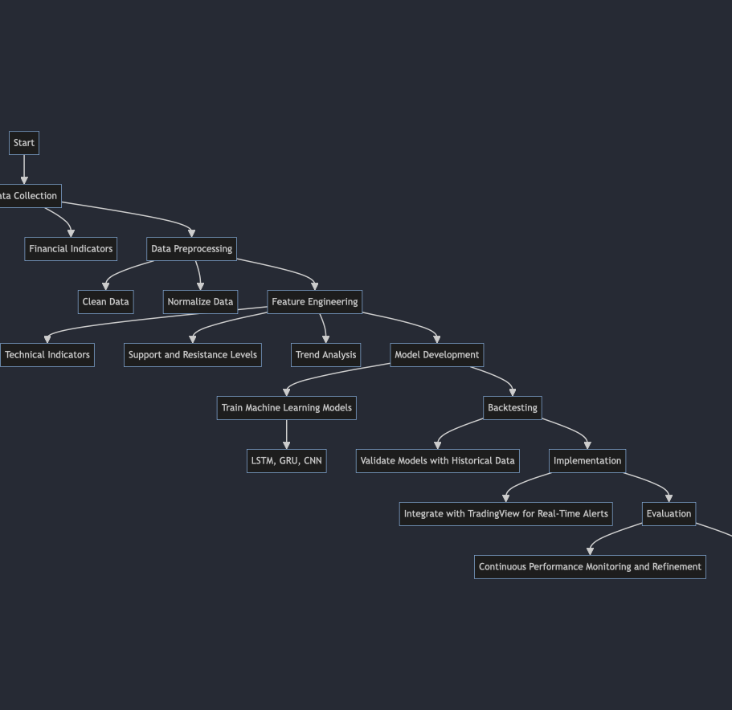
Methodology
Data Collection, Data Preprocessing, Feature Engineering, Model Development, Backtesting, Implementation, Evaluation.

Slide 9
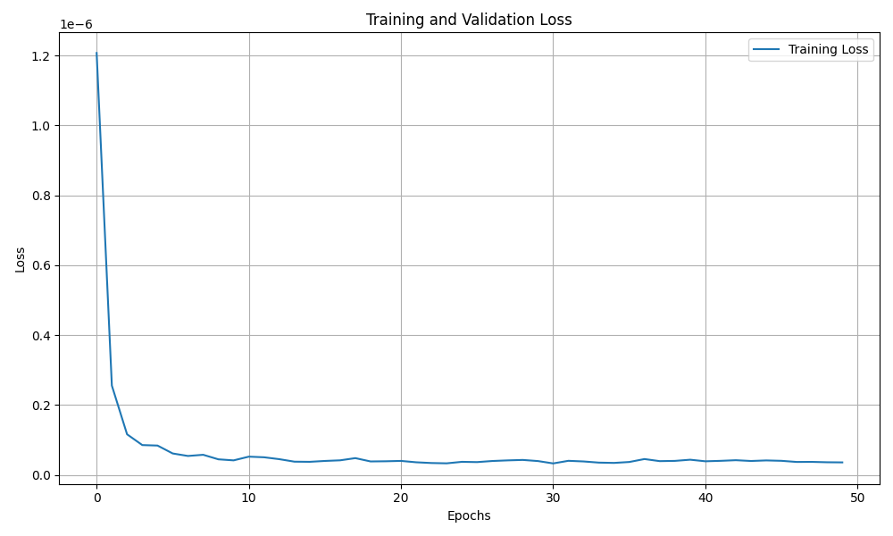
Results
The model was trained for 50 epochs, and the training and validation loss were recorded. The performance metrics indicate high accuracy.

Slide 10
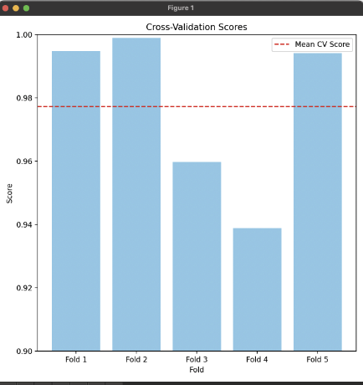
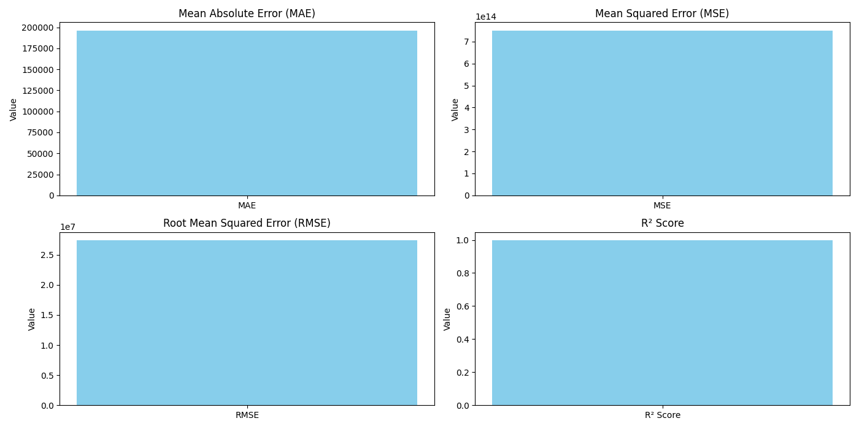
Model Accuracy
The performance of the model was evaluated using the following metrics: Mean Absolute Error (MAE), Mean Squared Error (MSE), Root Mean Squared Error (RMSE), and R? Score. The model achieved an R? score of 0.9972, indicating high accuracy.

Slide 11
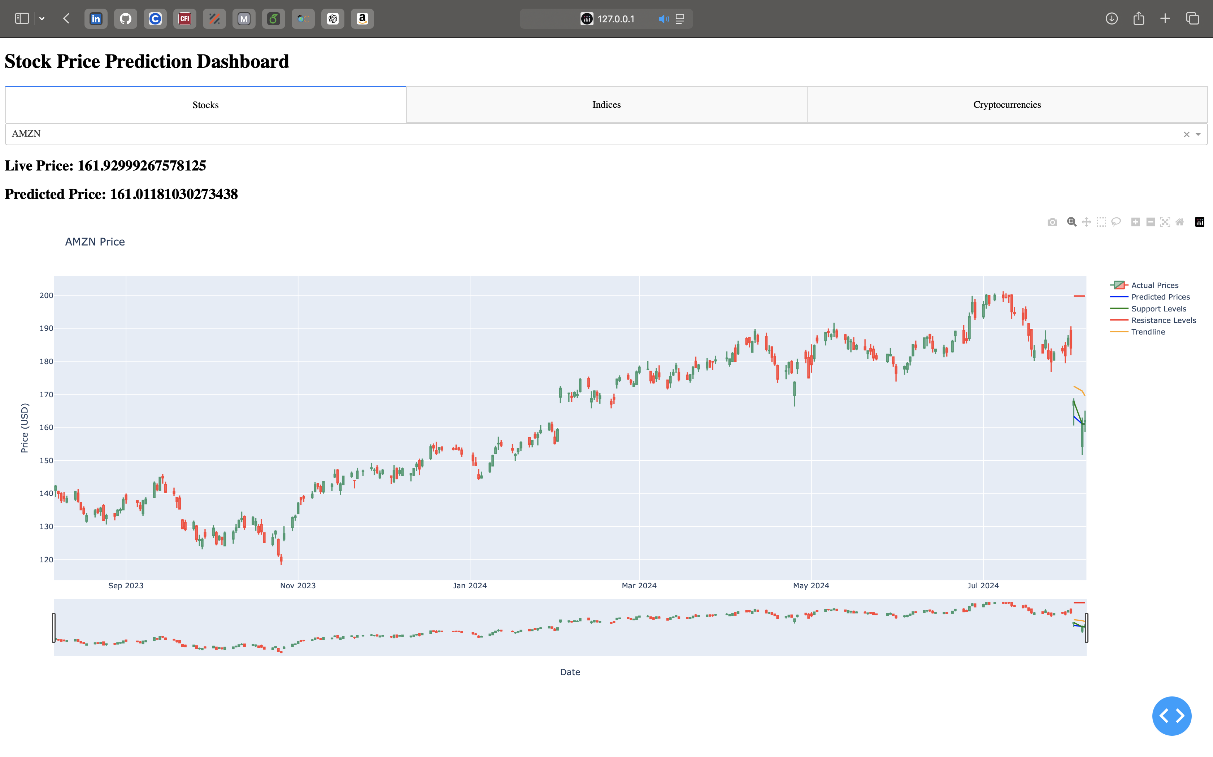
Dash Application and API Integration
Dash App Overview:
Developed using Dash and Plotly for interactive visualizations.
Displays live and predicted stock prices along with technical indicators.
API Connection:
Flask API endpoint /predict handles prediction requests.
API fetches data from Yahoo Finance using yfinance.
Processes data to generate support, resistance, and trend lines.

Slide 12
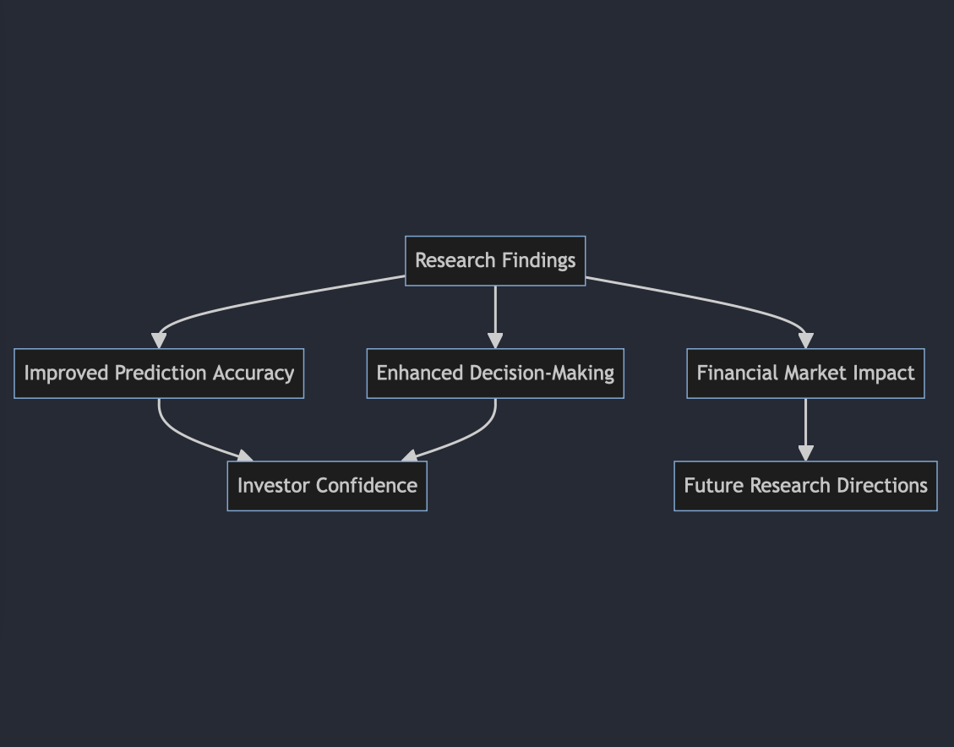
Discussion
The high R? score indicates that our model can explain a significant portion of the variance in stock prices. These findings imply that machine learning models, specifically those utilizing LSTM, GRU, and CNN architectures, can effectively predict stock prices with high accuracy.
Implications of Research Findings

Slide 13
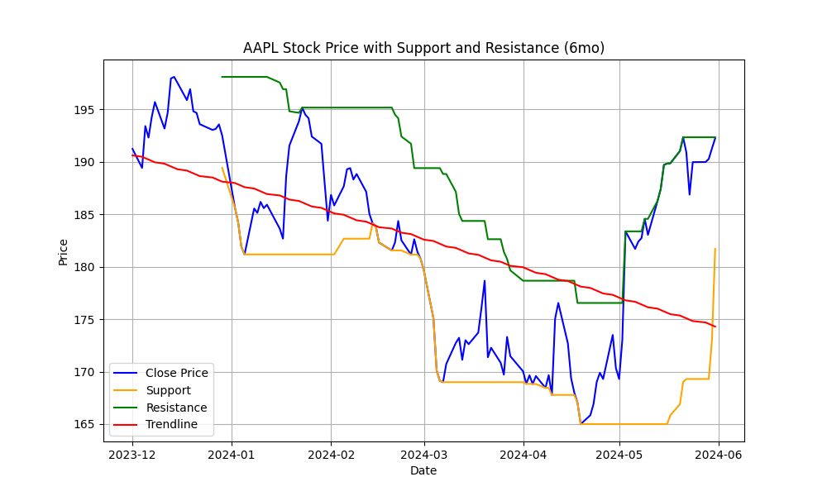
Conclusion
The stock price prediction model achieved high accuracy and robustness, as evidenced by the performance metrics and cross-validation scores.
The model generated predictions for AAPL stock, including support and resistance levels and trendlines.

Slide 14
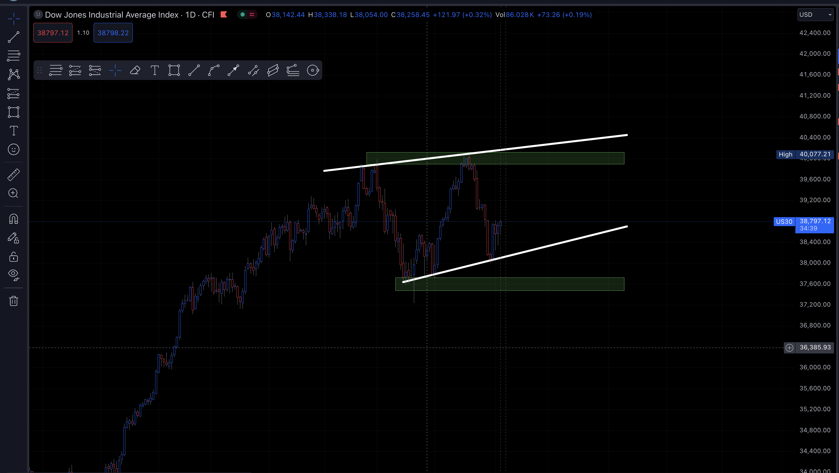
Future Work
Implementing the model on TradingView to show live trendlines and support/resistance levels.
Exploring additional technical indicators and alternative data sources such as social media sentiment and macroeconomic indicators.
Enhancing the model by incorporating ensemble learning techniques and advanced architectures like Transformers.
Developing a user-friendly interface for the Trader Alert System to facilitate real-time stock price predictions and alerts for end-users.
Conducting a comprehensive analysis of the model's performance in different market conditions, including periods of high volatility and economic downturns.

Slide 15

Acknowledgment
We would like to thank everyone who contributed to the successful completion of this project, starting from the guidance of our supervisor Dr. Ahmad Hussein and the teamwork with our colleagues.

