Slide 1

Sudoku Solver in C++: A Backtracking Approach
Learn how to solve Sudoku puzzles using C++ and backtracking. This presentation covers the algorithm, code, and optimizations. It will walk through each part in simple steps.
SA
by Safee Awan

Slide 2
What is Sudoku and Why Solve It?
The Puzzle
The Rules
Why Solve It?
Sudoku is a logic puzzle with a 9x9 grid. Some cells are pre-filled with numbers. The goal is to fill the remaining cells.
Each row, column, and 3x3 subgrid must contain all digits from 1 to 9, without repeating any digit within a row, column or 3x3 subgrid.
Sudoku is a fun way to train logic. It's also a great example of backtracking algorithms. It has applications to many areas, such as constraint satisfaction.

Slide 3
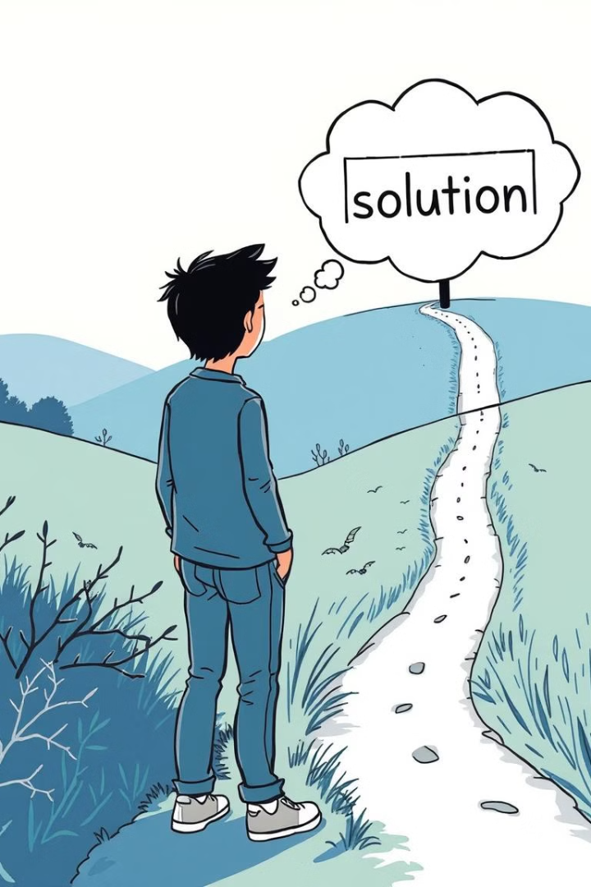
Backtracking: The Basic Idea
1
Try and Error
2
Recursive Approach
Backtracking involves trying different possibilities. If a choice leads to a dead end, we revert. Then, we try a different choice.
The algorithm uses recursion. It explores one branch fully before moving to the next.
3
Base Case
When we fill the entire board, it's solved. This is the base case for recursion.

Slide 4
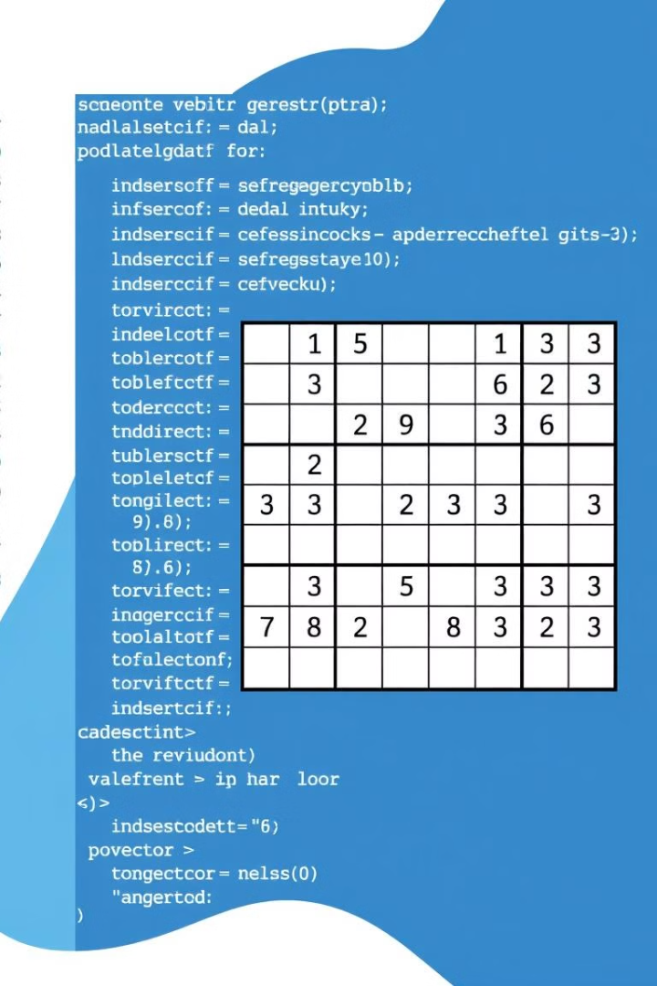



Representing the Sudoku Grid in C++
2D Vector
Zero for Empty
Coordinates
Use a 2D vector to represent the 9x9 grid. Each cell stores an integer.
Represent empty cells with the value 0. Pre-filled cells have values from 1 to 9.
Use row and column indices to locate cells. The top-left cell is (0, 0).

Slide 5
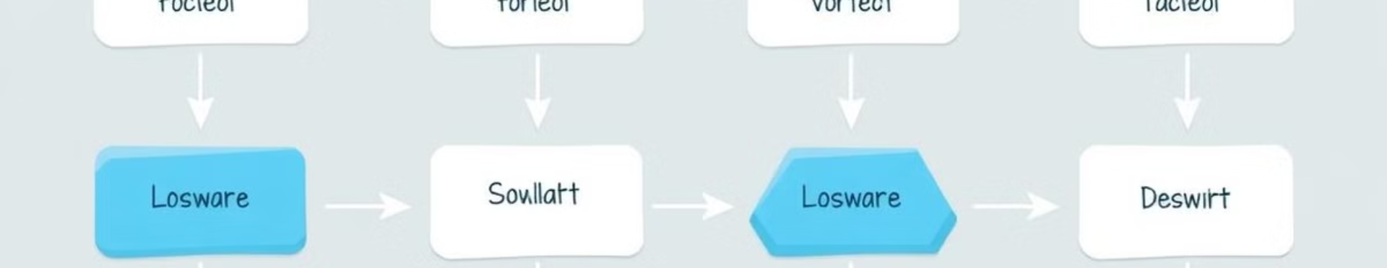




The Core Backtracking Algorithm Explained
Find Empty Cell
Try Digits 1-9
Check Validity
Recurse or Reset
First, find an empty cell on the grid (value is 0).
Try each digit from 1 to 9 in the empty cell.
Check if the digit is valid according to Sudoku rules.
If valid, recurse. If not, reset the cell and try the next digit.

Slide 6
C++ Code Walkthrough: Solving the Puzzle
1
isSafe()
2
solveSudoku()
3
printBoard()
Review the key functions in the C++ code. Understand how isSafe() checks validity. Follow solveSudoku() to see the algorithm. Then use printBoard() to display the result.

Slide 7



Optimizations and Further Improvements
Heuristics
2
Use heuristics to pick the best cell to fill.
Precompute
1
Precompute valid digits for faster checking.
Bit Manipulation
3
Improve validity checks with bits.

Slide 8

Conclusion: Sudoku Solved! Key Takeaways
Backtracking
Recursion
C++ Implementation
Backtracking is a general algorithm for solving problems by trying different choices and reverting if a choice fails.
Recursion is a powerful technique for implementing backtracking, allowing us to explore different branches of the solution space.
C++ provides the tools and flexibility to implement efficient and optimized Sudoku solvers using backtracking.

