Slide 1

Multiserver Queue simulation (M/M/c)
Hashim Al-Sadah
Abdulwahab Alghamdi
Hussain Alsinan

Slide 2
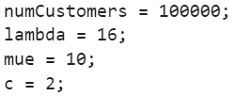
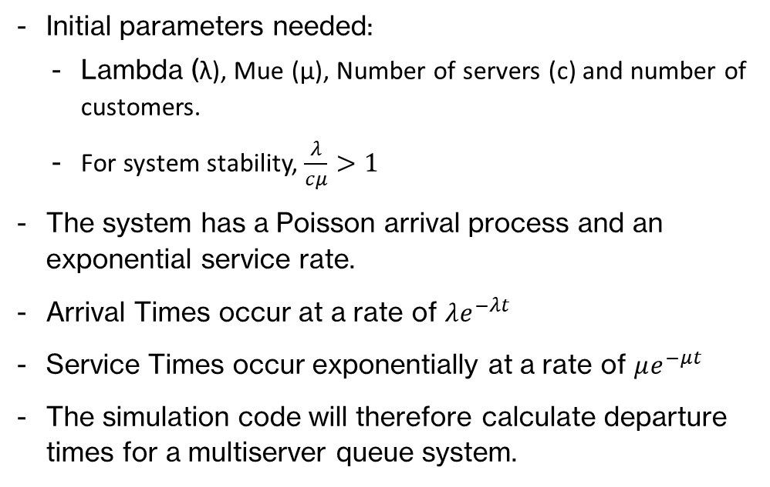
Simulation Code
Initial parameters needed:
Lambda (λ), Mue (µ), Number of servers (c) and number of customers.
For system stability, $\frac{λ}{cμ}>1$
The system has a Poisson arrival process and an exponential service rate.
Arrival Times occur at a rate of $λe^{−λt}$
Service Times occur exponentially at a rate of $μe^{−μt}$
The simulation code will therefore calculate departure times for a multiserver queue system.

Slide 3
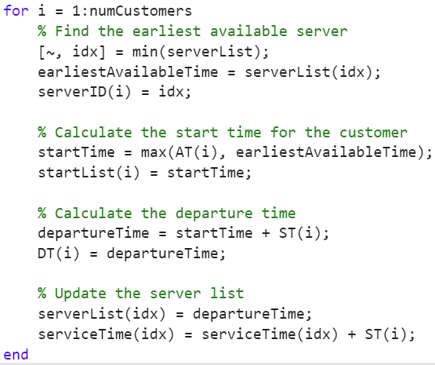
Main Simulation Loop (Finding Departure Times)
Find the server with the earliest available time.
Assign the corresponding minimum index to the earliest available time.
Calculate start time:
If AT(i) > earliest available time, it means the server was idle for some time and the start time will be AT(i).
If earliest available time > AT(i) it means the customer had to wait and the start time will be earliest available time.
Startlist will be updated.
Calculate departure time:
Departure time will be the start time + service time.
DT will be updated.
serverList which is the latest departure for every server will be updated.
ServiceTime which is the total service time for every server will be updated be adding the latest service time with total service time.

Slide 4
Example
serverList <0,0>
serverTime <0,0>
earliestAvailableTime = 0
startTime =0
departureTime = 0
AT | 2 | 3 | 4 | 7 | 11 | 18 | 20
ST | 1 | 3 | 5 | 1 | 2 | 6 | 10
startTime
DT
serverID

Slide 5
Example
serverList <3,0>
serverTime <1,0>
earliestAvailableTime = 0
startTime =2
departureTime = 3
AT | 2 | 3 | 4 | 7 | 11 | 18 | 20
ST | 1 | 3 | 5 | 1 | 2 | 6 | 10
startTime | 2
DT | 3
serverID | 1

Slide 6
Example
serverList <3,6>
serverTime <1,3>
earliestAvailableTime = 3
startTime =4
departureTime = 9
AT | 2 | 3 | 4 | 7 | 11 | 18 | 20
ST | 1 | 3 | 5 | 1 | 2 | 6 | 10
startTime | 2 | 3 | 4
DT | 3 | 6 | 9
serverID | 1 | 2 | 1

Slide 7
Example
serverList <9,6>
serverTime <6,3>
earliestAvailableTime = 6
startTime =7
departureTime = 8
AT | 2 | 3 | 4 | 7 | 11 | 18 | 20
ST | 1 | 3 | 5 | 1 | 2 | 6 | 10
startTime | 2 | 3 | 4 | 7
DT | 3 | 6 | 9 | 8
serverID | 1 | 2 | 1 | 2

Slide 8
Example
serverList <9,8>
serverTime <6,4>
earliestAvailableTime = 8
startTime =11
departureTime = 13
AT | 2 | 3 | 4 | 7 | 11 | 18 | 20
ST | 1 | 3 | 5 | 1 | 2 | 6 | 10
startTime | 2 | 3 | 4 | 7 | 11
DT | 3 | 6 | 9 | 8 | 13
serverID | 1 | 2 | 1 | 2 | 2

Slide 9
Example
serverList <9,13>
serverTime <6,6>
earliestAvailableTime = 9
startTime =18
departureTime = 24
AT | 2 | 3 | 4 | 7 | 11 | 18 | 20
ST | 1 | 3 | 5 | 1 | 2 | 6 | 10
startTime | 2 | 3 | 4 | 7 | 11 | 18
DT | 3 | 6 | 9 | 8 | 13 | 24
serverID | 1 | 2 | 1 | 2 | 2 | 1

Slide 10
Example
serverList <24,13>
serverTime <12,6>
earliestAvailableTime = 13
startTime =20
departureTime = 30
AT | 2 | 3 | 4 | 7 | 11 | 18 | 20
ST | 1 | 3 | 5 | 1 | 2 | 6 | 10
startTime | 2 | 3 | 4 | 7 | 11 | 18 | 20
DT | 3 | 6 | 9 | 8 | 13 | 24 | 30
serverID | 1 | 2 | 1 | 2 | 2 | 1 | 2

Slide 11
Example
serverList <24,30>
serverTime <12,16>
earliestAvailableTime = 24
startTime =20
departureTime = 30
AT | 2 | 3 | 4 | 7 | 11 | 18 | 20
ST | 1 | 3 | 5 | 1 | 2 | 6 | 10
startTime | 2 | 3 | 4 | 7 | 11 | 18 | 20
DT | 3 | 6 | 9 | 8 | 13 | 24 | 30
serverID | 1 | 2 | 1 | 2 | 2 | 1 | 2

Slide 12
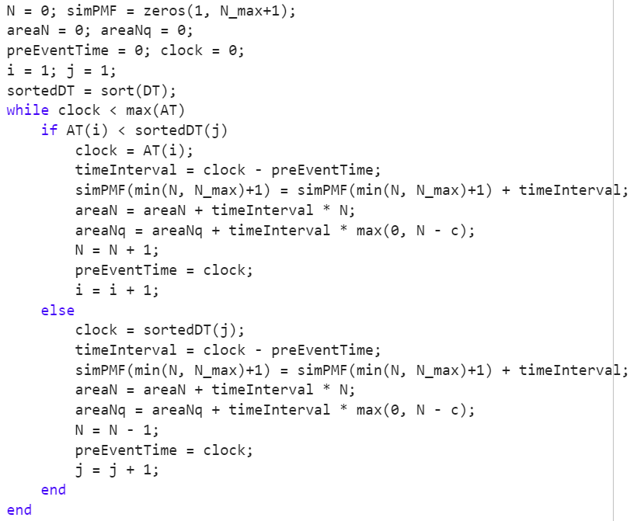
Tracking N and AUC
Event (clock)
if AT(i) < DT(j)
if AT(i) > DT(j)
Arrival
Departure
Calculate AUC
Calculate AUC
N+1
N-1

