Slide 1

Multiserver Queue simulation (M/M/c)
Hashim Al-Sadah
Abdulwahab Alghamdi
Hussain Alsinan

Slide 2
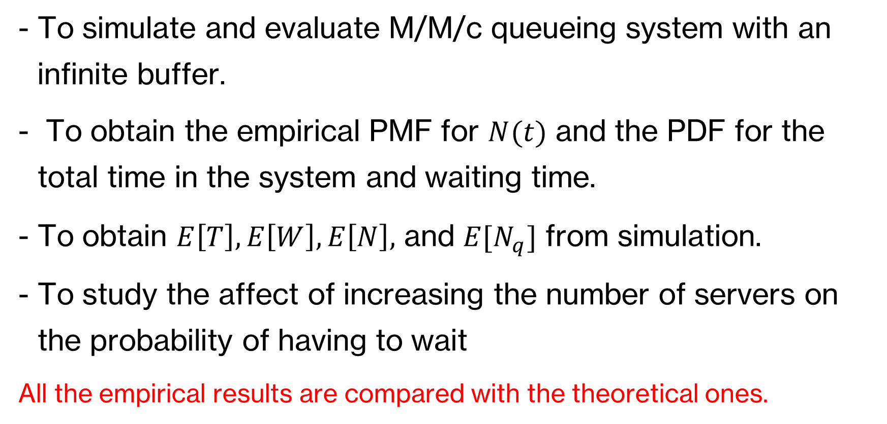
Objective
To simulate and evaluate M/M/c queueing system with an infinite buffer.
To obtain the empirical PMF for $N(t)$ and the PDF for the total time in the system and waiting time.
To obtain $E\left[T\right], E\left[W\right], E\left[N\right],$ and $E[N_{q}]$ from simulation.
To study the affect of increasing the number of servers on the probability of having to wait
All the empirical results are compared with the theoretical ones.

Slide 3
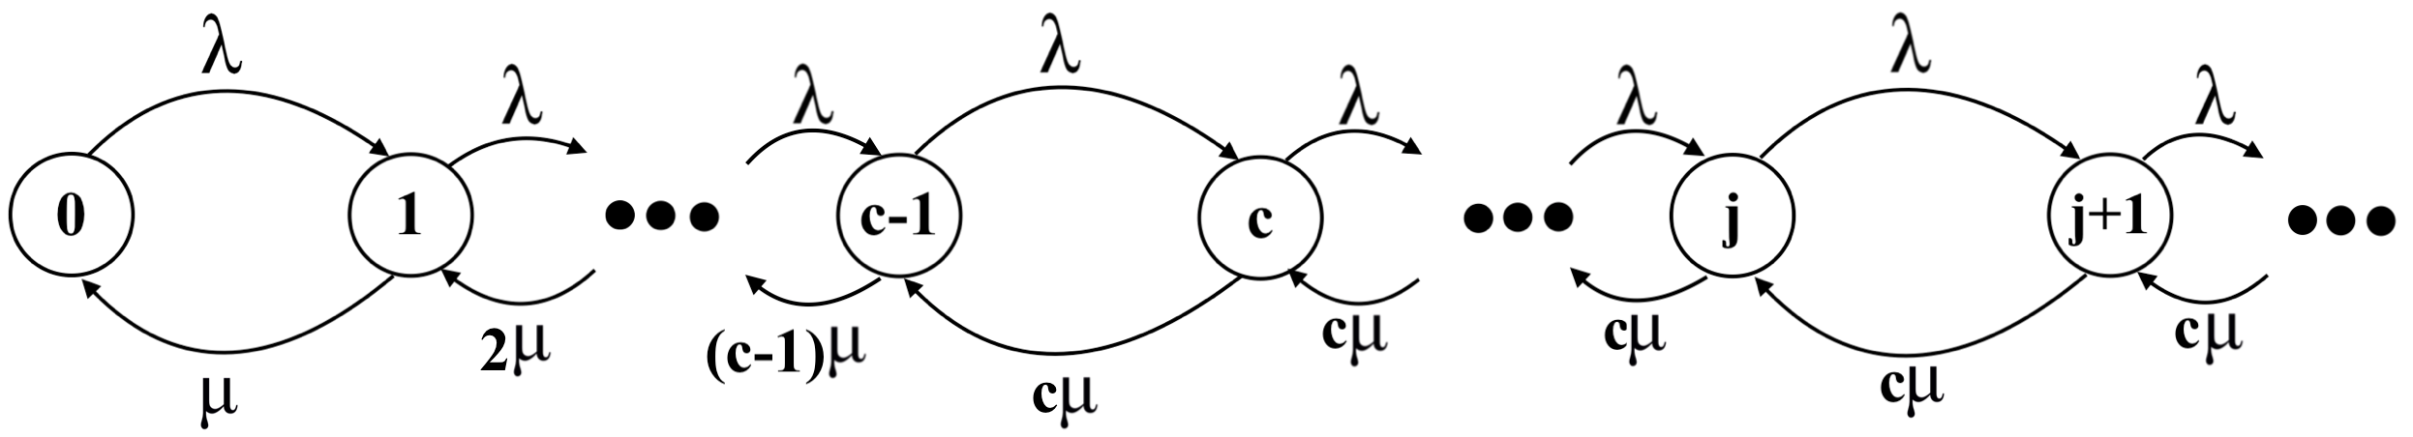
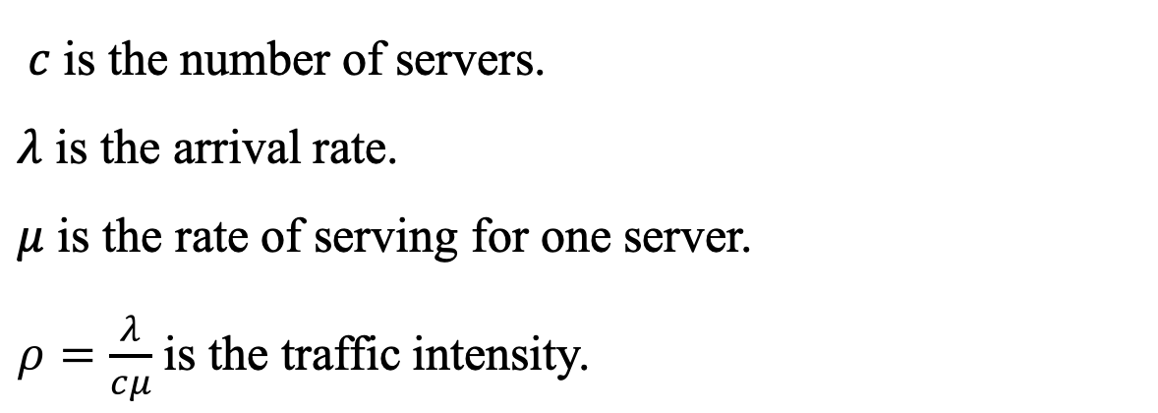
State Diagram
$c$ is the number of servers.
$λ$ is the arrival rate.
$μ$ is the rate of serving for one server.
$ρ=\frac{λ}{cμ}$ is the traffic intensity.

Slide 4
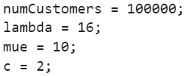
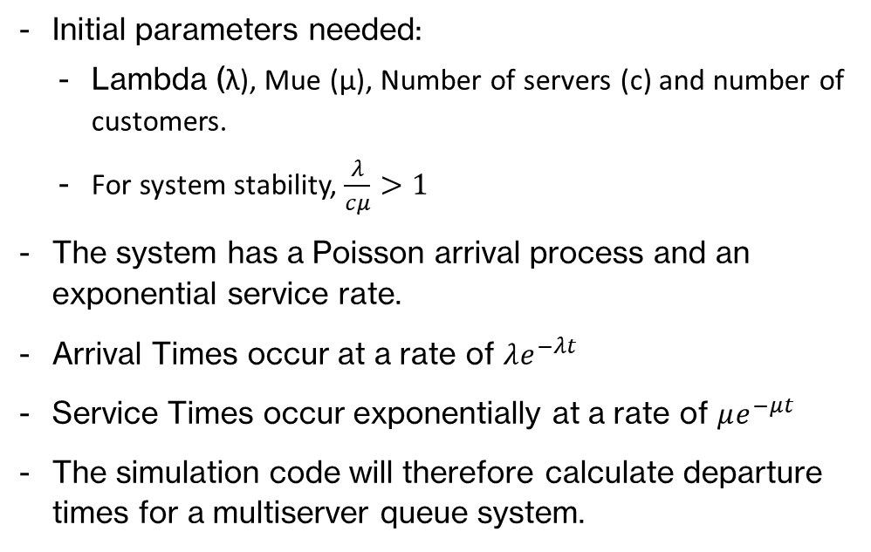
Simulation Code
Initial parameters needed:
Lambda (λ), Mue (µ), Number of servers (c) and number of customers.
For system stability, $\frac{λ}{cμ}>1$
The system has a Poisson arrival process and an exponential service rate.
Arrival Times occur at a rate of $λe^{−λt}$
Service Times occur exponentially at a rate of $μe^{−μt}$
The simulation code will therefore calculate departure times for a multiserver queue system.

Slide 5
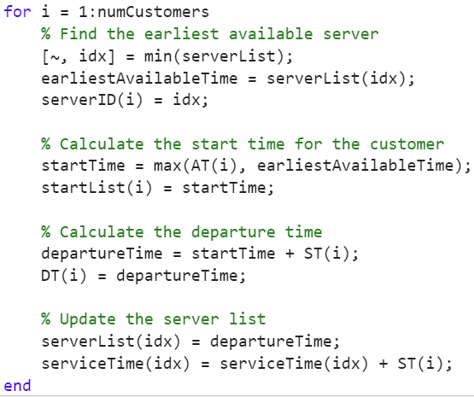
Main Simulation Loop (Finding Departure Times)
Find the server with the earliest available time.
Assign the corresponding minimum index to the earliest available time.
Calculate start time:
If AT(i) > earliest available time, it means the server was idle for some time and the start time will be AT(i).
If earliest available time > AT(i) it means the customer had to wait and the start time will be earliest available time.
Startlist will be updated.
Calculate departure time:
Departure time will be the start time + service time.
DT will be updated.
serverList which is the latest departure for every server will be updated.
ServiceTime which is the total service time for every server will be updated be adding the latest service time with total service time.

Slide 6
Main Simulation Loop (Finding Departure Times)
AT > Earliest
Find earliest available server
Server is idle, AT=startTime
Customer Arrival
DT = startTime+ ST
serverList Updated with DT
Capture Arrival Time
Server is busy, Earliest =startTime
AT < Earliest
Iteratively for N Number of Customers

Slide 7
Example
serverList <0,0>
serverTime <0,0>
earliestAvailableTime = 0
startTime =0
departureTime = 0
AT | 2 | 3 | 4 | 7 | 11 | 18
ST | 1 | 3 | 5 | 1 | 2 | 6
startTime
DT
serverID

Slide 8
Example
serverList <3,0>
serverTime <1,0>
earliestAvailableTime = 0
startTime =2
departureTime = 3
AT | 2 | 3 | 4 | 7 | 11 | 18
ST | 1 | 3 | 5 | 1 | 2 | 6
startTime | 2
DT | 3
serverID | 1

Slide 9
Example
serverList <3,6>
serverTime <1,3>
earliestAvailableTime = 3
startTime =4
departureTime = 9
AT | 2 | 3 | 4 | 7 | 11 | 18
ST | 1 | 3 | 5 | 1 | 2 | 6
startTime | 2 | 3 | 4
DT | 3 | 6 | 9
serverID | 1 | 2 | 1

Slide 10
Example
serverList <9,6>
serverTime <6,3>
earliestAvailableTime = 6
startTime =7
departureTime = 8
AT | 2 | 3 | 4 | 7 | 11 | 18
ST | 1 | 3 | 5 | 1 | 2 | 6
startTime | 2 | 3 | 4 | 7
DT | 3 | 6 | 9 | 8
serverID | 1 | 2 | 1 | 2

Slide 11
Example
serverList <9,8>
serverTime <6,4>
earliestAvailableTime = 8
startTime =11
departureTime = 13
AT | 2 | 3 | 4 | 7 | 11 | 18
ST | 1 | 3 | 5 | 1 | 2 | 6
startTime | 2 | 3 | 4 | 7 | 11
DT | 3 | 6 | 9 | 8 | 13
serverID | 1 | 2 | 1 | 2 | 2

Slide 12
Example
serverList <9,13>
serverTime <6,6>
earliestAvailableTime = 9
startTime =18
departureTime = 24
AT | 2 | 3 | 4 | 7 | 11 | 18
ST | 1 | 3 | 5 | 1 | 2 | 6
startTime | 2 | 3 | 4 | 7 | 11 | 18
DT | 3 | 6 | 9 | 8 | 13 | 24
serverID | 1 | 2 | 1 | 2 | 2 | 1

Slide 13
Example
serverList <24,13>
serverTime <12,6>
earliestAvailableTime = 13
startTime =18
departureTime = 30
AT | 2 | 3 | 4 | 7 | 11 | 18 | 20
ST | 1 | 3 | 5 | 1 | 2 | 6 | 10
startTime | 2 | 3 | 4 | 7 | 11 | 18 | 20
DT | 3 | 6 | 9 | 8 | 13 | 24 | 30
serverID | 1 | 2 | 1 | 2 | 2 | 1 | 2

Slide 14
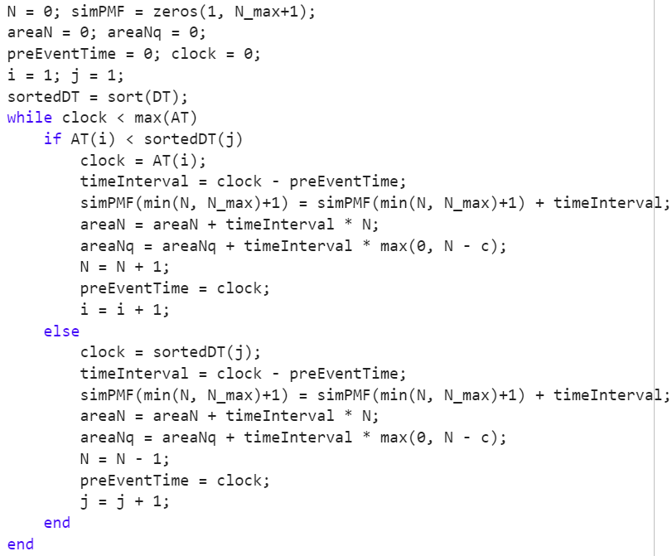
Tracking N and AUC
Event (clock)
if AT(i) < DT(j)
if AT(i) > DT(j)
Arrival
Departure
Calculate AUC
Calculate AUC
N+1
N-1

Slide 15
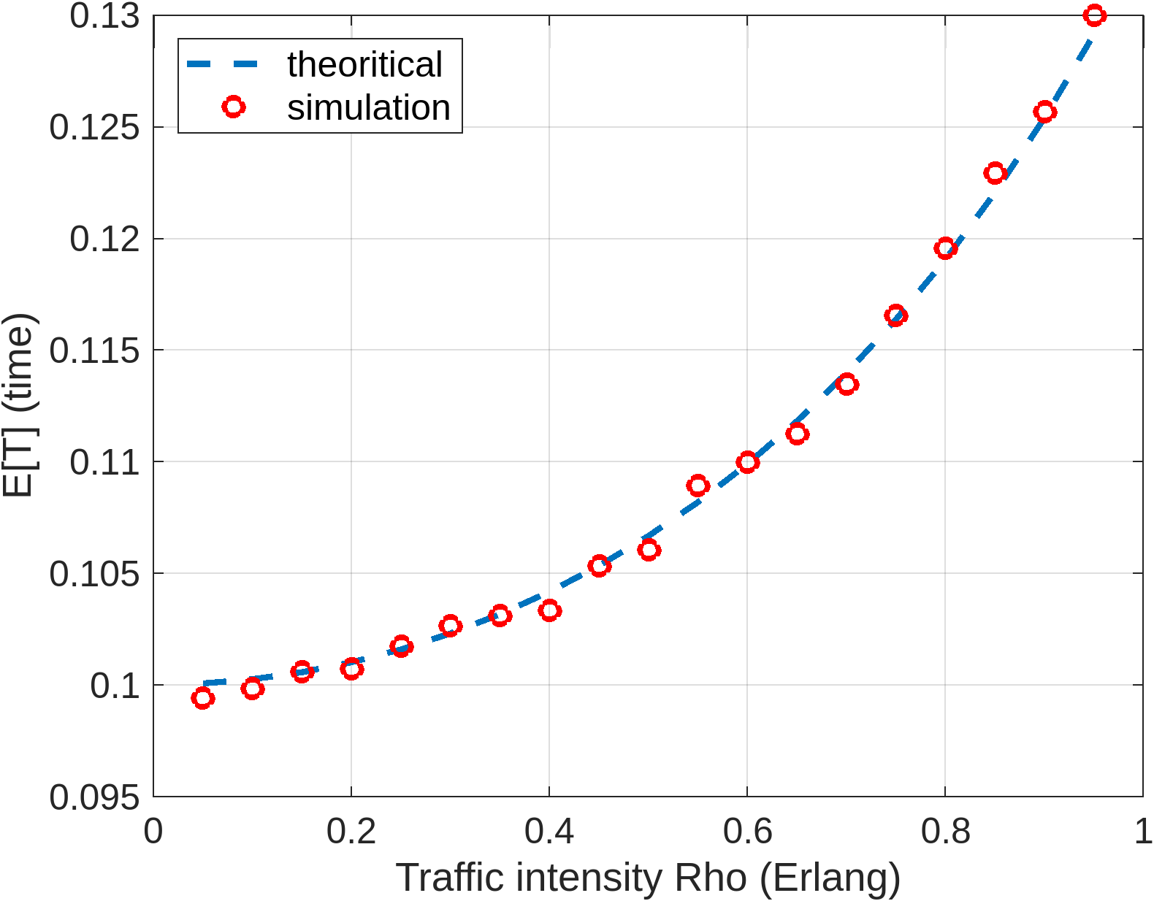
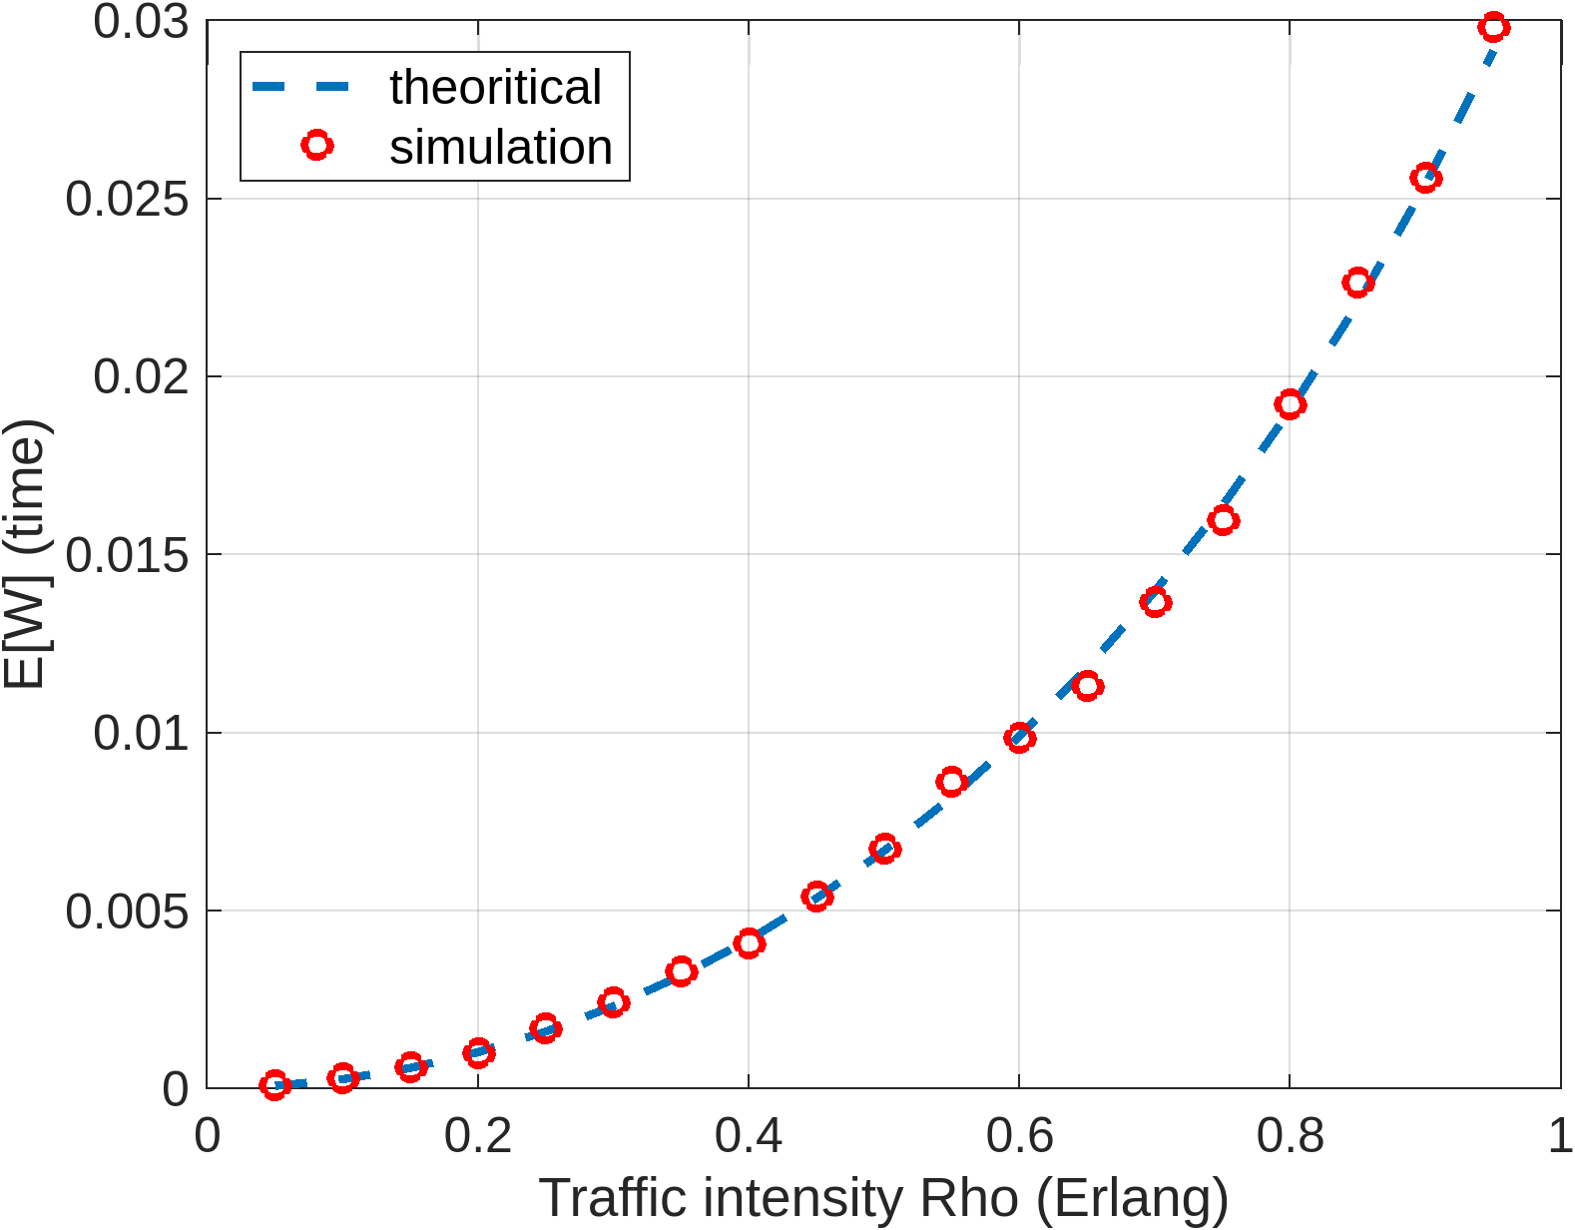

Results $(E\left[T\right], E\left[W\right])$

Slide 16
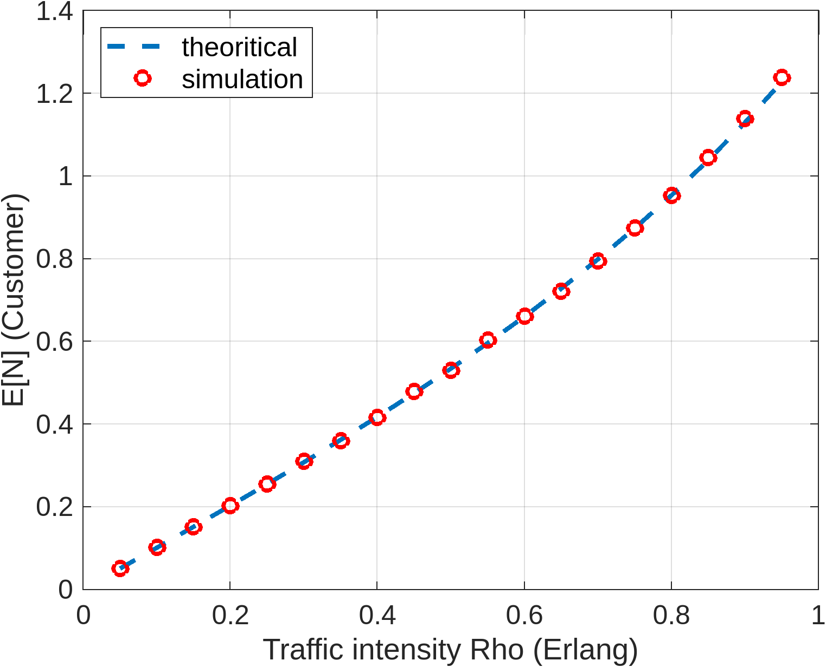
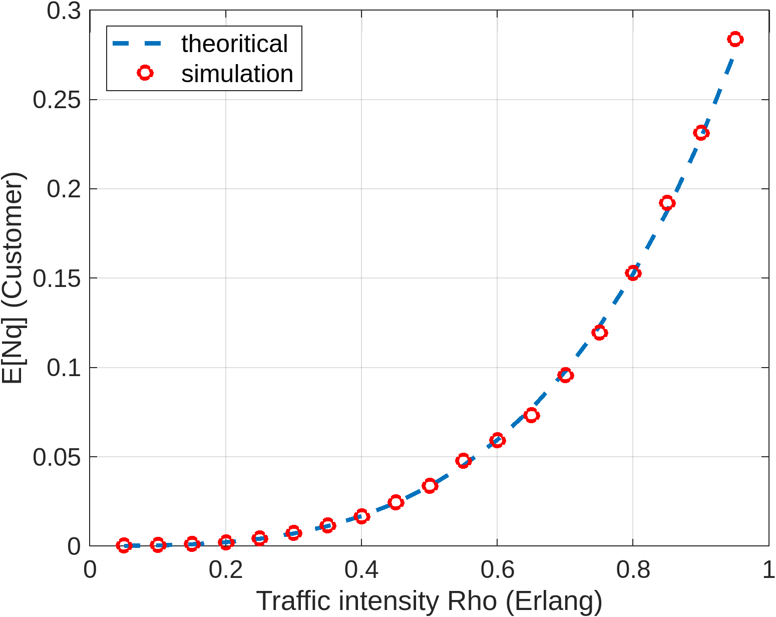

Results $(E\left[N\right], E[N_{q}])$

Slide 17
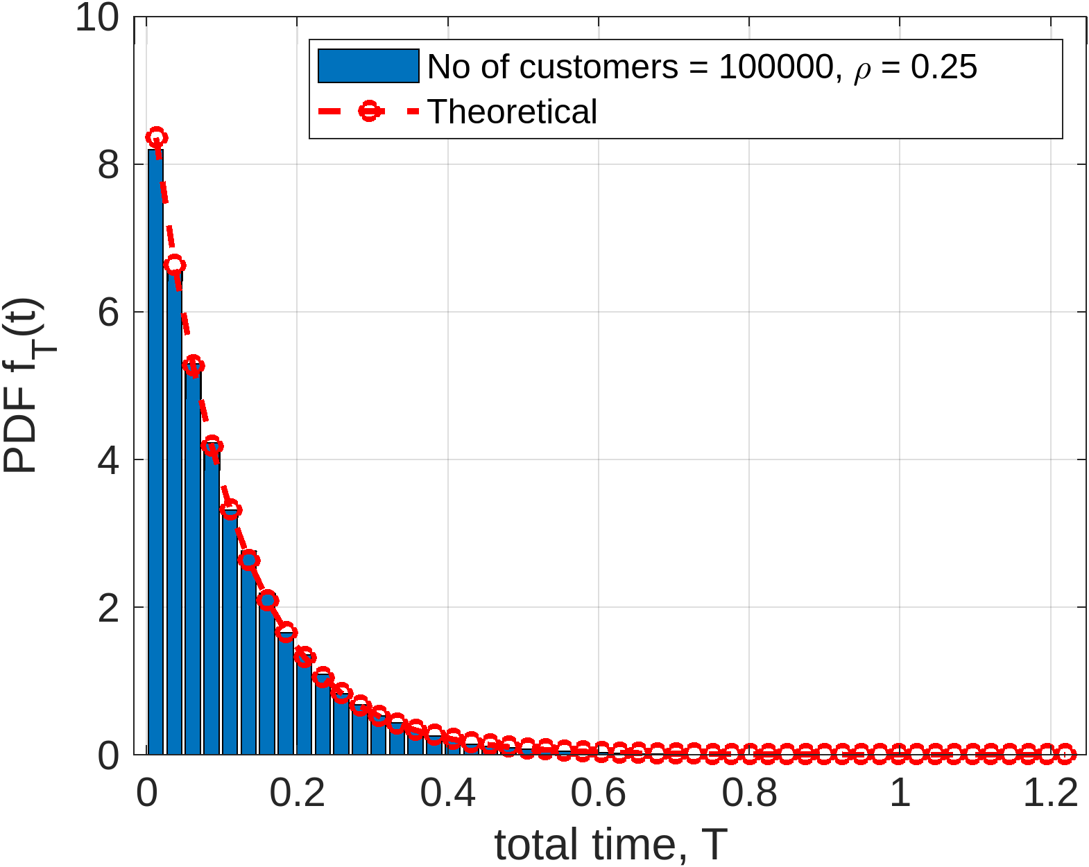
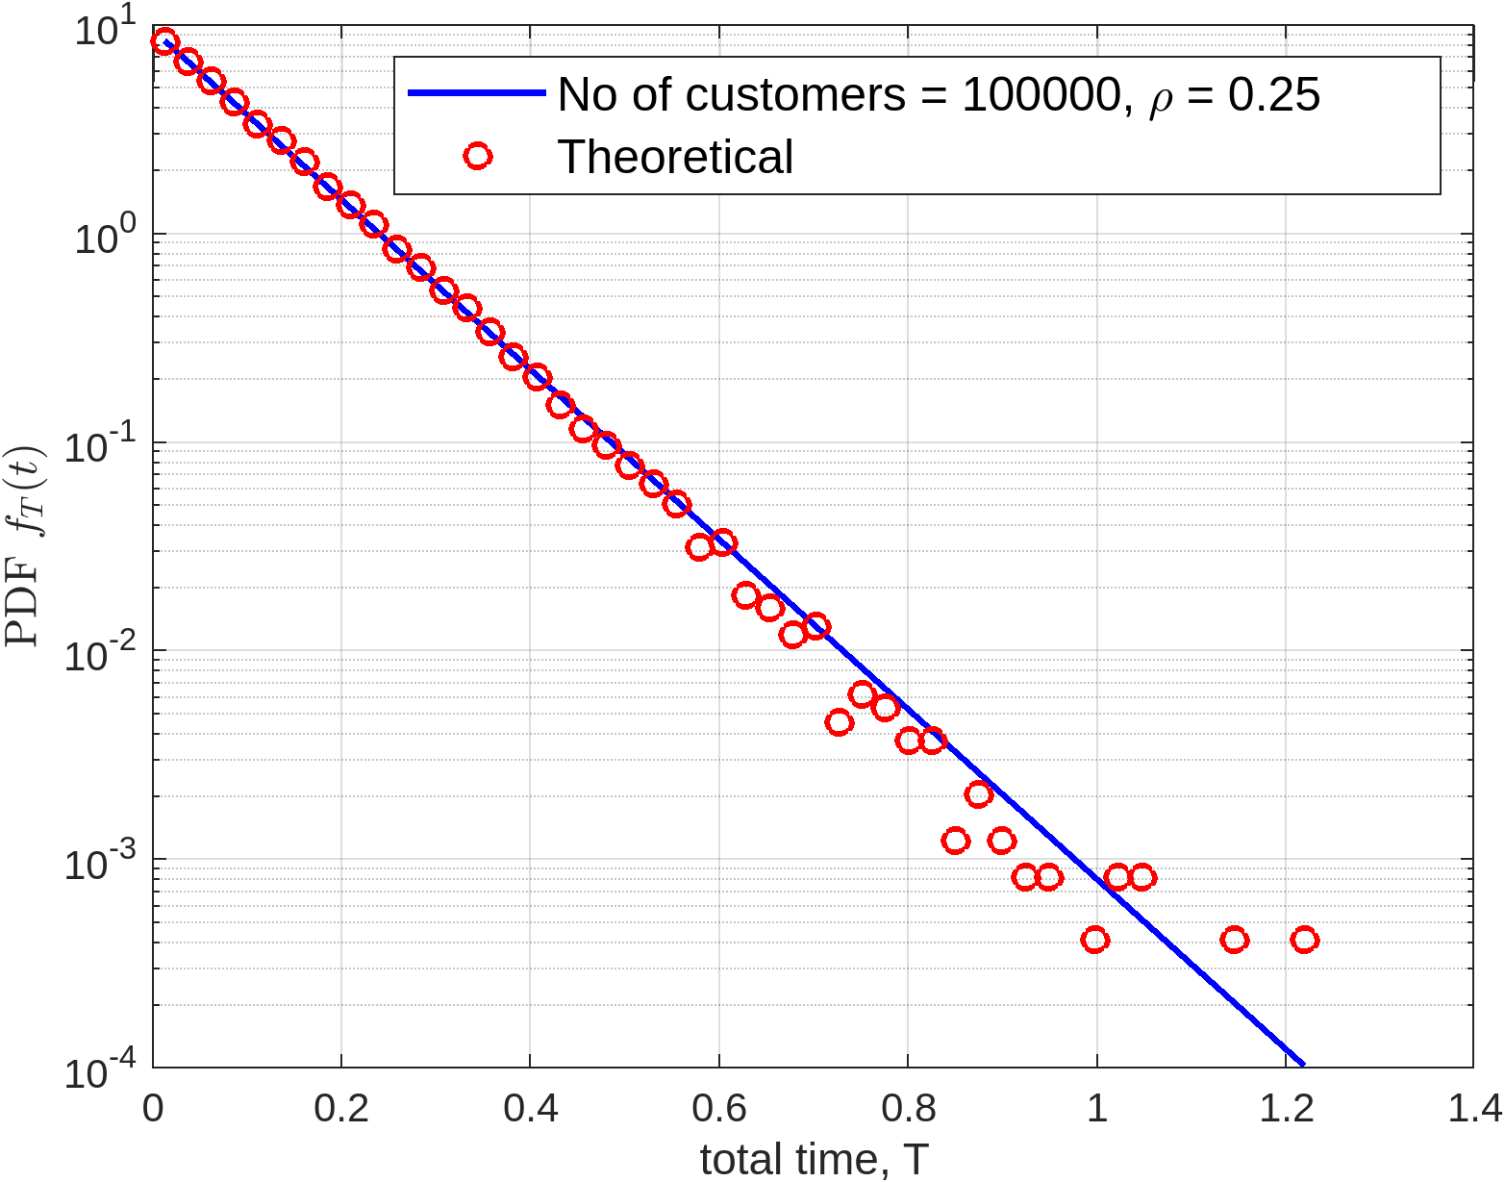
Results (total time PDF)

Slide 18
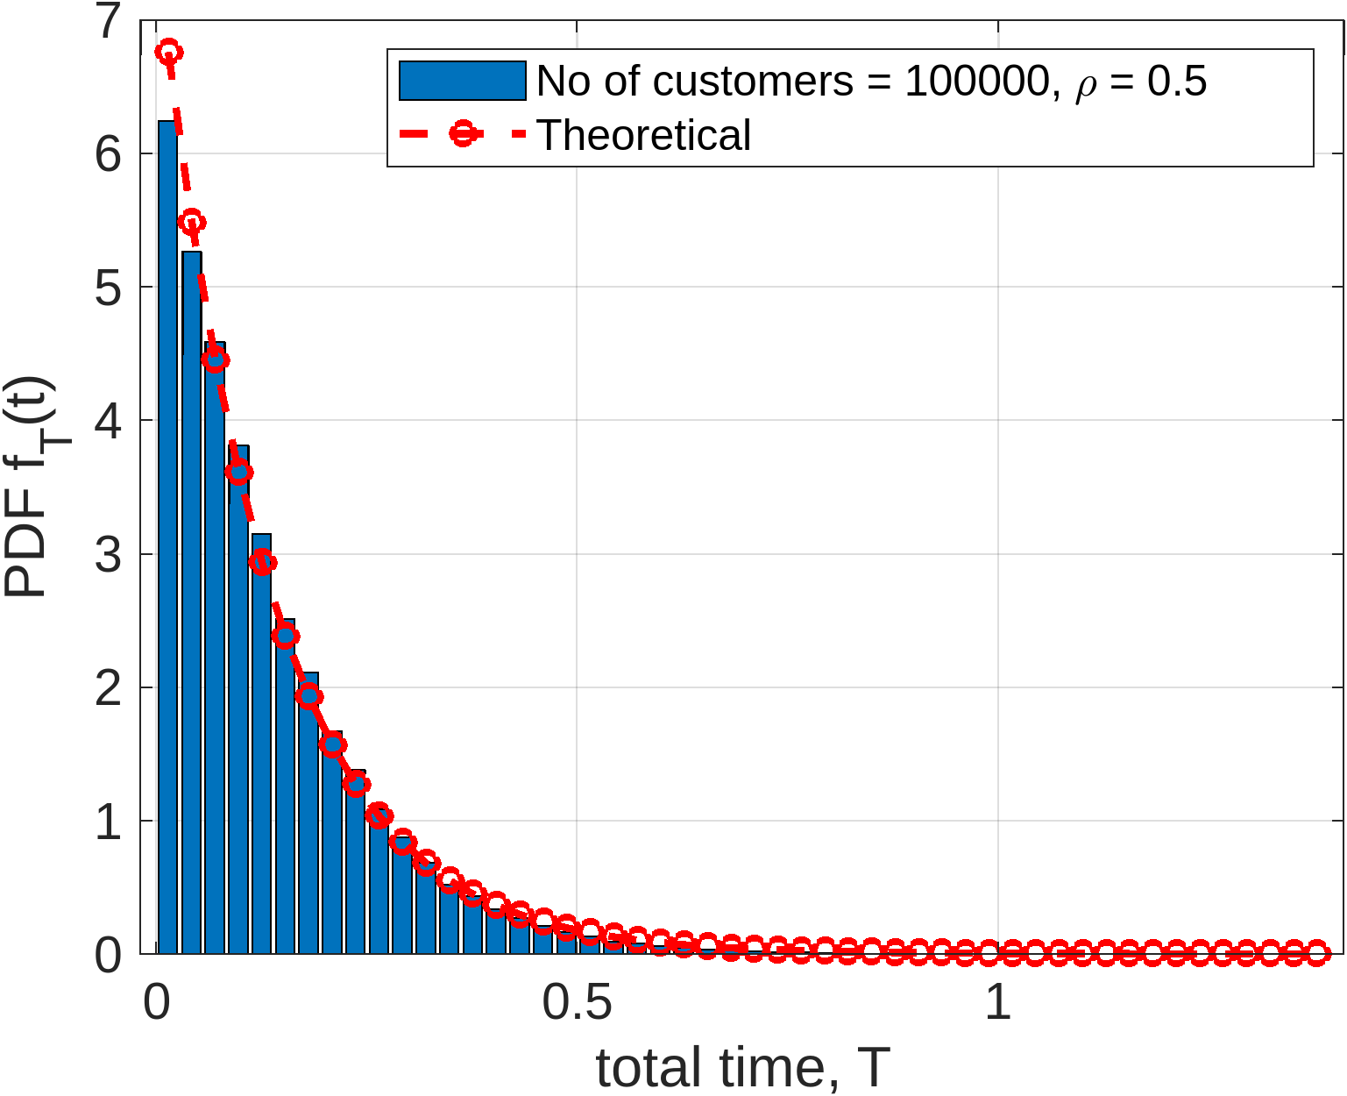
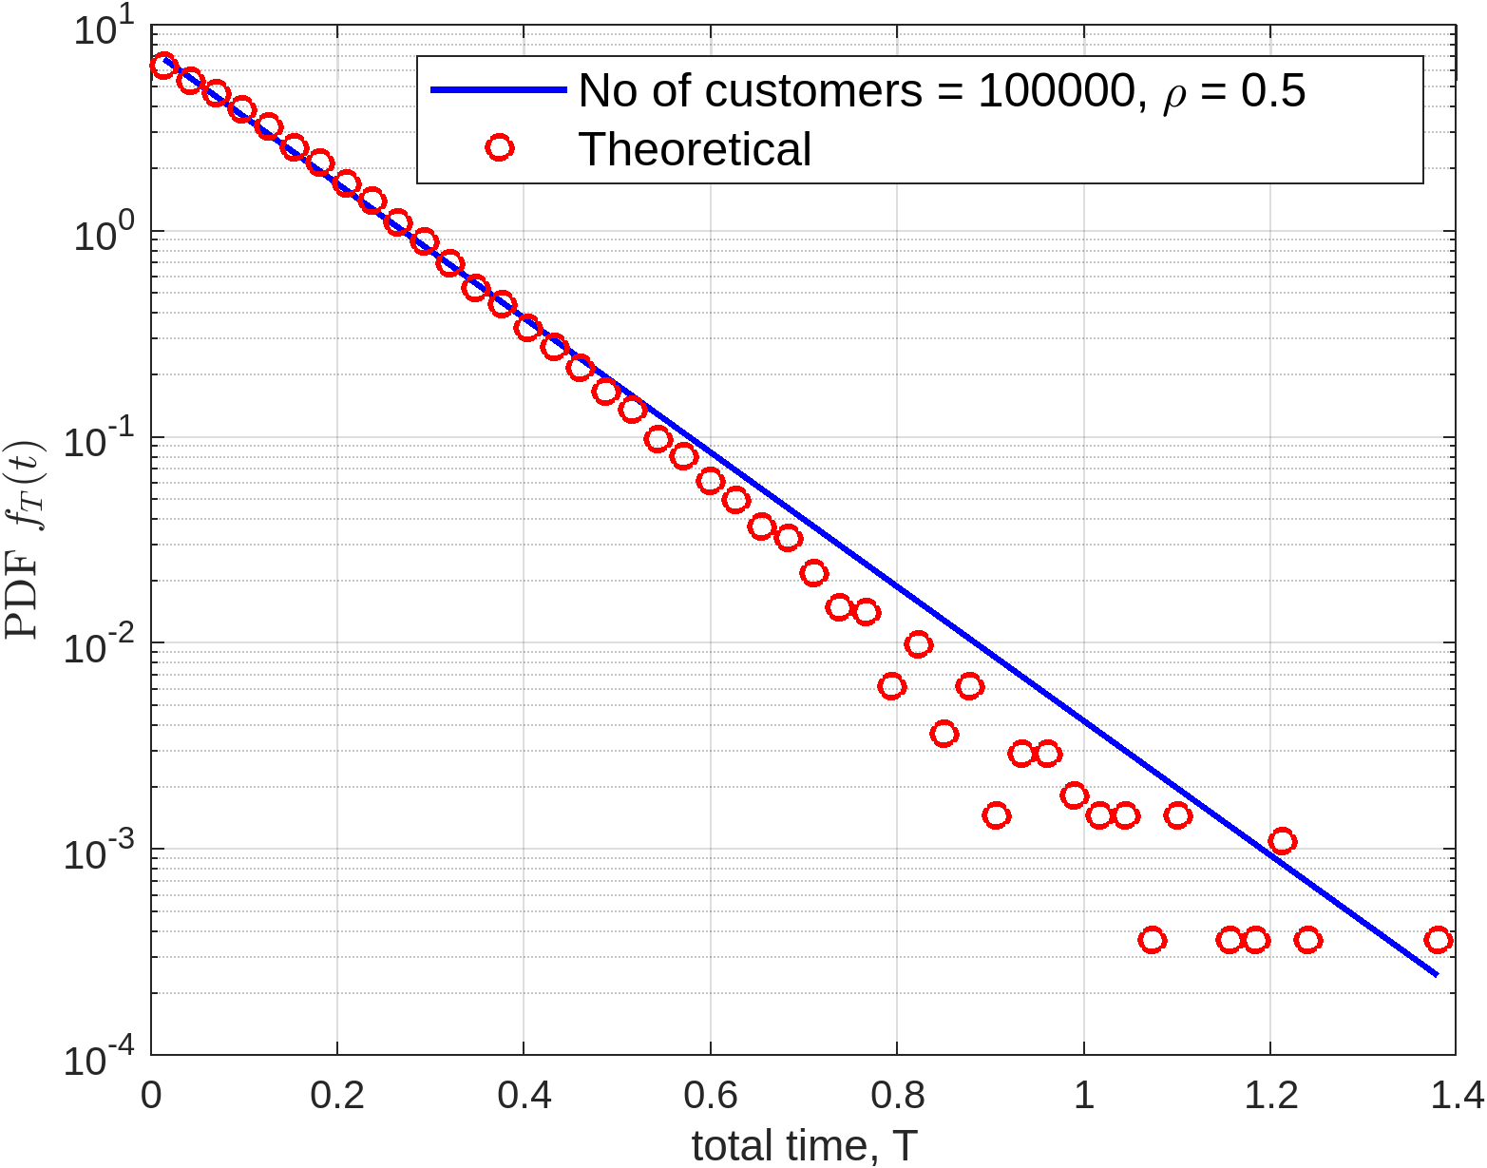
Results (total time PDF)

Slide 19
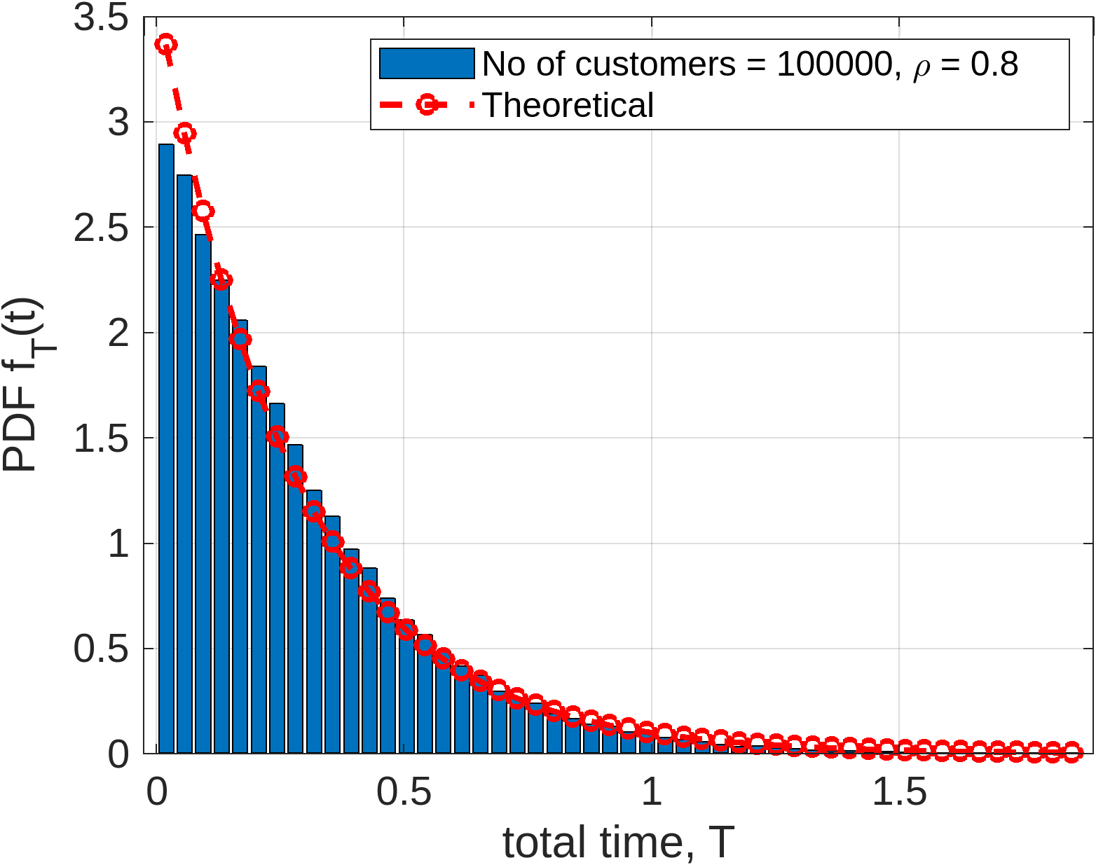
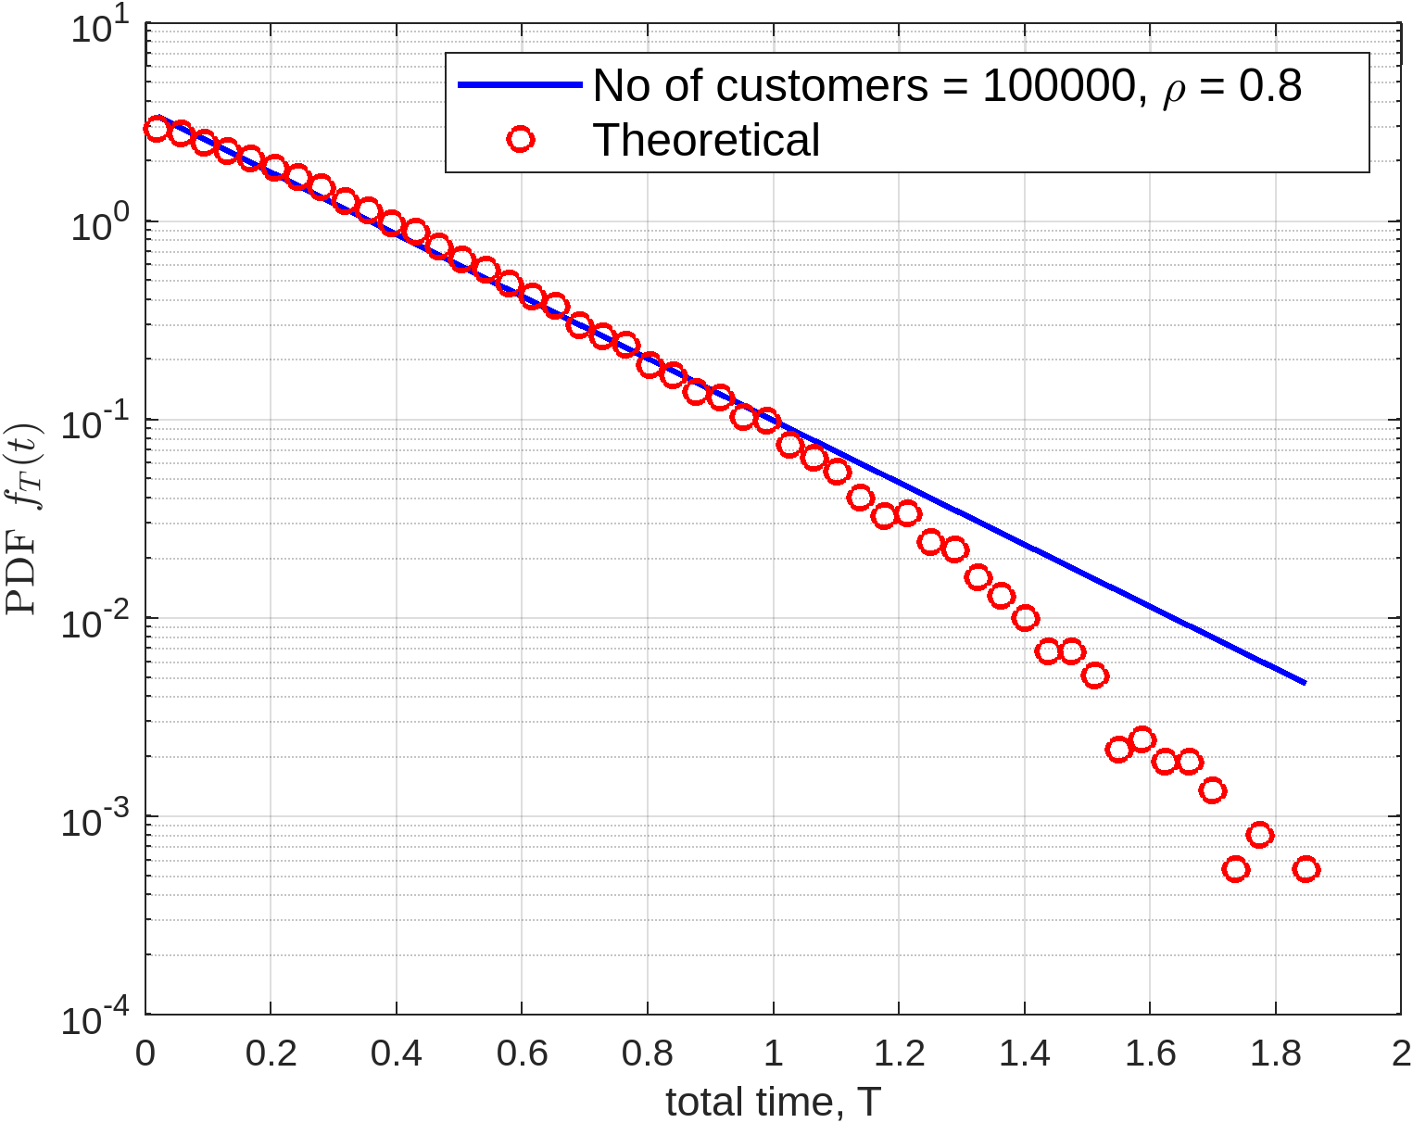
Results (total time PDF)

Slide 20
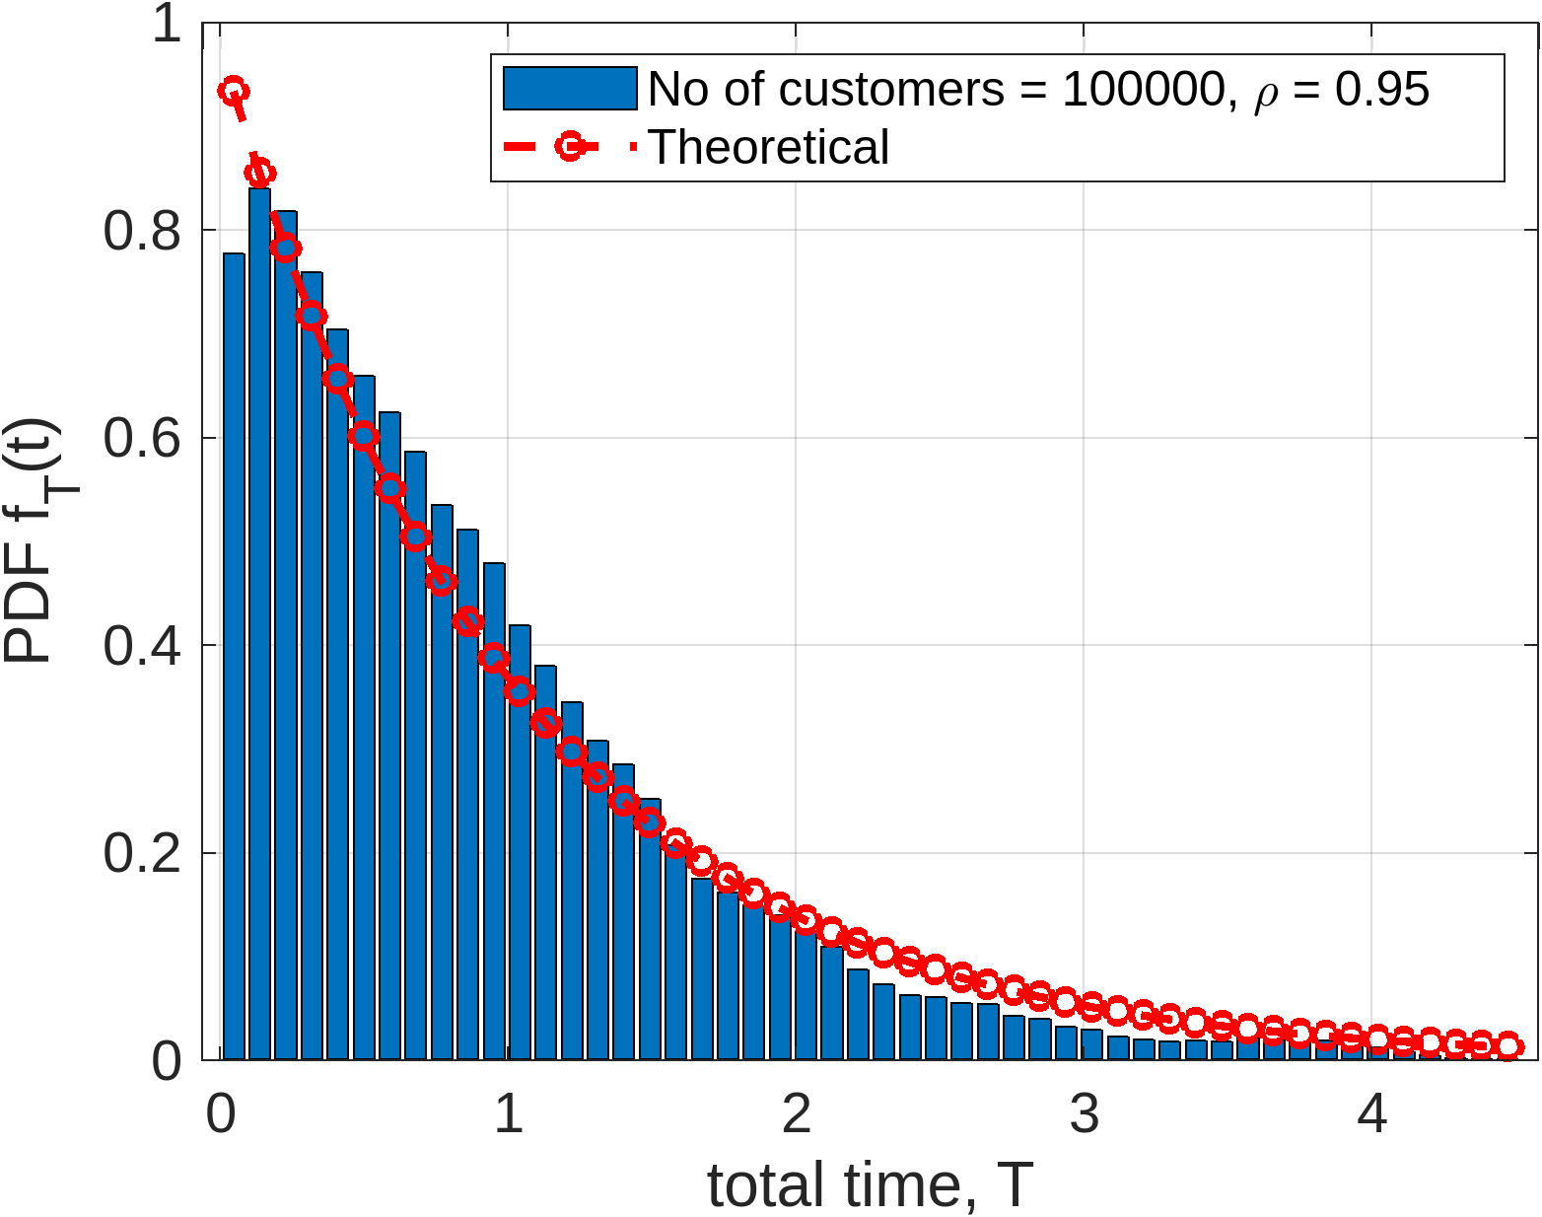
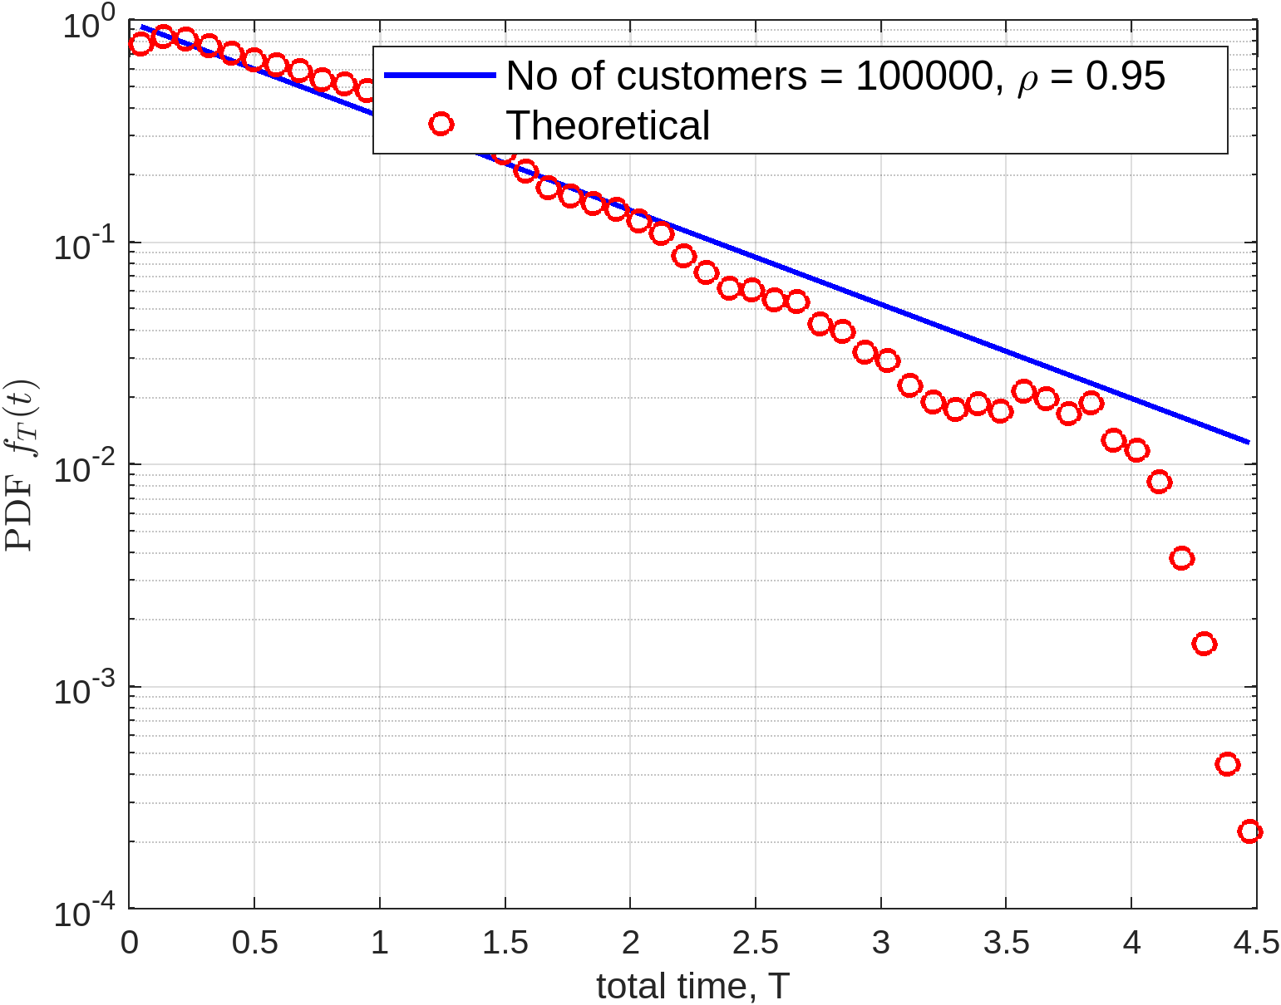
Results (total time PDF)

Slide 21
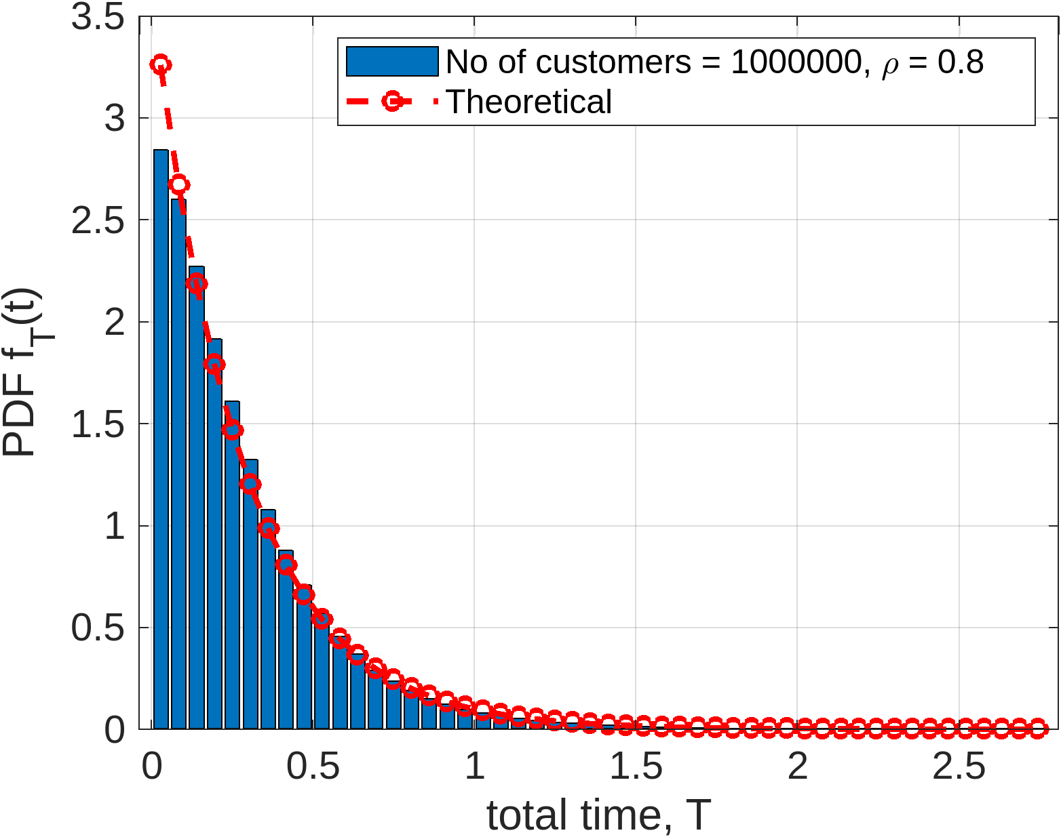
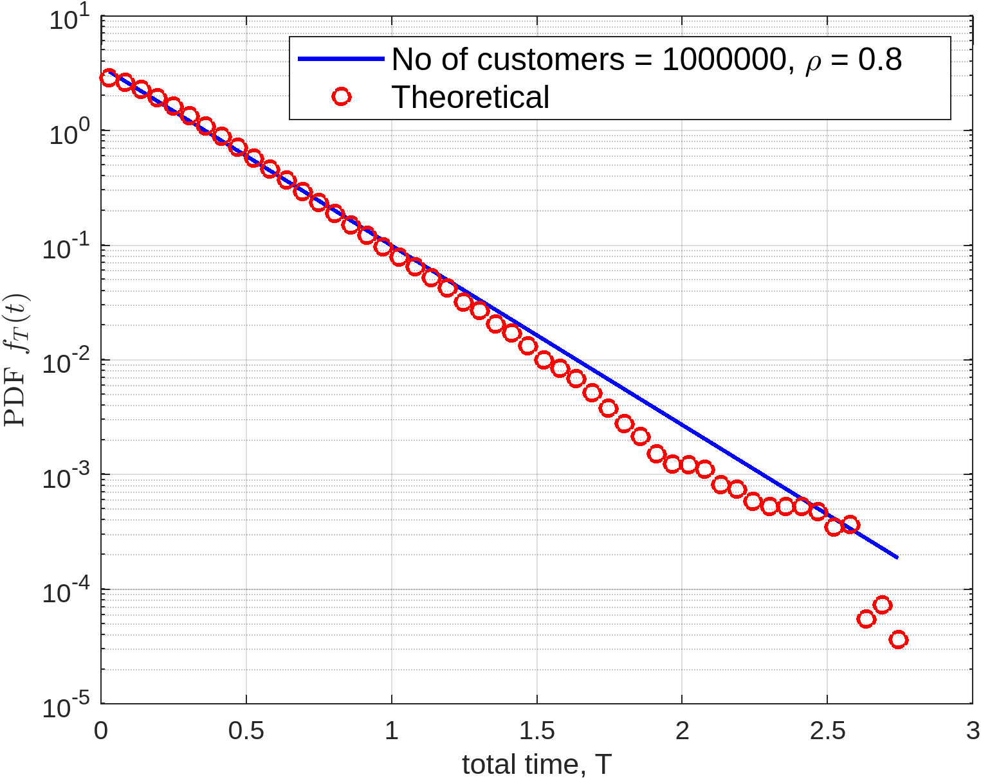
Results (total time PDF)

Slide 22
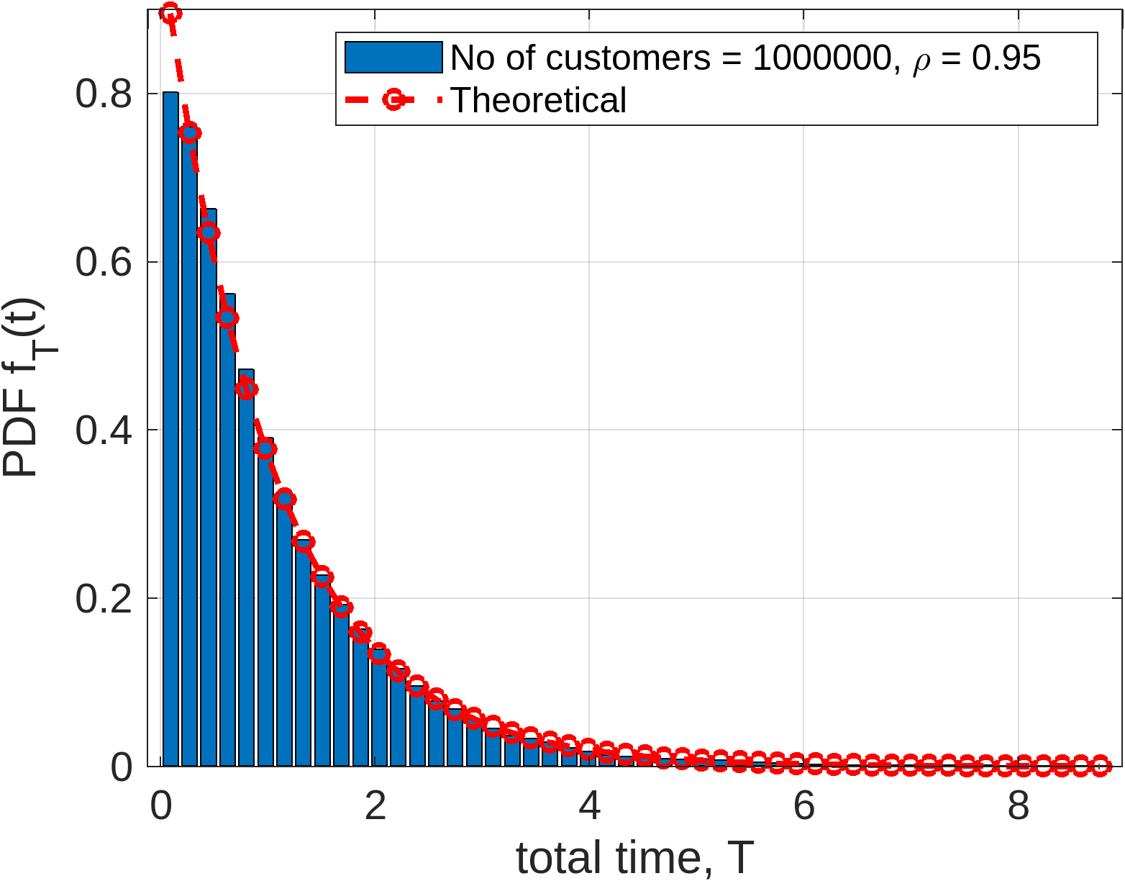
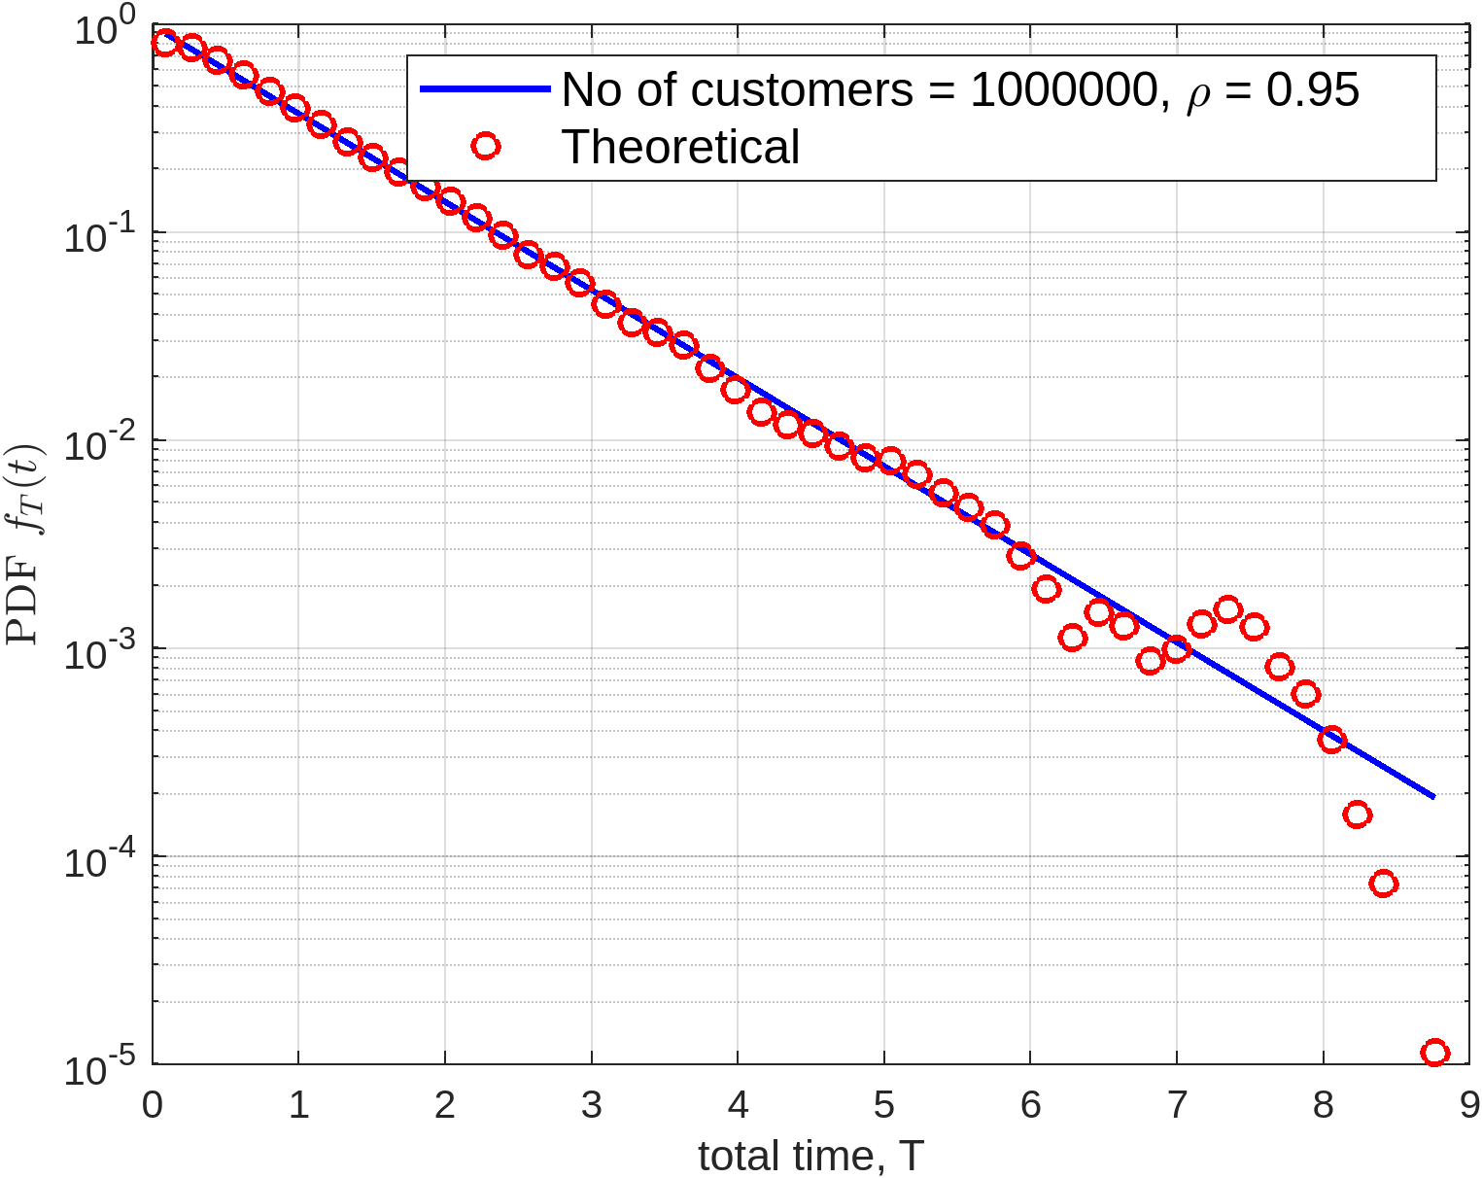
Results (total time PDF)

Slide 23

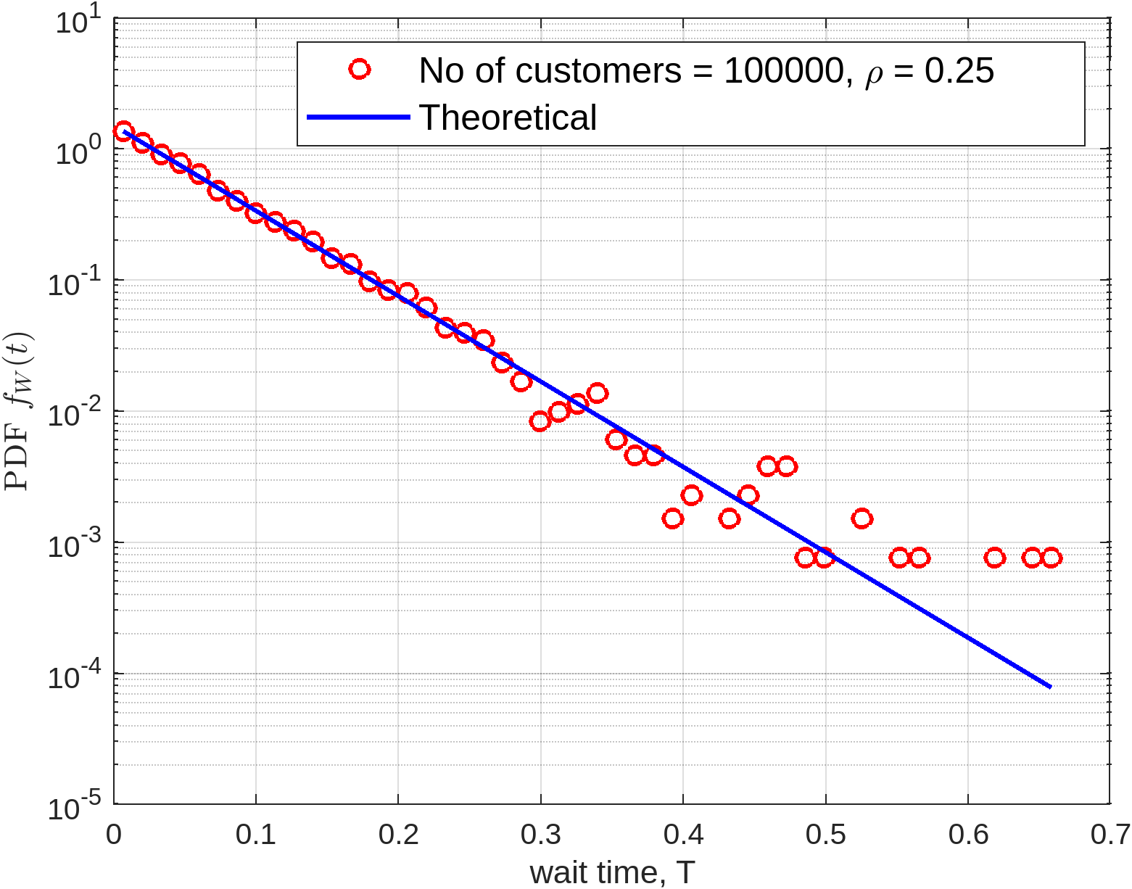
Results (waiting time PDF)

Slide 24
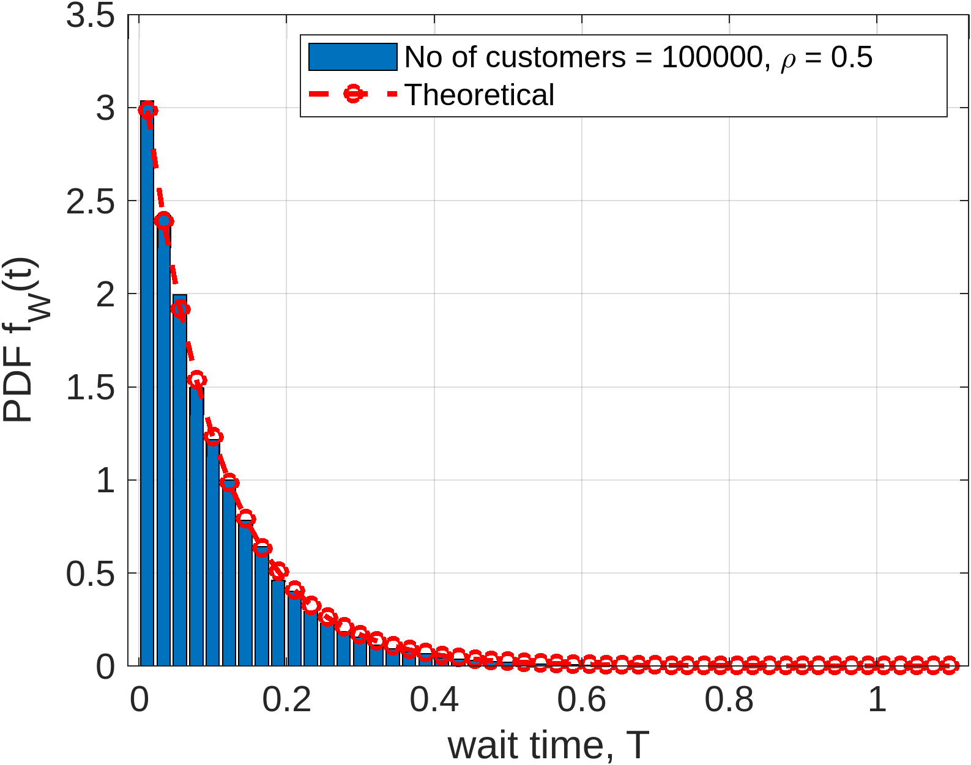
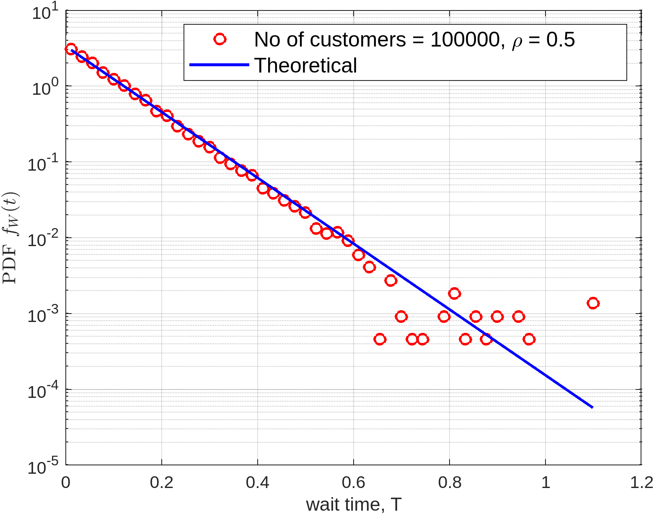
Results (waiting time PDF)

Slide 25
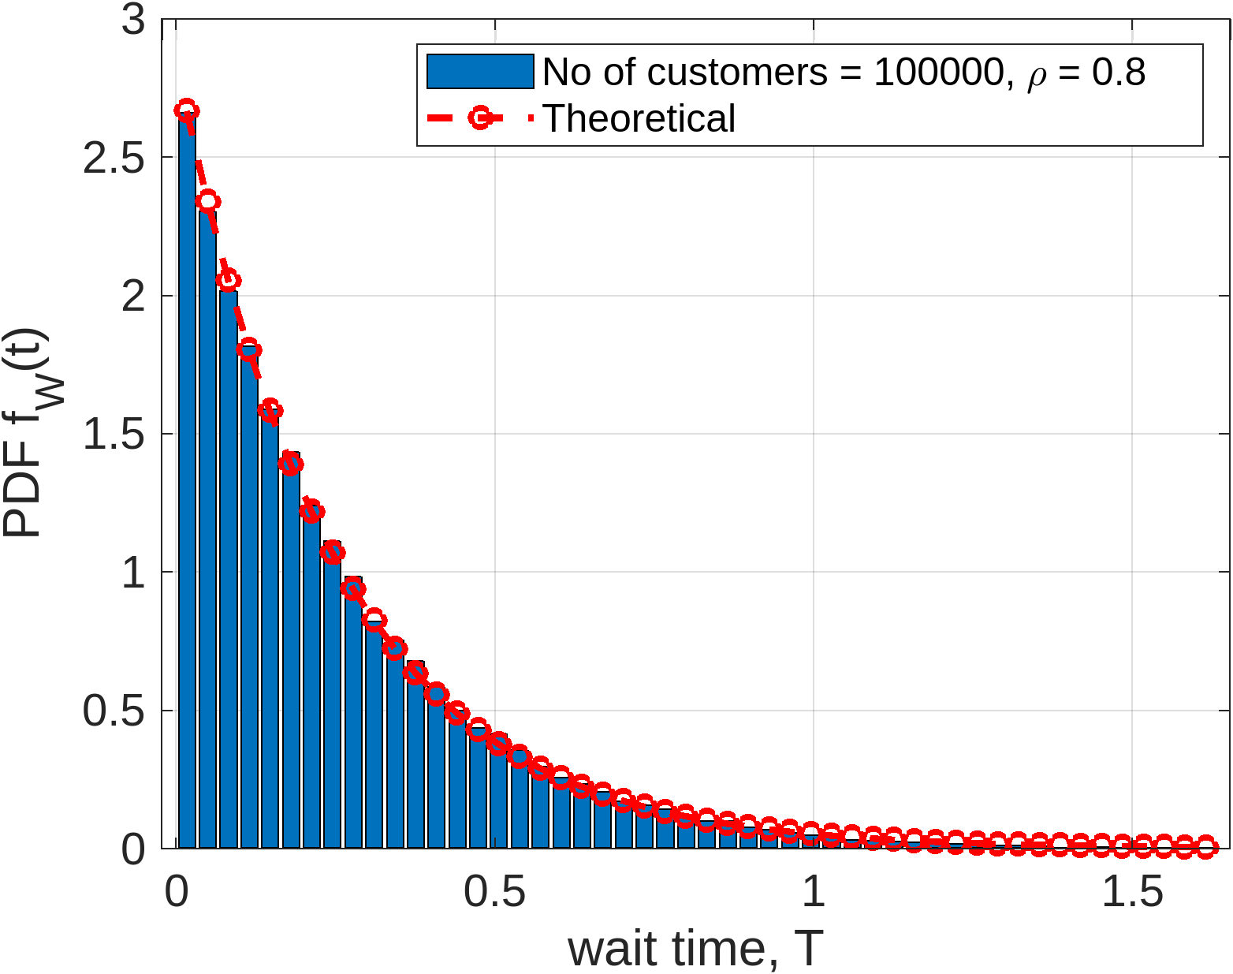
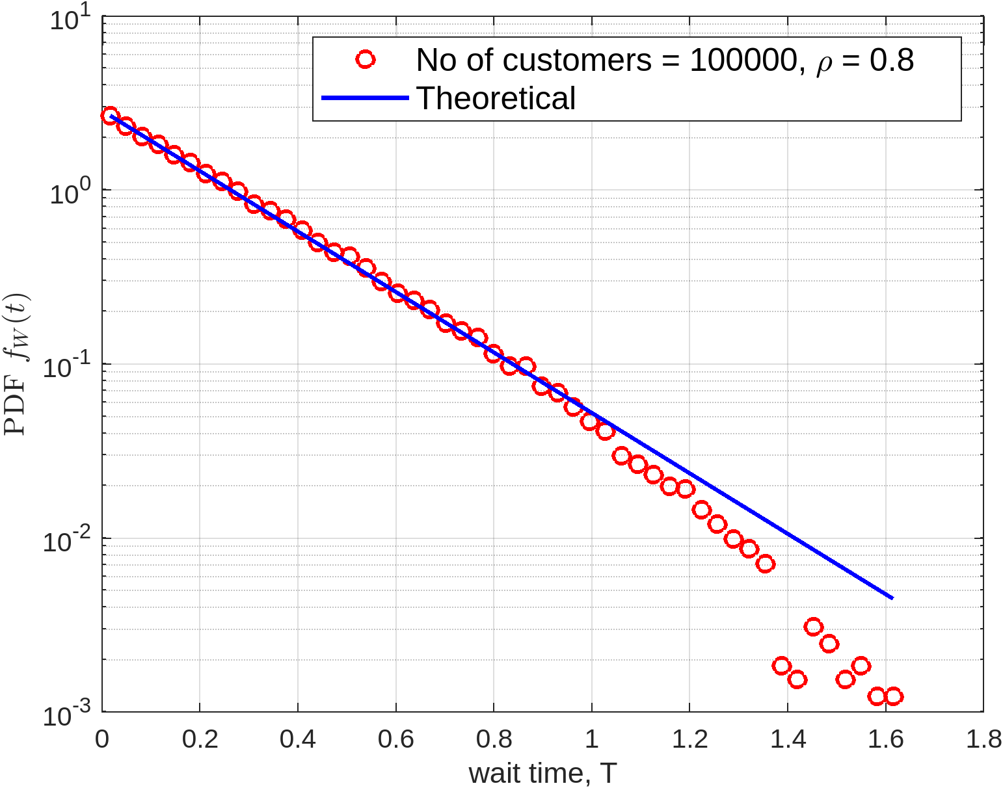
Results (waiting time PDF)

Slide 26
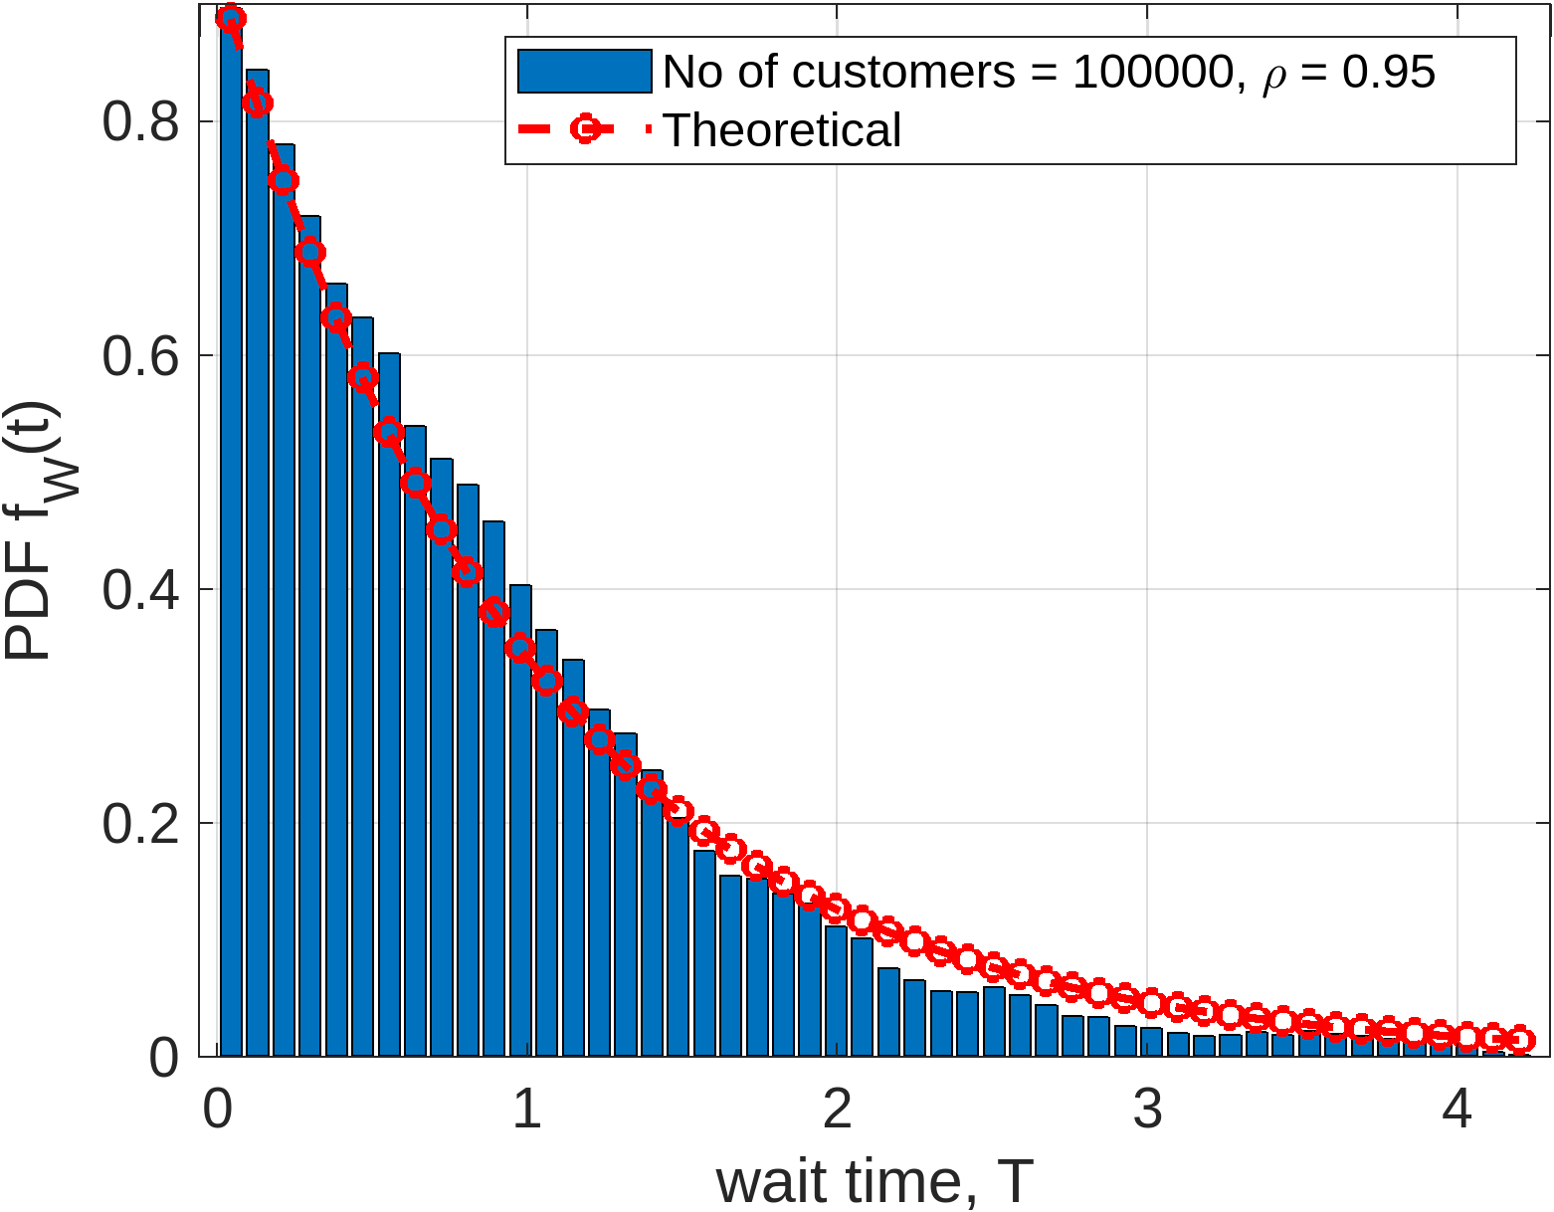
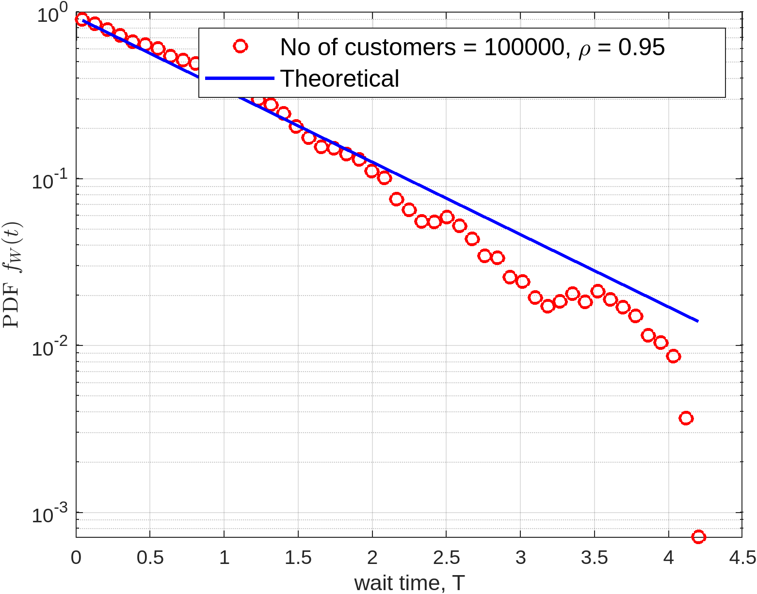
Results (waiting time PDF)

Slide 27

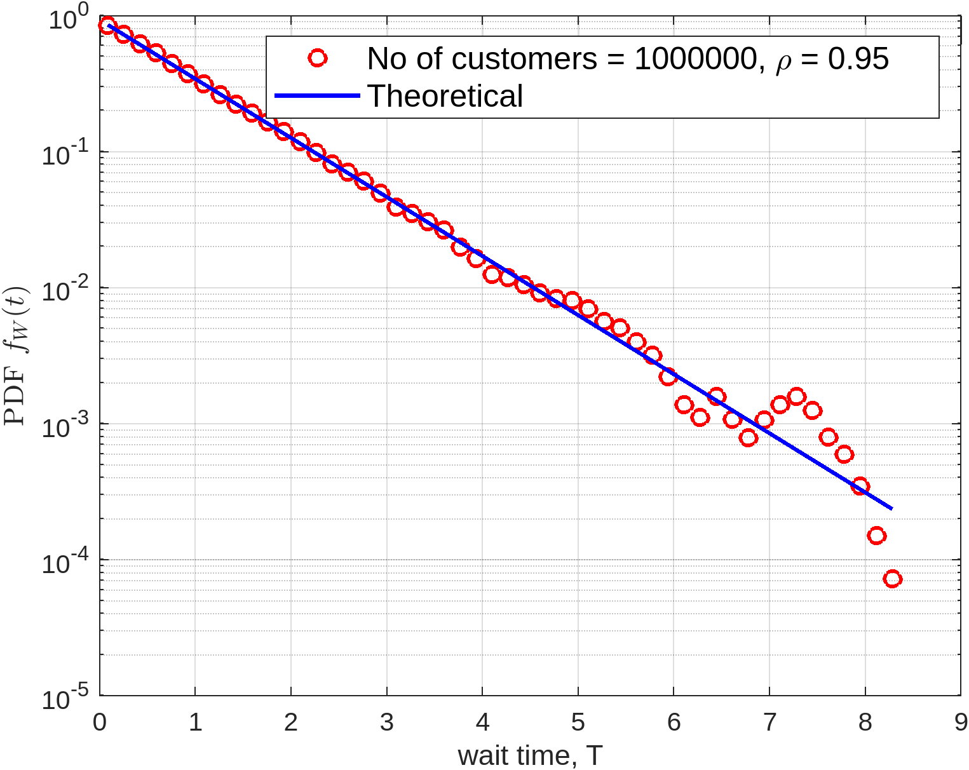
Results (waiting time PDF)

Slide 28
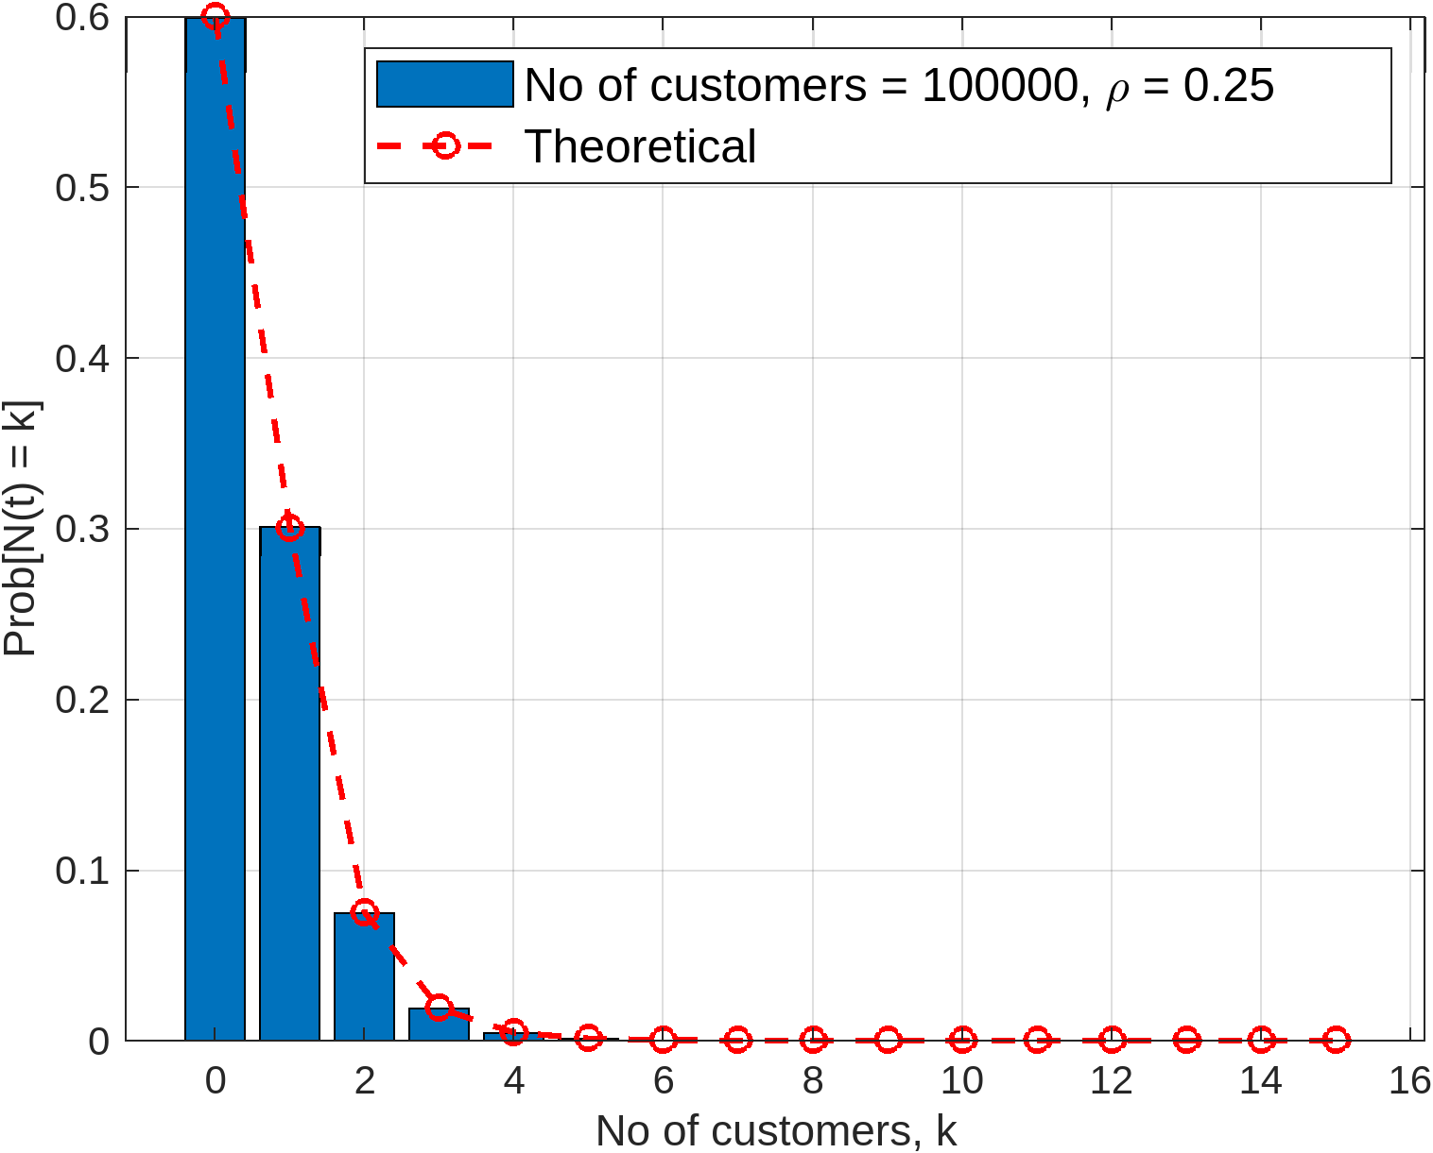
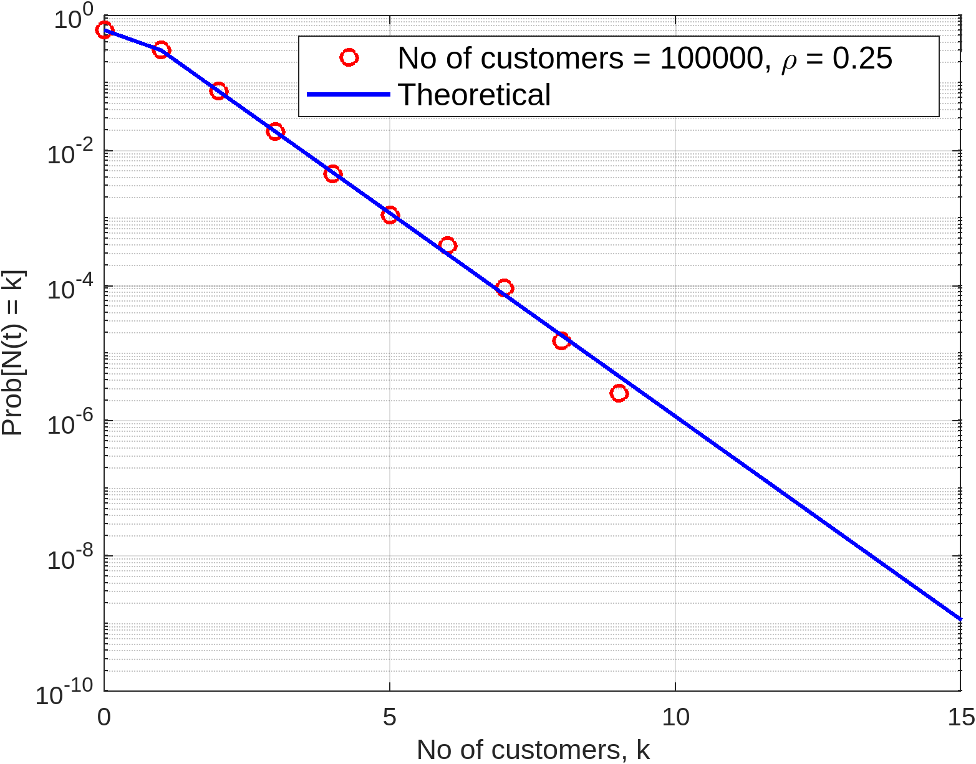
Results (no of Customers PMF)

Slide 29
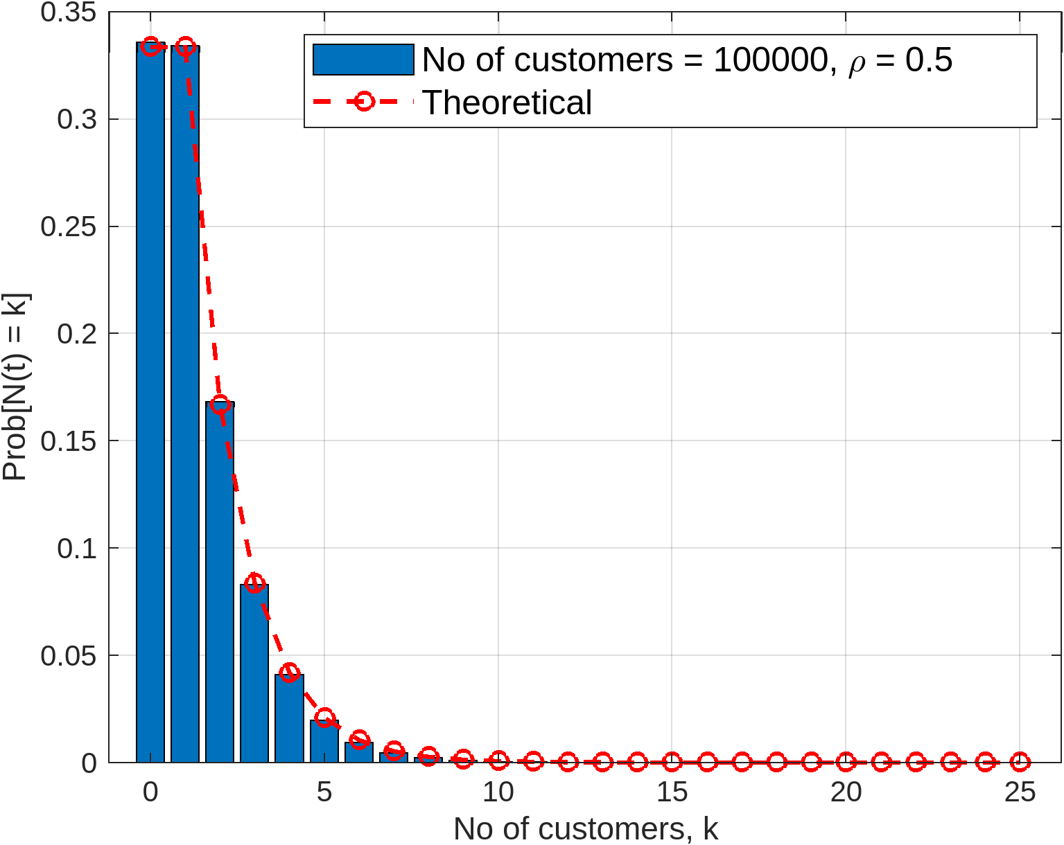
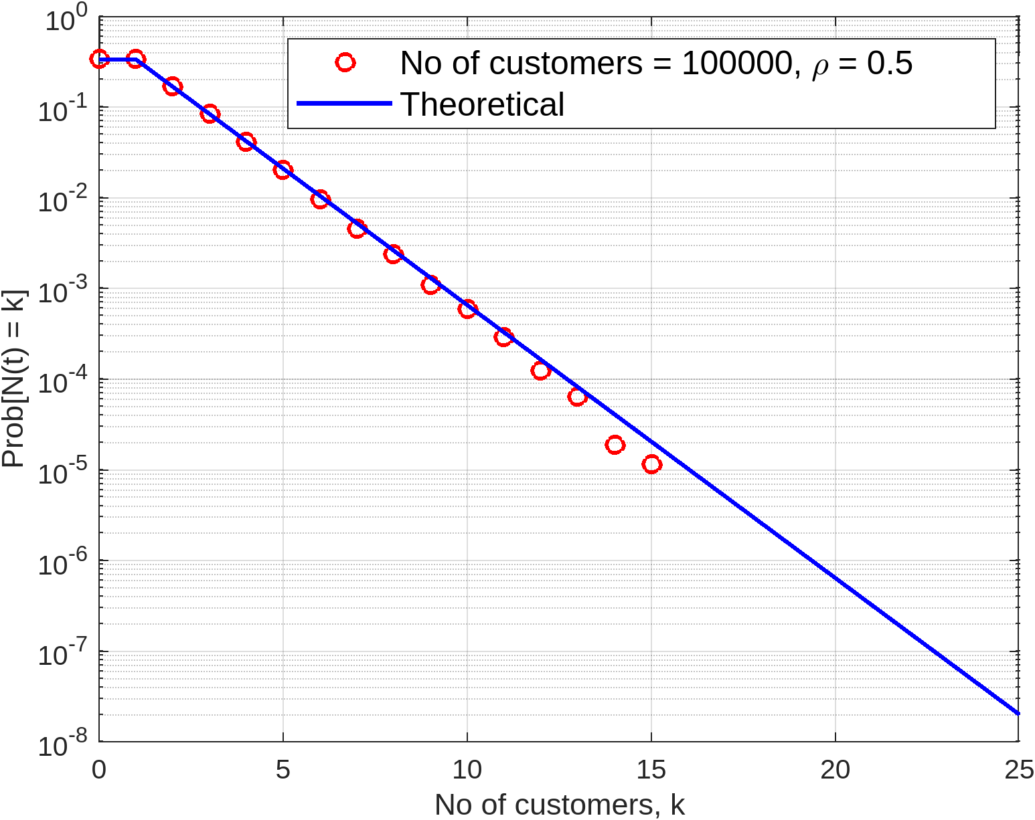
Results (no of Customers PMF)

Slide 30
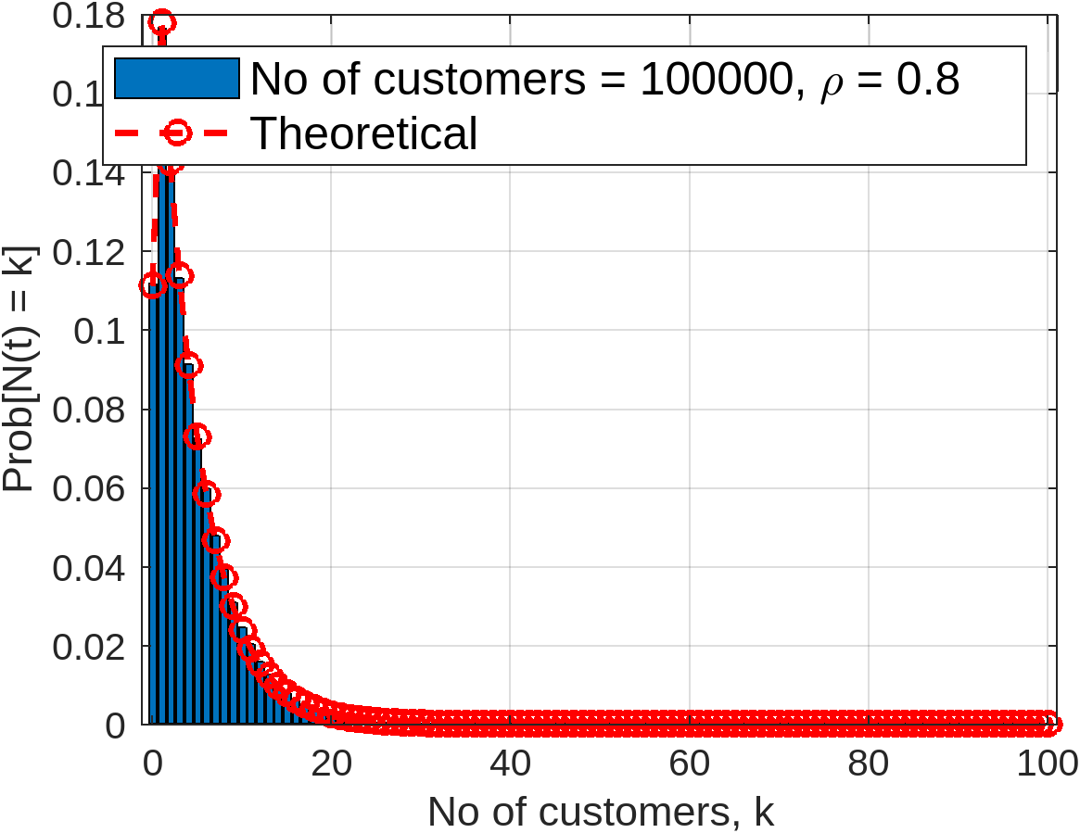
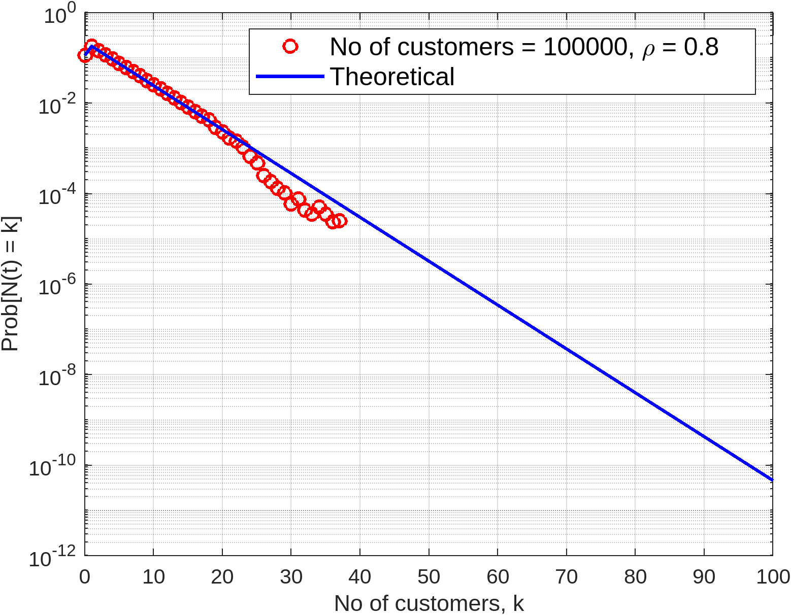
Results (no of Customers PMF)

Slide 31
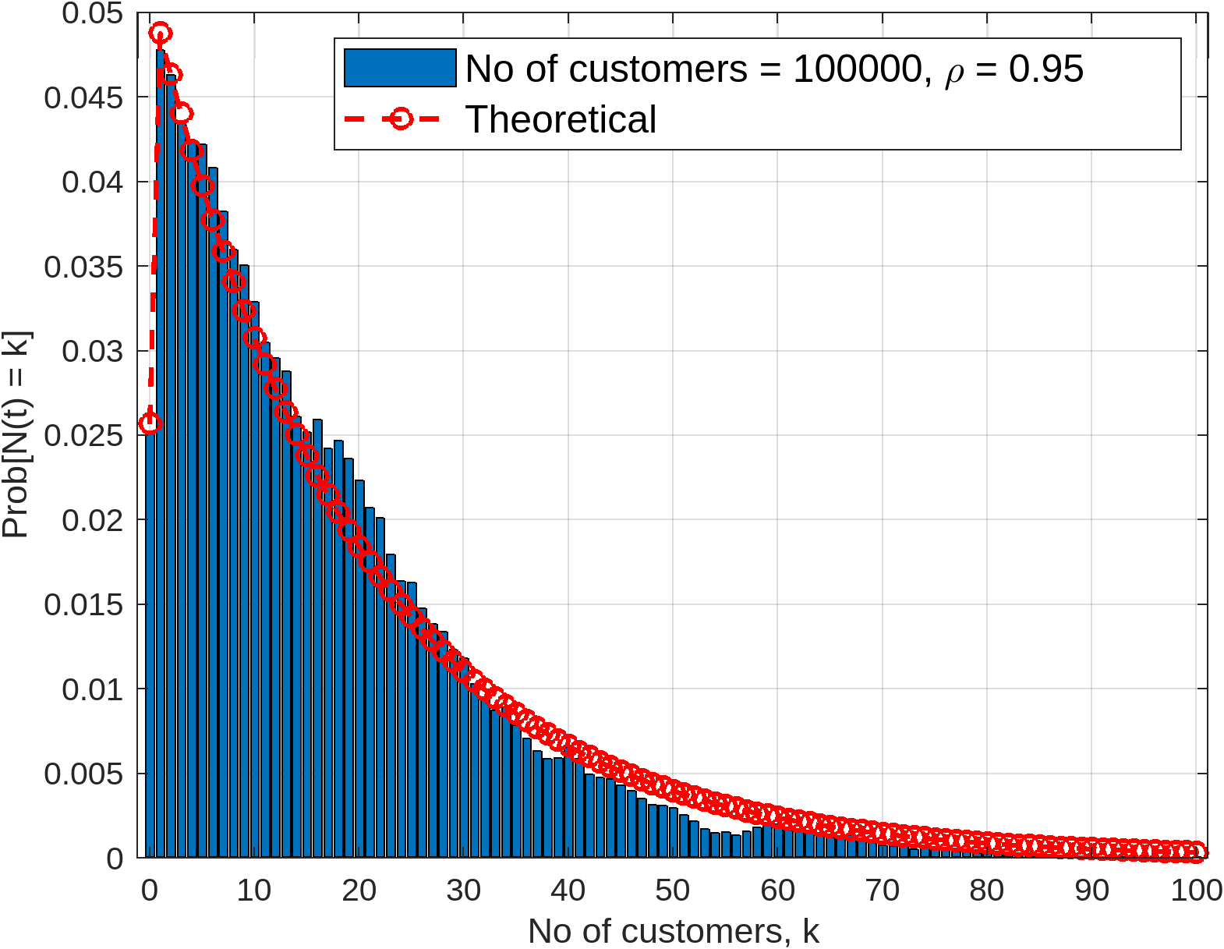
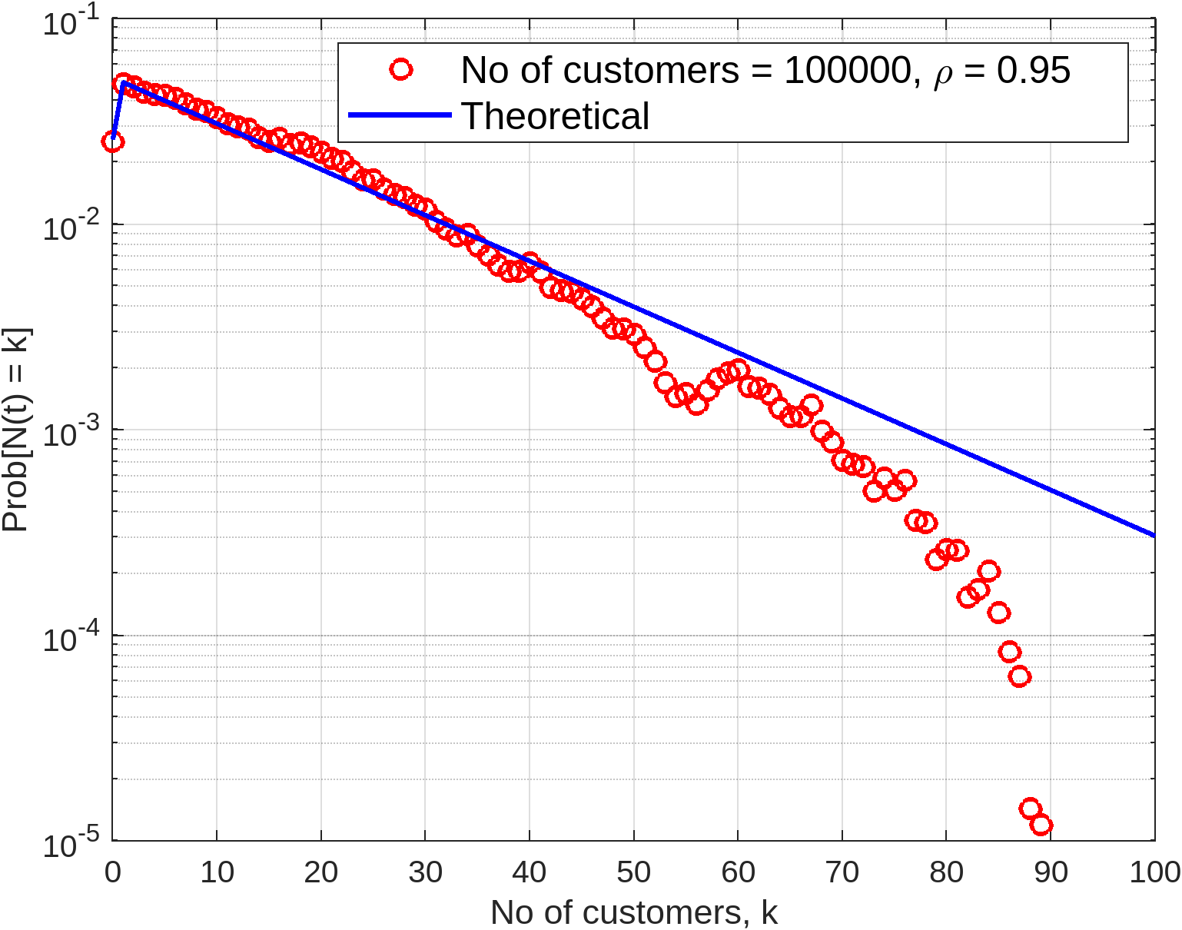
Results (no of Customers PMF)

Slide 32
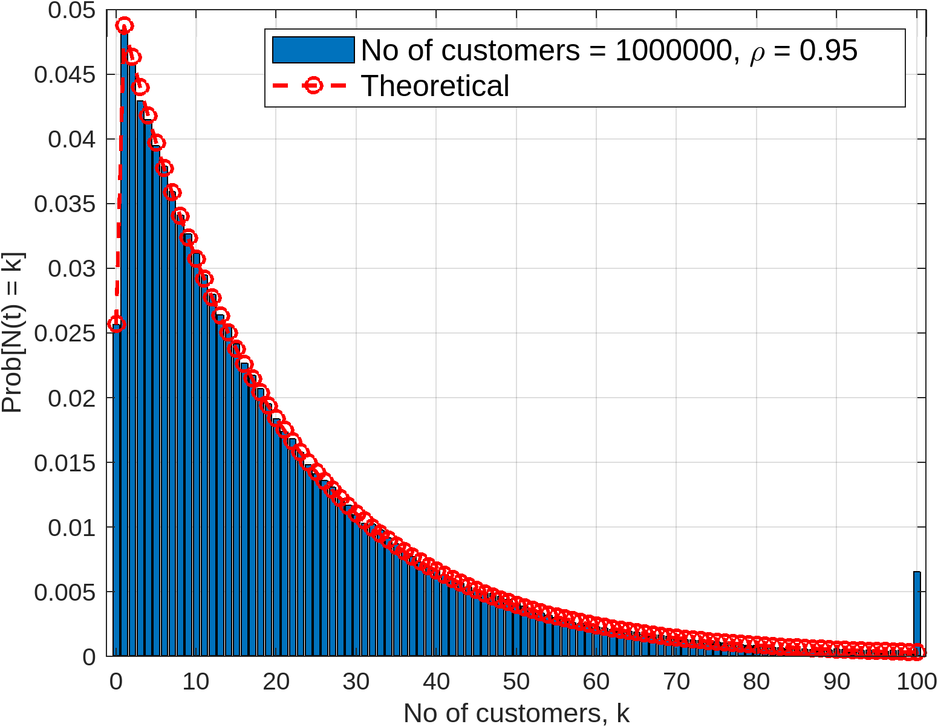
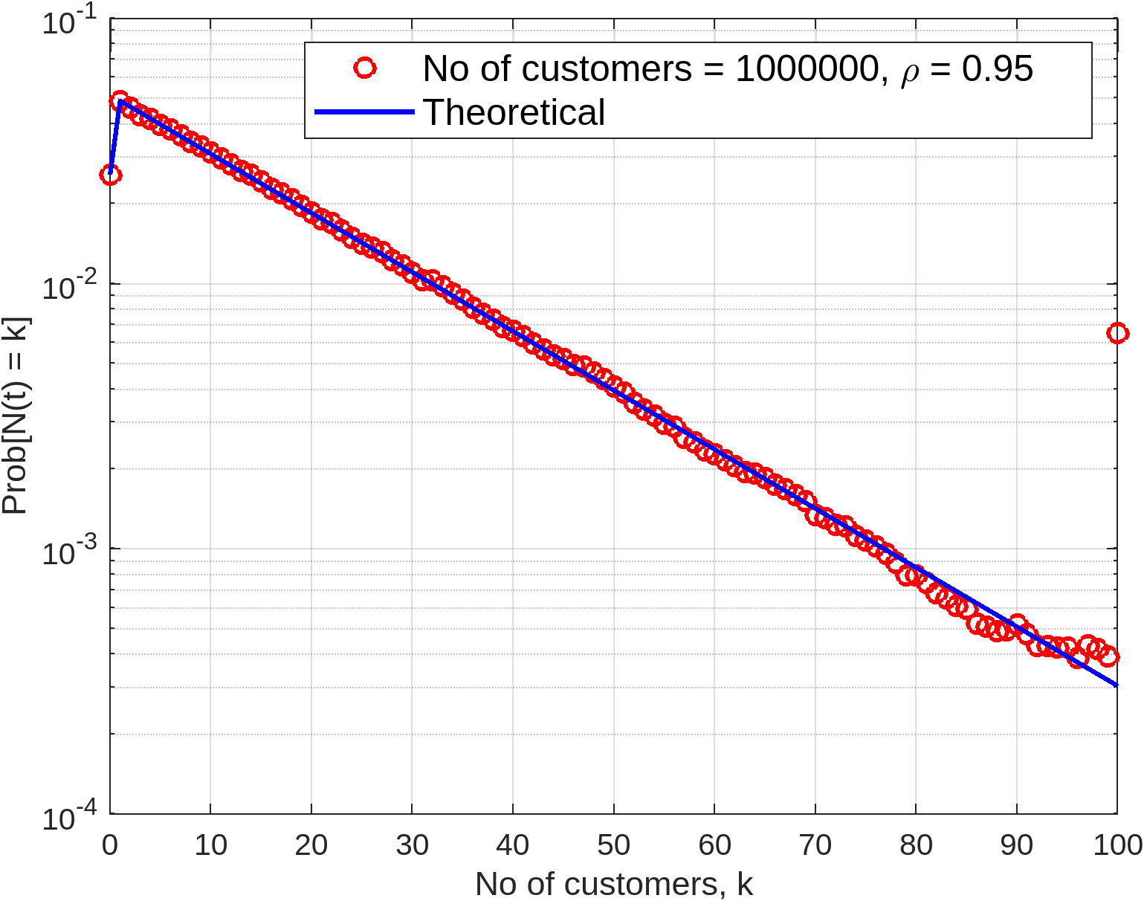
Results (no of Customers PMF)

Slide 33
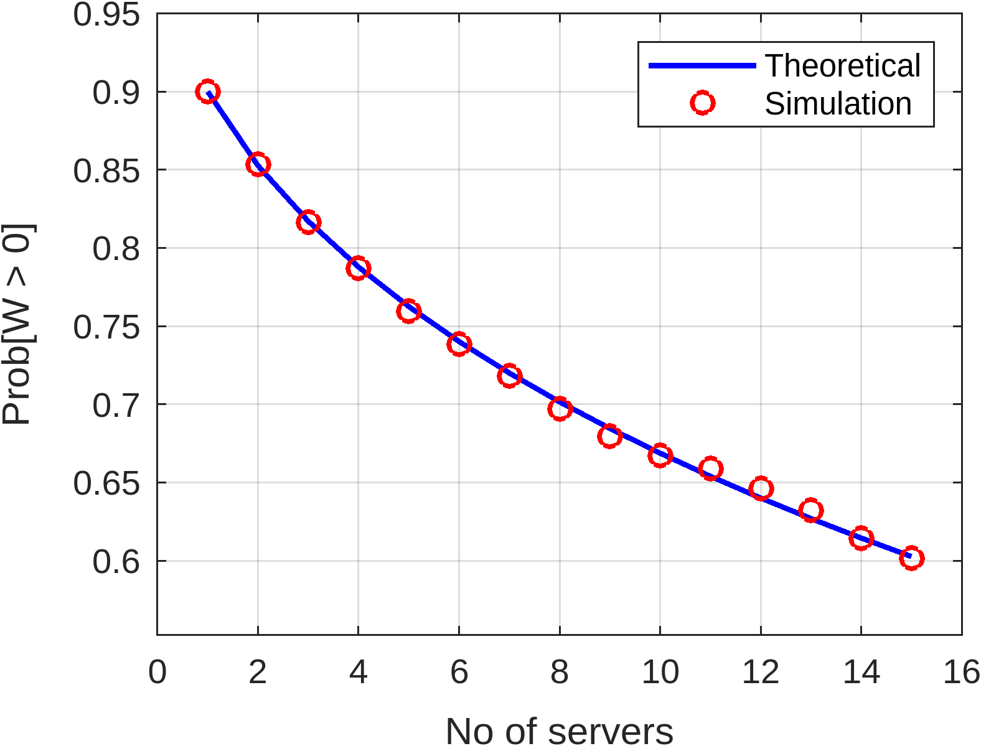
Results (waiting probability)

Slide 34
Conclusion
The results of the simulation are showing an excellent agreement with theoretical results, which indicates that the simulation code is working properly.

