Slide 1


Final Year Project
Trilyte: Real-Time Electrolytes Imbalance detection using ECG Signals
Supervised By: Miss. Nayab Khalid

Slide 2
Project Team
Hajira Imran (44594)
Maryum Malik (45369)
Aneeza Sherani (47436)

Slide 3
Table of Content
Background and Introduction
Literature Review
Problem Statement
Project Scope
Proposed Solution
Requirements Summary
Design Summary
Implementation Summary
Testing & Evaluation Summary
Conclusion and Outlook

Slide 4
BACKGROUND AND INTRODUCTION

Slide 5
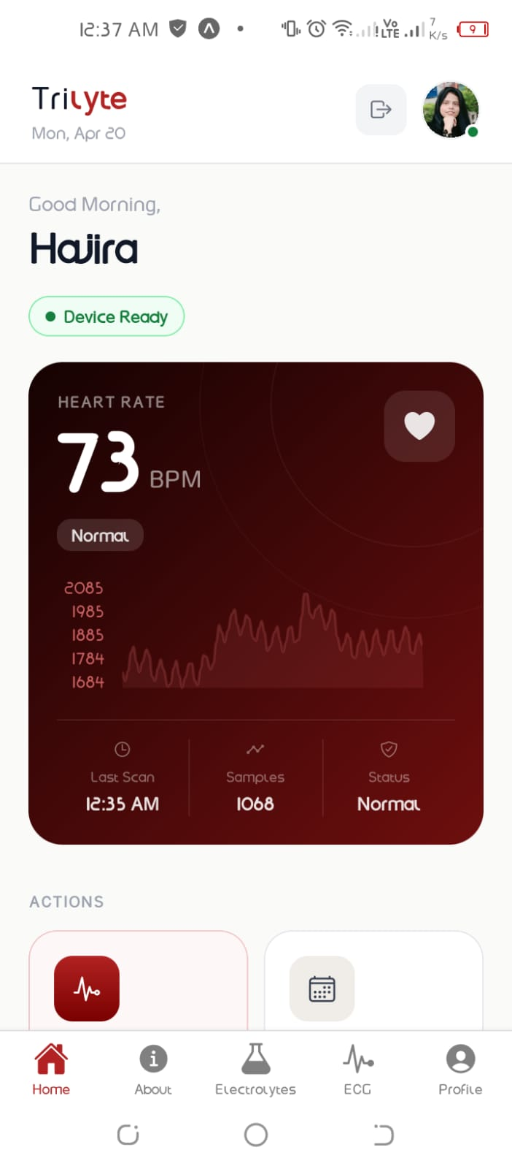
Introduction
About Trilyte?
Trilyte is an AI-based IoT healthcare system designed for real-time monitoring and prediction of electrolyte levels (Potassium, Calcium, and Magnesium) using ECG signal features. The system leverages machine learning to analyze cardiac electrical activity and infer possible electrolyte imbalances.

Slide 6
Background
ECG is a non-invasive method to record the heart’s electrical activity.
It represents heart signals as a waveform over time.
A normal ECG consists of P, Q, R, S, and T waves (PQRST complex).
Each heartbeat includes one full cycle:
P wave → atrial contraction
QRS complex → ventricular contraction
T wave → recovery phase

Slide 7
Background
Electrolytes (K, Ca, Mg) regulate heart electrical activity.
Imbalance causes changes in ECG patterns (waves, intervals, rhythm).
These changes can be analyzed using AI to predict electrolyte levels.

Slide 8
Literature Review

Slide 9
Literature Review
Feature/Area | Existing Apps (Kardia, Spandan, PMCardio) | Trilyte
Potassium Detection | ✔ (AliveCor, Spandan) | ✔ AI-Driven
Calcium Detection | ✖ (Only shows QT interval) | ✔ Direct Prediction
Magnesium Detection | ✖ | ✔ Integrated AI Model
Signal Processing | ✔ (Cloud-based) | ✔ AWS Lambda Preprocessing
Multi-Electrolyte Range | ✖ (Focus on K only) | ✔ K,Ca,Mg
Real-time Visualization | ✔ | ✔ECG Graph

Slide 10
PROBLEM STATEMENT

Slide 11
Problem Statement
Invasiveness: Existing methods require painful blood withdrawal using needles, making it difficult for children and elderly patients.
Time-Lags: Laboratory processing times (1–4 hours) prevent immediate medical intervention during emergencies.

Slide 12
Problem Statement
Lack of Continuous Monitoring: Blood tests only provide a "snapshot" in time; they cannot track fluctuations happening in real-time.

Slide 13
Project Scope
Non-Invasive Detection: ECG-based detection of K⁺, Ca²⁺, Mg²⁺ imbalances
IoT Infrastructure: AD8232 + ESP32 for data capture and transmission
Cloud AI: Feature extraction and MLP model on AWS lambda
Mobile App: React Native for monitoring , history etc.
Auto Analysis: ECG features (T-wave, PR interval) calculated automatically

Slide 14
ENDEAVOUR

Slide 15
Endeavour
Team Roles & Responsibilities
Hajira Imran: AWS Lambda deployment & app development
Maryum Malik: AI model(MLP), ECG preprocessing and app development
Aneeza Sherani: Hardware (AD8232 + ESP32) & app development

Slide 16
Endeavour
2. Software Development Process
We followed a Phase-wise / Iterative Development Model to ensure a structured workflow:
Hardware Prototyping: Sensor testing & calibration
AI and Backend: ECG model training & cloud setup
System Integration: Connected hardware with mobile app
Testing and Evaluation: Checked latency & accuracy

Slide 17
Endeavour
3. Way of Working as a Team
Collaborative Problem Solving: Switched to ESP32 improved sensors
Agile Coordination: Held regular meetings to sync progress.
Peer Review: Internal testing and module validation
Professionalism: Ethical practices & proper documentation

Slide 18
PROPOSED SOLUTION

Slide 19
Proposed Solution
Utilizing the AD8232 sensor to capture high-fidelity ECG signals through skin electrodes (No needles)
An integrated framework where the ESP32 microcontroller transmits data to the cloud for instant processing.

Slide 20
Proposed Solution
A Multi-Task MLP based Deep learning model that analyzes ECG waveforms to predict electrolyte levels.
A mobile application (React Native) that provides immediate visual alerts and tracks long-term health trends.

Slide 21
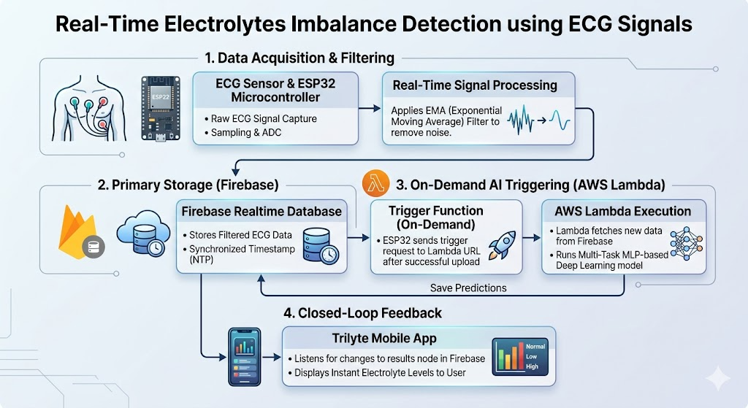

Slide 22
Requirements Summary
Functional Requirements
User registration and secure login system
Real-time ECG signal acquisition using AD8232 + ESP32
AI-based prediction of electrolyte levels (K⁺, Ca²⁺, Mg²⁺)
Display of results and recommendations in mobile app
Storage of ECG history with timestamps
Secure user logout and session management
Notes:
Is phase mei humne AD8232 sensor ko ESP32 ke sath connect kiya. AD8232 ECG signals capture karta hai aur ESP32 un signals ko cloud par send karta hai. Signal ko clean karne ke liye humne EMA filter use kiya, jisse noise reduce hota hai.

Slide 23
Non-Functional Requirements
Performance
Real-time ECG processing within ~30 seconds
Smooth data transmission via Firebase
Noise-free ECG signal processing and visualization
Security
Secure authentication and login system
Encrypted data transmission using HTTPS
Role-based access to protect user data
Safety
Non-invasive ECG monitoring (no internal body interaction)
Low-power hardware operation for safe usage
Notes:
Is phase mei humne Firebase aur AWS Lambda use kiya. Firebase data ko store karta hai aur AWS Lambda AI model ko run karta hai. Jab ECG data aata hai, Lambda usko process karke result generate karta hai

Slide 24
Hardware
AD8232 ECG sensor module
ESP32 microcontroller (Wi-Fi enabled)
Mobile device (Android/iOS)
Development system for training ML model
Software
Python (ML model development)
React Native (mobile application)
TensorFlow/Keras (deep learning model)
Firebase + AWS (cloud storage & processing)
HTTPS communication protocols
Notes:
Is slide mei humara AI model hai. Humne model ko cloud par deploy kiya. Yeh model ECG features ko analyze karta hai aur Potassium, Calcium aur Magnesium levels predict karta hai

Slide 25
Design Summary
1. System Architecture (3-Tier Model):
Perception Layer: Hardware (AD8232 + ESP32) for ECG signal acquisition.
Network/Cloud Layer: AWS Lambda for computation and Firebase for real-time data storage.
Application Layer: React Native mobile interface
For user interaction
Notes:
Is phase mei humne React Native app develop ki. App Firebase se real-time results fetch karti hai. User app mei ECG graph, results aur history easily dekh sakta hai

Slide 26
Design Summary
2. Logic & Data Flow
Designed a seamless pipeline: Sensor → WiFi (ESP32) → Cloud (AWS) → AI Inference → Mobile App.
Implemented Real-time Synchronization logic to ensure results appear within seconds of recording
Notes:
Is slide mei humne hardware testing batayi hai. Humne check kiya ke sensor accurate ECG signals de raha hai ya nahi. Aur noise reduce karne ke liye filter ki performance test ki

Slide 27
Design Summary
3. AI Model Design:
Utilized a Multi-Task Learning (MTL) approach.
Architecture includes Shared Layers (to learn common ECG patterns) and Task-Specific Heads (for individual Potassium, Calcium, and Magnesium prediction).
Notes:
Yahan humne system ka response time measure kiya. Sensor se app tak result aane mei average 12 se 15 seconds lagay. Iska matlab system near real-time work karta hai.

Slide 28
Design Summary
4. UI/UX Design Strategy
Developed intuitive dashboards for real-time ECG monitoring.
Designed Visual Alerts (Color-coded: Normal/High/Low) for quick medical interpretation
Notes:
“Is slide mei humne app testing ki. Humne login system, real-time data fetching aur app navigation test ki. Firebase aur AWS ke connection ko bhi verify kiya.

Slide 29
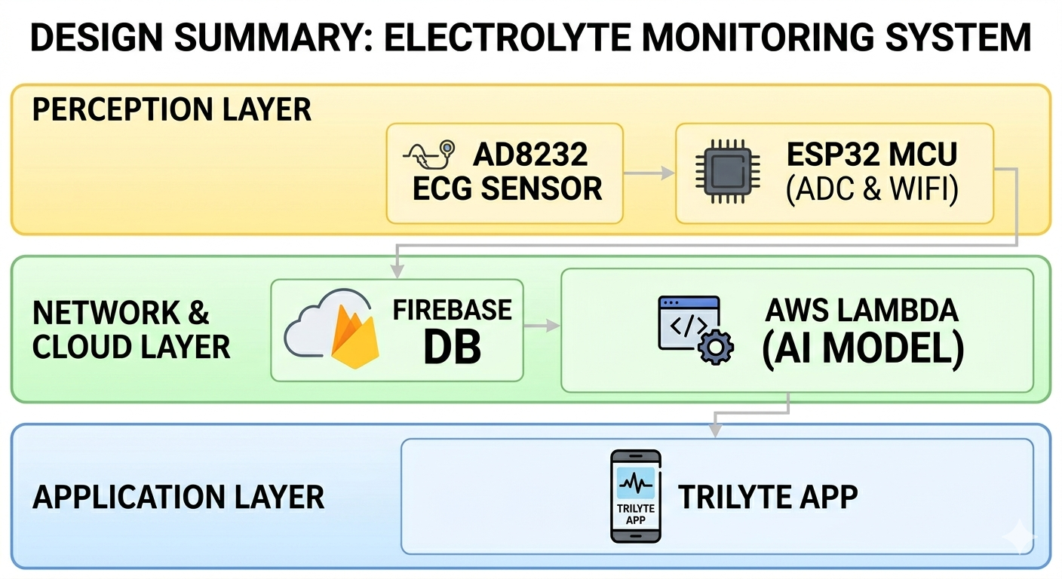
Visual Representation of Design Summary
Notes:
“Humne successfully aik non-invasive system develop kiya. Yeh system ECG signals se electrolyte levels predict karta hai. System ne 81% accuracy achieve ki. Iska major benefit yeh hai ke blood test ke baghair fast results mil sakte hain.

Slide 30
Implementation Summary
Phase 1: Hardware Interfacing
Integrating AD8232 ECG sensor with ESP32 using Analog Pins.
Implemented a 250Hz sampling rate to capture high-resolution cardiac data.
Applied an EMA (Exponential Moving Average) Filter in MicroPython to clean the raw signal before transmission.
Notes:
Humne AD8232 sensor ko ESP32 ke sath connect kiya.
AD8232 heart ki ECG signal leta hai aur ESP32 us signal ko aage cloud par send karta hai.
Signal ko clean karne ke liye humne EMA filter use kiya.

Slide 31
Implementation Summary
Phase 2: Cloud & Backend Setup
Configured Firebase Realtime Database for instant data logging and storage.
Deployed a Serverless Backend using AWS Lambda to host the Multi-Task DNN model.
Established a trigger mechanism where ESP32 initiates AI prediction via a specialized Lambda URL.
Notes:
“Is phase mei humne Firebase aur AWS Lambda use kiya.
Firebase data store karta hai.
AWS Lambda AI model ko run karta hai.
Jab ECG data aata hai, Lambda us data ko check karke result generate karta hai.”

Slide 32
Implementation Summary
Phase 3: AI Model Deployment
The multi-task deep learning model was converted to a cloud-compatible format (TFLite/Keras).
The model processes 8 specific ECG features
Notes:
“Is slide mei humara AI model explain hai.
Humne model ko cloud par deploy kiya.
Model ECG features ko read karta hai aur Potassium, Calcium aur Magnesium level predict karta hai.”

Slide 33
Implementation Summary
Phase 4: Mobile Application Integration
Developed the Trilyte App using React Native.
Implemented Real-time Listeners to fetch prediction results from Firebase the moment they are generated.
Notes:
“Is phase mei humne React Native app banai.
App Firebase se real-time result leti hai.
User app mei ECG graph, result aur history dekh sakta hai.”

Slide 34
Testing & Evaluation Summary
1. Hardware & Connectivity Testing
Noise Analysis: Tested the EMA Filter efficiency in removing motion artifacts and powerline interference.
Sensor Calibration: Validated AD8232 output against baseline ECG patterns to ensure signal clarity.
Notes:
“Is slide mei humne hardware testing batayi hai.
Humne check kiya ke sensor proper ECG signal de raha hai ya nahi.
Noise ko kam karne ke liye filter test kiya.”

Slide 35
Testing & Evaluation Summary
Latency Benchmarking: Measured end-to-end data flow (Sensor → Cloud → App); achieved an average response time of 12–15 seconds.
Notes:
“Yahan humne system ka response time check kiya.
Sensor se app tak result aane mei average 12 se 15 seconds lage.
Is ka matlab system near real-time work karta hai.”

Slide 36
Testing & Evaluation Summary
2. User Acceptance & App Testing:
Unit Testing: Verified core functions like User Authentication and Real-time Data Fetching.
UI/UX Evaluation: Ensured seamless navigation and readable results on React Native dashboard
Data Reliability: Cross-verified Firebase real-time sync with AWS Lambda trigger events.
Notes:
“Is slide mei app testing batayi hai.
Humne login, real-time data fetching aur app navigation test ki.
Firebase aur AWS ke connection ko bhi verify kiya

Slide 37
CONCLUSION AND OUTLOOK

Slide 38
Conclusion
Successfully developed a non-invasive, IoT-based electrolyte detection system.
81% Accuracy achieved in detecting Potassium, Calcium, and Magnesium levels.
Real Time Monitoring provided via user friendly mobile app
Needle-free solution offers a faster alternative to traditional blood tests.
Notes:
“Humne successfully aik non-invasive system develop kiya.
Yeh system ECG signal se electrolyte levels predict karta hai.
System ne 81% accuracy achieve ki.
Iska benefit yeh hai ke blood test ki need kam ho sakti hai aur result jaldi milta hai.”

Slide 39
Outlook
Model Optimization: Enhance accuracy beyond 81% using larger clinical datasets.
Smart Alerts: Integration of emergency SMS/Call notifications for critical levels.
Hardware Upgrade: Incorporate higher-resolution medical sensors
Notes:
Future mei hum model ki accuracy improve karna chahte hain.
Hum larger clinical dataset use karenge.
Emergency SMS ya call alert add karenge.
Aur better medical-grade sensors use karenge.”

