Slide 1



Documentation in
Hashim Nabil Al Sakkaf

Slide 2
Fabcademy Ethics
1- Always reply to emails
2- Always ask
3- Attend all workshops
4- Come to the fablab more often
5- Give credit to others
6- Search, search and learn
7- Use your own documentation style
8- Document as you go
9- Document Everything

Slide 3
Spiral Development. Failing as you can
1- Make it work. There is a fundamental design principle called satisfizing and here it is summarized: Doesn't matter how, but it has to work.
2- Make it integrated and resilient. At the very minimum, make it hold-able in one hand and resistant to shakes
3- Make it nice
Refine your project over and over until:
1- You are happy with the result
2- You run out of time

Slide 4
Assignment
work through a git tutorial build a personal site in the class archive describing you and your final project
Plan and Sketch a potential final Project
Document everything (how you made the website as well as the problems you faced
and how you solved them in addition to your experience in your own words!)

Slide 5
Laws of Time
First law of time. Everything consumes time
Second law of time. You can’t stop time. There is nothing you can do about it. You can pause but time will not
Third law of time. Time x Effort = constant. Given an initial large time to do something, the effort will be low. As time tends to zero, the effort tends to infinite.

Slide 6
List all the required tasks
If we think of the assignment as a puzzle then:
We have two uncertain things:
Knowing how many pieces (tasks) we have in the puzzle
How long it will take to complete each task

Slide 7
List all the required tasks
Determining the project management strategy. It consumes time.
Researching. It consumes time.
Lab cleanup. It consumes time.
Documenting. It consumes time.
Multimedia processing. It consumes time.
Testing. It consumes time.
Unforeseen. They exist and consume time. Allocate time for it.
Troubleshooting and debugging (no, this is not an unforeseen, this is a mathematical certain). It consumes time.
Rehearsing a presentation. It consumes time.

Slide 8
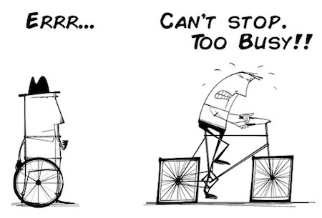
Busy is the new stupid
Make sure that you don't fill up your calendar with tasks, leaving no time for you to sit back, have some headspace and do some critical thinking.

Slide 9
Re-scheduling
If you ignored the third law of time and ran out of time then:
You need to reschedule your tasks
Drop some unrealistic goals

Slide 10
Deliver
The only thing certain in project management is that there is a deadline.
At that day you have to deliver. Doesn't matter if it is not what you wanted, if you don't like it, or if you are halfway done.
That day, you deliver whatever you have. Afterwards, if you want, you can meditate about what changes you should make in the future to achieve your goals.
But remember, you deliver that ugly thing you made. Always. Deliver.

Slide 11
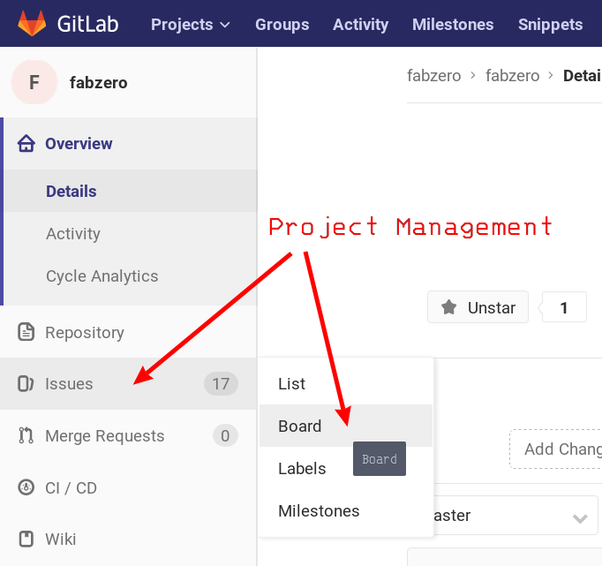
Using Gitlab/Github to manage your projects

Slide 12
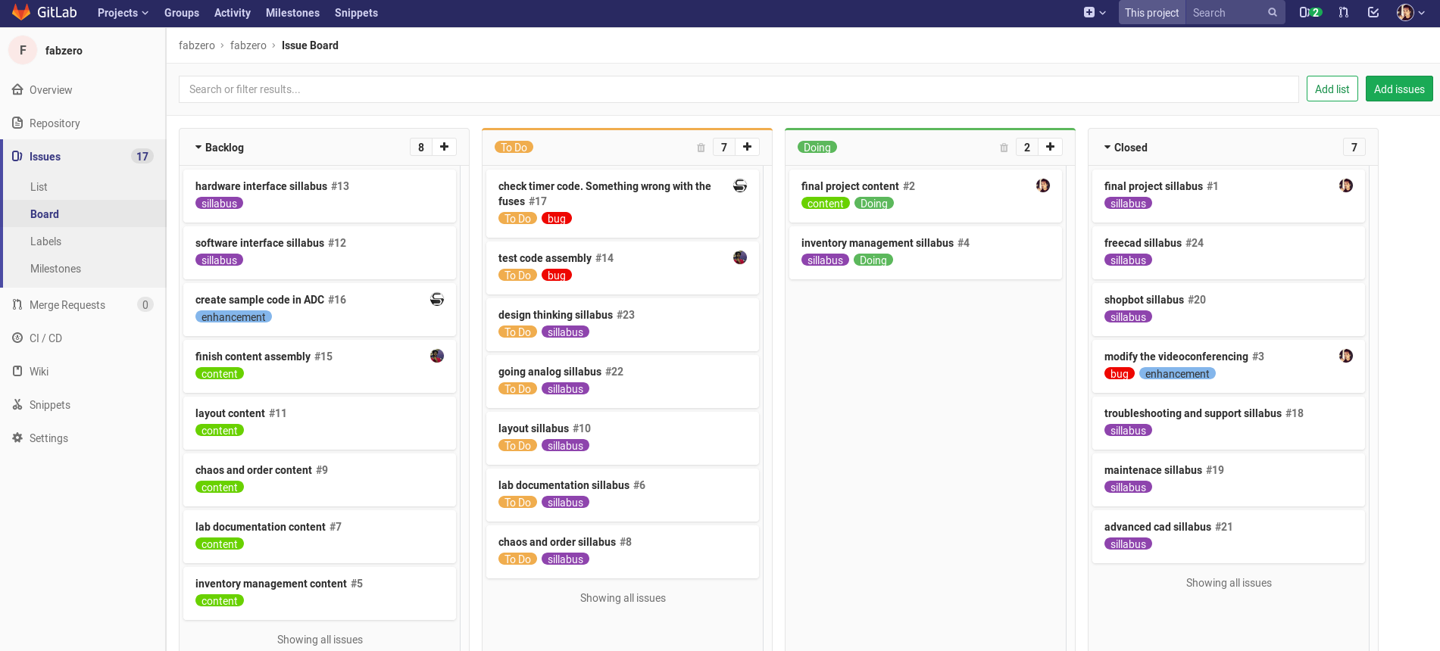
Using Gitlab/Github to manage your projects

Slide 13
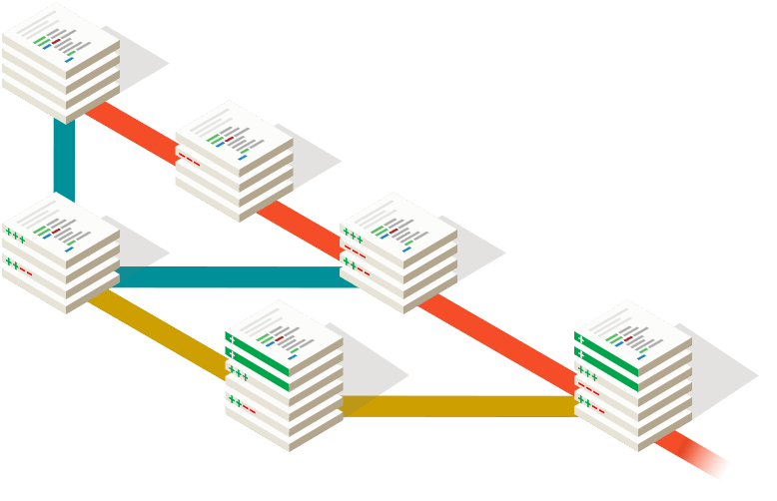
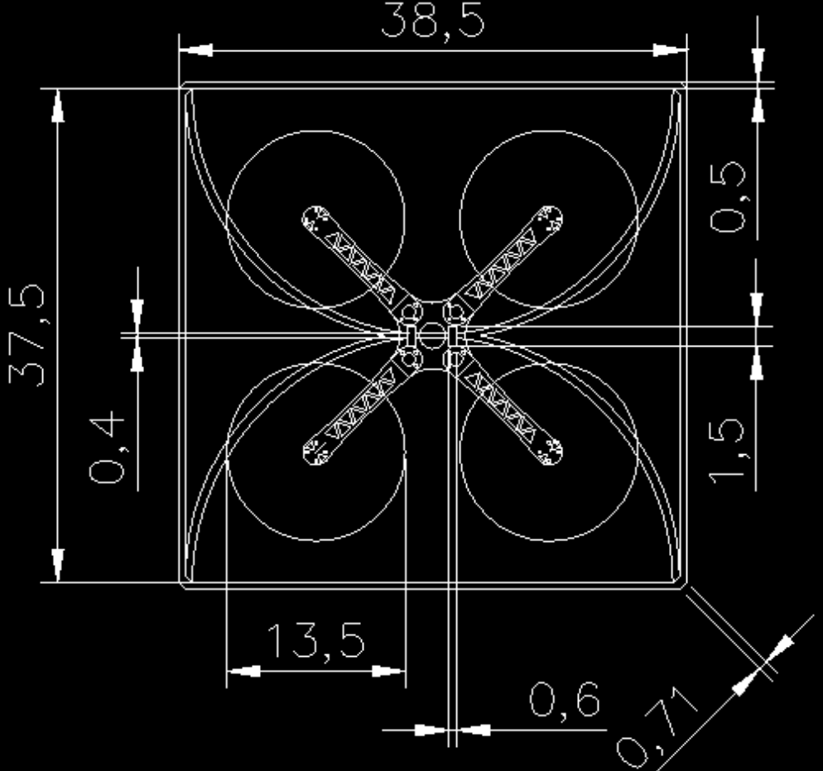
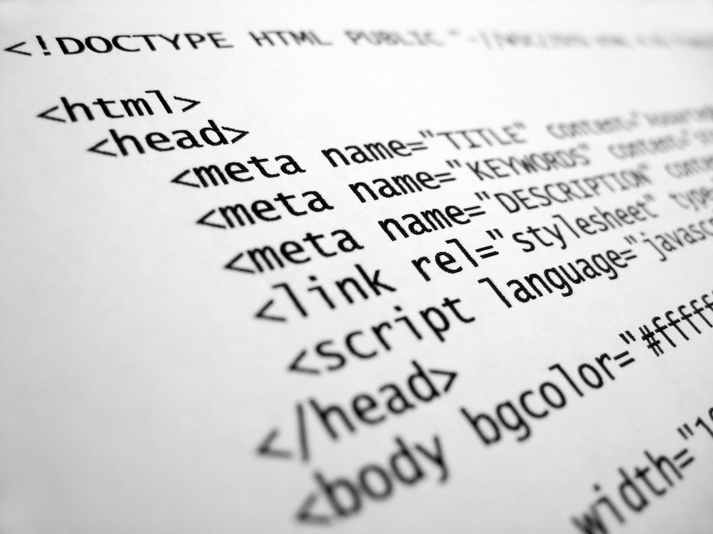
Project Management - overview
Control version system
Documentation
HTML
Notes:
Topics of this lesson
The same workflow you will have in the fab academy

Slide 14

Download Git on Windows

Slide 15
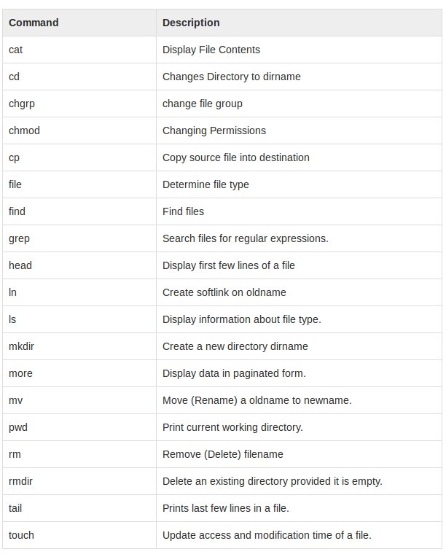
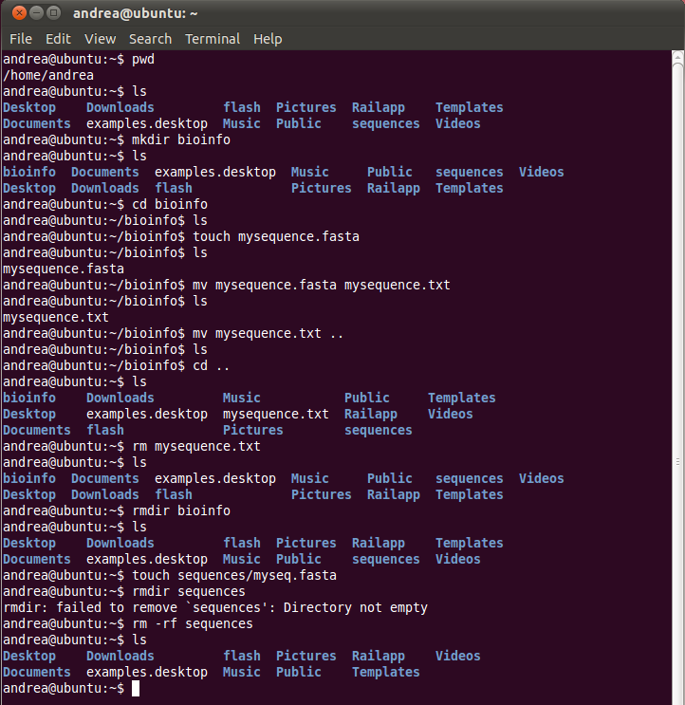
Version Control - bash commands intro

Slide 16
Version Control - bash commands intro
ls is a command which lists files and folders. -a is an option to display hidden files
cd command stands for change directory and it is used to go to other directories.
cd - : got to previous directory
Hint: Pressing “Tab” will autocomplete
mkdir used to create a new directory or folder
Ex) mkdir firstproject
touch used to create a new empty file
Ex) touch hello.txt
whoami will tell you who you are !

Slide 17
Documentation Tips
* Don’t use “space” to name a file or folder
Ex) Project Management → project_management
It is also recommended to not use upper cases for the same scenarios
* Use the same machine all the time (labtop)

Slide 18
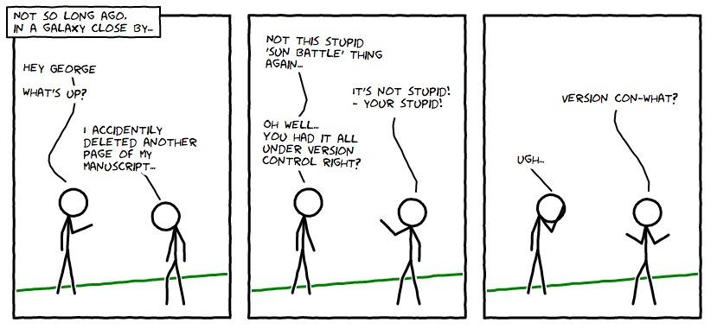
Version Control - concept
Definition: the management of changes to documents, computer programs, large web sites, and other collections of information
Why: teamwork, understanding, storing and restoring versions, backup
Dropbox is not a version control system!!!

Slide 19
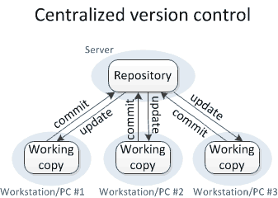
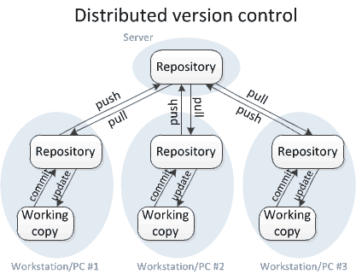
Version control - basics
Advantages of Distributed version control:
multiple central repositories (no Single Point Of Failure), faster and safer local operations

Slide 20



Version control - git
By far, the most widely used modern version control system in the world today is Git. Git is a mature, actively maintained open source project originally developed in 2005 by Linus Torvalds, the famous creator of the Linux operating system kernel.
GitHub is a web-based Git repository hosting service. It offers all of the distributed version control and source code management functionality of Git as well as adding its own features. It provides access control and several collaboration features such as bug tracking, feature requests, task management, and wikis for every project.
GitLab CE has similar functionality of GitHub, with the difference that is possible to self-host GitLab for you own usage and a private access to the code.

Slide 21
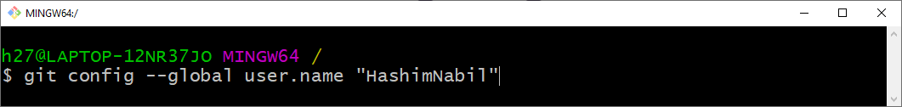
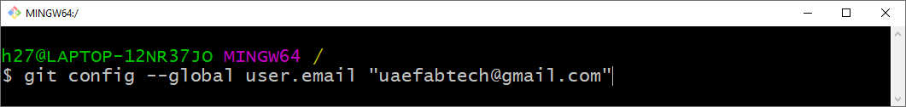
Configuring Git
Enter your Gitlab username!
Enter your Gitlab Email!

Slide 22
GitLab Tutorial
https://www.youtube.com/playlist?list=PLhW3qG5bs-L8YSnCiyQ-jD8XfHC2W1NL_

Slide 23
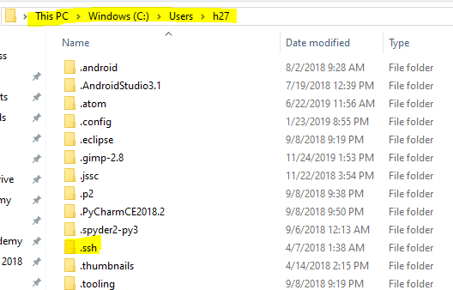
Generating the “ssh” key
Ssh-keygen –t rsa –b 4096 –C “your-email@example.com”
ssh = secure shell
Why???
So we can connect to Gitlab in secure way without the need to use our username and password each time!
Use this command to generate the key:

Slide 24
Connecting the “ssh” to GitLab
1- Go to the .ssh folder> id_rsa.pub
2- Open it with notepad ++
3- select everything and copy it! (ctrl +A then ctrl+c)
4- Go to Gitlab>settings> SSH Keys
5- paste your key there and click add key!

Slide 25
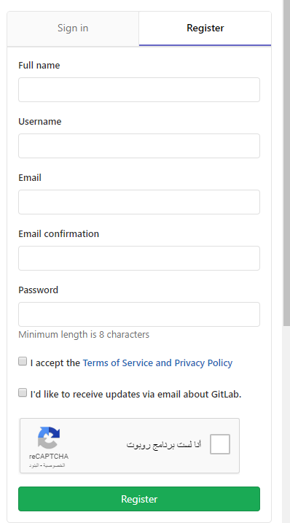
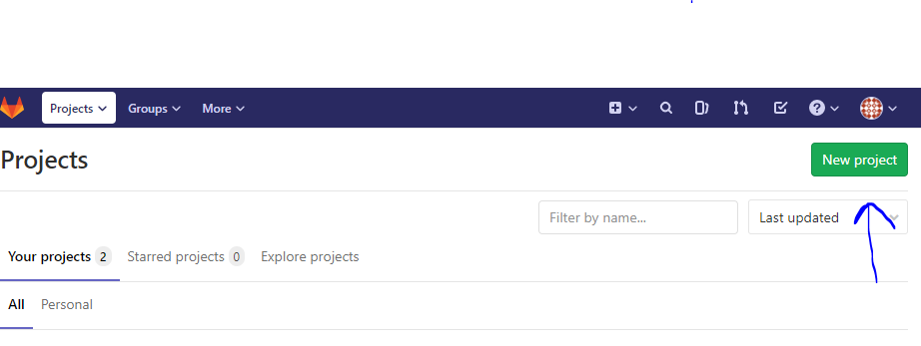
Creating a GitLab Project
1- Register
2- Create a New Project

Slide 26
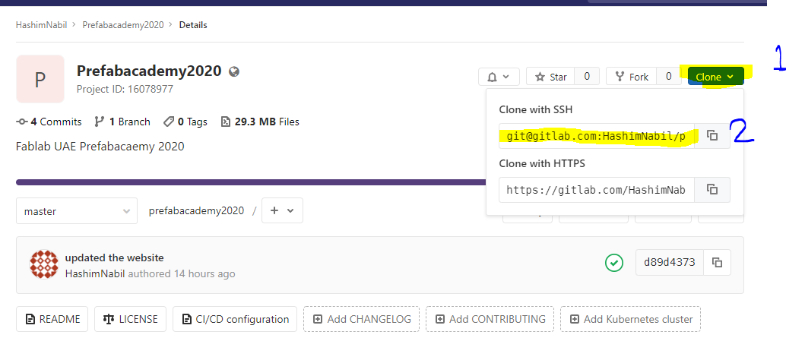
Cloning a Gitlab Project

Slide 27
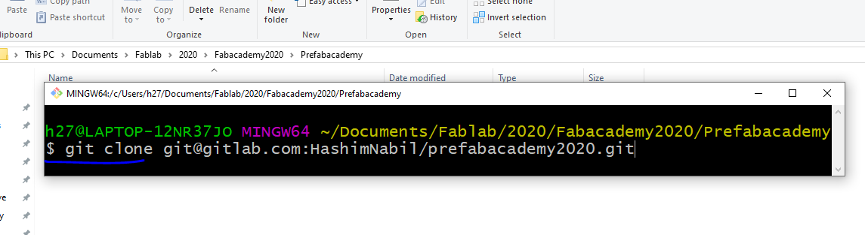
Cloning a Gitlab Project
1- Open Gitbash in the folder that you want your project to be in.
2- git clone ssh address of the project

Slide 28
Cloning a Gitlab Project
1- Open Gitbash in the folder that you want your project to be in.
2- git clone ssh address of the project

Slide 29
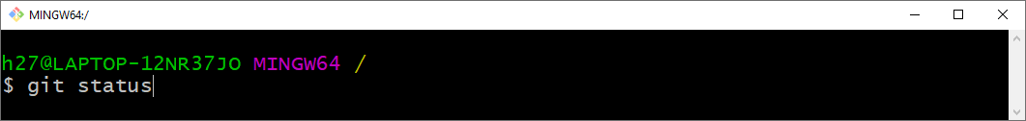
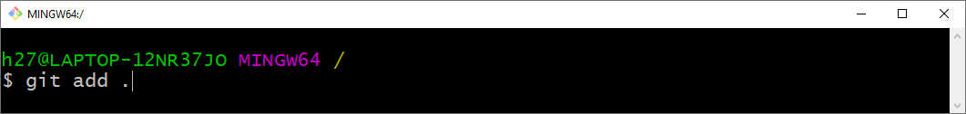
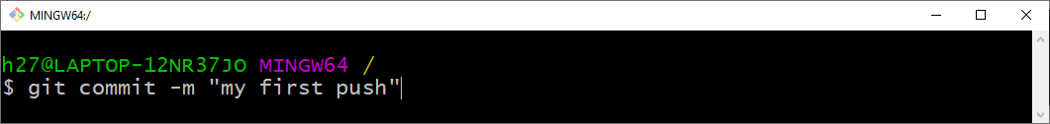
Pushing to GitLab
To know the state the working directory
To add the files
To commit the changes

Slide 30
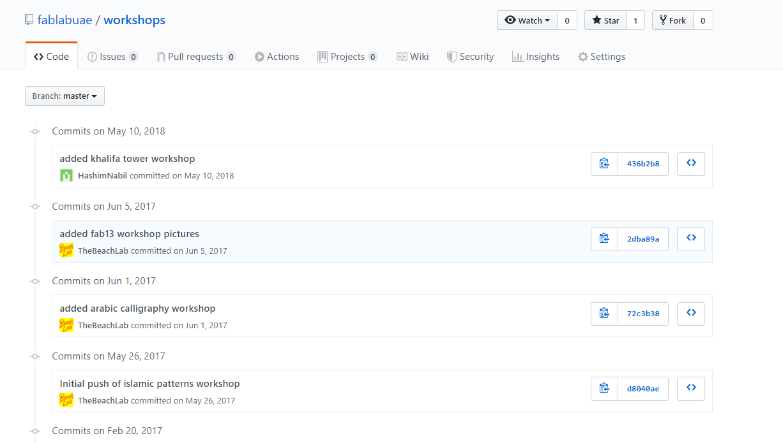
Why we write a commit message?

Slide 31

Pushing to GitLab
Push the changes to GitLab repository

Slide 32
Creating a Website

Slide 33
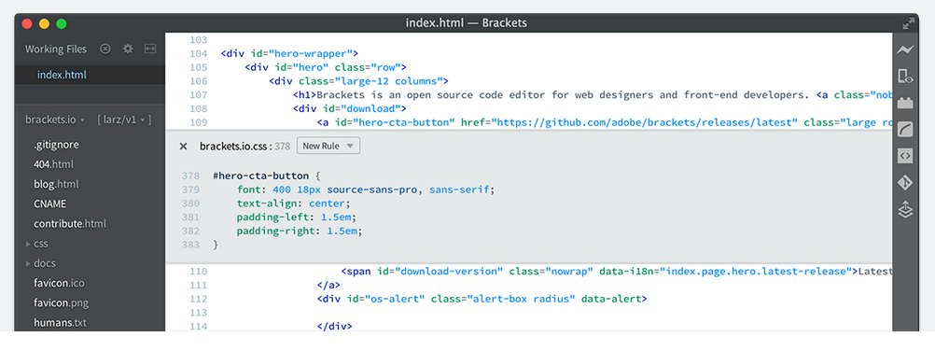
HTML - definition and IDE
HyperText Markup Language (HTML) is the standard markup language for creating web pages and web applications. With Cascading Style Sheets (CSS), and JavaScript, it forms a triad of cornerstone technologies for the World Wide Web. Web browsers receive HTML documents from a web-server or from local storage and render them into multimedia web pages. HTML describes the structure of a web page semantically and originally included cues for the appearance of the document.
Notes:
HTML will be read and interpreted by the browser
It can be considered the basic to develop a web page
It will embed and support other technologies such as javascript

Slide 34
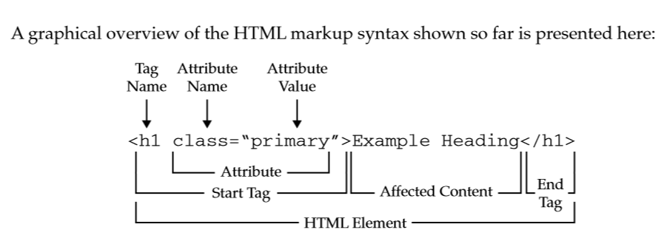
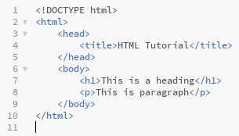
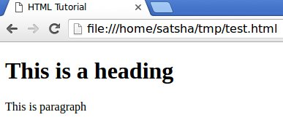
HTML - basic structure

Slide 35
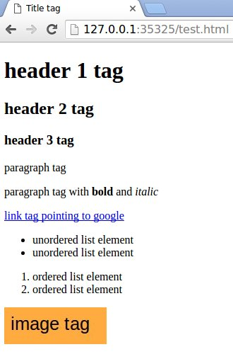
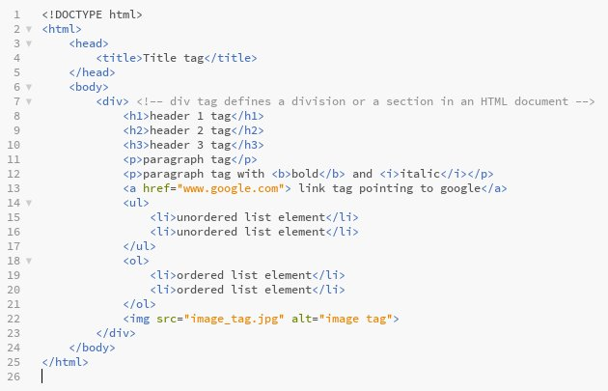
HTML - common tags

Slide 36
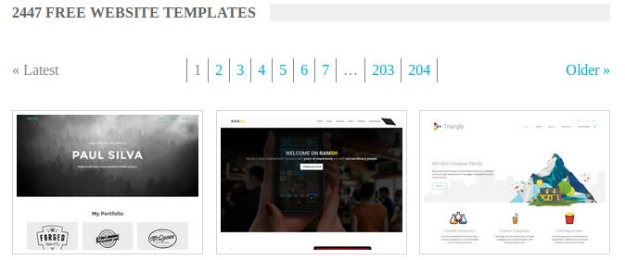
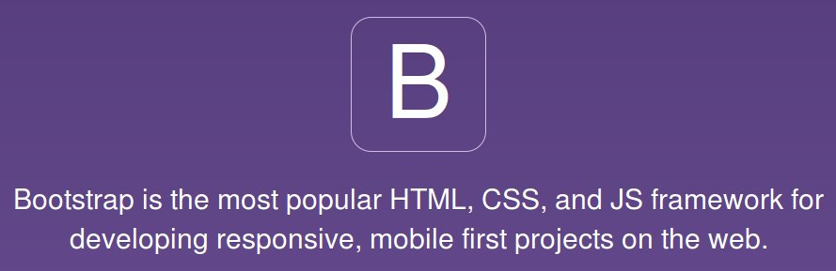
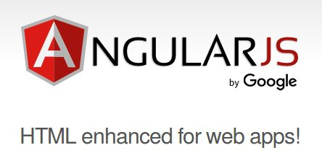
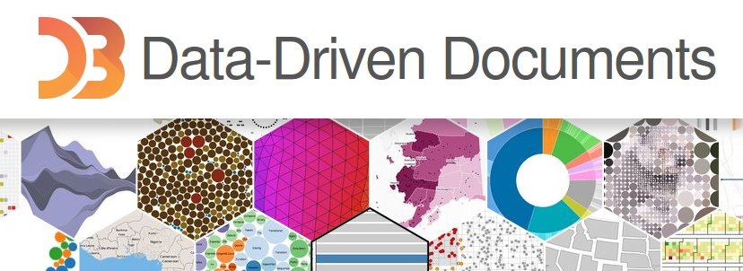
HTML - framework and templates

Slide 37
HTML Tutorial
https://www.w3schools.com/html/

Slide 38
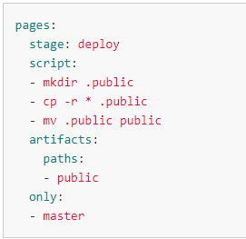
Configuring Gitlab to host website
https://about.gitlab.com/blog/2016/04/07/gitlab-pages-setup/

Slide 39
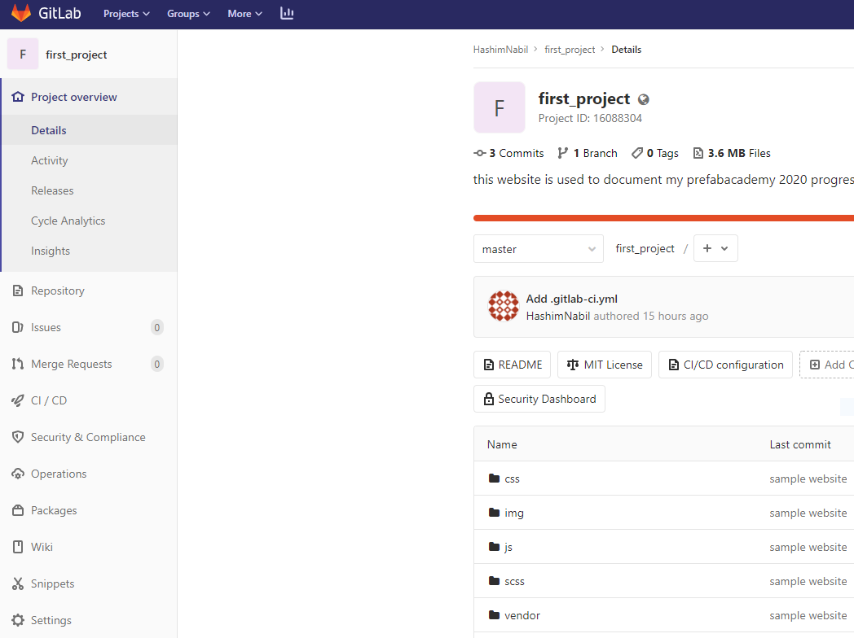
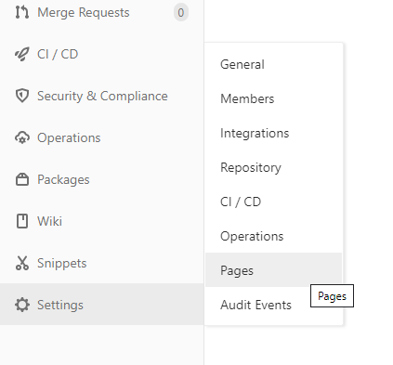
Accessing your website in Gitlab
2
1

Slide 40
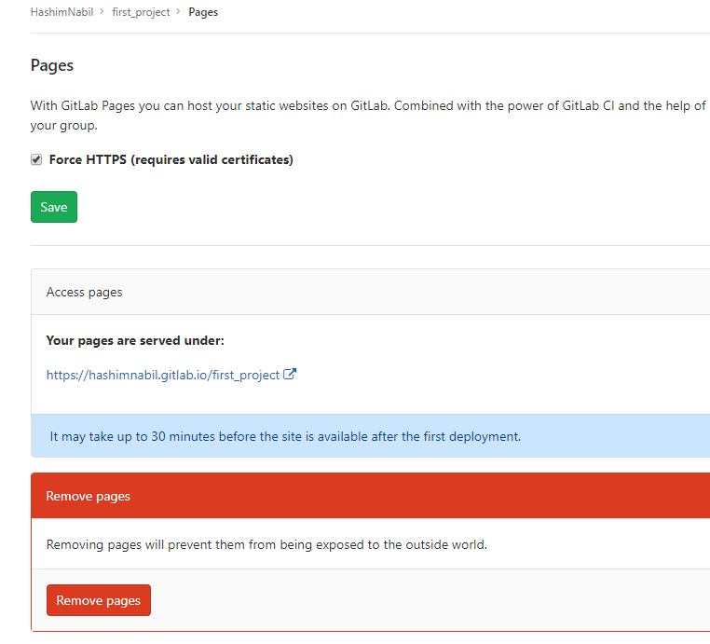
Accessing your website in Gitlab
This link will direct you to your page so once you pick your template and start editing it and pushing it to your Gitlab project, you need to send the link to me.
The faster you do the better!
3

Slide 41
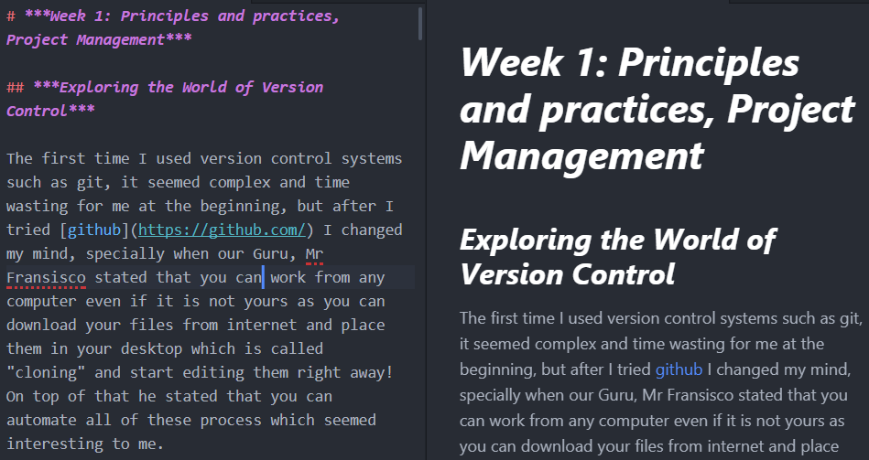
Markdown: Definition
You can try markdown after you push your website!
Is way to create content for the web in “PlainText” (What you write is what you see) with few symbols :)

Slide 42

Atom Editor
A text editor that integrates markdown nicely!
Download from: https://atom.io/

Slide 43
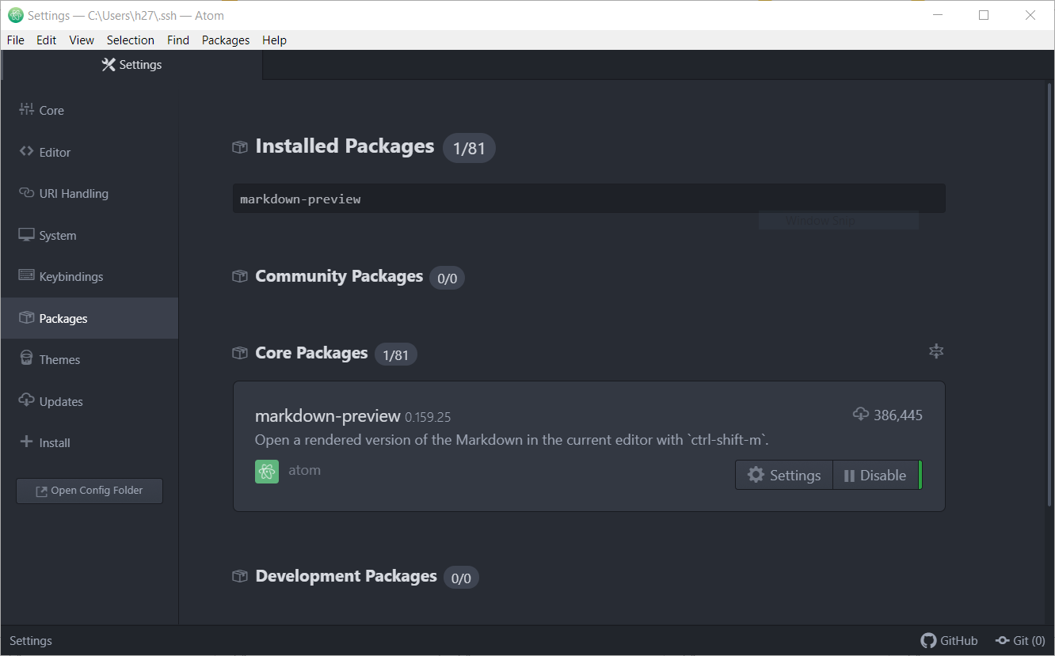
First you have to download the
Markdown-preview package!

Slide 44
Markdown: Tutorial
https://www.markdowntutorial.com

Slide 45
References
https://gitlab.fabcloud.org/fabzero/fabzero/blob/master/program/basic/projectmanagement.md
https://github.com/satshakit

